Slide 1


Chemical Safety at CERN
– An Overview
Laura Rowland – EP ADSO, Chemical Safety Officer

Slide 2
Chemical Safety at CERN
Important aspects to consider:
  Chemical handling;
  Chemical storage;
  Registration of chemical inventory on CERES;
  Chemical waste disposal and chemical transport.
First step: All users handling chemicals OR working in an area where chemical hazards exist should complete the Chemical Safety – Awareness training on LMS.
  Available in ENG or FR.
  Online course with short exam to complete.

Slide 3
General Practices for using Chemical Products
All persons working with chemical products should undergo health surveillance by the Medical Service and complete form OHS-0-0-3 “Identification of Occupational Risks”.
Closed toe shoes, long trousers and sleeves (or lab coat) must be worn.
Protective gloves and safety glasses should be used when handling chemical products.
  If respiratory protective equipment (RPE) is needed (as stated on SDS) a Fit Test must have been completed, see LMS – Online and Classroom course required.
Work area to be kept clean and tidy.

Slide 4
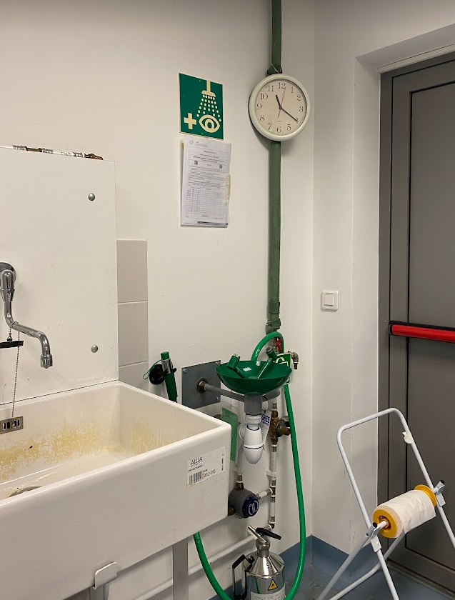
General Practices for using Chemical Products
Local exhaust ventilation, safety showers and eye washes should be regularly tested and maintained.
Ensure unobstructed access to safety showers and eye wash units at all times.
Regular testing of eye wash and safety showers (once a week) must be documented in the Safety File (Safety Form C-1-0-3 available on HSE website).
Maintenance via Service Desk ticket.
Fume hoods must be tested on an annual basis – this can be arranged by HSE (with external contractor) and regular maintenance must be ensured by the person responsible.

Slide 5
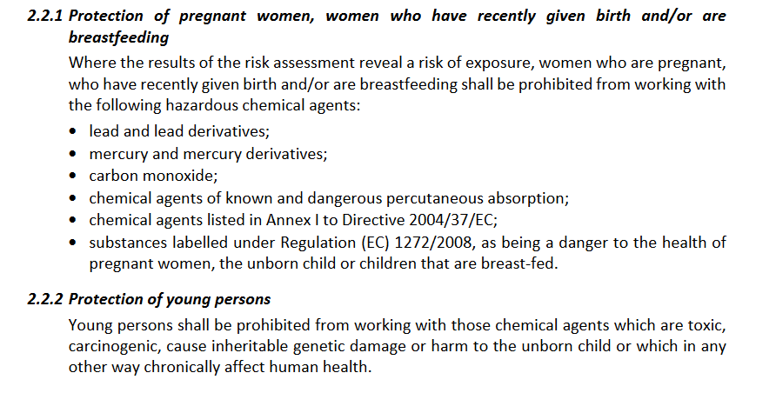
Protection of Pregnant Women and Young Persons

Slide 6
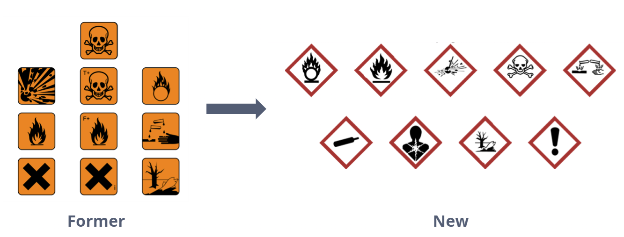
Chemical Storage
All chemical products:
  Must be clearly labelled.
      Note: Old style labels MUST be updated:
  Stored in original containers (in good condition), when possible.

Slide 7
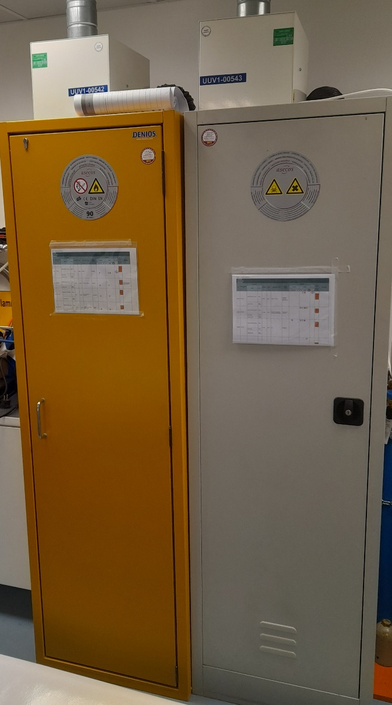
Chemical Storage
Storage of chemical products:
  Limit the quantities stored.
  Stored in chemical cabinet (ventilated with retention trays and hazard pictograms – SCEM 50.55).
  Products should be returned to the chemical cabinet after use.
  Filters should be maintained every year.
      This can be completed by EN-CV (note: contact must be made with EN-CV, no automatic enrollment – funded by equipment owner).

Slide 8






Chemical Storage
Storage of chemical products:
Must be stored according to SG-C-1-0-1:
  Separate incompatible chemicals;
  Place flammable liquids / water reactive chemicals / oxidizing chemicals in specific cupboards;
  Place toxic chemicals in ventilated cupboards;
  Separate strong acids and bases.
All chemicals must be registered in CERES.
Compatibles
Incompatibles
Compatibles under particular conditions

Slide 9
Chemical Storage
Storage of chemical products:
Must be stored according to SG-C-1-0-1:
  Separate incompatible chemicals;
  Place flammable liquids / water reactive chemicals / oxidizing chemicals in specific cupboards;
  Place toxic chemicals in ventilated cupboards;
  Separate strong acids and bases.
All chemicals must be registered in CERES.
Compatibles
Incompatibles
Compatibles under particular conditions

Slide 10
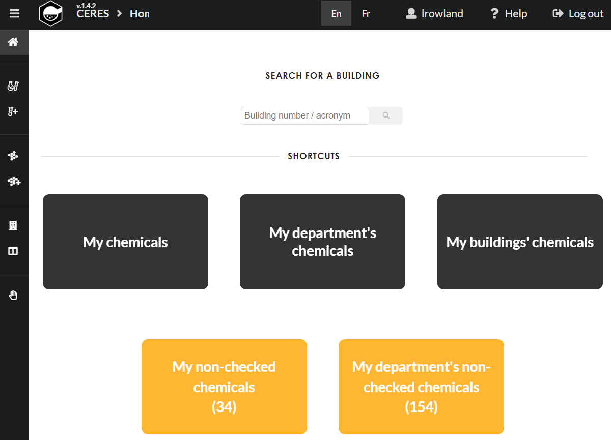
CERES – Chemical Inventory and Risk Assessment
CERES = CERN Chemical Register for Environment, Health and Safety.
CERES is an inventory database for chemical products of different types and physical properties used at CERN.
CERES performs automatic risk calculations and implements an automatic notification system that helps keeping chemical records up-to date.

Slide 11
CERES – Chemical Inventory and Risk Assessment
Instructional videos for using the platform
CERES = CERN Chemical Register for Environment, Health and Safety.
CERES is an inventory database for chemical products of different types and physical properties used at CERN.
CERES performs automatic risk calculations and implements an automatic notification system that helps keeping chemical records up-to date.
Request access here
(Chemical Awareness LMS course required)

Slide 12
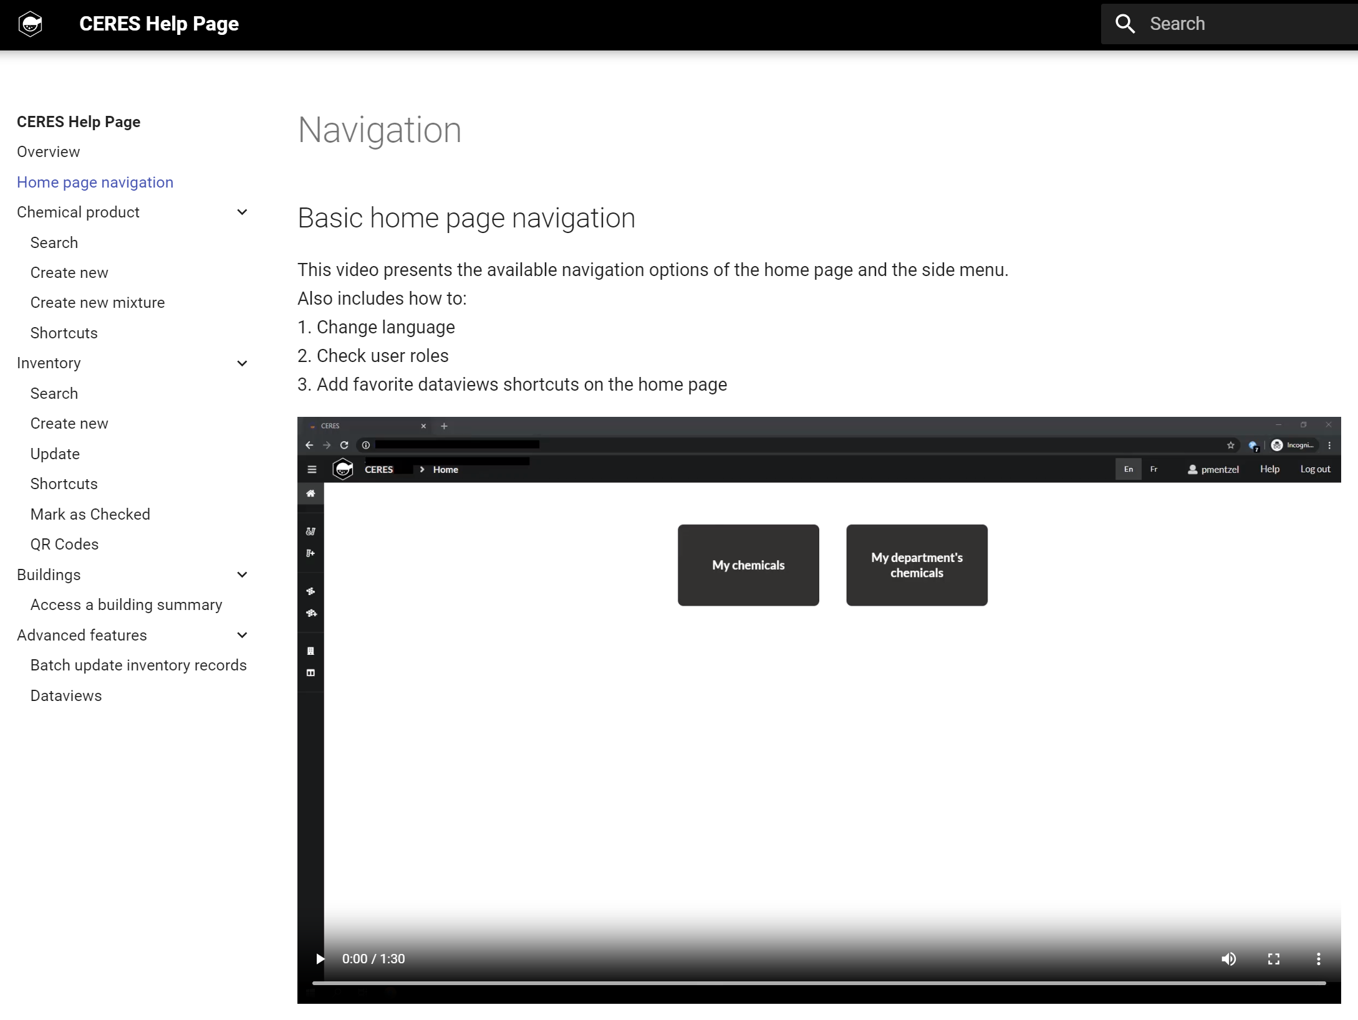
CERES – Chemical Inventory and Risk Assessment
Instructional videos for using the platform
CERES = CERN Chemical Register for Environment, Health and Safety.
CERES is an inventory database for chemical products of different types and physical properties used at CERN.
CERES performs automatic risk calculations and implements an automatic notification system that helps keeping chemical records up-to date.
Request access here
(Chemical Awareness LMS course required)

Slide 13
CERES – Chemical Inventory and Risk Assessment
Allows search for specific chemical / whole building inventory
CERES = CERN Chemical Register for Environment, Health and Safety.
CERES is an inventory database for chemical products of different types and physical properties used at CERN.
CERES performs automatic risk calculations and implements an automatic notification system that helps keeping chemical records up-to date.
See existing inventory
Add new inventory item

Slide 14
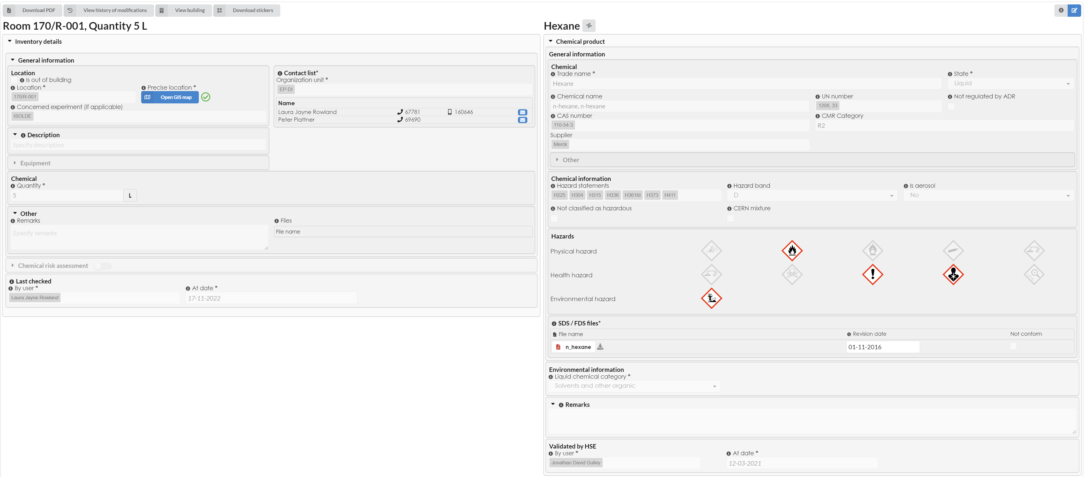
CERES – Chemical Inventory and Risk Assessment

Slide 15
CERES – Chemical Inventory and Risk Assessment
Each entry verified by HSE and must be re-confirmed every 12 months by the listed Safety Contacts.

Slide 16
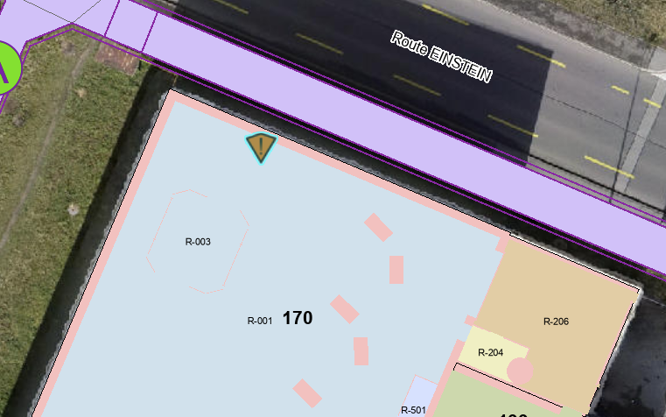
CERES – Chemical Inventory and Risk Assessment
Storage location must be identified

Slide 17
CERES – Chemical Inventory and Risk Assessment
SDS must be uploaded
Chemical Risk Assessment – Automatically generated from Hazard Statements

Slide 18
CERES – Chemical Inventory and Risk Assessment
SDS must be uploaded
Chemical Risk Assessment – Automatically generated from Hazard Statements

Slide 19
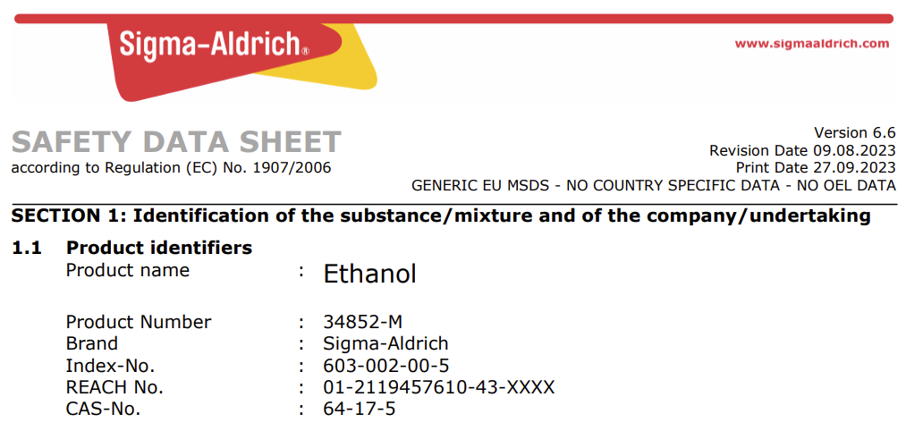
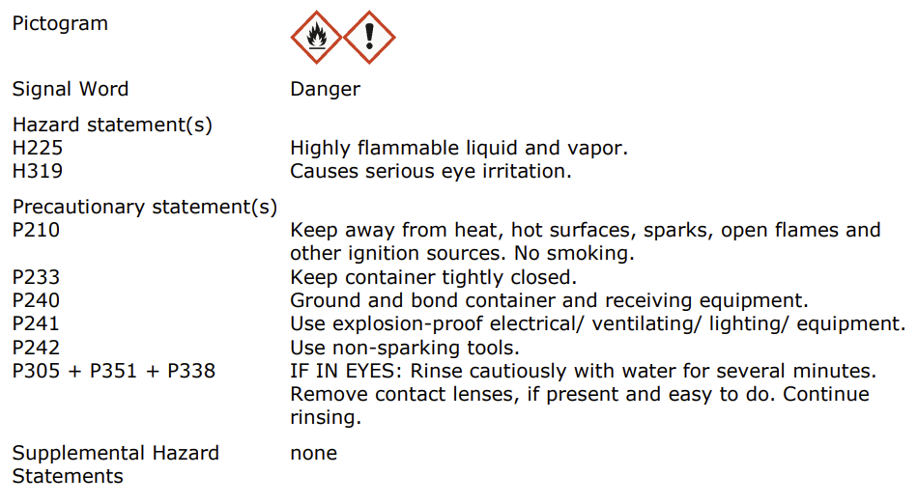
Safety Data Sheets
A Safety Data Sheet (SDS) is provided by a supplier to the customer before or at the time of first delivery.
Used to communicate information on chemical product risks.
SDS must be read and all safety measures applied, including PPE, handling and storage requirements.
Only chemical products with their SDS are accepted at CERN.

Slide 20
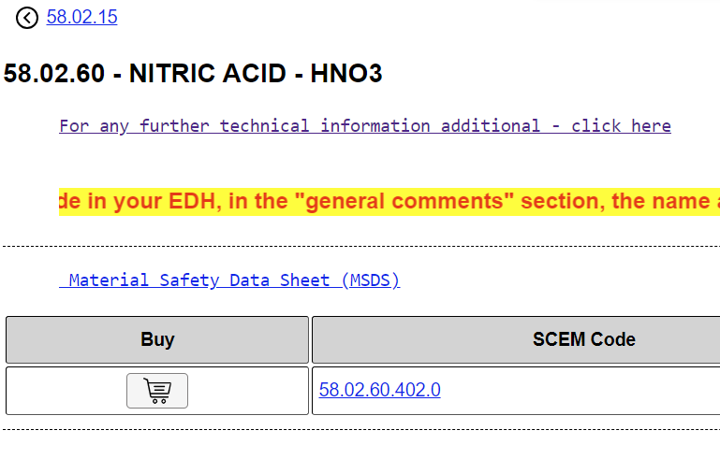
Safety Data Sheets
A Safety Data Sheet (SDS) is provided by a supplier to the customer before or at the time of first delivery.
Used to communicate information on chemical product risks.
For products purchased on CERN Stores: SDS are available on EDMS and linked on the CERN Store Catalogue entry.

Slide 21
Chemical Waste
The chemical product owner is solely responsible for their chemical products from purchase, during use and until they have been correctly disposed of. This includes the empty containers. Additional users should be informed of correct use by the product owner.
Two online trainings outline how to dispose of chemical waste at CERN:
  Transport of Chemical Products and Chemical Waste (for all waste);
  Transport of Chemicals in Limited Quantities (LQ) (for small quantities, quantity limit defined in column 7a of Table A of Chapter 3.2 for each substance in the ADR regulations).
For the disposal of gas bottles, a practical guide is available.
For support, please contact the EP Safety office or the SCE Department (gestion-des-déchets-chimiques@cern.ch) and the HSE Department (safety-chemistry@cern.ch) – The online training must have been followed first.

Slide 22

ADR Regulations
ADR regulations govern the transport of dangerous goods to ensure protection of persons, the environment and property.
This includes the transport of chemical waste.
ADR is applicable for transport on or between the CERN sites.
Also relevant for the transport of machinery or equipment containing dangerous goods.
Available online in ENG and FR.

Slide 23
Chemical Waste Disposal
Chemical waste should be identified and transferred into transport compliant packaging (original packaging is preferred if compliant and in good condition).
    Approved packaging for chemical transport available at SCEM 55.50.75.D;
    Tinplate jerrycans for chemical transport available at SCEM 55.50.40.B;
    Note: All plastic packaging has a lifespan of 5 years (date of manufacture engraved on packaging).

Slide 24
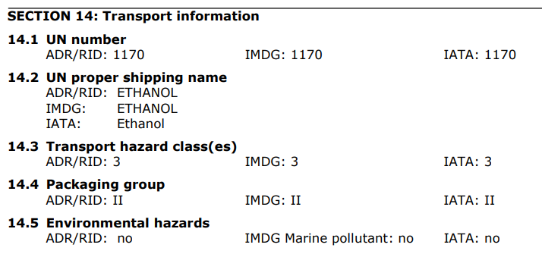
Chemical Waste Disposal
Chemical waste should be identified and transferred into transport compliant packaging (original packaging can be used if in good condition)
    Approved packaging for chemical transport available at SCEM 55.50.75.D
    Tinplate jerrycans for chemical transport available at SCEM 55.50.40.B
    Note: All plastic packaging has a lifespan of 5 years (date of manufacture engraved on packaging).
Packaging must comply with packaging group listed on SDS, Section 14 (see online training for further details).
Note: The Safety Data Sheet (SDS) does not always take into account the use of the product. For example, a new oil is not regulated (no UN number). However, after use, unless analysis shows that it is not hazardous, it must be classified as UN 3082 - ENVIRONMENTALLY HAZARDOUS SUBSTANCE, LIQUID, waste oil.

Slide 25
Chemical Waste Disposal
Chemical waste should be identified and transferred into transport compliant packaging (original packaging can be used if in good condition)
    Approved packaging for chemical transport available at SCEM 55.50.75.D
    Tinplate jerrycans for chemical transport available at SCEM 55.50.40.B
    Note: All plastic packaging has a lifespan of 5 years (date of manufacture engraved on packaging).
Packaging must comply with packaging group listed on SDS, Section 14 (see online training for further details)
UN number also found on SDS.

Slide 26
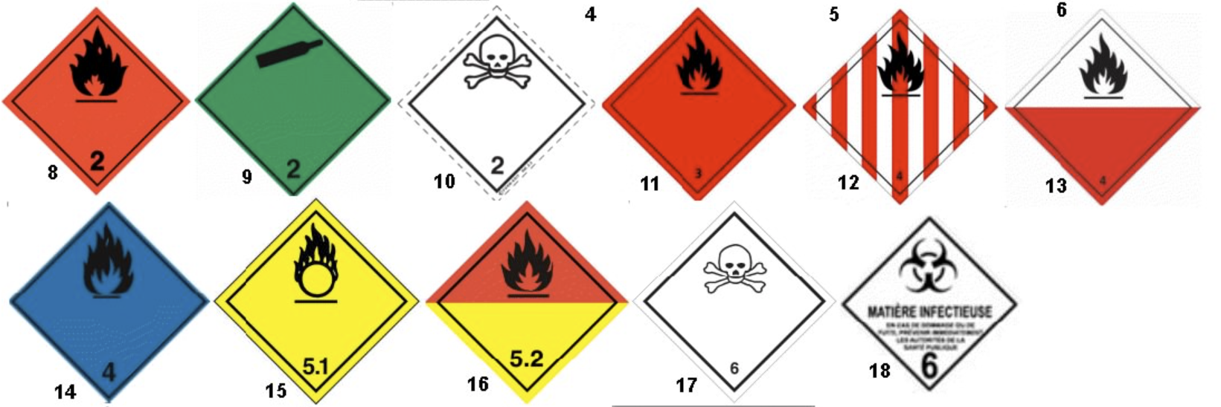
Chemical Waste Disposal
Packaging labelled for road transport with:
    UN number clearly written (permanent);
    Transport hazard labels attached (available at SCEM 50.55.21);
    Official shipping name (preceded with Waste where applicable).
    E.g. “UN1170, WASTE ETHANOL, Class 3, PG II ”

Slide 27

Chemical Waste Disposal
Packaging labelled for road transport with:
    UN number clearly written (permanent);
    Transport hazard labels attached (available at SCEM 50.55.21);
    Official shipping name (preceded with Waste where applicable).
    E.g. “UN1170, WASTE ETHANOL, Class 3, PG II ”
Notes:
A note for packaging multiple products + inventory

Slide 28
Chemical Waste Disposal
Packaging labelled for road transport with:
    UN number clearly written (at least 12mm tall)
    Transport hazard labels attached (available at SCEM 50.55.21)
    Official shipping name (preceded with Waste where applicable).
    E.g. “UN1170, WASTE ETHANOL, Class 3, PG II ”
Overpacks can be used to send products with similar hazards in the same package (see online training).

Slide 29
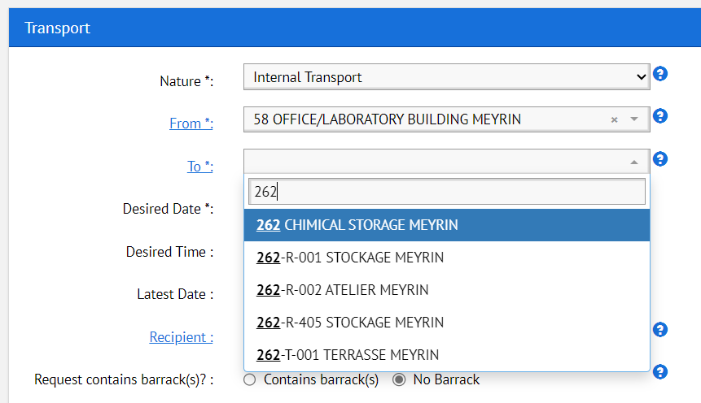
Chemical Transport
An EDH Internal Transport request can then be raised:
    Sent to Building 262.

Slide 30
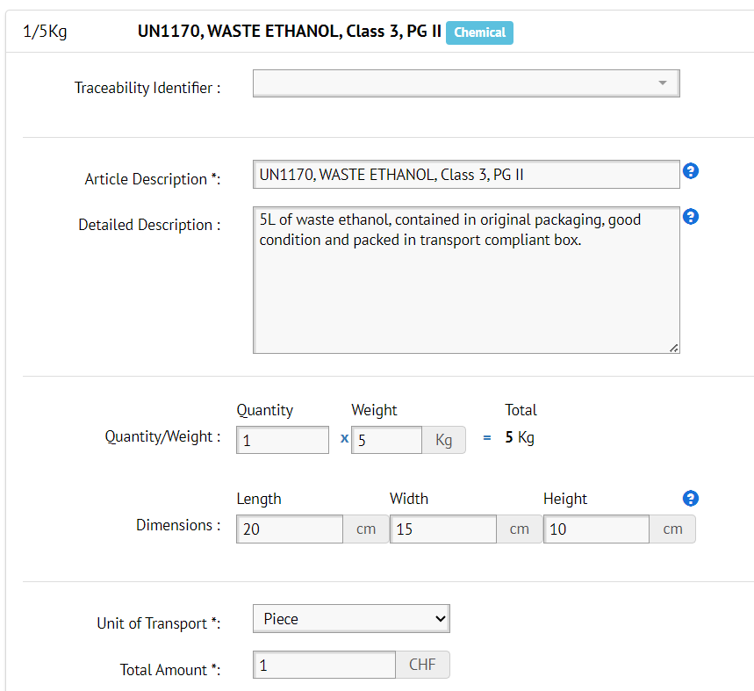
Chemical Transport
An EDH Internal Transport request can then be raised:
    Sent to Building 262.
    Accurate information of waste for transport included on EDH form.

Slide 31
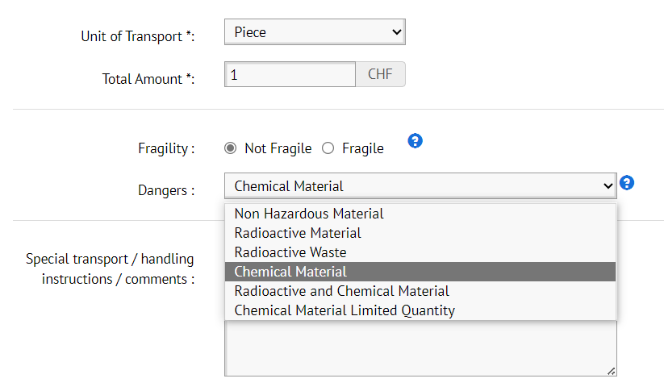
Chemical Transport
An EDH Internal Transport request can then be raised:
    Sent to Building 262.
    Accurate information of waste for transport included on EDH form.
    “Chemical Material” selected under dangers (or “Chemical Material Limited Quantity” if applicable and online training has been followed).

Slide 32
Chemical Transport
  Packages must be secured by the sender for transport (e.g. by stretch wrapping a pallet).
    During transport, hazard labels and UN numbers must be visible. Therefore, when using non-transparent stretch film, each UN number, hazard label, as well as the words "overpack", must be affixed to two opposite sides of the pallet.
  The same process is followed for transport of chemical products and machinery or equipment containing chemical products (and official shipping name does not include waste).
  Flyer for Transport of Chemical Products and Waste available at EDMS 2173394 (access after completing online training).

Slide 33
Further Information
Chemical Safety Rules are available on HSE website.
Safety Regulation on Chemical Agents sets out minimum requirements for the protection of persons from risks to their occupational health and safety.
General Safety Instructions are also available and document:
  Prevention and protection measures;
  Explosive atmospheres;
  Monitoring of exposure to hazardous chemical agents in workplace atmospheres.
Safety Guideline “Safe Handling and Storage of Lead” SG C-0-0-3.
CMR chemicals must be substituted where possible, otherwise risk assessed (with HSE).

Slide 34
Any Questions?

