Slide 1


Experimental areas evacuation drills

Slide 2
Evacuation drills – HSE Objectives
One of the HSE Objectives for the end of 2025 (approved by the ED) is:
  “Organise evacuation exercises of all accelerators and experimental areas before LS3.”
ECN3 – done in 2023
EHN1
EHN2
East Hall
ISOLDE Hall
AD Hall
In the next 2 years

Slide 3
Role of EXSO for evacuation drills
Participate to the organisation with the Safety Offices (DSOs, TSOs, Fire Brigade, etc.) – Coordination is with DSOs office
Give inputs as:
  best period for the drill (activities and people present in the area)
  who could be emergency guide within the collaboration (people present most of the time)
In general, with the TSO: make sure the evacuation routes within the experiment are free from obstacles, emergency lights are working, evacuation panels are well in place
Usually organised few months in advance

Slide 4
Emergency guides training
Emergency guides assist for a safe evacuation
Training programme:
  E-learning (15 minutes): Emergency Guides – Preparation
  Classroom (2h30): Emergency Guides
  Familiarisation visit on site with the TSO

Slide 5
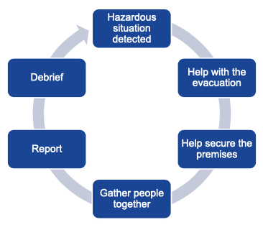
Emergency guides training
Training programme:
  E-learning (15 minutes): Emergency Guides – Preparation
CERN context (i.e. planned evacuations, roles)
Evacuation principles/features (plans, signs, alarms)
Duties of Emergency Guide:
  Help with the evacuation → i.e. direct the occupants, prevent people from retouring in the building
  Help secure the premises → i.e. close doors, windows
  Gather people together → i.e. ensure they remain at assembly point

Slide 6
Emergency guides training
Training programme:
  E-learning (15 minutes): Emergency Guides – Preparation
  Classroom (2h30): Emergency Guides
Detailed explanation of Emergency Guide’s duties
Case studies (how to reach in different scenarios)

Slide 7
Emergency guides training
Training programme:
  E-learning (15 minutes): Emergency Guides – Preparation
  Classroom (2h30): Emergency Guides
  Familiarisation visit on site with the TSO
Contact the TSO of the building to arrange a visit of the building, to familiarise with the evacuation routes, the position of the assembly point and the other emergency features

Slide 8
Emergency guides training
Training programme:
  E-learning (15 minutes): Emergency Guides – Preparation
  Classroom (2h30): Emergency Guides
  Familiarisation visit on site with the TSO
Highly recommended to EXSOs to be trained as Emergency Guides for the building where the Experiment is located!

Slide 9
Additional recommended trainings
Fire Extinguisher (classroom, 2h)
  Fire prevention and protection aspects
  Hands on experience on how to use fire extinguishers on various types of fire
First Aid – Life-Saving Actions (classroom, 3.5h)
  Protection and alert
  How to react in case of wound, loss of consciousness, cardiac arrest, airways obstruction

Slide 10
Thank you for your attention!
Any question?

