Slide 1
Report from the MCWG, 3rd R2E Committee Meeting
M. Calviani for the MCWG (link), EN/STI

Slide 2
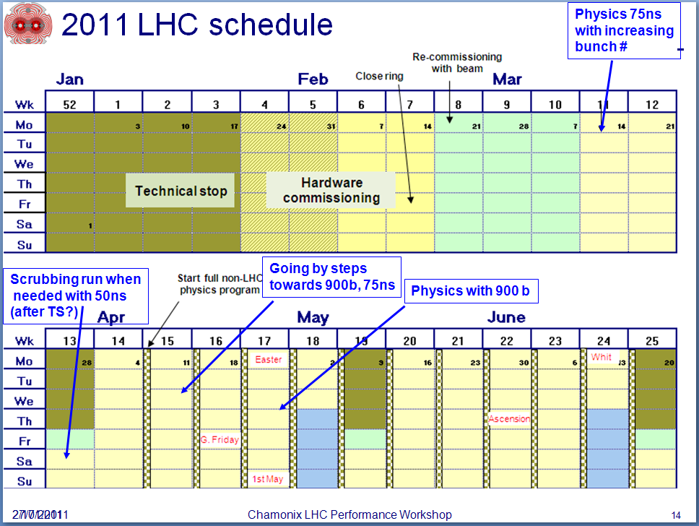
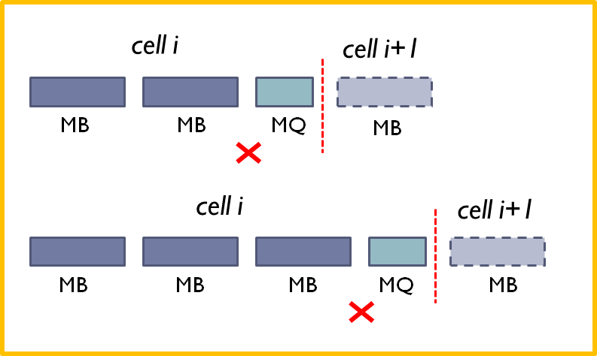


Update since the last R2E Project Meeting (1/3)
Info from the last 3rd MCWG meeting (17th February): http://indico.cern.ch/conferenceDisplay.py?confId=126601
Highlight from Chamonix 2011 operation (link)
  75 ns operation
  Scrubbing at 50 ns after the 1st TS end of March
  Beam-Gas issue in the ARC, QPS issue where firmware update has not been performed?
RadMon relocation campaign summary (link)
  Installation of new BatMons have been completed (triplets (UPS/UJ16, UPS/UJ56) + TDIs (RA87 + RA23) + UX15 + TOTEM)
  “Standardization” of RadMon locations

Slide 3
Update since the last R2E Project Meeting (2/3)
Summary of new extraction procedure for BLMs (link)
  Improved method for evaluating the offset (very important!), 1.5-5*10⁻⁷ Gy/s
  New data with sanity checks
  Cumulated dose over 1 hour now available on TIMBER (monitorName:DOSE_INT_HH)
BLM cumulative doses and expected hadron fluences (link)
  Identification of highest loss locations, based on BLM cumulative dose
  Using the RadMon/BLM ratio, HEH fluence estimated for locations where RadMons are not present (link to table)
  Collimators + TANs are obvious location + hot-spots in cell 11 and certain cells of the ARC during ion operation
Summary of 2010 operation in terms of intensity/luminosity (link)

Slide 4
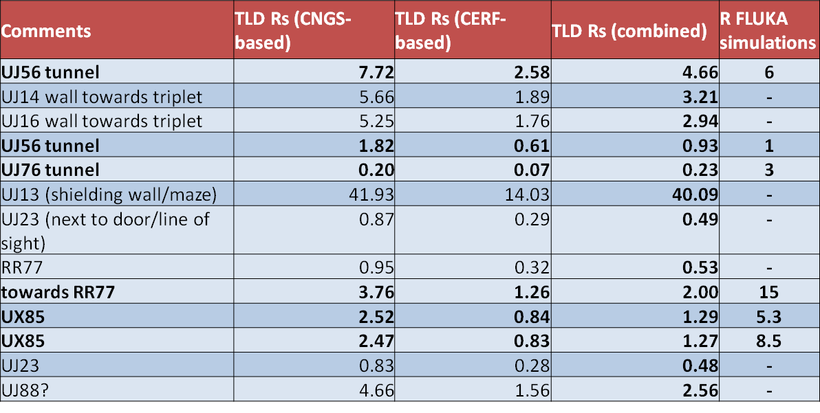
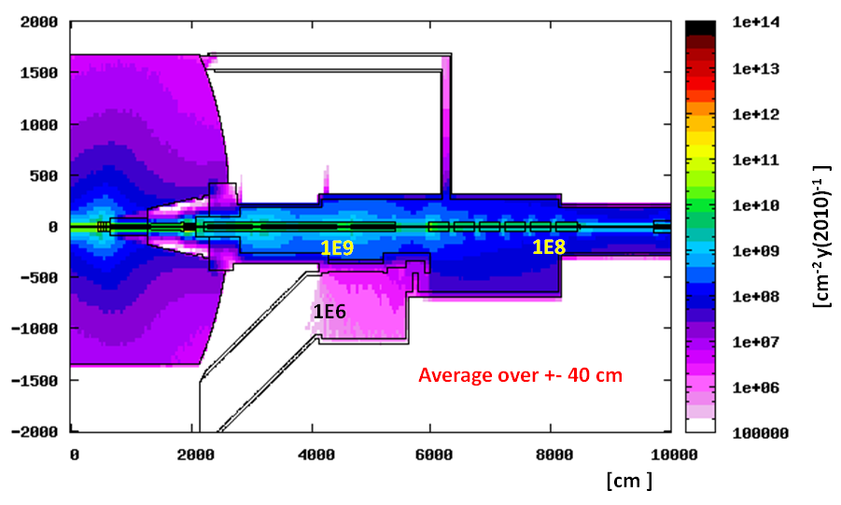
Update since the last R2E Project Meeting (3/3)
Updates on the TLD-extracted R values and comparison with FLUKA simulations for selected areas (link)
UJ56 tunnel scoring volumes are large (extending meters along UJ56 wall)
UJ76 / RR77 / UX85 scoring volumes are small and localized (40x40x40 cm)
Updates on P1 simulations (link)
  Implementation of the RadMons/PMI/PAT for P1R tunnel
  Application benchmark on 1RM03S, good agreement (within 5-10%) between RadMon SEU readings and FLUKA expected HEH fluence

