Slide 1
Data Acquisition,
Trigger and Control
(for large Physics Experiments)
Concepts & Principles
Acknowledgements:
This presentation is based on the work of many people throughout many years, Thanks!

Slide 2
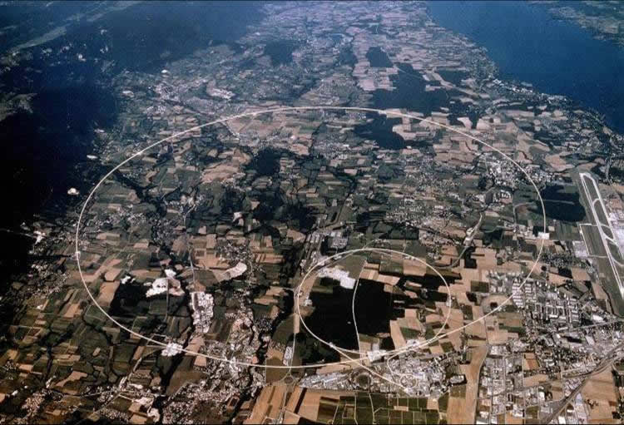

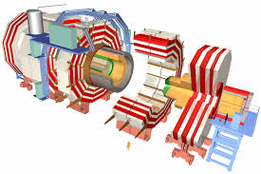
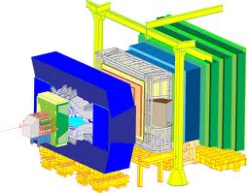
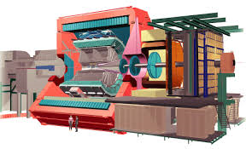



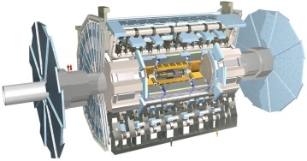
The LHC Experiments

Slide 3
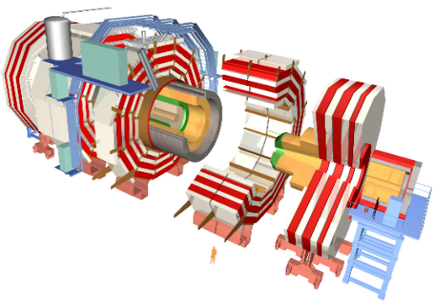
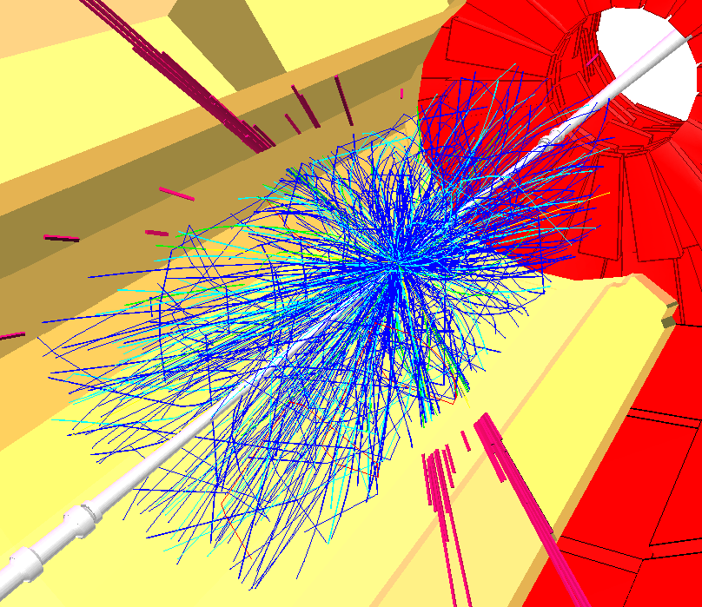
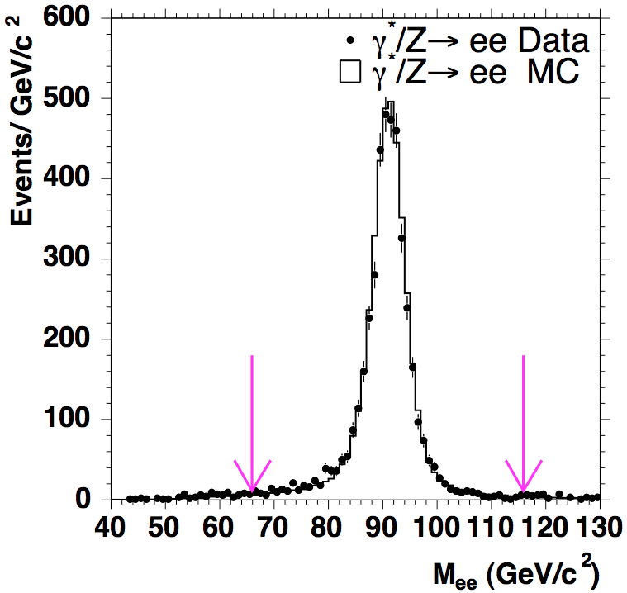
Data Acquisition at the LHC
Data Acquisition enables physics analyses to be performed on the data produced by the detector. Definitions:
  Trigger System
    Selects in Real Time “interesting” events from the bulk of collisions. - Decides if YES or NO the event should be read out of the detector and stored
  Data Acquisition System
    Gathers the data produced by the detector and stores it (for positive trigger decisions)
  Control System
    Provides the overall Operation, Configuration and Monitoring

Slide 4
Trigger, DAQ & Control
Detector Channels/Front-End Electronics
HwTrigger
Readout Units
Monitoring, Control & Operations
Event Building
High Level Trigger
Storage
DAQ

Slide 5
LHC in Numbers

Slide 6
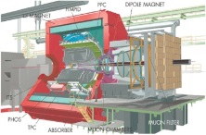
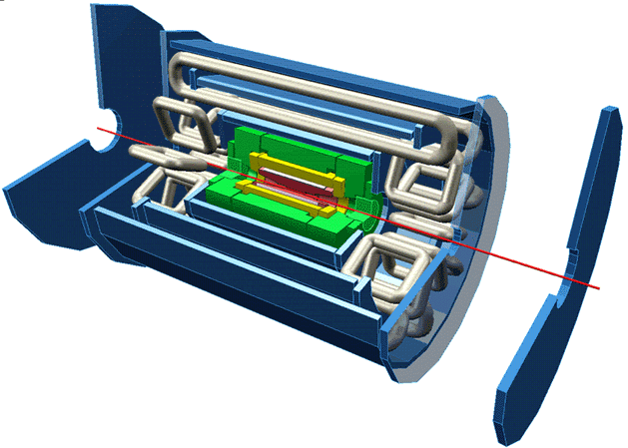
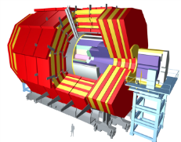
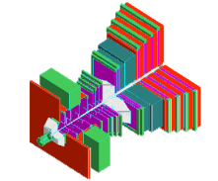
LHC Exp DAQ (until 2020)
 | Event Size (MByte) | L1 Rate (KHz) | Bandwidth (GByte/s) | Storage Rate (KHz) | Storage (GBytes/s)
ALICE | 25 | 1 | 25 | 0.050 | 1.250
ATLAS | 1 | 100 | 100 | 0.200 | 0.200
CMS | 1 | 100 | 100 | 0.200 | 0.200
LHCb | 0.05 | 1000 | 50 | 5 | 0.250

Slide 7
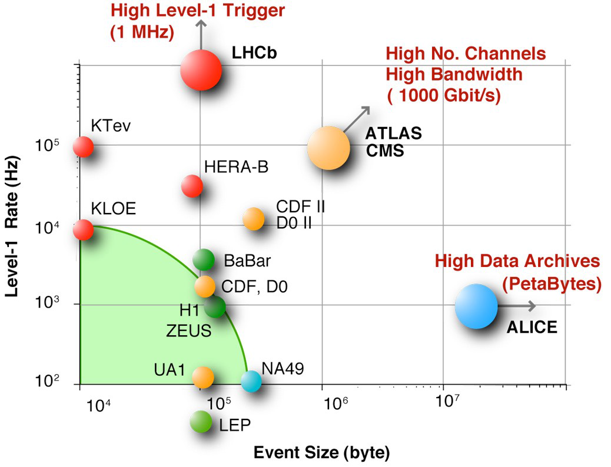
LHC DAQ Phase-space

Slide 8
Basic Concepts

Slide 9
Trivial DAQ
External View
sensor
Physical View
CPU
sensor
ADC Card
disk
Logical View
Proces-
sing
ADC
storage
Trigger (periodic)

Slide 10
Trivial DAQ with a real trigger
Sensor
Trigger
Delay
Discriminator
Start
ADC
Proces-
sing
Interrupt
What if a trigger is produced when the ADC or Processing is busy ?
storage

Slide 11
Trivial DAQ with a real trigger (2)
Sensor
Trigger
Discriminator
Delay
Start
Busy Logic
ADC
and
not
Proces-
sing
Interrupt
Set
Q
Ready
Clear
Deadtime (%) - the ratio between the time the DAQ is busy and the total time
storage

Slide 12
Trivial DAQ with a real trigger (3)
Sensor
Trigger
Discriminator
Delay
Start
Busy Logic
ADC
and
Full
FIFO
DataReady
Proces-
sing
Buffers: De-randomize data -> decouple data production from data consumption -> Better performance
storage

Slide 13
Trivial DAQ in collider mode
Sensor
Timing
Beam crossing
BX
Start
ADC
Abort
Trigger
Discriminator
FIFO
Full
Busy Logic
DataReady
Proces-
sing
We know when a collision happens the TRIGGER is used to “reject” the data
storage

Slide 14
LHC timing
p p crossing rate 40 MHz (L=10³³- 4×10³⁴cm⁻² s⁻¹)
25 ns
40 MHz
Level 1
≈ μs
100 kHz
Level 2
≈ ms
1 kHz
Level n
Level 1 trigger time exceeds bunch interval
Event overlap & signal pileup (multiple crossings since the detector cell memory greater than 25 ns)
Very high number of channels

Slide 15
Trivial DAQ in LHC
Timing
Sensor
BX
Beam crossing
Clock
Analog
Pipeline
Pipelined
Trigger
Accept/Reject
ADC
Busy Logic
FIFO
Full
DataReady
Proces-
sing
Front-end Pipelines: To wait for the trigger decision + transmission delays are longer than beam crossing period
storage

Slide 16
Less trivial DAQ
N channels
N channels
N channels
ADC
ADC
ADC
Trigger
Proces-
sing
Proces-
sing
Proces-
sing
Some processing
can proceed in parallel
Event
Building
Proces-
sing
storage

Slide 17
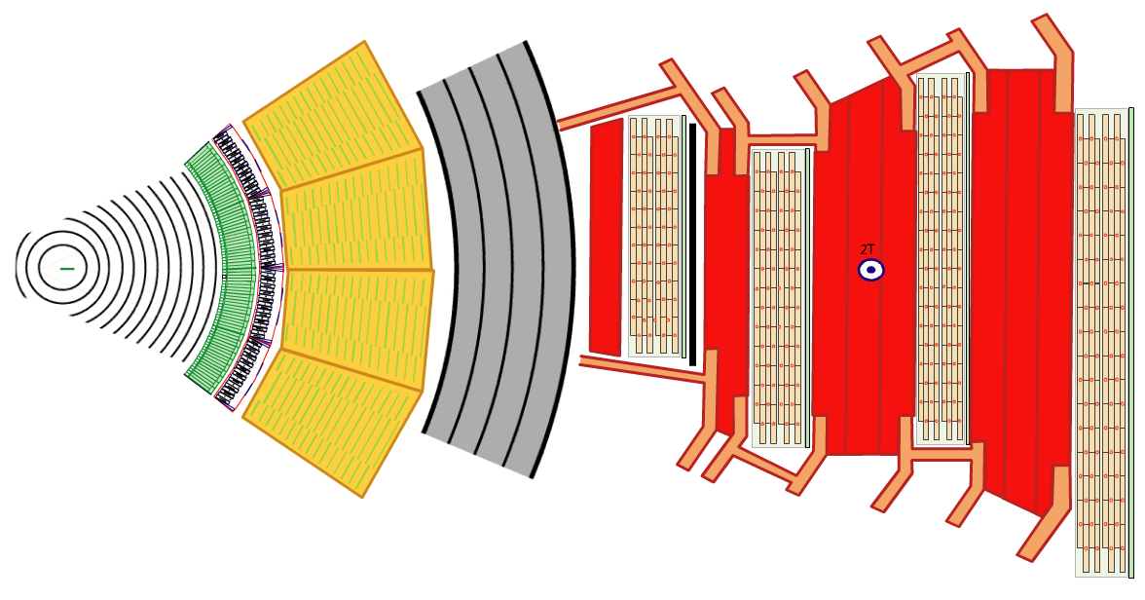
The Real Thing
15 million detector channels -> ~ 1 MByte
@ 40 MHz
= ~1,000,000 * 40,000,000 bytes
= ~ 40 TB/sec
?

Slide 18
Trigger

Slide 19
Trigger System
The Trigger system detects whether an event is interesting or not
Typical ATLAS and CMS* event
20 collisions may overlap
This repeats every 25 ns
A Higgs event
^{*)}LHCb isn’t much nicer and in Alice (PbPb) it can be even worse

Slide 20
Trigger Levels
Since the detector data is not promptly available and the trigger function is highly complex, it is evaluated by successive approximations:
  Hardware trigger(s):
    Fast trigger, uses data only from few detectors
    has a limited time budget
    Normally implemented using custom electronics
    Level 1, Sometimes Level 2
  Software trigger(s):
    Refines the decisions of the hardware trigger by using more detailed data and more complex algorithms.
    It is usually implemented using processors running a program.
    High Level Triggers (HLT)

Slide 21
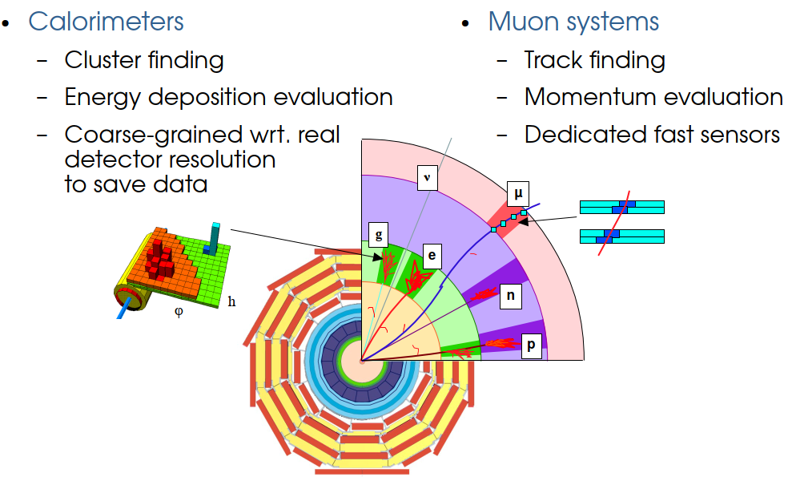
Hardware Trigger

Slide 22
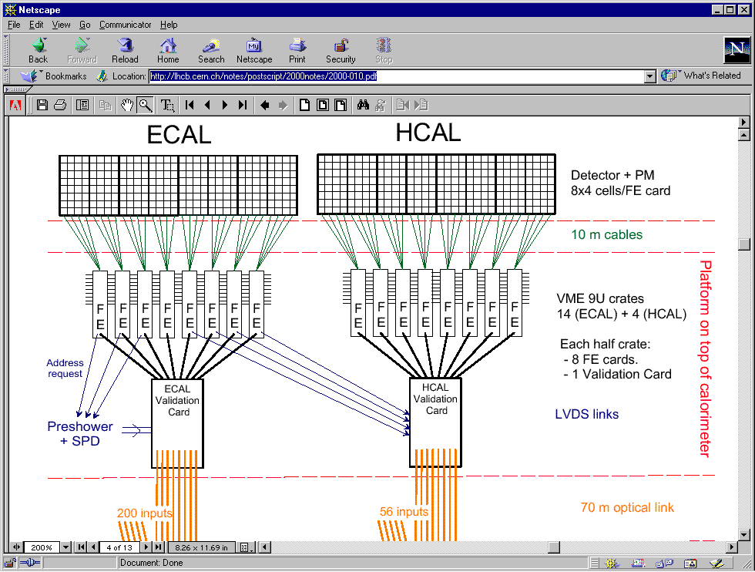
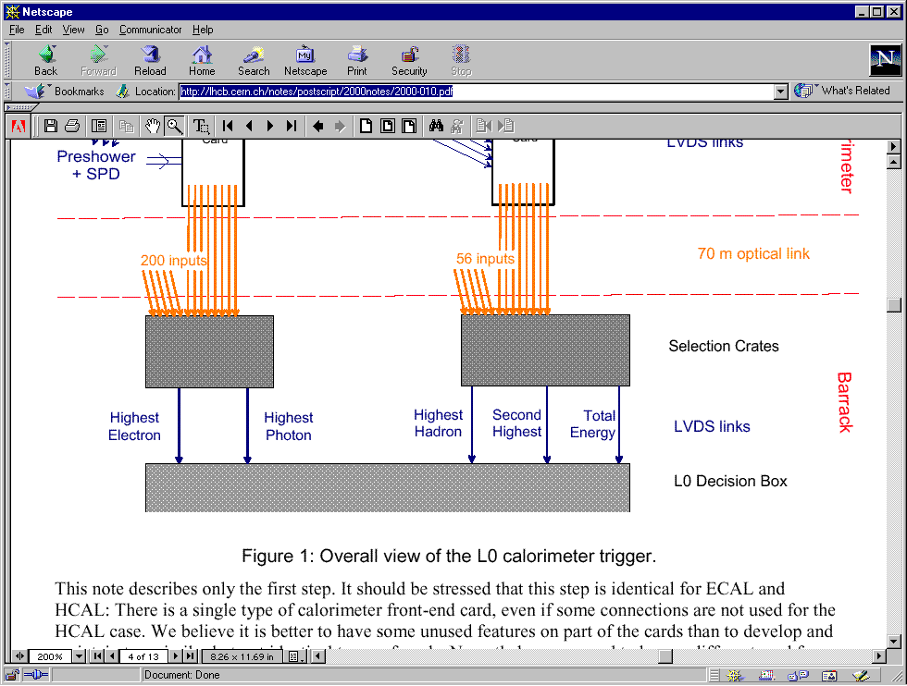
Example: LHCb Calorimeter Trigger
Detect a high energy in a small surface
Don’t forget the neighbors
Aggregate
information
Evaluate
decision(s)

Slide 23
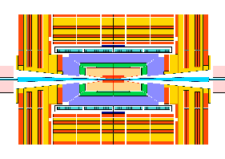
LHC: Trigger communication loop
Global Trigger
Local level-1
≈ 3 μs
latency
loop
Timing and trigger has to be distributed to ALL front-ends
Trigger
Primitive
Generator
Font-End
pipeline delay
≈ 3μs
accept/reject
40 MHz synchronous digital system
Synchronization at the exit of the pipeline non trivial. ⇒ Timing calibration

Slide 24
Trigger Levels in LHCb
(up to 2020)
Detectors
Level-0 (4 μs) (custom processors)
  High p_{T} for electrons, muons, hadrons
HLT (≈ms) (commercial processors)
  Refinement of the Level-1. Background
  rejection.
  Event reconstruction. Select physics
  channels.
  Needs the full event
40 MHz
Trigger
level 0
1 MHz
Readout
buffers
Event
building
Processor
Farms
High level
Trigger
5 KHz
Storage

Slide 25
Trigger Levels in ATLAS
Level-1 (3 μs) (custom processors)
  Energy clusters in calorimeters
  Muon trigger: tracking coincidence matrix.
Level-2 (≈ms) (~commercial processors)
  Few Regions Of Interest relevant to trigger decisions
  Selected information (ROI) by routers and switches
  More sophisticated algorithms on full-granularity data
Level-3 (≈s) (commercial processors)
  Reconstructs the event using all data
  Selection of interesting physics channels
Detectors
40 MHz
Front-end
Pipelines
Trigger
level 1
100 KHz
Region of
interest
RoI
Readout
buffers
Trigger
level 2
3 KHz
Event
building
Processor
Farms
Trigger
level 3
200 Hz
Storage

Slide 26
Data Acquisition

Slide 27
Front-end electronics
Detector
Front-End Electronics
Amplifier
Filter
Readout Units (~500)
Shaper
Range compression
Event Building Network
clock
Sampling
Digital filter
HLT Compute Units (~2000)
Zero suppression
Storage
Pipeline
DAQ
Feature extraction
Buffer
Custom point-to-point radiation-hard links
Format & Readout

Slide 28
Front-End Electronics
Detector dependent (Home made)
  On Detector
    Pre-amplification, Discrimination, Shaping amplification and Multiplexing of a few channels
    Problems: Radiation levels, power consumption
  Transmission
    Long Cables (50-100 m), electrical or fiber-optics
  In Counting Rooms
    Hundreds of FE crates : Reception, A/D conversion and Buffering

Slide 29
Data Acquisition proper
Front-End Electronics
Readout Units (~500)
Every Readout Unit has a piece of the collision data
tagged with a unique id
All pieces must be brought together into a single Compute unit
The Compute Unit runs the software filtering (High Level Trigger)
Event Building Network
HLT Compute Units (~2000)
Storage
DAQ

Slide 30
Event Building to a CPU farm
Data sources
Event Fragments
Event Building
Full Events
Event filter CPUs
Data storage

Slide 31
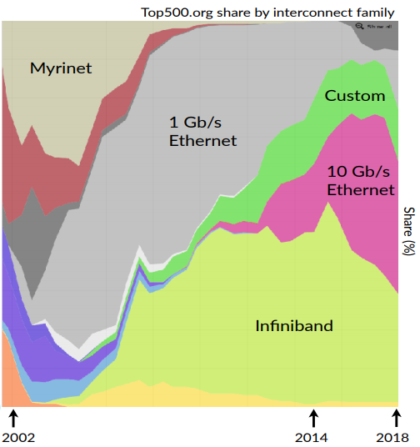
Network Technology
Need to use what is popular -> best price
Myrinet very popular when LHC experiments started being designed
Used by CMS until 2014
Others could postpone the decision and used Ethernet

Slide 32
Event Filters
Higher level triggers (3, 4, …)
Event
building
Event filter
Trigger
level 3,4
Storage
LHC experiments can not afford to write all acquired data into mass-storage. -> Only useful events should be written to the storage
The event filter function selects events that will be
used in the data analysis. Selected physics channels.
Uses commercially available processors (common PCs)
But needs thousands of them running in parallel.

Slide 33
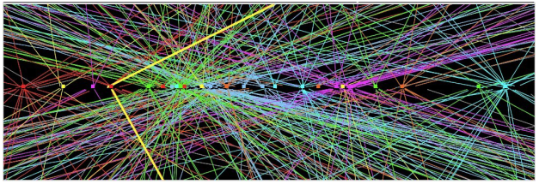
High Level Trigger
Full Event “Reconstruction”
  Reconstruct all charged particle trajectories
    Find segments, connect them, re-fit to physical trajectory
  Associate the particles with the correct p-p collision
    Multiple interactions in each crossing
  Measure all the energy depositions in the calorimeters
    with fine granularity
  Associate tracks and energy depositions
Decide whether it’s interesting

Slide 34
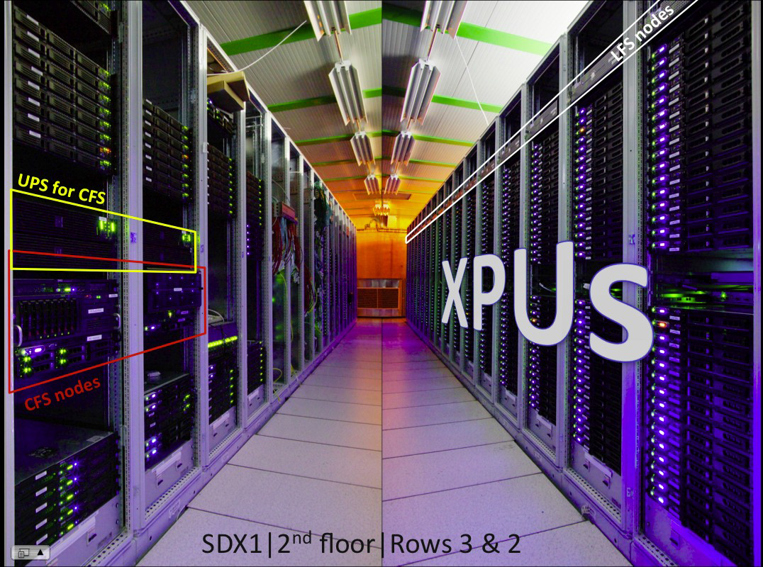
ATLAS HLT Farm

Slide 35
LHC Readout Architecture
Detector Front Ends
...
Trigger Level 1/2
Readout Units
Event Manager
Event Builder (Network)
...
Event Filter Units
Storage
With or Without Event Manager
Push or Pull Protocols

Slide 36
LHCb DAQ (up to 2020)
Detector
L0
VELO
ST
OT
RICH
ECal
HCal
Muon
Trigger
L0 trigger
FE
FE
FE
FE
FE
FE
FE
LHC clock
TFC
Electronics
Electronics
Electronics
Electronics
Electronics
Electronics
Electronics
System
Readout
Readout
Readout
Readout
Readout
Readout
Readout
Board
Board
Board
Board
Board
Board
Board
Front - End
Experiment Control System
MEP Request
50 GB/s
READOUT NETWORK
Event Building
250 MB/s
SWITCH
SWITCH
SWITCH
SWITCH
SWITCH
SWITCH
SWITCH
SWITCH
C
C
C
C
C
C
C
C
C
C
C
C
C
C
C
C
C
C
C
C
C
C
C
C
C
C
C
C
P
P
P
P
P
P
P
P
P
P
P
P
P
P
P
P
P
P
P
P
P
P
P
P
P
P
P
P
U
U
U
U
U
U
U
U
U
U
U
U
U
U
U
U
U
U
U
U
U
U
U
U
U
U
U
U
HLT farm
MON farm
Average event size 50 kB
Average rate into farm 1 MHz
Average rate to tape 5 kHz
Event data
Timing and Fast Control Signals
Control and Monitoring data

Slide 37
Operations

Slide 38
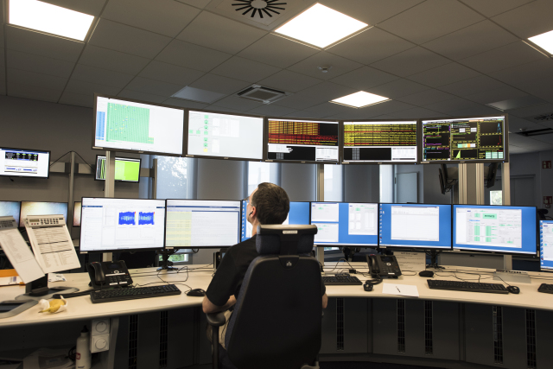
Operations
Experiments run 24/24 7/7
In LHCb Only 2 (non-expert) operators
Monitoring
  Detect any problems
  as soon as possible
Configuration
  Prepare for a particular
  running mode
Automation
  Avoid human
  mistakes
  Speed up standard
  procedures

Slide 39
Monitoring Dataflow
The other DAQ
Event Data
Automatic
Actions
Counters
Rates
Status
Counters
Rates
Alarms
RO/EB
Units
Counters
Rates
UI
Alarm
UI
Timing
& Trigger
UI
Control
System
UIs
(Run Control)
HLT
HLT SubFarms
UI
Infrastr
HLT SF Ctrl
HLT Nodes
Histos
Dataflow
D
I
M
Infrastr
D
I
M
Infrastr
D
I
M
DQHisto
Dataflow
Dataflow
Archive
(aggregation)
DQHisto
(aggregation)
DQHisto
History
Counters
Rates
Alarms
Status, Counters
Storage
Histos
Alarms
Counters, Rates
Infrastr
Data
Quality
UI
Monitoring
Dataflow
UI
History
Histos
Infrastr
Histos
Dataflow
Histo
Savesets
Histos
DQHisto
Reconstr.
Infrastr
Automatic
Analyses
Histos
Alarms
Histos
Dataflow
Operators
DQHisto
Event
Data

Slide 40
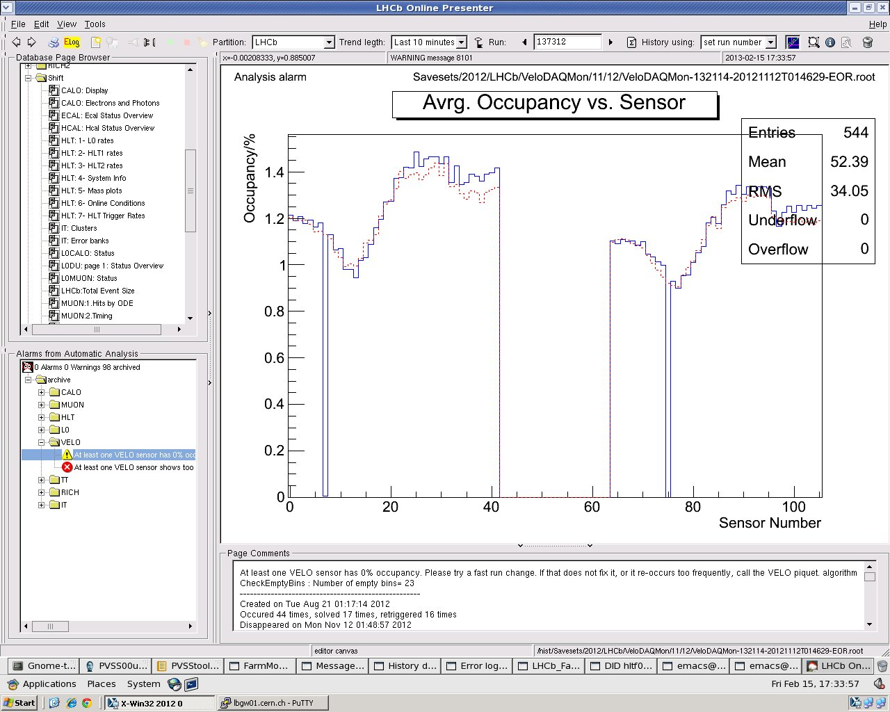
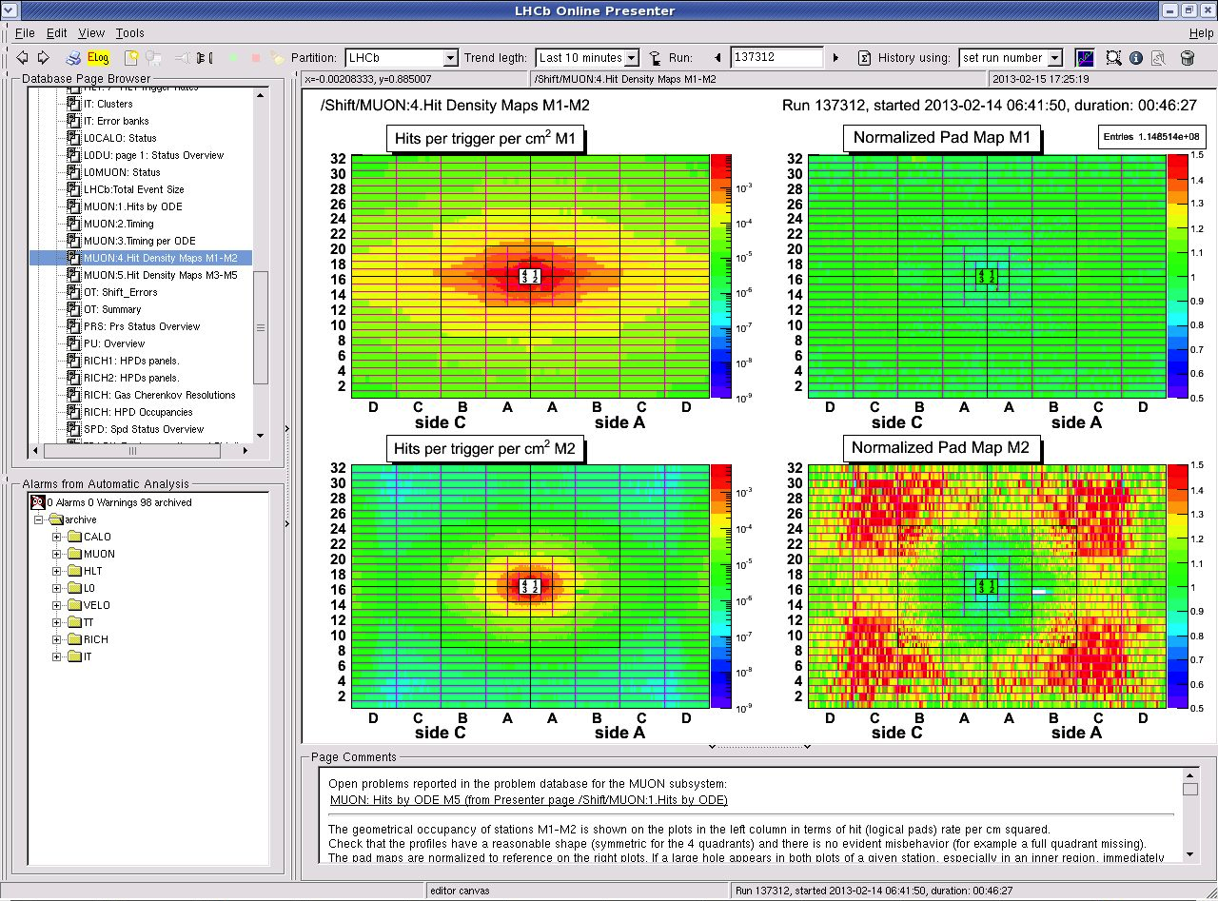
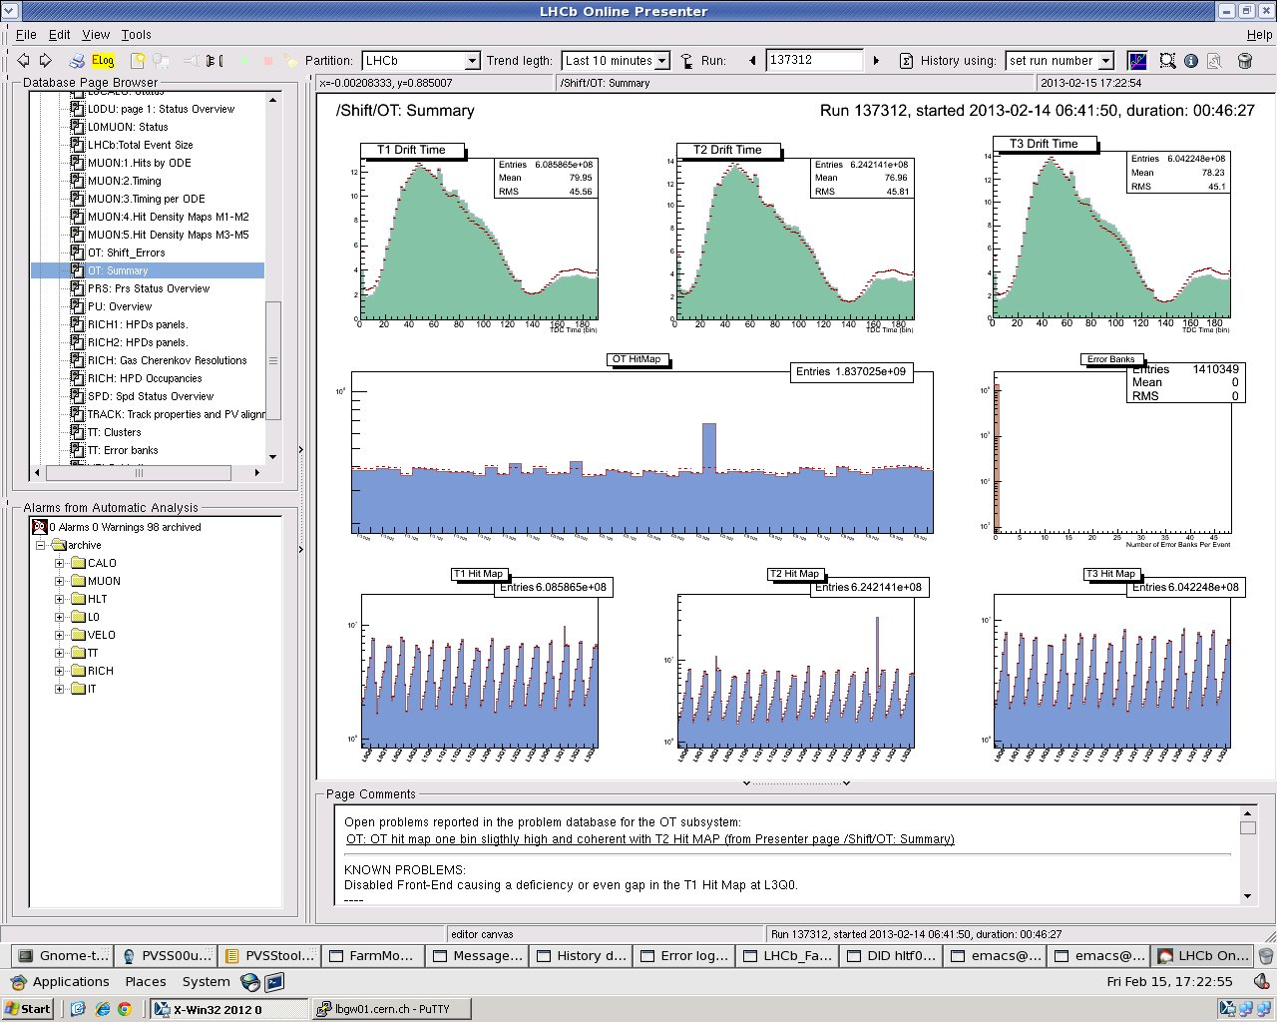
LHCb Data Quality (old)
  Monitor the quality of the data being acquired
  Compare with reference
  Automatic analyses

Slide 41
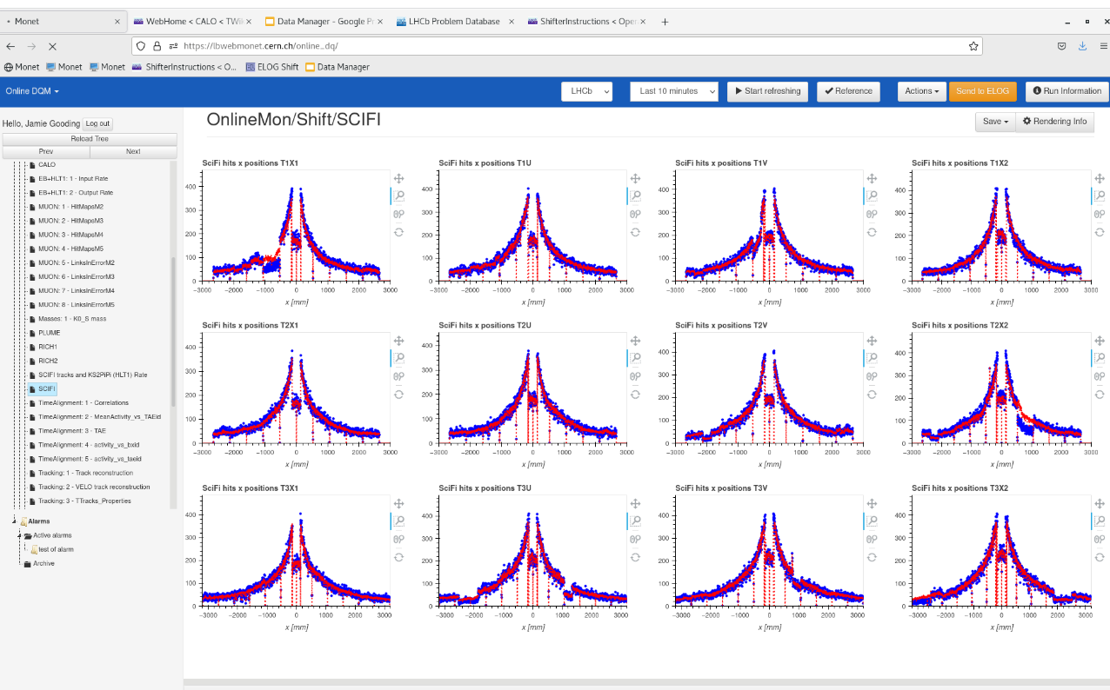
LHCb Data Quality: Monet

Slide 42
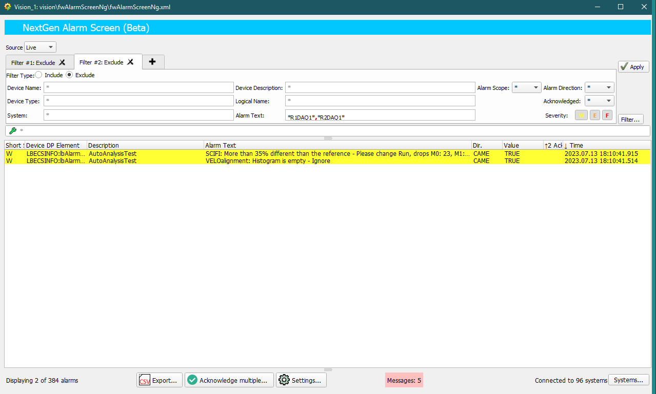
LHCb Alarm Screen

Slide 43
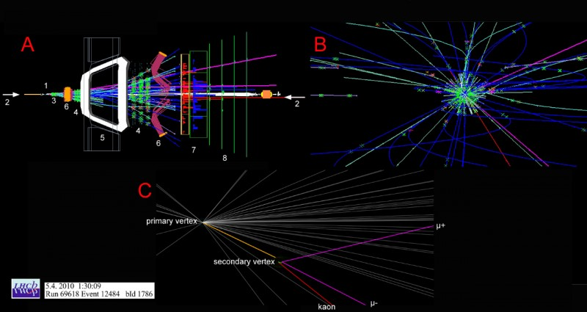
LHCb Online Event Display

Slide 44
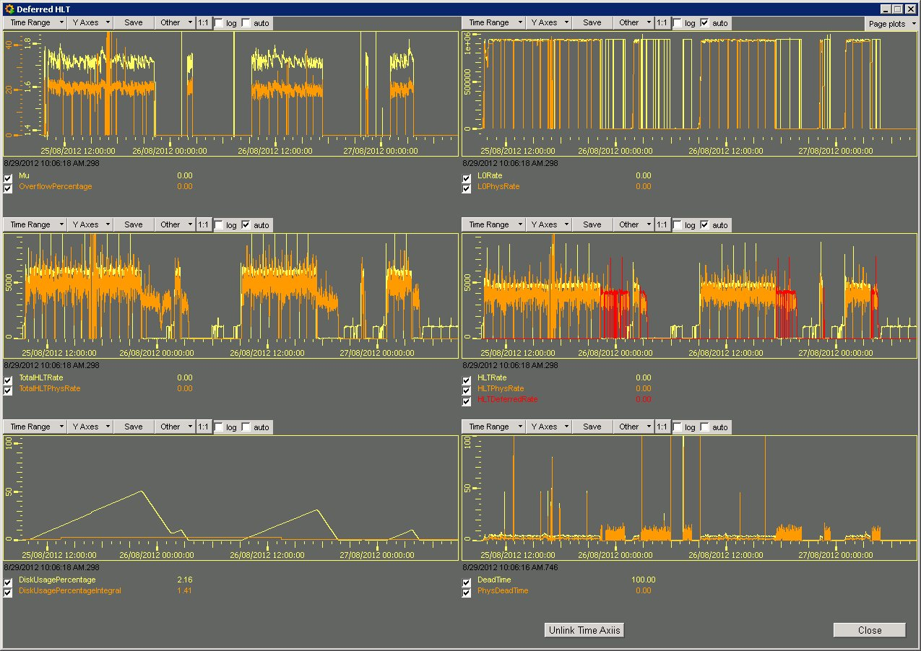
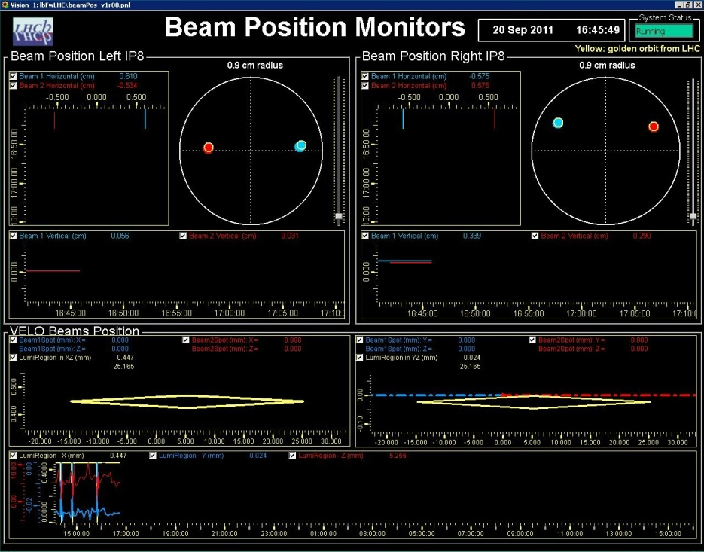
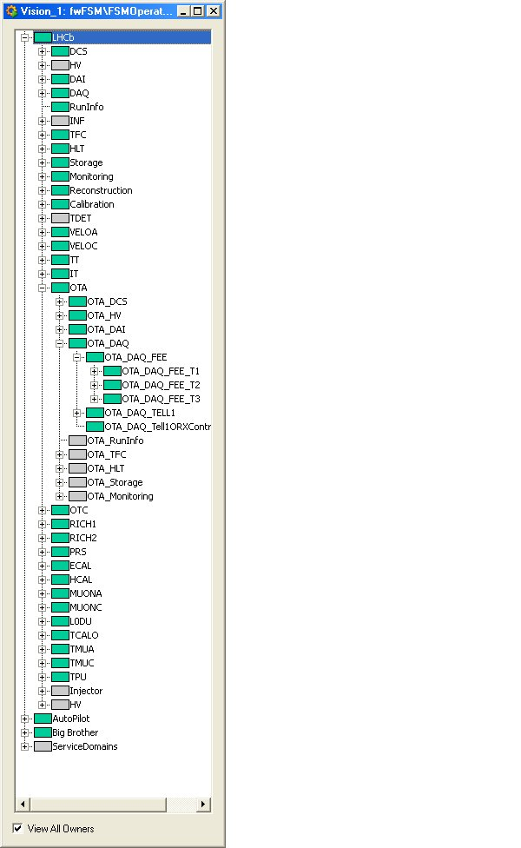
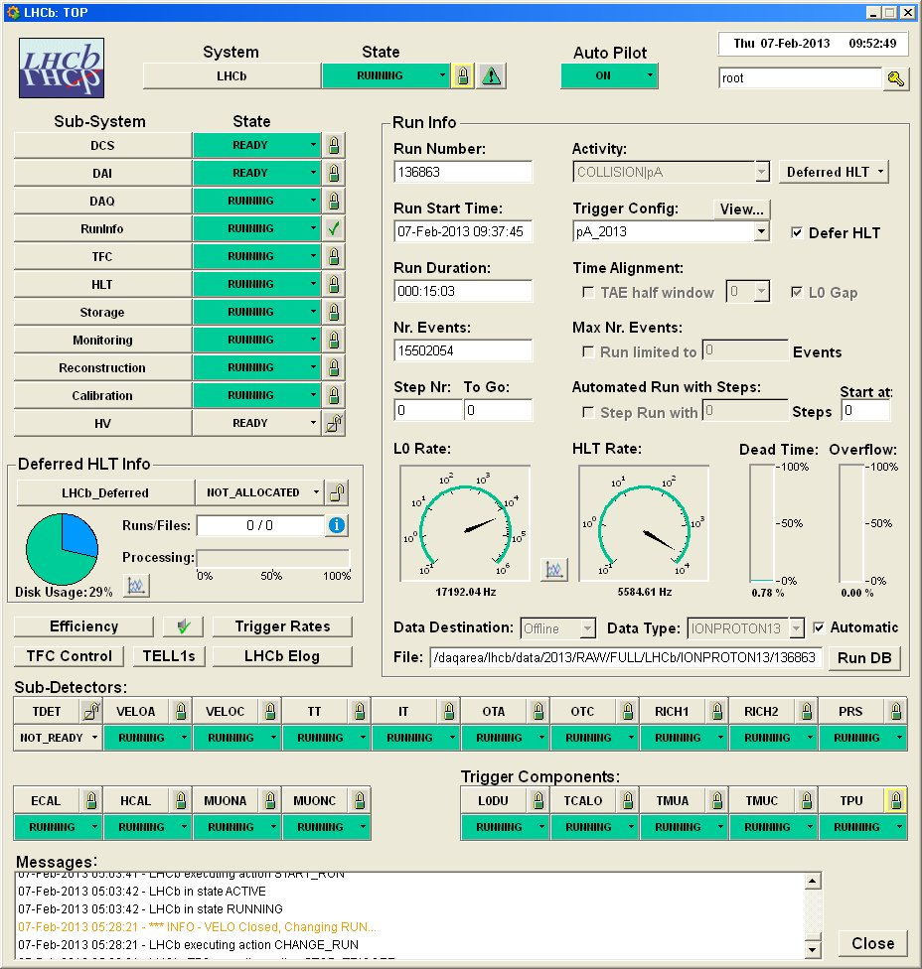
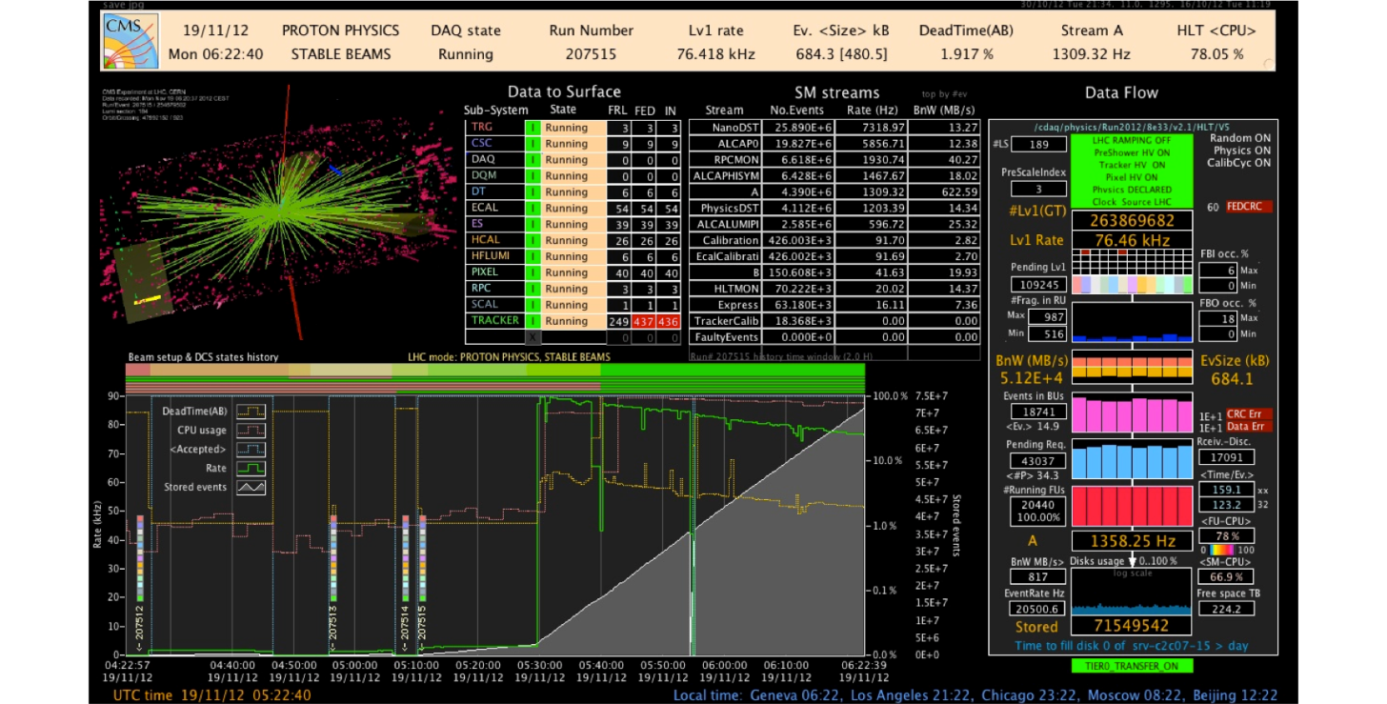
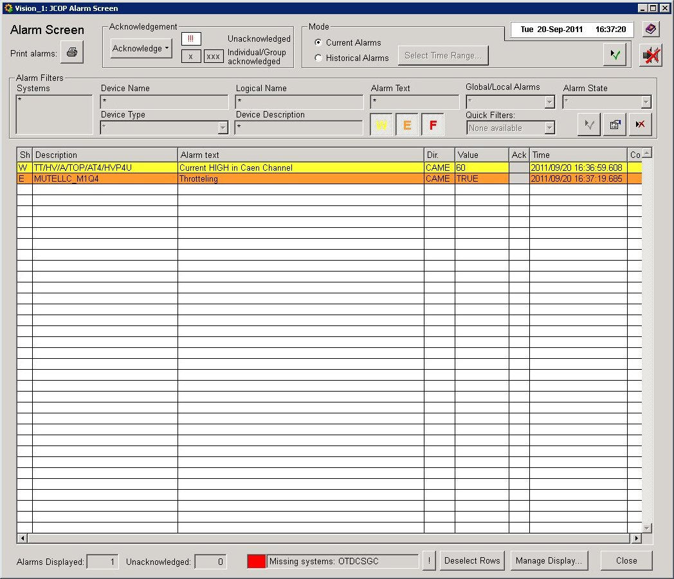
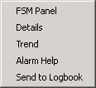
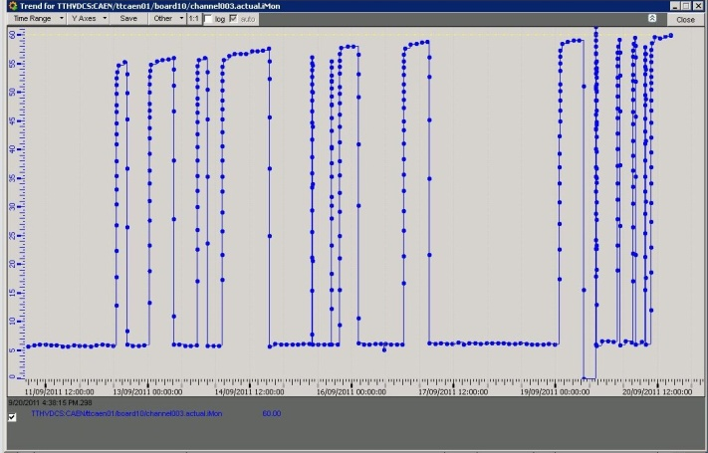
Operator Interfaces
Types of User Interfaces
  Alarm Screens and/or
  Message Displays
  Monitoring Displays
  Run Control & DCS Control

Slide 45
DAQ Upgrades

Slide 46
LHC DAQ Upgrades
 | Up to Yesterday |  |  | Upgrade (2022-2026)
 | L1 Rate (KHz) | Event Size (MByte) | Bandwidth (GByte/s) | L1 Rate (KHz) | Event Size (MByte) | Bandwidth (GByte/s)
ALICE | 1 | 25 | 25 | 50 | 20 | 1000
ATLAS | 100 | 1 | 100 | 200 | 4 | 800
CMS | 100 | 1 | 100 | 1000 | 4 | 4000
LHCb | 1000 | 0.05 | 50 | 40000 | 0.1 | 4000

Slide 47
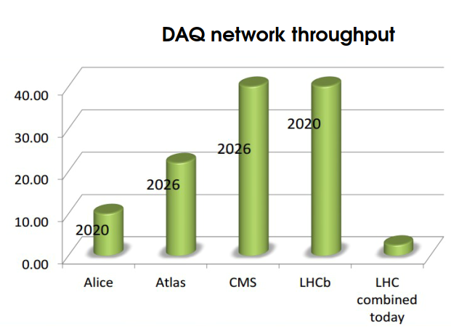
The Upgrades
2022
2022
up to 2022

Slide 48
LHC Exp. Upgrades
Reasons:
  More Physics/Faster Physics/Better Physics
  (Improved Detectors)
  Reduce impact of Hw Triggers:
    Working with partial information and with drastic simplifications has a price:
      Potentially interesting and valuable events are lost
    Directions:
      Eliminate / reduce hardware Level-1 (ALICE, LHCb)
      Substantially upgrade Level-1 (ATLAS, CMS)
  Emphasize Real-Time Alignment and Calibration

Slide 49
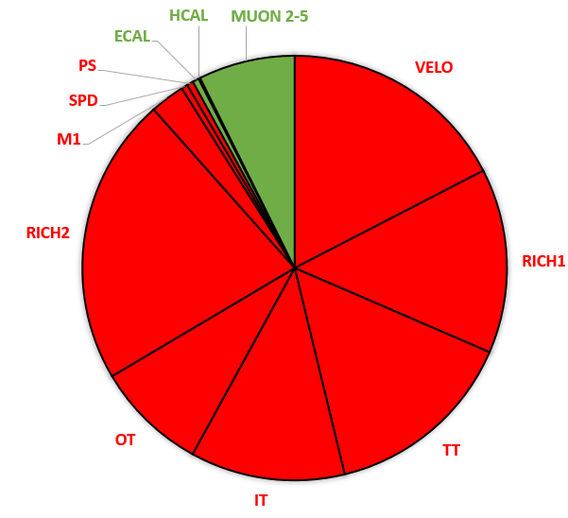
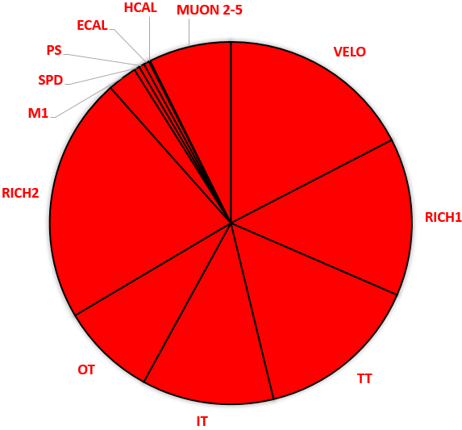
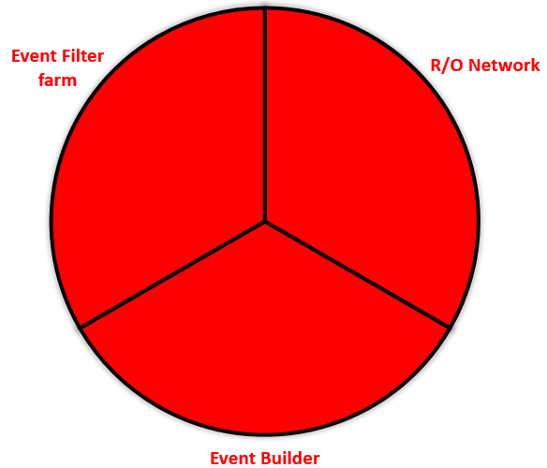
LHCb Upgrade
40 MHz Trigger-less Readout
  < 10% detector channels kept
  100% or R/O electronics replaced
  New DAQ system
  New Data Center
Detector Channels
R/O Electronics
DAQ
To be kept

Slide 50
The LHCb Example
1st Large Physics Experiment to completely abolish the Hardware Trigger -> Probably the largest Data Acquisition System in the world today
Spoiler: Commissioned last year -> And it works!!
Detector Channels/Front-Ends
Detector Channels/Front-Ends
40 MHz
40 MHz
x
1 MHz
HwTrigger
Readout Units
Readout Units
Monitoring & Control
Event Building
Monitoring & Control
Event Building
High Level Trigger
High Level Trigger
Storage
Storage
DAQ
DAQ

Slide 51
The New LHCb DAQ
Collapsed
Layers
(price/perf)
Detector Channels
TFC
Front End Electronics
Split HLT
Readout Boards/Event Builder/HLT1
40 MHz
Experiment Control System
Real-Time
Align & Calib
Monitoring
HLT1 Store
Alignment
HLT2 Farm
Offline Quality
Output data
HLT2 Store
DAQ
To Offline

Slide 52
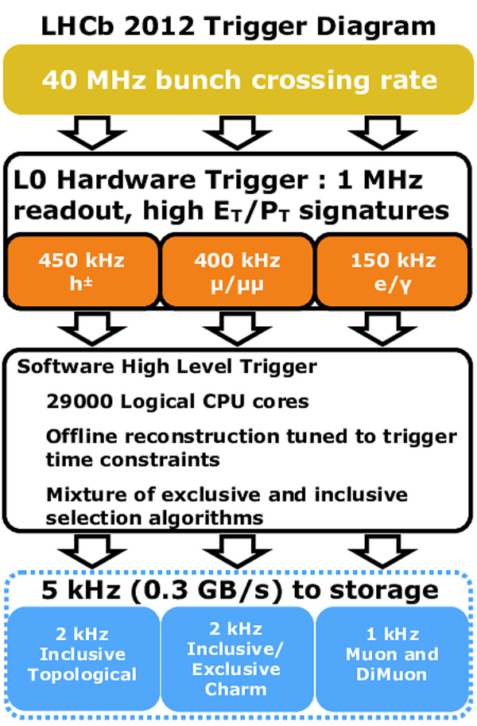
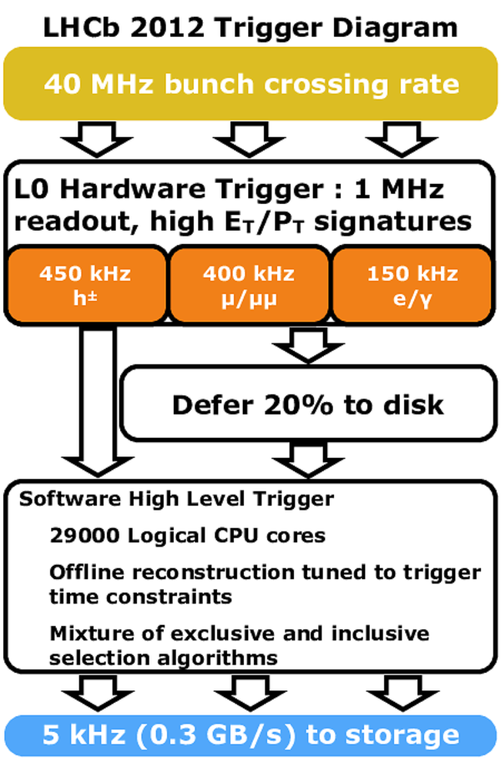
LHCb Dataflow Evolution
In 2012: More CPU needed for better Trigger
  Since: unused interfill CPU + free disk space

Slide 53
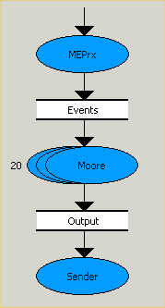
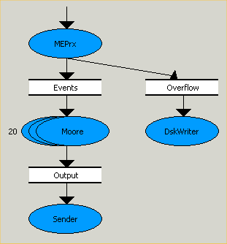
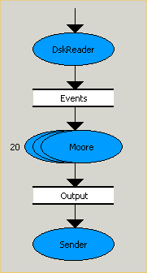
HLT Farm Usage Evolution
Resource Optimization in 2012 -> Deferred HLT
  Idea: Buffer data to disk when HLT busy / Process in inter-fill gap
  More time for more complex algorithms
Standard HLT
Deferred HLT
1 MHz
1 MHz
Farm Node Inter-fill
Farm Node
Farm Node during Physics
Farm Node
Farm Node
EvtBuilder
EvtBuilder
~20%
HLT
70 KHz
HLT
HLT
5 KHz

Slide 54
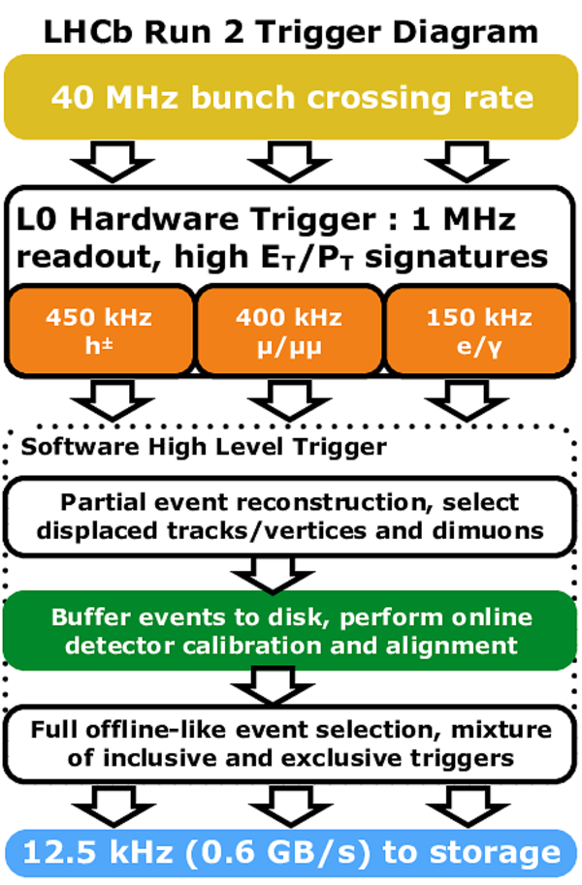
LHCb Dataflow Evolution
In 2015: Better Trigger and Trigger output data
  Since: HLT anyway composed of two steps

Slide 55
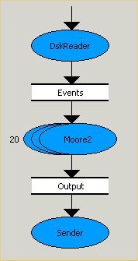
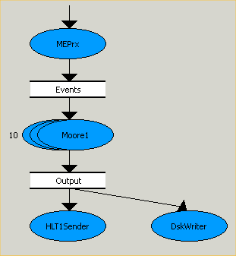
HLT Farm Usage Evolution
Even better Resource Optimization in 2015 -> Split HLT
  Idea: Buffer ALL data to disk after HLT1 / Perform Calibration & Alignment / Run HLT2 permanently in background
  Calibration and Alignment previously done Offine -> Better data!
1 MHz
Farm Node
EvtBuilder
Selected
Events
Calib&Align
Local disk
Buffer
HLT1
HLT2
100 KHz
100%
For DQ only
12.5 KHz
Conditions
DB

Slide 56
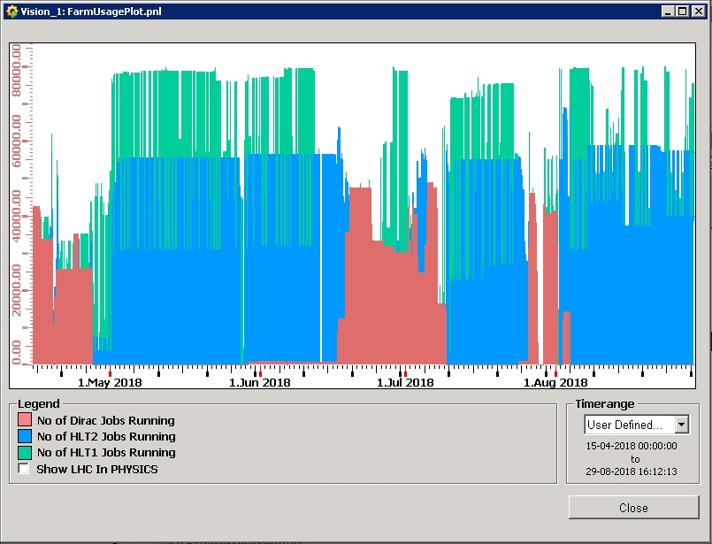
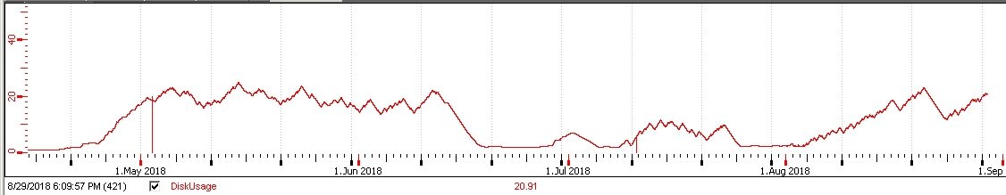
Farm Usage in 2018
  Keeping
  farm busy
  Simulation when less physics
  Disk Usage
  < 25%

Slide 57

LHCb Dataflow Evolution
x
In 2022: Even better -> No HW Trigger
  Since: Better readout and network technology available

Slide 58
New DAQ Design Principles
Selected Concepts:
  Simplicity (whenever possible)
  Integration & Homogeneity
  Promote HW Standardization
    Same hardware components for all sub-systems
  Promote SW Uniformity
    Guidelines, Framework Components, Templates
  Separate Data/Control paths
    From the Front Ends to the High Level Trigger

Slide 59


Online System Upgrade
New Data Acquisition Hardware and Dataflow Software
New Infrastructure & Sub-Detector Equipment

Slide 60

FE Electronics
DAQ
TFC+ECS
Front-end electronics
  Use CERN GBT chip
  (Gigabit Transceiver)
  A radiation hard ASIC (Application Specific Integrated Circuit)
  But unlike the drawing: separately for DAQ and for Timing & Control

Slide 61

Readout Units
PCIe40 cards in EB PCs
  PCIexpress card
  Large FPGA
  48 GBT links, 10 Gb/s each
  Versatile via the firmware
Located on surface
  Distance from FE: ~350m
In total:
  ~ 10000 optical links
  ~ 500 readout boards
  ~ 100 TFC/ECS cards
  (separated from data path)
Used also by ALICE (and others)

Slide 62
Networking
Again, use what is popular
-> best price
Basically the choice was
Infiniband and/or Ethernet

Slide 63


Event Builder
Two options tested
  Only one worked well
  within our time and budget
  (traffic pattern: All to One/flow control
  /switch buffering very expensive)
x
Complete events here
Complete events here
Technology: Infiniband
+ Ethernet for Distribution
Technology: Ethernet
(Would have been simpler and known)
Dedicated EB (TDR baseline)
Distributed EB

Slide 64


High Level Trigger
Processing Options (HLT1)
  Several R&D Projects in all these areas
Notes:
Task parallelism is the simultaneous execution on multiple cores of many different functions across the same or different datasets. Data parallelism (aka SIMD) is the simultaneous execution on multiple cores of the same function across the elements of a dataset

Slide 65


HLT1
x
HLT1
here
HLT1
here
Two options: CPU vs GPU
  Both worked: Cost (and politics/sociology) made the difference

Slide 66
LHCb Current DAQ Core
EB Servers
  ~160
  Hosting PCIe cards
Readout Units:
  ~500
  Powerful FPGA
  48 FE links (1Gb)
GPUs:
  ~160 -> ~320
  Fast HLT1 Pass
CPUs
  ~4000 (donated)
  Thorough HLT2

Slide 67

Data Processing
Improvements all the way to analysis strategy: Turbo stream
  Since we can automatically perform final alignment and calibration online
  So we can achieve offline quality alignment and calibration in the trigger
  Store only part of the event → allows for higher output bandwidth

Slide 68

Alignment and Calibration
Why do we need alignment & Calibration?
  Physical movements, magnetic field, temperature, pressure effects
  Better mass resolution
  Better particle identification (PID)
  Store less background → More bandwidth for physics!
What and when do we align?

Slide 69


HLT2
A large CPU Farm
  Around 4000 PCs
  (many inherited for free)
  Also runs Calibration and Alignment tasks
A brand new Computer Center

Slide 70
Configuration, Control and Monitoring

Slide 71
Control System Tasks
Configuration
  Selecting which components take part in a certain “Activity”
  Loading several millions of parameters (according to the “Activity”)
Control core
  Sequencing and Synchronization of operations across the various components
Monitoring, Error Reporting & Recovery
  Detect and recover problems as fast as possible
  Automate Standard Operations
User Interfacing
  Allow the operator to visualize and interact with the system

Slide 72




Control Framework
Can be based on Commercial SCADA Systems (Supervisory Control and Data Acquisition)
  Commonly used for:
    Industrial Automation
    Control of Power Plants, etc.
  Providing:
    Run-time Database and Tools
    Archiving of Monitoring Data including display and trending Tools.
    Alarm definition and reporting tools
    User Interface design tools
  Used in LHC experiments DCS and LHCb for everything
Or can be home made

Slide 73
The Control System
External Systems (LHC, Technical Services, Safety, etc.)
Detector & General Infrastructure (Power, Gas, Cooling, etc.)
Detector Channels
TFC
Front End Electronics
Experiment Control System
Readout Boards/Event Builder/HLT1
Monitoring
HLT1 Store
Alignment
HLT2 Farm
HLT2 Store
DAQ
To Offline

Slide 74
Experiment Control System
ECS
Implementation:
(JCOP project)
  Framework
Deployment:
  Runs distributed over >100 PCs
  (Virtual Machines)
INFR.
DCS
TFC
DAQ
HLT
LHC
Status & Alarms
SubDet1
DCS
SubDet2
DCS
…
SubDetN
DCS
SubDet1
DAQ
SubDet2
DAQ
…
SubDetN
DAQ
Commands
SubDet1
LV
SubDet1
TEMP
SubDet1
GAS
SubDet1
FEE
SubDet1
RO
Legend:
Control
Unit
LV
Dev1
LV
Dev2
…
LV
DevN
FEE
Dev1
FEE
Dev2
…
FEE
DevN
Device
Unit
Control Units are logical entities:
  Behave as a Finite State Machine / Rule Based system:
    Capable of Partitioning: Exclude/Include children
    Can take local decisions: Sequence & Automate Operations or Recover Errors
Device Units
  Provide the interface to the device (hardware or software)

Slide 75
Control System Behaviour
Distributed “Intelligent” Hierarchical System
ECS
ERROR
Recover
UNKNOWN
Configure
NOT_READY
CONFIGURING
Reset
INFR.
DCS
TFC
DAQ
HLT
READY
LHC
Start
Stop
RUNNING
…
…
SubDet1
DCS
SubDet2
DCS
SubDetN
DCS
SubDet1
DAQ
SubDet2
DAQ
SubDetN
DAQ
Status & Alarms
Commands
SubDet1
LV
SubDet1
TEMP
SubDet1
GAS
SubDet1
FE
SubDet1
RU
Legend:
Control
Unit
…
…
Device
Unit
LV
Dev1
LV
Dev2
LV
DevN
FE
Dev1
FE
Dev2
FE
DevN

Slide 76

Operations
Main Tools:
  RunControl
    Handles the DAQ & Dataflow
    Allows to:
      Configure the system
      Start & Stop runs
  AutoPilot
    Knows how to start and keep a run going from any state.
  BigBrother
    Based on the LHC state:
      Controls SD Voltages
      VELO Closure
      RunControl

Slide 77

Run Control
  Run Control & The Autopilot:
    Configures,
    Starts and Keeps the RUN going.
    Configuration Driven by an “Activity”

Slide 78


Run Control
ALICE:
Tcl/Tk
ATLAS:
Java
(modular)
LHCb:
JCOP FW
(UI builder)
CMS: Web Tools (JavaScript+HTML)

Slide 79


Big Brother
Based on LHC state, controls:
  Voltages
  VELO Closure
  Run Control
Can sequence activities, ex.:
  End-of-fill Calibration
Confirmation requests and Information
  Voice Messages

Slide 80




Detector Control System
JCOP FW
ALICE
ATLAS
CMS
LHCb

Slide 81

LHCb Control System
Courtesy of CMS DCS Team (by analyzing our FSM tree)

Slide 82
Concluding Remarks
Trigger and Data Acquisition systems have become increasingly complex.
Luckily the requirements of telecommunications and computing in general have strongly contributed to the development of standard technologies:
  Hardware: Fast ADCs, Field-Programmable Gate Arrays, Analog memories, multi-core PCs, Networks, Helical scan recording, Data compression, Image processing (GPUs), ...
  Software: Distributed computing, Software development environments, Supervisory systems, Artificial Intelligence tools...
We can now build a large fraction of our systems using commercial components (customization will still be needed in the front-end).
It is essential that we keep up-to-date with the progress being made by industry.

Slide 83
LHC/LHCb Fill Sequence
NO_BEAM
Injection Permit = FALSE, Internal Clock, Any state of LHCb
Handshake for Injection(TI8_Setup)
Act: Lower Voltages, VELO Out
INJECTION
Injection Permit = TRUE
RAMP
Injection Permit = FALSE Act: Start Raising Voltages
At FLAT_TOP: Act: External Clock, Reset DAQ
PHYS_ADJUST
PHYSICS
Act: Raise Voltages, VELO In
Handshake for Adjust
(Act: Lower Voltages, VELO Out)
(ADJUST)
DUMP/EOF
Act: VELO Out, Internal Clock
Act: EOF Calibrations
Handshake: Confirm Handshake -> Prepare detector -> Confirm Ready
Simple Confirmation

Slide 84
Other Tools & Components
Main Framework Components:
  Communications
    Device Access and Message Exchange between processes
  Intelligence: Finite State Machines/Expert System Functionality
    System Description, Synchronization and Sequencing
    Error Recovery, Assistance and Automation
  Databases
    Configuration, Archive, Conditions, etc.
  User Interfaces
    Visualization and Operation
  Other Services:
    Process Management (start/stop processes across machines)
    Resource Management (allocate/de-allocate common resources)
    Logging, etc.

Slide 85

Communications (example)
DIM – Distributed Information Management System
  Efficient and light weight data exchange across processes
  (and machines)
  Available for:
    C, C++, Java, Python
    Linux, Windows, etc.
  Client/Server (Publish/Subscribe)
  Services
    Set of data, any type or size
      Single items, arrays or structures
    Free name space
      But better use a naming convention
    Servers publish Services.
    Clients subscribe to Services.
      Once, at regular intervals or on change
    Clients can also send Commands to Servers
  Name Server
    Keeps the coordinates of available Services

Slide 86

Automation (example)
SMI++ - State Management Interface
  A Tool for the Automation of large distributed
  control systems
  Method:
    Classes and Objects
      Allow the decomposition of a complex system into smaller manageable entities
    Finite State Machines
      Allow the modeling of the behavior of each entity and of the interaction between entities in terms of STATES and ACTIONS
    Rule-based reasoning
      React to asynchronous events
      (allow Automation and Error Recovery)
Obj
SMI Domain
Obj
Obj
ERROR
Recover
NOT_READY
Configure
Reset
Obj
READY
Obj
SMI Domain
StartRun
StopRun
RUNNING
Obj
Obj
Obj
Proxy
Proxy
Proxy
Hardware Devices

Slide 87
SMI++ - The Language: SML
  Finite State Logic
    Objects are described as FSMs
    their main attribute is a STATE
  Parallelism
    Actions can be sent in parallel to
    several objects.
  Synchronization and Sequencing
    The user can also wait until actions
    finish before sending the next one.
  Asynchronous Rules
    Actions can be triggered by logical
    conditions on the state of other objects.

Slide 88
Online Databases
Three main logical Database concepts in the Online System
But naming, grouping and technology can be different in the different experiments…
Config.
DB
Configuration settings
for a running mode
if needed for next run settings
(Pedestal Followers)
Experiment’s HW & SW
Control
System
PVSS
Archive
Monitoring data
(at regular intervals)
if History needed
DB
if needed by Offline
Cond.
To Offline
To Offline
DB

