Slide 1



MDT DCS Offline Monitoring
Ethan Hazelton
University of Michigan
07/27/2023

Slide 2
Presentation Outline:
Overview of Project
Explanation of each component of the project
Demonstration of web portion
How does this project add to MDT monitoring?
What is still left to do?
What have I learned?
Travels
Ethan Hazelton – hazeltet@umich.edu
ATLAS Experiment
2

Slide 3
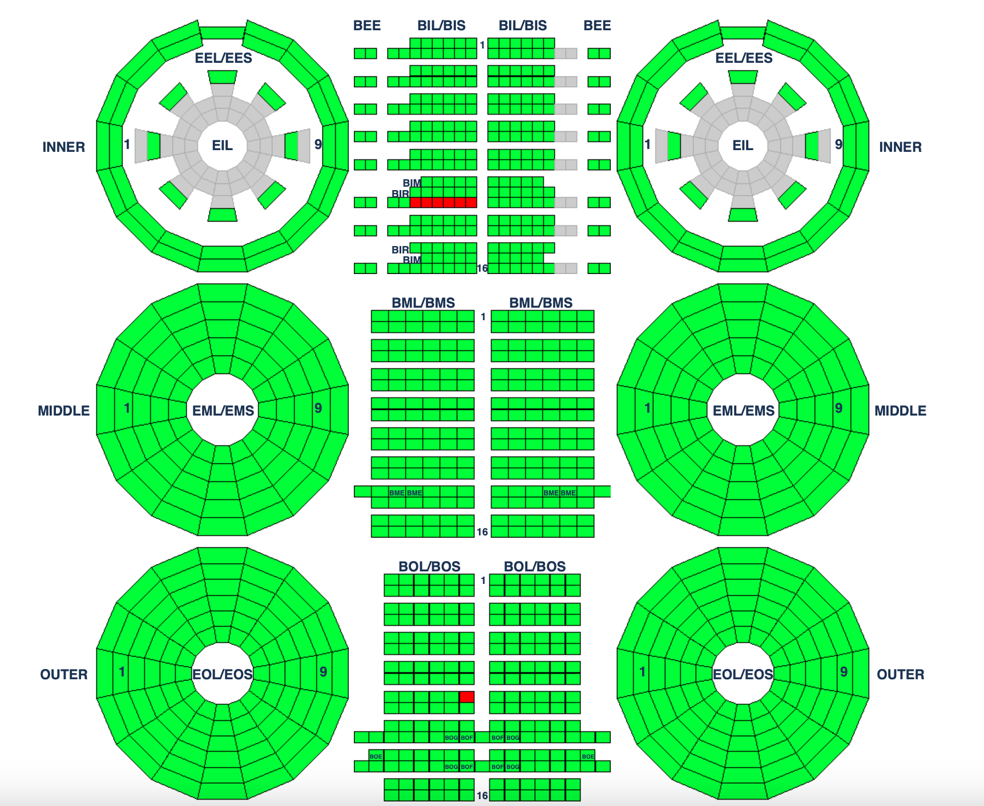
Project: MDT DCS Offline Monitoring
Working with Zhen Yan (Boston University) and Tiesheng Dai (University of Michigan)
Goal of the project: Generate figures using DCS data for offline monitoring of MDT detectors/electronics
  Build web application to display data
Purpose: Important to review detector performance from different runs (more on slide 14)
Ethan Hazelton – hazeltet@umich.edu
ATLAS Experiment
3
Notes:
Cant look at every single chamber in person

Slide 4
Overview:
Will not have time to complete the entire project
Most focus on:
  Spark
  Analysis
  Web Portion
  Update HTML
Ethan Hazelton – hazeltet@umich.edu
ATLAS Experiment
4

Slide 5
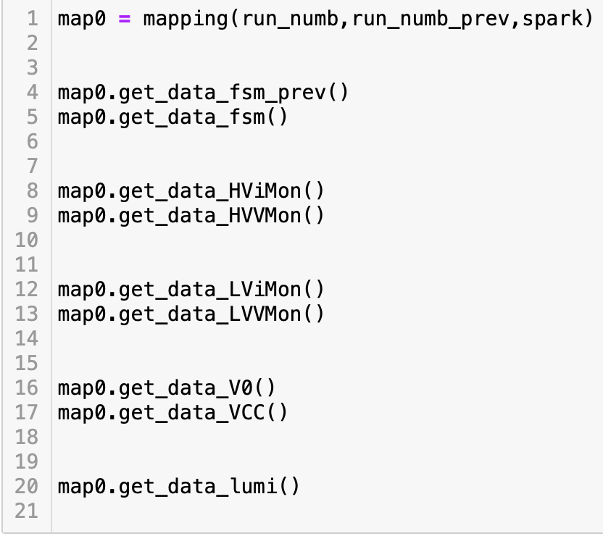
Spark:
To query the DCS database:
  Apache Spark (pyspark)
  SQL
Apache Spark is an analytics engine for large-scale data processing
  Pyspark is the python API for the use of Apache Spark
Data from each MDT chamber must be exported to a .parquet file to be read for analysis
Partitioned data by run number
FSM States
(Ex: On, Standby)
Chamber power supply current & voltage
LV power supply current & voltage
Voltage max threshold
Voltage into CSM
LHC instantaneous luminosity
Ethan Hazelton – hazeltet@umich.edu
ATLAS Experiment
5

Slide 6
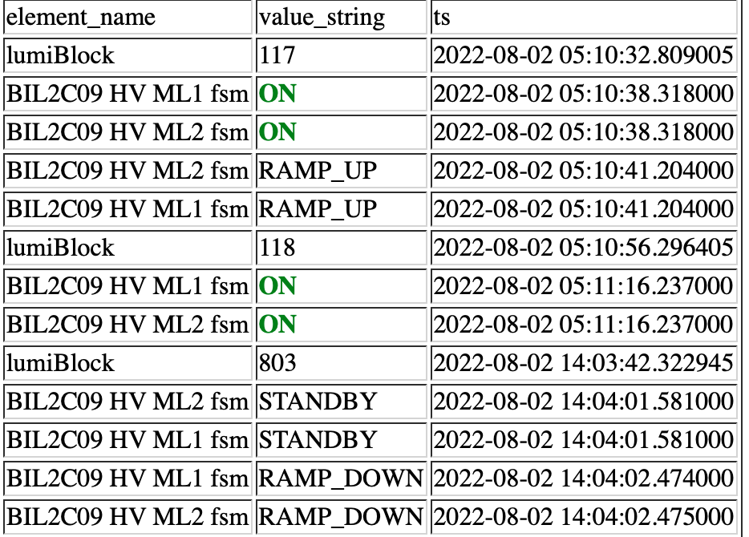
Python Analysis:
FSM (Finite State Machine):
  Important to monitor JTAG, HV power supply (PS), and LV power supply
  Need to see chamber failures and the lumiblock they happened
  FSM diagram and table to present information
Ethan Hazelton – hazeltet@umich.edu
ATLAS Experiment
6

Slide 7
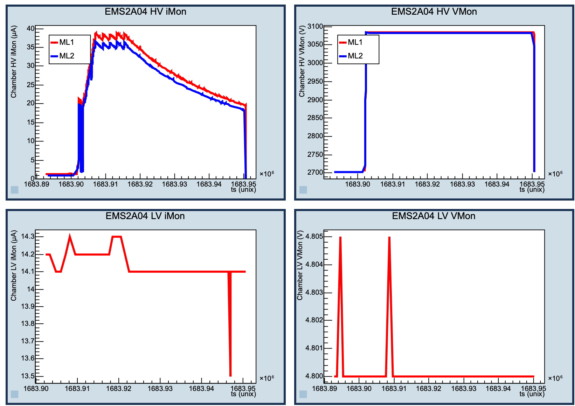
Python Analysis:
HV(High Voltage) iMon & Vmon:
  iMon = PS current output
  Vmon = PS voltage output
  Power sent directly to MDT detectors
LV(Low Voltage) iMon & Vmon:
  iMon = PS current output
  Vmon = PS voltage output
  Power sent directly to electronics for MDT readouts
Ethan Hazelton – hazeltet@umich.edu
ATLAS Experiment
7

Slide 8
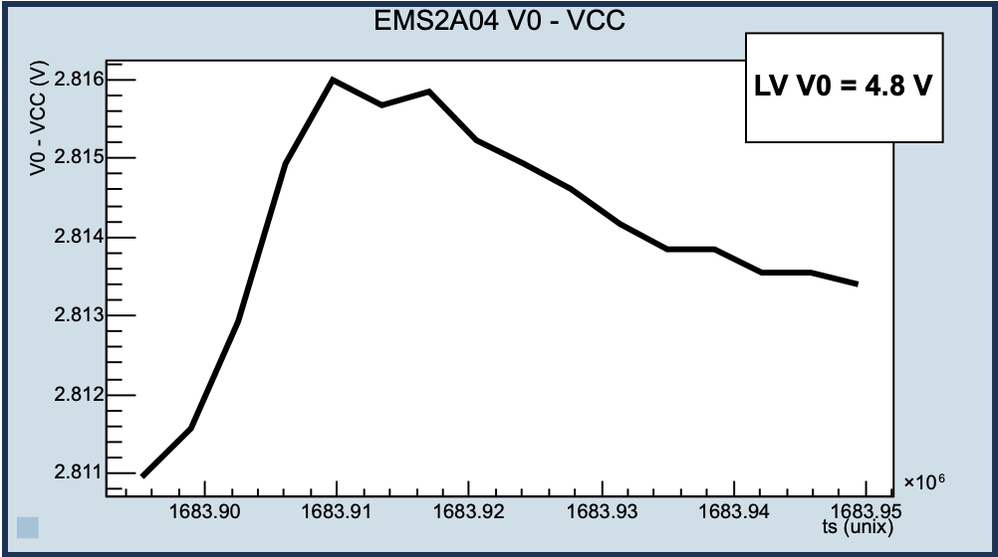
Python Analysis:
LV V0 – CSM VCC:
  V0 is the maximum voltage threshold for the LV electronics
    Causes shutoff
  VCC is the voltage read from the CSM (Chamber Service Module)
    Receiving power form LV PS
  Represents how close LV electronics are getting to the threshold
Ethan Hazelton – hazeltet@umich.edu
ATLAS Experiment
8

Slide 9
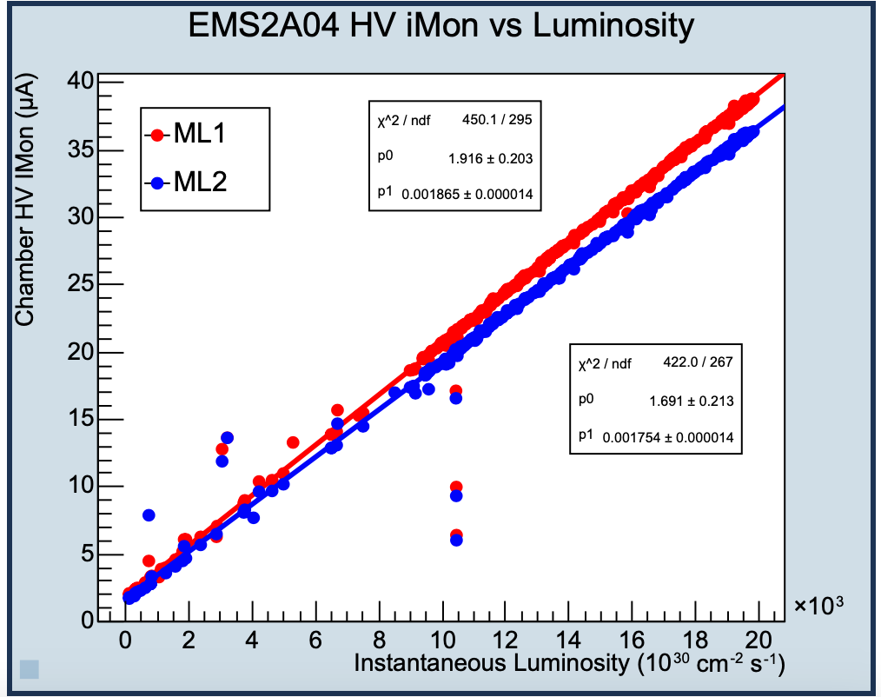
Python Analysis:
HV iMon vs LHC Instantaneous Luminosity:
  iMon should increase linearly with luminosity
  Lines of very different slopes indicate a problem
  Data constrained by stable beam flag and Atlas good physics flag
Ethan Hazelton – hazeltet@umich.edu
ATLAS Experiment
9

Slide 10
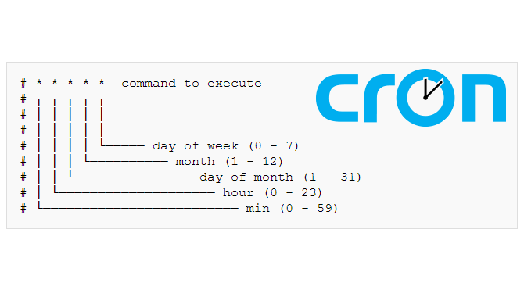
Cronjob:
For use when web server is operational
Every few days a job must be run to grab the new MDT DCS data and run the analysis for each new run
  For website to be up to date
Unfinished
Ethan Hazelton – hazeltet@umich.edu
ATLAS Experiment
12

Slide 11
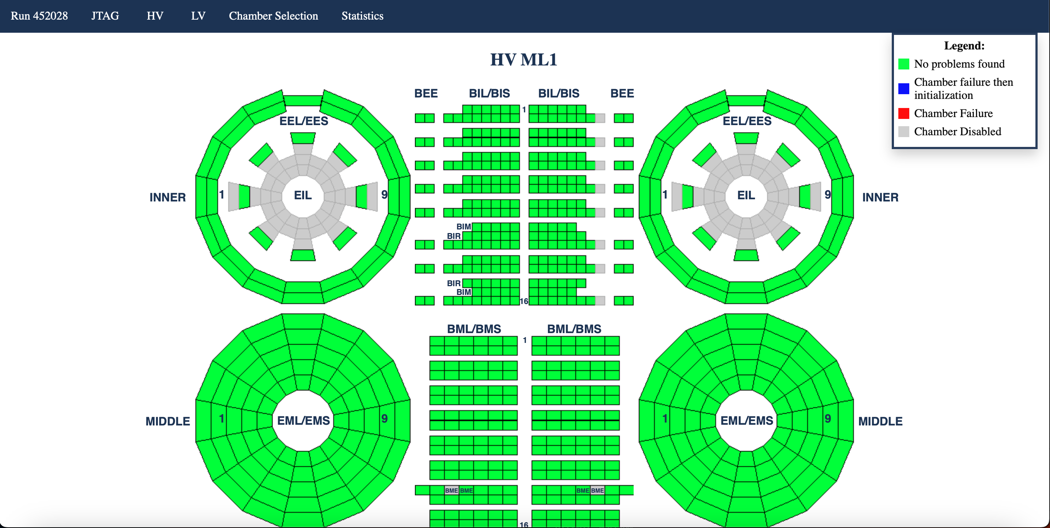
Web & Update HTML:
Uses Python Flask for backend and to interact with python pyspark and analysis
Web template designed with HTML & CSS
JS used for some frontend functionality
Update HTML updates web home page with links to new run analysis
Can only run on local server as of now
Ethan Hazelton – hazeltet@umich.edu
ATLAS Experiment
10

Slide 12
Demonstration
(Must share screen)
Ethan Hazelton – hazeltet@umich.edu
ATLAS Experiment
13

Slide 13
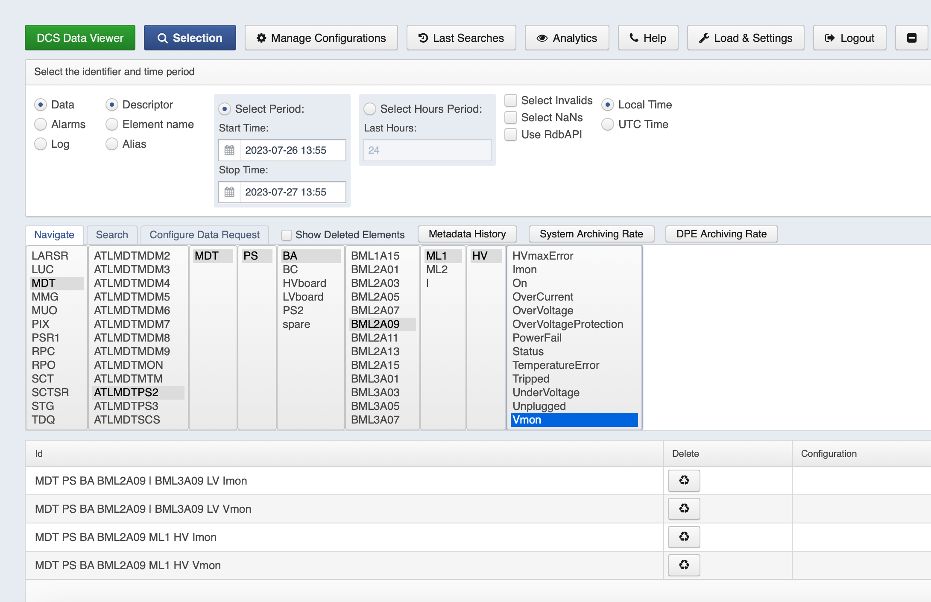
How this adds to MDT monitoring:
MDT Online & Offline monitoring exists
A study of the MDT DCS Offline data does not exist
  Limited online monitoring for MDT
  DCS Data view shows raw data
Supplementary study for MDT detector condition
Ethan Hazelton – hazeltet@umich.edu
ATLAS Experiment
14

Slide 14
Still left to do:
Documentation (README, code comments, code organization, error management)
Optimization (Spark & analysis)
Provide Gitlab with DCS data and analysis from all Run3 ATLAS runs so far (~250 runs)
Chamber selection page => Chamber summary
Home page run table
Statistics page
Cronjob and CERN web server launch
Speak with MDT experts about additional plots for analysis
Speak with DCS experts about optimization of Spark
Ethan Hazelton – hazeltet@umich.edu
ATLAS Experiment
15

Slide 15
What I have gained from this:
Working with dataframes/databases
  SQL (Structured Query Language)
  Python pandas
Improved project organization skills
Web design (frontend & backend)
Improved ROOT skills
Ethan Hazelton – hazeltet@umich.edu
ATLAS Experiment
16

Slide 16
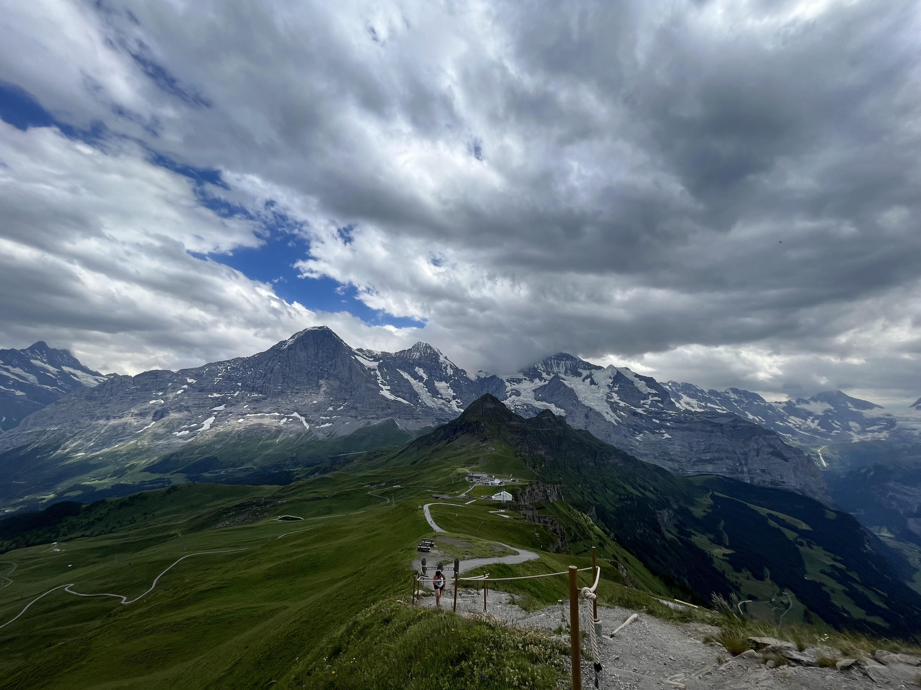
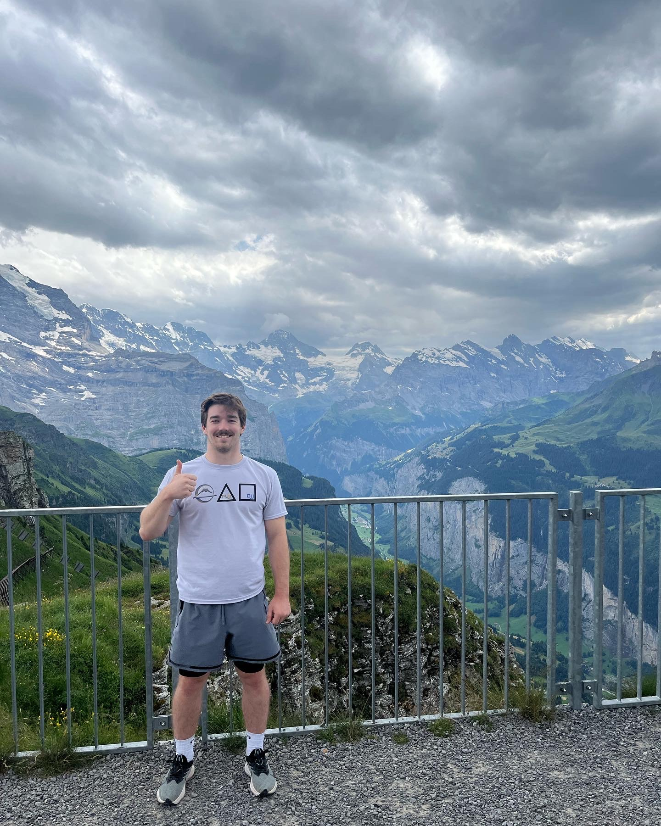

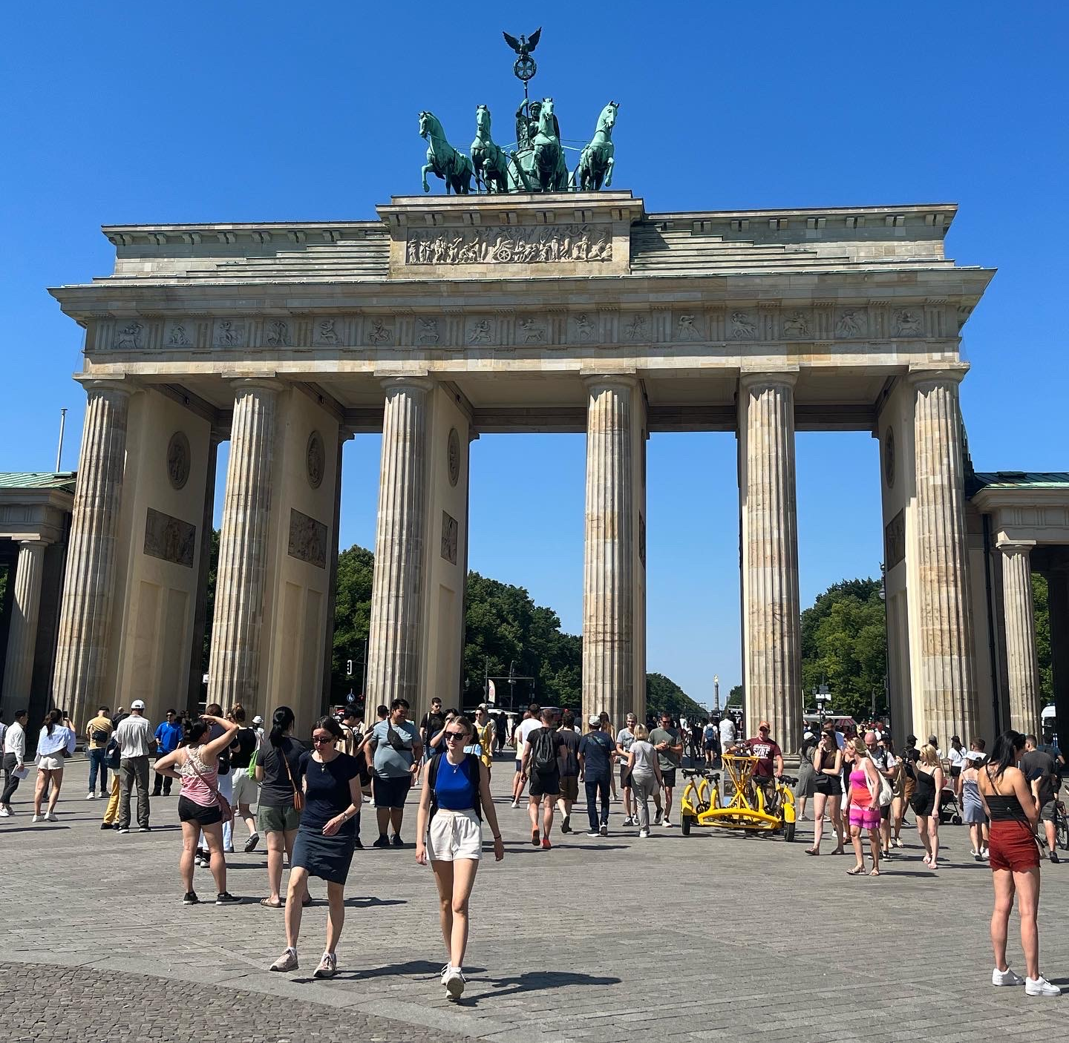
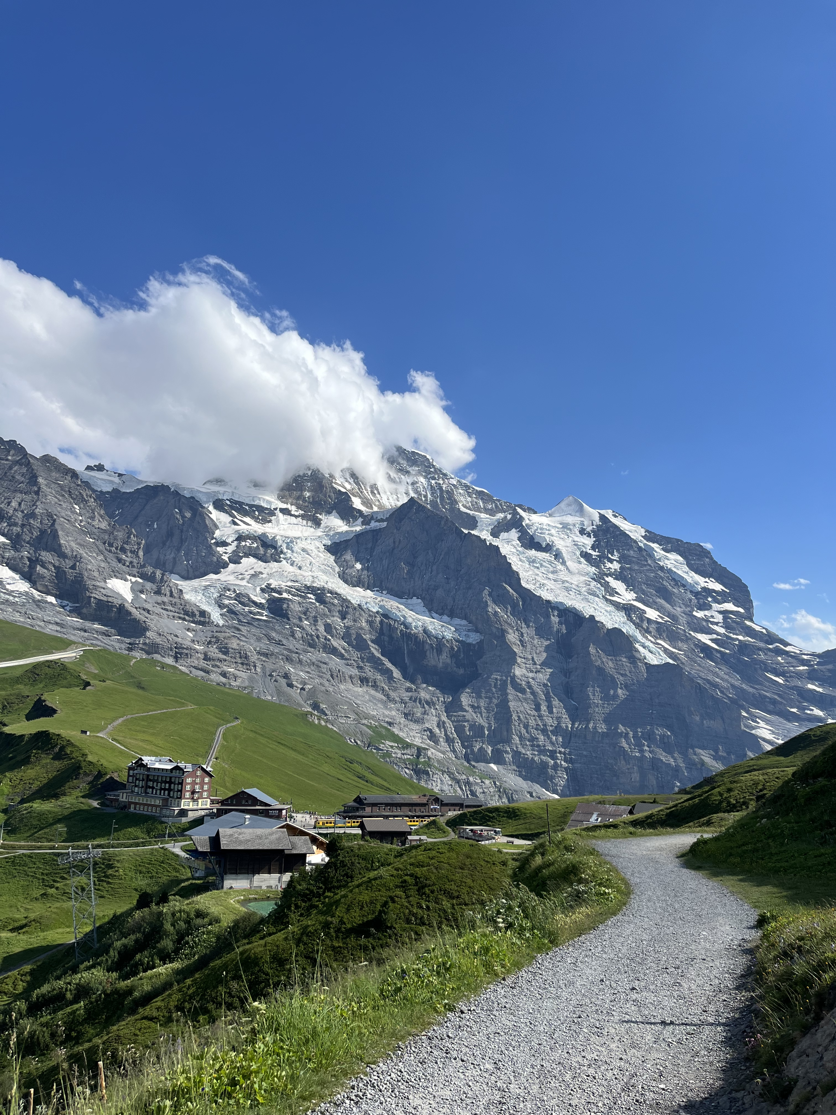
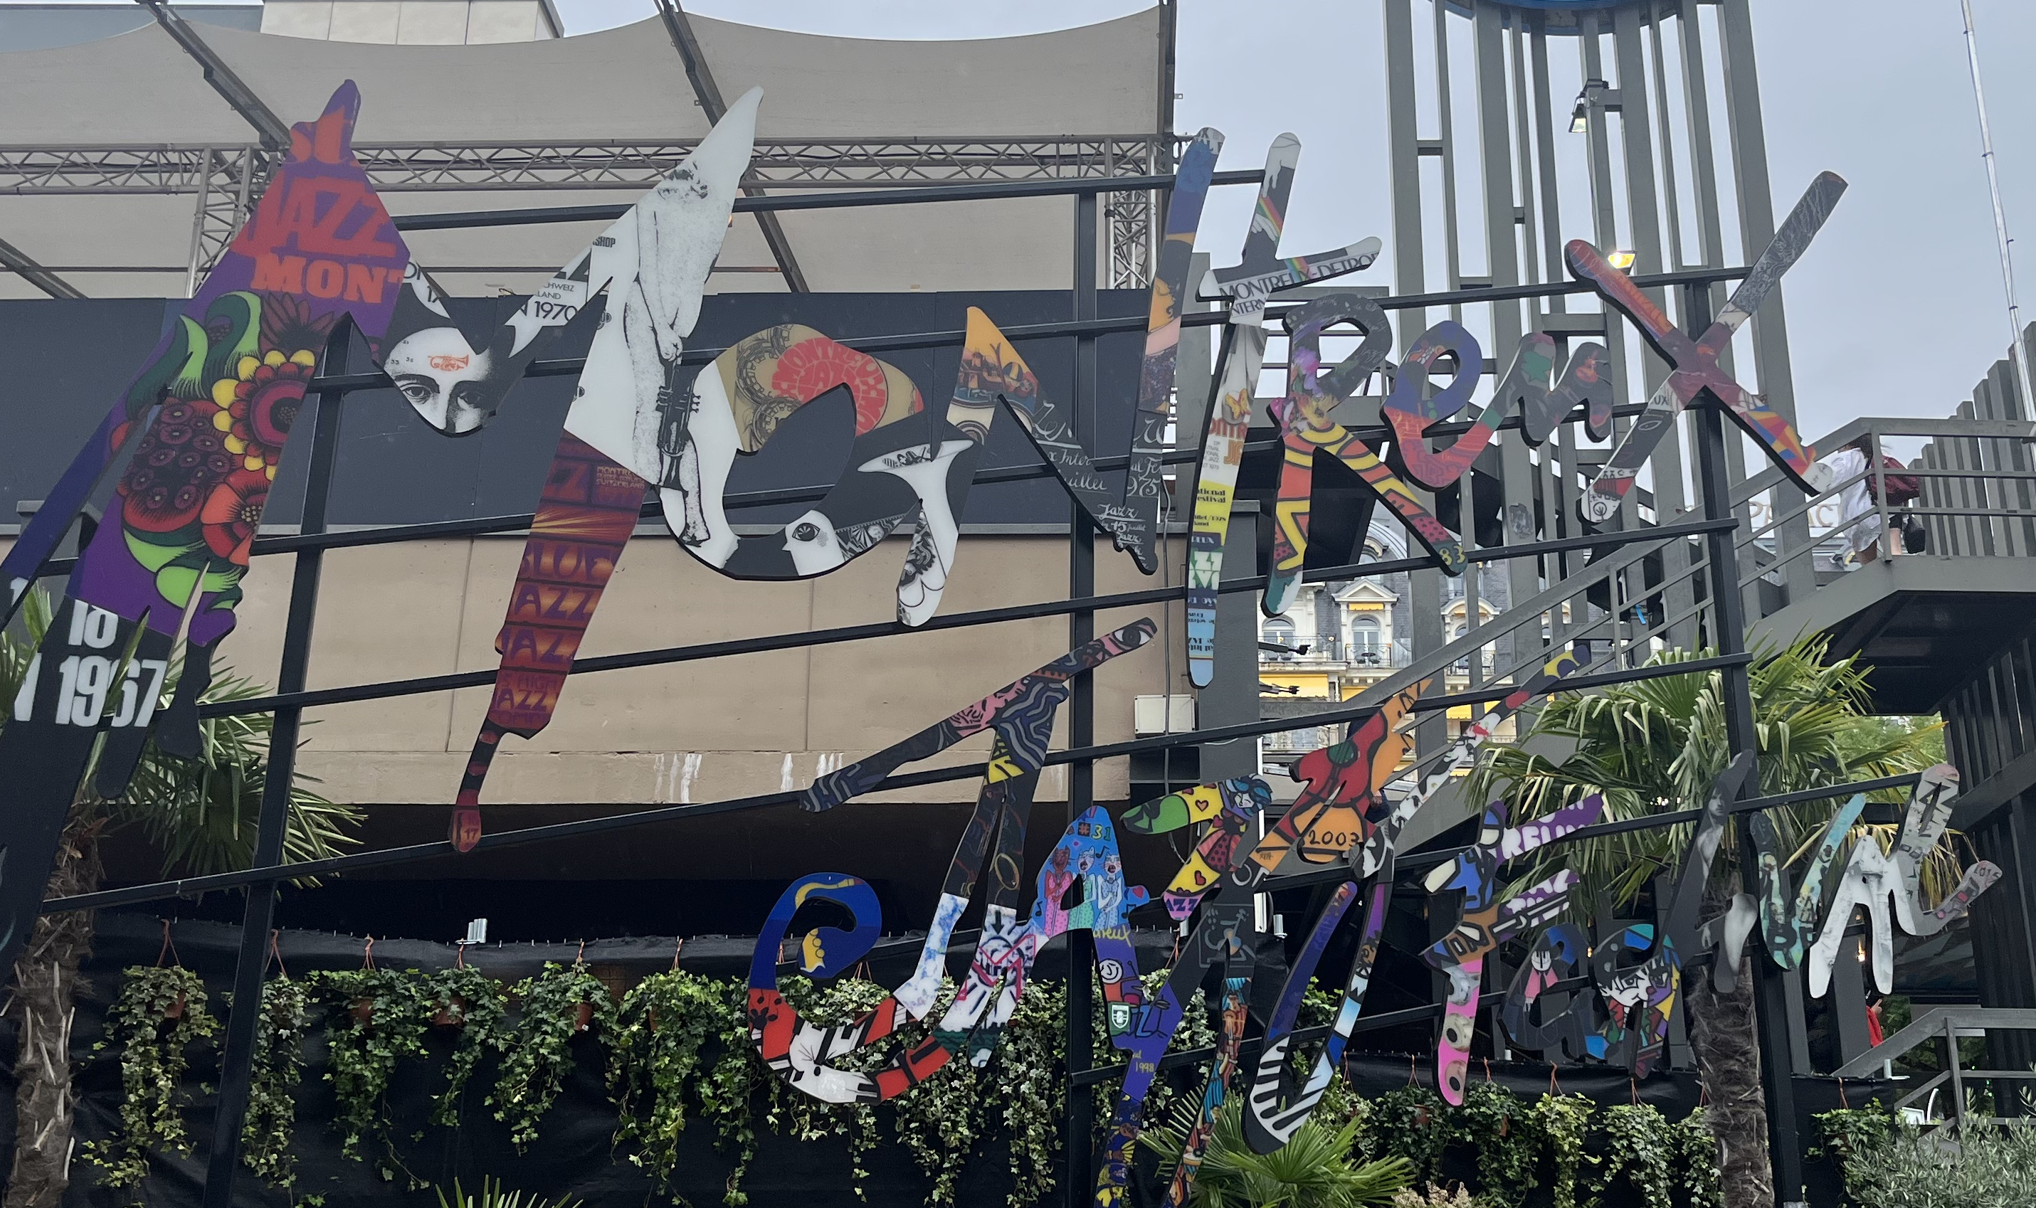
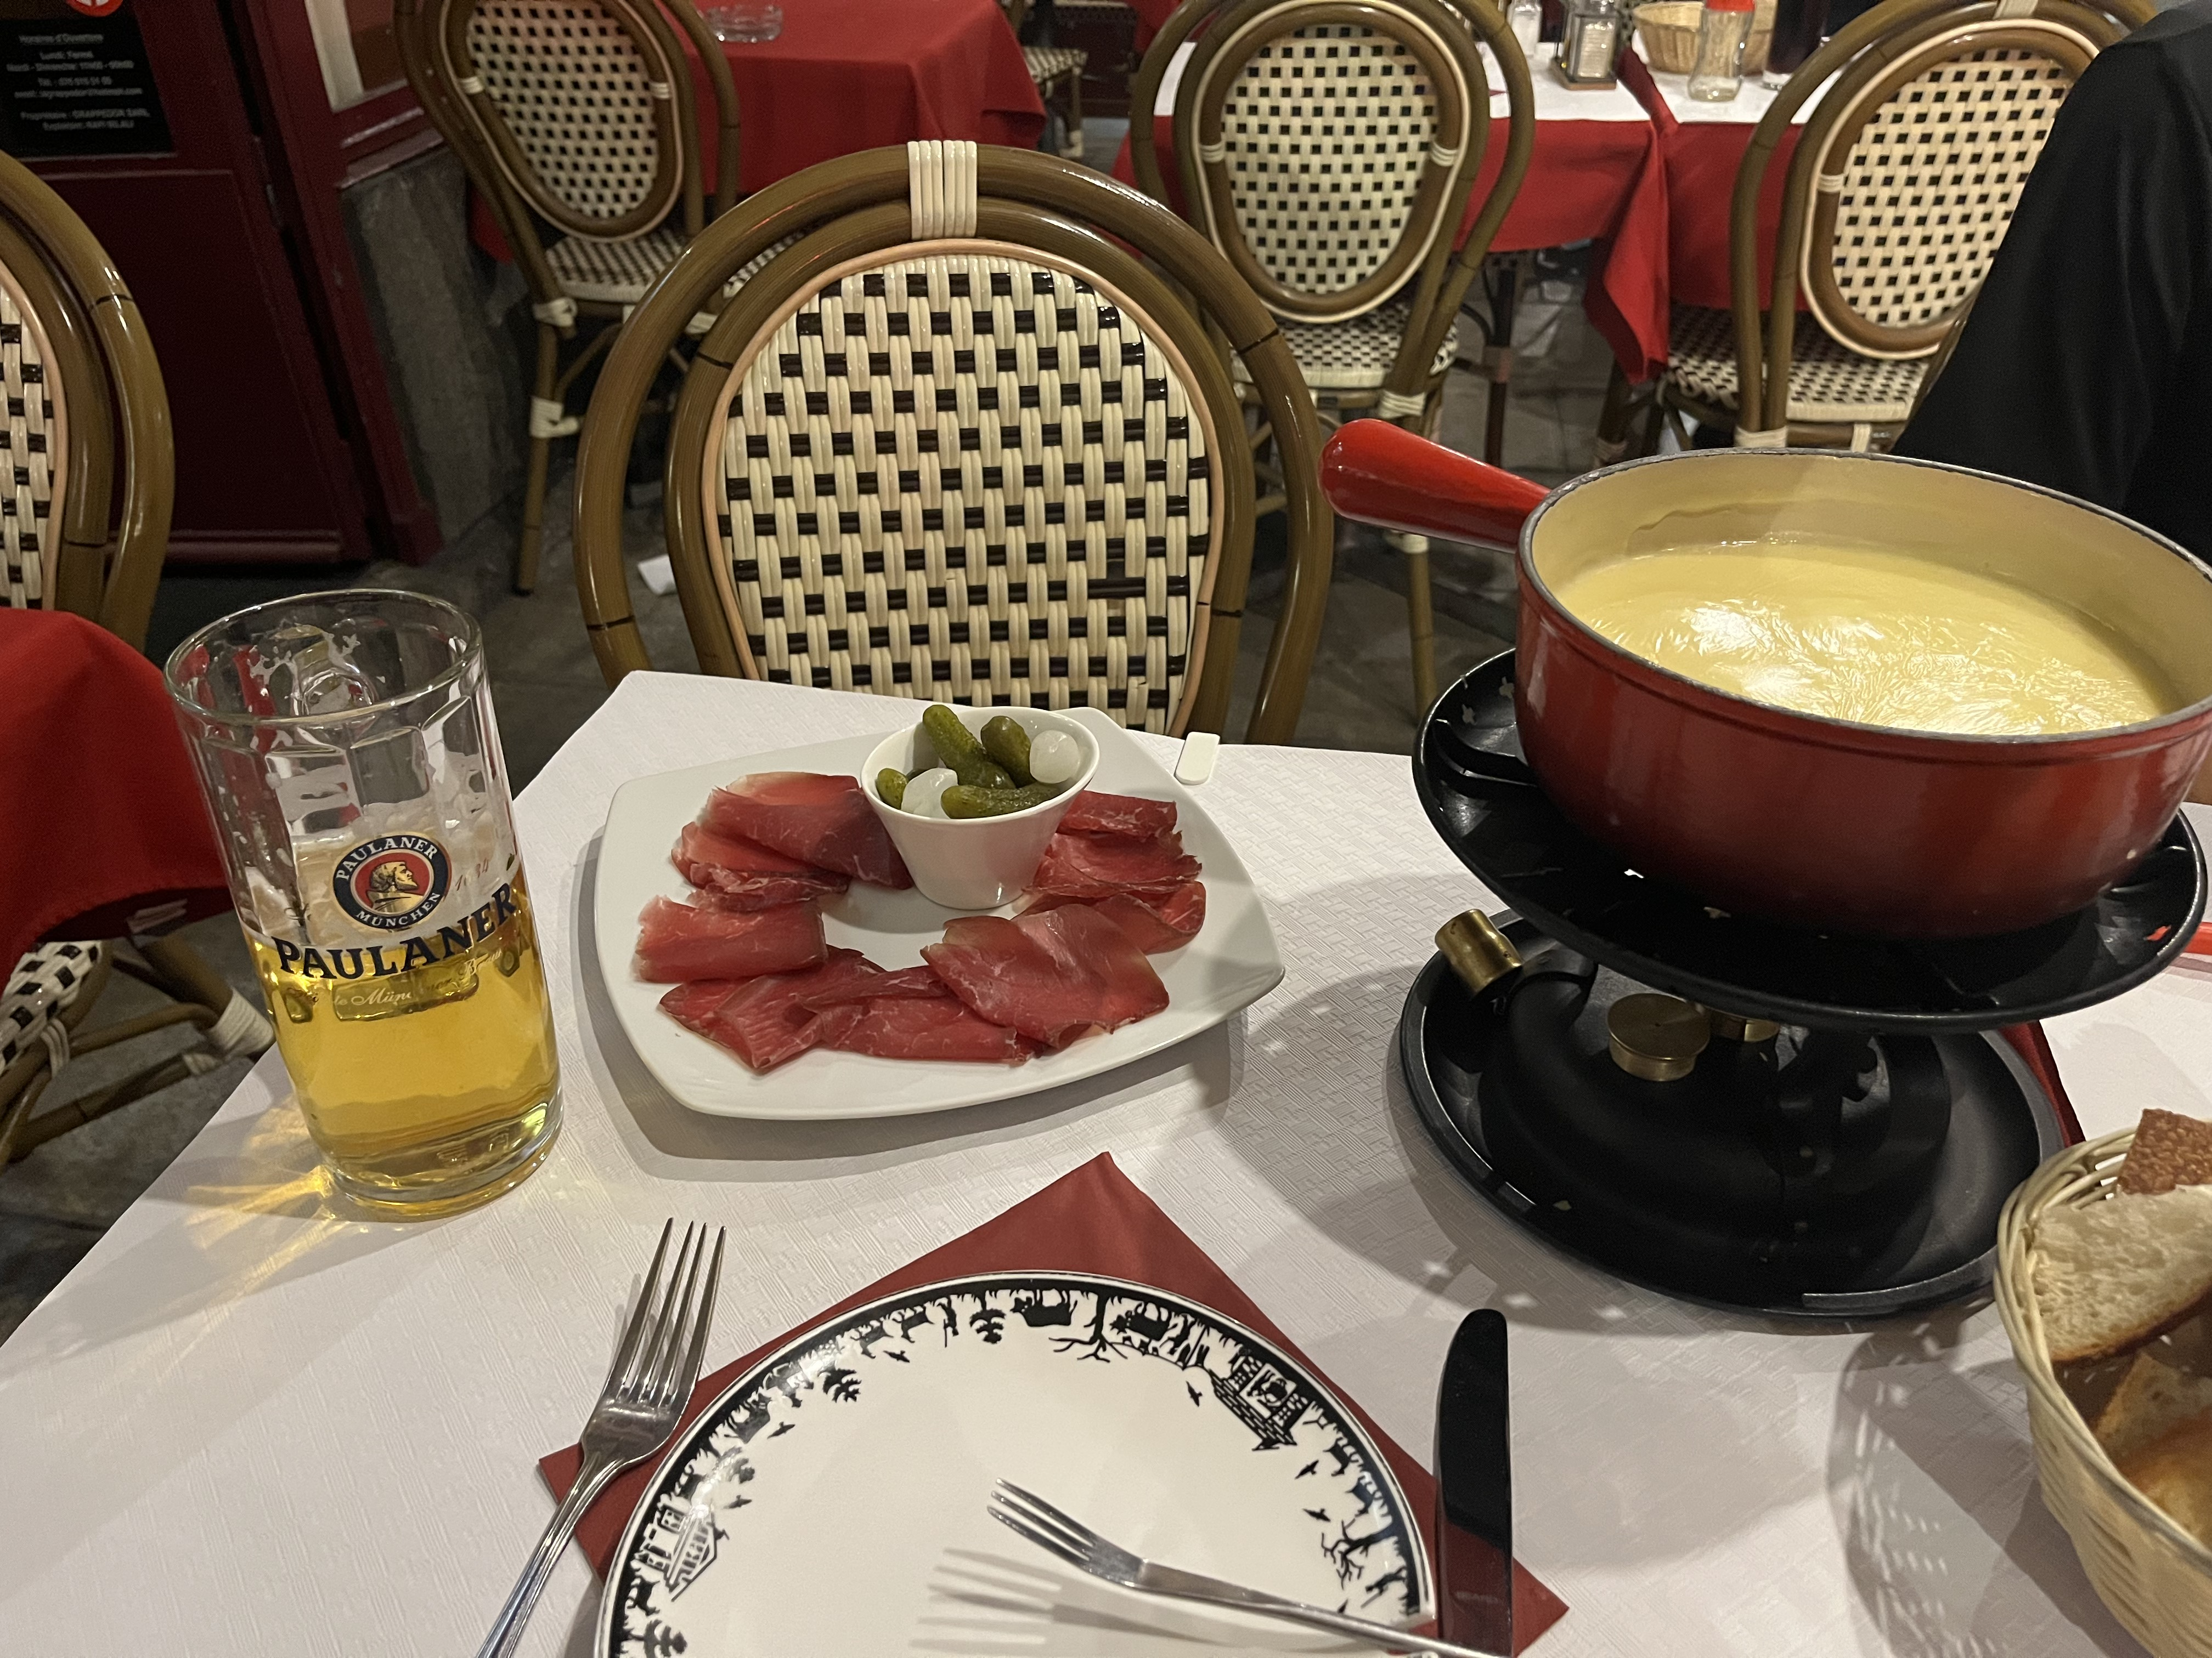
Travel:
Ethan Hazelton – hazeltet@umich.edu
ATLAS Experiment
17

Slide 17
Thank you!
Ethan Hazelton – hazeltet@umich.edu
ATLAS Experiment
18

