Slide 1
Operation Report on the New Small Wheel (NSW) of ATLAS Detector
Harriet Bufan Shi, University of Michigan
bufan.shi @cern.ch

Slide 2
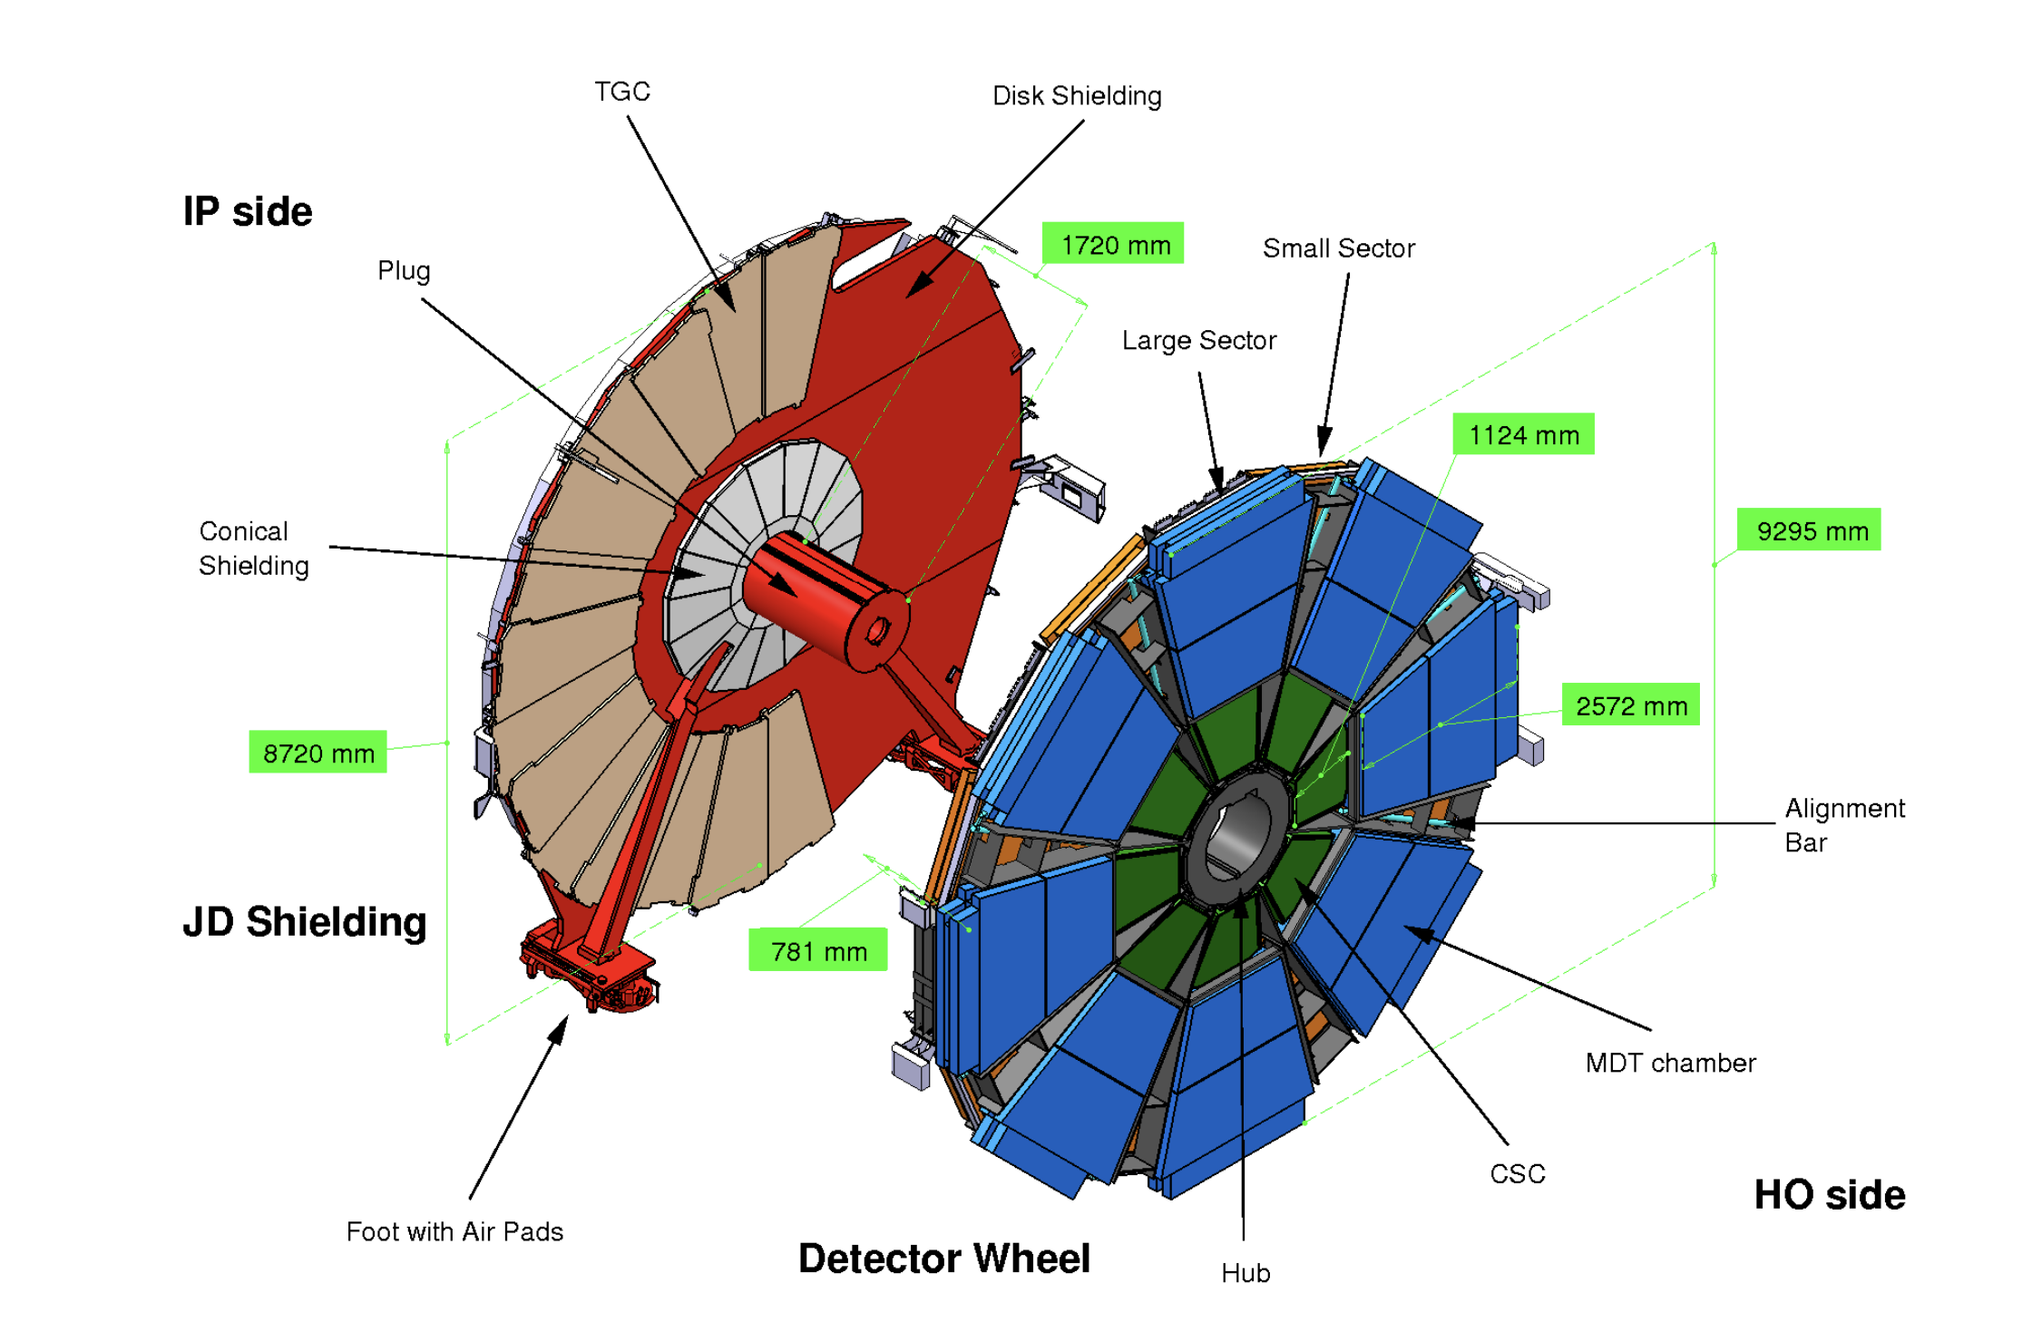
agenda
Purpose and motivation
Structure
Trigger
Small Thin Gap Chamber (sTGC)
Electronics
My work

Slide 3
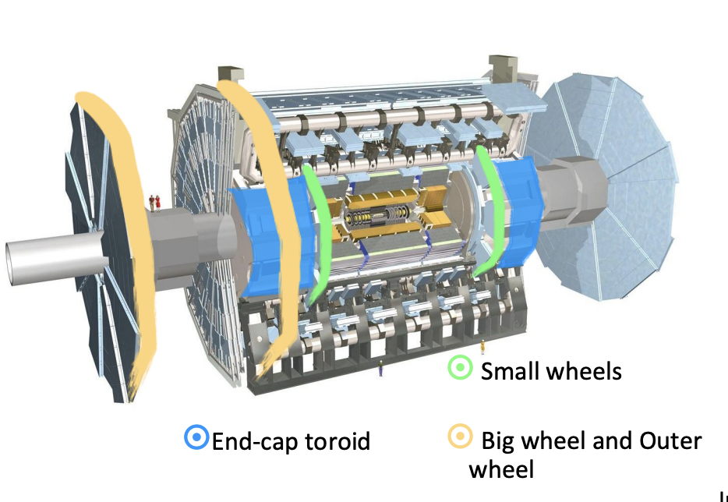
ATLAS muon new small wheel upgrade
Goal: despite the fact that Small Wheel cannot withstand such background high rates, people wanted to improve trigger rate.
“Replaced the innermost Muon station in the forward region (Small Wheel) to improve LV1 trigger & maintain good tracking at End-cap towards HL-LHC runs with high background rates. “
2 Novel Gaseous Detector Technologies:
Micromesh Gaseous Structure Detector (Micromegas)
Small-strip Thin Gas Chamber (sTGC)

Slide 4
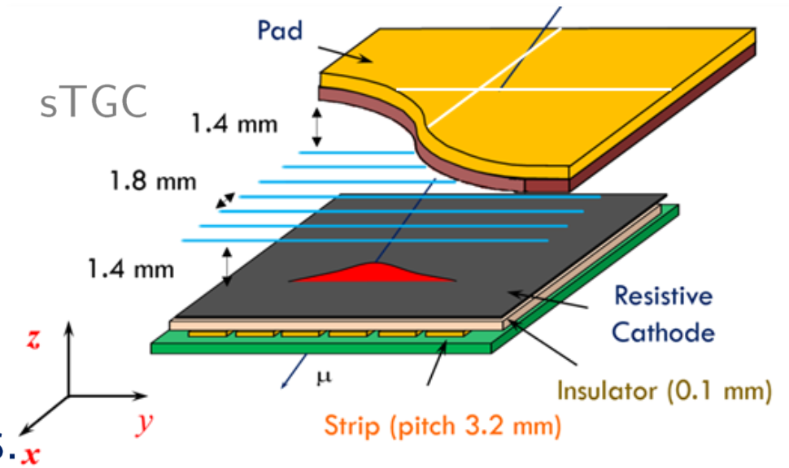
stgc
Primarily deployed for triggering given their single bunch crossing identification capability
Complement with Micromegas, in theory, are able to measure track hits with a resolution better than 150 µm (depending on the incident track angle)

Slide 5
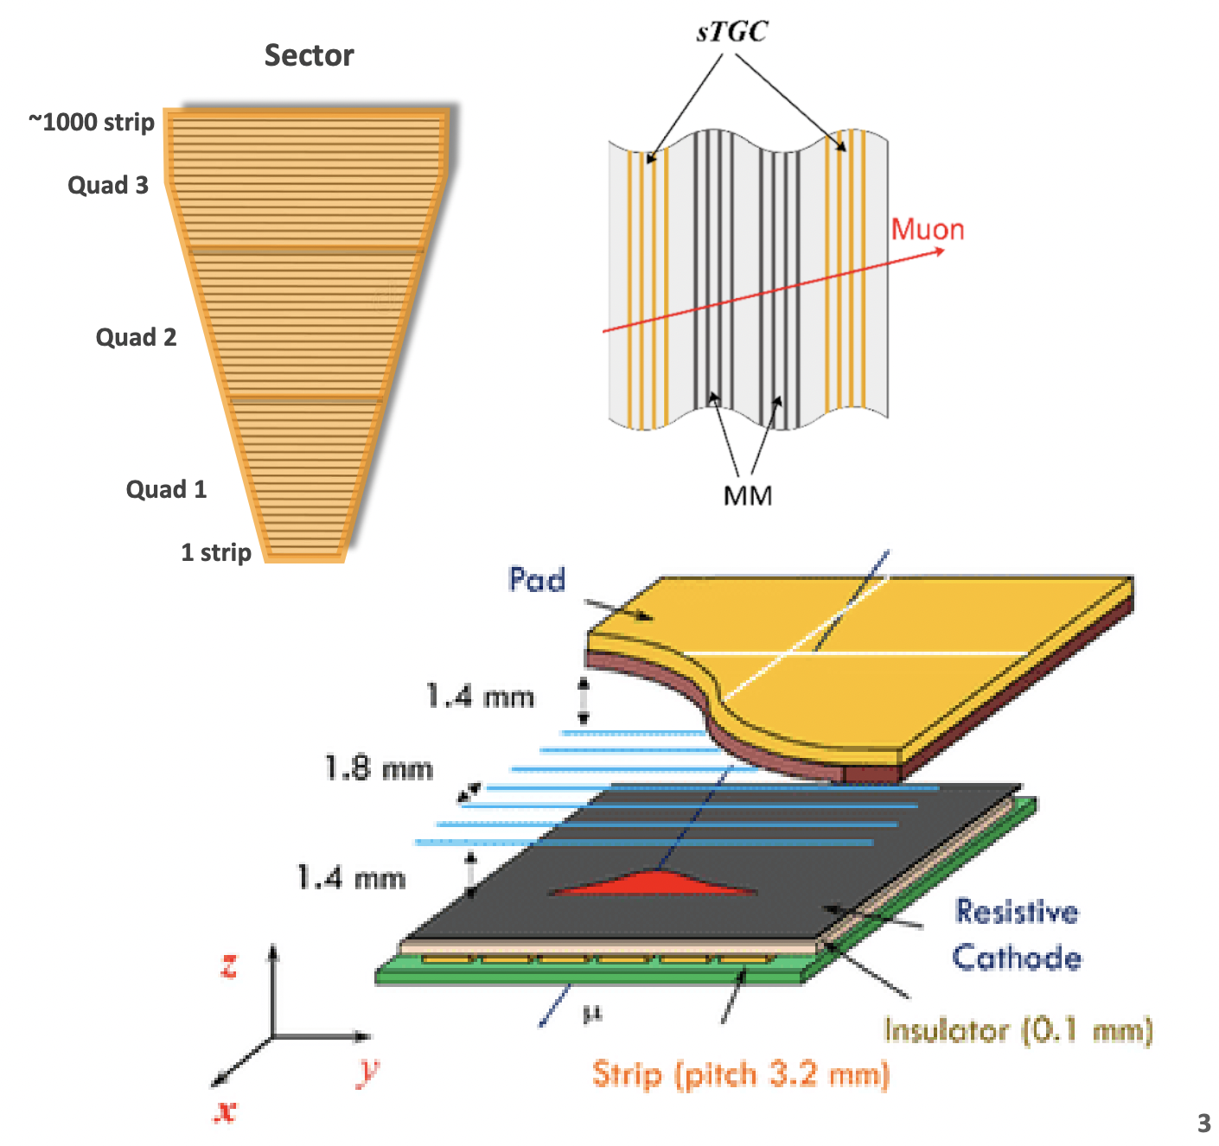
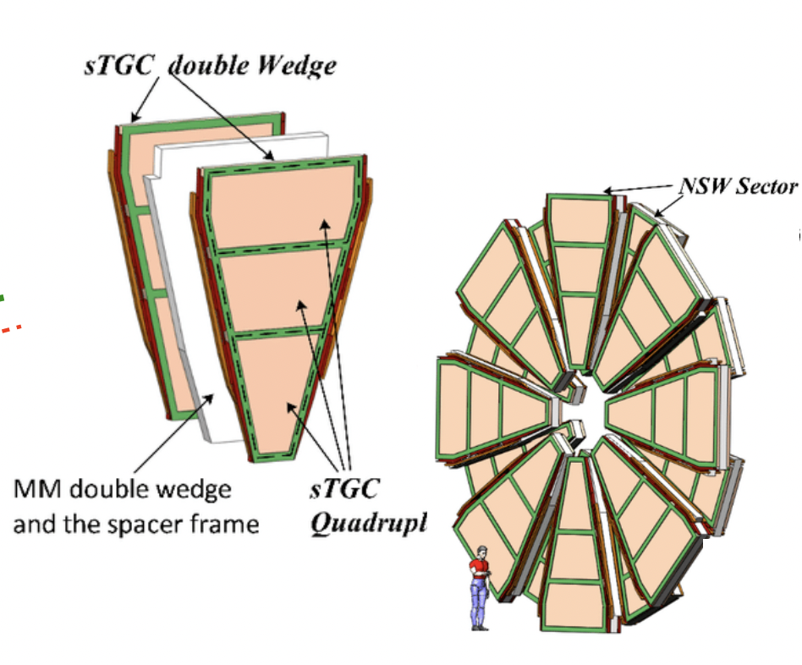
Structure
NSW have 32 Sectors (16 on A-side, 16 on C-side)
sTGC is filled with CO2 gas
Strong HV is applied. So ions can drift to the wires.
Induced charge signals will be picked up from electrodes to determine the position of incident particle.

Slide 6
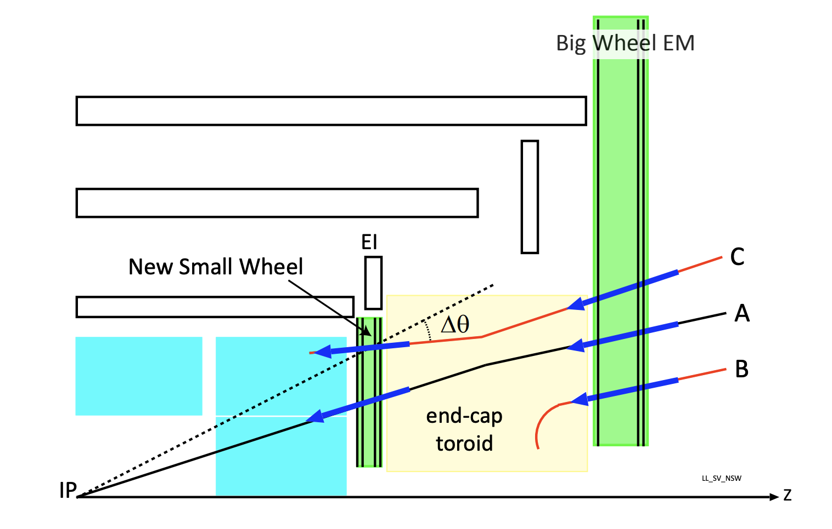
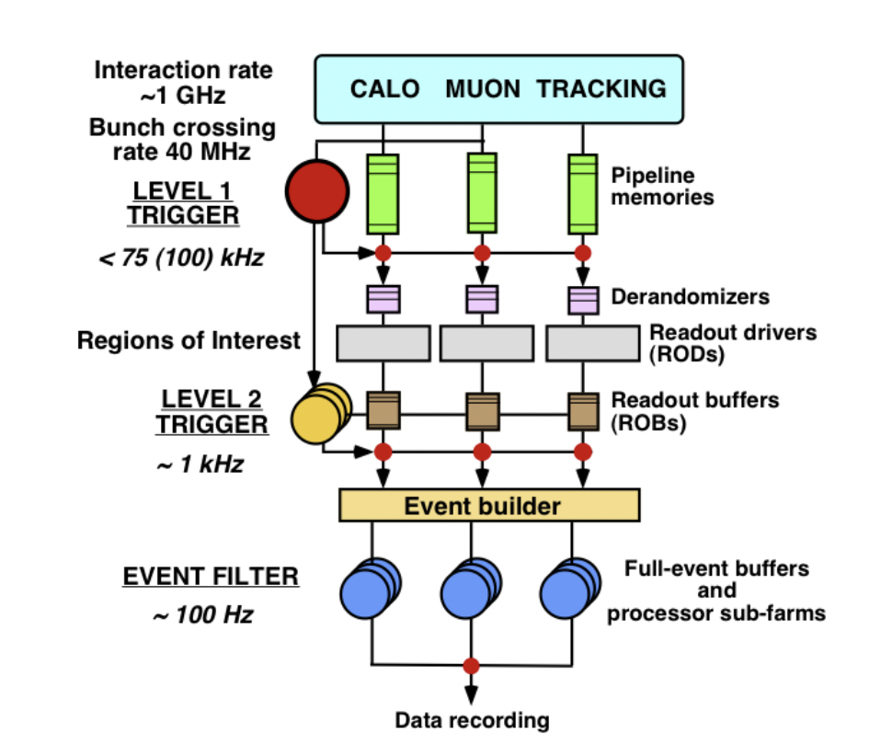
Trigger system of atlas
A trigger is an event or a condition that initiates or starts a specific process or action in an experiment or a measurement system.
Three-stage system
Level 1 trigger:the first stage of event selection for the ATLAS experiment at the LHC
New Small Wheel improves on Level-1 trigger – by confirming tracks with bigwheel.

Slide 7
The chain of data acquisition
Amplify the tiny induced charge current
Record the induced signal and time
Digitize them and send to Front-End Boards (FEB) (Right next to detector) and to the back-end (the ATLAS control room)

Slide 8
electronics
FEB (Front and End Boards): amplify and digitize detector signals.
PFEB (Pads - ): gather and analyze pad triggers
SFEB (Strips -): accept pad triggers to define strip readout interest regions.
L1DDC (Level-1 Data Driven Card): connected with PFEB or SFEB, also have some hardware monitoring purposes.

Slide 9
My work – what can go wrong?
I had been working closely with the operation of New Small Wheel…
Things that are on but are causing problems:
FEB boards/L1DDC on and off
E-link
Things that aren’t on:
FEB board (known)
High Voltage

Slide 10
My work -
Gnam system summarize detector conditions in one run.
From the Gnam file we can conclude sFEB boards are completely off during one run.
There are 37 FEB boards on record that are permanently disabled.

Slide 11
My work -
If both SFEB and PFEB aren’t showing any data. We suspect there is an HV problem, but it might also be the problems of power supply.
Over all <5% of region has HV_problems.

Slide 12
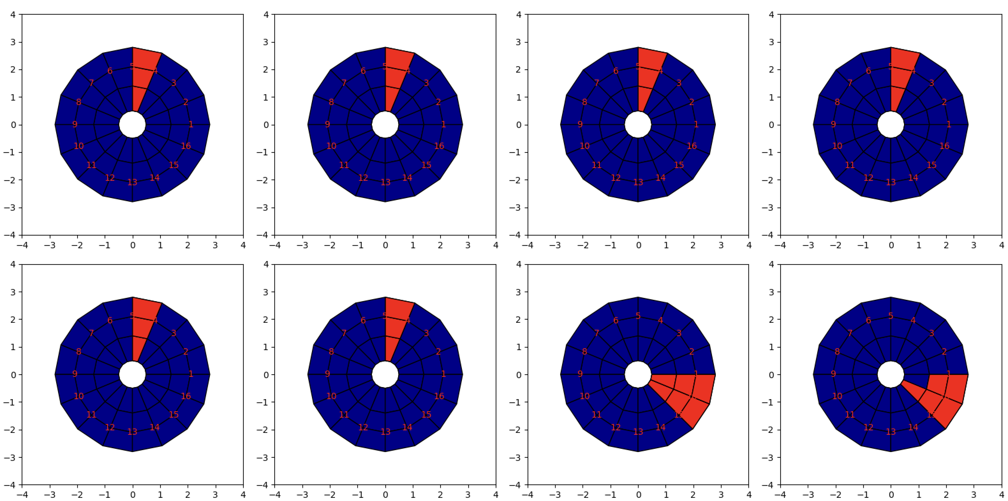
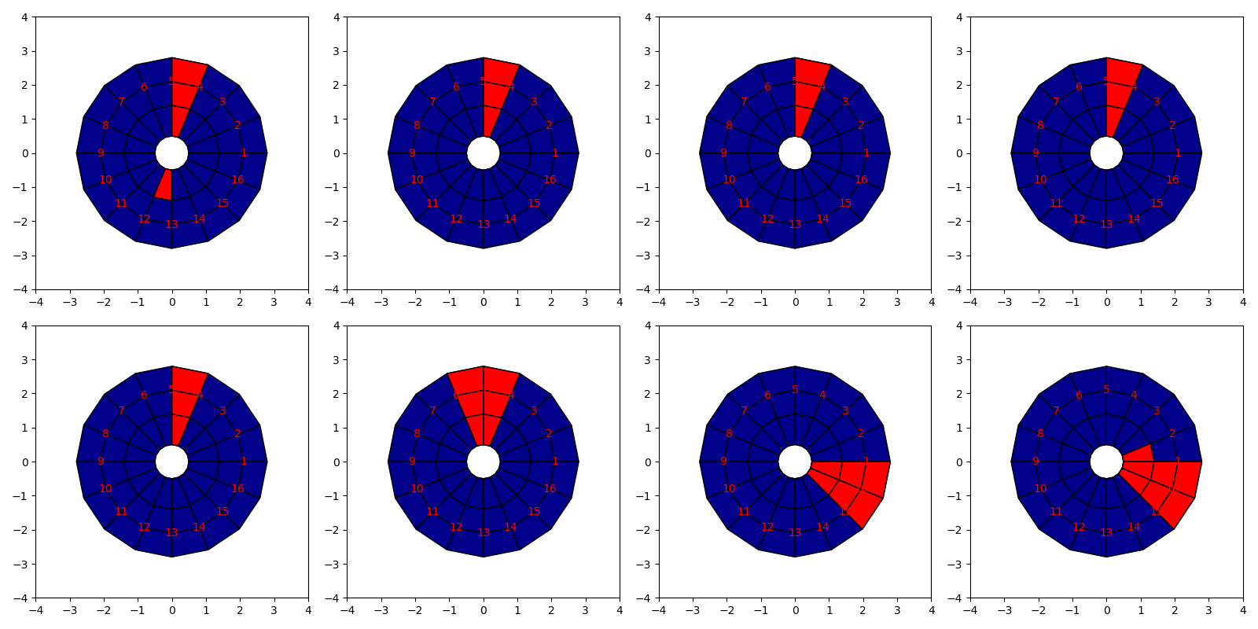
My work -
Just now we saw board dynamics from Run to Run, we now shift focus to board dynamics within one Run.
Usually lose connection on same sectors
Usually, when FEB lose connections, all FEB connected to L1DDC card lose connection.
All pads (on C-side) FEBs that indicated to be on and off during the time interval of July 17th – July 19th
All strips (on C-side) FEBs that indicated to be on and off during the time interval of July 17th – July 19th

Slide 13
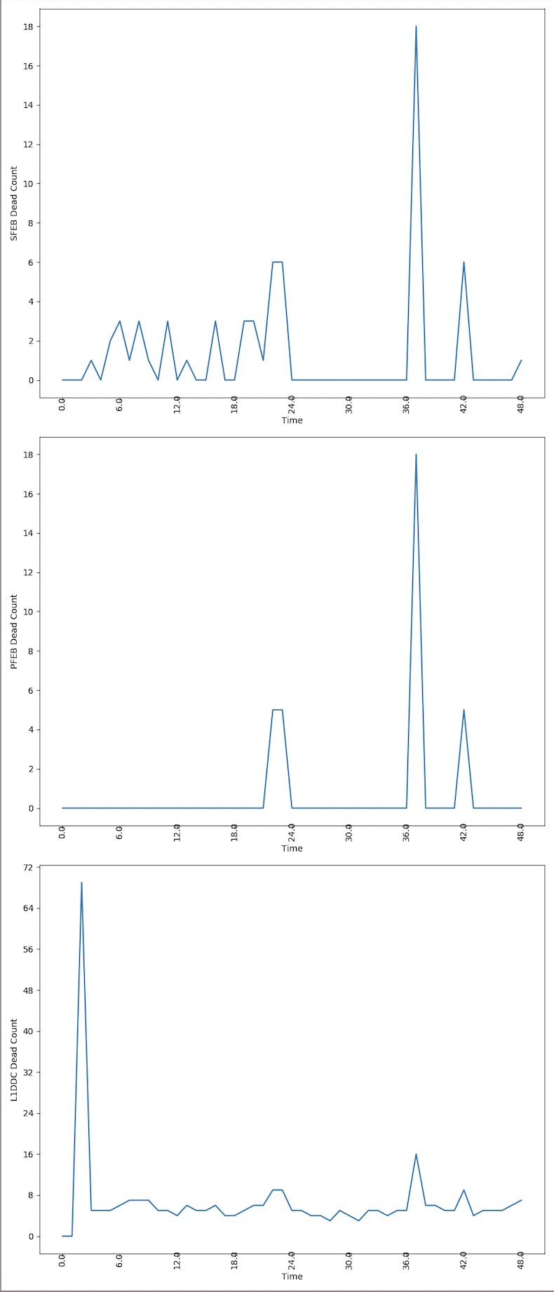
SFEB Disabled Count
PFEB Disabled Count
L1DDC Disabled Count
L1DDC constantly on and off, it usually doesn’t matter until it impact SFEB and PFEB.

Slide 14
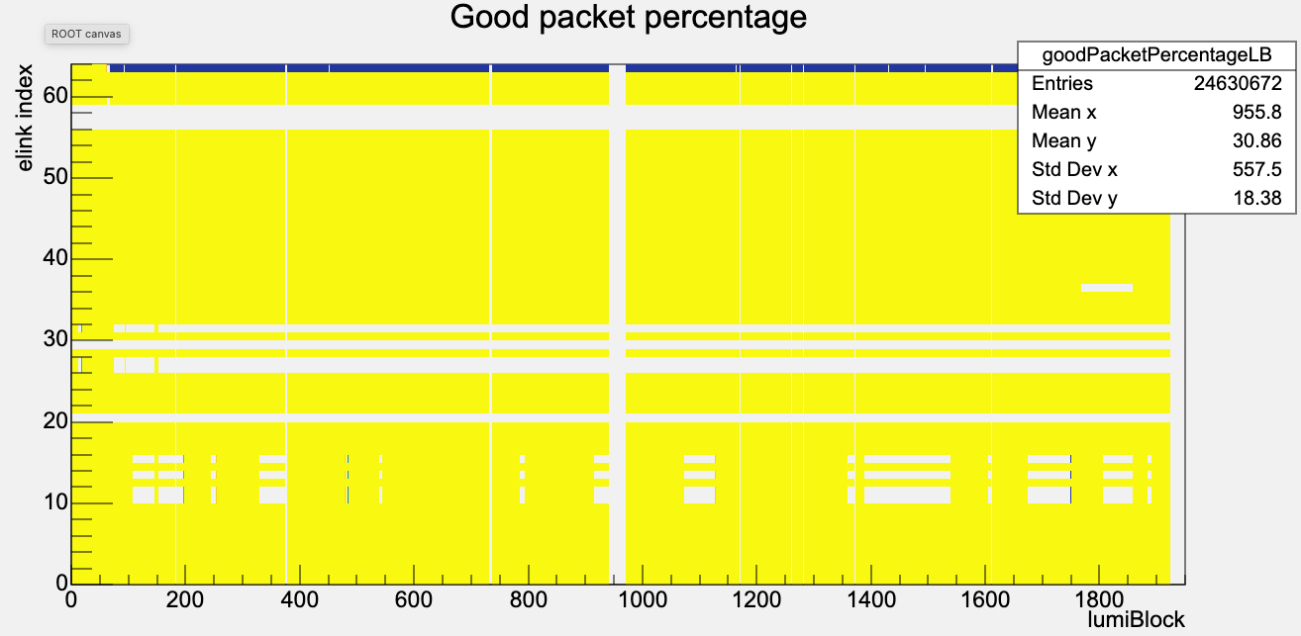
About electronics links
To examine e-links, we examine good package percentages.
E-links instabilities will corrupt data quality
Recurring issues of elinks on and off

Slide 15
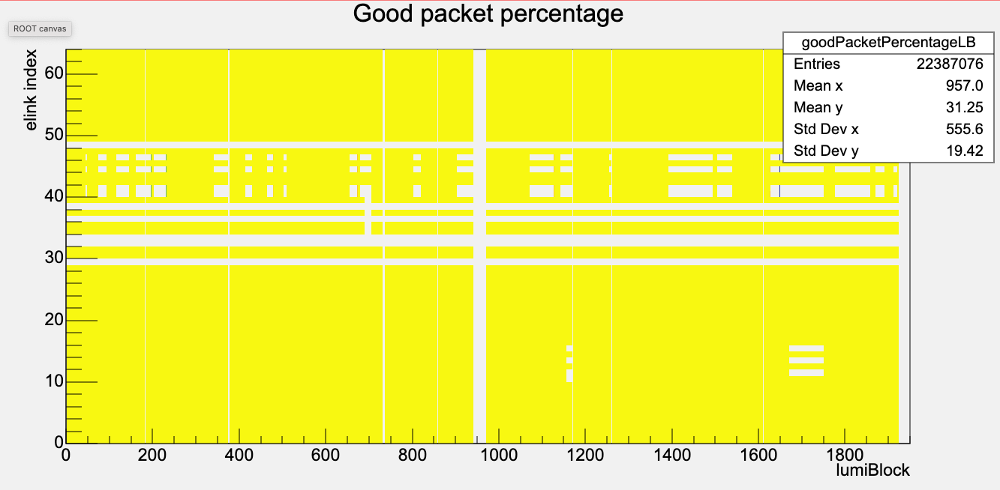
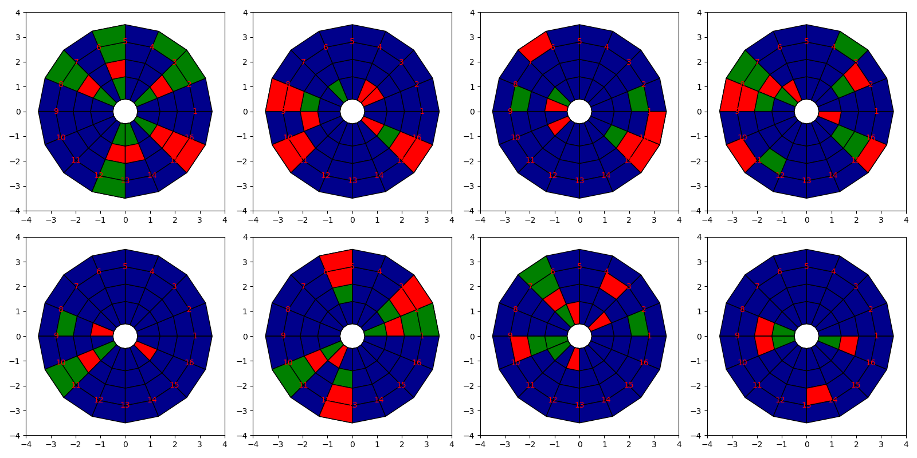
Good package percentage: C10, 452573
Instability is usually associated with the same L1DDC card.

Slide 16
summary
SFEBs and PFEBs are crucial for data-collecting purposes. Their fluctuations should be avoided as much as possible.
L1DDC’s operation is unstable.
Suspected L1DDC’s temperature fed up FELIX’s buffer. Impacting SFEBs and PFEBs operation.
Those problems could probably be solved by disable temperature control.

Slide 17
outlook
Here until Aug. 25th.
Continue to work closely with the operation team. Continue monitoring the condition of all electronics throughout the runs.

Slide 18
references
(1) The ATLAS Collaboration. “Technical Design Report - New Small Wheel.” CERN Records, 2013, doi:CERN-LHCC-2013-006.
(2) Guan, Liang. “Development of Trigger and Readout Electronics for the ATLAS New Small Wheel Detector Upgrade, 2017.
(3)Guan, Liang. “Performance of ATLAS New Small Wheels in Preparation for LHC Run3 Data Taking”, 2022.

