Slide 1


Combination of searches for Higgs Boson decaying into Dark Photons
Evan Rootness, Zirui Wang, Bing Zhou, Tairan Xu, Tiesheng Dai
27 July 2023
Notes:
Alright, so today I’ll talk about the dark photon combination analysis I’ve been working on here at CERN.

Slide 2
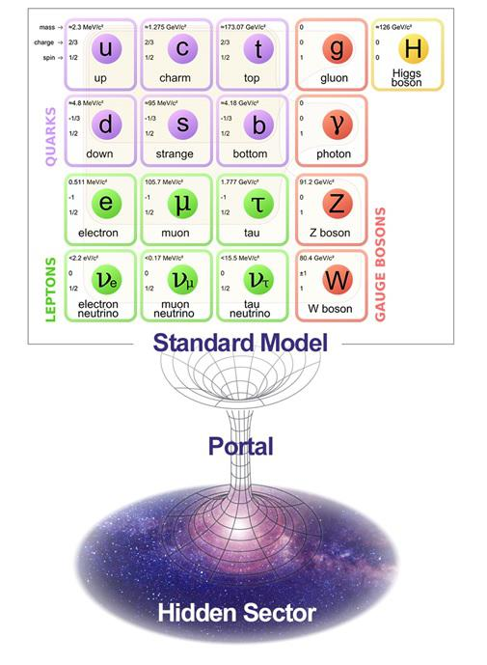
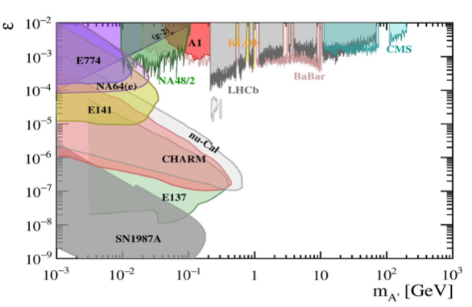
Introduction
Dark matter theory
Several searches in past decade for massive dark photons
Lower energy
Higher energy
Kinetic mixing parameter
0
0
1
𝛾_{d}
dark photon
Limits on the massive dark photon from di-lepton searches
Notes:
Now, first off, what is the dark photon? Well, theorists have proposed the dark photon as a possible connection of the standard model to dark matter and the dark sector, which is an extension of the standard model. The dark photon’s connection to both the dark sector and the standard model is what makes us want to search for them with the proton-proton collisions at the LHC. In fact, there have already been multiple searches at CERN for one form of the dark photon, the massive dark photon. The plot here shows where experiments have searched for this massive dark photon and so far, been able to probe a large parameter space. Now, my project is searching for the massless dark photon, which has been searched for less than the massive dark photon, and why we’re hopeful we might find it.

Slide 3
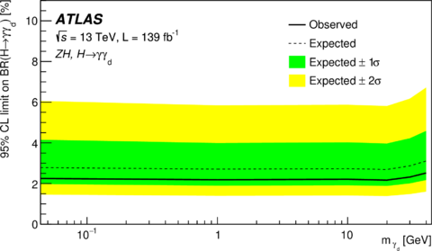
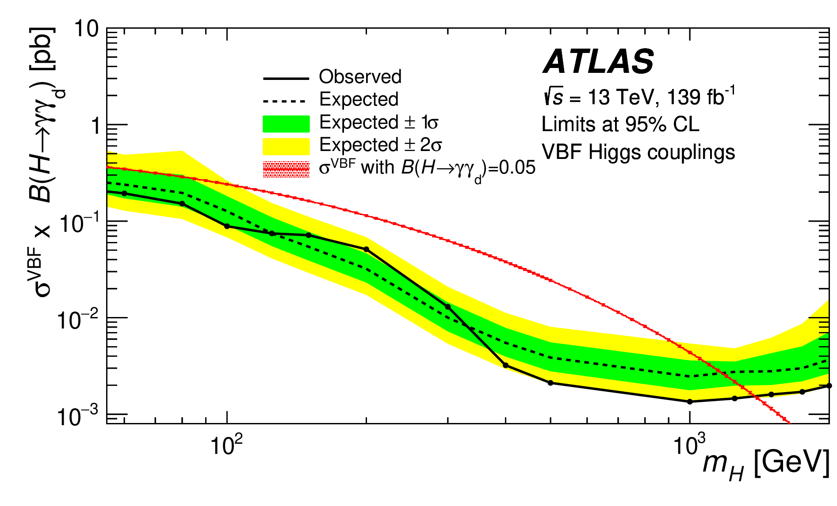
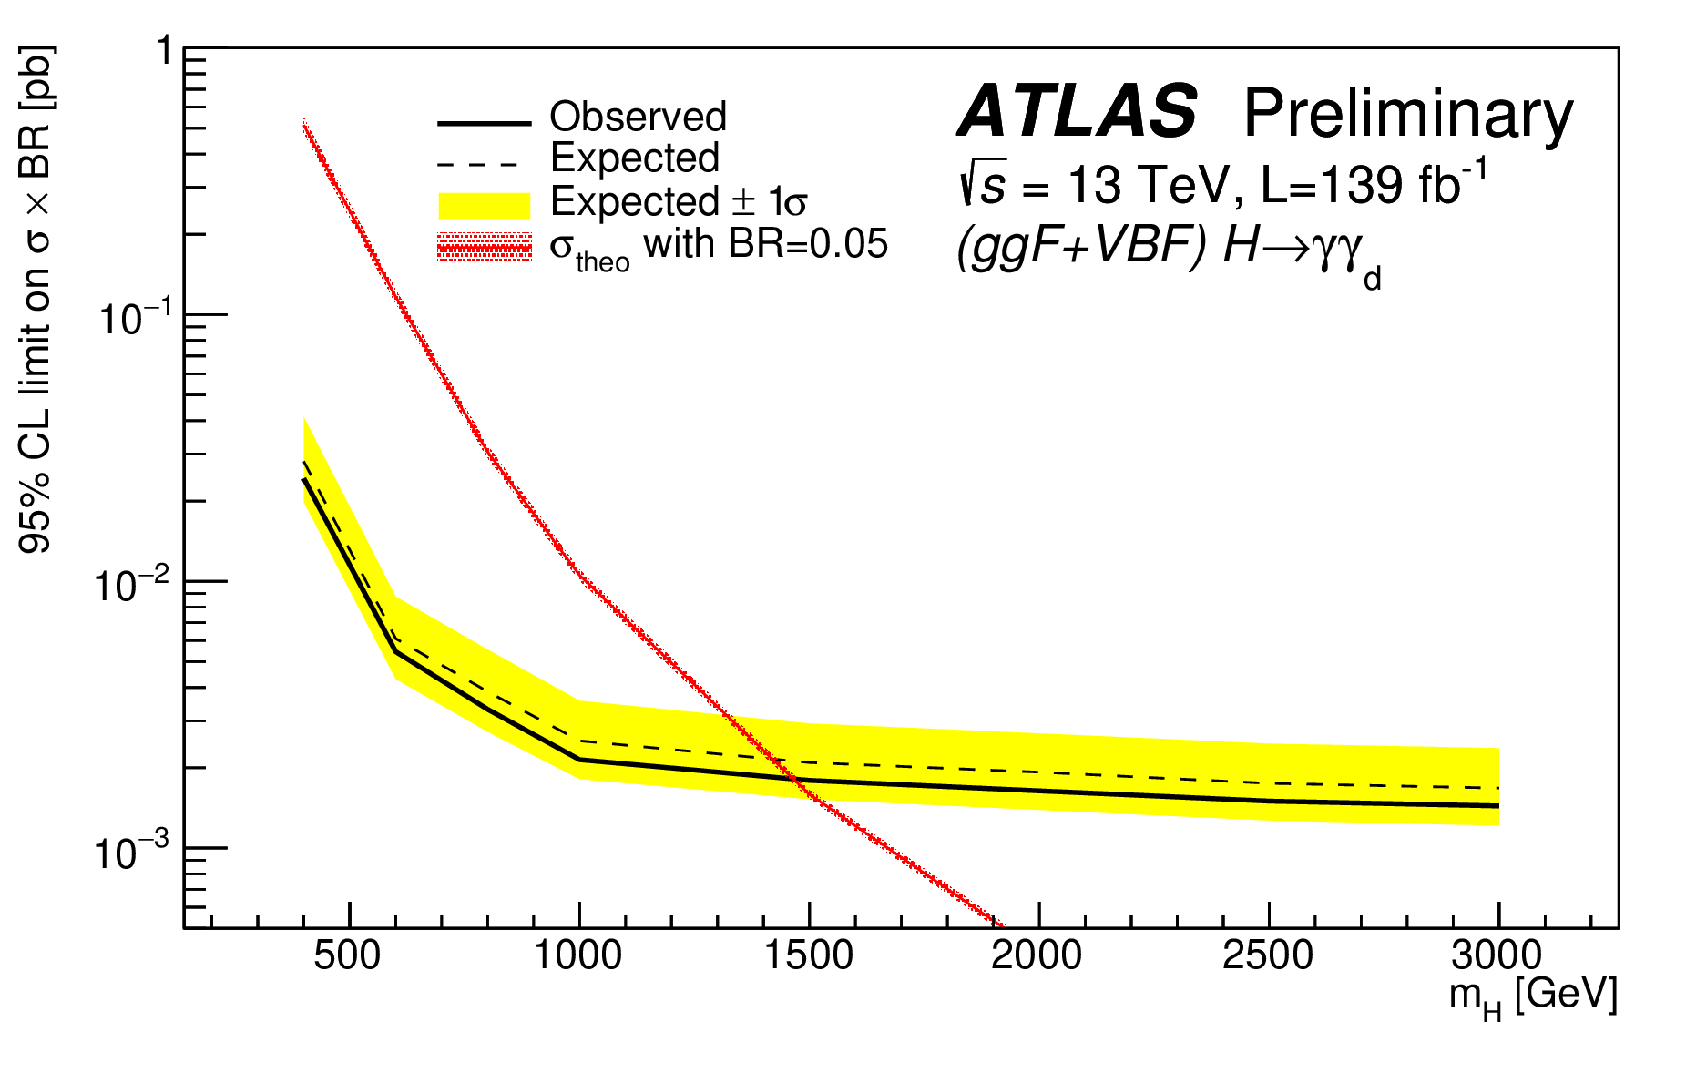
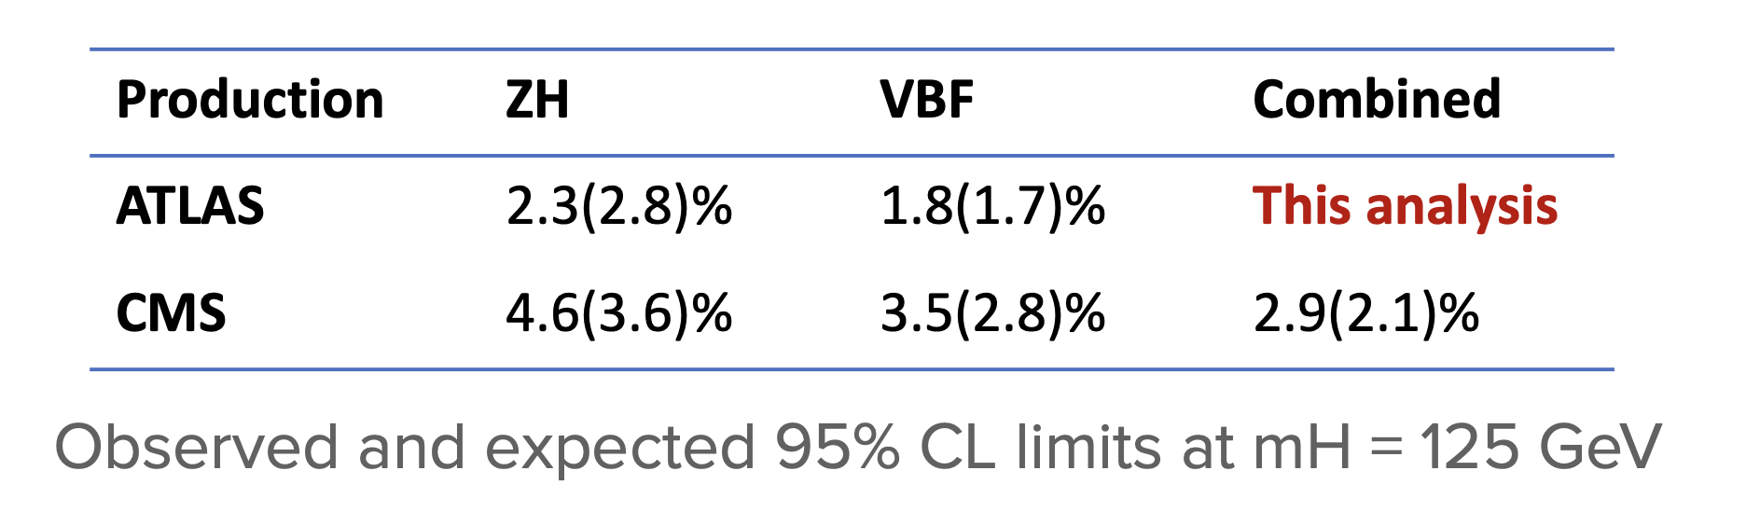
ATLAS Dark Photon Search
ZH
Dark Photon Combination Analysis team in ATLAS’s Common Dark Matter Subgroup (CDM)
Atlas has produced single channel limits, more stringent than CMS for mH = 125 GeV
ATLAS has also probed dark photons from BSM Higgs decays
Our goal: combine different channels for a better sensitivity
VBF
Channels
ggF
Notes:
This summer I worked with the dark photon combination analysis team in ATLAS, which is a part of the common dark matter subgroup. My mentor was Zirui Wang who is a post-doc from Michigan. ATLAS has already produced the limits for 3 single channels. And the results from ATLAS are more sensitive than CMS’s limits. Furthermore, we want to use these lower limits to produce an even lower limit. This table is just showing the ZH and VBF channels and their combination, but we will also be combining the VBF and ggF channels as well.

Slide 4
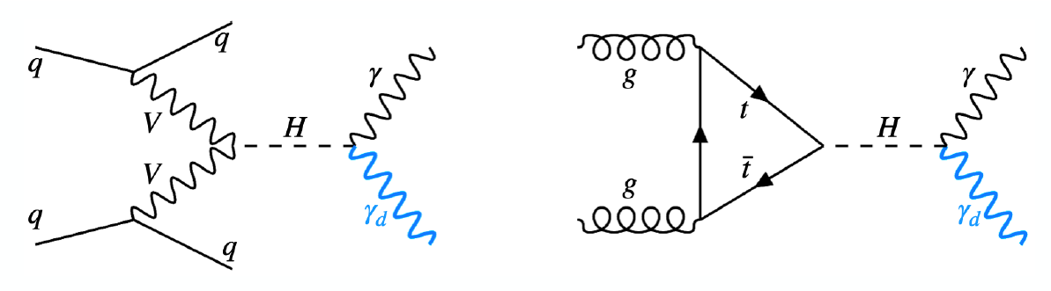
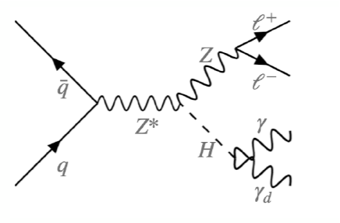
Theoretical Motivation
Dark sector theorized to connect SM to DM
Portals arise from kinetic mixing between one dark and one visible gauge boson (dark photon and hypercharge)
Event signatures: photon + MET + 2 jets, photon + MET, or photon + MET + 2 leptons
VBF
ggF
ZH
Notes:
The theory behind the dark photon contains new physics. First, as I mentioned before, the dark sector is theorized to connect with the standard model. And the dark sector is thought to contain its own particles and interactions separate to the standard model. The dark photon gives us a way to observe the dark sector even if we can’t observe the other parts of it. More specifically, it’s thought that the kinetic mixing between a photon and a dark photon is what brings about portals in which the standard model and dark sector can interact with each other. This linking of the two is what makes the experimental detection of the dark photon possible.
The event signatures are shown here at the bottom, the first one is vector-boson fusion where two quarks radiate into two vector bosons and two jets, and then the vector bosons annihilate to produce a Higgs Boson. The Higgs Boson’s decay can then be searched for decays into a photon and dark photon. The ggF channel, which stands for gluon-gluon fusion is when two gluons fuse into a Higgs Boson through a top loop. Again, we look for the Higgs’ decay into a photon and dark photon. And finally, the ZH channel starts with a quark and antiquark and becomes a Z boson and Higgs boson. The Z boson then decays in two leptons, and the Higgs decays into a photon and dark photon. Now, in all these channels, the dark photon will not be seen of course, but we look for its missing transverse energy.
In the ZH channel, since there are two leptons in the event signature, there is a negligible chance that the VBF or ggF production modes could be seen as ZH, so we don’t need to worry about those when we produce ZH likelihood models. However, because ggF and VBF’s event signatures are only distinguished by the two jets that VBF has, and jets are more likely to be wrongly identified or missed by the detector, we need to account for that. You can see this in the plot here (go to previous slide) that the channel is ggF, but possible VBF events that were misidentified were accounted for.
The dark photon is a part of this dark sector as a U(1) unbroken gauge boson that interacts with photons through kinetic mixing.

Slide 5
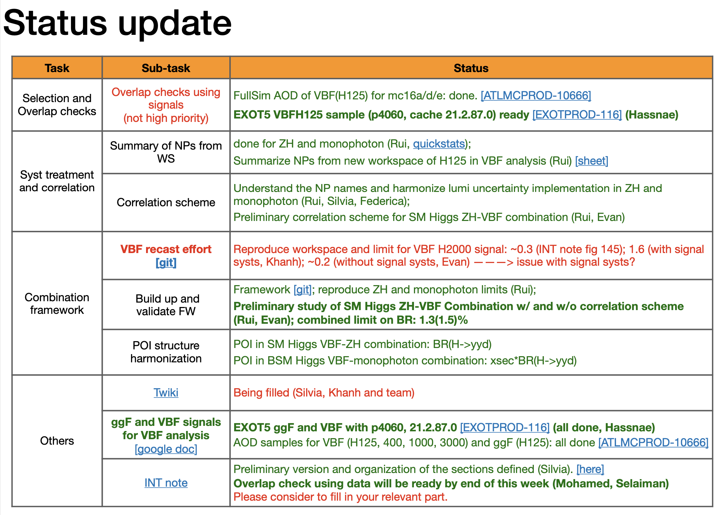
Group activities and action items
Action items from analysis contacts
I’m working on tasks highlighted
Notes:
Here is the list of all the things that the dark photon combination group is working on or has been done recently to work towards our final combination results. What I’ve been doing is highlighted, and now I’ll go into what I’ve done here at CERN for the past two months and a half.

Slide 6
1. Systematic studies
ZH channel
VBF channel
Notes:
First, is the studies I did on the systematics. I’ll only highlight the ZH and VBF channels here because those were the two channels we combined. But I also studied ggF, and we will combine ggF with VBF soon.

Slide 7
Input channel systematic checks: ZH channel
Derived the impacts from systematics in several workspaces from input analyses
Identified which nuisance parameters (NPs) had the most impact
Identified large/over-constrained pulls for correlation scheme in combination
“alpha_Smooth” is the uncertainty that comes from smoothing all other NPs
“k1” is a MC-statistical uncertainty, which is not constrained
“alpha_MUON_SCALE_smooth” is the uncertainty on
“Pileup” NPs come from the uncertainty that the detector registered simultaneous events
Jet Flavor NPs are uncertainties that come from determining which flavor a jet is
ZH: 0 GeV 𝛾_{d} mass
Notes:
First is ZH. One of the first things I did was produce these systematic impact plots for different mass points and for both the expected and observed data sets. On the plot, you can see 15 of the nuisance parameters with their impact on signal along with their pulls. Nuisance parameters are parameters which need to be accounted for when we are calculating the main parameter of interest, but they themselves aren’t of much interest to us. There are different types of nuisance parameters, like detector-simulation related uncertainties, which could be calibrations, efficiencies, or resolutions. There are also theoretical uncertainties, like other possible production modes of the event signature. There are also monte carlo uncertainties. Here in blue are quick explanations of some of the nuisance parameters which have the largest impact on the signal of missing transverse energy, or the dark photon that we’re looking for. The most impactful parameter is alpha_smooth which is the parameter which controls the smoothing on all of the other nuisance parameters. Another example is the jet flavor nuisance parameters, which come from the uncertainties on identifying which flavor a jet is, as the name suggests.
As you can see in the plot, only k1 has a large pull. K1 however is a Monte-Carlo statistical uncertainty, which we can’t correlate with other channels. So, there aren’t any nuisance parameters we need to consider when we make the correlation scheme in the ZH channel.

Slide 8
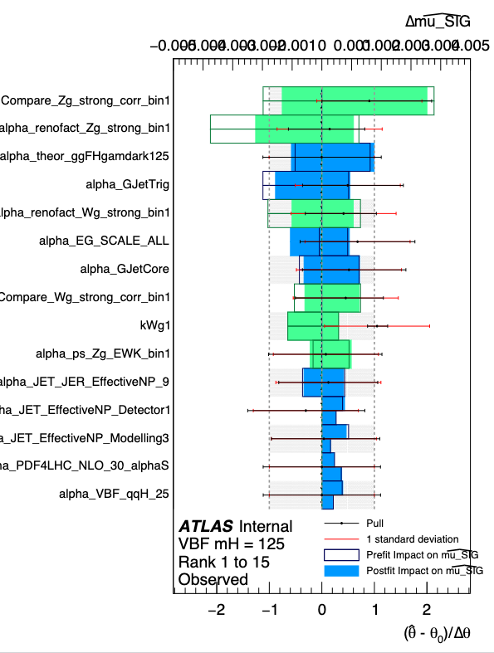
Input channel systematic checks: VBF channel
Checked impacts of NPs for appendix in group INT note
Largely pulled or over-constrained VBF NPs
Checked correlation impacts
EG_SCALE_ALL and JET_fJvtEfficiency have largest impacts on the signal
Will not correlate any of these NPs because they are largely pulled
NP not correlated | Relative Diff Obs % | Relative Diff Exp %
EG_SCALE_ALL | 1.082 | -0.939
JET_EffectiveNP_Modelling1 | 0.226 | 0.072
JET_EtaIntercalibration_TotalStat | 0.006 | -0.235
MET_SoftTrk_ResoPerp | -0.113 | 0.137
JET_Pileup_PtTerm | 0.204 | 0.074
JET_fJvtEfficiency | 0.861 | -0.407
MET_SoftTrk_Scale | 0.067 | -0.594
Notes:
Next is the VBF channel, where unfortunately, we did find largely pulled and over-constrained nuisance parameters. The criteria for what we call an unhealthy pull is, if it’s pulled by greater than 0.5 or over-constrained by less than 70% then it shouldn't be correlated. This could cause the other channel’s nuisance parameter, which originally had no problem with its pull, to be largely pulled or over-constrained. You can see in the plot on the right some of these, for example the top one. It might be hard to tell, but the tiny dot in the middle of the horizontal line is greater than 0.5 on the bottom x-axis.
I checked how much effect each of these problematic nuisance parameters had on the signal and we came to the decision not to correlate any of these when we built the correlation scheme. And these results were added to the group internal note.

Slide 9
2. Combination study
POI structure harmonization
Maximum correlation scheme
Compare results to CMS
Notes:
Now we can move on to the actual combination.

Slide 10
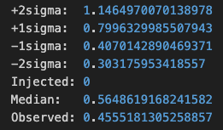
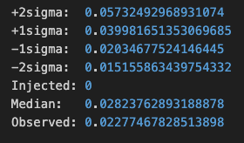
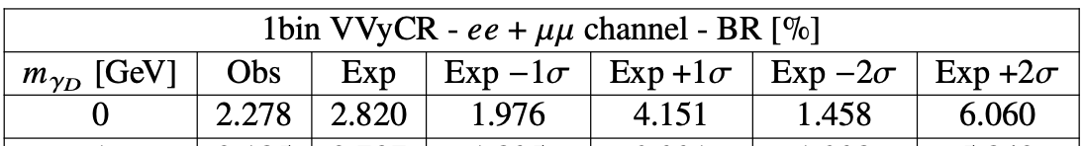
POI structure harmonization:
Rescale ZH
Originally, the ZH signal template corresponded to a 5% BR
The limit on raw input workspace is 45.6(56.5)%, 20 times larger than the published results
We rescaled the signal to 100% and reproduced the published results
Published Results
Notes:
One thing we did for the combination was rescale the ZH signal first because it originally corresponded to a signal 20 times smaller than the single channel’s published results. Like you can see in these images, the raw workspace was giving limits of around 50%, whereas it should have been around 2.5%. We were able to make a quick fix for this with a simple rescaling, and reproduced the published notes before we combined workspaces.

Slide 11
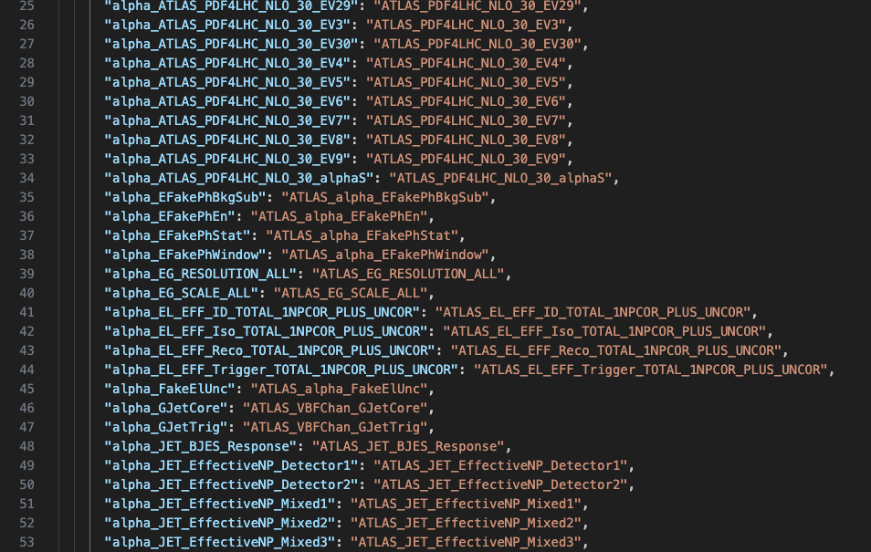
Maximum Correlation Scheme
Started combination by correlating all NPs that were in both VBF and ZH channels
Correlation scheme to match NPs from different channels
Notes:
The step I’m showing here is the correlation scheme, which I used to correlate nuisance parameters that are in both the channels we are trying to combine. As I’ve pointed out in my previous slides, there are some nuisance parameters which we will not correlate, even though they are in both channels. I did however create a combined workspace with all possible NPs correlated to compare to other iterations. Therefore, we call this combination scheme the ”maximum correlation scheme”.

Slide 12
Fully Correlated vs. Fully Uncorrelated
 | Expected | Observed | -2 sigma | -1 sigma | +1 sigma | +2 sigma
VBF+ZH (no correlation | 0.0146 | 0.0135 | 0.0078 | 0.0105 | 0.0208 | 0.0282
VBF+ZH (maximum correlation) | 0.0148 (+0.2%) | 0.0132 (-0.3%) | 0.0079 | 0.0107 | 0.0212 | 0.0287
The correlation scheme has different impacts on the expected and observed results
Notes:
Here are the results I got from combining VBF and ZH with no correlation scheme and the maximum correlation scheme. You can see that the expected and observed limits are both affected by the correlation scheme, so it’s important to create a correlation scheme which is conservative in not over-correlating nuisance parameters with unhealthy pulls, but also with the most sensitive limits we can get.

Slide 13
Decorrelating all over-constrained/pulled NPs
 | Observed | Expected | -2 sigma | -1 sigma | +1 sigma | +2 sigma
VBF+ZH | 0.0133 | 0.0147 | 0.0079 | 0.0106 | 0.0211 | 0.0286
Preliminary combined results
Results lie between the completely uncorrelated and maximum correlation results
 | ZH | VBF | Combined
CMS | 4.6(3.6)% | 3.5(2.8)% | 2.9(2.1)%
ATLAS | 2.3(2.8)% | 1.8(1.7)% | 1.3(1.5)%*
Notes:
When I correlated all nuisance parameters but the over pulled and over-constrained ones, the limits were in between the completely uncorrelated and maximum correlation scheme results as expected. These preliminary results are the first ZH and VBF combined limits we have from ATLAS data, and they look very promising, as theorists predict the branching ratio to be about 1%.

Slide 14
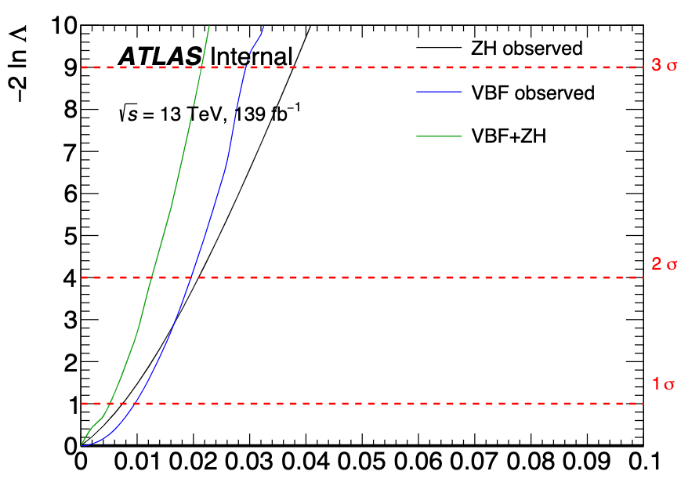
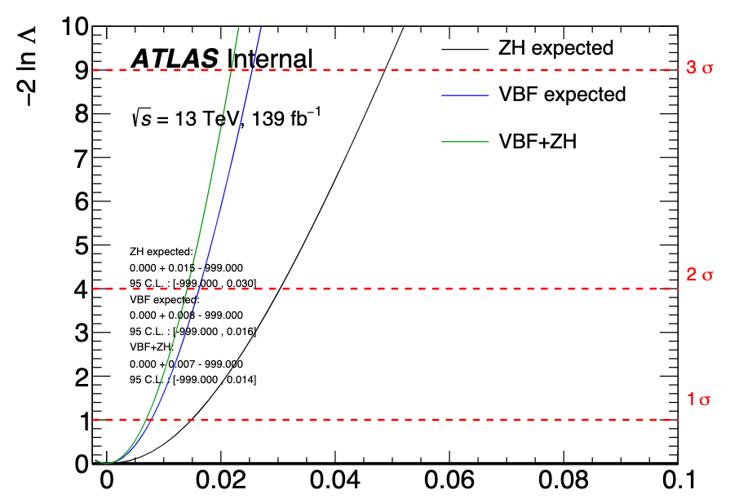
VBF + ZH Likelihood scans
Observed
Expected
Both observed and expected illustrate that the combination gives a more constrained limit
Notes:
And here are just the likelihood scans from ZH, VBF, and the combined workspace, which illustrate how we obtain our limits. The 95% confidence limit we use is just below the 2 sigma. The green, combined workspace obviously gives us a more sensitive, or lower limit than either of the single channels do.

Slide 15
3. VBF RECAST study
Higher Higgs mass points
Systematics issue
Notes:
The last subject I’ll talk about is our VBF RECAST study, which is what we are doing to prepare for combining more VBF workspaces with ggF workspaces. This is what we are currently working on in the dark photon combination group.

Slide 16
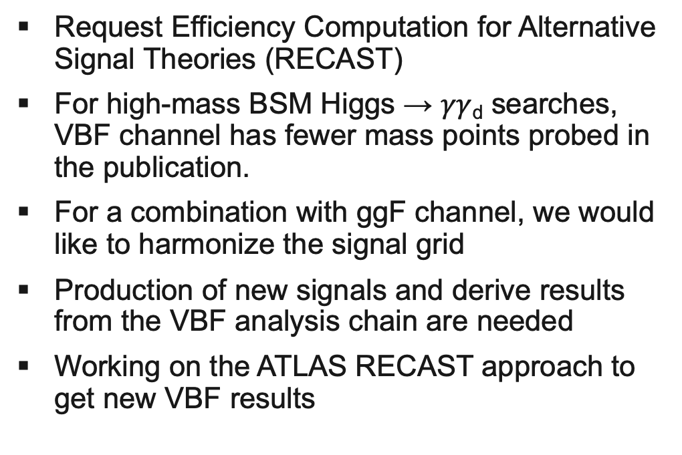
VBF RECAST – Higher Higgs Mass Points
Request Efficiency Computation for Alternative Signal Theories (RECAST)
For high-mass BSM Higgs → $γγ$_{d} searches, VBF channel has fewer mass points probed in the publication.
For a combination with ggF channel, we would like to harmonize the signal grid
Production of new signals and derive results from the VBF analysis chain are needed
Working on the ATLAS RECAST approach to get new VBF results
DAODS – input derivation samples
MiniNtuples – Calculating variable values used in analysis
Histograms – applying selections and preparing input for last step
WS – Statistical analysis and limitsetting
Takes DAODS with a few broad cuts, but still most events, then makes selections to get the event signature of the channel we want
Notes:
Now, RECAST stands for request efficiency computation for alternative signal theories, but I just like to think of it in terms of these steps here on the side. There are 4 steps we use which turns DAODS into the workspaces we use for the combination. Basically, its taking events which have gone through a few very broad cuts, and then narrows it down to the specific events we want, the events with dark photon signatures. The reason we are doing this recast on VBF is to get workspaces for multiple Higgs mass points which we also have for ggF. That way we can combine workspaces with more Higgs masses.

Slide 17
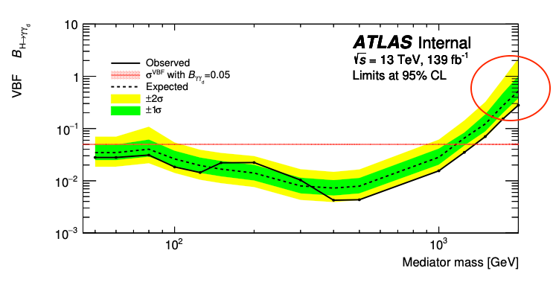
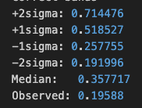
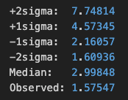
VBF RECAST
~0.3-0.6
When RECAST ran without systematics on signal, limits close to internal note results
VBF channel Internal note results
Limits without systematics on signal
Limits with full systematics
To identify the problematic NPs, we are fixing specific nuisance parameters and checking impacts
When ran with systematics on signal, an order of magnitude higher than internal note results! 150% BR!
Notes:
Now, when we run recast without systematics on just the background and not the signal as well, our limits are close to the single channel internal notes limits. However, when we run RECAST with systematics on both background and signal, our results are an order of magnitude higher than that. So there must be some problem causing this large difference. And to find the problem, I am working on fixing specific nuisance parameters and checking their impacts until I find the problem nuisance parameters.

Slide 18
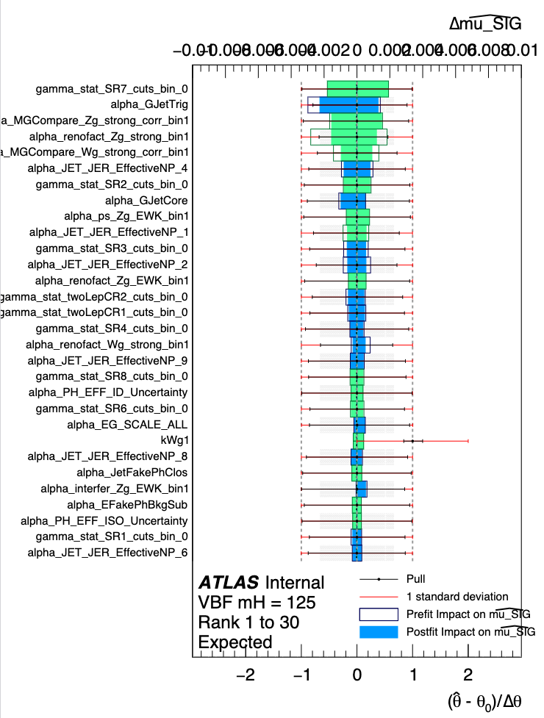

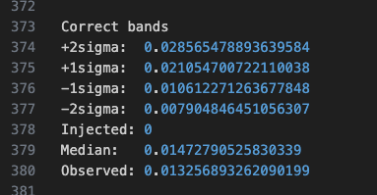
What I’ve accomplished
Derived ranking results of systematic impacts and pulls
Identified problematic pulls and high-impact nuisance parameters
Created correlation scheme for VBF + ZH combination using systematic impact results
Derived input likelihood models for VBF workspaces
Produced likelihood scans of workspaces
Combined VBF and ZH workspaces for Higgs mass = 125 GeV
Notes:
So that was what I’ve done up until now. Just as a summary, I produced the systematic impact plots and pulls, identified the overpulled or over-constrained nuisance parameters, created a correlation scheme using the results from my systematic studies, I combined the VBF and ZH channels for the Higgs mass 125 GeV, and currently I’m working on running RECAST for new VBF workspaces.

Slide 19
What I’ve accomplished
Notes:
Here is our group’s task list with what I’ve completed so far and what I’m working on.

Slide 20
What next?
First, produce VBF workspaces for higher Higgs masses (RECAST)
Then combine VBF + ggF for multiple masses (Higgs = 500, 700, … 3000 GeV)
Our VBF + ZH combination used a preliminary VBF workspace, we will redo the combination when the updated VBF workspace becomes available
Notes:
And what we need to do next is as I’ve stated, produce those VBF workspaces for higher Higgs mass points so that we can then combine VBF and ggF together. Also, we will need to redo the VBF and ZH combination with the updated VBF workspace when that becomes available.

Slide 21
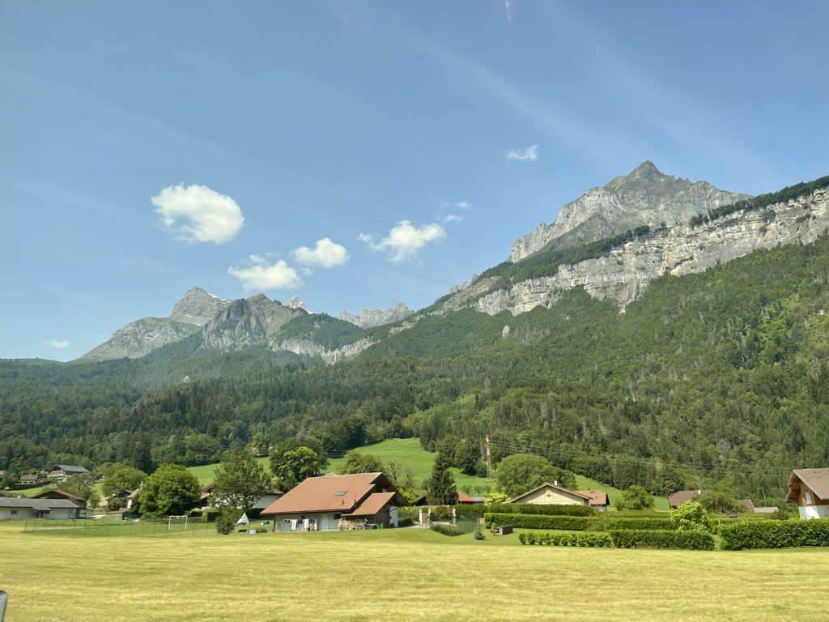
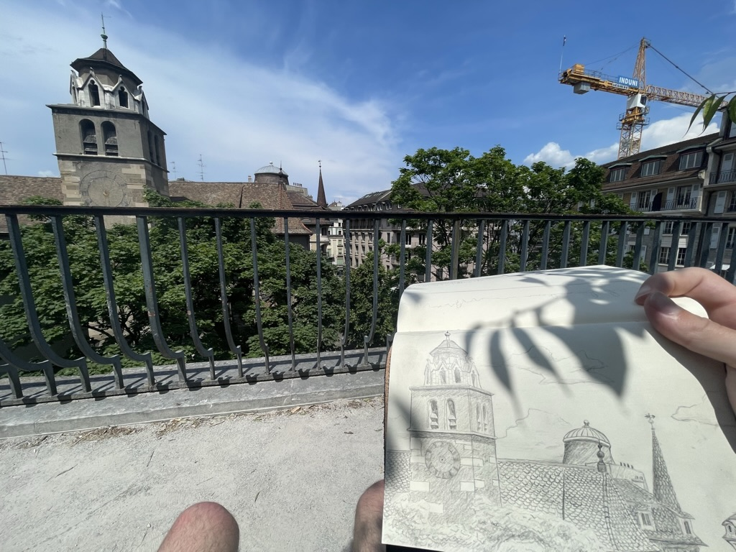
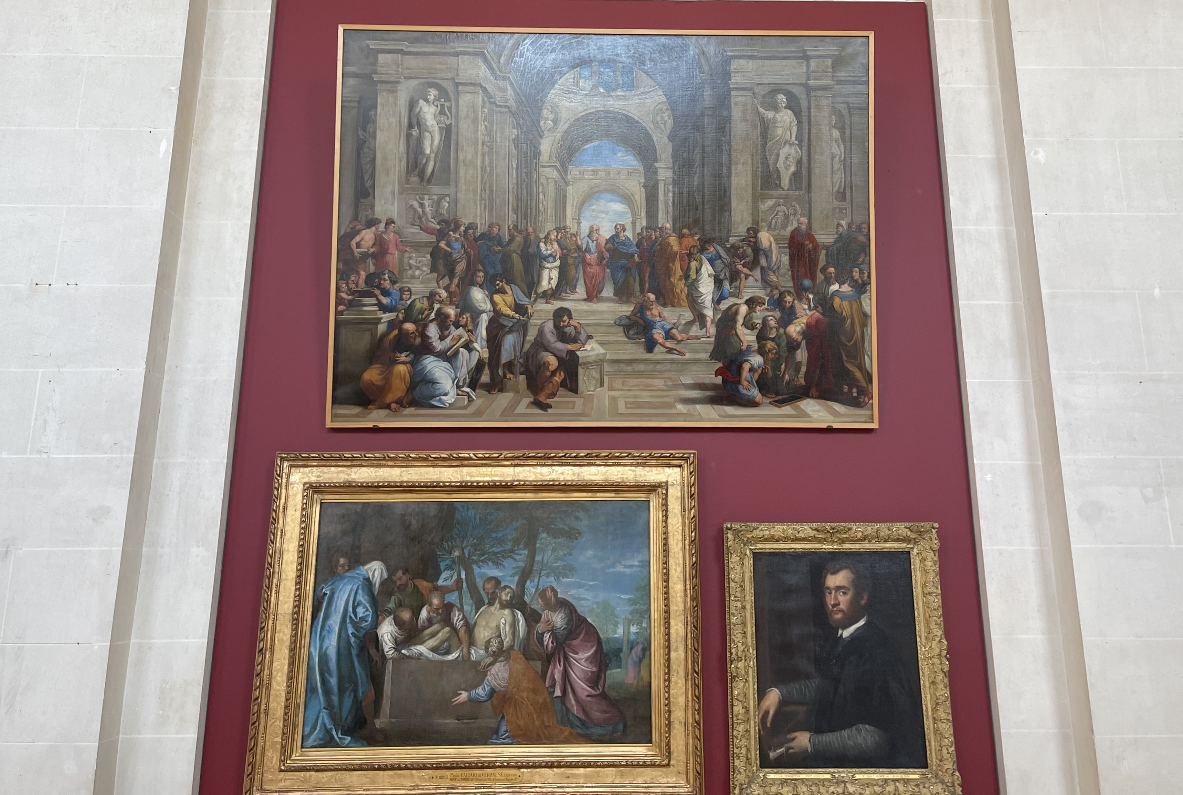
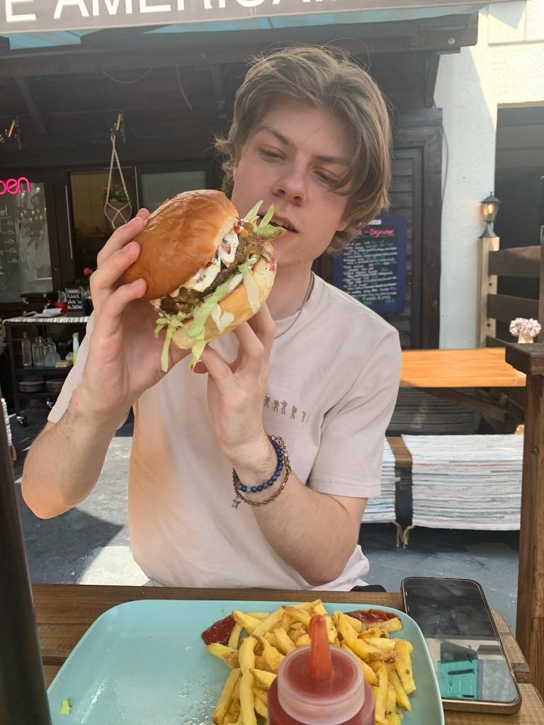
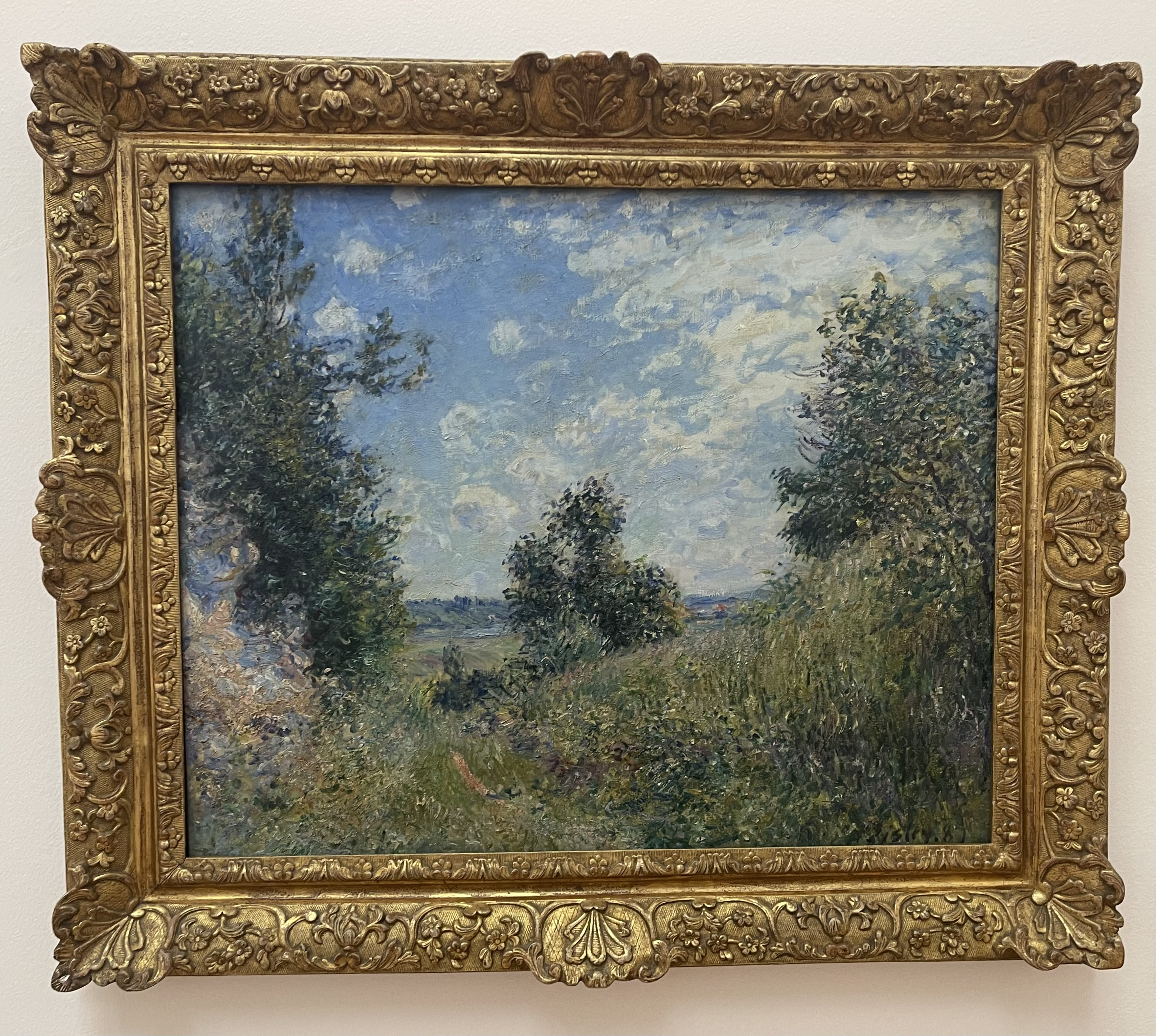

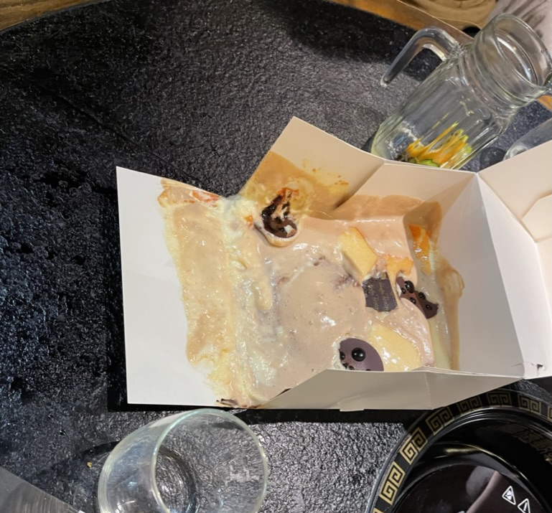
Pictures
Notes:
Here are some more pictures of my time here in Europe, including a very melted birthday cake for Lynn.

Slide 22
Thanks!
Notes:
And that’s all, thank you for listening. Does anyone have any questions?

Slide 23
Backup

Slide 24

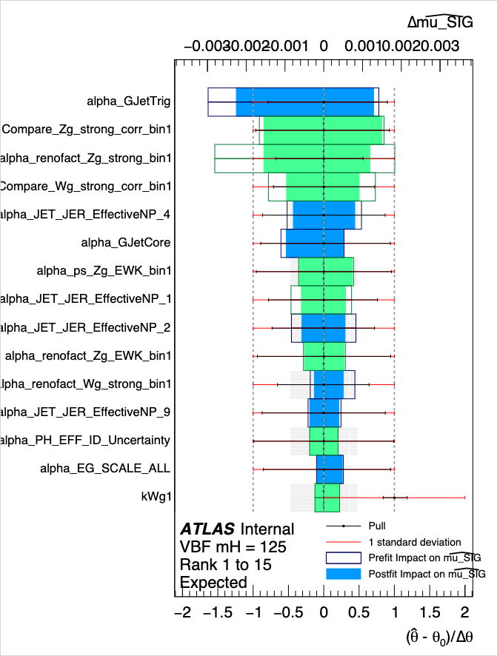
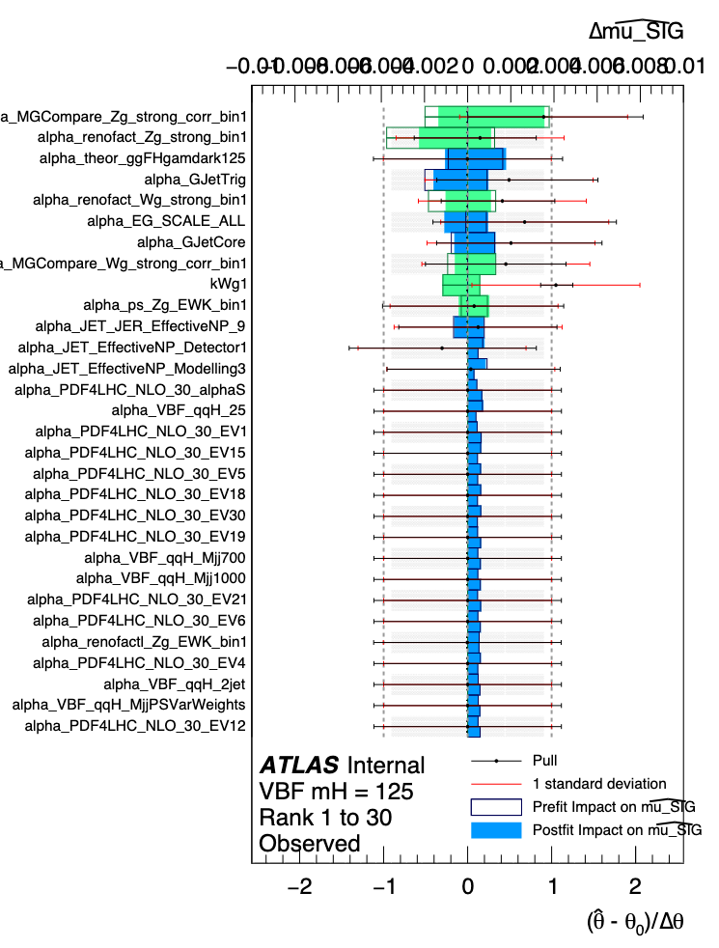
VBF
Systematic impact plots
Leading impacts from theoretical uncertainties
One-sided effect to be investigated
JER most important CP experimental uncertainties

Slide 25
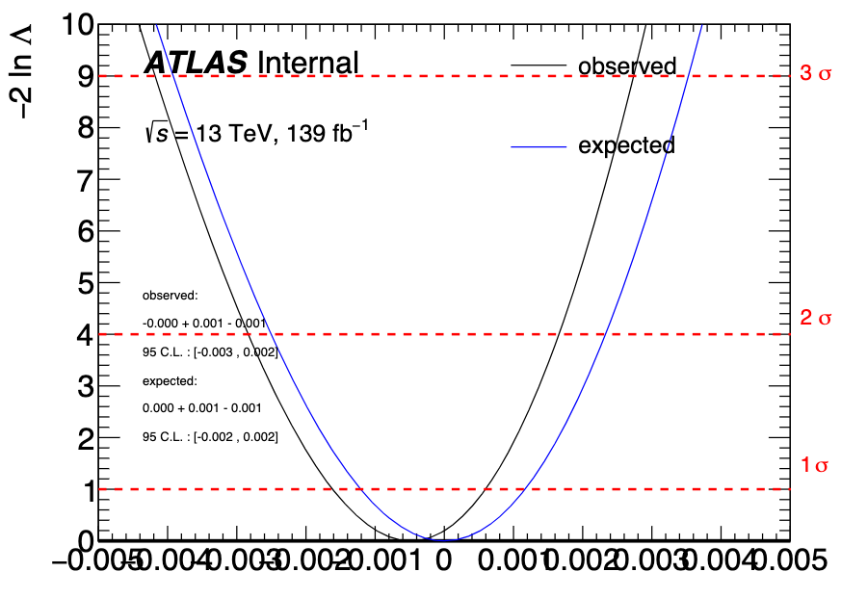
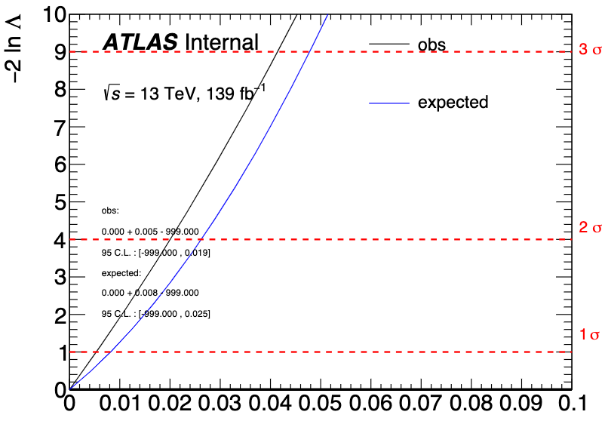
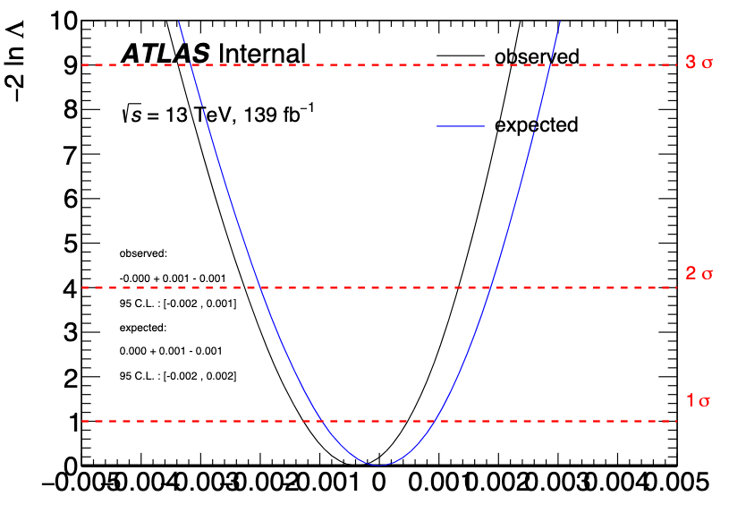
Likelihood model validation: Scans
Derived likelihood scans for VBF, ZH, ggF, and combined workspaces
ggF:
mH=1500 GeV
ggF:
mH=3000 GeV
95% CL interval
ggF: mH=400 GeV

