Slide 1


Animation for AEgIS
July 28, 2023
Olivia Adams with Stefan Haider
1/10

Slide 2

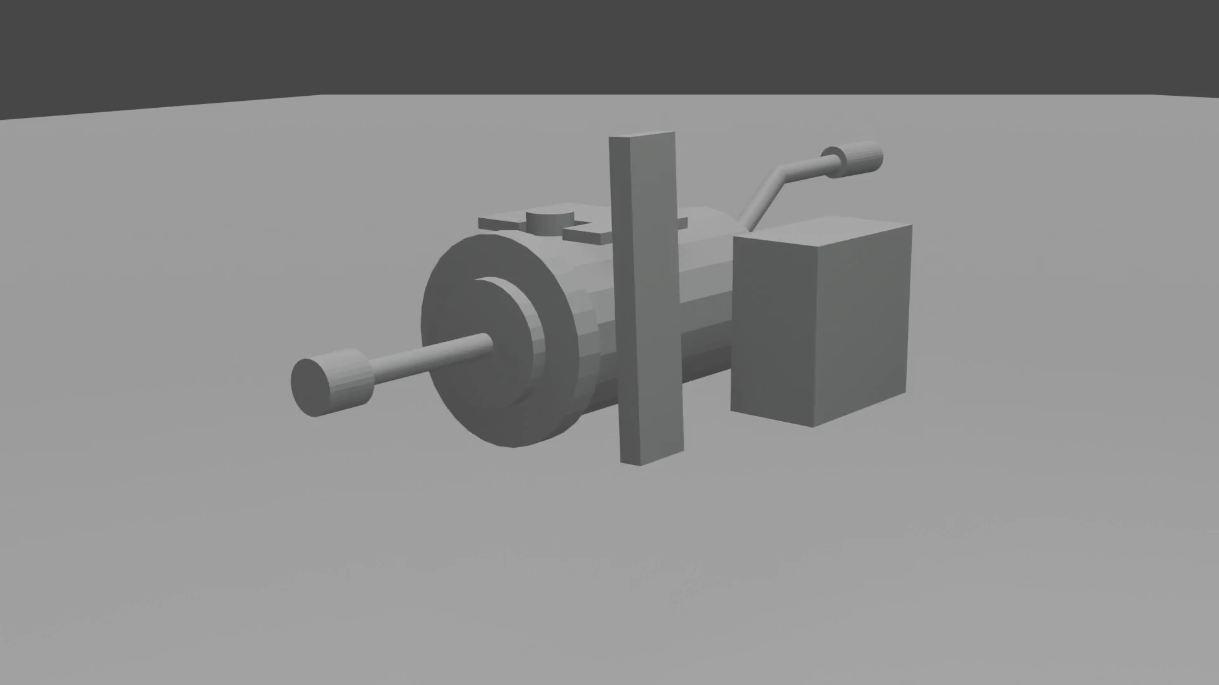
Recap!
AEgIS is looking for gravity’s effect on antimatter
First needs antimatter!
Animating the process
Joining the seen to the unseen
2/10

Slide 3
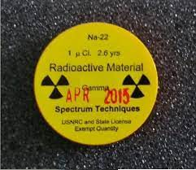
So Far?
Goal: Show total antimatter formation
Five total videos
Commented Code
All Codes
Antiprotons are outside of target
Positrons have passed through this cloud into target
3/10

Slide 4
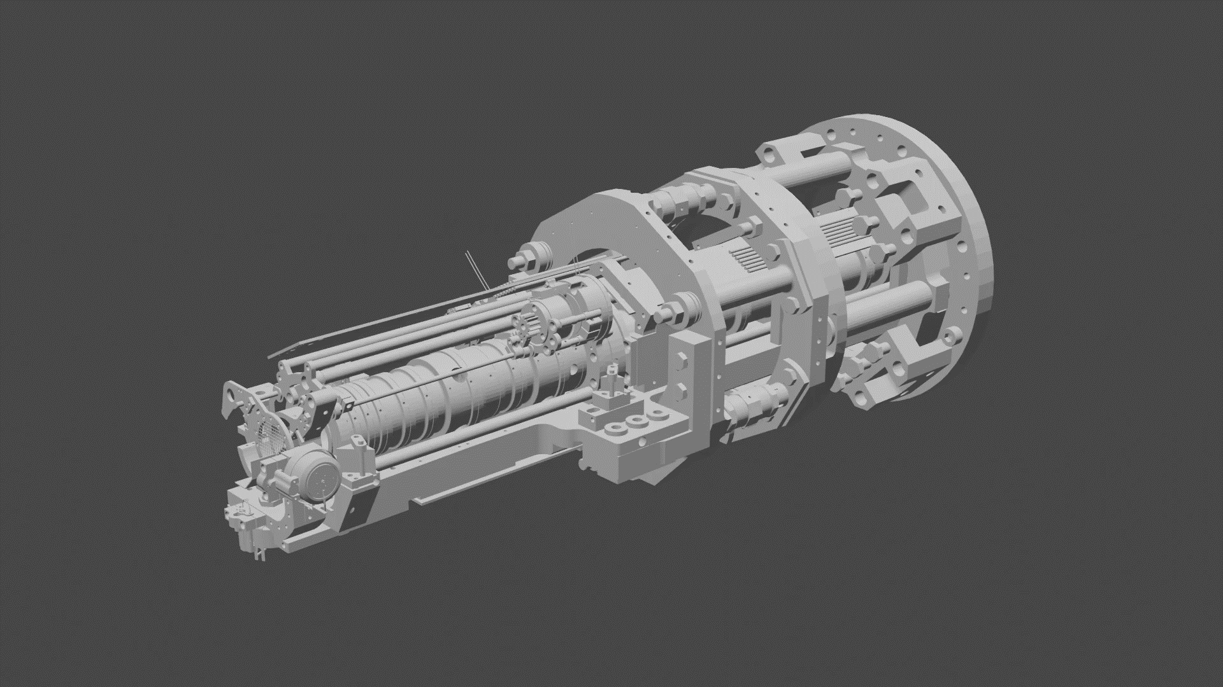
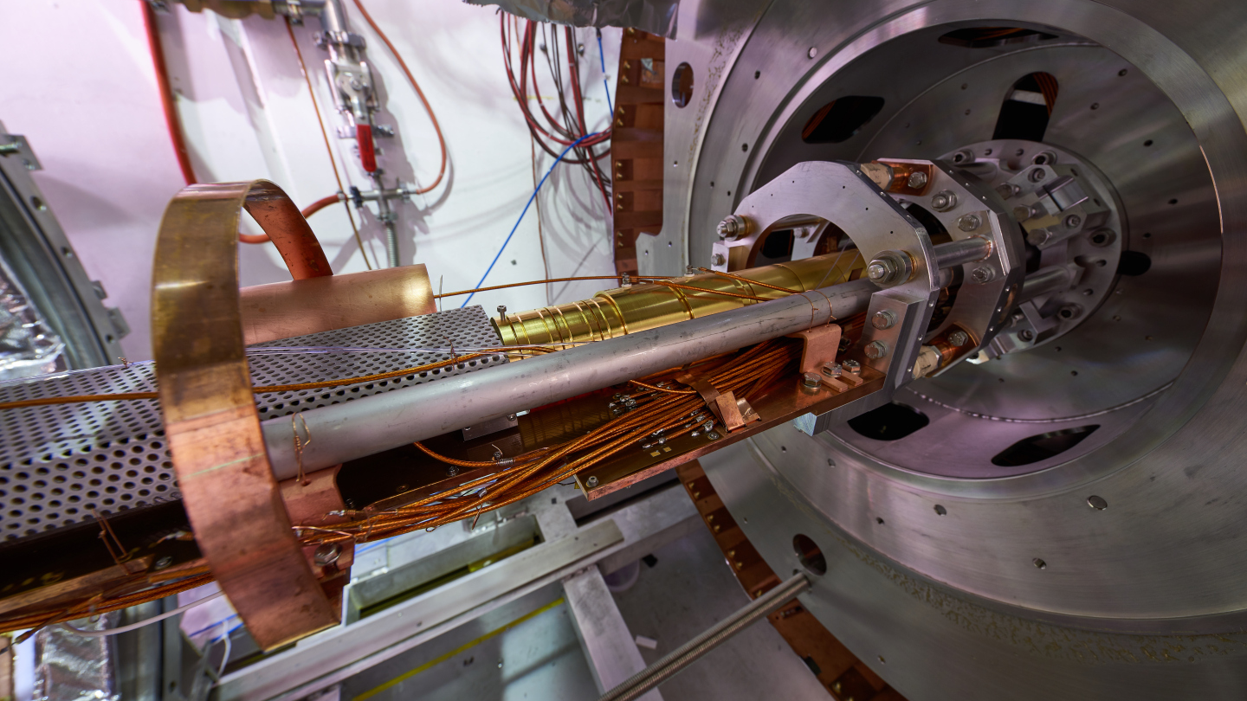
Total Model
4/10

Slide 5
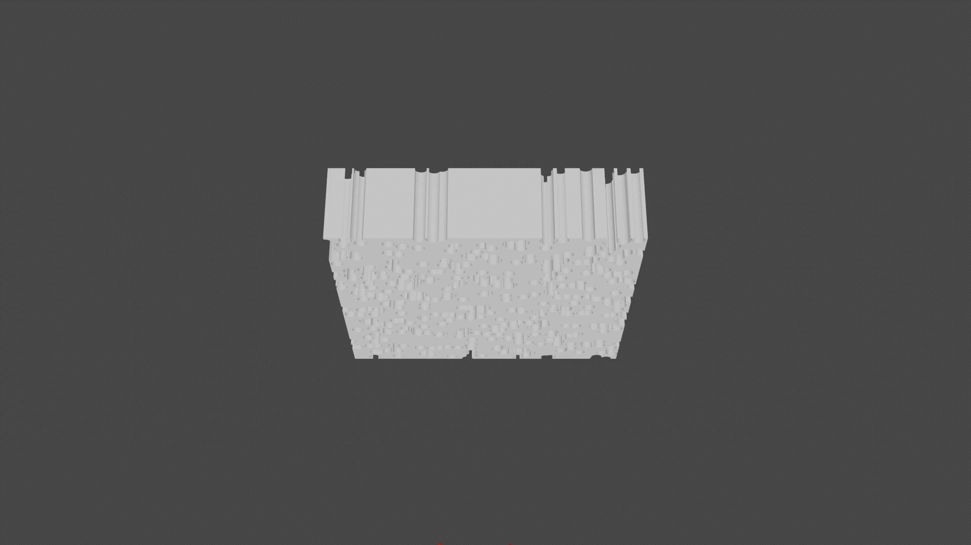
Silicone Target
5/10

Slide 6

Atomic Level
6/10

Slide 7

Silicone Oxide
7/10

Slide 8
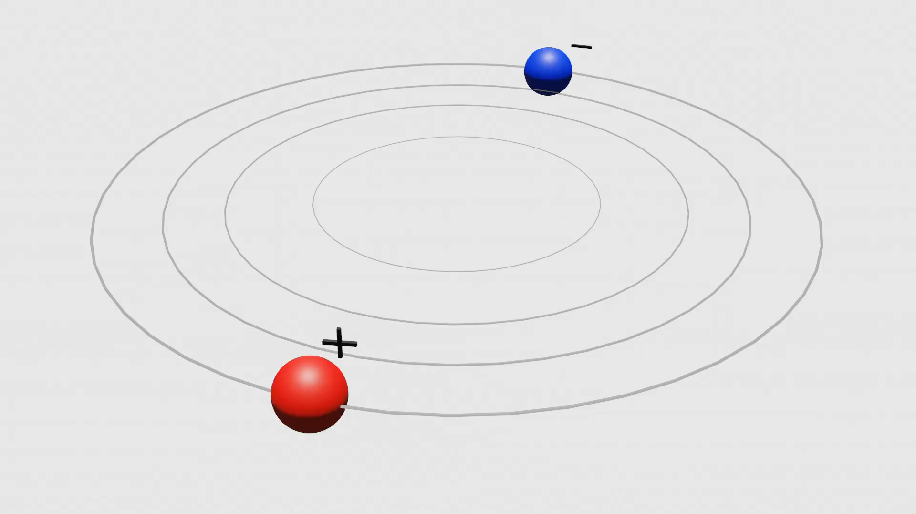
Positronium (1)
8/10

Slide 9

Positronium (2)
9/10

Slide 10
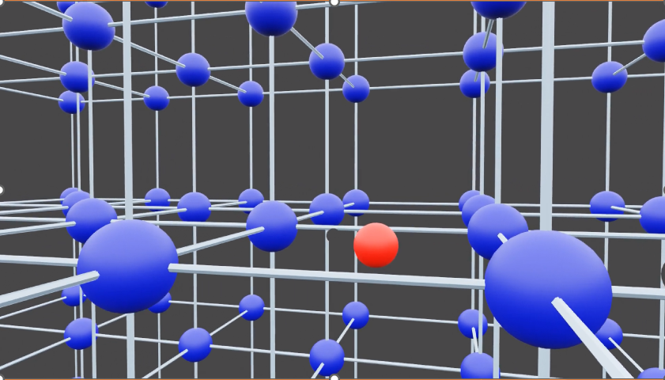
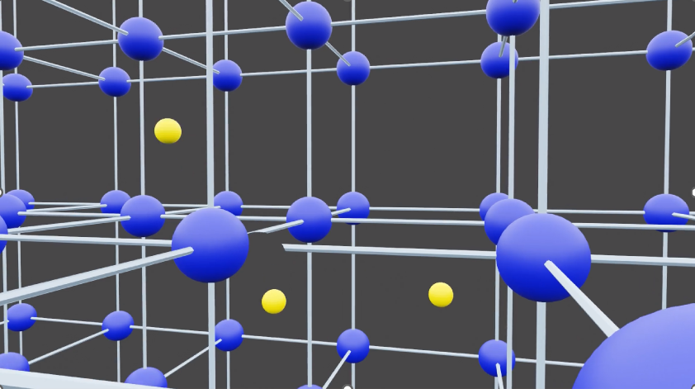
To Do
Edit all the videos!
Animate laser excitation
Animate combination into anti-hydrogen
Label and/or voiceover
10/10

