Slide 1
New Features in Detector Construction Application for CMS - HGCAL Database
Corbin Tinnon
Supervisors: Muhammad Imran & Hafeez Hoorani

Slide 2
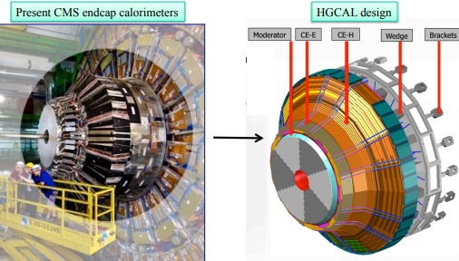
High-Granularity Calorimeter (HGCAL)
The HGCAL will replace the existing endcap calorimeters
Need to maintain excellent calorimetric performance under the HL-LHC operations with an expected to increase the Luminosity by a factor of 10, leading to a higher needed radiation tolerance and event pileup on detector
two major sections: the electromagnetic calorimeter (CE-E) and the hadronic calorimeter (CE-H)

Slide 3
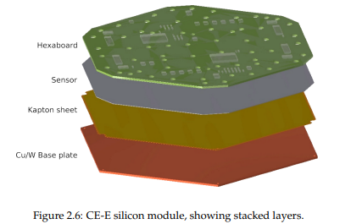
HGCAL Database(DB)
Component Tracking: The DB store and track all information related to the detector components. This includes everything from the moment of delivery to the integration into the detector itself, including shipping details.
Data Storage: The database will store a myriad of data associated with the detector components. This includes calibration data, conditions data, and configuration data.

Slide 4
HGCAL Database(DB)
Detector Construction: DB will use parent-child relationships to build higher-level objects. This allows for tracking of how smaller components are used to construct larger ones. This process effectively builds a virtual model of the entire HGCAL detector within the database, with all readout channels mapped out.
Mapping Detector Channels to Readout Channels: Having a virtual model of the entire HGCAL detector in the database allows for easy mapping of detector channels to readout channels. This is important for understanding where the final measurement data is coming from within the detector.

Slide 5
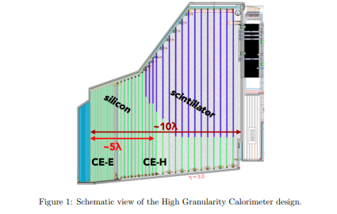
HGCAL Database(DB)
I will be directly working on different features including the detector assembly process. My main concern will to be to find solutions to errors present within this code.

Slide 6
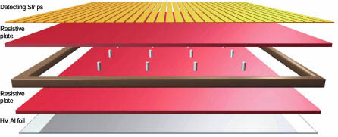
Introduction & Working Principle of RPC
Resistive Plate Chambers (RPCs) are fast gaseous detectors providing a parallel muon trigger system.
Consists of two parallel plates: a positively-charged anode and a negatively-charged cathode, both made of high-resistivity plastic material.
Separated by a thin gas volume which aids in electron movement.

Slide 7
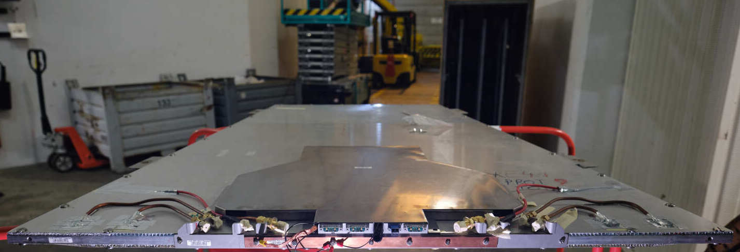
The Role and Enhancement of RPCs in HL-LHC
RPCs are used in the CMS muon system and will be upgraded to sustain efficient muon triggering and reconstruction performance in the HL-LHC phase.
Excellent timing resolution makes them apt for this application.

Slide 8
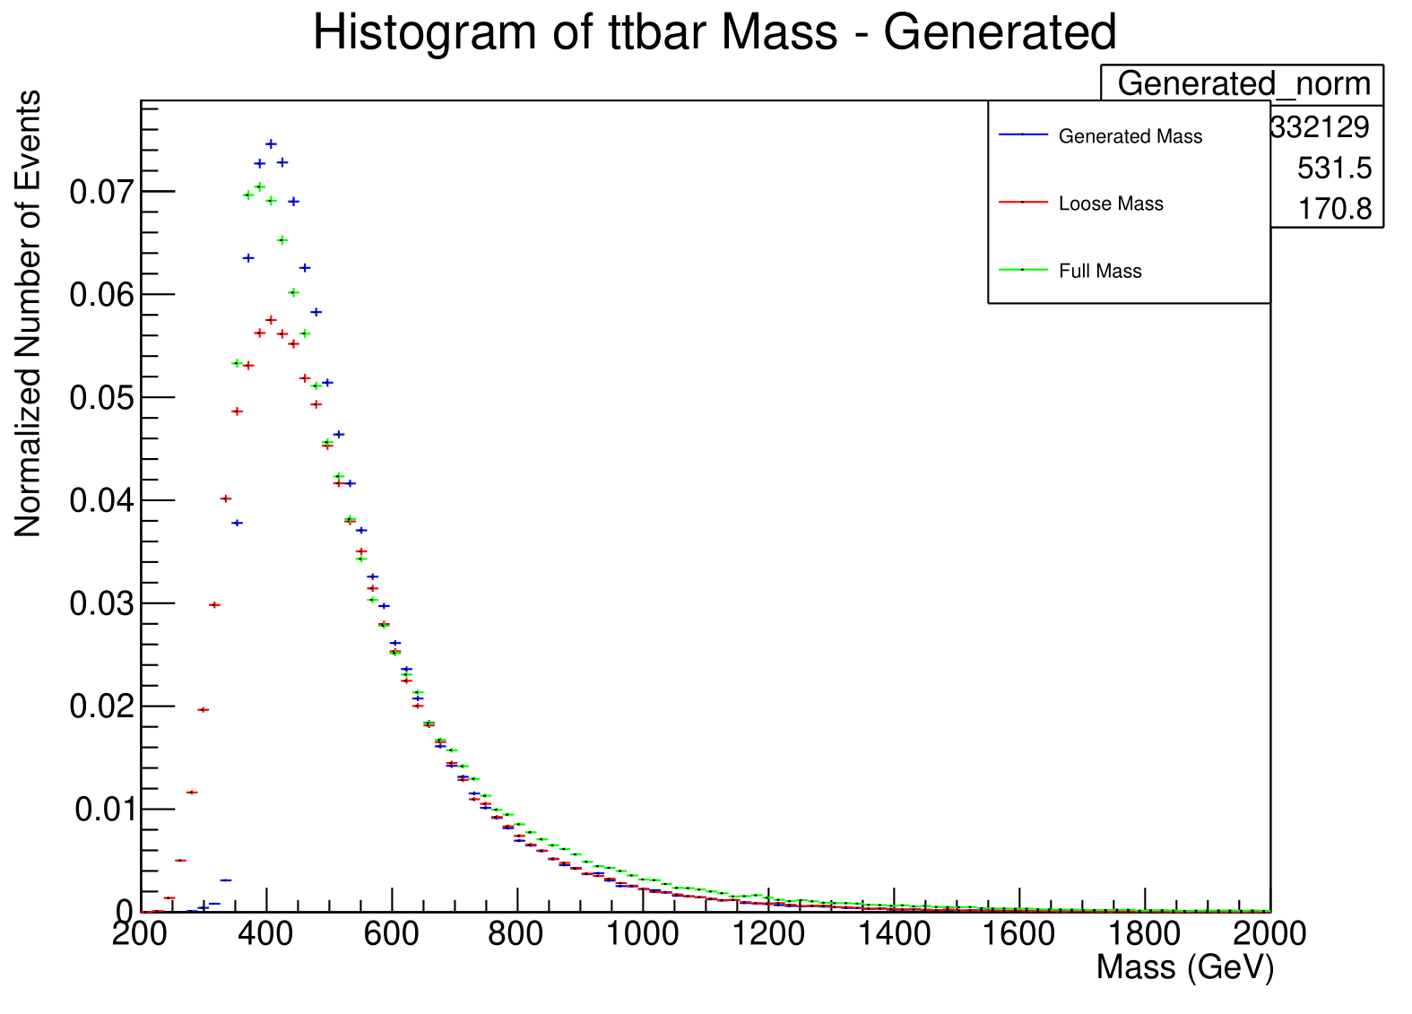
GNN-Based Measurement of Top Quark Mass
Develop a novel method to measure the mass of the top quark (mₚₒₗₑₜ) using Graph Neural Networks.
The analysis investigates events involving the production and subsequent decay of top quark-antiquark pairs, with a particular emphasis on decays leading to a high multiplicity of jets.

Slide 9
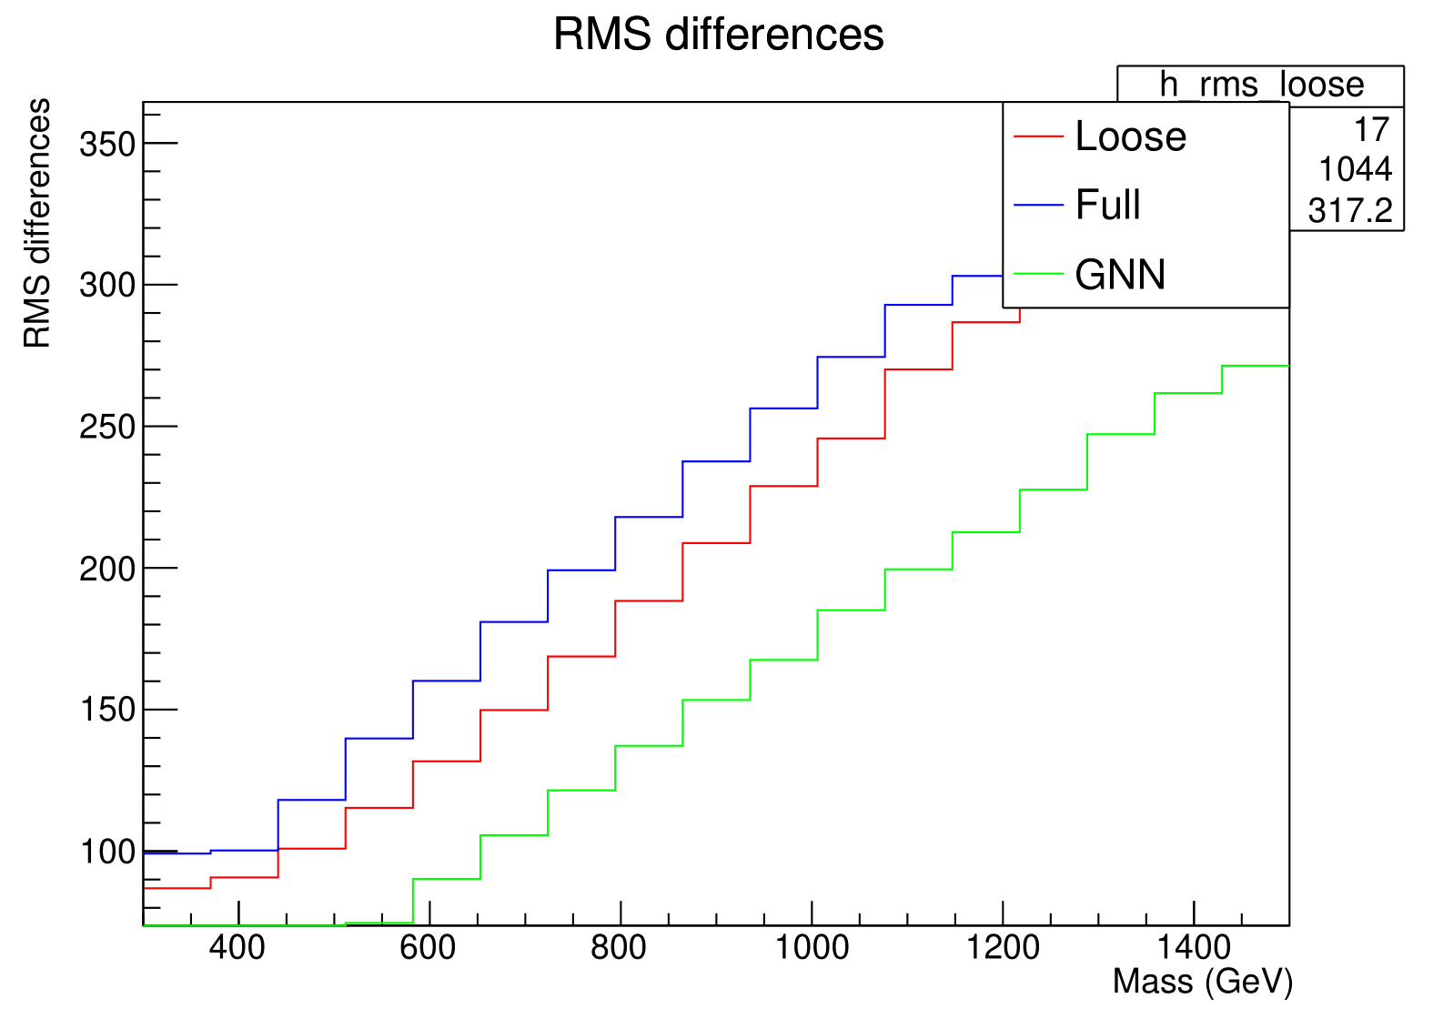
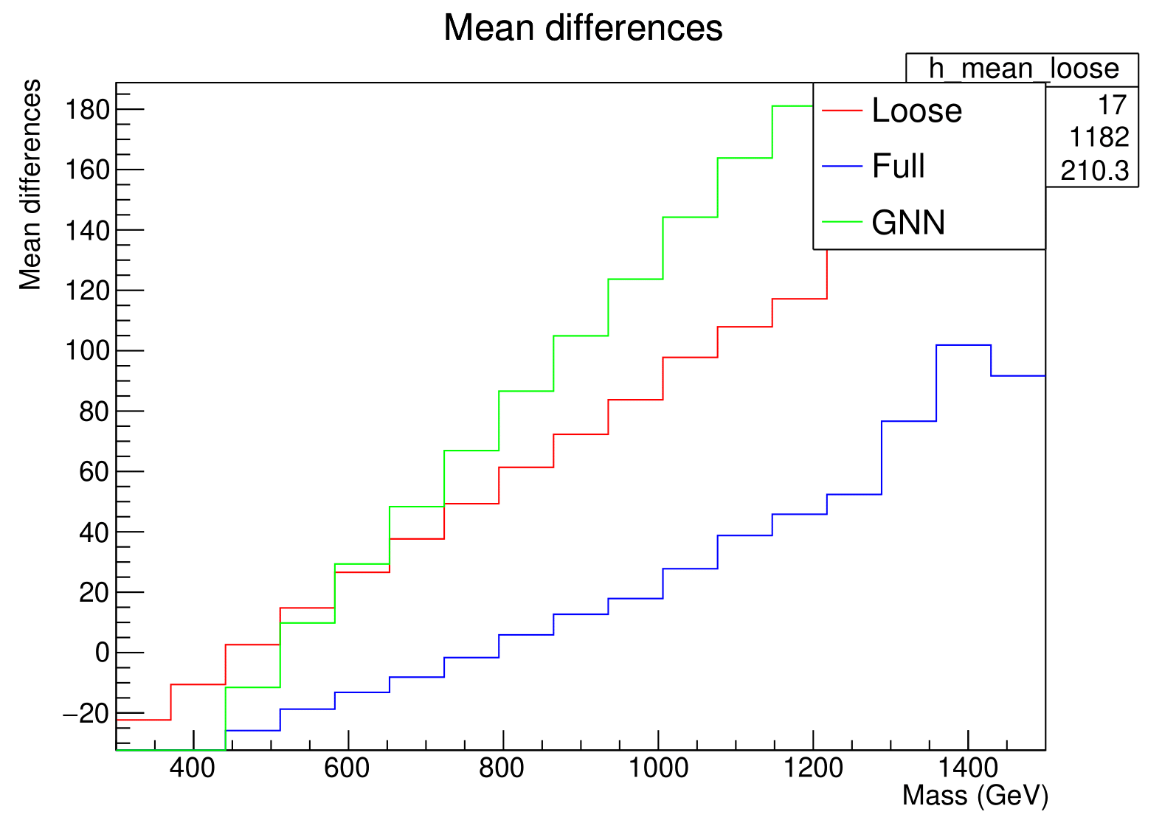
Progress in GNN Training & Performance Optimization
Performance Optimization: Parallel to the training, optimization efforts are ongoing. Our target is to surpass the performance of prior reconstruction methods. This involves fine-tuning the GNN's parameters and potentially revising the network architecture to achieve superior results.

