Slide 1
TAU Identification Improvements for ATLAS Phase-1 Upgrades in L1Calo Trigger System
Srinidhi Budhiraju
Supervisor: Ralf Gugel

Slide 2
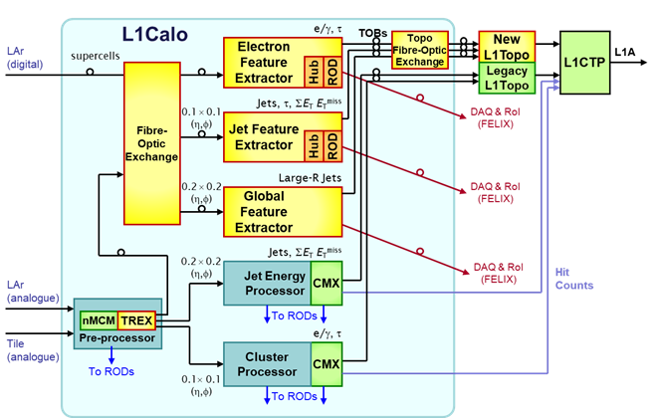
Review
2 levels in ATLAS trigger system
  Level 1
  HLT
Primary Goal: Study cTau in L1Calo and find ways in which rate can be reduced

Slide 3
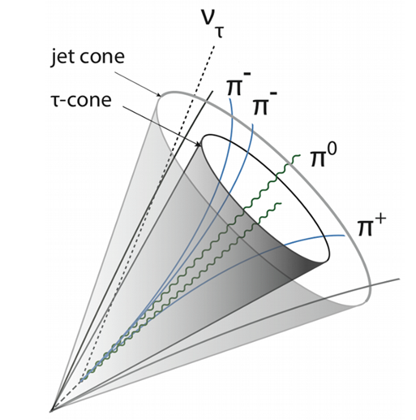
Taus & Jets
Taus
  ~2/3 decay hadronically
  Narrow spray of few hadrons
  Difficult to differentiate from Jets
Jets
  Spray of many hadrons
  Cover larger area
  More frequent, not very interesting
Discrimination: Isolation criteria
  Tau energy in narrow cone
  Compare to energy in larger cone

Slide 4
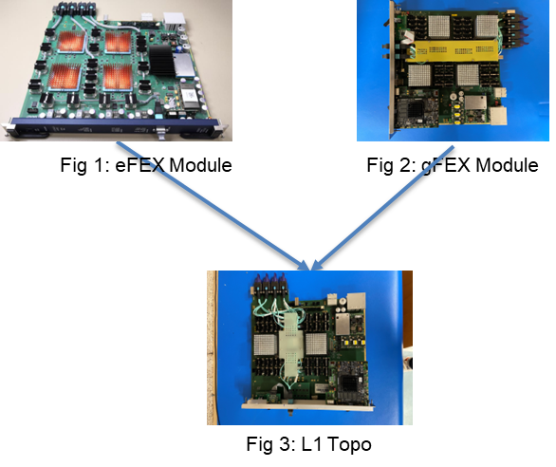
L1Calo - Calorimeter Trigger
Feature Extractors
  eFEX: •e/γ & τ candidates
    Finer granularity
  jFEX: jets and τ candidates
    Coarser granularity
  gFEX: large radius jets
L1Topo: Combined information from eFEX and jFEX

Slide 5
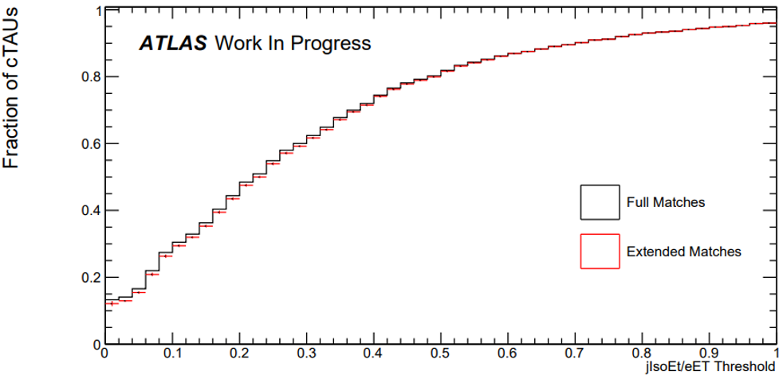
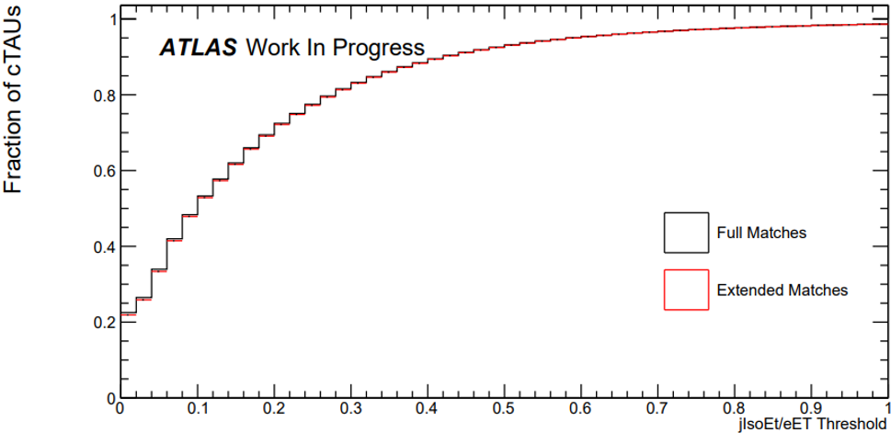
cTAU Matching Efficiency - Present Algorithm
Background
eTAU: detected by eFEX
jTAU: detected by jFEX
cTAU: combination of eTAU and jTAU
Exact match between eTAU (eta & phi) & jTAU (eta & phi)
Goal: increase fraction of cases with meaningful jIsoET
Signal

Slide 6
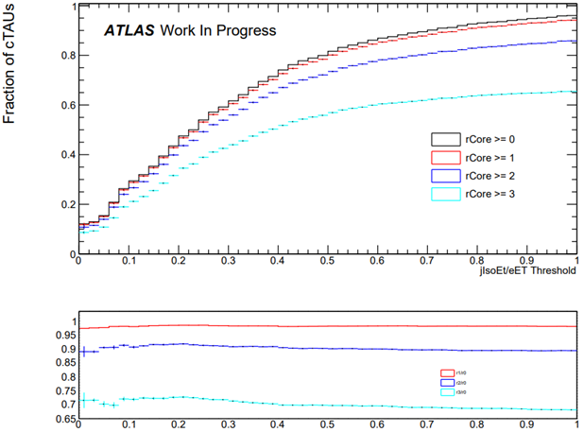
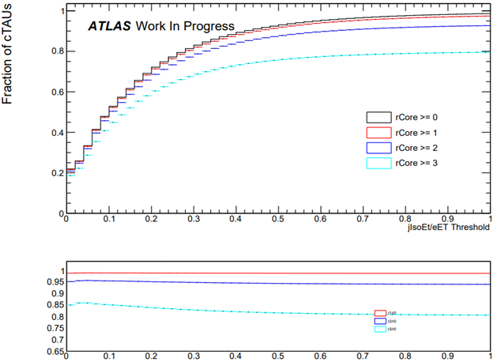
rCore Studies
Background
Signal
Possible improvement by considering additional information
Discriminants are jIsoEt/ET and rCore
  If less correlated, may gain more by combining them
Ratio plots shows the ratio wrt no cut on rCore

Slide 7
Results
cTAU matching efficiency
  No significant reduction in rate by expanding algorithm
rCore studies
  Lot of cTAUs rejected in backgroundMC, but also a lot rejected in signalMC
  Not ideal

Slide 8
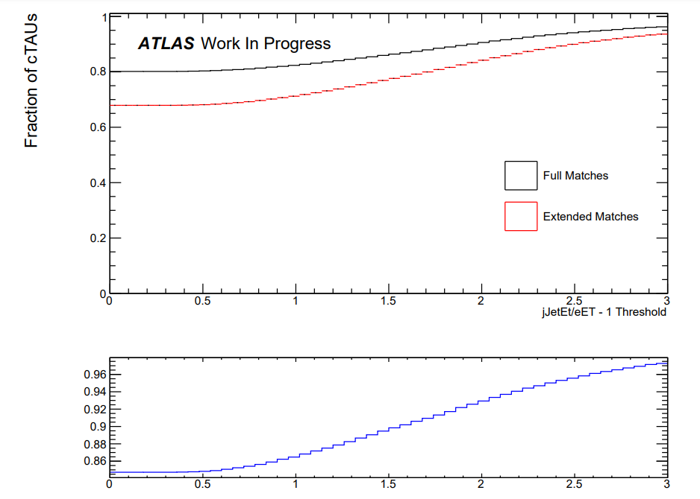
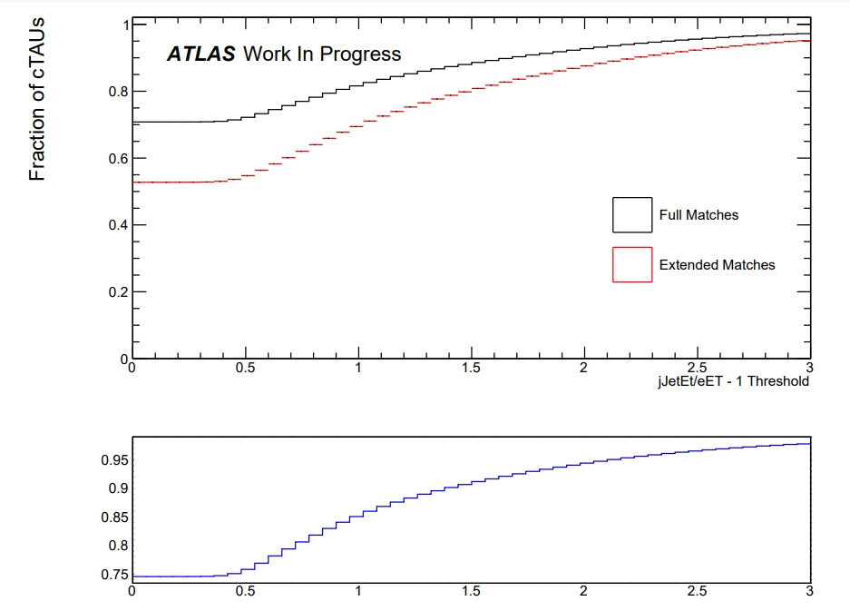
Further Studies
Studying jJets may be better replacement for jIsoEt/ET as energy inside rCore area taken into account
Background
Signal

