Slide 1



Temperature and Humidity Monitor for CMS Tracker Electron
Testing
Peter Carney

Slide 2

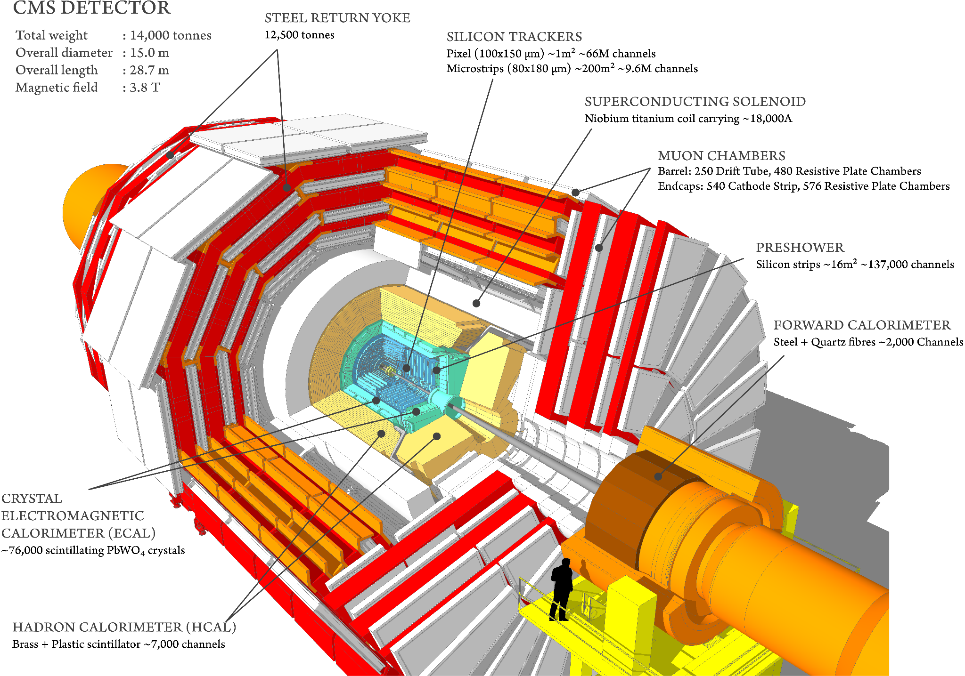
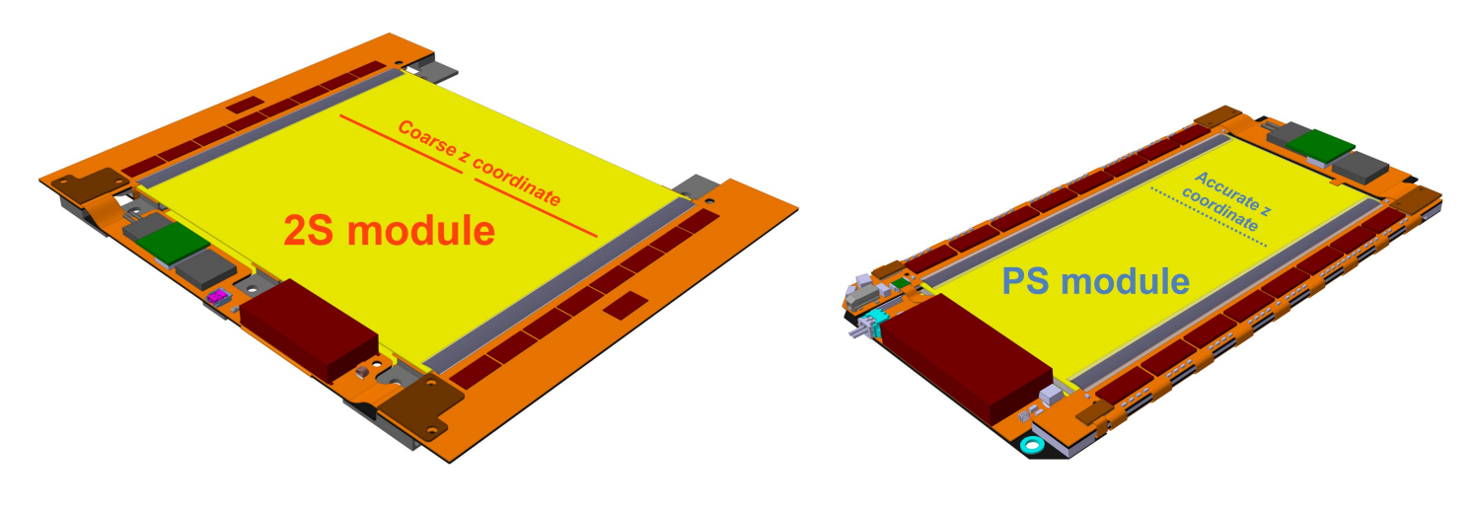
CMS Tracker System
Front End Hybrid Electronics
Used to gather and deliver
binary data from silicon sensor
Phase-2 upgrade desires less bulk electronics
1

Slide 3
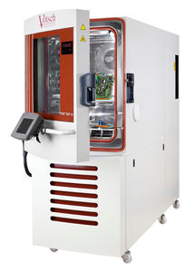
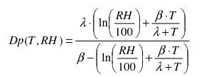
Testing of the FEH Electronics
Tests of the FEH Electronics must be done in Climatic Chamber
Testing done at 25 °C and -40 °C
Temperature, dew point, and relative humidity monitor needed to conduct testing.
2

Slide 4
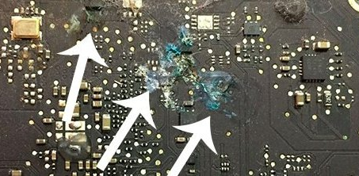
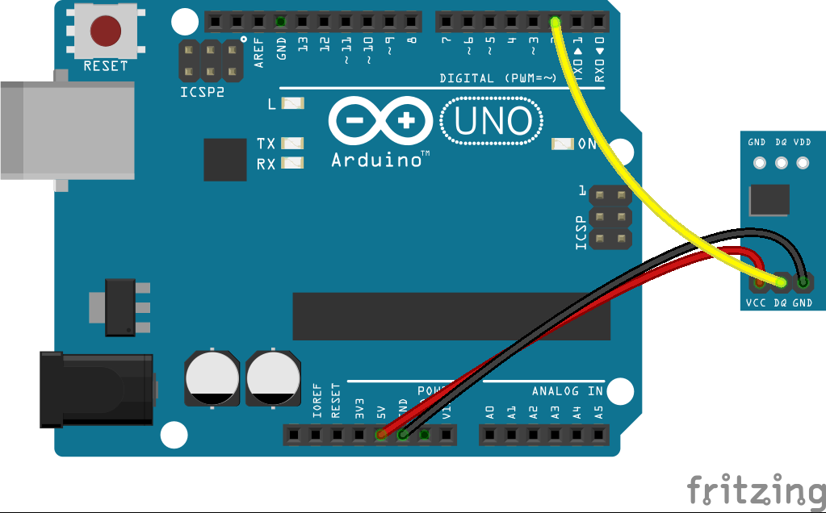
Why is the monitoring needed?
Condensation ruins electronics → can cause a short circuit
Climatic Chamber relative humidity sensor broken → We supply another
Two Monitoring Systems used:
  Built in chamber sensors
  Strip sensors placed inside chamber
3

Slide 5
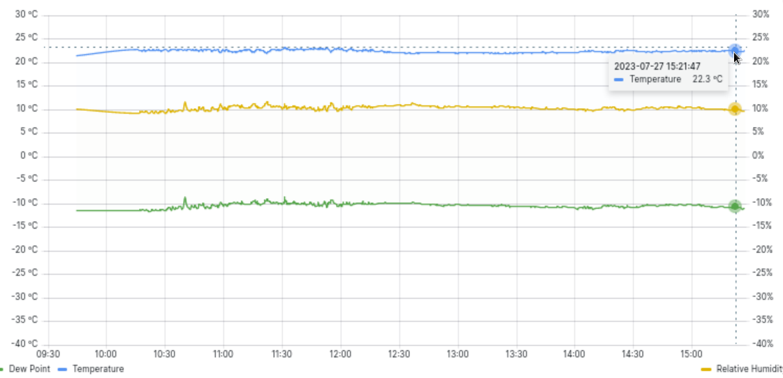
Creating Temperature Monitor
Climatic Chamber Conditions
Temperature in C
Relative Humidity in %
Time
4

Slide 6
Accomplished
Next Steps
Configured Linux on my Laptop
Got data collection and raw data monitoring working
Met with collaborators to install the Arduino board + sensors in climatic chamber
Connected my laptop to climatic chamber → can control it remotely
Created active monitoring display
  Climatic chamber data
  Arduino sensor data
  Both show agreement with ± 5°C difference
Created live popup window through python → more robust configuration
Write script to display automatic signals/warnings depending on temperature.
Finish popup window data display
Meet with collaborators to implement popup display on lab computer (maybe)
Write paper/make presentation
5

Slide 7
Thank You
6

