Slide 1
Studies of Short-Lived Kaon Decays at LHCb
Garath A. Vetters
28/07/2023

Slide 2



Brief Recap
Learned the basics of particle physics, the Standard Model, etc through independent studying and attending lectures.
Learned how High Level Trigger (HLT) programs are written along with the various tests that can be performed on a data sample
Generated a histogram of K_{s}⁰ → μ⁺ + μ⁻ as a proof of concept.
Learned a little more about how to work in Linux
Garath Vetters | Studies of Short-Lived Kaon Decays at LHCb
*
‹#›

Slide 3
What’s been done since the last presentation?
Main focus has been on the K_{s}⁰ → e⁺ + e⁻ decay process
  Histograms have been generated and Feynman diagrams have been created
  This particular decay process was chosen since it could provide options for new physics and has never been measured before within LHCb, to provide some reasons.
Code written by a fellow collaborator at LHCb has been used for the K_{s}⁰ → e⁺ + e⁻ decay
  More sophisticated program
  Ongoing and future work will prove validity of collaborator’s code
Tests have been run on the K_{s}⁰ → e⁺ + e⁻ simulation batch to ensure results are valid
  I.E. efficiency tests, MCTruth tests, offline analysis (In progress)
Garath Vetters | Studies of Short-Lived Kaon Decays at LHCb
*
‹#›

Slide 4
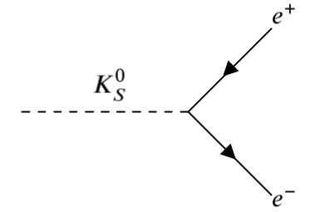
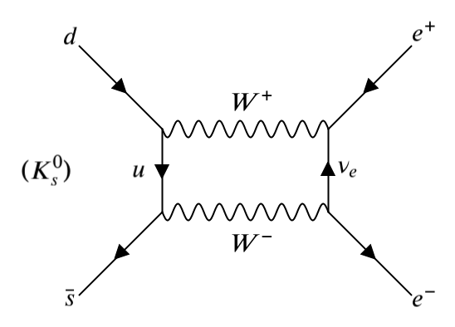
Feynman Diagrams of K_{s}⁰ → e⁺ + e⁻
Simple Example
  (+) Good starter for understanding how the decay occurs.
  (-) K_{s}⁰ is not an elementary particle.
  (-) Feynman diagram does not show how K_{s}⁰ decays into an electron-positron pair.
More Accurate Example*
  (+) Example gives a better idea of how the decay transpires
  (+/-) More complex arrangement also requires more knowledge of the forces at play.
  *This is one of countless feynman diagrams that can be created for such a decay process
Garath Vetters | Studies of Short-Lived Kaon Decays at LHCb
*
‹#›

Slide 5
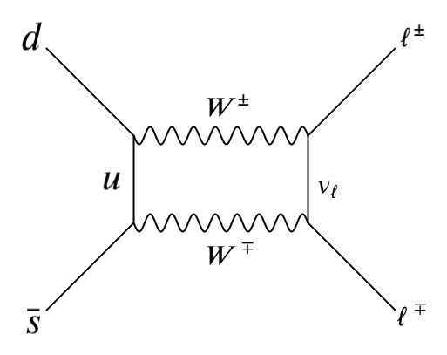
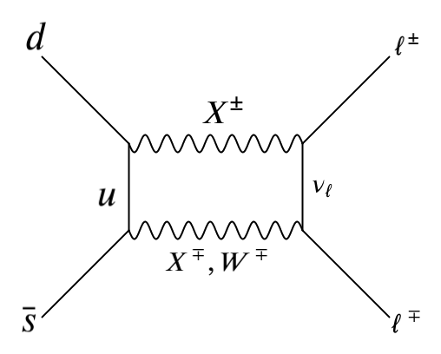
A little bit of theory
General case of K_{s}⁰ → l⁺ + l⁻
  K short decays via the weak force.
    Mediator is W boson.
  K short decay violates CP (charge conjugation and Parity) symmetry
    Decay does not yield equal amount of matter and antimatter
How this leads to Beyond Standard Model Physics
  Instead of being mediated by a W boson, the K short decay could be mediated by some X particle.
    Could potentially be a dark photon candidate
Garath Vetters | Studies of Short-Lived Kaon Decays at LHCb
*
‹#›

Slide 6
Efficiency Table
Signal MC Used | Line | # Events | # Selected Events | Efficiency
Ks --> 2mu | KS0ToMuMu | 5000 | 131 | 0.026 +/- 0.002
Ks --> 2e | KS0ToEE | 5000 | 11 | 0.002 +/- 0.001
Ks --> 4mu | KS0ToMuMuMuMu | 20000 | 59 | 0.003 +/- 0.0004
Ks --> 2mu2e | KS0ToMuMuEE | 20000 | 23 | 0.001 +/- 0.0002
The above efficiencies were found via an efficiency test in Moore Analysis
  Efficiencies show how frequently the code finds the desired results
Garath Vetters | Studies of Short-Lived Kaon Decays at LHCb
*
‹#›

Slide 7
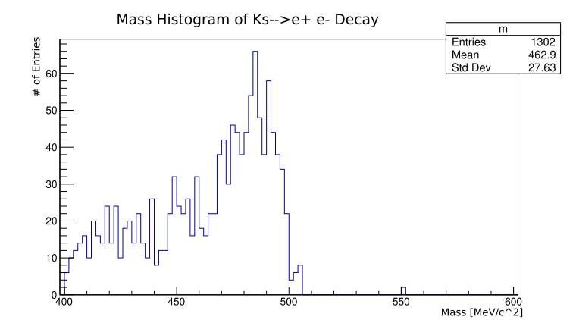
Mass Histogram of K_{s}⁰ → e⁺ + e⁻
Done with a sample of 200,000 counts
  Mass histogram was generated first as a benchmark.
    Personally-written code was used for first test.
  Given the difficulty of detecting electrons, a large sample was used.
    inclusion or exclusion of Bremsstrahlung could alter the mean mass value.
  While a defined peak does exist, the number of entries appears to be higher than expected.
    Possible double-counting from program?***
(Value from PDG: Mass of K⁰ = 497.614 ± 0.024 MeV/c^2)
Garath Vetters | Studies of Short-Lived Kaon Decays at LHCb
*
‹#›

Slide 8
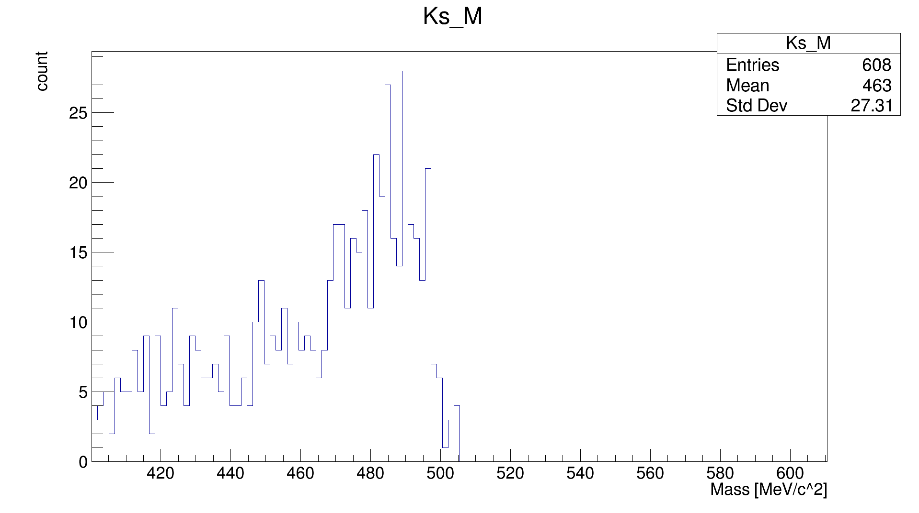
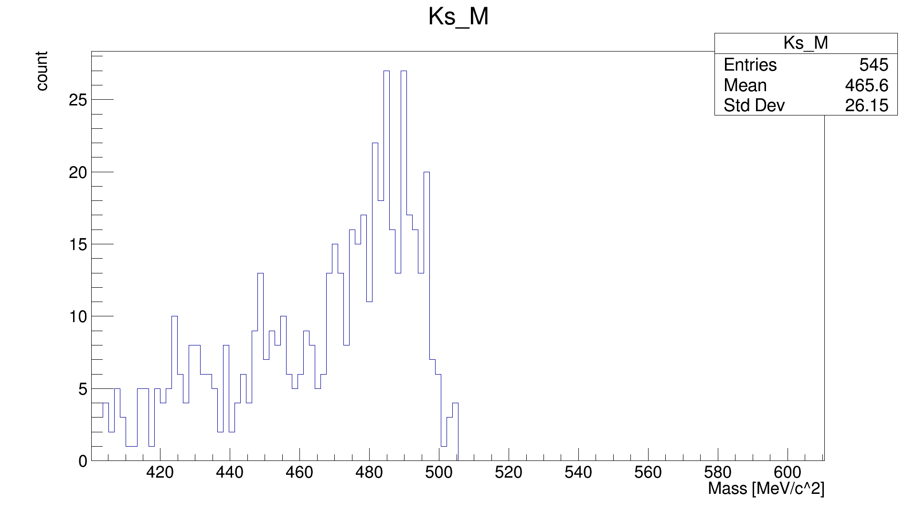
Mass histograms of K_{s}⁰ → e⁺ + e⁻ (Attempt #2)
Histogram without MCTruth
Histogram with MCTruth
asd
K_{s}⁰ → e⁺ + e⁻ Mass Histogram (No MCTruth)
K_{s}⁰ → e⁺ + e⁻ Mass Histogram (w/ MCTruth)
Notice the difference?
Garath Vetters | Studies of Short-Lived Kaon Decays at LHCb
*
‹#›

Slide 9
MCTruth?
MCTruth stands for Monte Carlo Truth
  Used to verify that results are valid.
  MCTruth compares a given simulation set with a model based on the real world.
    events that is in both sets are accepted while everything else is removed.
Monte Carlo simulation that passed reconstruction algorithms***
Valid events that pass MCTruth
Monte Carlo simulation that did not pass reconstruction algorithms
Garath Vetters | Studies of Short-Lived Kaon Decays at LHCb
*
‹#›

Slide 10
Ongoing/Future Work
Current work is focusing on a procedure called offline processing.
  Involves taking a large set of data and applying cuts to see how the data set is altered.
    Since MCTruth had such a minimal change, Offline processing could help improve removal of the background within the K_{s}⁰ → e⁺ + e⁻ mass histogram.
  Main goal of this step is to apply tighter cuts to the results to see how the signal is affected
    Rate of the K_{s}⁰ → e⁺ + e⁻ krigger line is another main focus.***
More analysis will most likely be carried out on the K_{s}⁰ → e⁺ + e⁻ process to ensure results are valid
Extra details (i.e fitted lines) will be added to histograms via ROOT
  Histograms were created using RDataFrame (RDF) within ROOT.
  Extra details will (eventually) be applied via PyROOT
Garath Vetters | Studies of Short-Lived Kaon Decays at LHCb
*
‹#›

Slide 11

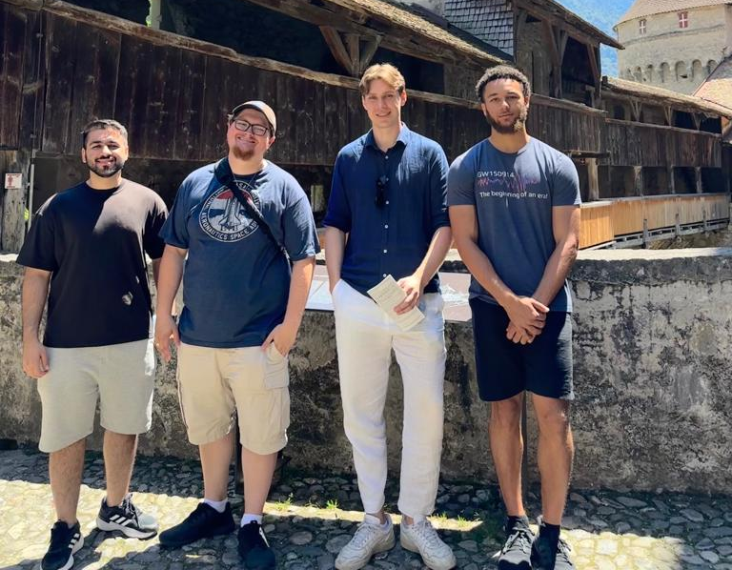
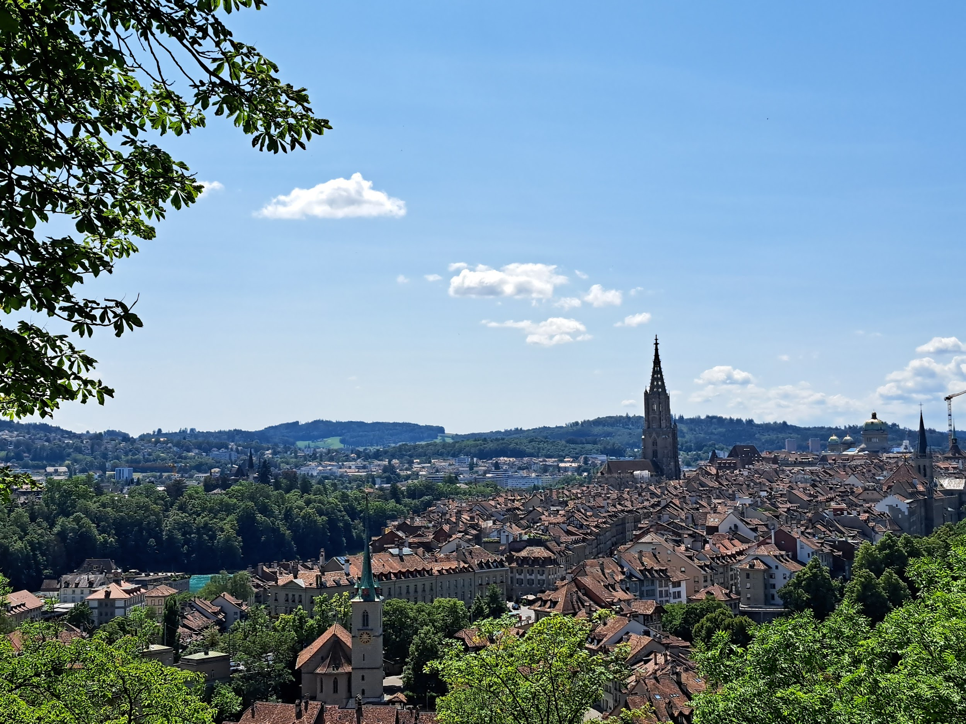


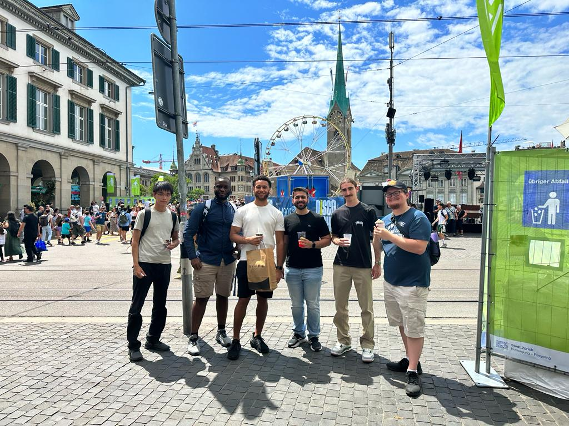
More Pictures
Garath Vetters | Studies of Short-Lived Kaon Decays at LHCb
*
‹#›

Slide 12
Any questions?

Slide 13
Extra slides

Slide 14
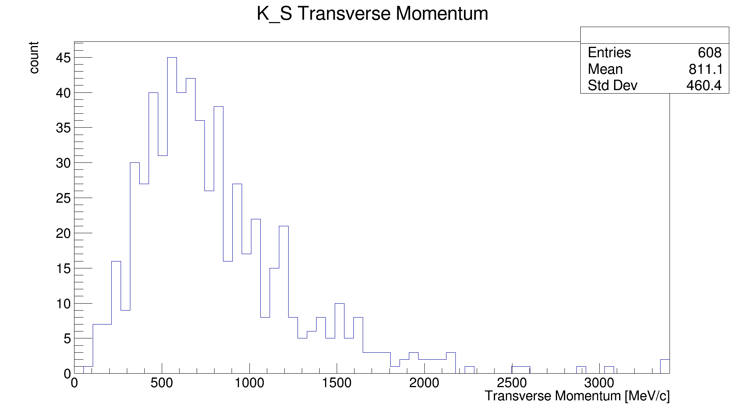
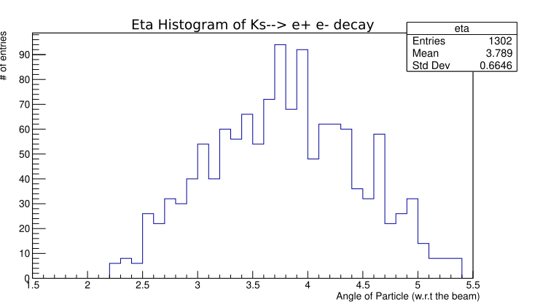
Other Histograms of K_{s}⁰ → e⁺ + e⁻
Transverse Momentum (PT) histogram
  (+) (Mostly) uniform peak means most particles had (roughly) the same pt
  (-) Possible background around central peak.
Angle w.r.t the beam (eta) histogram
  (+) Scale is reasonable
  (+) events within plot are within the LHCb acceptance values
Garath Vetters | Studies of Short-Lived Kaon Decays at LHCb
*
‹#›
Notes:
May cut this out of the presentation

