Slide 1
Future Oracle use by CMS Offline DM/WM management
PhEDEx, DBS, T0AST…

Slide 2
This talk
Oracle-based Offline DM/WM applications
  What they are, what they’re for
  Who uses them and how
  How we expect them to change in the future

Slide 3
PhEDEx: Physics Experiment Data Export
  Manages distribution of all data for CMS
T0AST: Tier0 Activity State Tracker
  Manages the Tier0 workflow
DBS: Dataset Bookkeeping Service
  Relationships between datasets, what the data is

Slide 4
PhEDEx
Manages bulk data transfers & deletions
  Reliability, robustness, performance, scale
  Data-placement policy, data consistency, custodiality
  Knows where all the data is, all the time
‘central’ agents, site agents
  Direct DB connection, one agent per task
Data-service and website
  Interaction with users (make transfer requests)
  Other components of CMS DM/WM
    Tier0, MC production, external monitoring (site/group-specific)

Slide 5
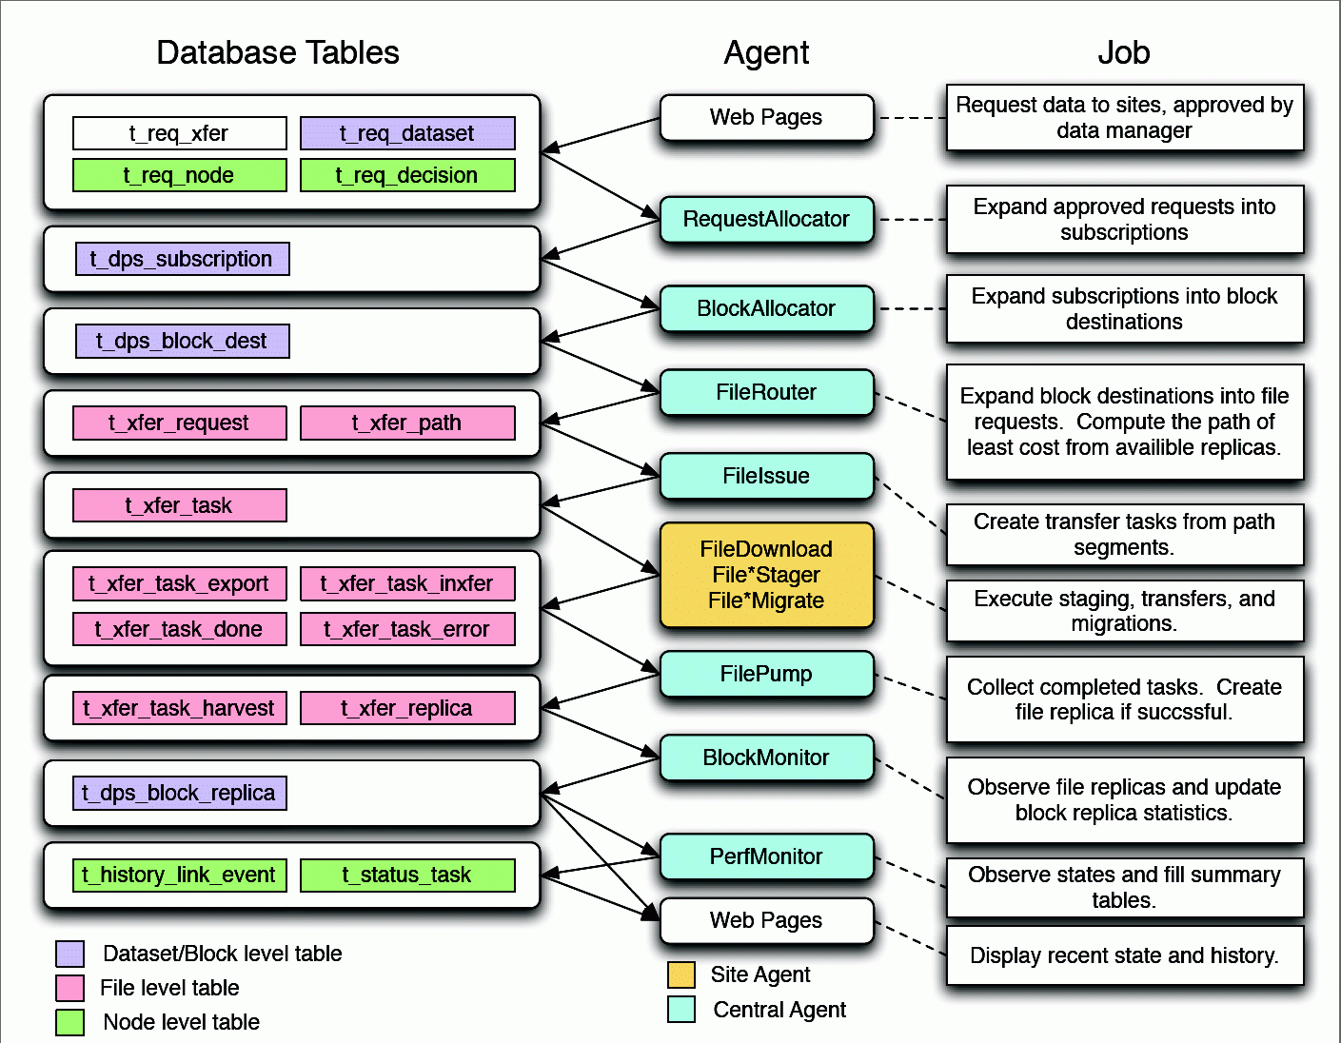

Slide 6
PhEDEx in numbers
~16 million files, transfers >= 200 TB/day
over 100 sites (T0, T1, T2, T3)
Database
  Currently occupies ~50 GB
    Grows at ~2GB/month, likely to continue
    Should be ~linear with data volume
  CPU use moderate
    Should go with active transfer-volume
    Scalability of central agents perhaps our biggest concern

Slide 7
PhEDEx scalability
Performance tested with the LifeCycle agent
  Custom test-agent drives accelerated lifecycle
  Verifies schema, agents, at >10x ‘today’ levels
  Maintain confidence that we are >1year away from (known) problems
  Identify problematic SQL or agent behaviour early
    Increasingly find bottlenecks are in the agents, not the DB
  Useful for testing new DB hardware (11gr2)

Slide 8
T0AST
Tracks files, batch jobs, & metadata
Drives the T0 processing and data-handling
Fed by information from several sources
  Cessy -> Meyrin transfer system injects files
  StorageManagerDB & PopConLogDB trigger the T0 to start processing
  ConfDB provides HLT/trigger/dataset mapping
Injects data into PhEDEx and DBS

Slide 9
Prevent inconsistent DB states
  Expected software crashes, batch failures, transfer problems,
  Esp. in early days, but can happen at any time
  SQL-surgery should not become the norm
Designed to crash and fail quick and clean
  Fix problem at source, restart the crashed component
    Largely successful with this strategy
T0Mon, data-service for monitoring
  Used inside & outside the T0 (express visualisation…)

Slide 10
Small number of clients
  But very active on the database!
Periodically backup and wipe the DB
  No need to maintain history
  4th iteration in 2 years
    25 GB at last cleansing. 7 GB in 3 weeks since
Test schema by replays on separate instance
  Also test schema-evolution, SQL optimisation
    Rely on Oracle stats for guidance
Schema stable, no major changes foreseen
  Expect client-code to evolve more than schema

Slide 11
Driven by data-rate
  Bandwidth, but also rate of files
    0.6M files per day during running (0.5M from detector)
    15K files per day output to PhEDEx and DBS
  Processing reduces file-rate
Number of primary datasets => #workflows
  Increases complexity, volume of metadata
Row-churn
  Metadata updates with high turnover
  Caching cannot help
Table-growth, slows down queries over time
  Optimise for recent data, helps, but not perfect

Slide 12
DBS
Catalogue of all CMS data
  How it was produced, what it contains
  Starting point for data-discovery for physicists
  85 thousand datasets, 18 million files
Interacts with…
  SiteDB for user auth, PhEDEx for block-location
  DAS (WMAgent) for MC production & reprocessing
    Accounts for 2/3 of current activity
  CRAB for user-analysis jobs

Slide 13
DB is ~200 GB
  Will grow ~linear with data-volume
  Need to maintain history
    Never delete information from DBS
Variable workload, factor 10 or more
  Clients distributed everywhere around CMS
  Work-cycles come and go (MC, real data)
  Difficult to set performance targets

Slide 14
Schema migration non-trivial
  Currently in the middle of a major re-design
    DBS2 => DBS3
  Needs integration with several client tools
  Re-deployment of many DM/WM components simultaneously
DBS3 testbed ‘soon’
  Run validation, scale, performance tests
  Integration tests with clients
  Query-optimisation, well advanced
  Release data contingent on outcome of tests,
    Reasonable to expect by end of this year

Slide 15
Summary
PhEDEx:
  Mature, slow evolution of schema
  Can test schema under realistic circumstances
T0AST:
  Mature, slow evolution of schema
  Re-initialise to limit size or for schema updates
DBS:
  Major schema update this year, stable after that
  Most visible of the three, less predictable loads

