Slide 1
Database Futures Workshop
6-7 June 2011
Engineering Requirements
GS/ASE

Slide 2
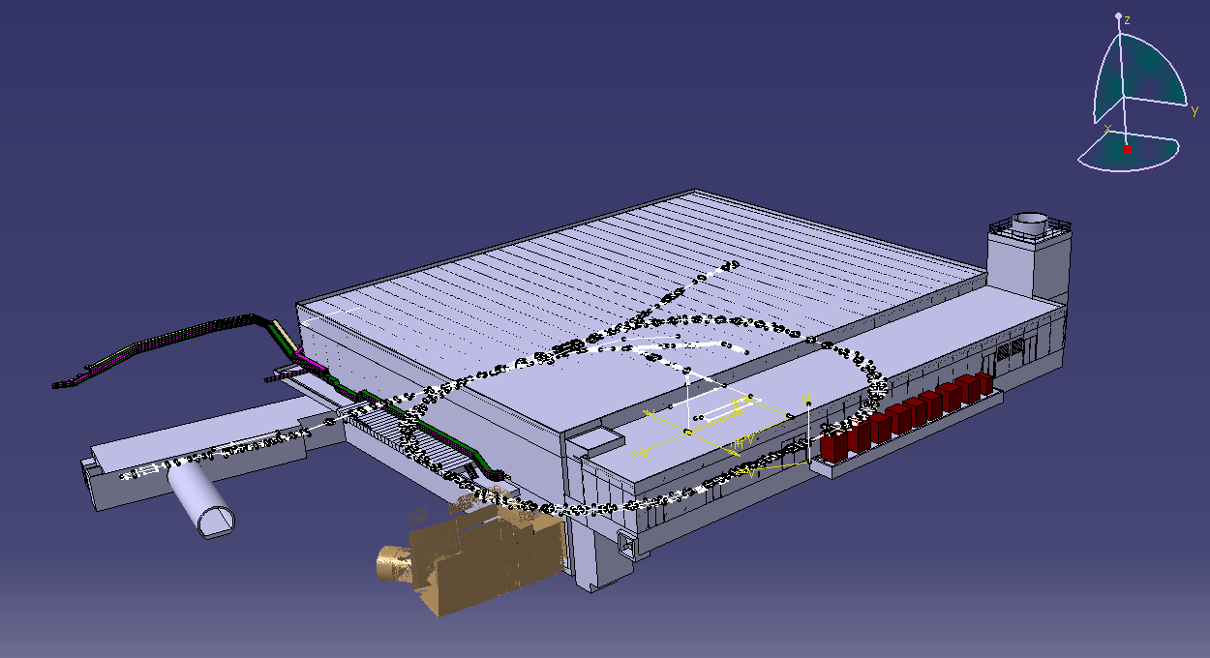
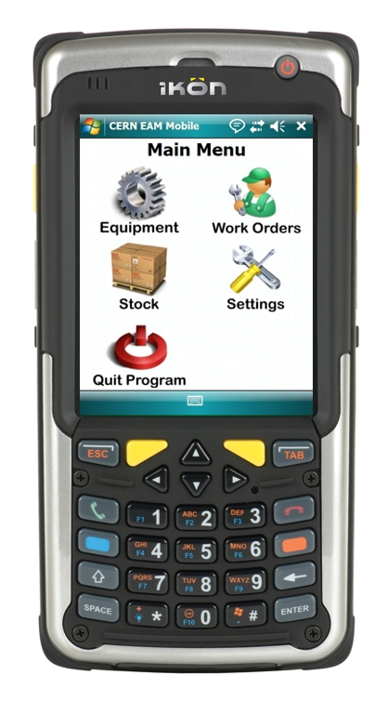
Some Engineering Databases
EDMS
  Several integrated Oracle DBs
    Around 65 Gb
  Mostly based on commercial tools
  1.2 million documents
  1.5 million files – 925 Gb (not in DB)
  9’750 registered users; 4’000 active in 2011
CMMS
  Computerized Maintenance Management
  680’000 assets
  3.3 million work orders

Slide 3
Some Engineering Databases
TIM
  Technical Infrastructure Monitoring
  Linked to the CERN Operation
  35 Gb
  90’000 monitoring points
  37’000 alarms
  2 million updates/day in the database

Slide 4
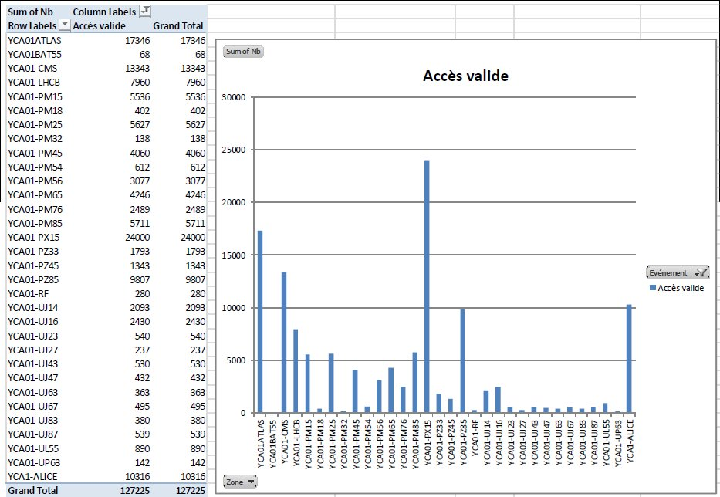
Some Engineering Databases
Access Control Systems
  Site Access
  PS, SPS, LHC Access
    Linked to beam operations
  Site and LHC Access Control Systems on Oracle
    27 Gb

Slide 5
Requirements
EDMS, CMMS
  Availability 24/24 365 days (no Xmas shutdown)
  A few hours of downtime however acceptable
  Dependency on the configurations certified by the applications suppliers
    Sometimes unrealistic
  We are on the « General Purpose » instance
    Not really a problem

Slide 6
Requirements
TIM, Access Control
  Availability 24/24 365 days
  A few hours of downtime however acceptable
    But strongly linked to the operation of the machines
  This especially concerns major upgrades
    Such as migration to 11g

Slide 7
Requirements
Special case for new systems around the Site Access
  Key distributors, electronic locks, car sharing, car plate readers, restaurant cards
  Most of the suppliers are working with MS SQL Server
  Our 1st choice is to work with the Oracle version
  We are sometimes forced to work with SQL Server
    Lack of proper interfaces (Web services)
    Even if limited to the minimum, gateways between oracle and SQL Server are required.
    SQL Server Support in IT ?

Slide 8
Thank you for your attention !
Questions ?

