Slide 1
SPS status
Arthur Spierer for the SPS team
20th of July 2023, PS-SPS users meeting

Slide 2
SPS week 29
  Coordinator next week: Michael Schenk
  Coordination meeting on Monday 11.30
  Availability from Thu to Thu: Overall 89%, NA: 89%, HiRadMat: 97.4%
    Beam stop on Wednesday from 8:00 to 10:00 for CV and RF interventions
  SFTPRO
    Requested units starting from Wednesday on T2/T4/T6 : 30/105/45
  HiRadMat
    Smooth run, high intensity extractions on Friday
  No LHC beams since Monday
  Parallel MDs on Monday, Tuesday and Thursday (replacement for previous week)
  Next week
    Short parallel MDs Monday and Tuesday
    Dedicated on Wednesday
    Parallel on Thursday
    Empty bucket Channelling to be put in operation if experts available

Slide 3
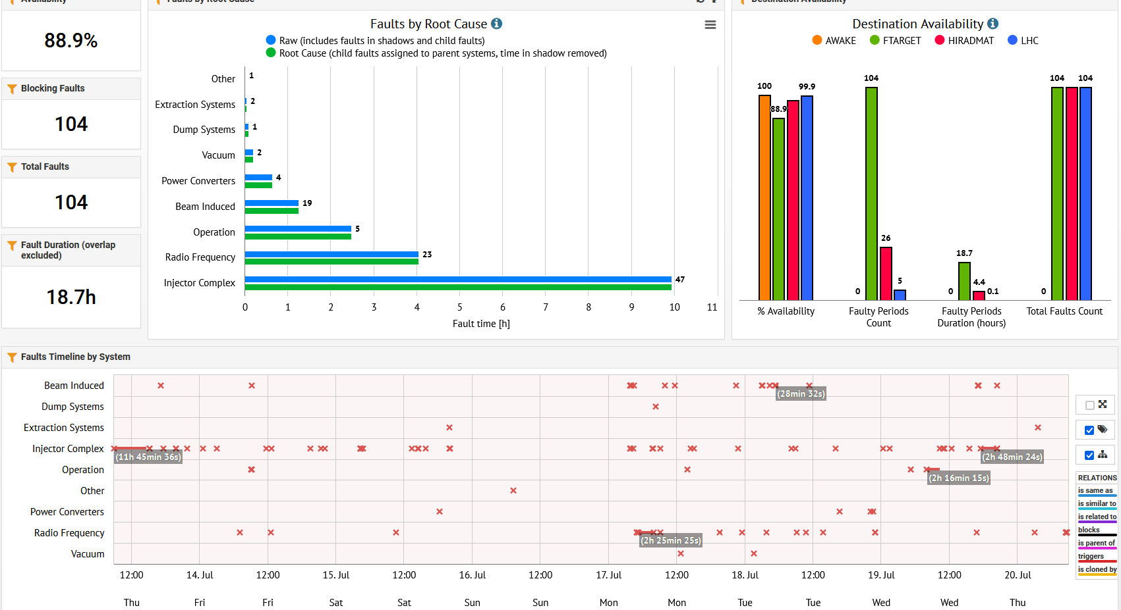
SPS availability overview

