Slide 1
What about your stress?
A tool : Flash disconnection
Katia Schenkel
2023
EDMS reference
Notes:
Hello everyone, and welcome to the first in a series of 3 events in the mental health campaign on stress management.
Why this theme? Stress is the 1st reason for consultation with CERN psychologists. Either it's the main reason, or it's present alongside problems of concentration, performance, sleep, etc.
We wanted to give you the tools you need to better manage the professional situations you face.
After a theoretical introduction to stress, I'll introduce you to a quick tool you can use again and again, called flash disconnection.
The conferences are recorded and will be available on our website if you want to watch them again, or if you want to follow one of the other 2 conferences offline. They complement each other, but can be followed separately.

Slide 2
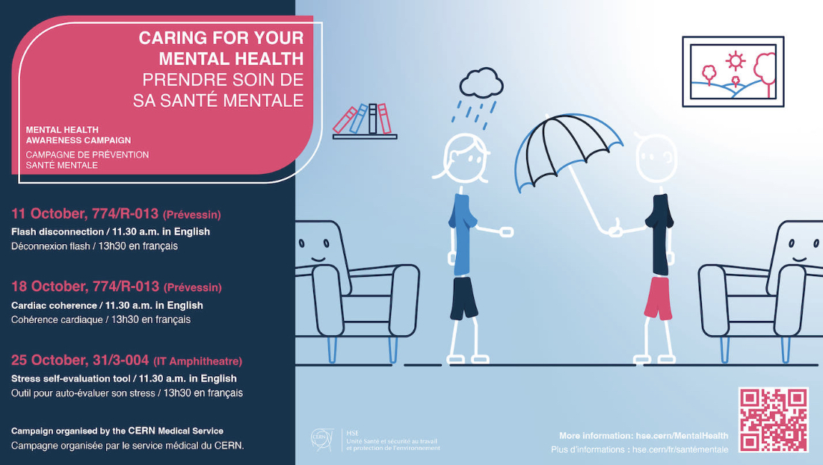

Slide 3

Definitions
Neurobiological, physiological reflex and psychological reaction of adaptation, alarm, mobilisation and defence of the individual confronted with an aggression, a threat or an unexpected situation.
  Focus attention
  Mobilize energy
  Prepare to action
Assessment of the balance between:
  Demand / requirements (actual or perceived)
  Capacities / resources (real or perceived)
Notes:
There are many definitions of stress. Today, I've chosen to present 2 definitions that I find relevant.
The first is more focused on the physical side and the second on the psychological side.
As you can see from the first, there's a lot going on in our bodies during a stressful event. Sébastien will go into more detail on the physiology of stress next week.
Stress is a reaction adapted by our body to cope with the situation, and has the advantage of focusing our attention, mobilizing our energy and preparing us for action. So stress is not something to be fought, but rather dosed and regulated.
The 2nd definition is based more on our assessment of the situation. If we perceive an imbalance, it leads to this imbalance. If I feel that what I'm being asked to do exceeds my resources or capabilities, this will generate stress. I'm going to have to find a way of redressing the balance by acting on the resources (training, help, delegating, etc.) or on the constraints (requesting a deadline, etc.).

Slide 4
Stress
OVERWHELMING STRESS
Limit of tolerability
2. Coping
ADAPTED STRESS
3. release
1. alarm
Baseline
4. recovery
Notes:
This is an adaptation of Seyle's stress model.
This model sees each stress episode in 4 stages.
First, the alarm phase. Ex. the startle when I cross the road and hadn't seen the bike, or when I receive an e-mail from my superior.
Then I put strategies in place to deal with the situation.
There's a relaxation phase, which is more noticeable in the case of major stress, but which is always present (e.g. crying, trembling, severe fatigue, etc.).
The recovery phase. It takes about 90 minutes to evacuate the stress hormone cortisol.
We then return to our baseline.These 4 phases are adapted stress. It's our way of coping with a stressor.
There are 2 main ways of exceeding our stress tolerance limit. A potentially traumatic event (accident, aggression, violent death of a loved one, etc.) or the fact of having several episodes of stress when we haven't recovered our baseline. This is what we call cumulative stress.

Slide 5
Cumulative stress
Causes
Stressers, sometimes minor, frequent, constant, repetitive.
(≠ intense stress)
Professional circle
Private circle
Repercussions
Accumulation of "difficult" events both professional and private
Slow and progressive development
Cumulative stress
Negative consequences
Lack of both physical and psychological recovery
Physical
Psychological
Pre-existing personal vulnerability factors
The fewer opportunities for recovery, the faster the development of cumulative stress!
!
Notes:
There can be several causes of cumulative stress.
An accumulation of stressors, sometimes minor but frequent and repetitive.
An accumulation of difficult events in private and professional life. Lack of physical or psychological recovery. Pre-existing vulnerability.
We can have a single cause or a combination of causes.
A slow, gradual process is then set in motion, culminating in cumulative stress, with negative consequences and repercussions in both professional and private life.
The person is often unaware of this process, and it is sometimes family or colleagues who spot it.

Slide 6

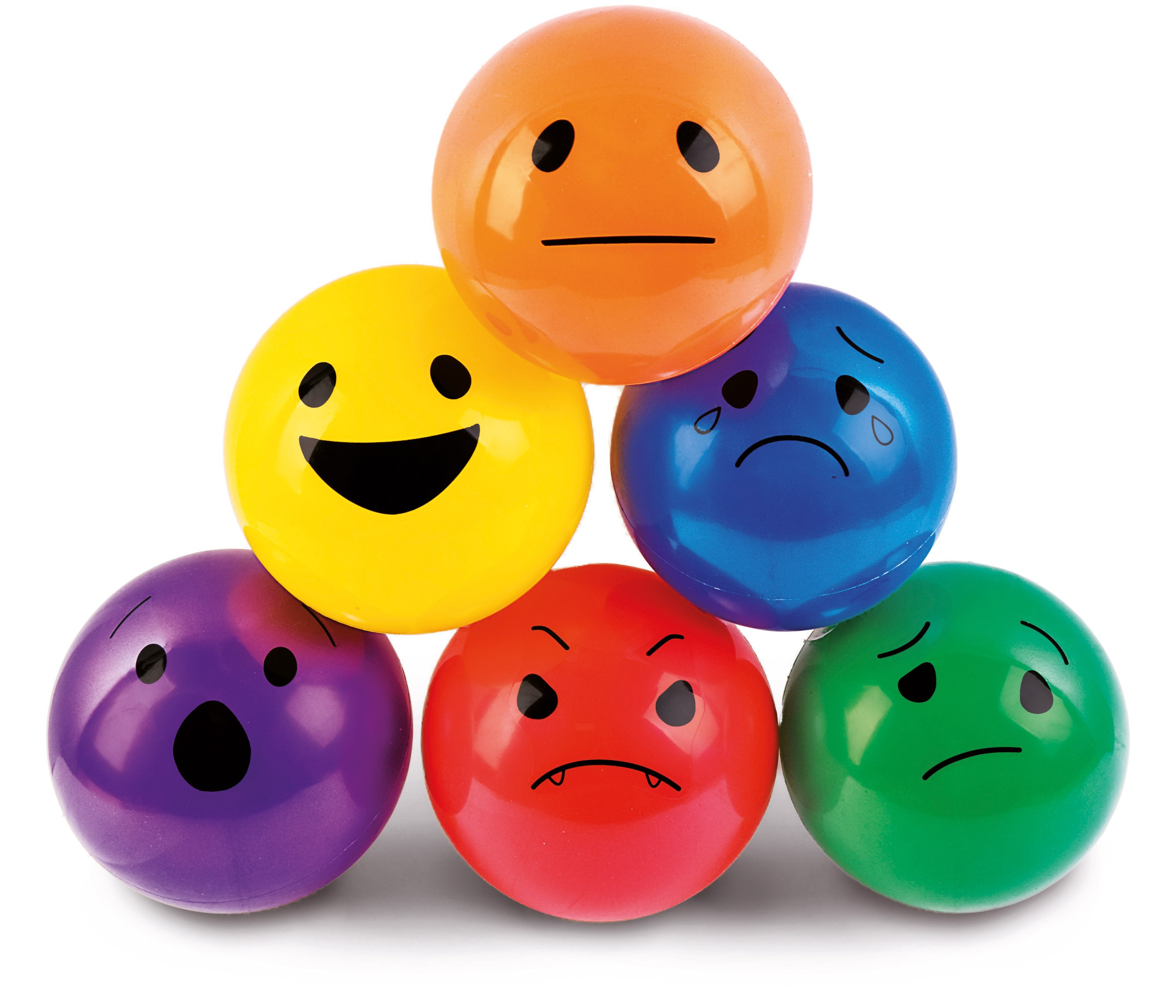


Stress signals
Physical
E.g. Headache, tiredness, sweating, sleep issues, palpitations, vertigo, digestive issues, …
Psychical
Emotional
E.g. Irritability, general insatisfaction, pessimism, lack of self trust, distress, …
Psychological
E.g. Lack of concentration, memory lapses, indecisiveness, limited or short-term perspective, difficulty in accepting novelty, …
Behavioral
E.g. Altered communication, conflicts, isolation, loss of performance, absences, workaholism, …
Notes:
A key point in this mechanism is self-awareness and the identification of stress signals.
This self-assessment is important because it will then enable you to put countermeasures in place.
Maria will go into more detail on these points in 2 weeks' time.

Slide 7
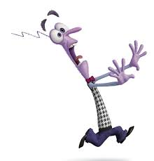



Reactions to a threat (Laborit)
FLIGHT
FREEZE
FIGHT
These are an individual's automatic reactions to cope with aggressions that disrupt their natural balance.
Notes:
Faced with a threat, we have 3 ways of reacting: the 3Fs
These are automatic reactions to aggression or the perception of aggression.
In situations where our lives are not directly in danger, this can manifest itself as: the urge to leave a meeting, to change departments, to get stuck in a conversation about a task because we don't know how to carry it out, or because it involves too much pressure. Or irritation over little things.
These reactions are signs that I feel in danger, and it's important to identify them in order to deal with the situation.
In general, our system will prefer flight or fight, and if neither of these strategies is possible, we'll freeze.

Slide 8
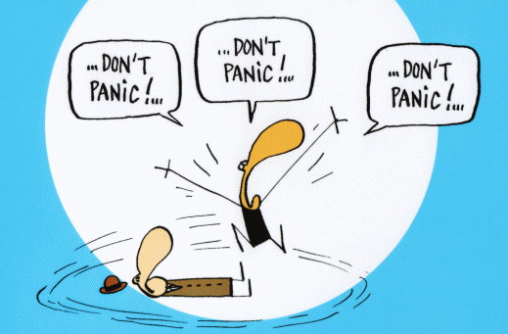
Good practices
Mix et Remix
Notes:
In Part 2, we'll look at a few tools or models that can help you manage stress and distance yourself from certain situations.

Slide 9
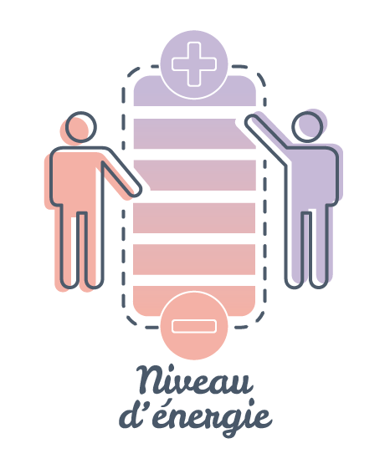
Self-assessment of stress/energy levels
Carrying out this assessment helps to :
Prevent stress contagion
Implement counter-measures
Maintain a feeling of psychological security
Energy level
Notes:
When we talk about stress, we often talk about its impact on sleep or the energy it takes from us and the fatigue it causes.
Take the image of a telephone battery.
If it's full, I can surf the web, answer messages and make phone calls without any problem.
If I've only got one bar left, I'll have to make choices and prioritize.
If the phone goes dead because I haven't recharged it first, even if it's plugged in, it's going to take a long time to come back on.
This is one of the foundations of cumulative stress and stress management.This self-assessment helps prevent stress contagion, implement countermeasures and maintain a sense of security.

Slide 10
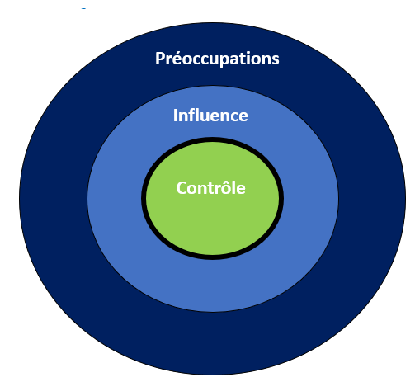
Focus on what you can control
What are my means of action?
  My zone of influence?
  Countermeasures?
(Stephen, R. Covey)
Notes:
We often waste a lot of energy and mental energy on things we can't change.
This model of the 3 circles can help us identify the areas over which we have power to act and focus on them.
The first circle is the circle of control. It's entirely up to us. What I do, what I say...
The second circle is the circle of influence. I can act, but not everything is in my hands and depends on someone else. I can ask for something, and it may be to accept or refuse. What's certain is that if I don't ask, nothing will happen, but by asking I don't know the outcome.
The third circle is that of concern. As we can see, it's a long way from the control circle, and depends on factors outside my control.
When I'm in this circle, I have to ask myself one question:
Is it in my power or not?
If not, what can I do, what's in my hands, to return to my circle of control and reduce stress and feelings of powerlessness.
Flash disconnection and the breathing techniques we're going to look at now can be useful tools for this.

Slide 11
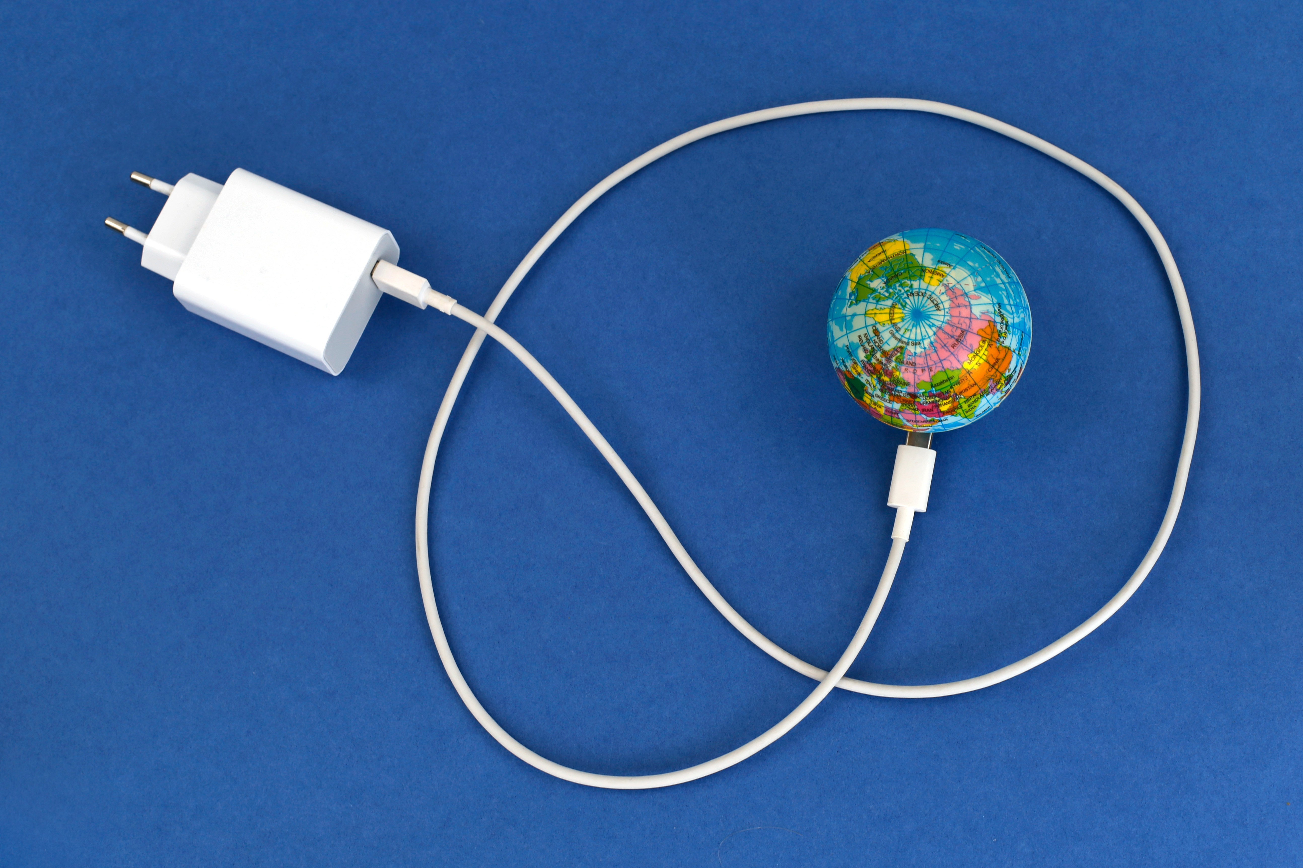
Flash Disconnection
Notes:
This method stems from the potential optimization techniques created by Dr. Edith Perreault Pierre in the French army to help soldiers manage stress and recover.

Slide 12
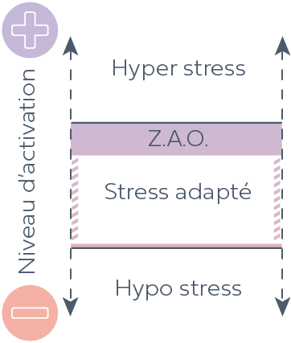
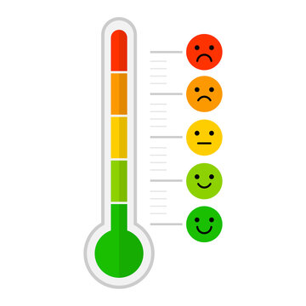
Step 1: Evaluate your activation level / Internal weather forecast
10
Hyperstress
7
Activation level
Adapted Stress
4
Hypostress
0
Notes:
Step 1: Take stock of your current weather.
Are you in your adapted stress zone?
Hypostressed? In other words, a little tired or sluggish in relation to your current activity?
Hyperstressed? In other words, over-activated in relation to your current activity.
Take 1 minute either to make the assessment on the barometer or to calculate it on the other chart.

Slide 13
Breathing techniques
Notes:
We're going to do a few breaths before the technique.
I'll explain them to you and you can choose the one that suits you best.
Square breathing. Take the same amount of time for each phase. Inhale, hold, exhale, hold.
Triangle breathing. Inhale, hold, exhale. Always with the same rhythm.
Relaxed breathing. I breathe in on 1 or 2 beats and breathe out longer on 4, 5 or 6 beats.
You choose the one that speaks most to you and take 3-4 breaths at your own pace.

Slide 14
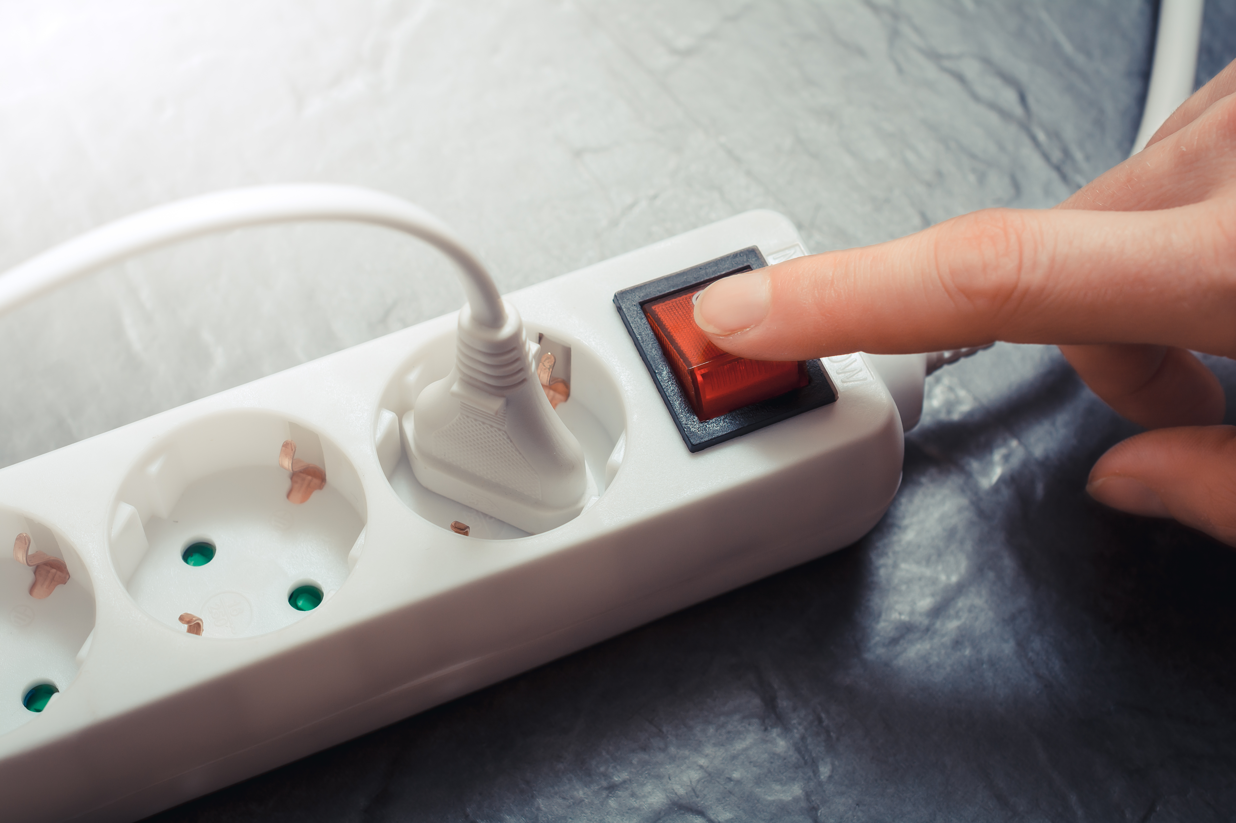

Step 2: Let yourself be guided
Octobre 2023
Notes:
First, you're going to pick up an object you have in front of you.
It could be a pen, a sheet of paper, a watch, your hand...
You’re now going to put yourself in a state of curiosity. As if you were seeing the object for the 1st time. As if you were abroad and had never seen it before.
You're going to look at it from every angle, its size, length, colors, shapes. Is there anything written on it? Are there any signs of wear?
Once you've had a good look, close your eyes and do the same with your fingers. What's the object's temperature? Is it smooth or rough, and what is its texture? Are there things you're discovering now that you hadn't seen before?
Does this object make a noise when I handle or tap it?
Does it smell? Pleasant? Unpleasant?If I had to imagine a taste for this object, what would it be?
And you can open your eyes again

Slide 15
Step 3: Evaluate your activation level / Internal weather forecast again
10
Hyperstress
7
Activation level
Adapted Stress
4
Hypostress
0
Notes:
You do a weather check or re-evaluate your activation level compared to before exercise.
Is it the same? Has anything changed? What have I noticed in my thoughts as a result of this exercise?
In general, it helps us to focus. It helps us to stay in the present moment, and to disconnect from stress or strong emotion fairly quickly.

Slide 16

Tool basics
Deep breathing:
  Reduces cortisol levels
  Improves sleep quality
Visualization reduces anxiety and stress
Notes:
Research has shown interesting results for this type of tool.
Deep breathing has been shown to reduce cortisol levels in the body and increase sleep quality and speed to sleep.
Visualization lowers anxiety and stress levels

Slide 17
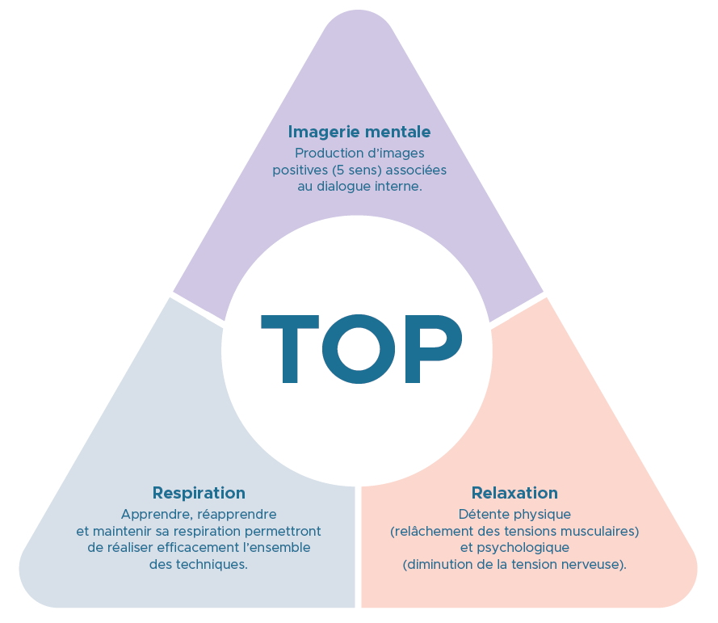
Potential Optimization Techniques presentation
A set of mental techniques and strategies that enable each individual to mobilize his or her psycho-cognitive and physiological resources to best effect, depending on the situation.
Developed for and by the French Army
  Objective: give soldiers the tools to manage stress, promote recovery and operational efficiency
Today used in companies to :
  Manage stress and Recovery
Notes:
This tool stems from the potential-optimization techniques created by Dr. Edithe Perreault Pierre and now used in sport and business.
These techniques are based essentially on breathing, relaxation, mental imagery and internal dialogue.

Slide 18
Conclusion
Stress is one of the psychosocial risks that have a significant impact on the health of employees
  The risk of cumulative stress is increased in the current situation (post-pandemic)
It is essential to evaluate it for yourself
There are preventive measures to act on stress and cumulative stress
The medical service and psychologists are available to discuss it
Notes:
First and foremost, it's essential to assess our own stress levels.
It is this self-knowledge and self-assessment that will enable us to take action and implement the right tools to manage our stress and limit the negative consequences of chronic stress.

Slide 19



If you need primary care, advice or support
We are here for you!
  Building 57
  Monday – Friday
  8.00 - 12.30 | 13.30 - 17.00
Ground floor
- Infirmary: for anyone on the CERN site
1st floor
- Psychologists: for MPE & MPA
- Occupational Health Medicine: for MPE & students

