Slide 1
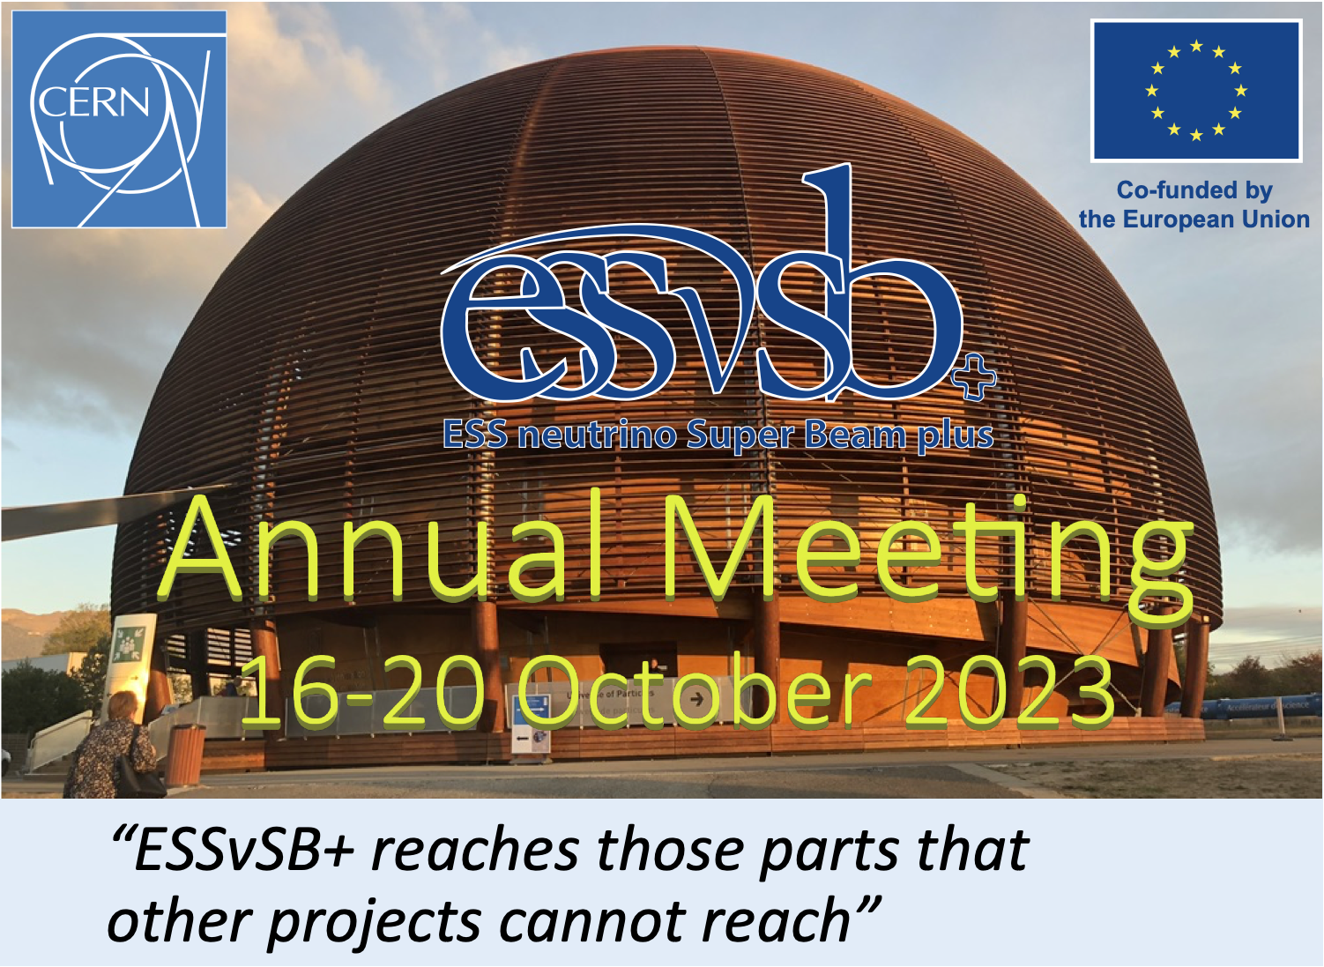
Marcos Dracos

Slide 2
Agenda
 | Monday (16/10) | Tuesday (17/10) | Wednesday (18/10) | Thursday (19/10) | Friday (20/10)
Morning | Arrival | Neutrino platform Invited talk: The making a large underground LArgon Detector for the DUNE experiment - engineering aspects and challenges (Lluis Secundino Miralles Verge) | Plenary session: Visit to Super-K and Hyper-K (T. Ekelof) Zinkgruvan mine and ESSnuSB (D. Saiang) WPs sessions | Plenary session: Neutrino-Nucleus cross section modelling at the low energy regime: Theoretical overview (N. Jachowicz) WPs (summary and future plans) discussion | Governing Board (+IAP preliminary report, open session)
Afternoon | Plenary session introduction Status of ESSnuSB+ Present and future studies with LHC neutrinos (Jamie Boyd) WPs (status report) | WPs sessions Dinner | WPs sessions | IAP (closed) DEB (open session)
https://indico.cern.ch/event/1309436/overview
+photo (when?)

Slide 3
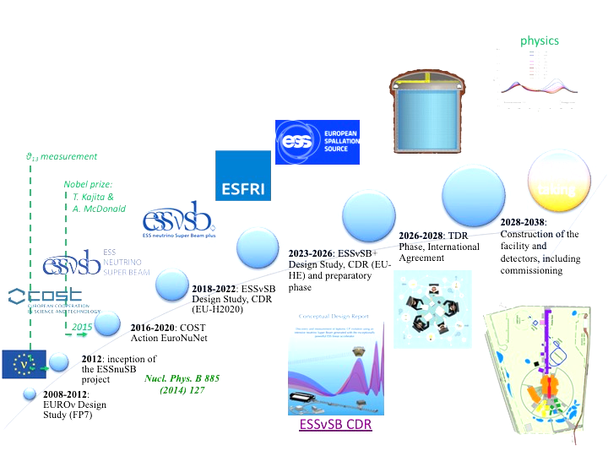
A bit of history for all new members

Slide 4

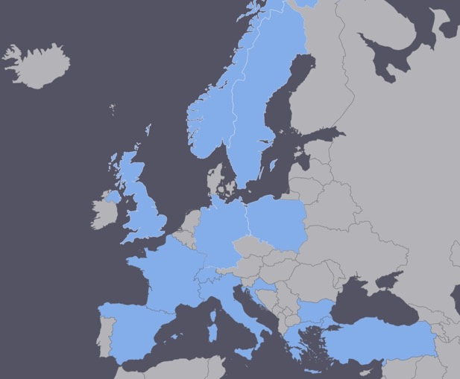
Lepton CP Violation at the European level
COST application for networking has been succeeded: CA15139 (2016-2020)
  EuroNuNet : Combining forces for a novel European facility for neutrino-antineutrino symmetry violation discovery (http://www.cost.eu/COST_Actions/ca/CA15139)
  Major goals of EuroNuNet:
    to aggregate the community of neutrino physics in Europe to study the ESSνSB concept in a spirit of inclusiveness,
    to impact the priority list of High Energy Physics policy makers and of funding agencies to this new approach to the experimental discovery of leptonic CP violation.
  13 participating countries (network still growing).

Slide 5
ESSνSB at the European level
A H2020 EU Design Study has been submitted end of March (Call INFRADEV-01-2017)
Title of Proposal: Discovery and measurement of leptonic CP violation using an intensive neutrino Super Beam generated with the exceptionally powerful ESS linear accelerator
Duration: 4 years
Total cost: 4.7 M€
Requested budget: 3 M€
15 participating institutes from
11 European countries including CERN and ESS
6 Work Packages
Decision: end of August
ESSνSB
BENE (2004-2008)
ISS (2005-2007)
EUROν (2008-2012)
LAGUNA (2008-2010)
LAGUNA-LBNO (2010-2014)
COST Action CA15139 (2015-2019)

Slide 6
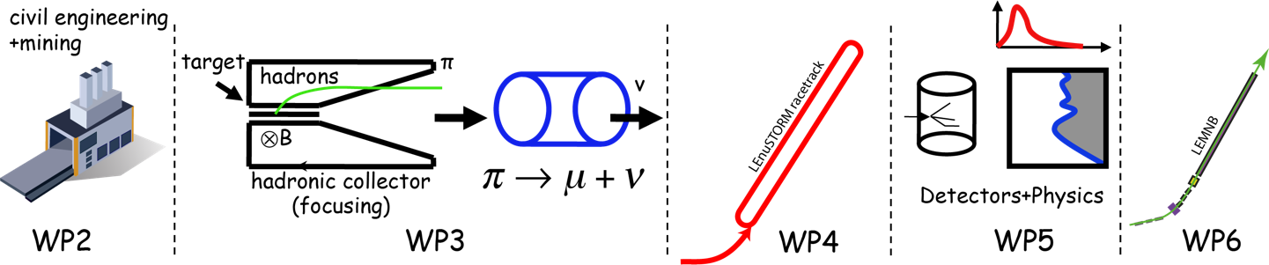
And now ESSνSB+
EU Design Study has been submitted end of April (HORIZON-INFRA2022-DEV-01)
Title of Proposal: Study of the use of the ESS facility to accurately measure the neutrino cross-sections for ESSνSB leptonic CP violation measurements and to perform sterile neutrino searches and astroparticle physics
Duration: 4 years
Total cost: 5 M€
Requested budget: 3 M€
20 participating institutes from
11 European countries including CERN and ESS
6 Work Packages

Slide 7
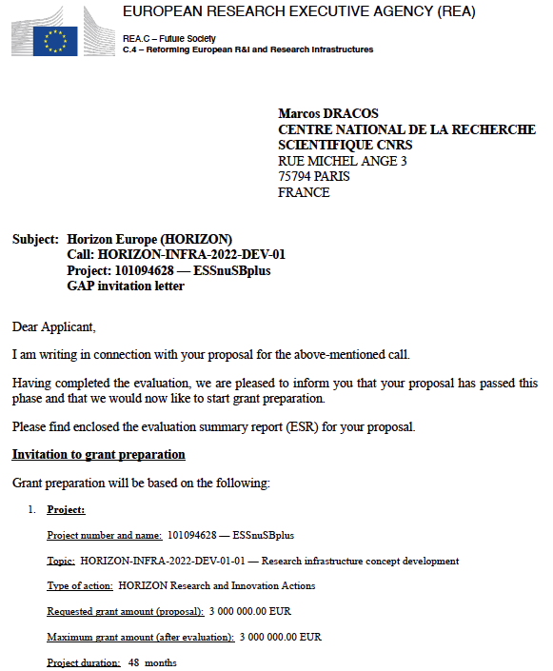
Design Study ESSνSB+
approved!
Project: 101094628 - ESSnuSBplus

Slide 8
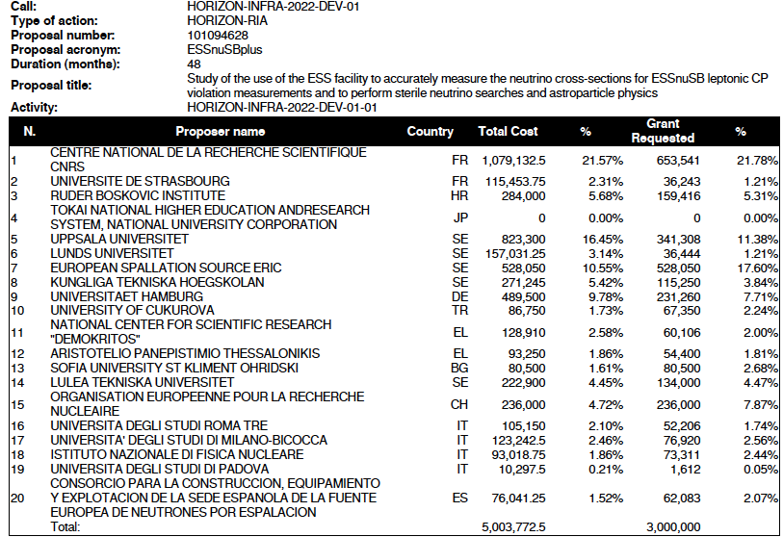
Proposal Evaluation Form

Slide 9

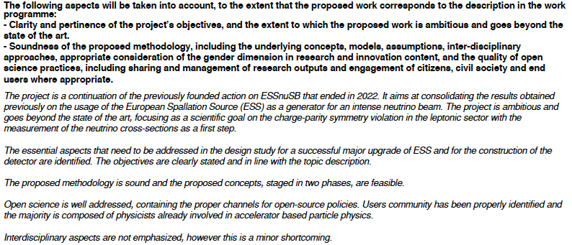
Evaluation Summary Report
/15

Slide 10
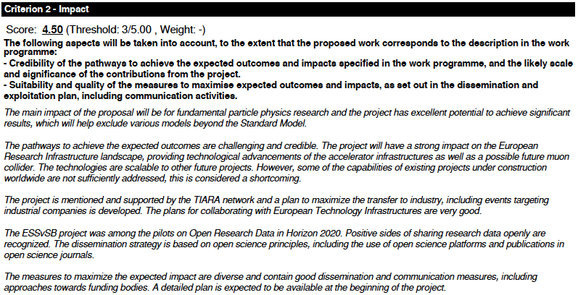
Evaluation Summary Report

Slide 11
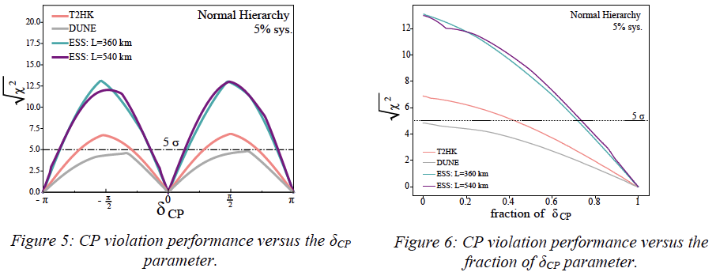
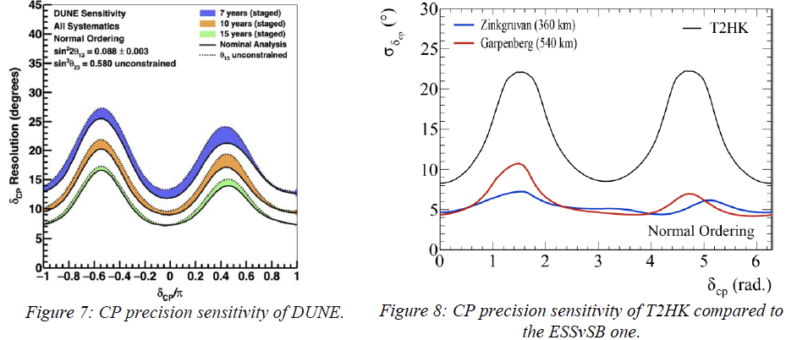
Evaluation Summary Report
included in the submitted project

Slide 12
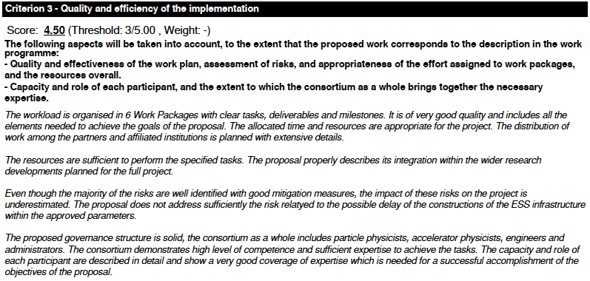
Evaluation Summary Report

Slide 13
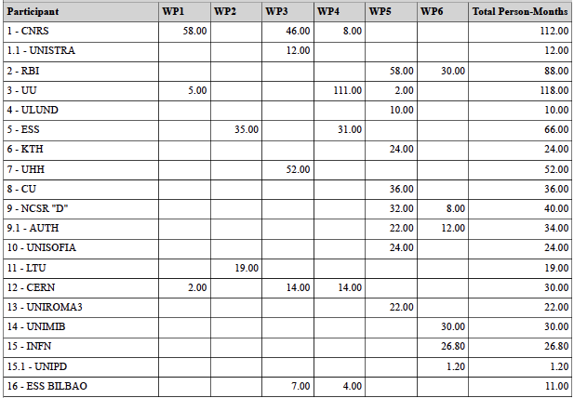
Project Effort in person-months

Slide 14
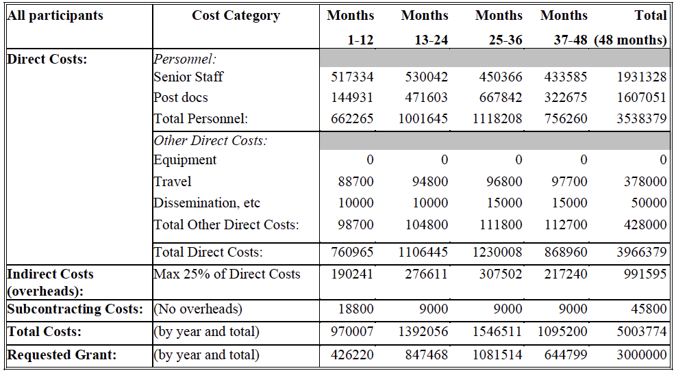
Project Budget

Slide 15
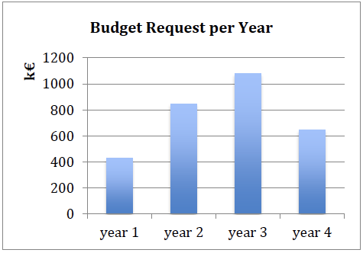
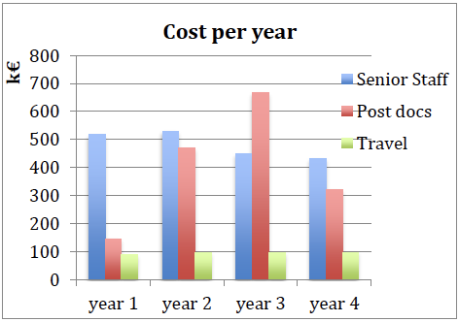
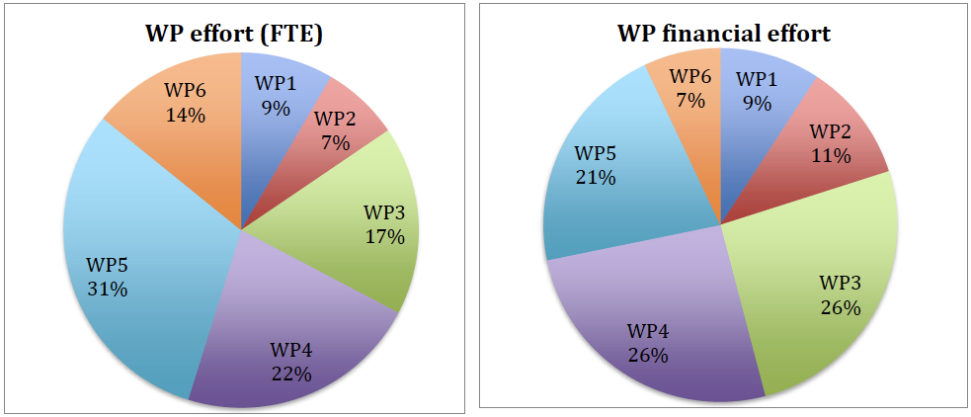
Project effort per year
Expenditure profile of the EC requested budget per year.
Cost per year for senior staff, postdocs and traveling.

Slide 16
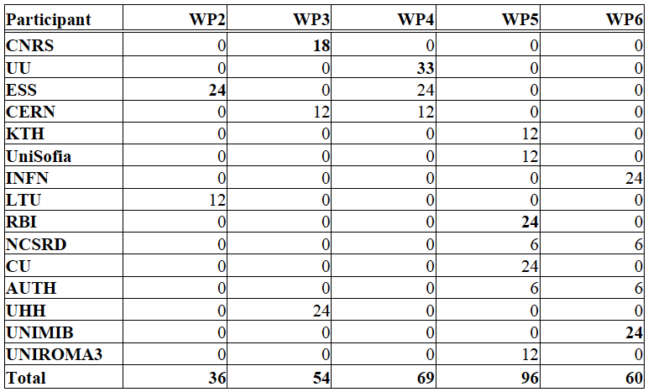
Official Post-doc list
(person-months)
Total: 315 months
~13 two-years postdocs

Slide 17
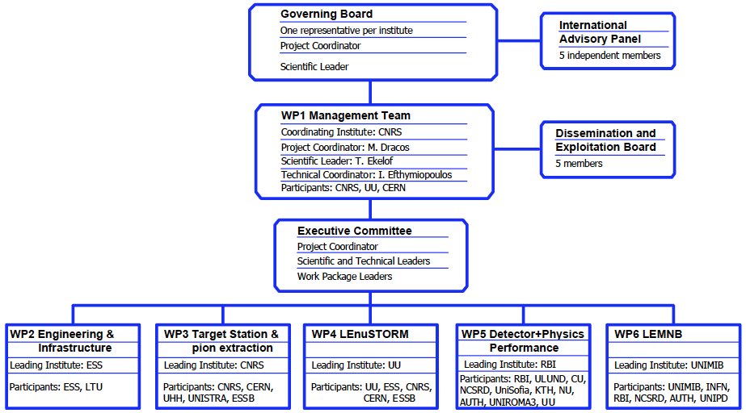
ESSνSB+ Structure
ESFRI task force
6 members
+Carole Mabrouk

Slide 18
Project Administration
Grant Agreement
  Signed in December
Consortium Agreement
  internal document, required by EU
  signed by all members during Spring
All documents can be found on DocDB
  private part (xxxxx / yyyyyy): https://essnusb.eu/DocDB/private/DocumentDatabase
  public part: https://essnusb.eu/DocDB/public/DocumentDatabase
Our web-site: https://essnusb.eu
EU: https://cordis.europa.eu/project/id/101094628

Slide 19
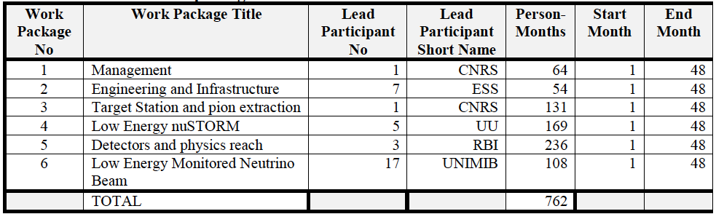
Work Packages

Slide 20
Appointment of the Work Package Coordinators
WP2: Engineering and Infrastructure: leading institute ESS
  Coordinator: Nick Gazis
  Co-coordinator: David Saiang
WP3: Target Station and pion extraction: leading institute CNRS
  Coordinator: Eric Baussan
  Co-coordinator: Tamer Tolba
WP4: Low Energy nuSTORM: leading institute UU
  Coordinator: Maja Olvegard
  Co-coordinator: Natalia Milas
WP5: Detectors and physics reach: leading institute RBI
  Coordinator: Budimir Klicek
  Co-coordinator: Monojit Ghosh
  (Contact for CERN Cherenkov activities?)
WP6: Low Energy Monitored Neutrino Beam: leading institute UNIMiB
  Coordinator: Francesco Terranova
  Co-coordinator: Andrea Longhin

Slide 21
DEB Members
+ PC and SL
5 members
  Colin Carlile (Lund)
  Tamer Tolba (Chair, Hamburg U.)
  Elian Bouquerel (CNRS)
  George Fanourakis (Demokritos)
  Natalia Milas (ESS)

Slide 22
International Advisory Panel
Composed of 5 international experts,
Gives recommendations:
  on the crucial technical choices according to the international context,
  on the distribution of resources to comply with priorities,
  on activity planning.
It will meet once per year (every ESSνSB+ annual meeting).
  give a first report to the GB
  written report two months after

Slide 23
International Advisory Panel
Gerardo d’Auria, Elettra, Sincrotrone Trieste, Italy,
  ~Civil engineering / WP2
Teppei Katori, Dept of Physics, King’s College London, UK,
  ~Cross-sections / WP5 + WP6
Yong Joong Lee, Target Systems R&D, Second Target Station, Oak Ridge National Laboratory, USA,
  ~Target station / WP3
Livia Ludhova, Jülich Forschungszentrum, IKP-2 Neutrino Group, Germany,
  ~Detectors / WP5 + WP6
Shinji Machida, STFC, ISIS Neutron and Muon Source, UK,
  ~Accelerator / WP4
Up to them to define their organisation...

Slide 24
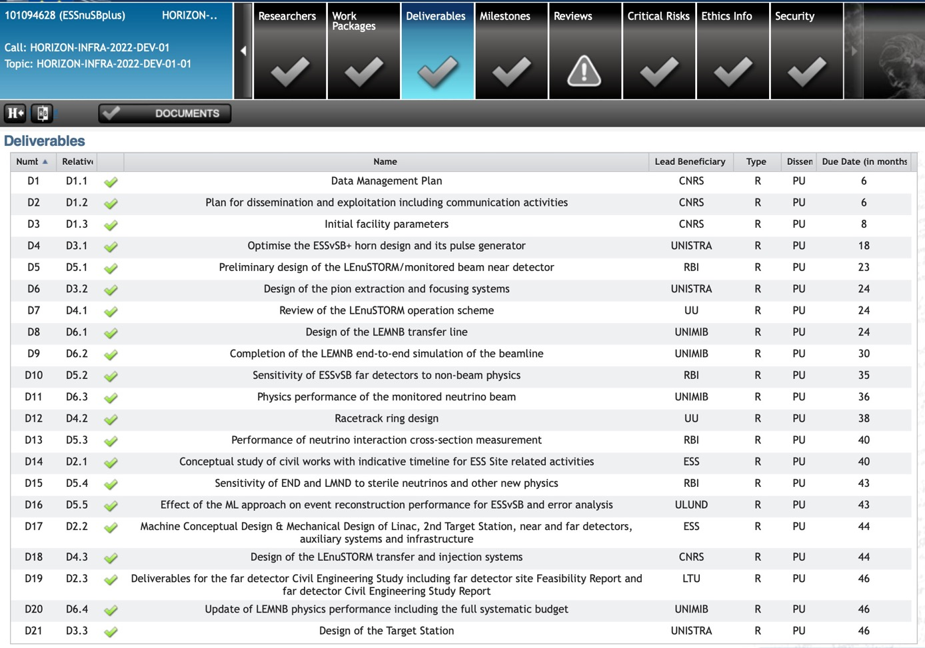
Deliverables
delivered

Slide 25
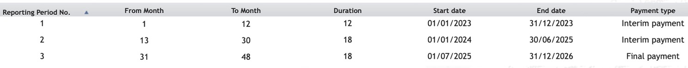
Reporting Periods
for ESSnuSB+:
Three parts:
Financial (administration)
Technical (WPs)
New: Policy brief (2-pages):
  Implementation of RI
  Access to RI
  Funding of RI
  International cooperation of RI
  Employment and skills in RI
  Greening of RI
  Interaction of RI with industry
  ERIC legal framework
  Technology development, data and digital services, digitalisation
  Level of connection of RI to European Open Science Cloud
  Contribution to other research areas and to broader EU priorities
  Sustainability of RI

Slide 26
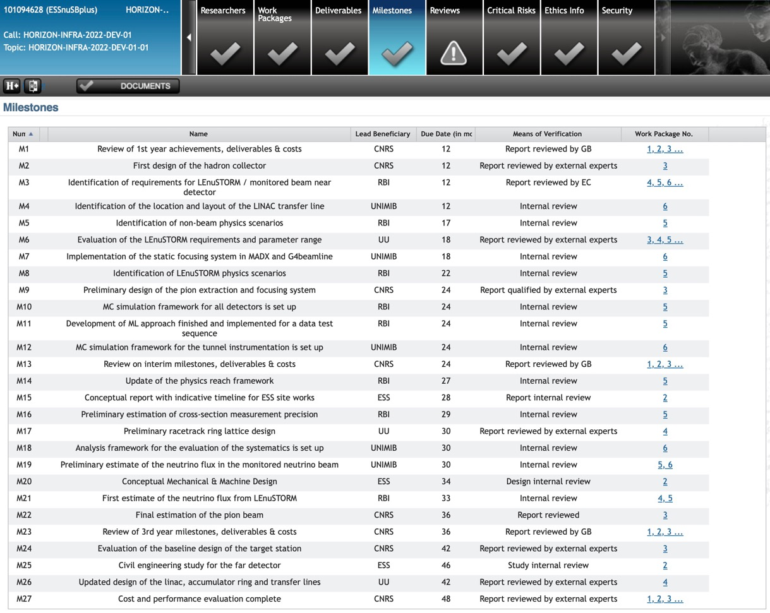
Milestones

Slide 27
Meetings
(from CA)
 | Ordinary meeting | Extraordinary meeting
Governing Board | At least once a year | At any time upon written request of the Executive Committee or 1/3 of the Members of the Governing Board.
Executive Committee | At least 3 times per year | At any time upon written request of any Member of the Executive Committee.
Management Team | At least 6 times per year | According to needs.
International Advisory Panel | Once per year | Upon request of the Governing Board.
Dissemination and Exploitation Board | At least 3 times per year | Upon request of the Governing Board.

Slide 28
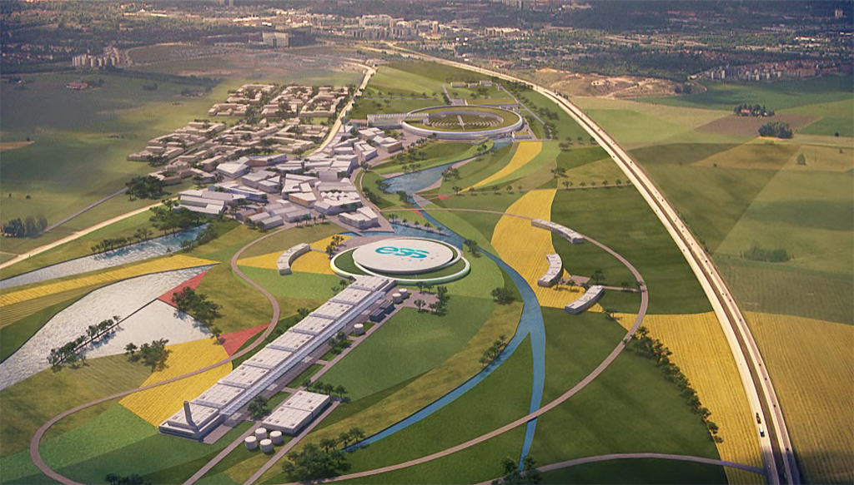
Backup

Slide 29
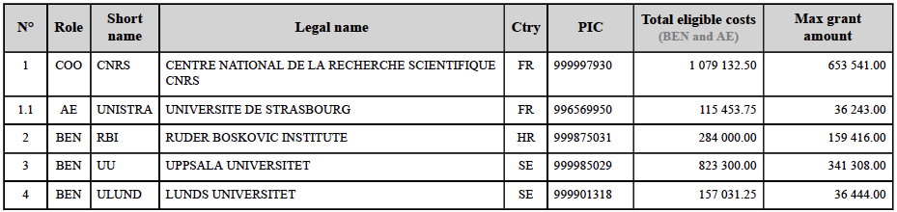
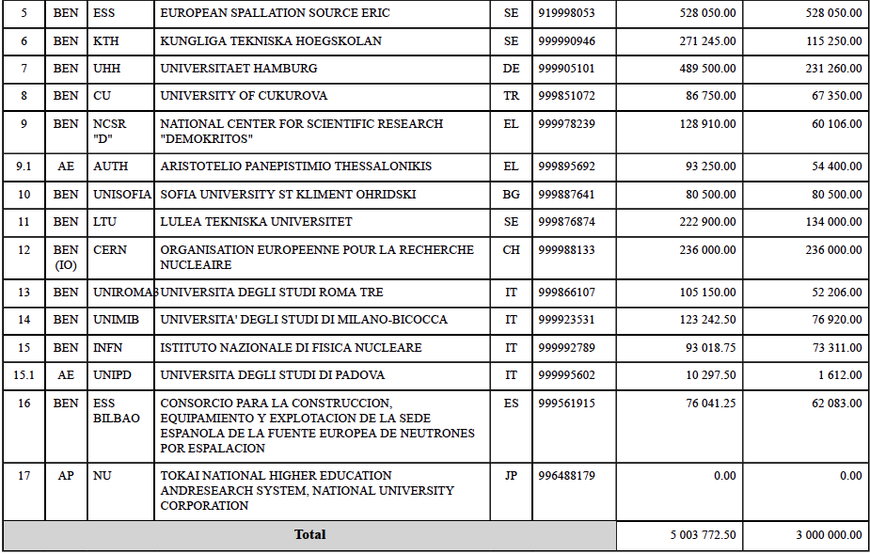
Project Budget per institute

