Slide 2
ESSnuSB+ First Annual Meeting
WP2+ Engineering & Infrastructure
Status Report
PRESENTED BY Nick Gazis
on behalf of Work Package 2+
Nick Gazis, David Saiang, Mamad Eshraqi, Dawid Patrzalek, Emmanouil Trachanas, Andrea Bignami, Michail Anastasopoulos, jean-Michel Lagniel, Rasmus Johansson, Boris KiLdetoft, Natalia Milas

Slide 3
Agenda for WP2+ session on Wednesday 18 Oct.
1 Introduction – Nick Gazis
2 Physics Requirements & Input – Mamad Eshraqi
3 SPIRAL2 Construction Management at GANIL – Jean Michel Lagniel
4 ESS civil engineering & licensing – Boris Kildetoft
5 Costing considerations & licensing – Dawid Patrzalek
6 Design & model updates – Emmanouil Trachanas
7 ETHEL tests & lab possibilities at ESS MML – Andrea Bignami
8 Far Detector civil engineering & licensing – David Saiang
9 Discussion

Slide 4
WP2+Engineering & Infrastructure
Members, roles & contact info
WP2+ New IAP Member: Gerardo D’Auria gerardo.dauria@elettra.eu
WP2+ Leader & ESS site responsible: Nick Gazis nick.gazis@ess.eu
Deputy WP2+ Leader & Far Detector site responsible: David Saiang david.saiang@ltu.se
Overall ESSnuSB+ cost responsible & licensing: Dawid Patrzalek dawid.patrzalek@ess.eu
Civil design & licensing for the ESS site: Boris Kildetoft boris.kildetoft@ess.eu
ESS site design, EL infra responsible & MoM Admin: Emmanouil Trachanas emmanouil.trachanas@ess.eu
Model & CAD design responsible: Michail Anastasopoulos michail.anastasopoulos@ess.eu
(with support from Rasmus Johansson rasmus.johansson@ess.eu)
ESS MML lab tests & measurements responsible: Andrea Bignami andrea.bignami@ess.eu
Physics requirements & input: Mamad Eshraqi mamad.eshraqi@ess.eu & Natalia Milas natalia.milas@ess.eu
(with support from Jean-Michel Lagniel jean.michel.lagniel@gamil.fr)
Administration, Legal, Grants & Collaboration admin responsibles:
Adrameh Gaye adrameh.gaye@ess.eu & Martha Dadson martha.dadson@ess.eu

Slide 5
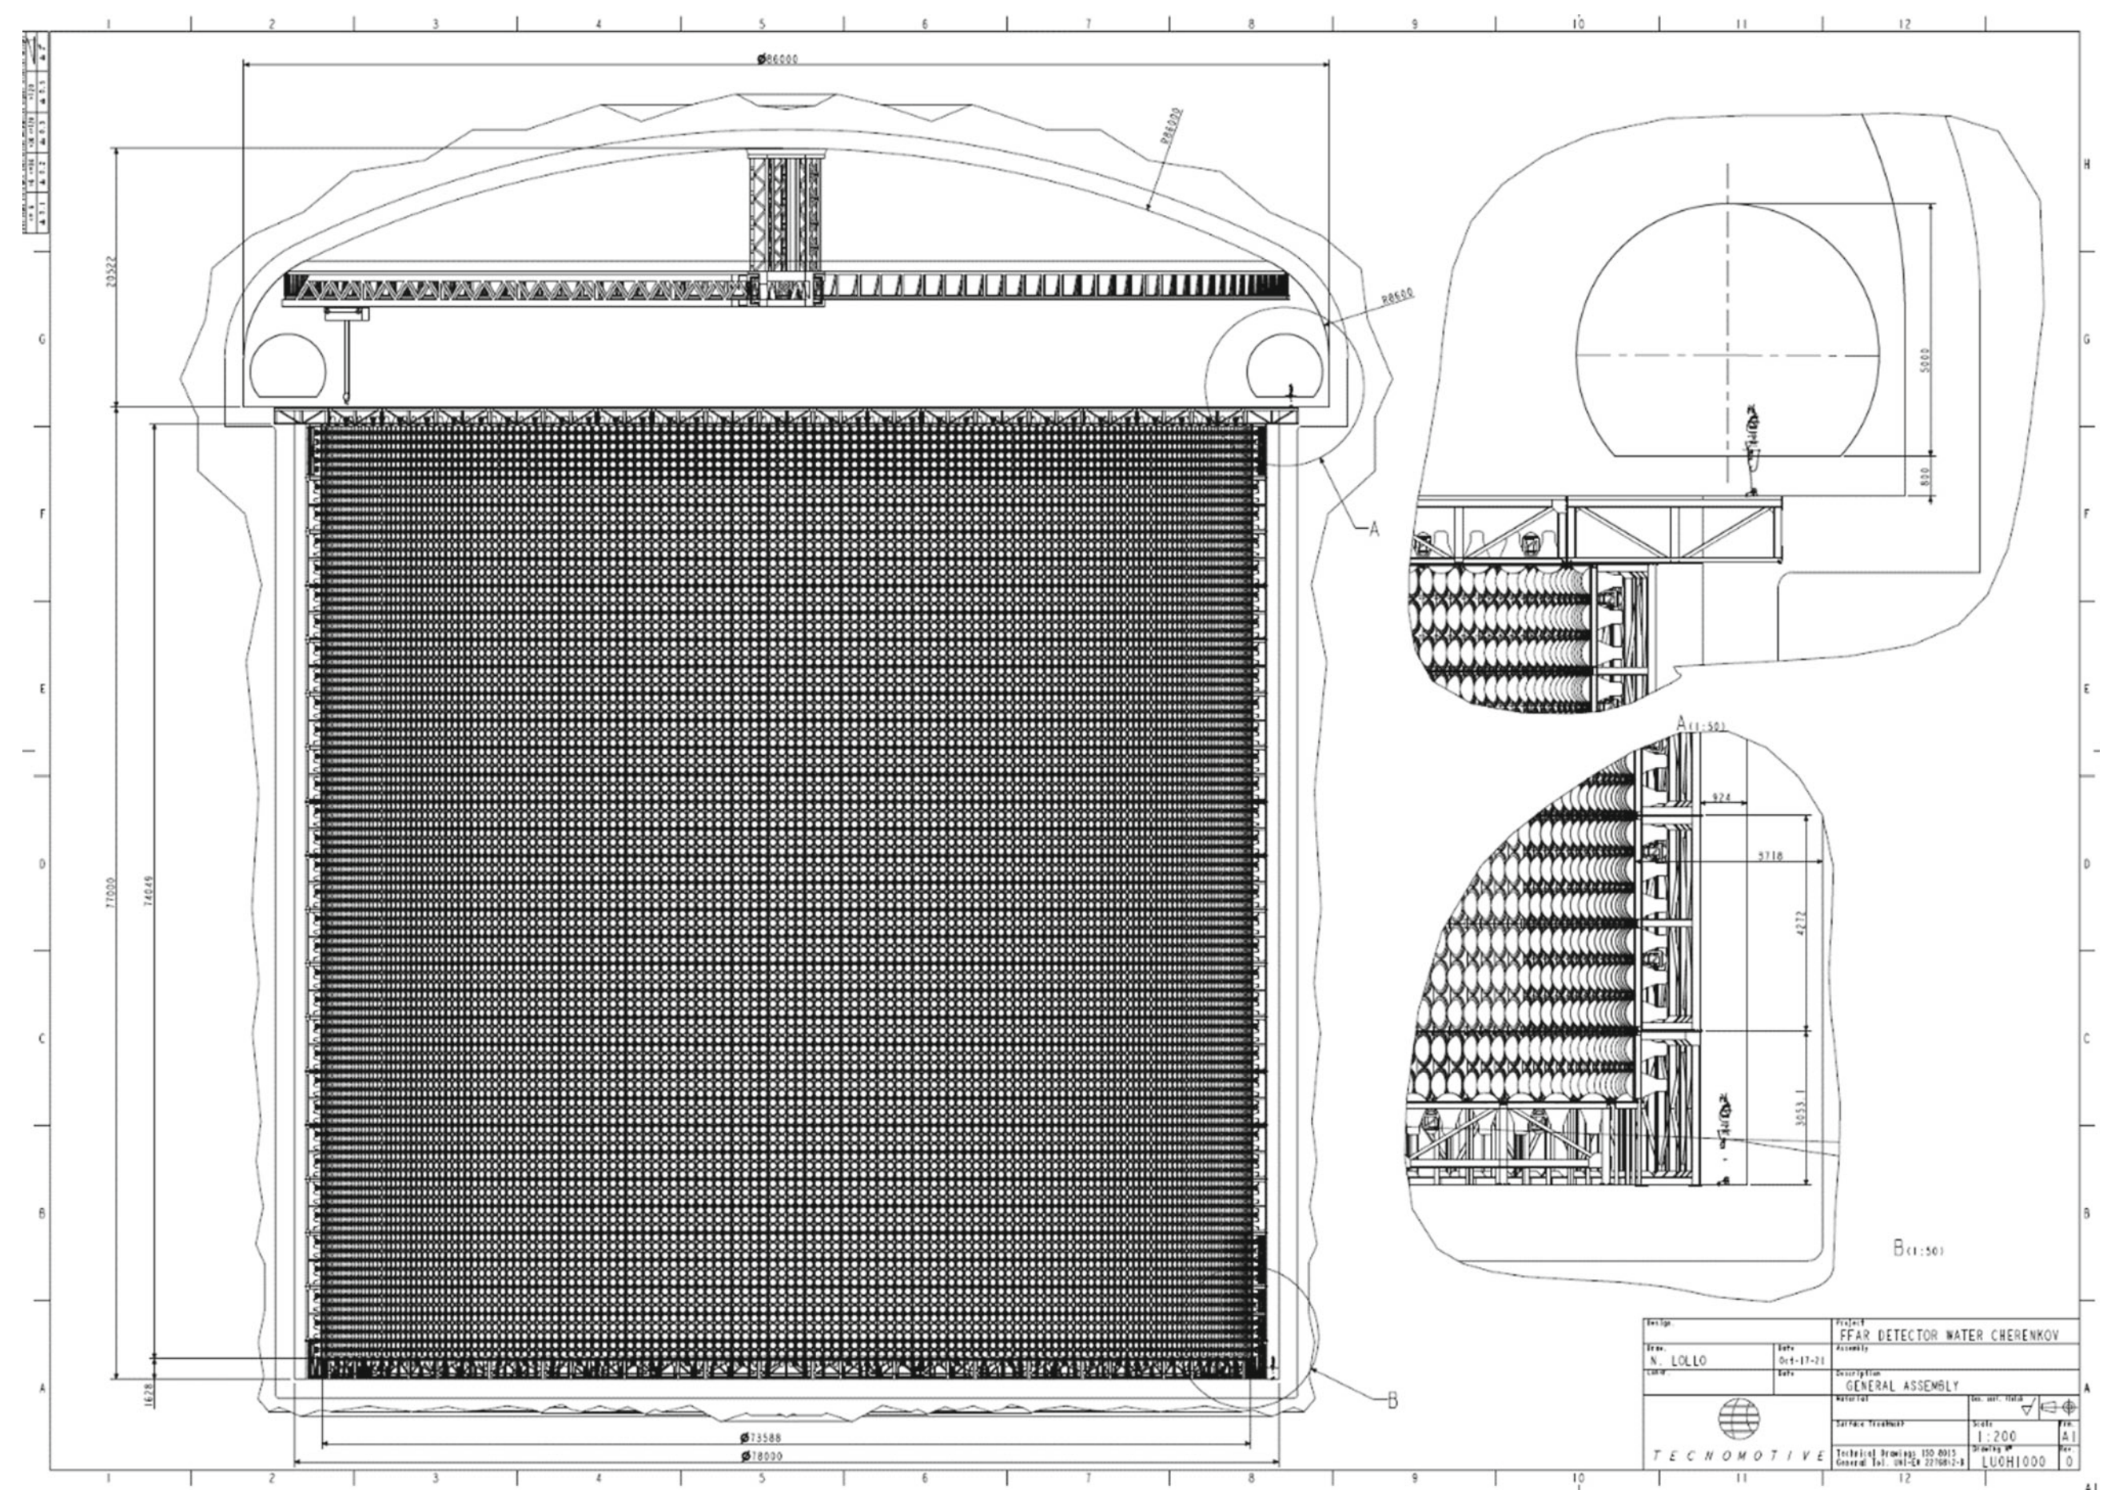
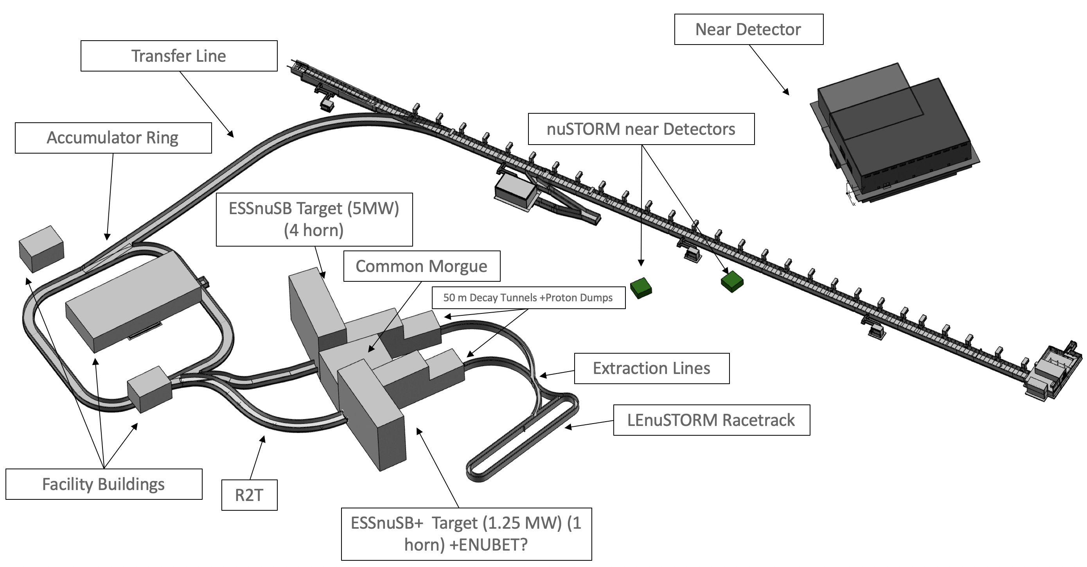
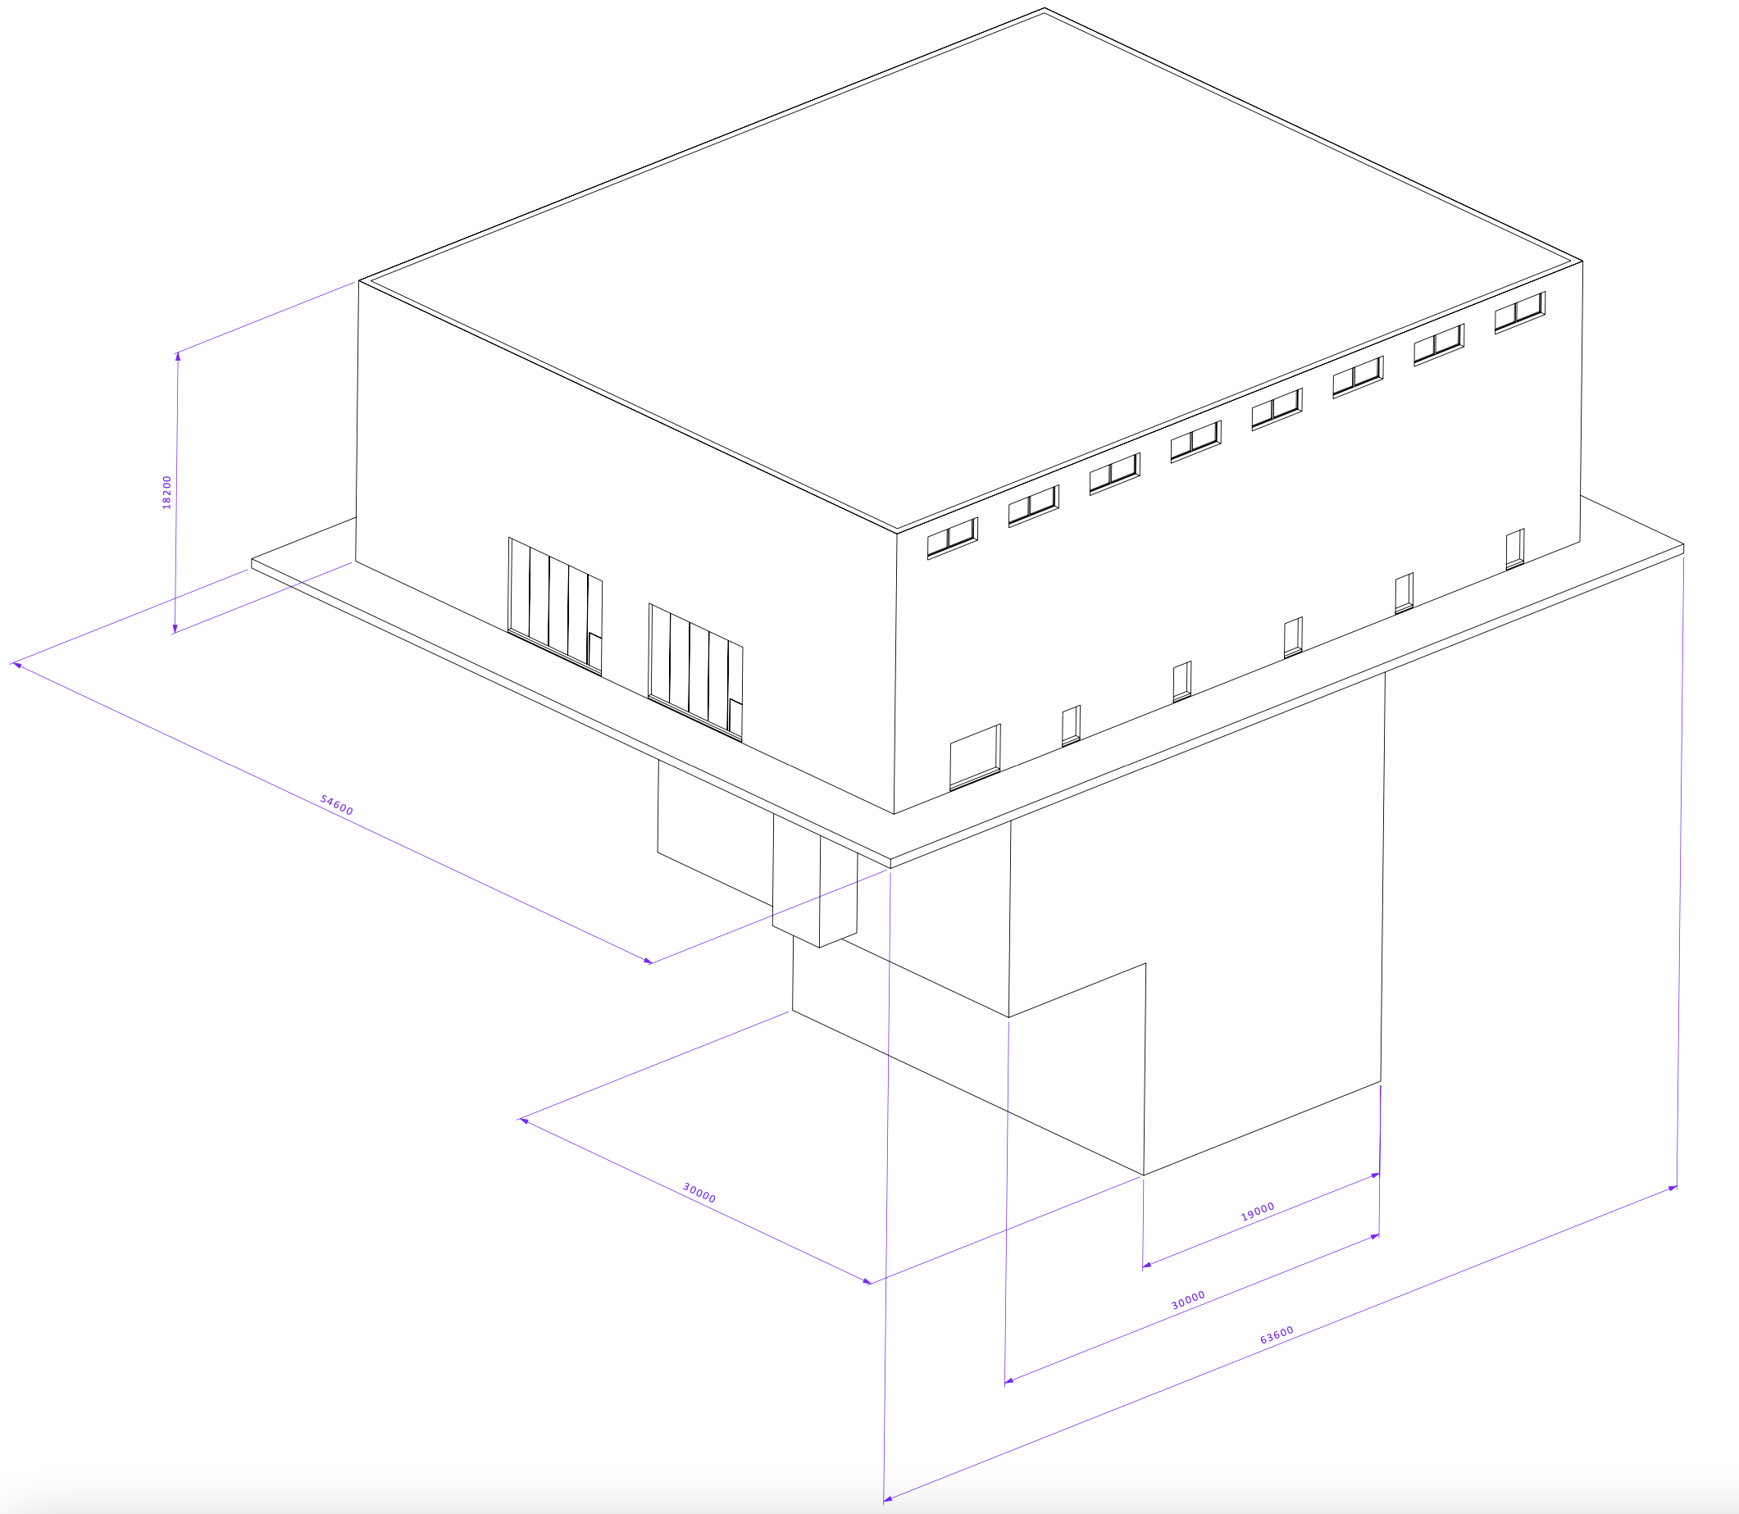
Deliverables
What was delivered and what do we have in front of us?
D1.3 – Initial facility parameters DONE (contributed)
D2.1 – Conceptual study of civil works
with indicative timeline for ESS Site related activities
D2.2 – Machine Conceptual Design & Mechanical Design of
Linac, 2nd Target Station, near and far detectors,
auxiliary systems and infrastructure
D2.3 – Deliverables for
the Far Detector
Civil Engineering
Study including
Far Detector site
Feasibility
Report and
Far Detector
Civil Engineering
Study Report
Far Detector at Zinkgruvan site
Near Detector at ESS site

Slide 6
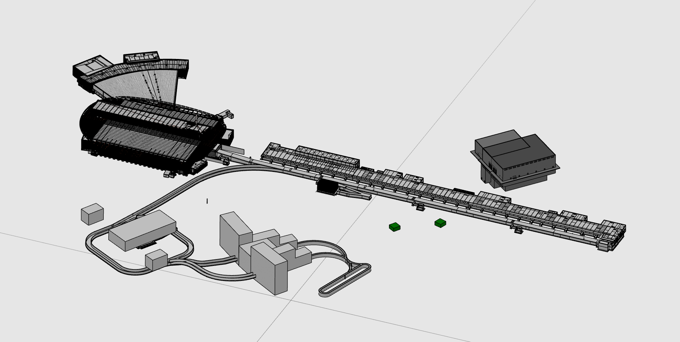
Mechanical Design update (ESS-4965198)
Emmanouil Trachanas talk – 15:40 on Wed 18 Oct

Slide 7
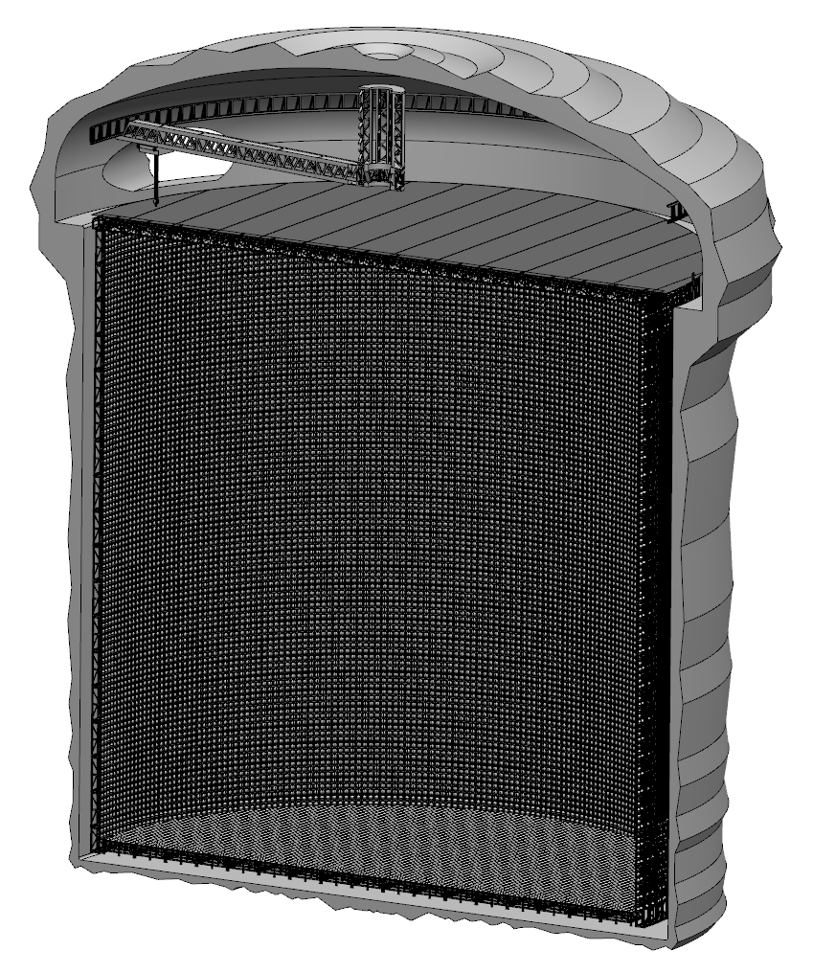
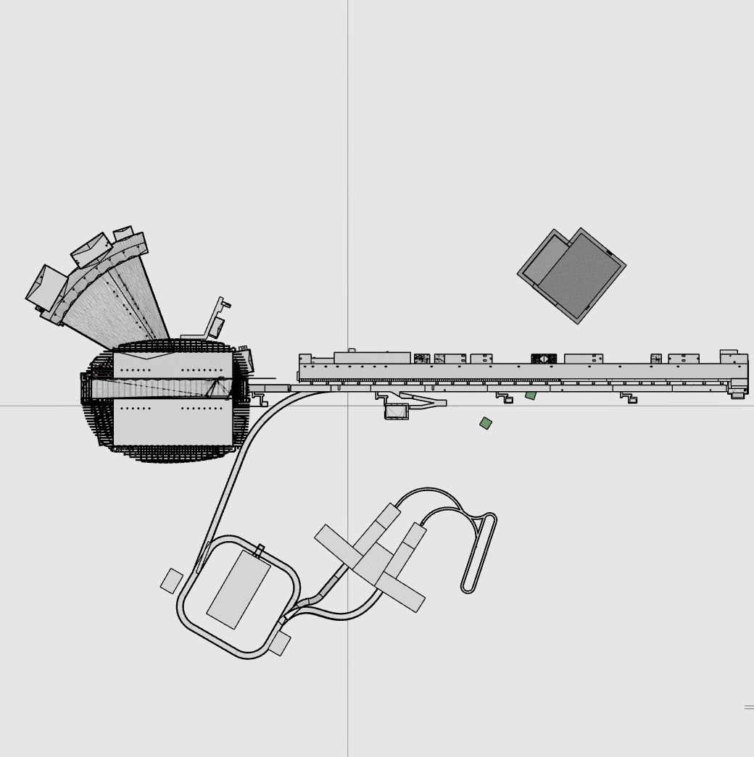
Costing & licensing
Dawid Patrzalek talk – 14:55 on Wed 18 Oct
WP2+ consolidates centrally and estimates the total cost for ESSnuSB+ realization.
However, the different deliverables are under the responsibility of the different WPs.
The cost calculations have to take into account inflation factors, local labour costs, new infrastructure, logistics and project support expenses.
The cost calculations will not include the existing ESS infrastructure, personnel etc.
ESS is a greenfield project but ESSnuSB+ will not be.

Slide 8
Far Detector
David Saiang talk – 16:25 on Wed 18 Oct
Far Detector Civil Engineering roadmap
2023
2026
2029
2034
2040
Conceptual study
Design study
Permitting
Construction
Commissioning

Slide 9
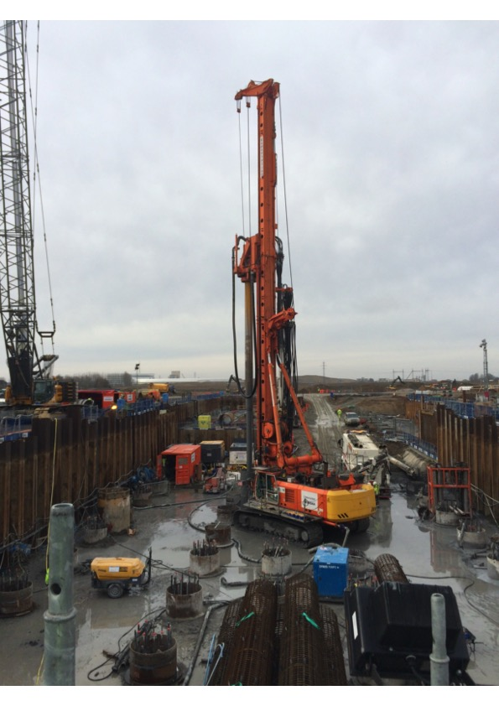
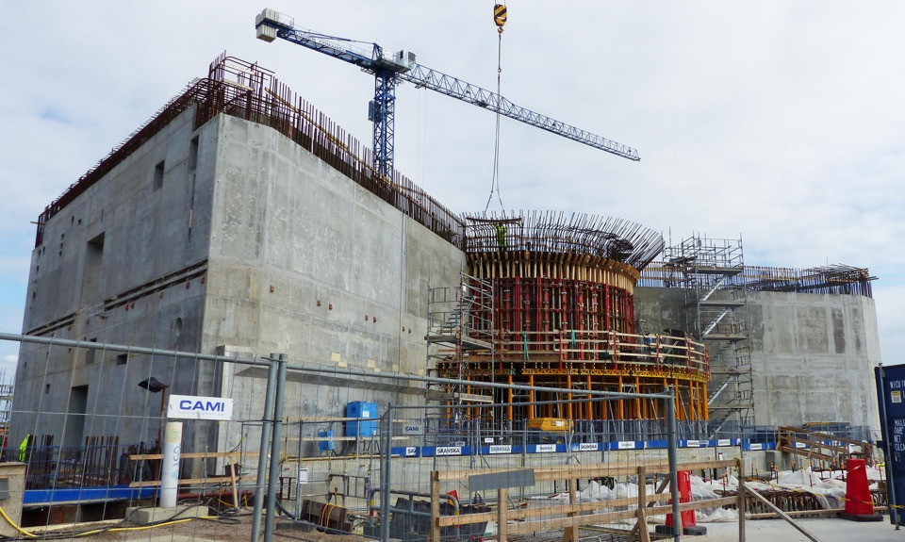
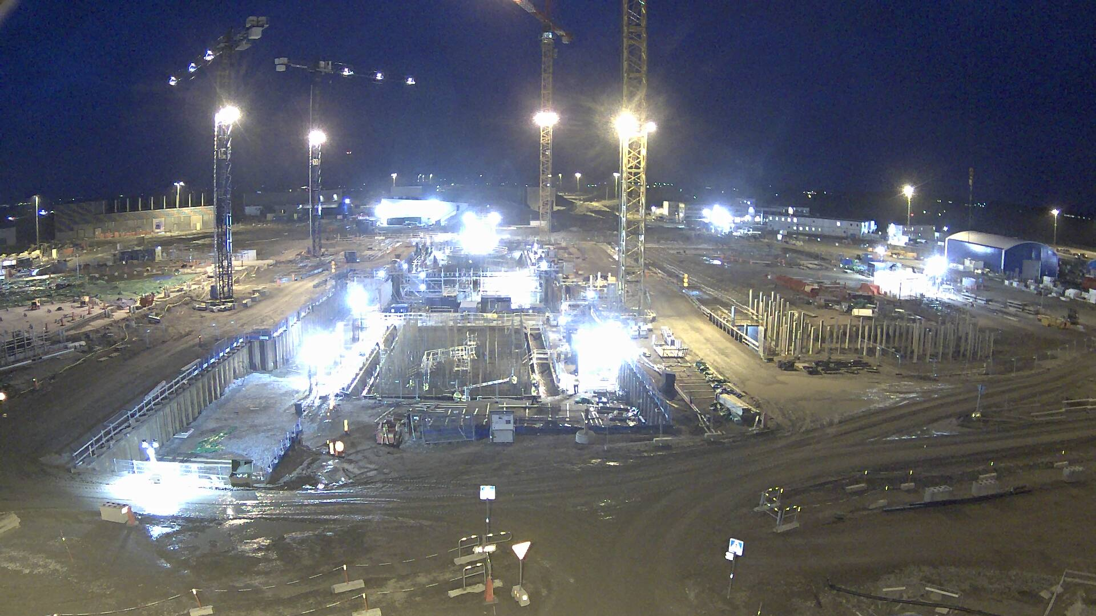
Timeline & Civil Eng
Boris Kildetoft talk – 14:35 on Wed 18 Oct
INDICATIVE TASKS
Legal process, preparation and pre-studies
  Concretize technical design to a level suitable for starting permit process
  Swedish environmental code process
Conceptual design of civil structures and geology
  Desk Pre-study and planning
  Geological investigation on site drilling and radar
  Bedrock investigation with drilling and deformation analysis
Site planning and local issues
  Contracts or agreements for land
  Architectural competition or parallel assignments
  Building permit
  Estimated time aspect 4-10 years
  Estimated time aspect 2-4 years
  Estimated time aspect 2 years

Slide 10
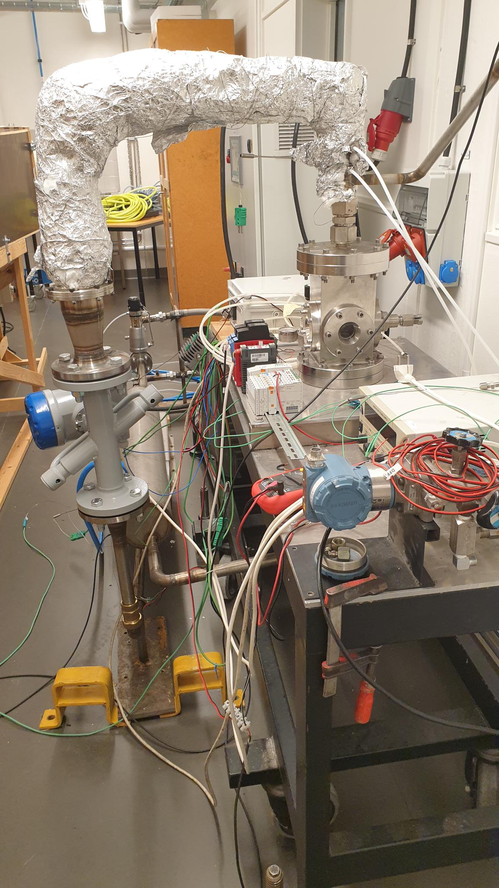
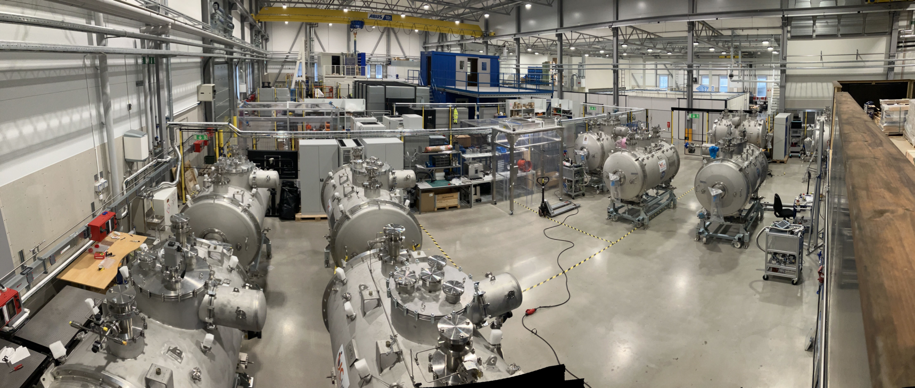
Move ETHEL testing at ESS MML lab
Andrea Bignami talk – 16:00 on Wed 18 Oct
ESS Mechanical Measurements Lab (MML) used to host all Spoke Cryomodules, after the successful modifications, they are now installed in the tunnel.
Part of that space can be repurposed to host ETHEL and other test benches.
MML has strong engineering experience and expertise in testing prototypes, ESS machines but also a large range of engineering measurements etc.

Slide 11
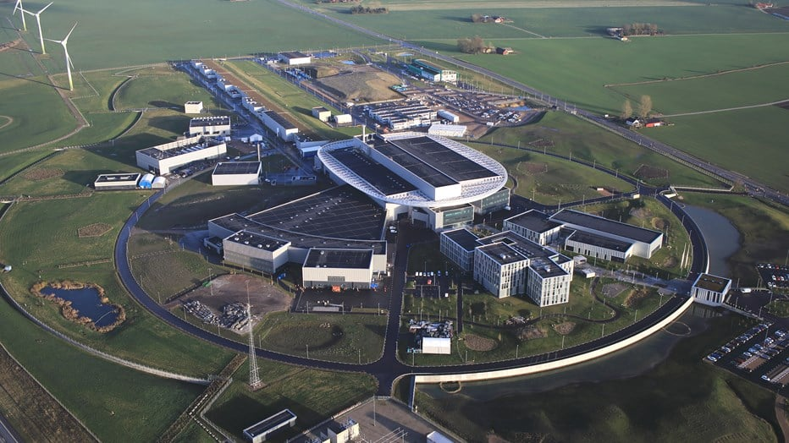
Discussion
For your consideration
Vertical bend & extraction from the ESS LINAC
Access & Logistics to ESS site
Licensing for excavating the Far Detector site
other
Near
Detector
ESSnuSB+
Target

Slide 12
Finish presentation

