Slide 1
WP3 : Target Station and Pion Extraction
Eric Baussan (Coordinator) & Tamer Tolba (Co-coordinator)
ESSnuSB+
1st Annual Meeting
CERN (16-19/10/2023)

Slide 2
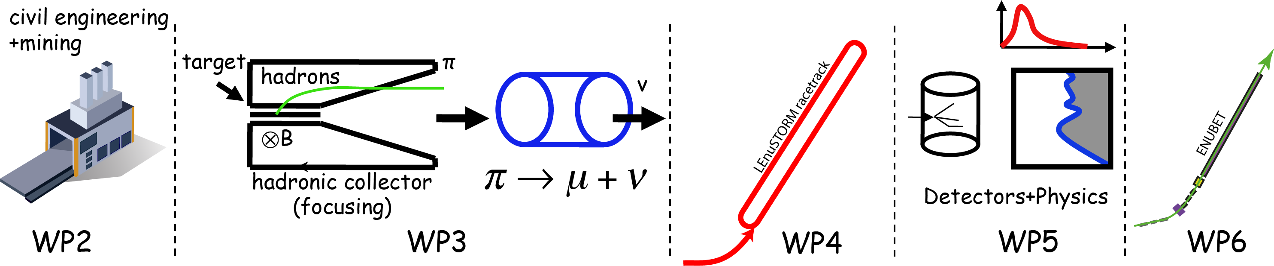
WP3 : Objectives
Main objective : Study the Target Station and pion extraction to feed LEnuSTORM and LEMNB.
  The WP will design and demonstrate with simulation studies the feasibility of a magnetic horn for pion collection in a 1.25 MW proton beam and the integration of a target of a suitable technology into the horn.
  The study will have, as an early priority task, to propose a layout of the underground target station, including the pion extraction system. This will allow the studies on LEnuSTORM and LEMNB to start using reasonable assumptions about the pion fluxes to be used.
  It includes cost and safety issues and will incorporate existing information into the CDR and focus on the new work that needs to be done compared to those already studied in ESSνSB.

Slide 3
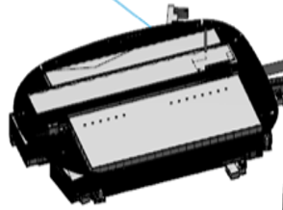
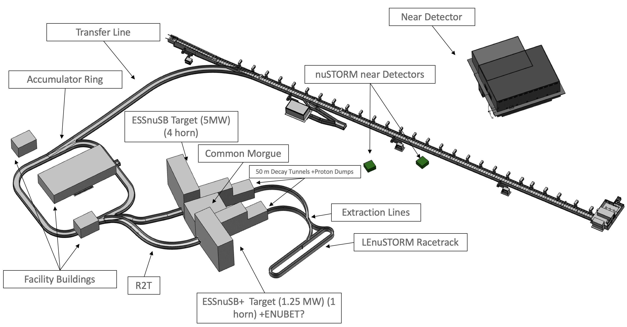
WP3 : Target Station implantation
Transfer Line

Slide 4
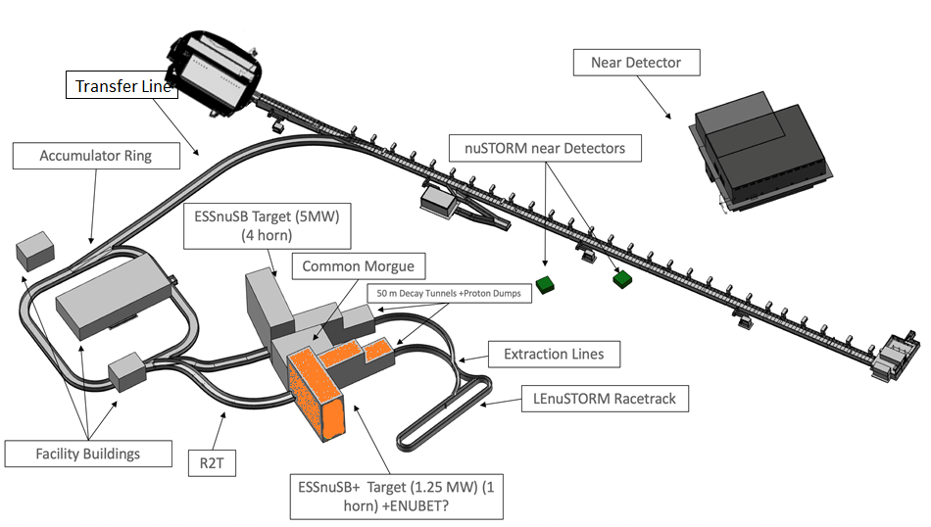
WP3 : Target Station implantation

Slide 5
WP3 : Working Structure
Work package number | 3 | Lead beneficiary: |  |  |  |  |  | 1
Work package title | Target Station and pion extraction
Participant number | 1 |  | 9 | 15 |  | 2 | 20
Short name of participant | CNRS |  | UHH | CERN |  | UNISTRA | ESSB
Person/months per participant: | 46 |  | 52 | 14 |  | 12 | 7
Start month: | 1 |  |  |  | End month: |  |  |  | 48
* Human resources will be evolved with respect to the hiring process
Task List
3.1: Coordination of the Target Station WP (CNRS/UNISTRA)
3.2: Adapt the ESSνSB target station to the pion production requirements (CNRS, UHH, UNISTRA)
3.3: Investigate pion Extraction and Initial Focusing System (UHH, CNRS, CERN, UNISTRA)
3.4: Target Station Facility (CNRS, ESSB, UHH, UNISTRA)

Slide 6
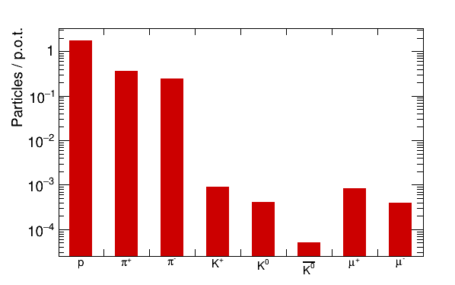
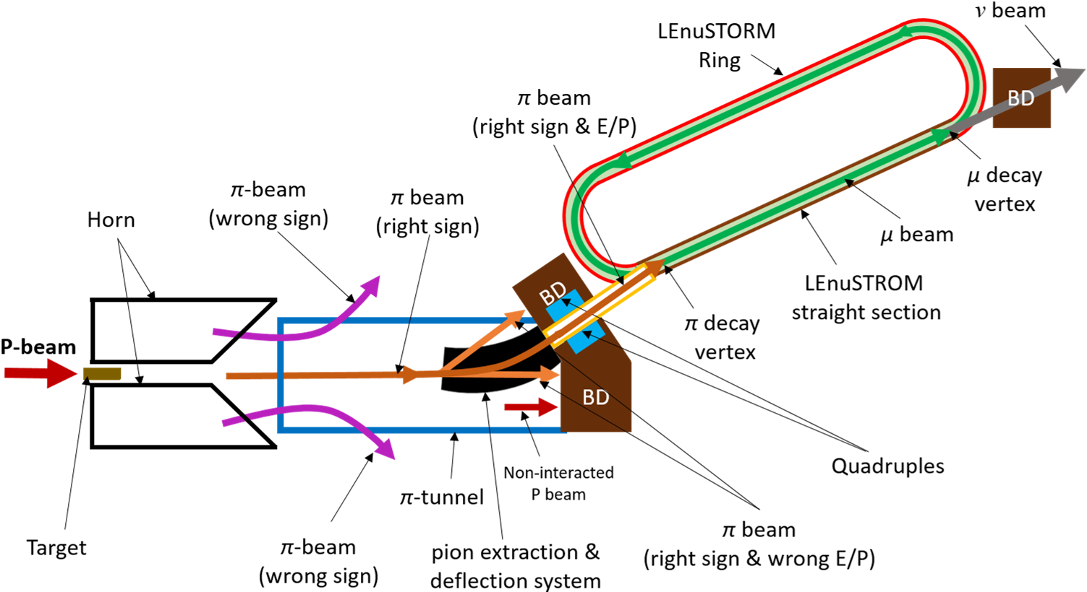
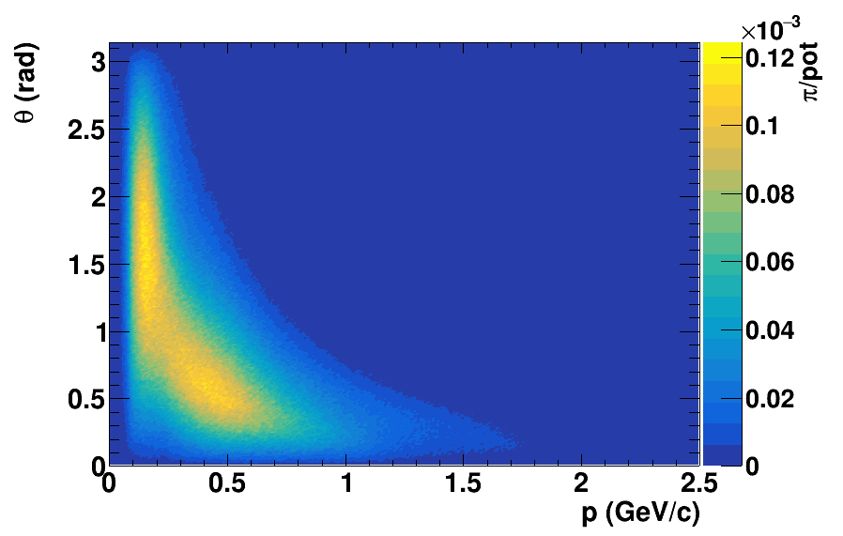
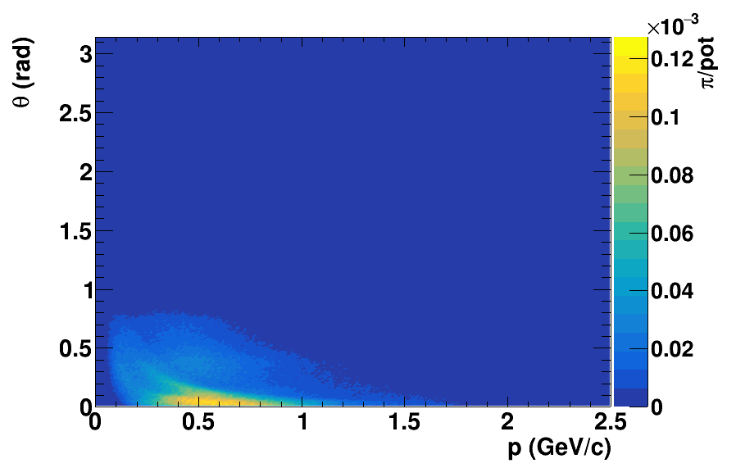
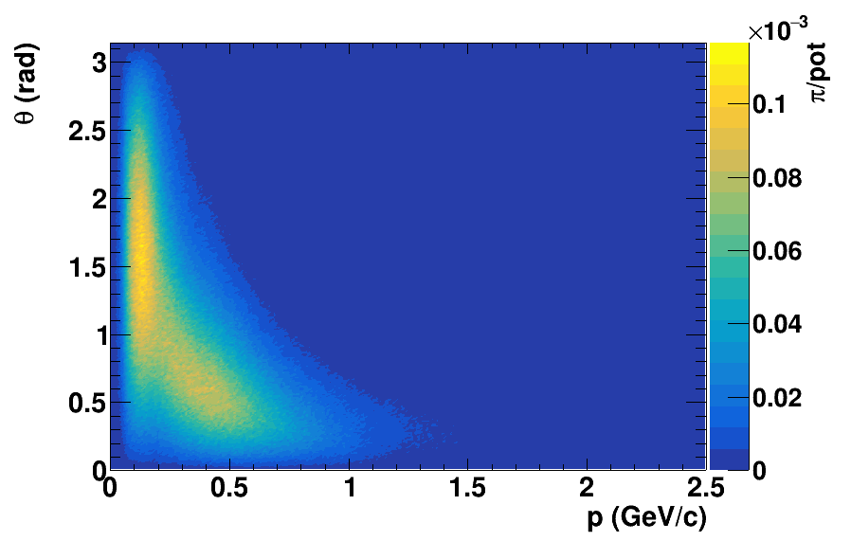
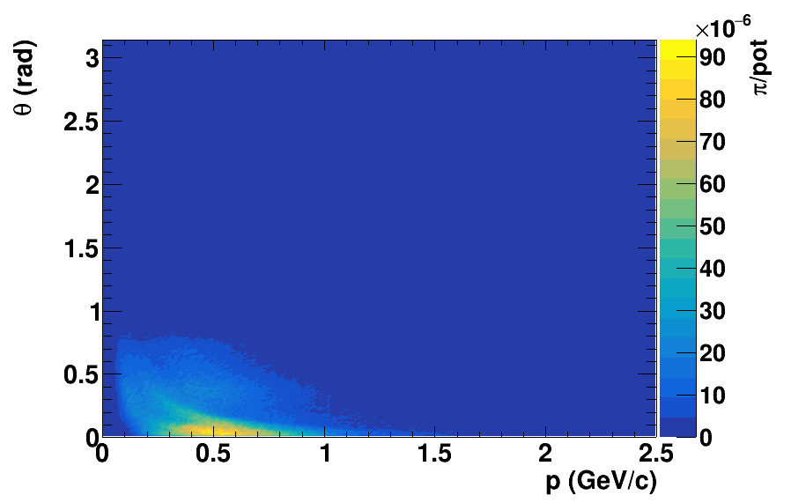
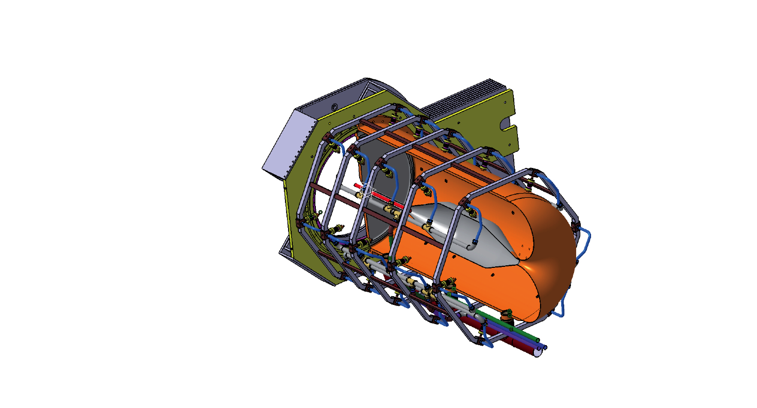
WP3 : Global Overview
Objective: to produce π± beam
One horn/target-system
Short (10 m – 15 m) pion tunnel
Include pion collection and extraction system
Pion focusing system
Transfer-line to the LEnuSTORM ring and LENMB facility
π⁺
π⁺
π⁻
π⁻
One horn-target system
Adaptation of the ESSnuSB horn to the ESSnuSB+ physics goals

Slide 7
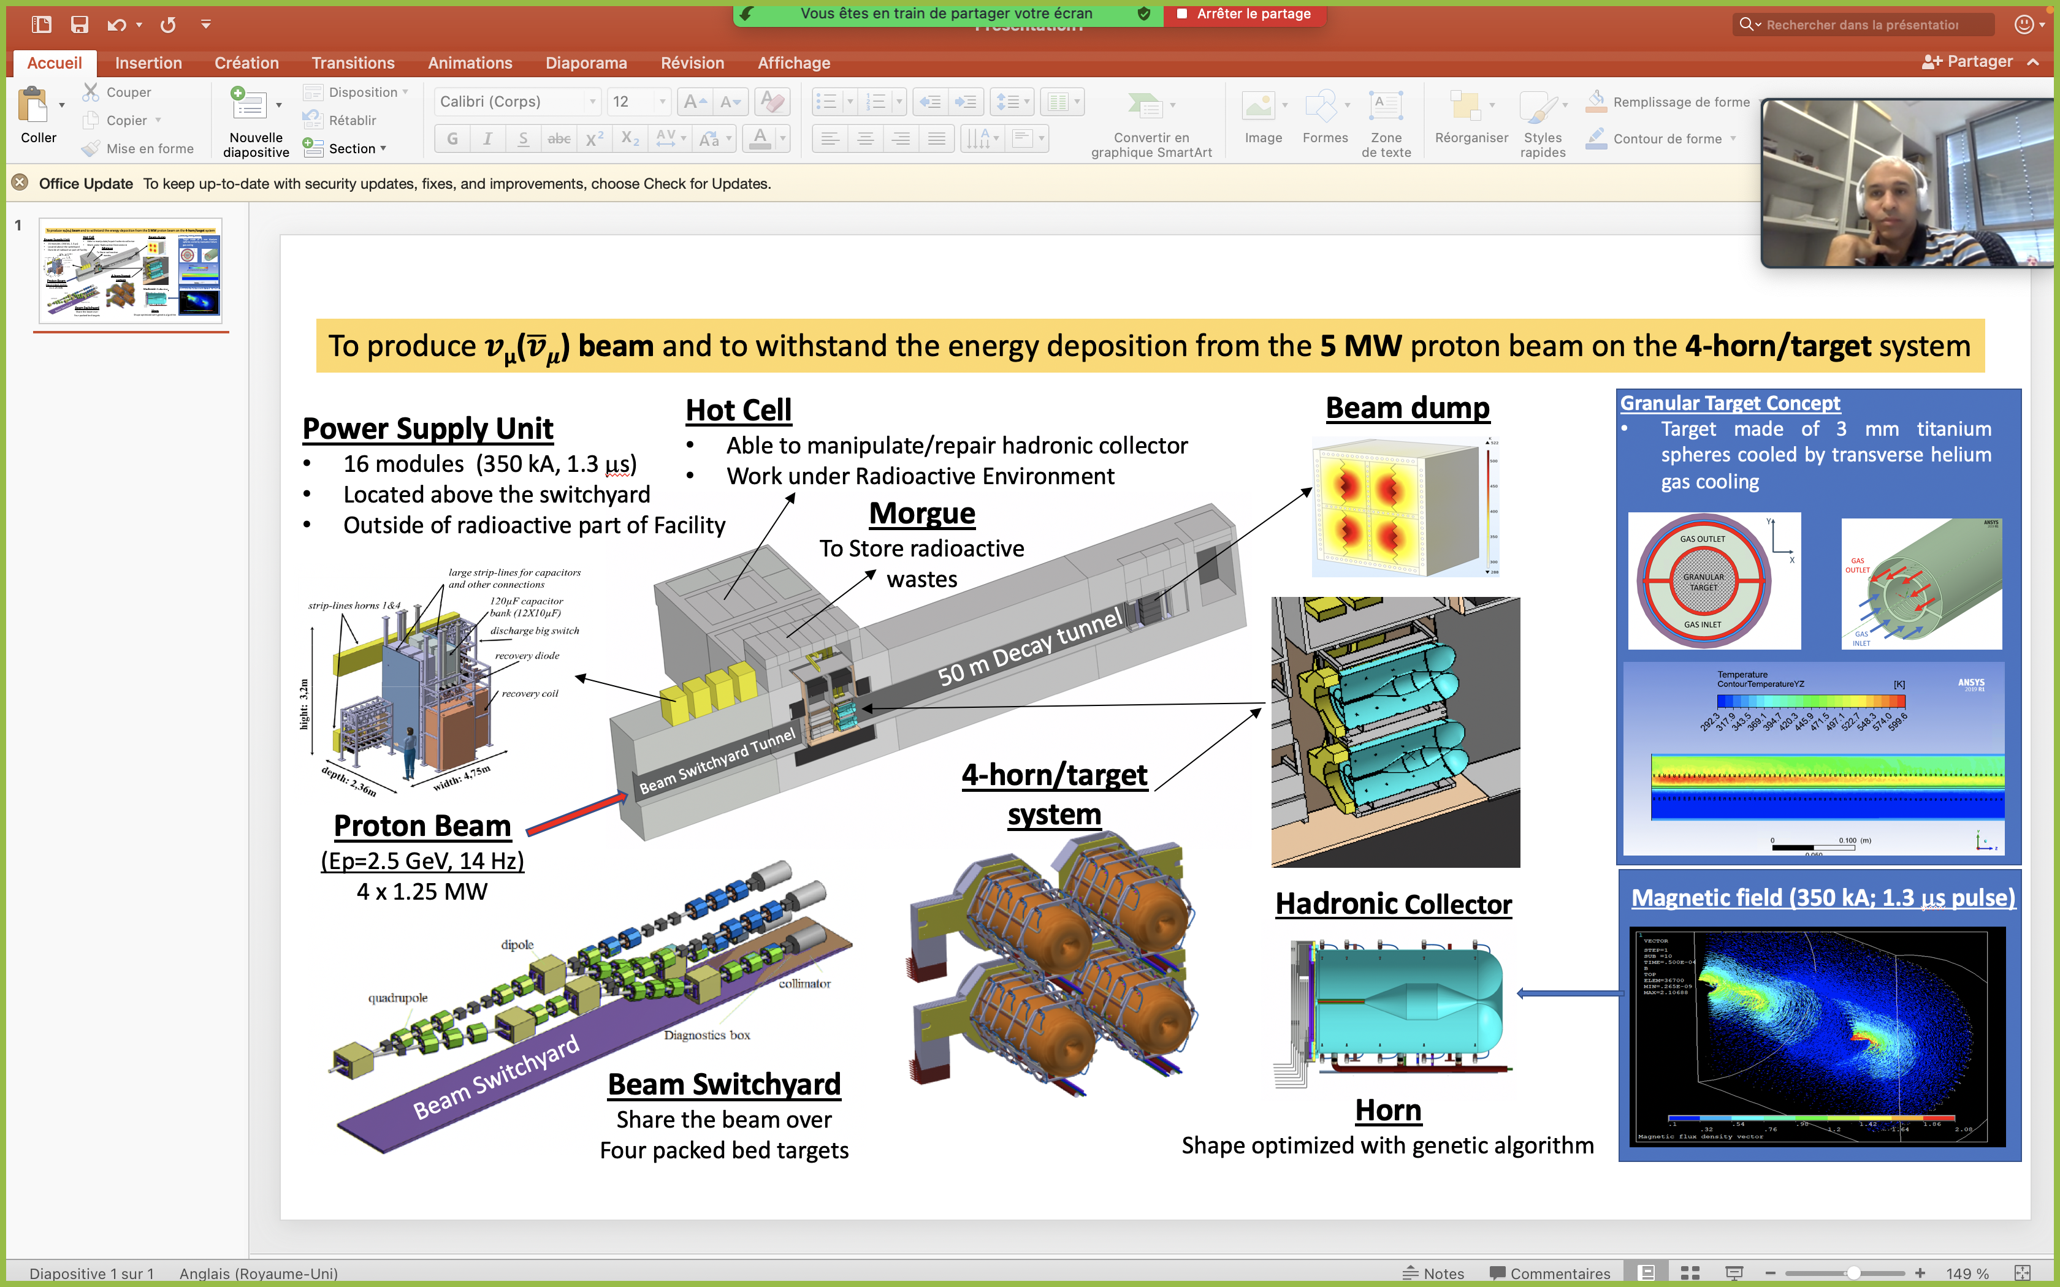
WP3 : Global Overview

Slide 8
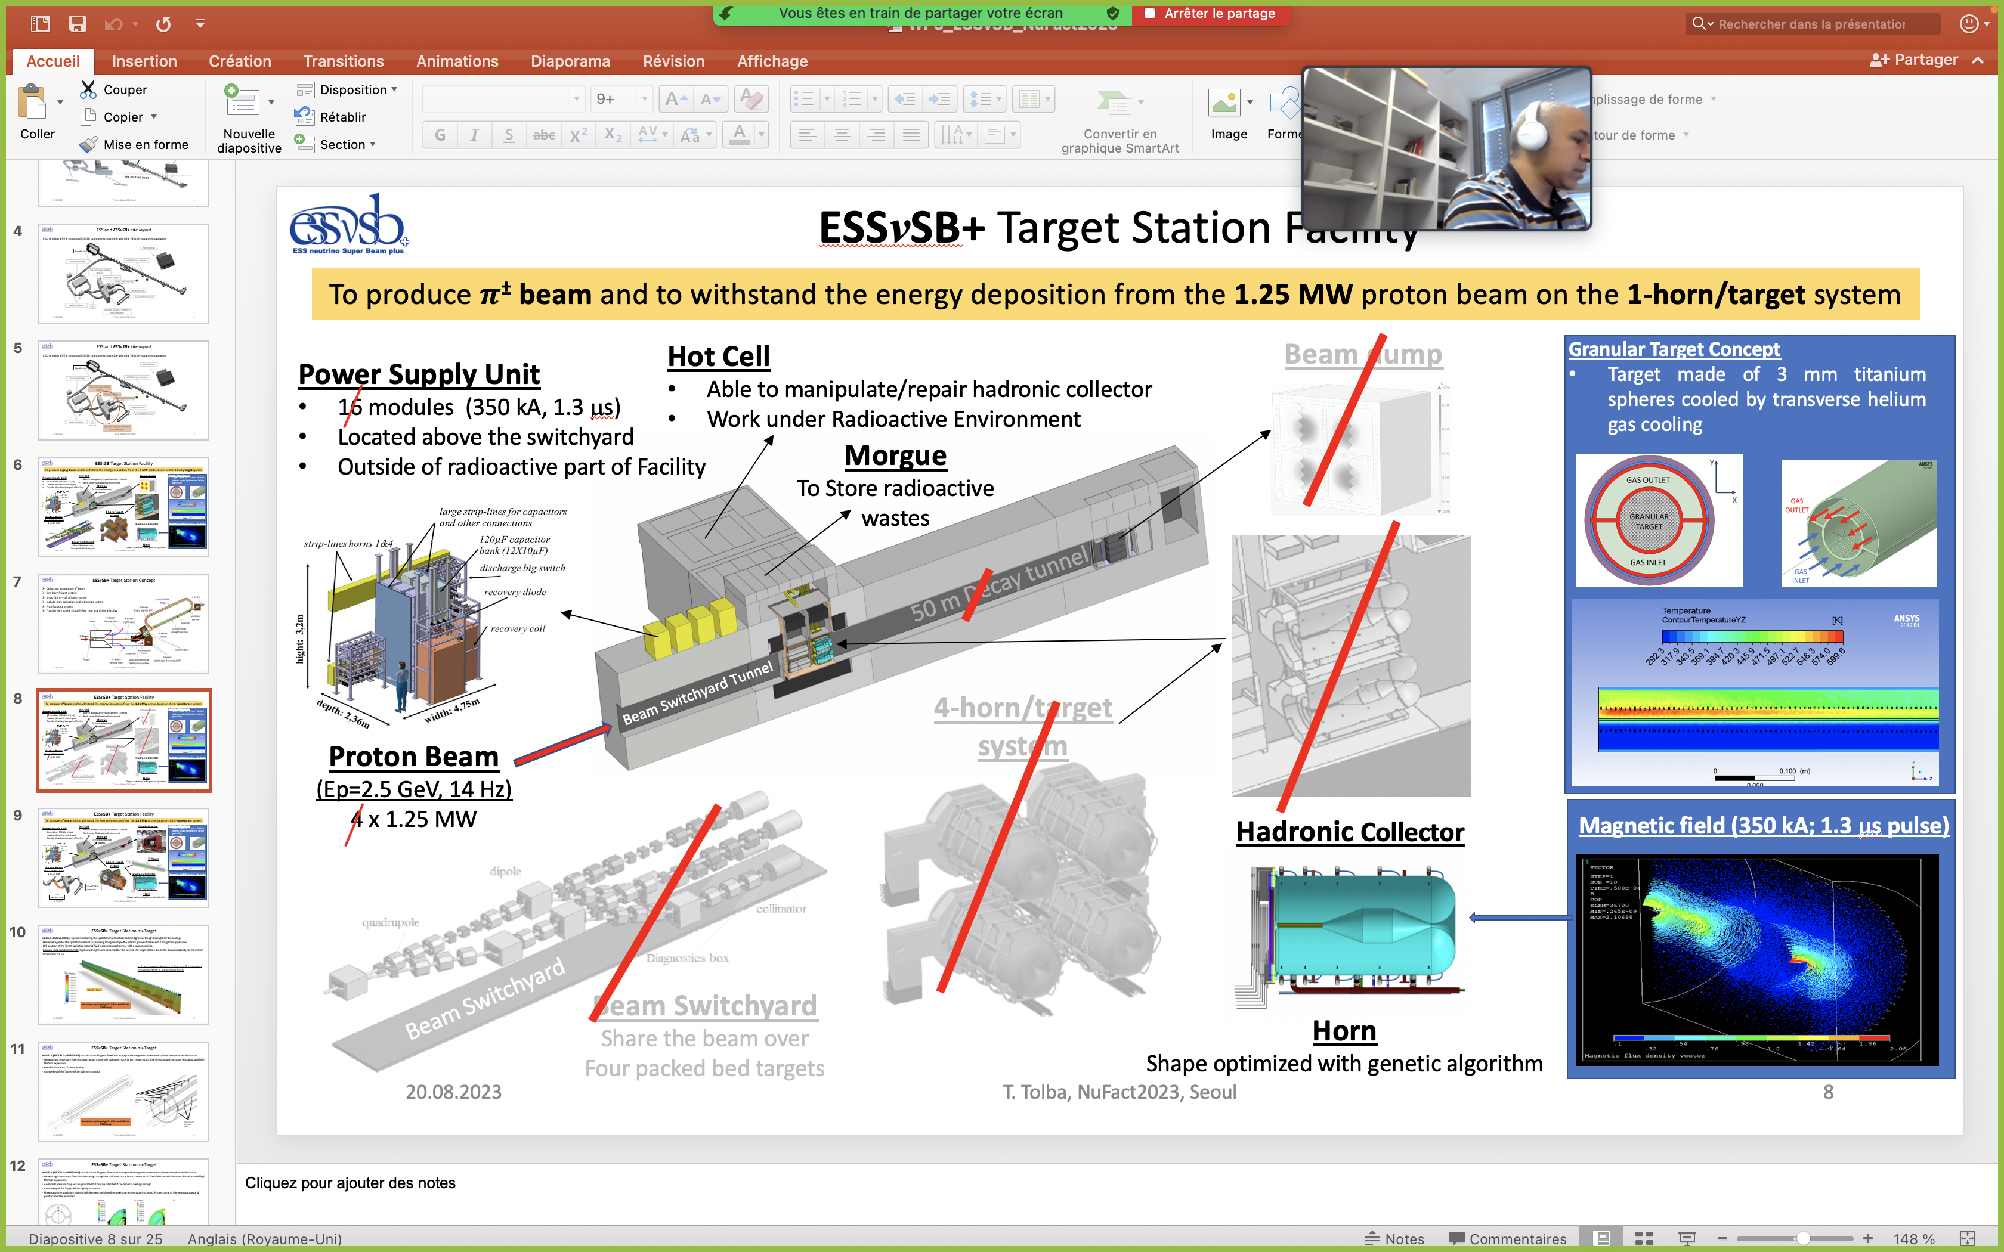
WP3 : Global Overview

Slide 9
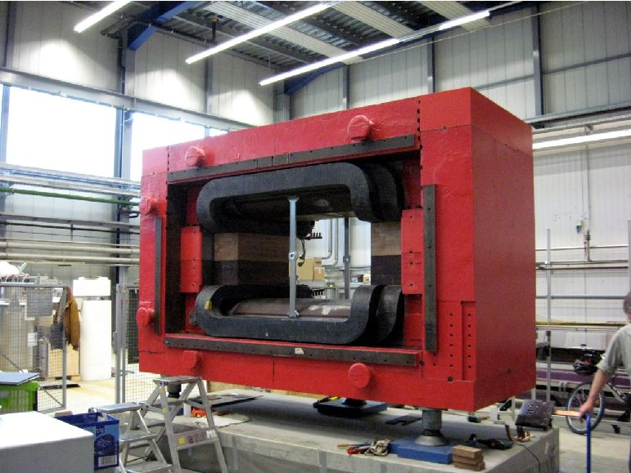
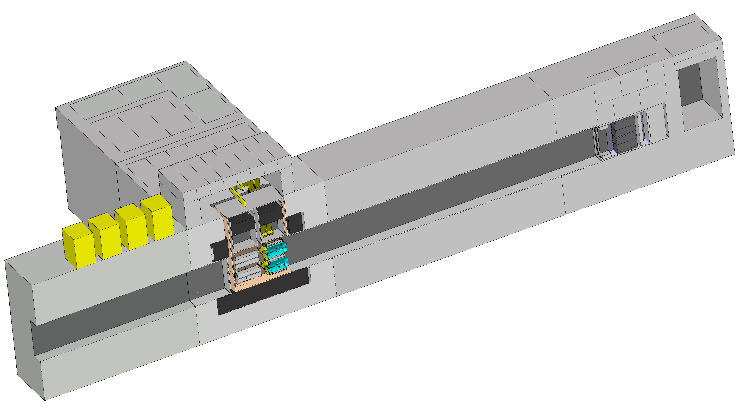
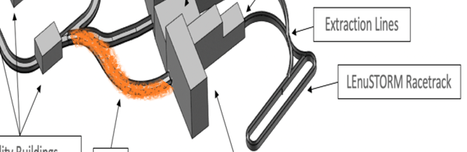
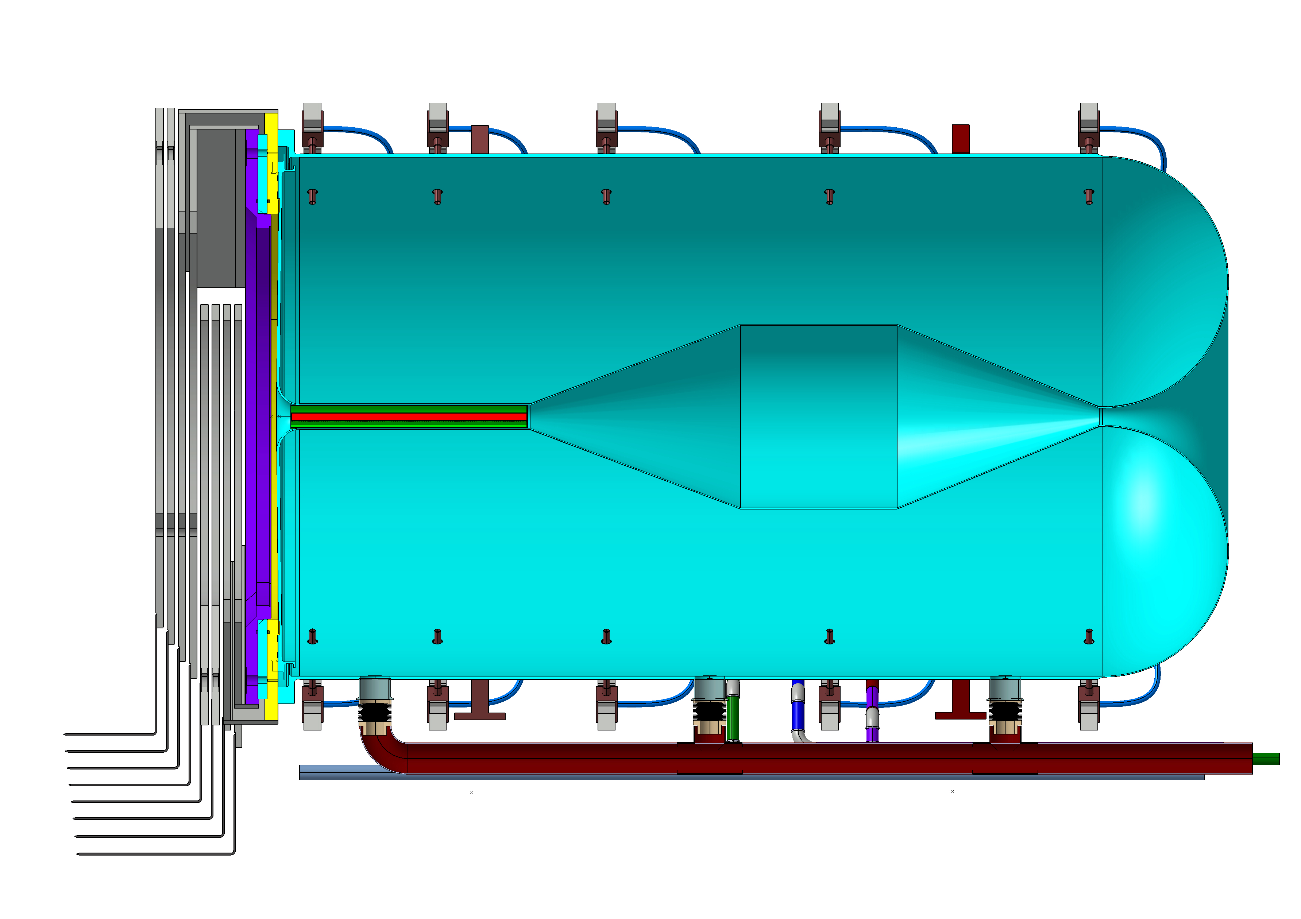
WP3 : Global Overview
Hot Cell
Able to manipulate/repair hadronic collector
Work under Radioactive Environment
Dipole Magnet
Power Supply Unit
8 modules (350 kA, 1.3 μs)
Located above the switchyard
Outside of radioactive part of Facility
Morgue
To Store radioactive
wastes
~10 m pion tunnel
Dipole
1-horn/target system
Proton Beam
(Ep=2.5 GeV, 14 Hz) 1 x 1.25 MW
Hadronic Collector
LEnuSTORM
racetrack
c
Transfer Line

Slide 10
WP3 : Timeline
Phase 1
Target Station: preliminary report on pion and muon production and extraction for LEnuSTORM and ENUBET use
Detectors: initial near detector design
Phase 2
Optimisation of the Target Station and of the pion and muon extraction
Detector and physics performance: design of detector and physics performance
LEnuSTORM: preliminary report
LEnuSTORM: detailed simulations
LEMNB: optimization of pions use to tagg neutrinos
LEMNB: design using initial proton beam parameters
Civil engineering: initial evaluation of all new infrastructures
Civil engineering: synergetic design of all facilities and safety evaluation
Phase 1 :
  Preliminary design of the new Target Station will be based on ESSnuSB.
  All initial parameters will be fixed during the first 6 months.
  Evaluation of this design if it is also well suited for pion collection for LEnuSTORM and LEMNB
Phase 2 :
  Optimisation of the target station elements (target/hadron collector station, the pion extraction system, the shielding and the beam dump)
=> Production of a Conceptual Design Report and a Costing
* From the Grant agreement

Slide 11
WP3 : Task distribution
Hadronic collector system:
  Horn Optimisation (CNRS/UHH)
  Target and its integration, and beam windows (ESS-Bilbao)
  Thermo- and mechanical stress of each element, eg target, horn and support structure (ESS-Bilbao/UHH)
  Horn power supply (CNRS)
Pion extraction and deflecting system (UHH/CNRS)
Transfer ”Line” between the end of the deflection system and Low Energy Nustorm ring and LEMNB facility (CNRS/CERN/UHH) with cooperation with WP4.
Target Station Facility :
  Target Station (Horn Support Structure) (ESS-Bilbao)
  Shielding (UHH/CNRS)
  Design of the target station complex (Cooperation with WP2)

Slide 12
WP3 : European document schedule
Summary Deliverable & Milestones
  MS 3.1 : First design of the hadron collector (M12)
  D3.1 : Optimize the ESSnuSB+ horn design and its pulse generator (M18)
  MS 3.2 : Preliminary design of the pion extraction and focusing system (M24)
  D 3.2 : Design of the pion extraction and focusing systems (M24)
  MS 3.3 : Final estimation of the pion beam (M36)
  MS 3.4 : Evaluation of the baseline design of the target station (M42)
  D 3.3. : Design of the Target Station (M46)

Slide 13
WP3 : Resources
Status of recruitment of postdocs & PhD
  V. Hariharan employed by UHH till 31/12/2023.
  One postdoc position is foreseen within WP3 activities at CNRS, Strasbourg, France in the field of neutrino physics.
  PhD Thesis in discussion within doctoral school in Strasbourg.
The announcements will be posted on the ESSnuSB+ webpage and sent to European and national forums. (The position opened and advertised on 11 Oct. 2023.)

Slide 14
WP3 : Workflow
Regular internal meetings
  Four WP3 Meetings (Video-Conference) organized up to now.
  WP3 Frequency one per month.
  Meeting on Civil Engineering with WP2
Conferences and Workshops
  « The Design Studies of the Special ESSvSB+ Target station », (T. Tolba)
  NUFACT 2023, Seoul, Korea

Slide 15
WP3 : Target Station and Pion Extraction
Eric Baussan (Coordinator) & Tamer Tolba (Co-coordinator)
WP3 – parallel session

Slide 16
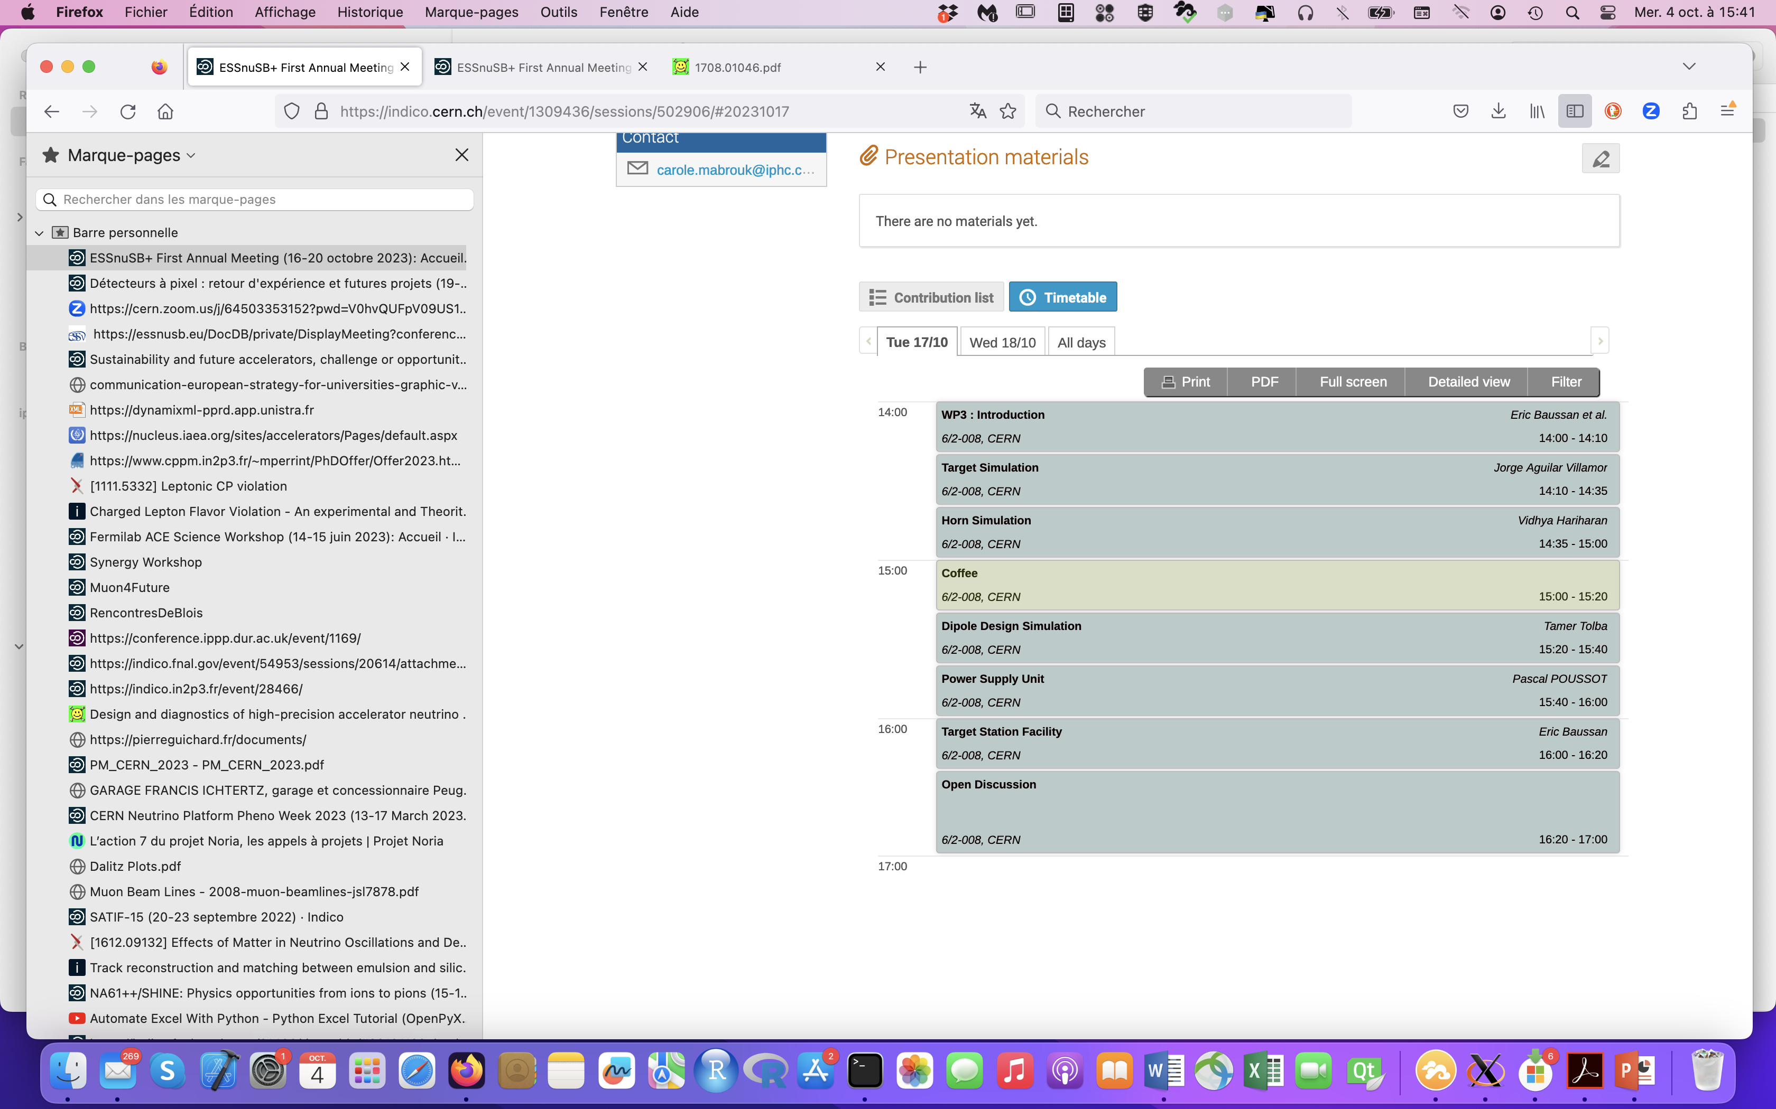
WP3 : Parallel session
Target simulation (Jorge Aguilar)

Slide 17
WP3 : Parallel session
Horn simulation (Vidya Hariharan)
Workflow of Genetic Algorithm
Initialize Population
aCalculate
Fitness
Check stop Criterion
Select
Survivors
Evolution
Mutation
CrossOvers

Slide 18
WP3 : Parallel session
Status of dipole (T. Tolba)

Slide 19
WP3 : Parallel session
Status of Power Supply Unit (P. Poussot)

Slide 20
WP3 : Parallel session
Status of Target Station (E. Baussan)
Hot Cell
Able to manipulate/repair hadronic collector
Work under Radioactive Environment
Morgue
To Store radioactive
wastes
Horn

Slide 21
WP3 : Target Station and Pion Extraction
Summary
  The first phase of the project will study the physics possibilities of the make a preliminary design of the target station.
  Use the feedback from previous study for the concept.
  Investigate a new magnetic device to feed the LEnuSTORM ring and identify technological lock for the initial focussing.
  Implementation on the ESS site.
  Safety and costing.

