Slide 1
ESSnuSB+ First Annual Meeting
WP2+ Engineering & Infrastructure
Summary & Future Plans
PRESENTED BY Nick Gazis
on behalf of Work Package 2+
Nick Gazis, David Saiang, Mamad Eshraqi, Dawid Patrzalek, Emmanouil Trachanas, Andrea Bignami, Michail Anastasopoulos, jean-Michel Lagniel, Rasmus Johansson, Boris KiLdetoft, Natalia Milas

Slide 2
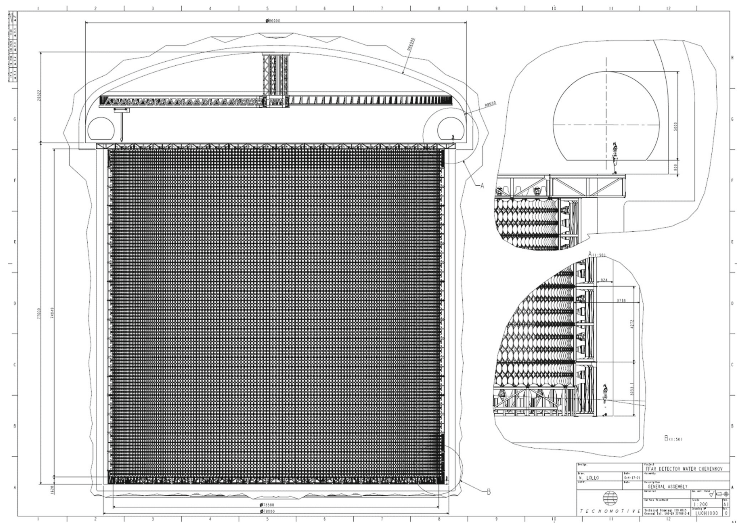
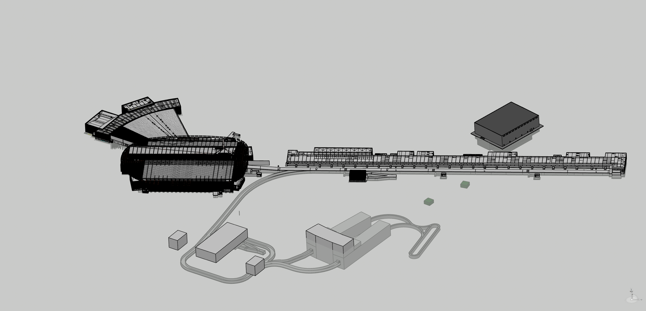
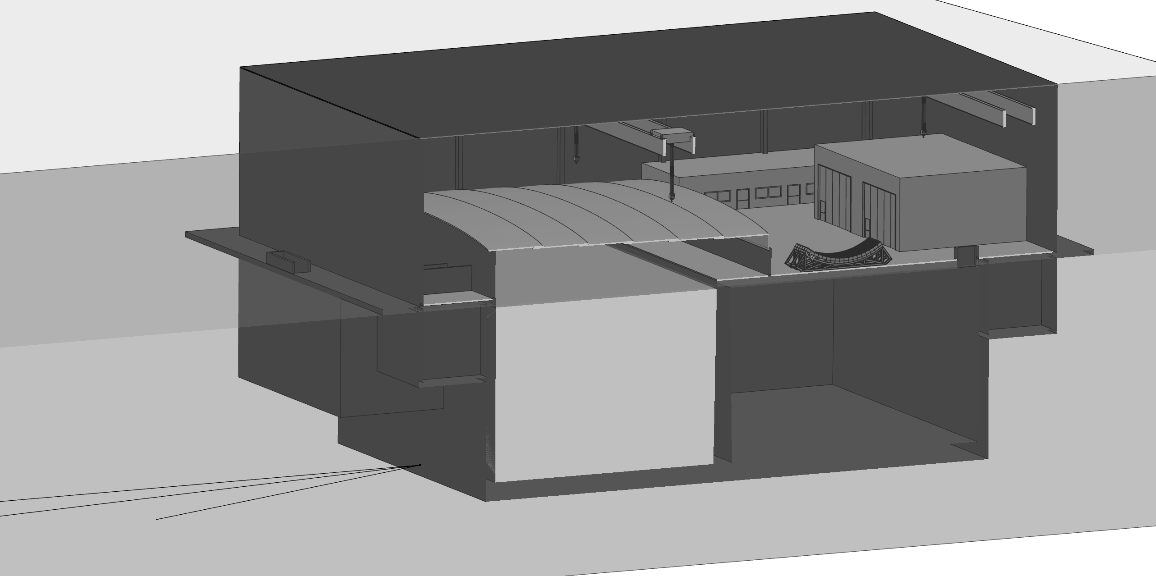
Deliverables & Continuous design updates
what do we have in front of us?
D2.1 – Conceptual study of civil works
with indicative timeline for ESS Site related activities
D2.2 – Machine Conceptual Design & Mechanical Design
(incl. EL specs) of Linac, 2nd Target Station, near and
far detectors, auxiliary systems and infrastructure
D2.3 – Deliverables for
the Far Detector
Civil Engineering
Study including
Far Detector site
Feasibility
Report and
Far Detector
Civil Engineering
Study Report
Far Detector at Zinkgruvan site
Near Detector at ESS site

Slide 3
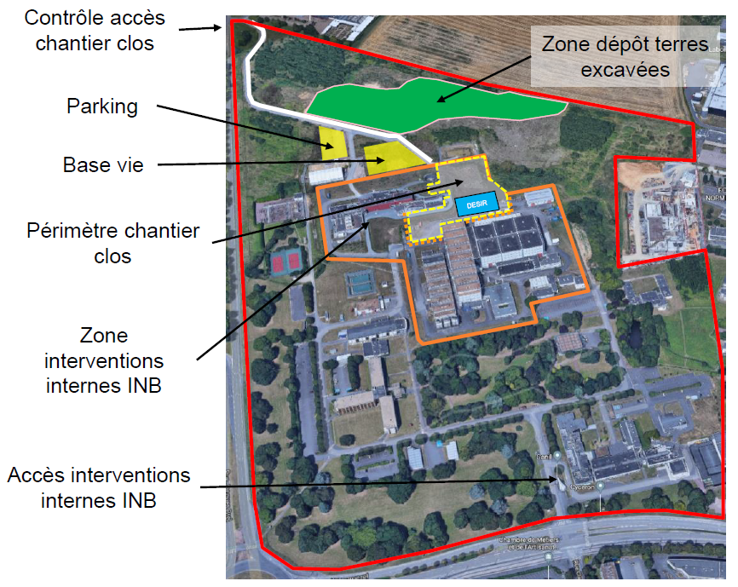
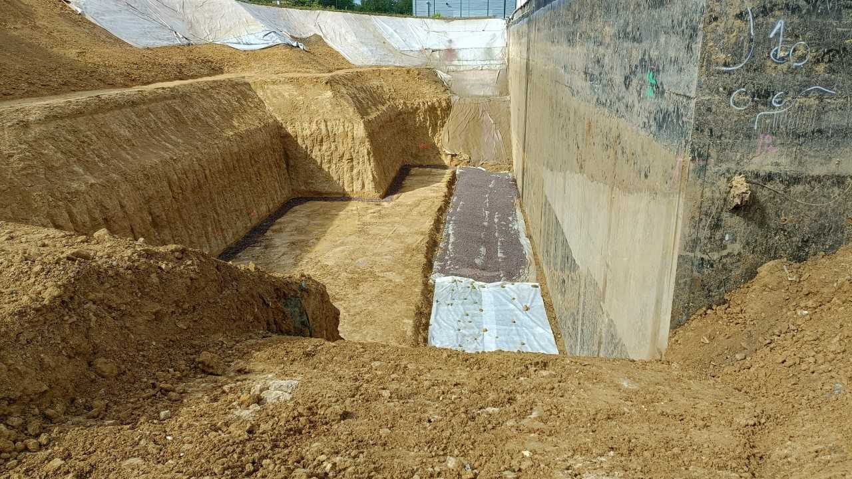
GANIL & SPIRAL2 + DESIR
Closed and independent construction site
Excavation trenches need space and stagged execution:

Slide 4
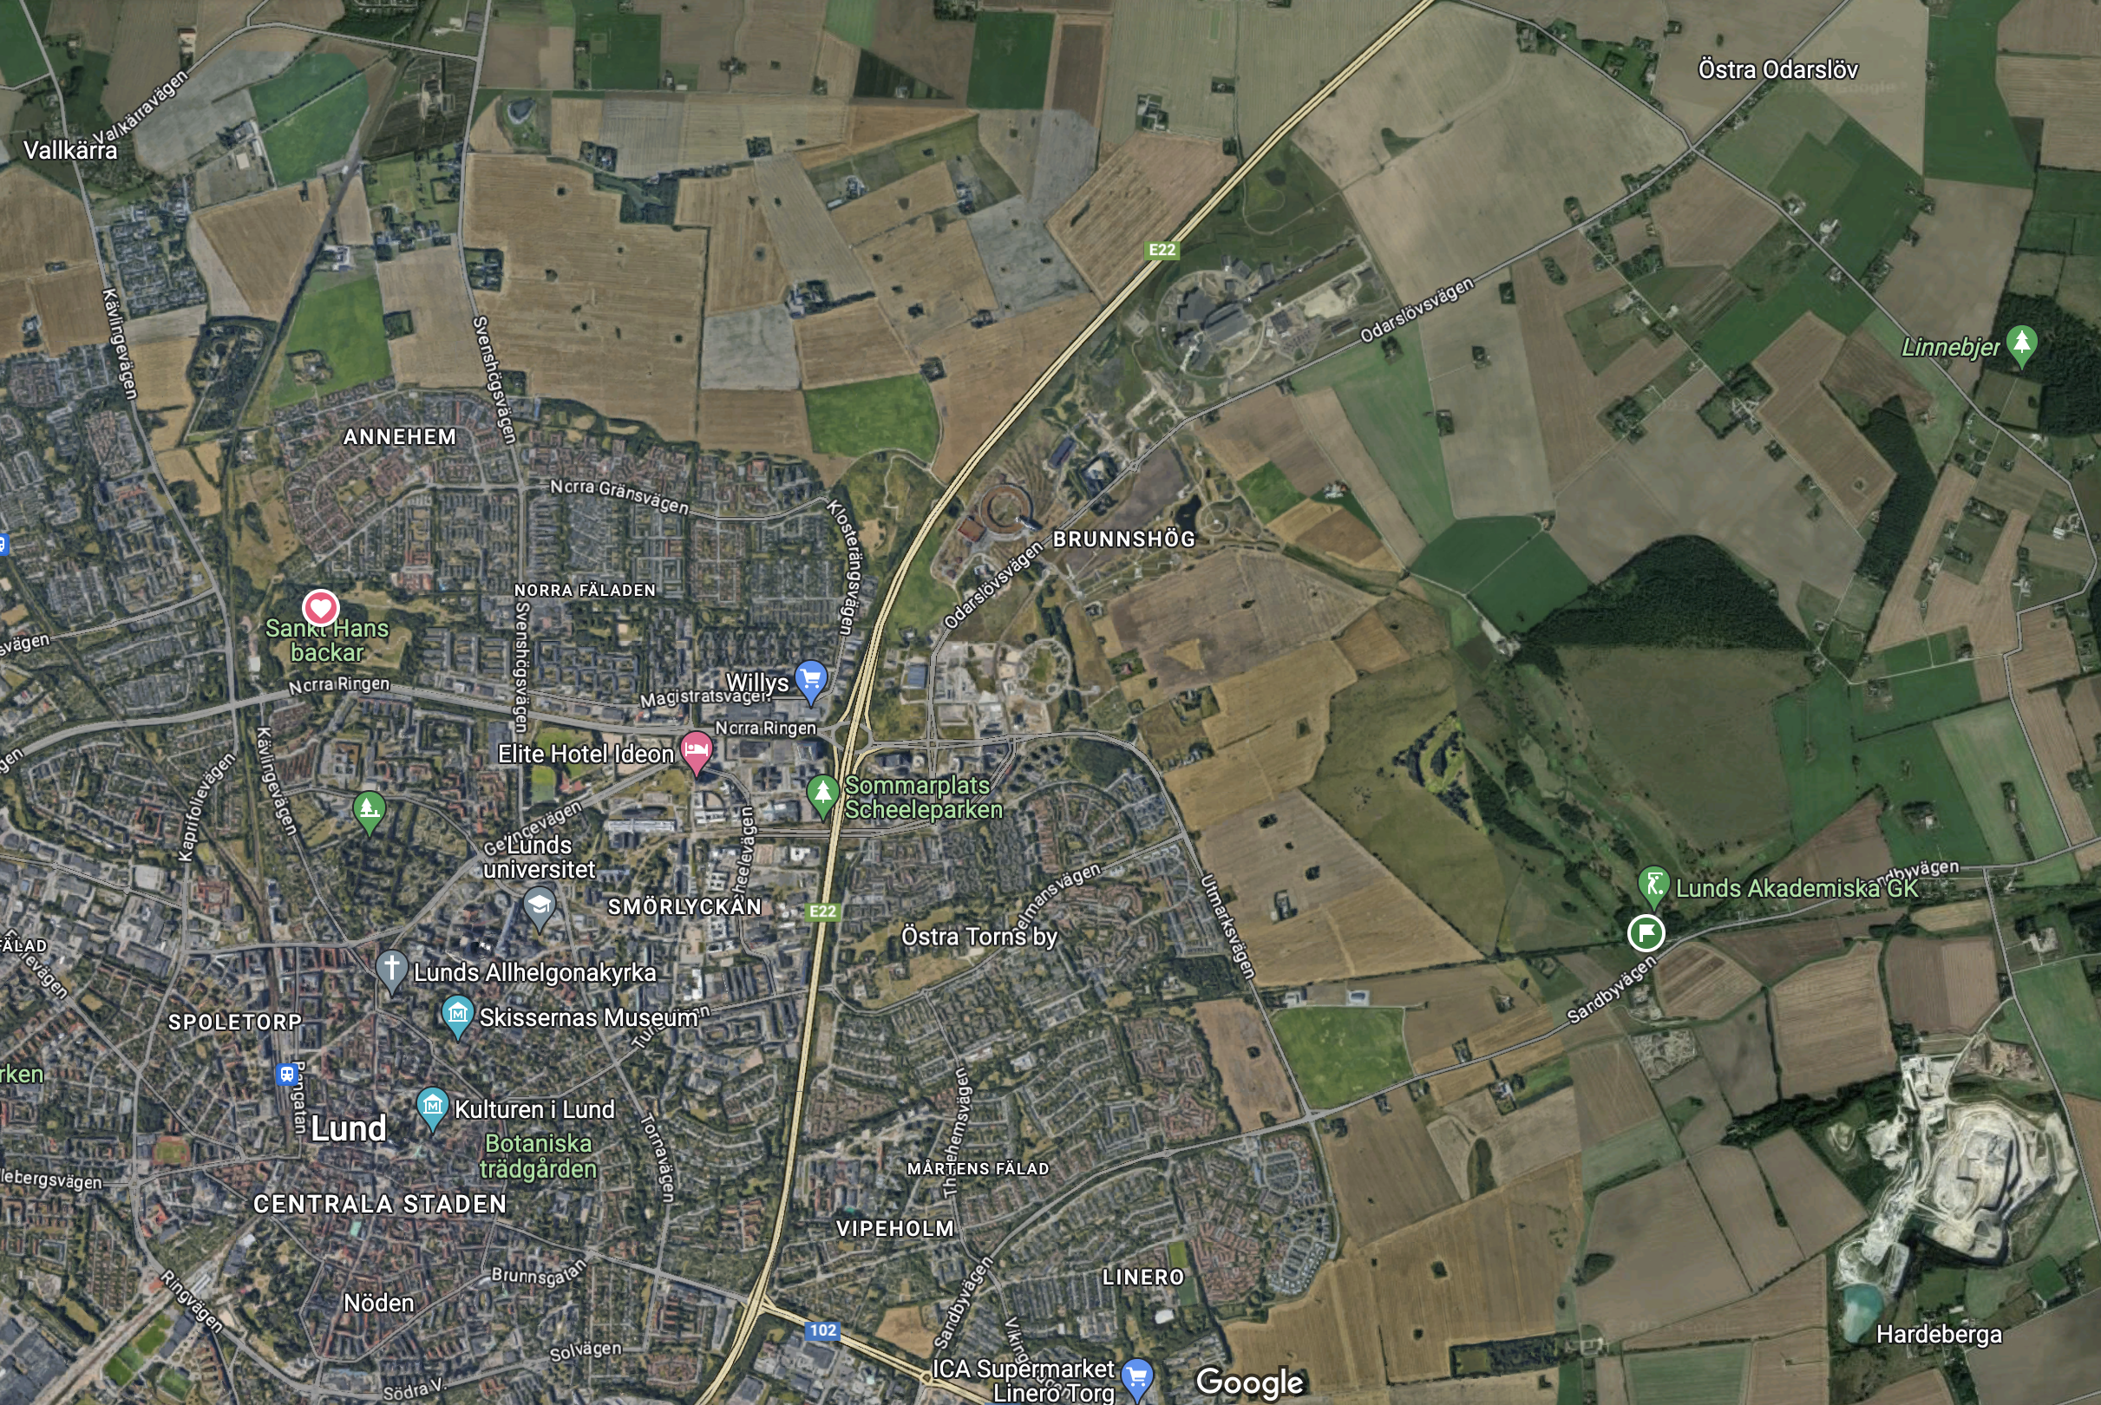
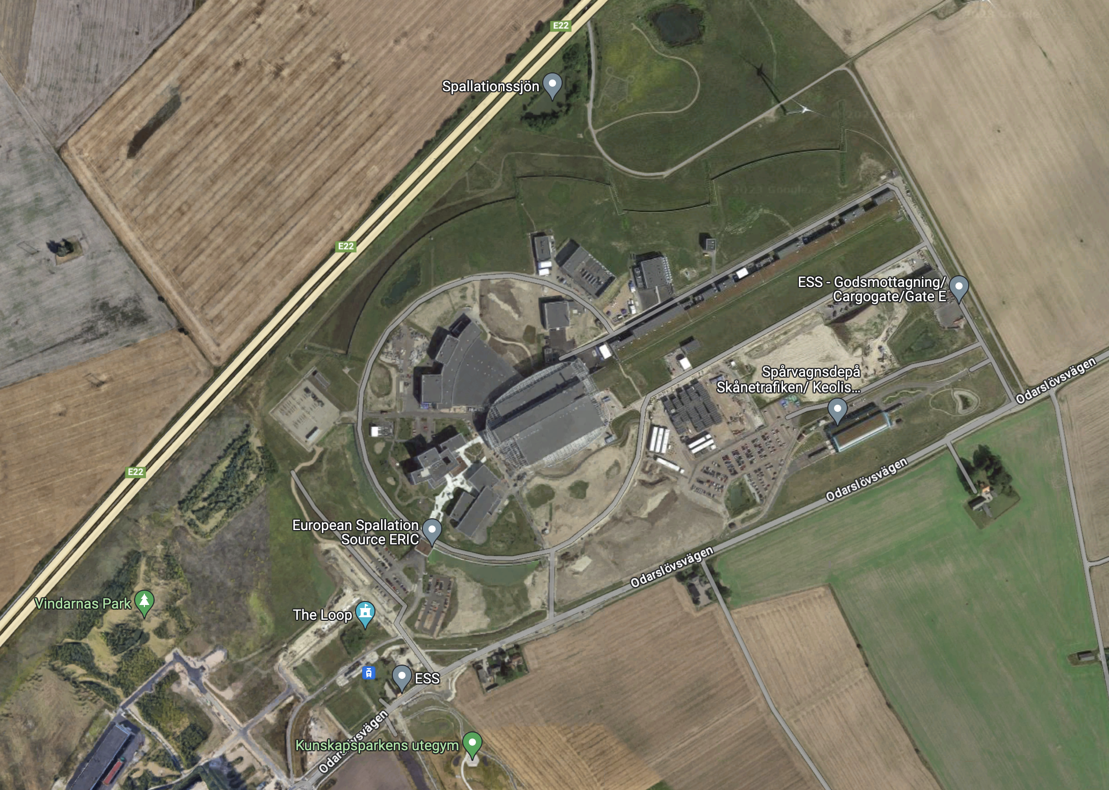
Access to the future ESSnuSB+ site
Staged approach (one step at the time..)
Currently, there is no direct
access from the highway.
ESSnuSB+ Near Detector
ESSnuSB+ Target

Slide 5
Costing
Closed session
Proposals:
Compartmentalize the budget per WP and then per deliverable
Introduce a stagged approach
  What do we need now?
  What do we need later?
Introduce project planning reviewer
Invite Recommendations from an an External Review
Actions:
WPs create their budget proposals – URGENT
Define further the critical cost driving factors
Refine the costing methodology
Stagged approach per WP

Slide 6
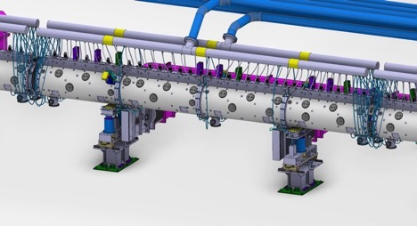
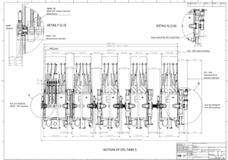
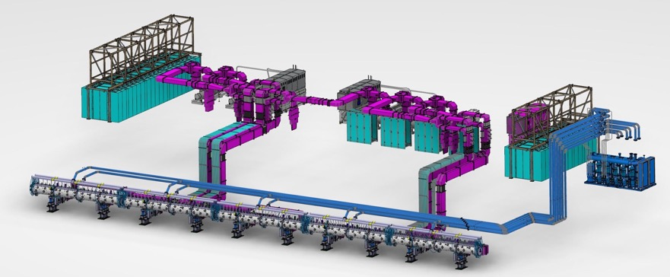
Example for WPs’ costing considerations
More than meets the eye..
A linac does contain the accelerator parts
but also the power sources, electronics, controls, waveguides, cooling sources etc
and accessiblity for side-operations such as assembly, installation, maintenace etc,
that need also design effort and space to fit in.
DTL
DTL assy for operations
DTL assy dwg

Slide 7
Licensing
Time estimations for ESSnuSB+
Licensing for ESS site: ~ 2 years
  Finalize baseline design
  Legal advisor, technical, environmental consultation
  Geotechnical, hydrological, environmental, legal pre-studies
  ESS supervisory authorities preparation
  Early municipal consultation & building permit application
Total duration for ESS site start-up to permit incl. Environmental Code, Swedish Radiation Authority, etc.: ~ 4-10 years
  Swedish Environmental Code applications, verifications, etc.
  Impact on Geotechnical, hydrological, environmental aspects
  Applications, Risk assessments, safety investigations, Permit decisions, etc.
  Licensing team: 5 FTEs for 5 years
  Preliminary Engineering Design
  Shielding & sealing calculations
  Annual licensing costs to SSM (Swedish Radiation Authority) increases during the permit process
Total duration for Zinkgruvan site: ~ 4-10 years
  Groundwater alteration permit (Vattendom)
  Hazardous activity legal process
  Swedish Environmental law (Miljöbalken) consultation

Slide 8
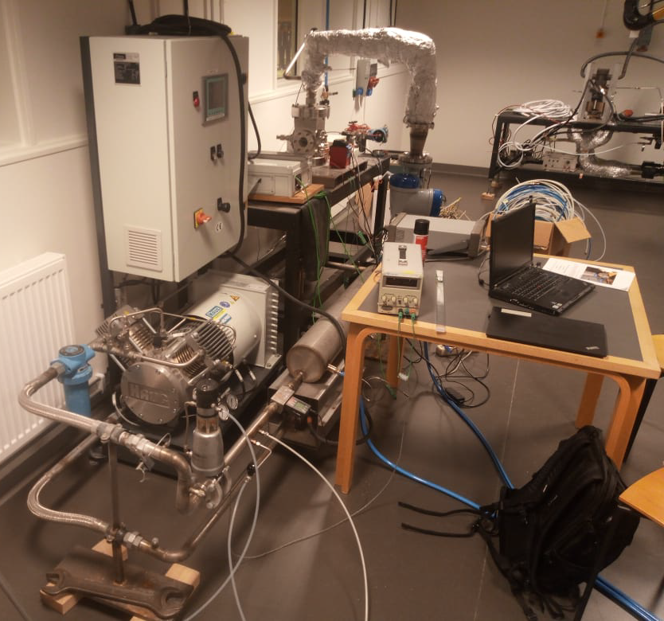
ETHEL moving & HiRadMat tests
Decision to move the ETHEL testing to ESS MML
As discussed and decided in the ESSnuSB+ First Annual Meeting, the ETHEL testing bench will move to ESS MML.
Preliminary date for the move is May-June 2023.
Andrea Bignami will participate at the February 2023 testing campaign at LTH in order to gain insight and hands-on experience in the ETHEL bench.
An effort will in parallel look into purchasing standard parts for the ETHEL bench, as part of the ESS MML infrastructure.

Slide 9
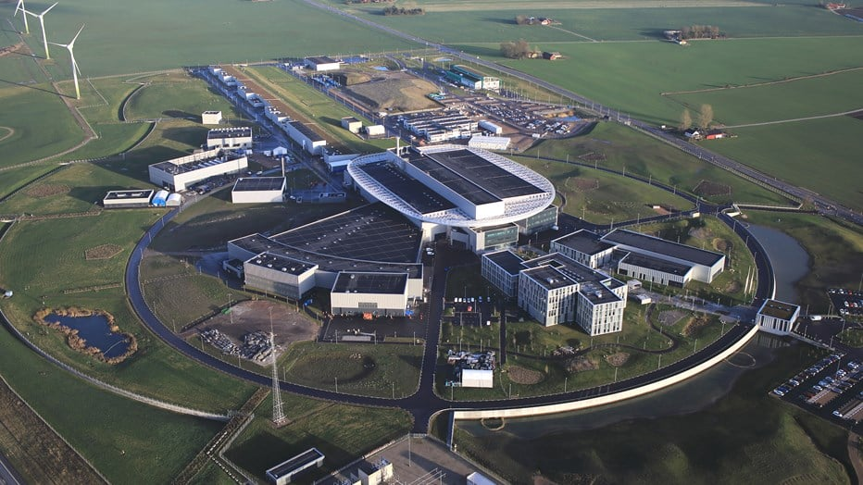
Discussion
For your consideration
Decision on Vertical bend & extraction from the ESS LINAC
Access & Logistics to ESS site
Licensing, infrastructure and cavern excavation for the Far Detector site
other
Near
Detector
ESSnuSB+
Target

Slide 10
Thank you.

Slide 11
Agenda for WP2+ session on Wednesday 18 Oct.
1 Introduction – Nick Gazis
2 Physics Requirements & Input – Mamad Eshraqi
3 SPIRAL2 Construction Management at GANIL – Jean Michel Lagniel
4 ESS civil engineering & licensing – Boris Kildetoft
5 Costing considerations & licensing – Dawid Patrzalek
6 Design & model updates – Emmanouil Trachanas
7 ETHEL tests & lab possibilities at ESS MML – Andrea Bignami
8 Far Detector civil engineering & licensing – David Saiang
9 Discussion

Slide 12
WP2+Engineering & Infrastructure
Members, roles & contact info
WP2+ New IAP Member: Gerardo D’Auria gerardo.dauria@elettra.eu
WP2+ Leader & ESS site responsible: Nick Gazis nick.gazis@ess.eu
Deputy WP2+ Leader & Far Detector site responsible: David Saiang david.saiang@ltu.se
Overall ESSnuSB+ cost responsible & licensing: Dawid Patrzalek dawid.patrzalek@ess.eu
Civil design & licensing for the ESS site: Boris Kildetoft boris.kildetoft@ess.eu
ESS site design, EL infra responsible & MoM Admin: Emmanouil Trachanas emmanouil.trachanas@ess.eu
Model & CAD design responsible: Michail Anastasopoulos michail.anastasopoulos@ess.eu
(with support from Rasmus Johansson rasmus.johansson@ess.eu)
ESS MML lab tests & measurements responsible: Andrea Bignami andrea.bignami@ess.eu
Physics requirements & input: Mamad Eshraqi mamad.eshraqi@ess.eu & Natalia Milas natalia.milas@ess.eu
(with support from Jean-Michel Lagniel jean.michel.lagniel@gamil.fr)
Administration, Legal, Grants & Collaboration admin responsibles:
Adrameh Gaye adrameh.gaye@ess.eu & Martha Dadson martha.dadson@ess.eu

Slide 13
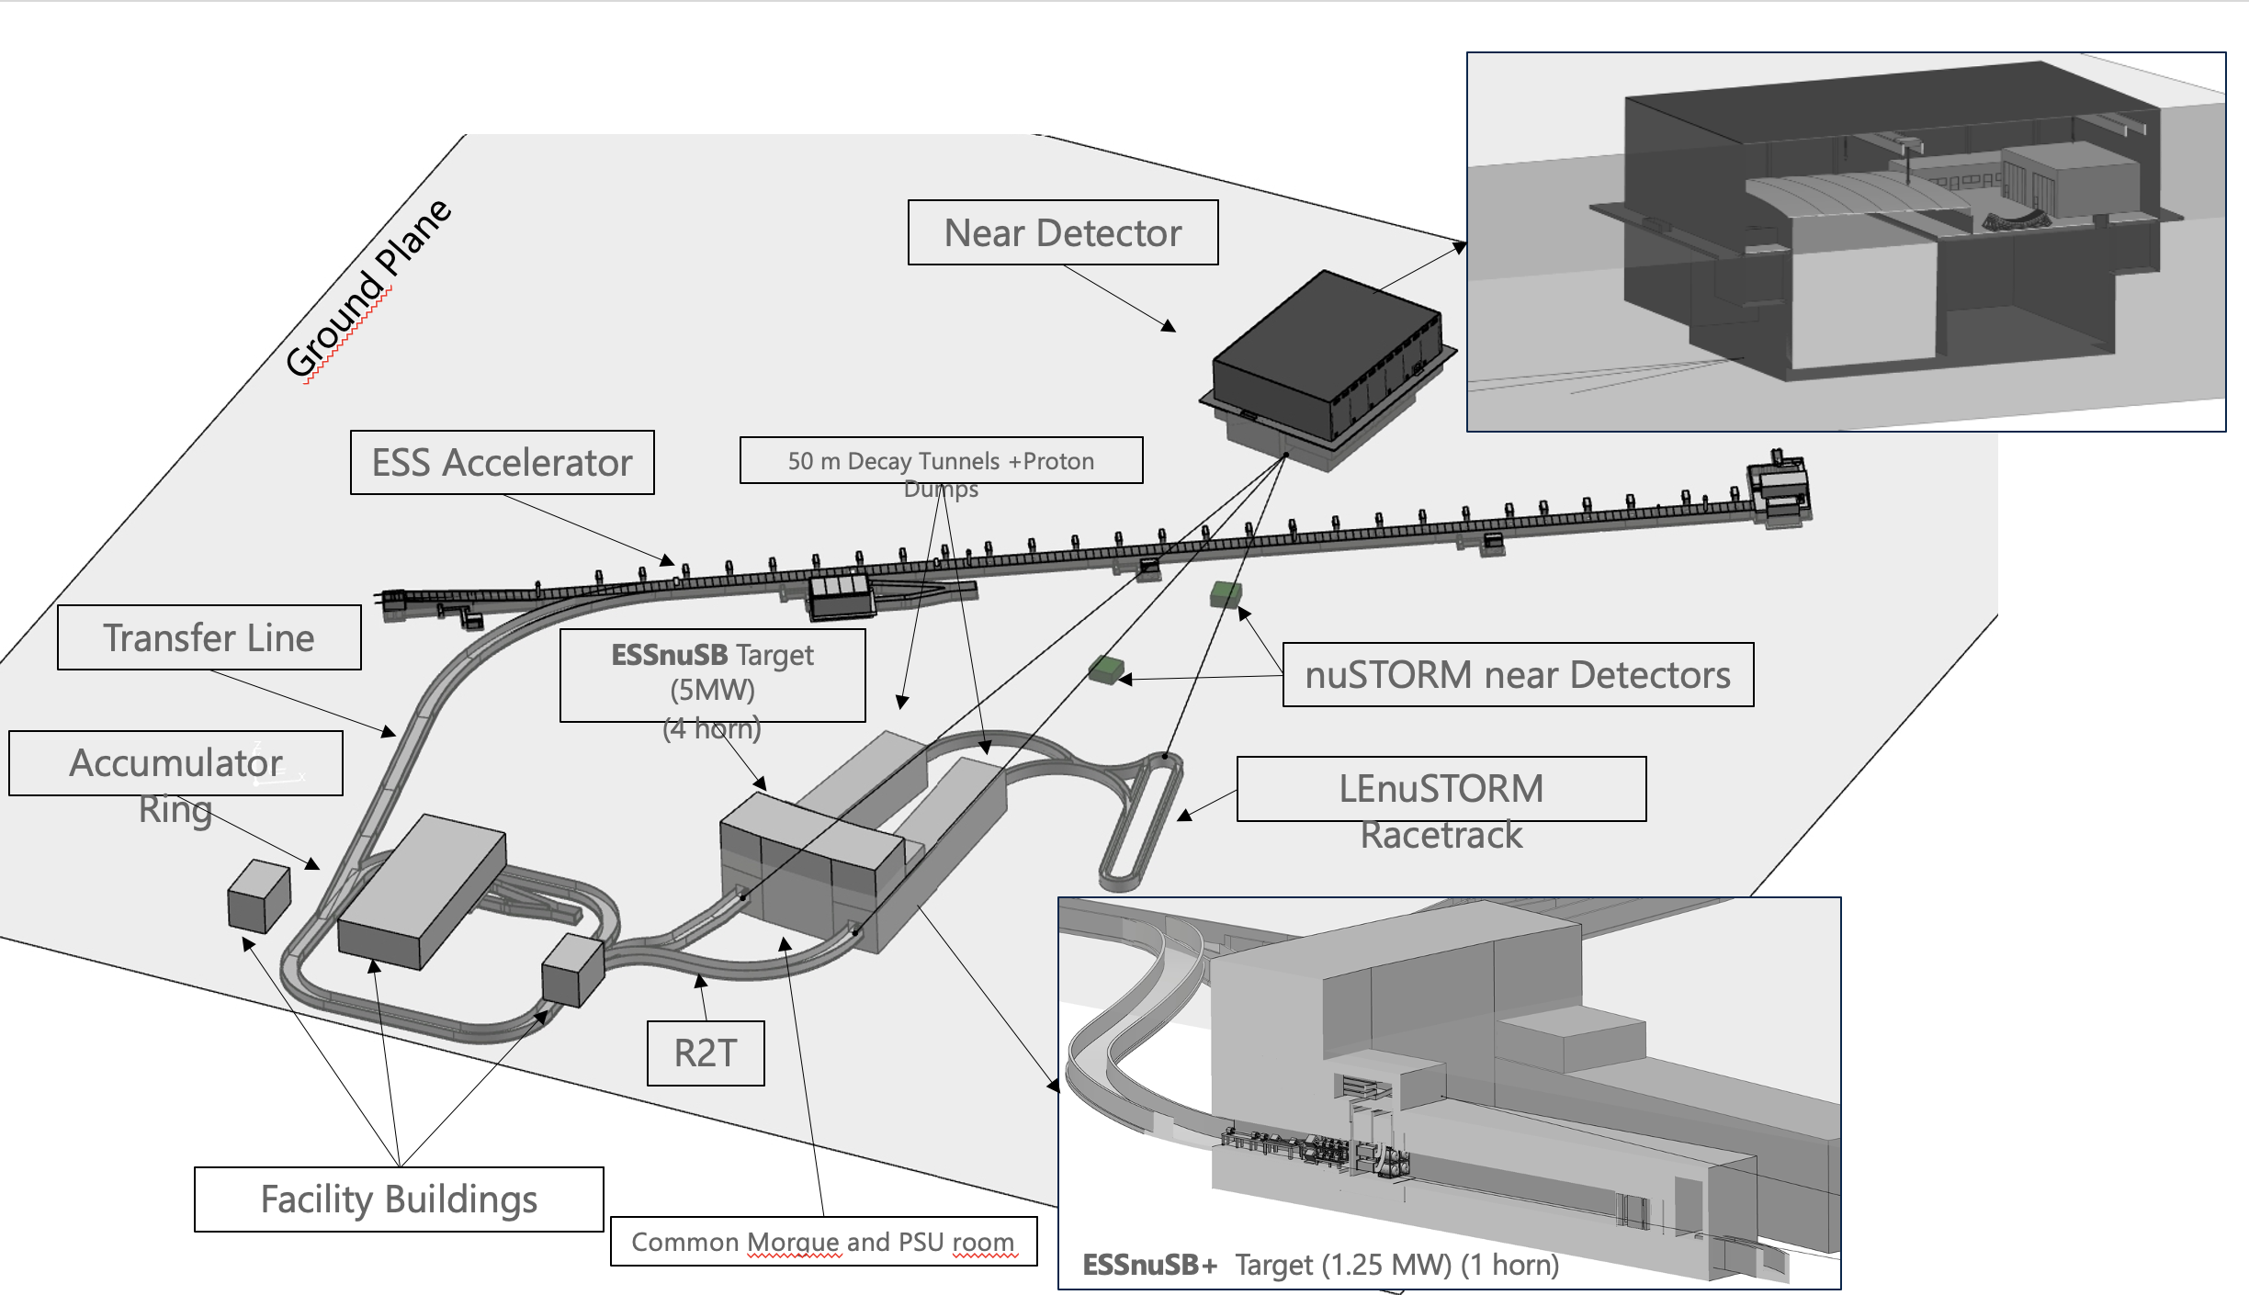
Mechanical Design update (ESS-4965198)
Latest 3D design

