Slide 1
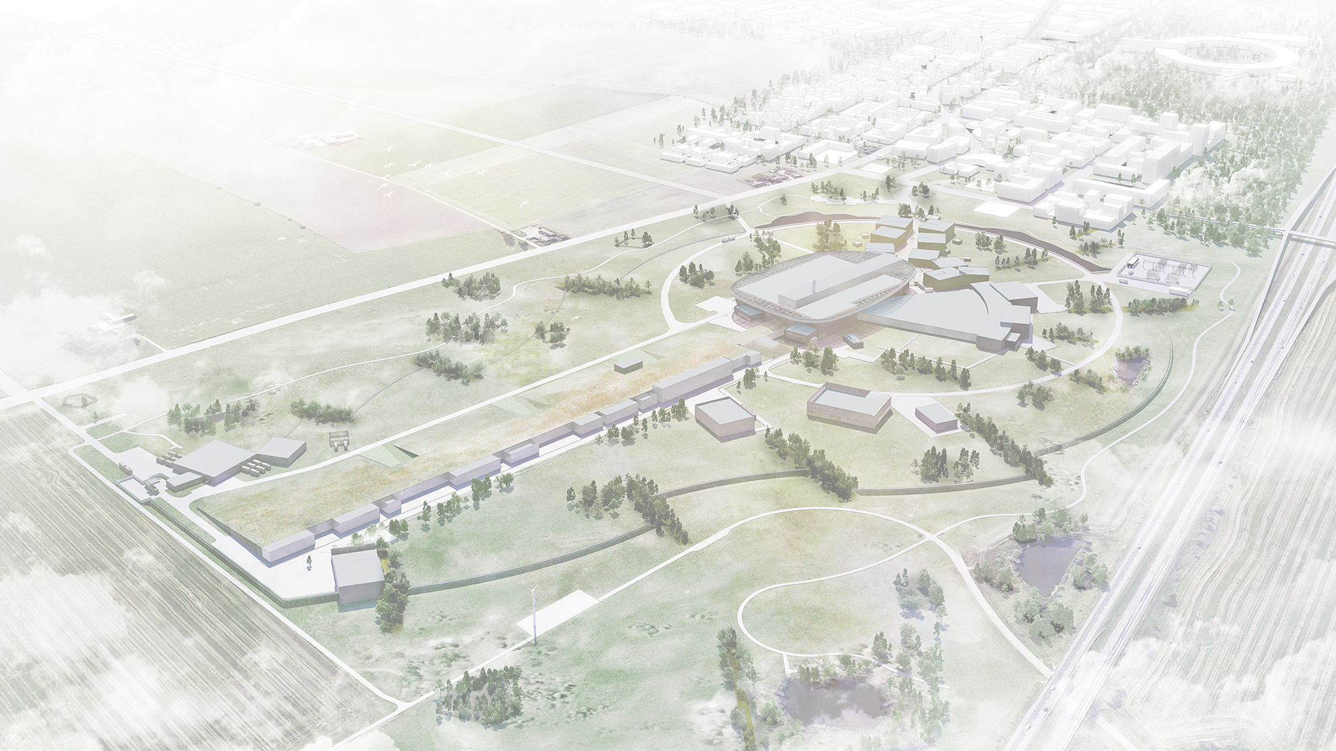

WP2 – Civil works
Boris Kildetoft, Architect SAR/MSA SWECO
Design Coordinator ESS Conventional Facilities
boris.kildetoft@ess.eu
+46 768 08 51 13

Slide 2
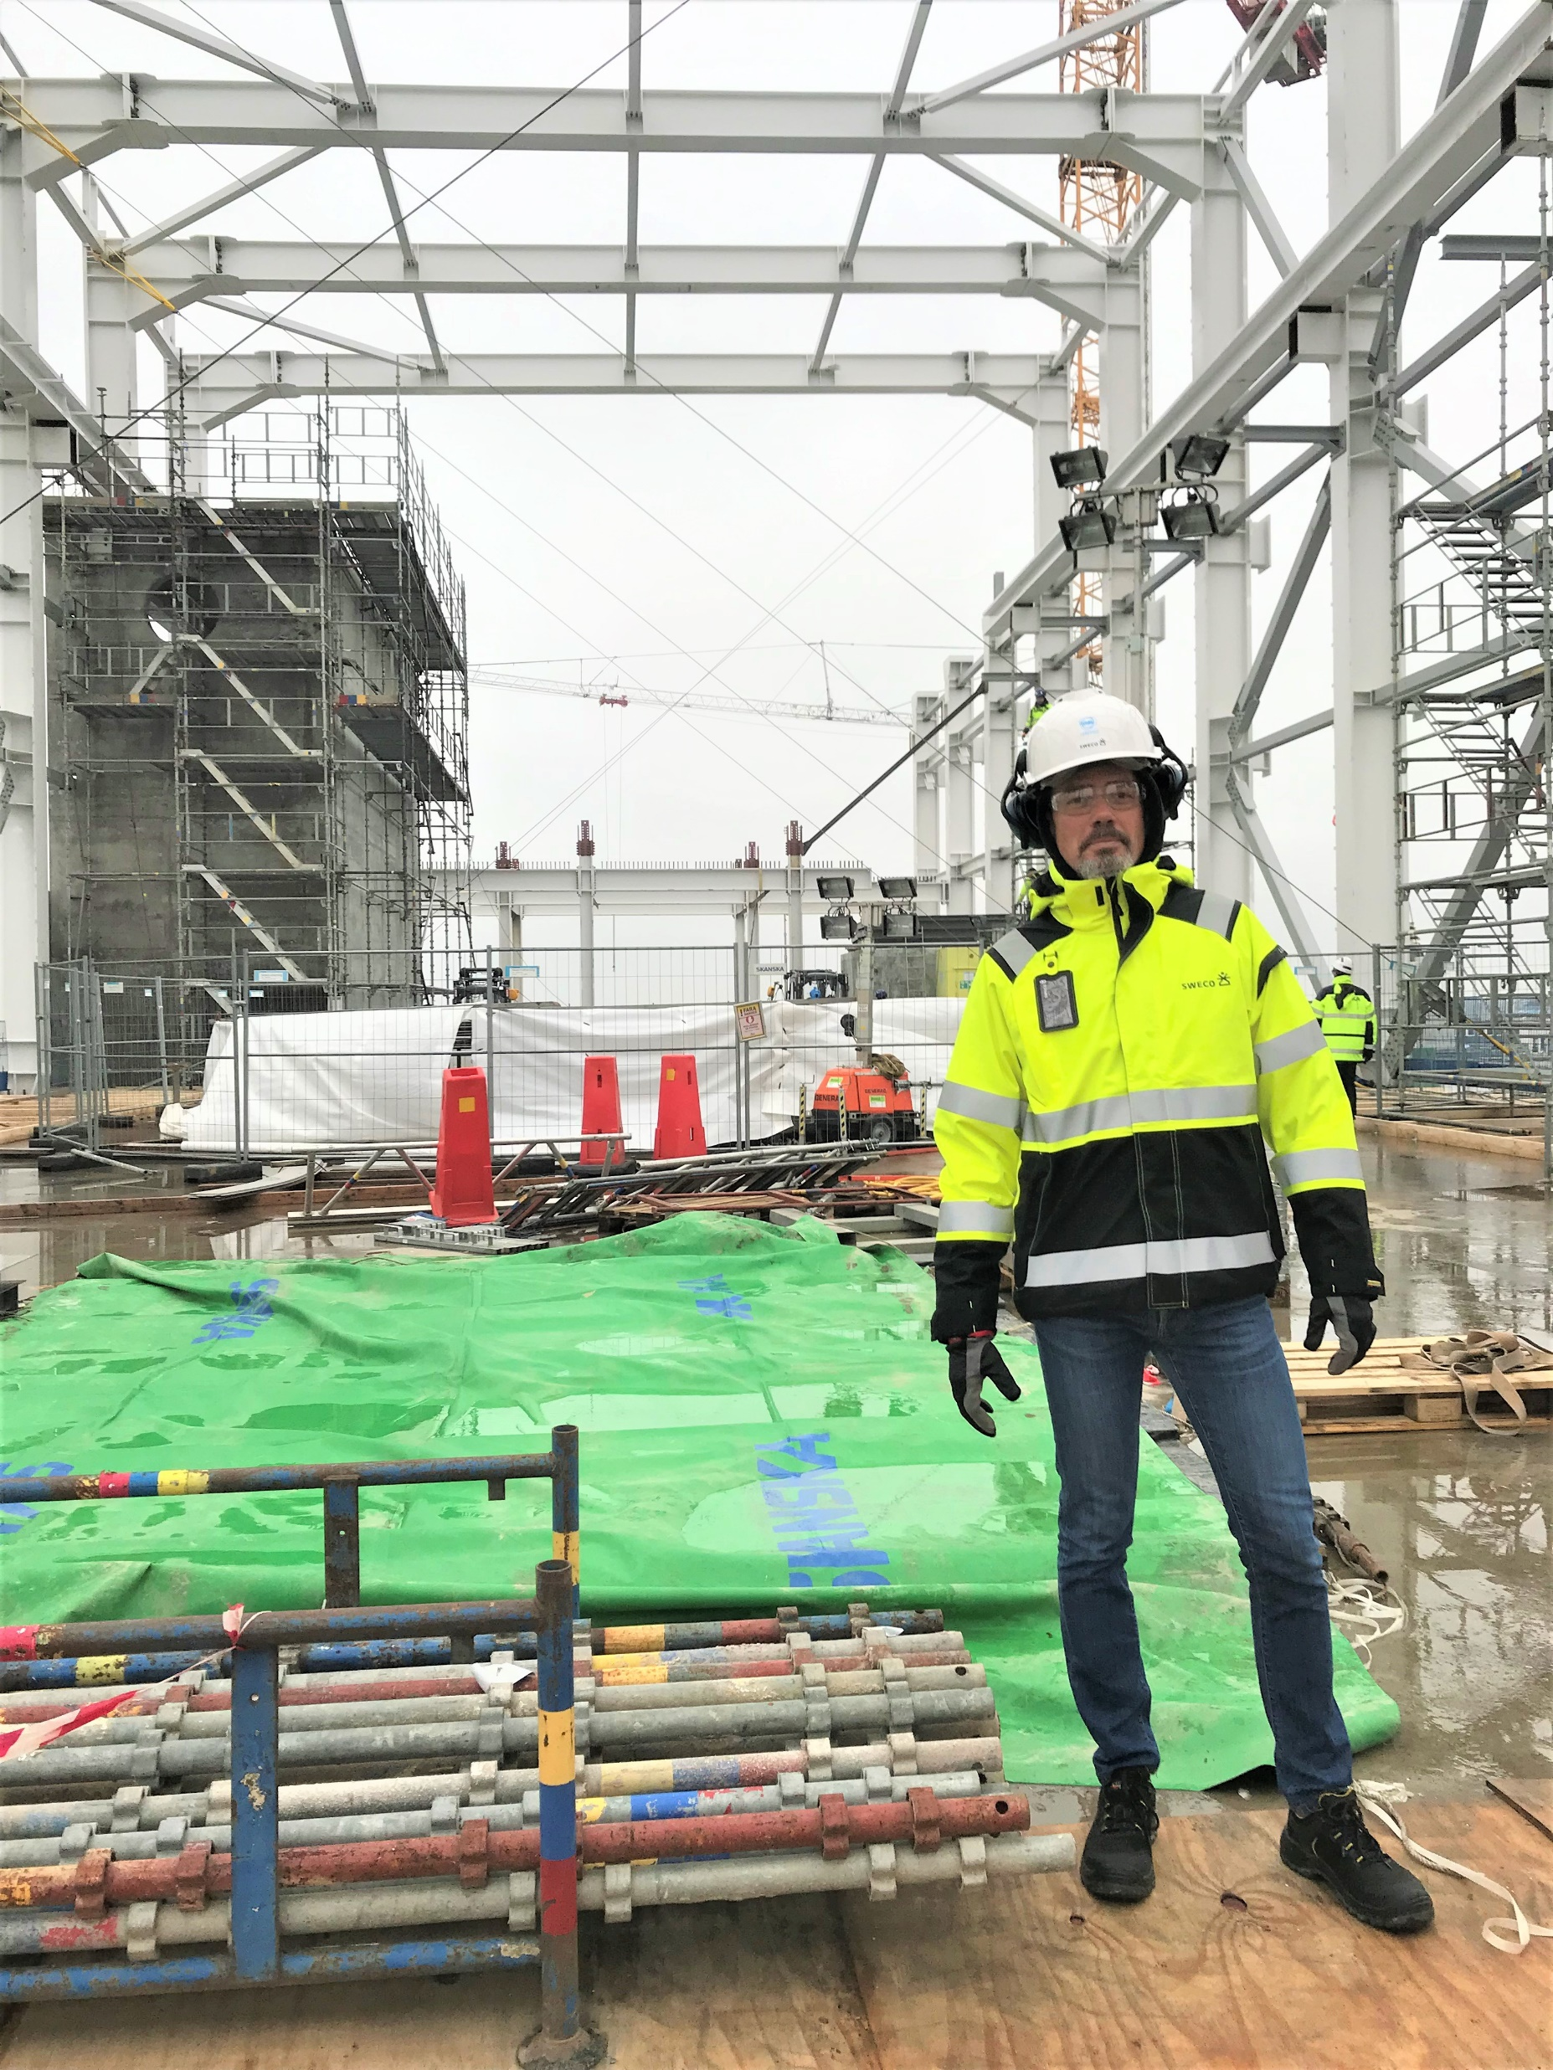
Personal background and previous assignments
1995-2005 Öresund bridge, Turning Torso, Citytunneln Malmö
2006 MAX-lab IV Synchrotron
2009 ESS building program development
2012 Secretary for the ESS architectural competition
2013 ESS Site wide design coordinator
2014 Preliminary design of ESS auxiliary buildings
2018 Detail design coordinator auxiliary buildings
2023 FM support at ESS – instrument environment and labs
2020 Ongoing - supporting ESSnuSB+ on civil works at ESS site

Slide 3
WP2 – Civil works
Summary of preliminary site conditions and challenges for ESSnuSB+ at the ESS site
Conditions;
Geological conditions favorable and stable
Space available within the ESS site
Challenges;
Dolerite rock partially present in ground at tunnel crossing section
Groundwater levels as new structures are partially below
Shielding and safety requirements towards south critical in layout
Licensing process

Slide 4
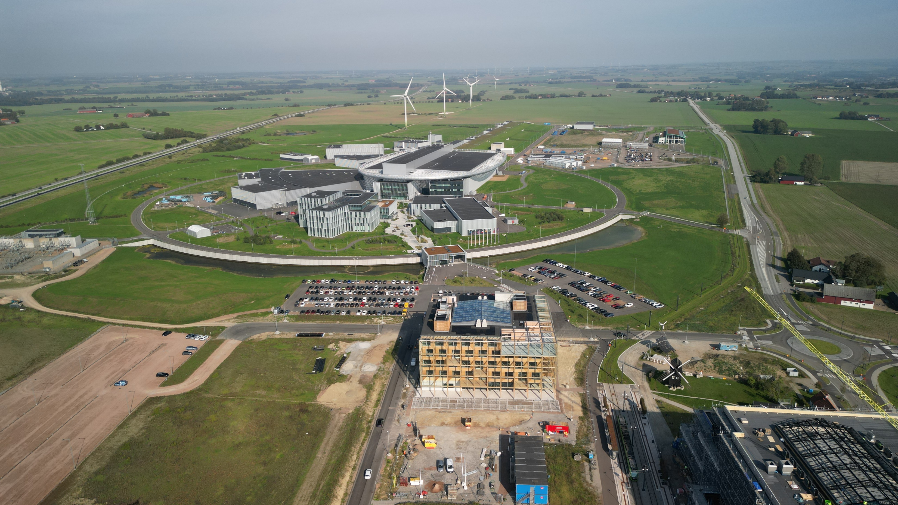
WP2 – Civil works
Current extension of ESS facility

Slide 5
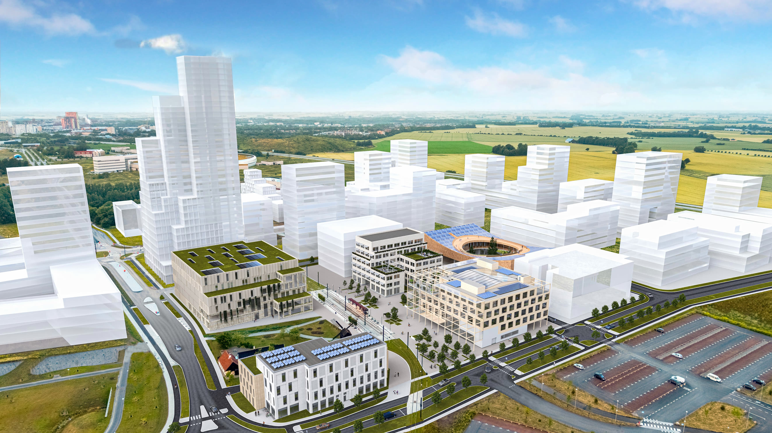
WP2 – Civil works
Sketch of SVS from ESS towards Lund

Slide 6
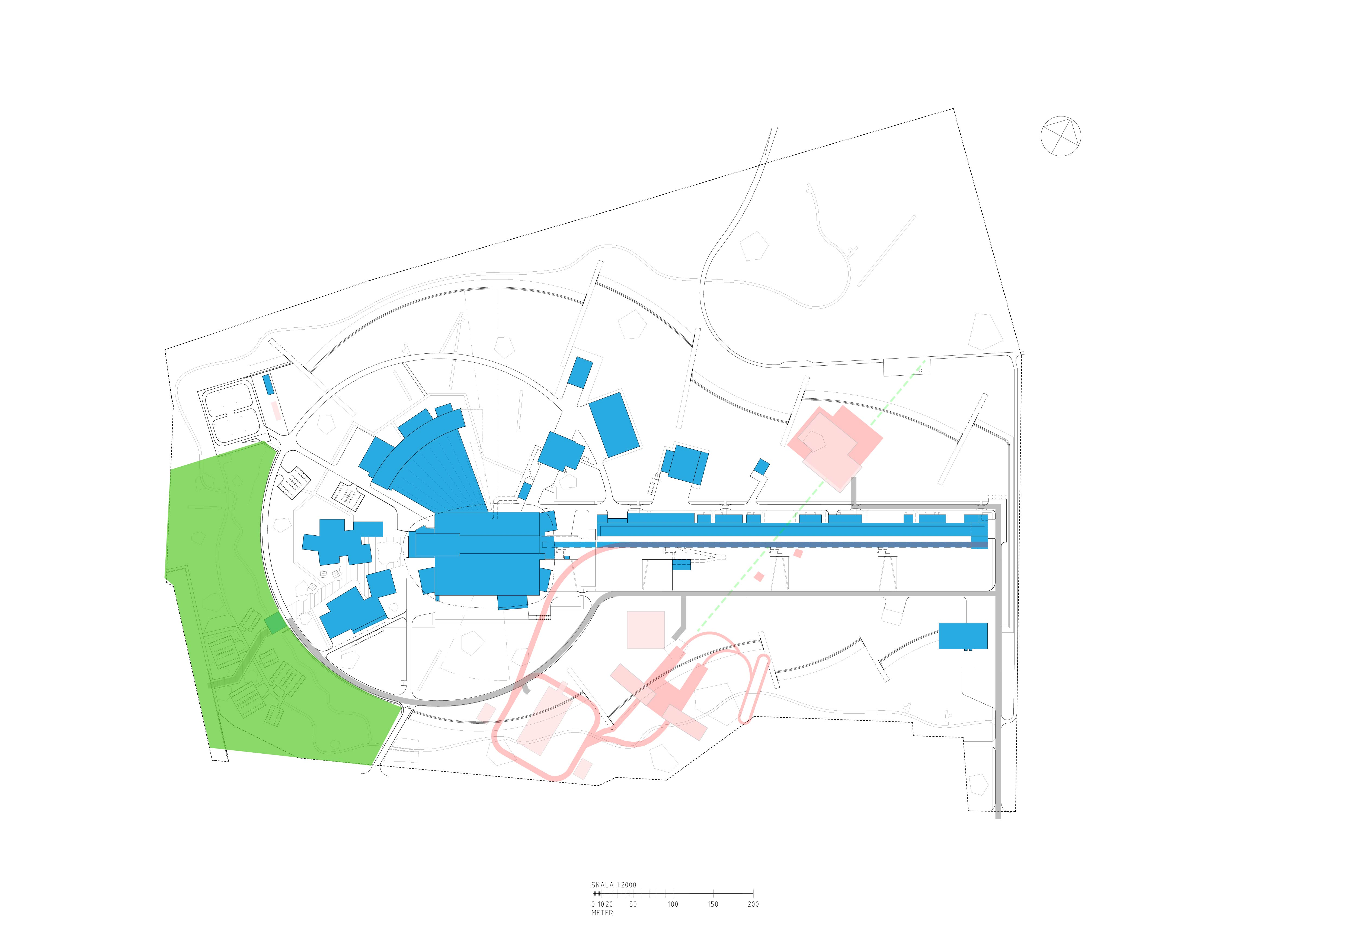
WP2 – Civil works
ESS site undeveloped area

Slide 7
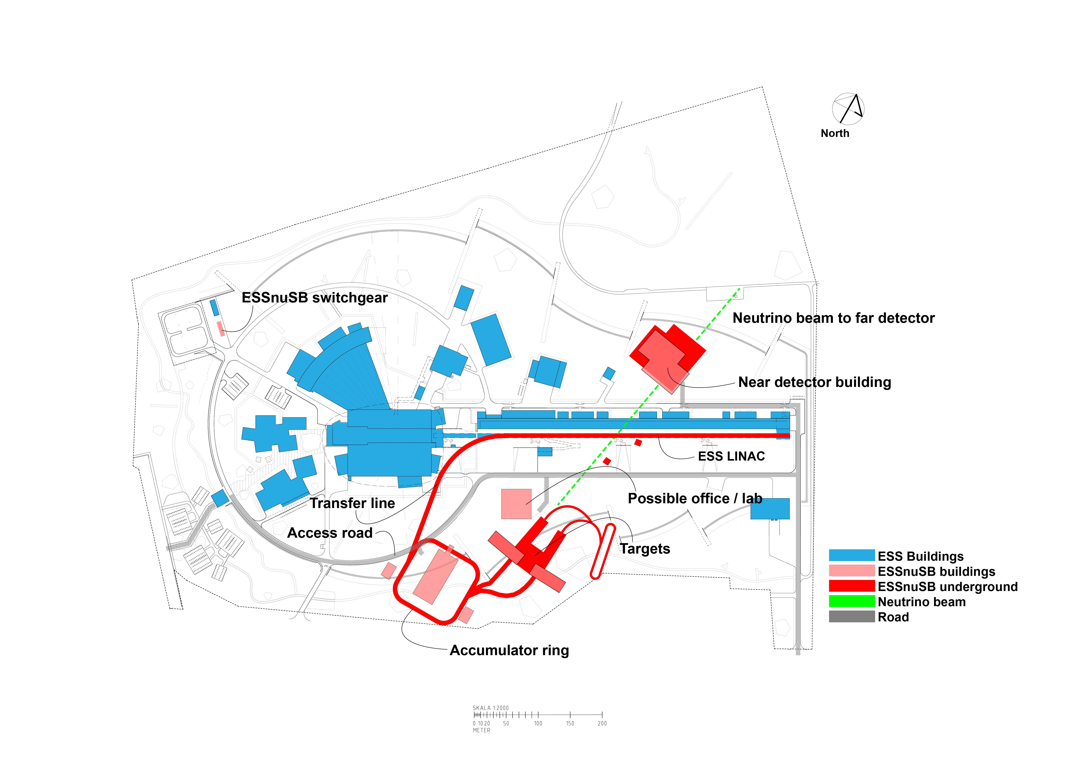
WP2 – Civil works
Current baseline layout

Slide 8
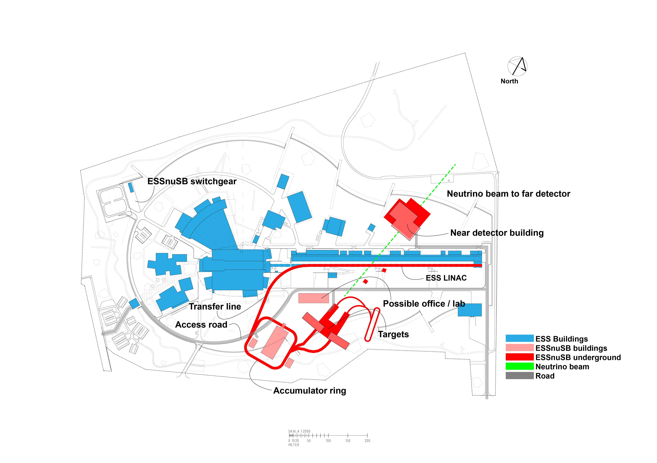
WP2 – Civil works
Alternative layout with shorter transfer line / incline

Slide 9
WP2 – Civil works
Alteration of baseline layout
seemingly not interfering
with geological

Slide 10
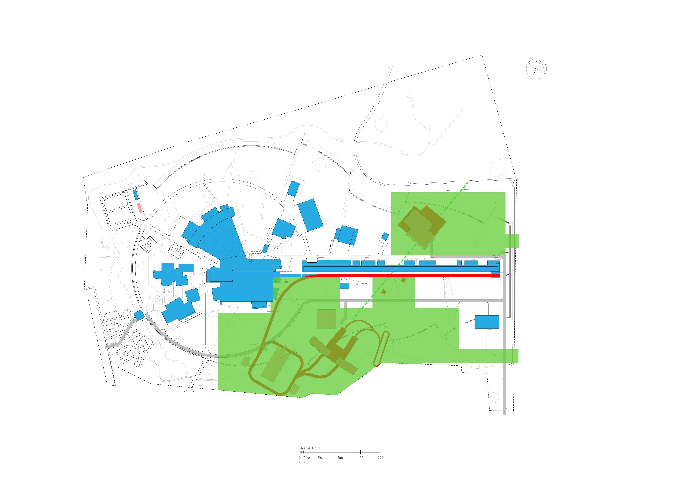
WP2 – Civil works
Perimeter and access during construction

Slide 11
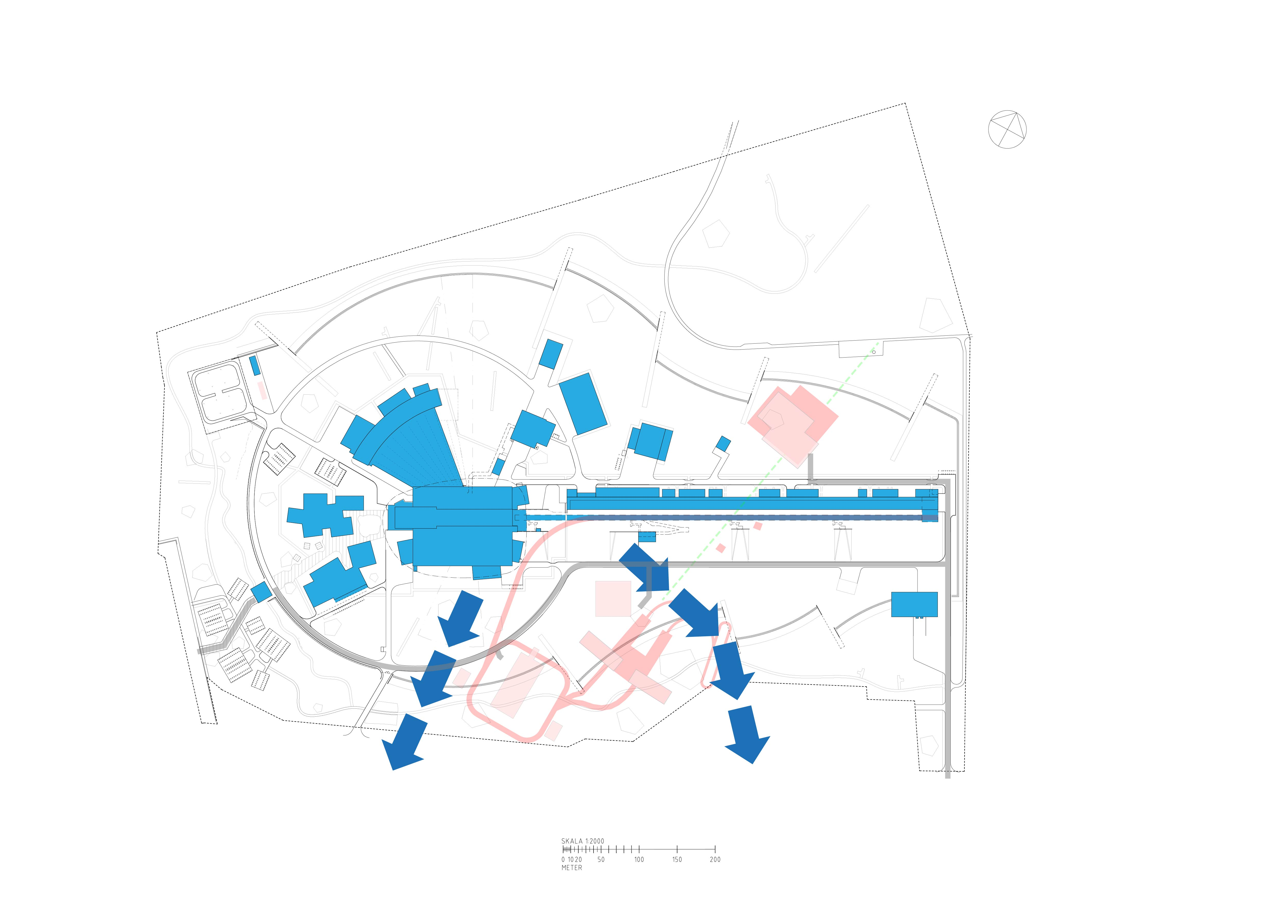
WP2 – Civil works
Groundwater runoff depending on lowest level of structures

Slide 12
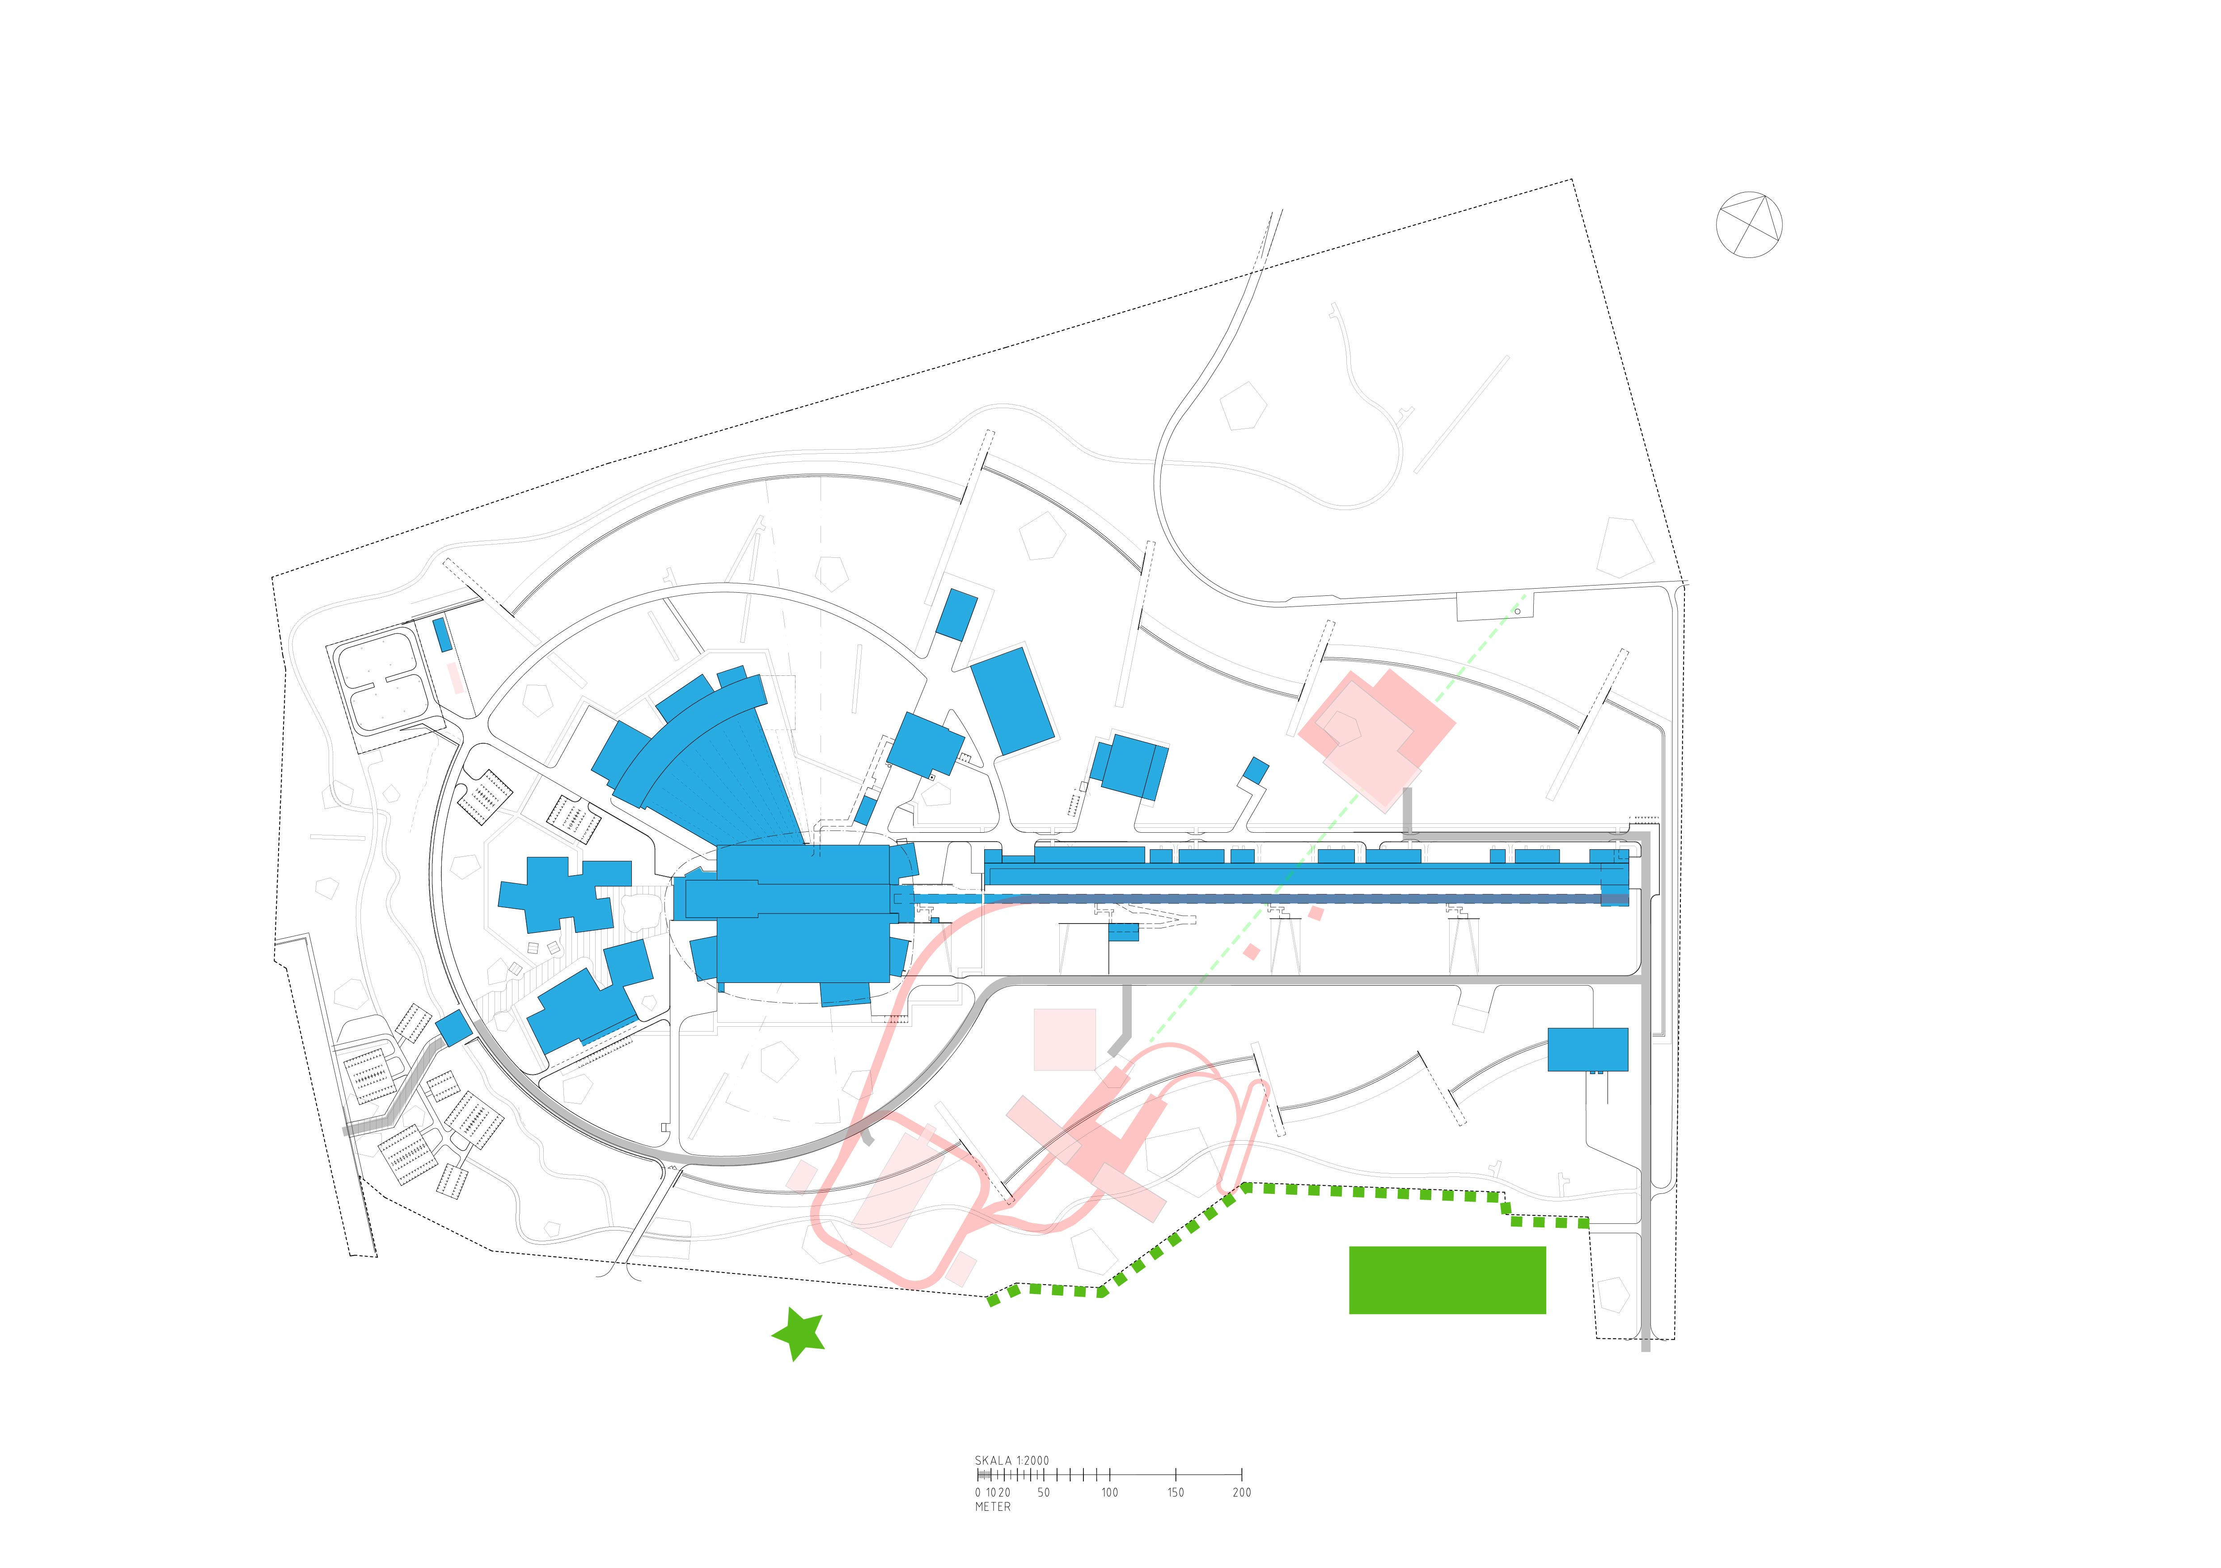
WP2 – Civil works
Third person location and tram depot

Slide 13
WP2 – Licensing
Licensing at ESS site
Concretize overall technical design
Involve legal advisor (in addition to technical/environmental consultants)
Pre-study of geotechnical/hydrological/environmental/legal aspects
Preparatory meeting(s)/communication with the supervisory authorities of ESS
Estimated time for point 1-4: 0,5-1,5 year
A municipal consultation regarding placement may be required in conjunction with the building permit application. Early discussion with municipality suggested.

Slide 14
WP2 – Licensing
Licensing at ESS site
Consultation process according to the Swedish Environmental Code
Carry out necessary technical (geotechnical/hydrological etc) and environmental impact
Investigations (including risk assessments)
Set up the full application(s)
Hand in the application(s) and await permit decision(s)
The process according to Swedish Environmental Code should / could be applicable also for ESSnuSB+ but this needs to be verified
Estimation of total time duration from start-up until final permit according to the Environmental Code and the first permit from the Swedish Radiation Protection Agency: approx. 4-10 years

Slide 15
WP2 – Licensing
Licensing at ESS site
Estimated time used for licensing by ESS team - 5 persons for 5 years
Consultants and design management for technical preliminary design process
Assessment of shielding and shielding calculations
Licensing cost paid to SSM (Swedish Radiation Safety Agency) annual € 650.000 will increase as ESSnuSB+ starts permit process

Slide 16
WP2 – Licensing
Licensing at Zinkgruvan site
Permit for change of groundwater required (Vattendom)
Hazardous activity to be trialed against law
Consultation according to Swedish Environmental law (Miljöbalken)
Estimated timeline 4-10 years for all permits

Slide 17
WP2 – Civil works
From TDR to civil project, consider using facilities project to optimize and integrate
Transfer line |  | Accumulator |  | Target |  | Detector |  | Utilities
Civil 1 |  | Civil 2 |  | Civil 3 |  | Civil 4 |  | civil 5
Civil structures and facilities project

Slide 18
WP2 – Civil works
Summary of issues to consider as basis for civil works design and licensing
Licensing process with legal authorities (SSM and environmental legislation)
Scientific program (TDR as basis for design)
Location and preliminary planning
Contracts for land
Building program
Architectural competition or parallel assignments (discuss with municipality)
Building permit
Preliminary design
Construction start (excavation and infrastructure)
Detail design
Completion

Slide 19
WP2 – Licensing

