Slide 1
WP2 – CIVIL ENGINEERING – FAR DETECTOR
David Saiang
LTU

Slide 2
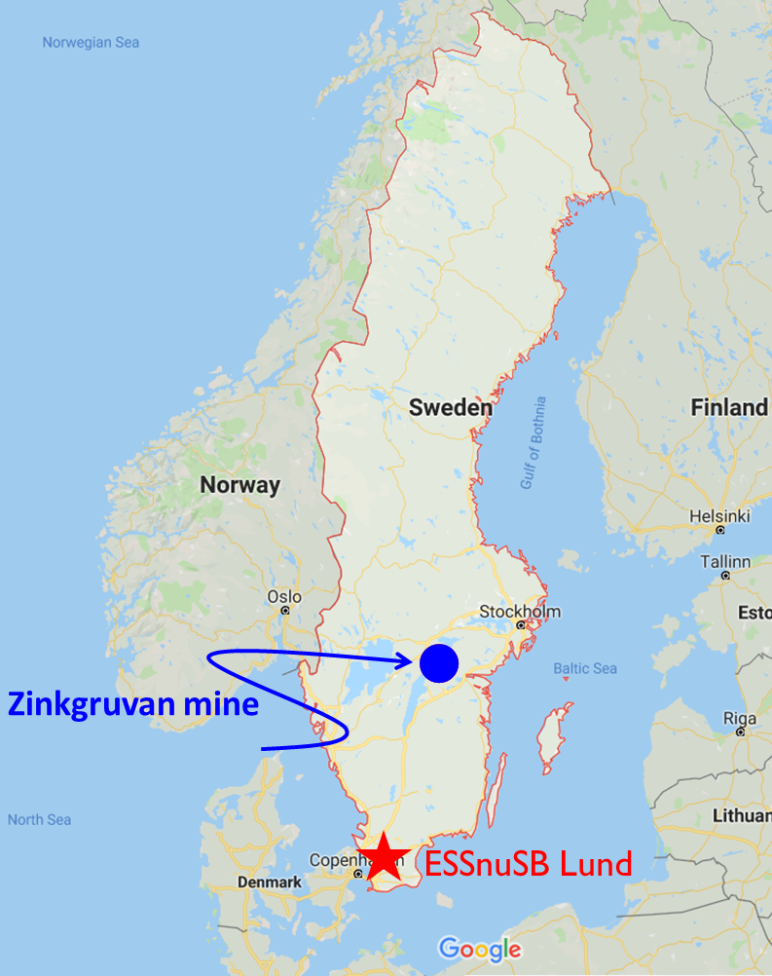
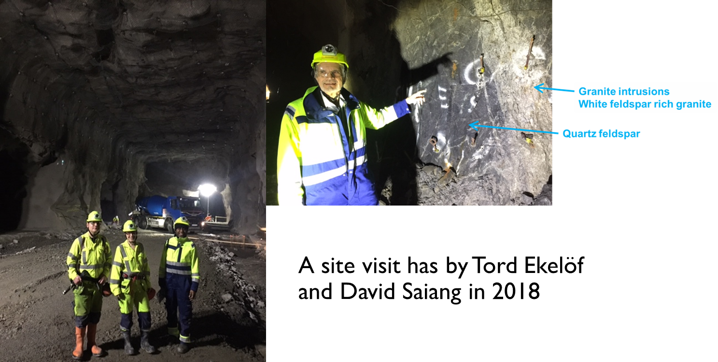
Where is the Far Detector (FD) planned?
~370 km

Slide 3
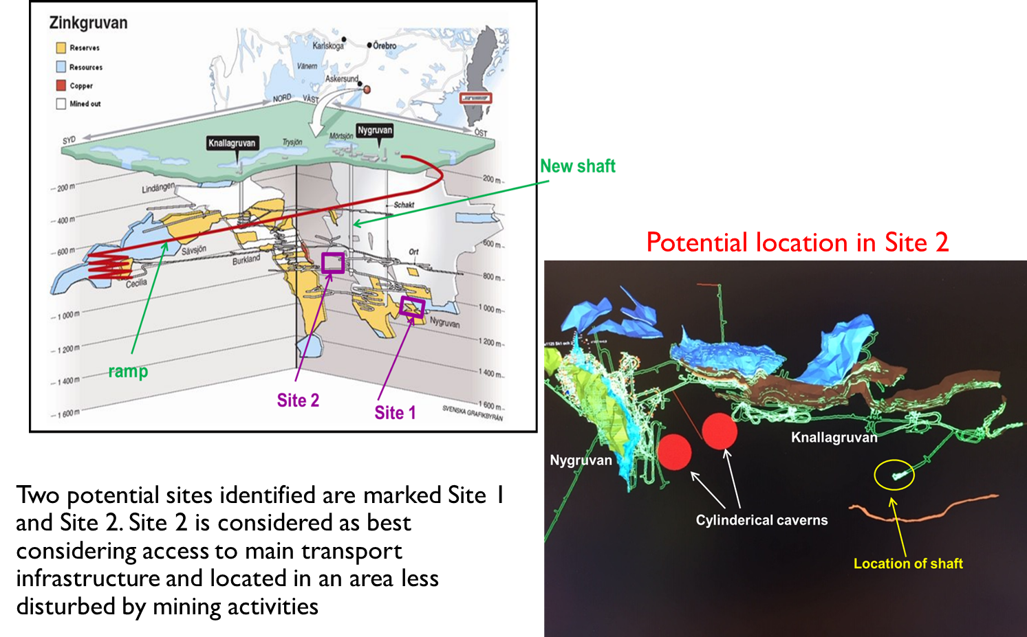
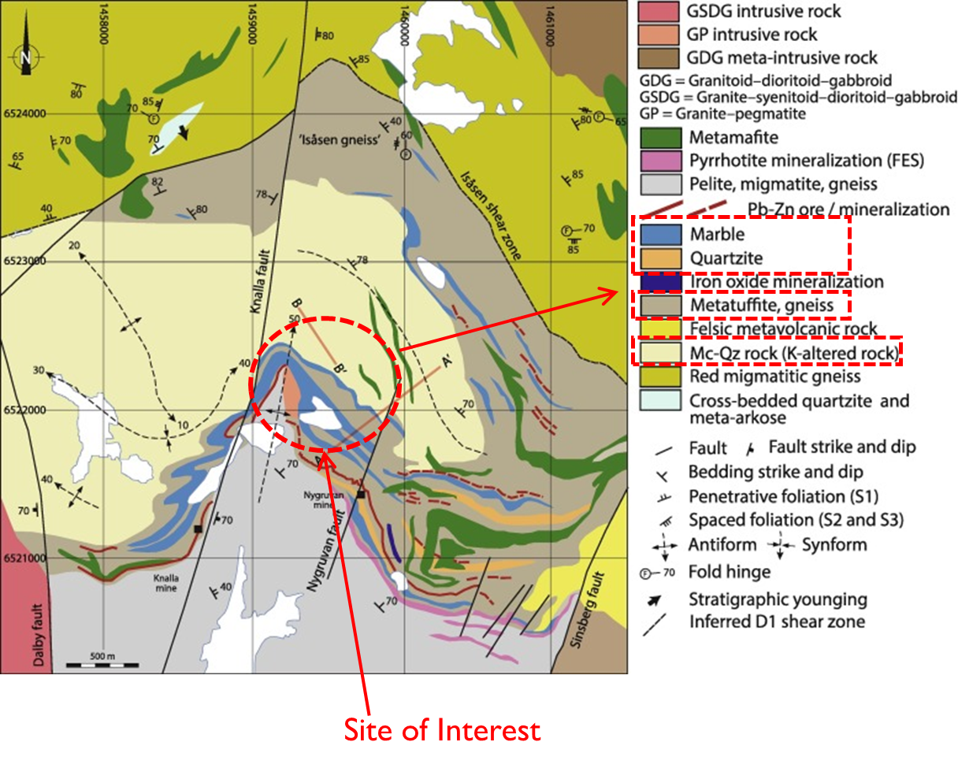
Zinkgruvan Mine
Areas of interest

Slide 4
HIGHLIGHTS OF PROGRESS TO DATE
Series of meetings with Zinkgruvan Mining (2023)
Zinkgruvan Mining admitted to ESSnuSB+ Consortium (2023)
Zinkgruvan appointed permanent contact, Anders Gustafsson, for ESSnuSB+ at the mine.
As sign of ”commitment” to support ESSnuSB+ the Zinkgruvan Mine Manager Mr. Craig Griffiths is participating at ESSnuSB+ Annual Meeting, as well as participating in the visits to Hyper-K and Super-K in Japan.
Memorandum of understanding between UU, LTU and ZM
Visited Snolab – Sudbury (March 2023) - Canada
Visited Hyper-K and Super-K (September 2023) - Japan
Visited pulsed power rock cutting techology lab (August 2023) – USA
Applied for funding – (i) ERAMIN Horizon Europe (ii) SMI/VINNOVA - 2023

Slide 5
Challenges to date
Far Detector Civil Engineering received <5% of the ESSnuSB Design Study budget
  Only sufficient for concept level studies
  Cannot fund Zinkgruvan Mining
  Because of RISKS - Zinkgruvan will only accept design level study to progress forward. Detailed evaluation with diamond drilling is mandatory!
Particle Physics Research is NOT a core business for Zinkgruvan Mining (nor a core reseach area for Luleå University of Technology)
  Therefore, Zinkgruvan cannot commit resources unless they are paid
  Therefore, LTU cannot be generous with in-kind contribution.

Slide 6
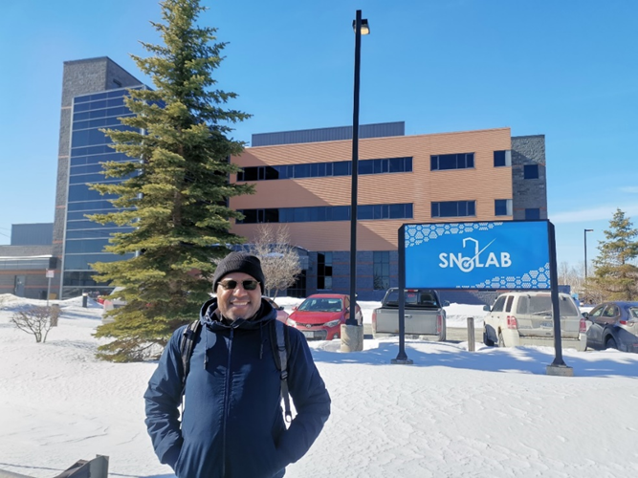
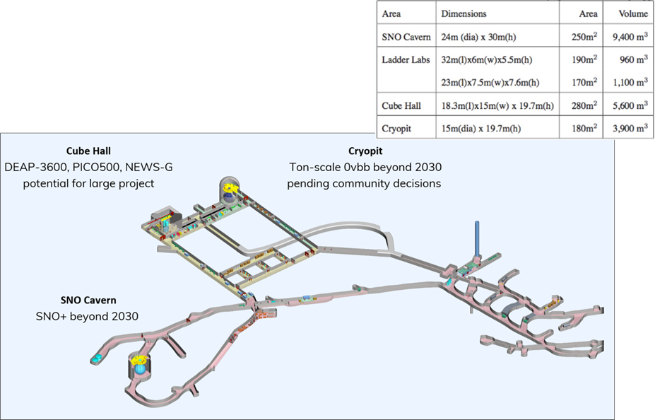
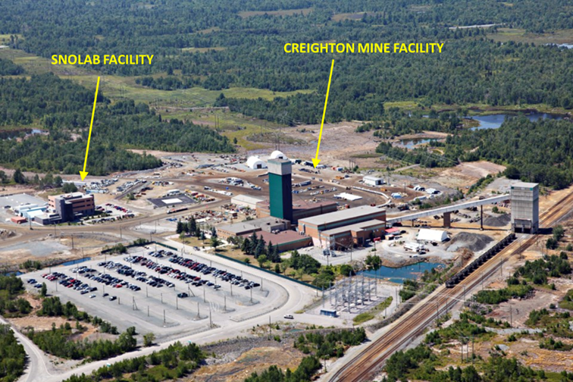
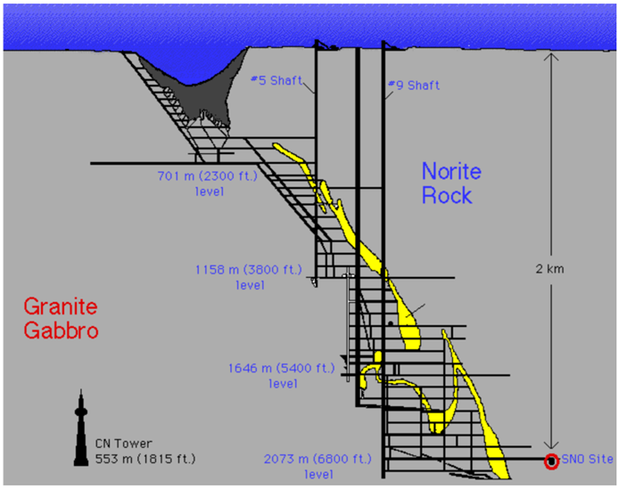
SNOLAB
Located at Vale’s Creighton Mine (Sudbury)
  2 km underground, 0.5 km stand-off
  In operation since 2011
  137 full-time staff
Expansion beyond 2030 pending community decissions
Safety, Risks and Insurance, key to collaboration
Community and mine acceptance
State of Ontario approved the permitting process

Slide 7
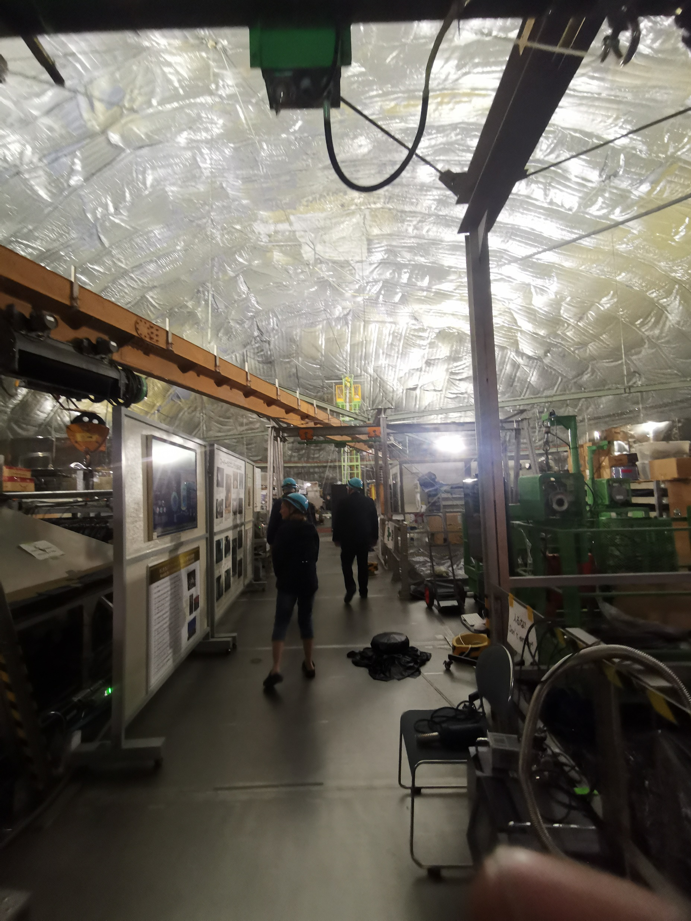
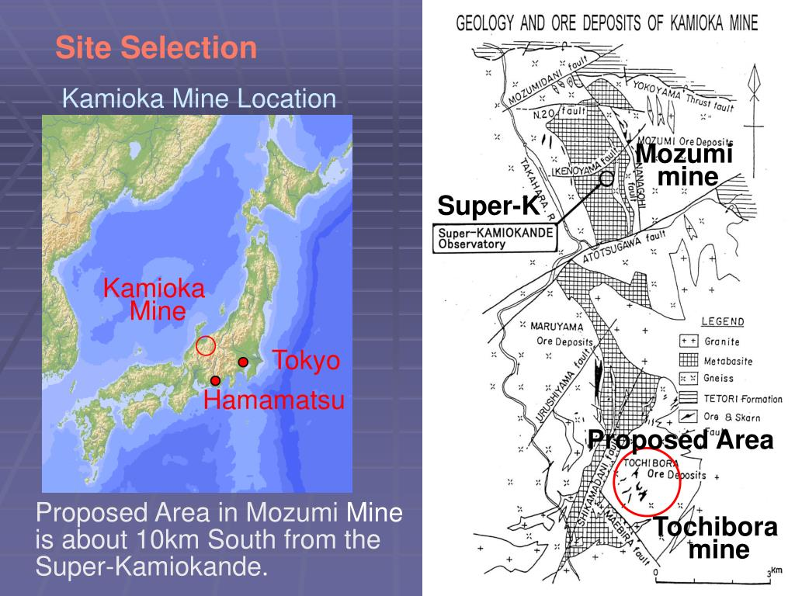
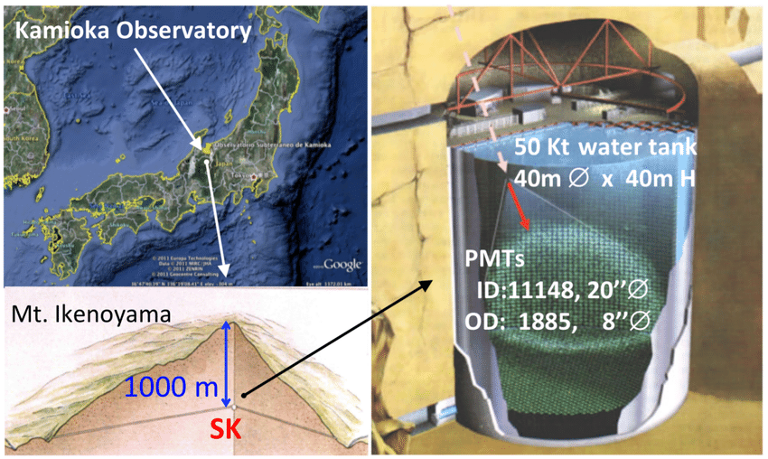
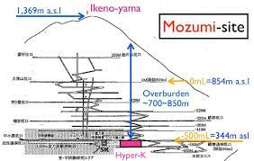
SUPER-K
Located at Kamiokande’s Mozumi Silver Mine (Toyama)
  1 km underground in post-mine voids
  In operation since 1996
Main cavern – 50 Kt water tank
  40m ø x 40m H and 20m dome radius
5 years to construct – excluding design studies
Super-K
Hyper-K
Super-K

Slide 8
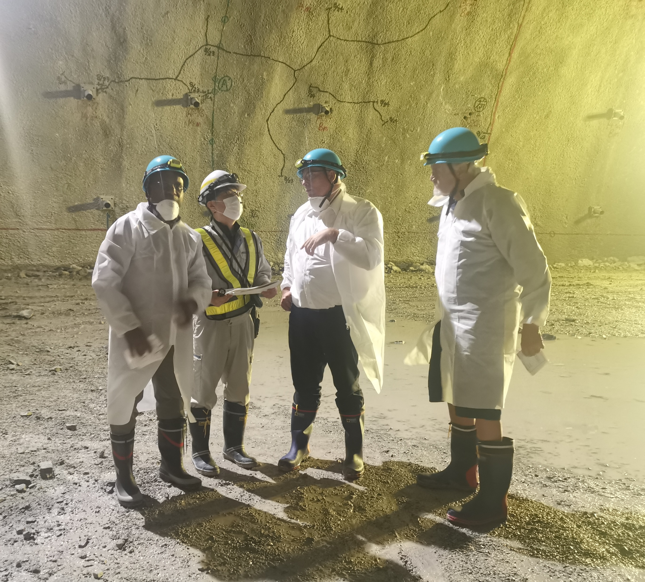
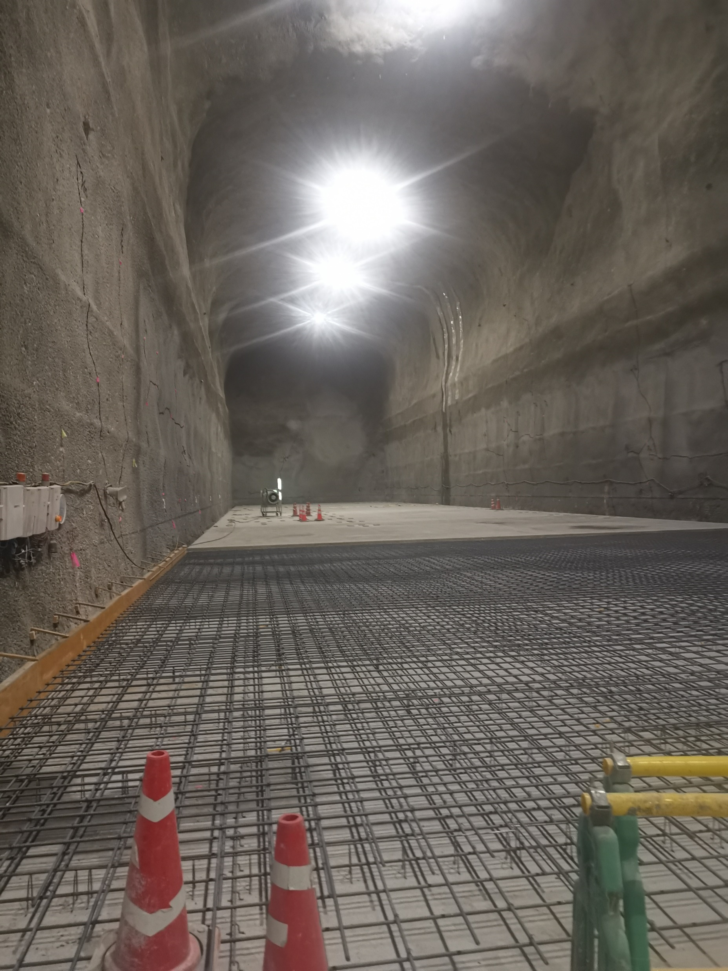
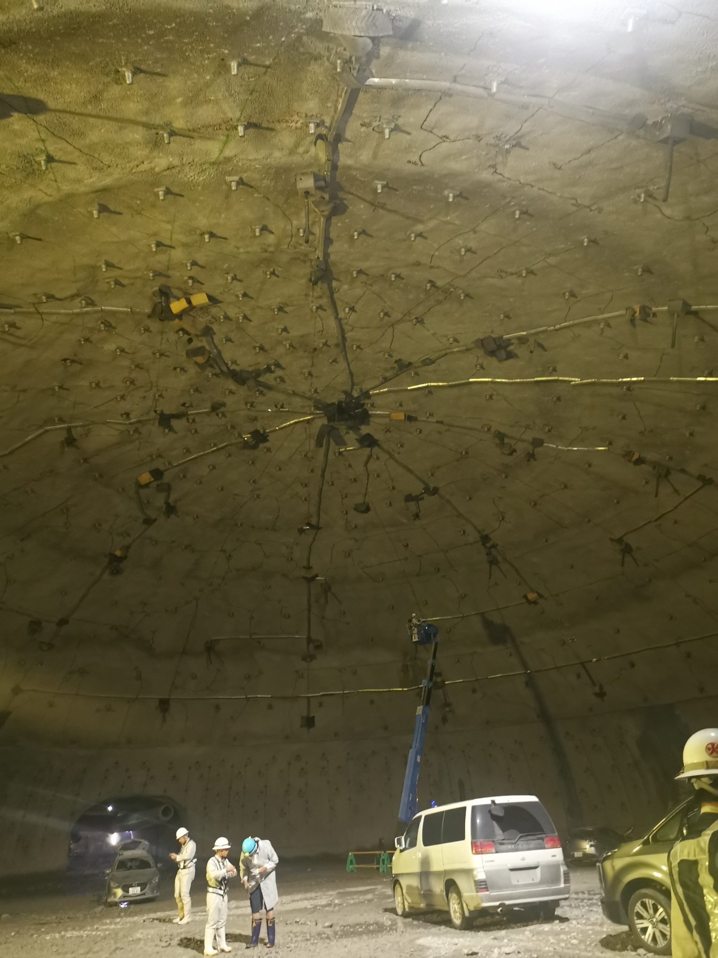
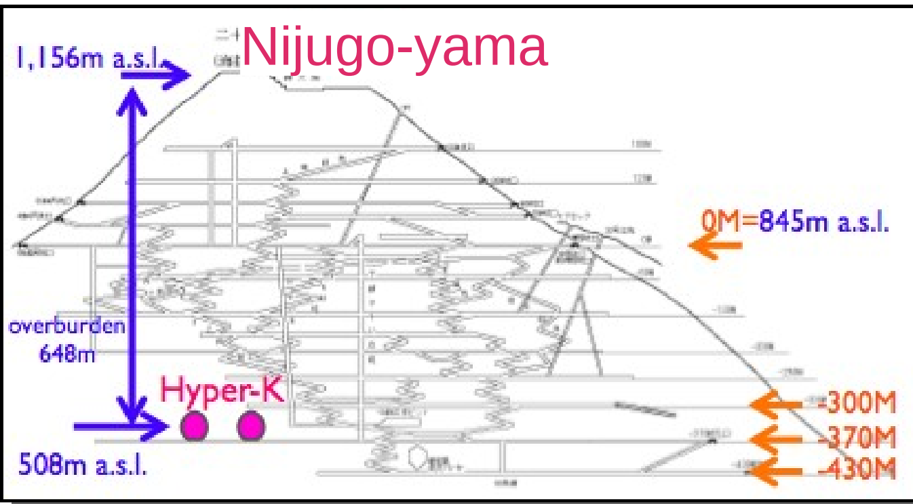
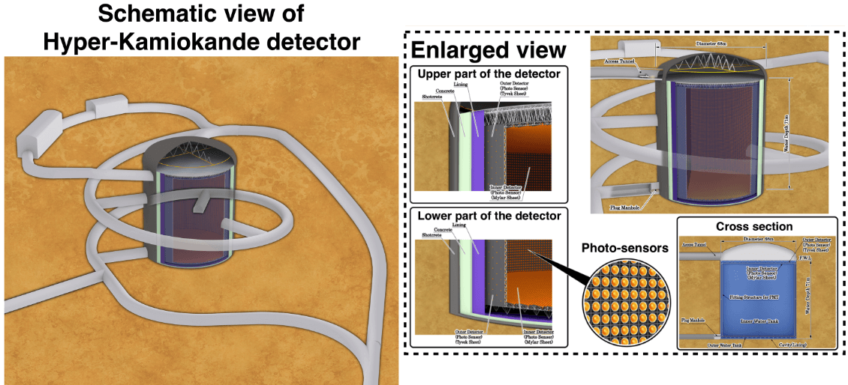
Hyper-K
Located at Kamiokande’s Tochibora Mine (Toyama)
  0.65 km underground in footwall of mining area
  Under construction – dome completed
Main cavern – 1000 Kt water tank
  70m ø x 70m H and 35m dome radius
  Massive reinforcements
Multiple cavities to facilitate cavern construction are completed.

Slide 9
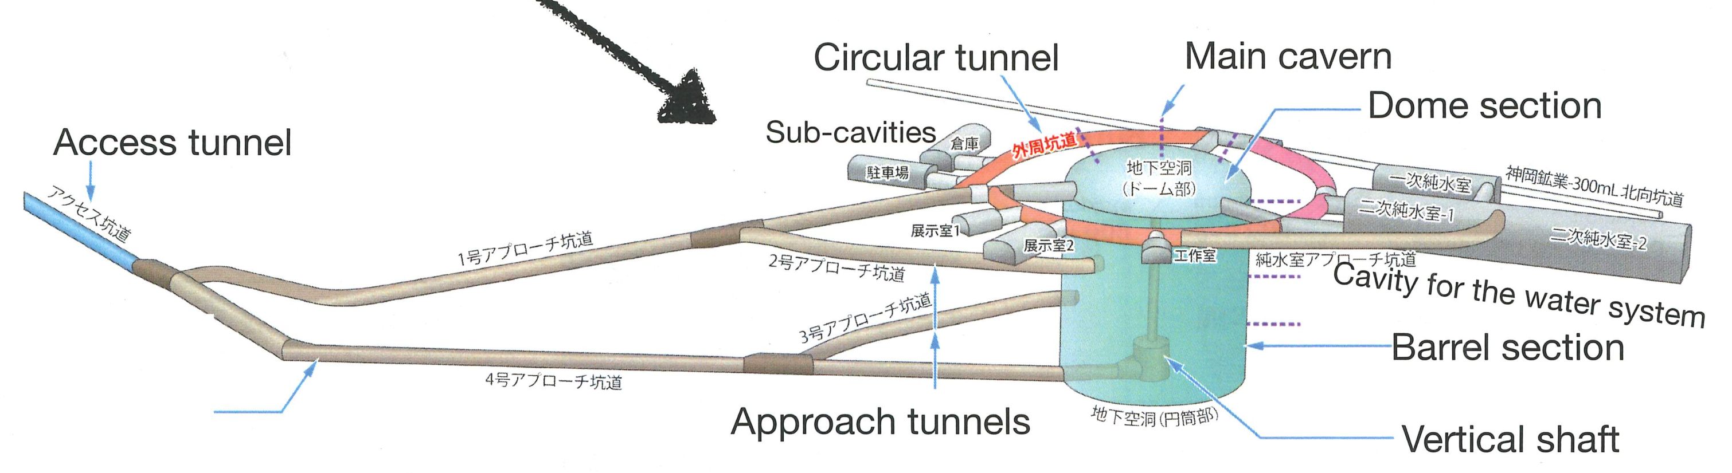

Key take aways
Hyper - K
For ESSnuSB – 2 x Hype-K construction
SNOLAB
Identify key infrastructure, considering safety and handling requirements

Slide 10
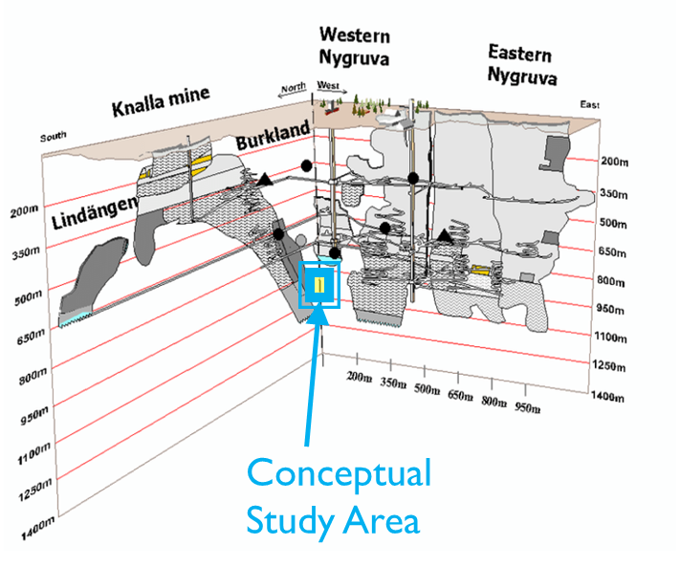
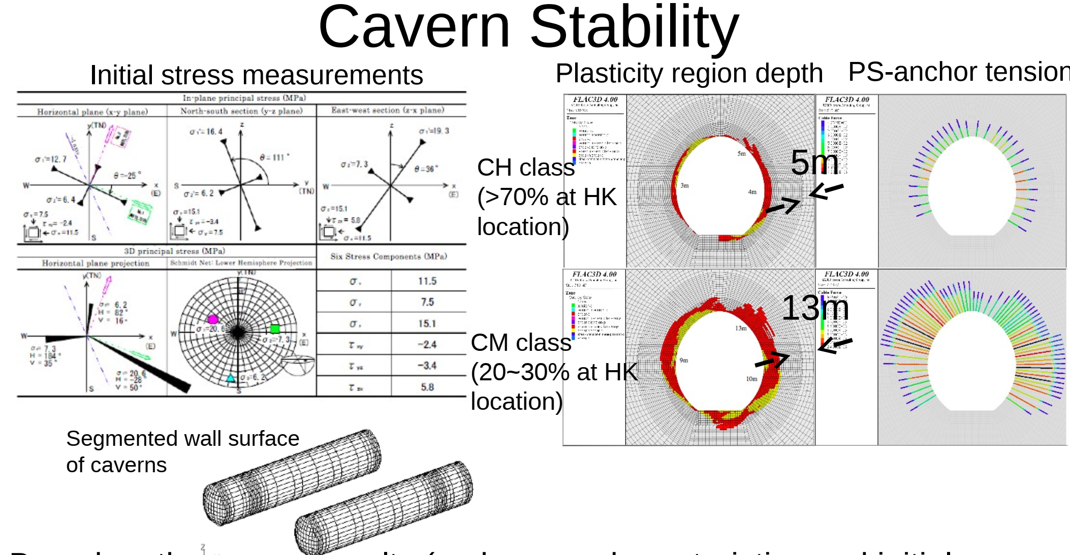
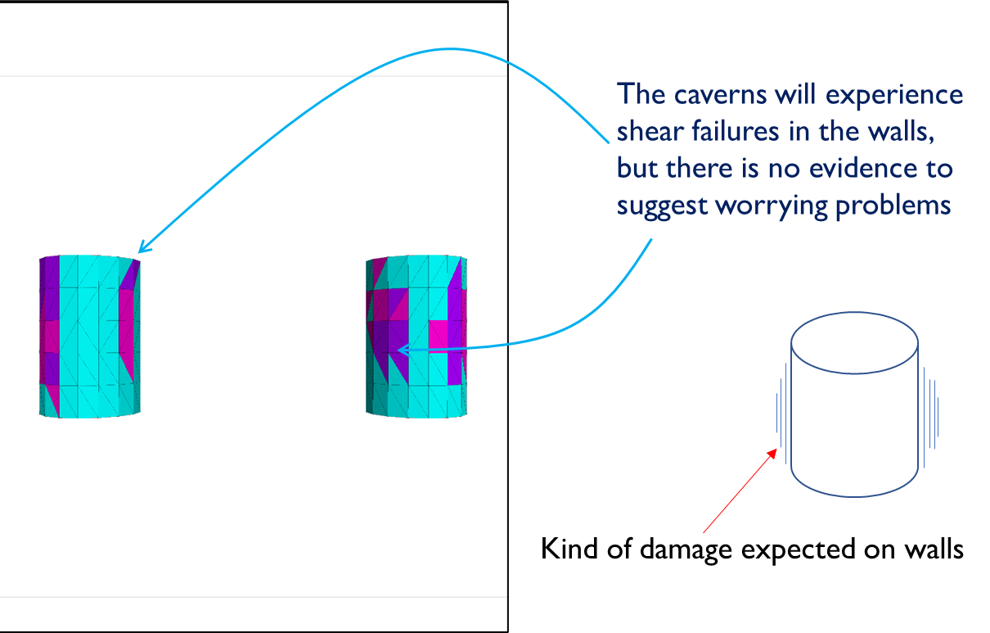
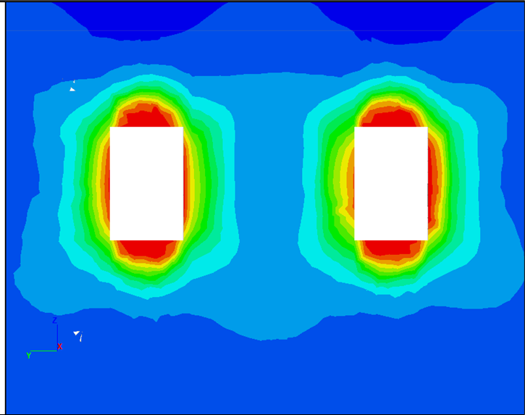
Similarities
ESSnuSB
ESSnuSB will be located at same depth as Super-K (1000 m)
Cavern layout will be same as Hyper-K
Reinforcement will be civil-engineered as Hyper-K but special to deep pre-tensioned reinforcement
  3 x 7-wire steel strand, 15-25 m long, pre-tensioned, 60 tonne capacity
  Welded still mesh with fibre-crete (10-15 cm)
1000 m
Hyper-K
ESSnuSB

Slide 11
Far Detector Civil Engineering Roadmap
2023
2026
2029
2034?
2040?
Conceptual study
Design study
Permitting
Construction
Commissioning

Slide 12
2023
2026
2029
2034
2040
Conceptual study
Design study
Permitting
Construction
Commissioning
Feasibility Assessement of Zinkgruvan as Candidate Site – Concept Level
Risk assessment – identify potential risks of the FD to the mine
Stability analyses of large caverns at an average depth of 1000 m
Engineering characterisation of rock mass from extrapolation of geology
Prope permitting processes with mining authorities in Sweden
Assess operational, environmental and legal constraints, show stoppers, etc
Draw up a list of tasks for Design Study
Cost estimation/budget for design Study
Major constraint:
Unable to fund Zinkgruvan to assist in the concept study
One deliverable – month 48

Slide 13
2023
2026
2029
2034
2040
Conceptual study
Design study
Permitting
Construction
Commissioning
Detailed Assessment
Environmental study (includes water resource)
Diamond drilling to faciliate geological studies, testing and engineering characterisation
Ground pressure measurement
Design and layout of the FD infrastructure
Rock mechanics
Assessment of operational parameters and risk factors
Construction calculations
Waste material management
Etc
Experience to be drawn from Near Detector Study

Slide 14
Sustainability Concepts
A sustainability concept to integrate FD/ESSnuSB with the mine and community
Mutual benefits of the Far Detector and the mine
Conform to EU’s demand for sustainability
(ESFRI) is an component for sustainability
”Post-Mining Usage of Underground Mining Spaces”
A Proposal submitted to Swedish Mining Innovations (SMI) – Vinnova. (Applicants: LTU, Zinkgruvan, UU and CNRS) - 2023
A Proposal submitted to ERA.MIN (European Raw Minreals) – Horizon Europé. (Applicants: A consortium of EU institutions, including LTU) - 2023

Slide 15
Some crucial estimates
Volume to go through the shaft
Two cylinders = 960 000 m³
Additional chambers and access tunnels = 440 000 m³
Total = 1 500 000 m³ (or 3 750 000 tonnes)
(with 60% swell factor = 2 400 000 m³)
Zinkgruvan shaft current capacity = 1.75 million tonnes/yr
Zinkgruvan current throughput = 1.5 million tonnes/year
ESSnuB will only utilize = 0.25 million tonnes/year
That means construction will take: 15 years!
NEW shaft will be necessary

Slide 16
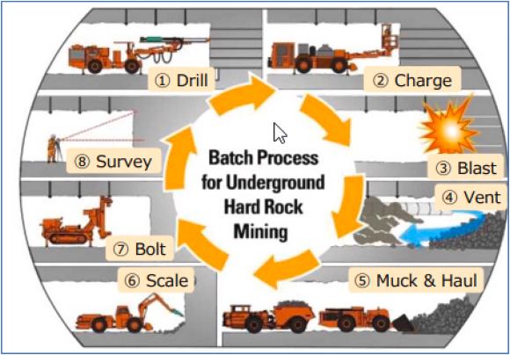
Some crucial estimates
Cost estimation (purely for construction)
Ultilities costs excluded (power, water, ventilation, etc)
Cost for excavation = 700-800 EUR/m³.
Cost for removing 1 500 000 m³ = 1.2 billion EUR
Realistically anywhere between 1.2 to 1.5 billion EUR
Now if we build a new shaft (1 km long) = additional 0.5 billion EUR will be required.
Utilities (power, water, ventilation, etc) = additional
Total cost = 2.0 billion EUR (optimistic estimate) – excludes ultilities cost

Slide 17
END REMARKS – LESSON’S LEARNT
Never tell Swedish Government or the EU Government that the ESSnuSB project will end after 10-15 years of research. It will be assummed as a non-sustainable investment and therefore does not warrante investment!
The project must be explained in the light of societal benefits and not purely on the mystery of big bang. It does not sell to communities and mining companies.
Our preminarly estimation of cost with Zinkgruvan’s mining experience is that, the far detector civil engineering will easily double what we initially estimated – may be in the range of 1.4 to 1.5 billion EUR (exclude shafts, utilities, reinforcement material).
Additional infrastructure, particulary shaft, will be needed. Zinkgruvan’s shaft has optimium capacity of 1.75 million tonnes per year. ESSnuSB will produce rougly 3.75 million tonnes in total. Thus, the shaft cannot sustain ESSnuSB production. ESSnuSB may only send 0.25 million tonnes at best through the shared shaft – that means 12 years of construction!

Slide 18
END REMARKS – LESSON’S LEARNT
Environmental permitting is very strict in Sweden! Zinkgruvan mine’s environmental permit is not applicable to the ESSnuSB. New environment impact study must be done and submitted to the Swedish environmental authority.
Permitting process alone may take 5 years if we are optimistic!
A Mining Lease is purely for mining purposes. ESSnuSB is not for mining purpose and cannot operate inside Zinkgruvan’s mining lease. A special permit needs to be issued by Swedish Mining Authority to allow ESSnuSB to operate inside Zinkgruvan’s mining lease.
Since Zinkgruvan is an active mine; safety, risk and insurance considerations must be elaborate.

Slide 19
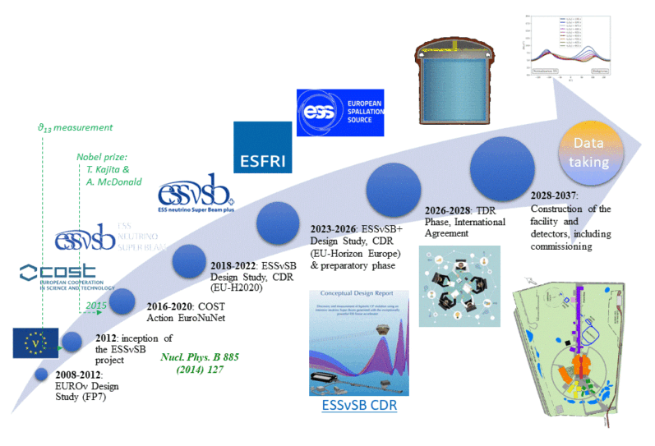
How does the far detector fit in the ESSnuSB roadmap?
How significant is the Far Detector?
How does it fit in the ESSnuSB roadmap?
What is the role of the host (Zinkgruvan Mining)?

Slide 20
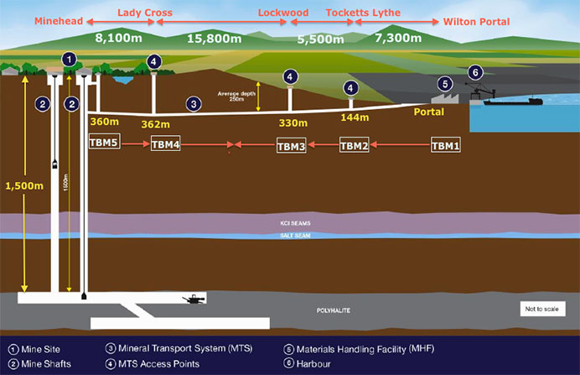
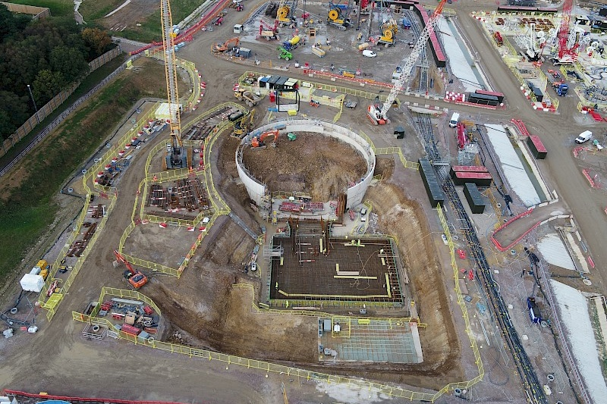
END
Twin shaft – 0.8 billion pounds
Total cost – 2.4 billion pounds

Slide 21
END

