Slide 1


ESSvSB+ DEB meeting
Tamer Tolba (for the DEB)
ESSvSB+ 1st annual meeting, CERN
16 – 20 Oct. 2023

Slide 2

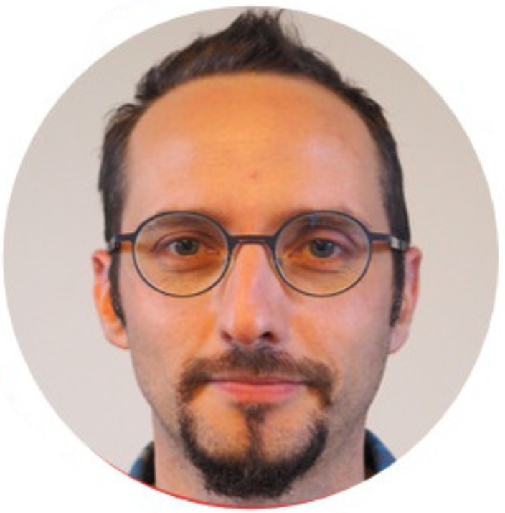
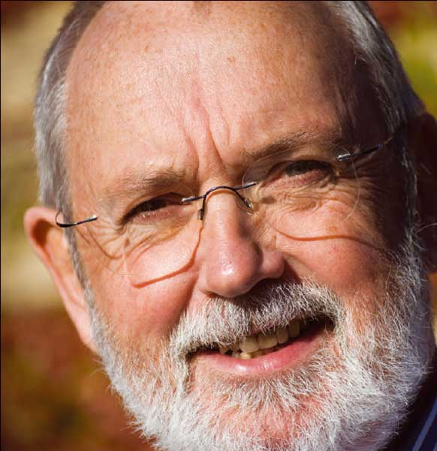
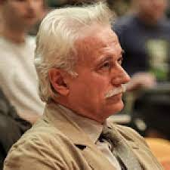
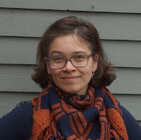
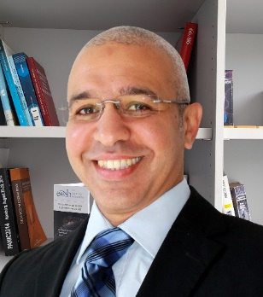
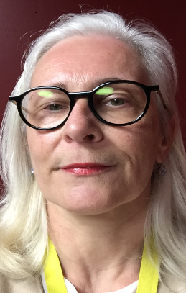
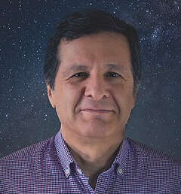
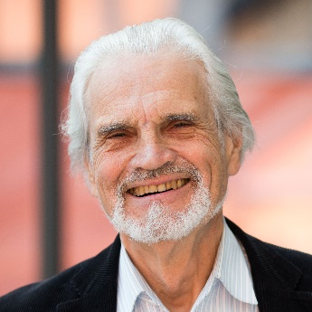
ESSnuSB+ DEB members
Elian BOUQUEREL
Colin CARLILE
Georgios FANOURAKIS
Natalia MILAS
Tamer TOLBA
Marcos DRACOS
Tord EKELÖF
Carole MABROUK
https://essnusb.eu/dissemination-exploitation-board-essnusb/
ESSNUSB-DIS-L@in2p3.fr

Slide 3
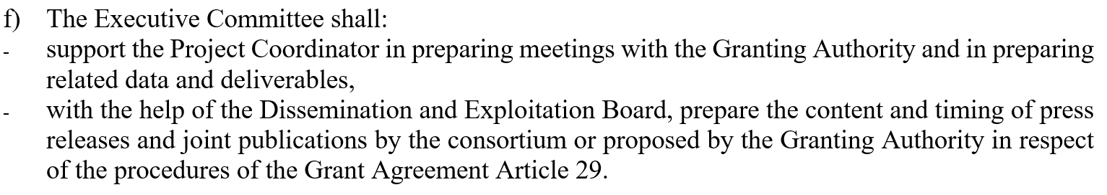

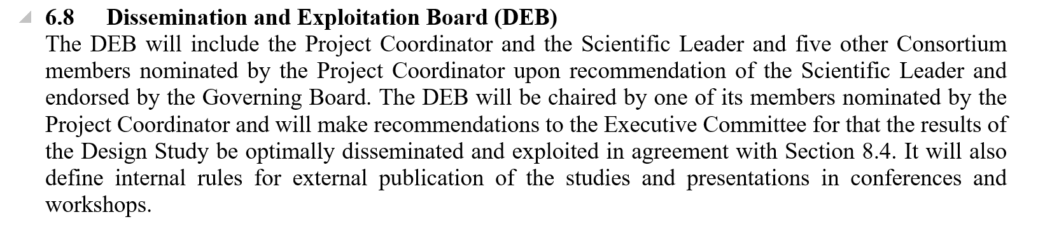
The role of the DEB committee
CONSORTIUM AGREEMENT
Section 6: Governance Structure
6.1 General Structure
6.3 Specific operational procedures for the Consortium Bodies
Section 8:
Dissemination and
Exploitation Board
(DEB)

Slide 4
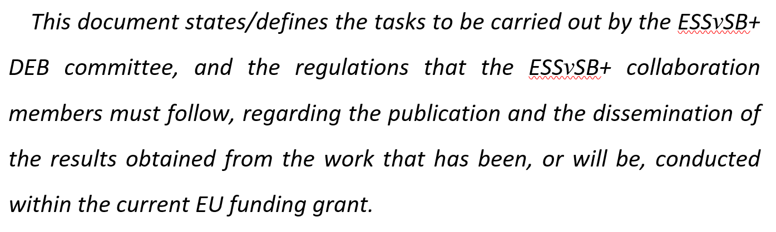
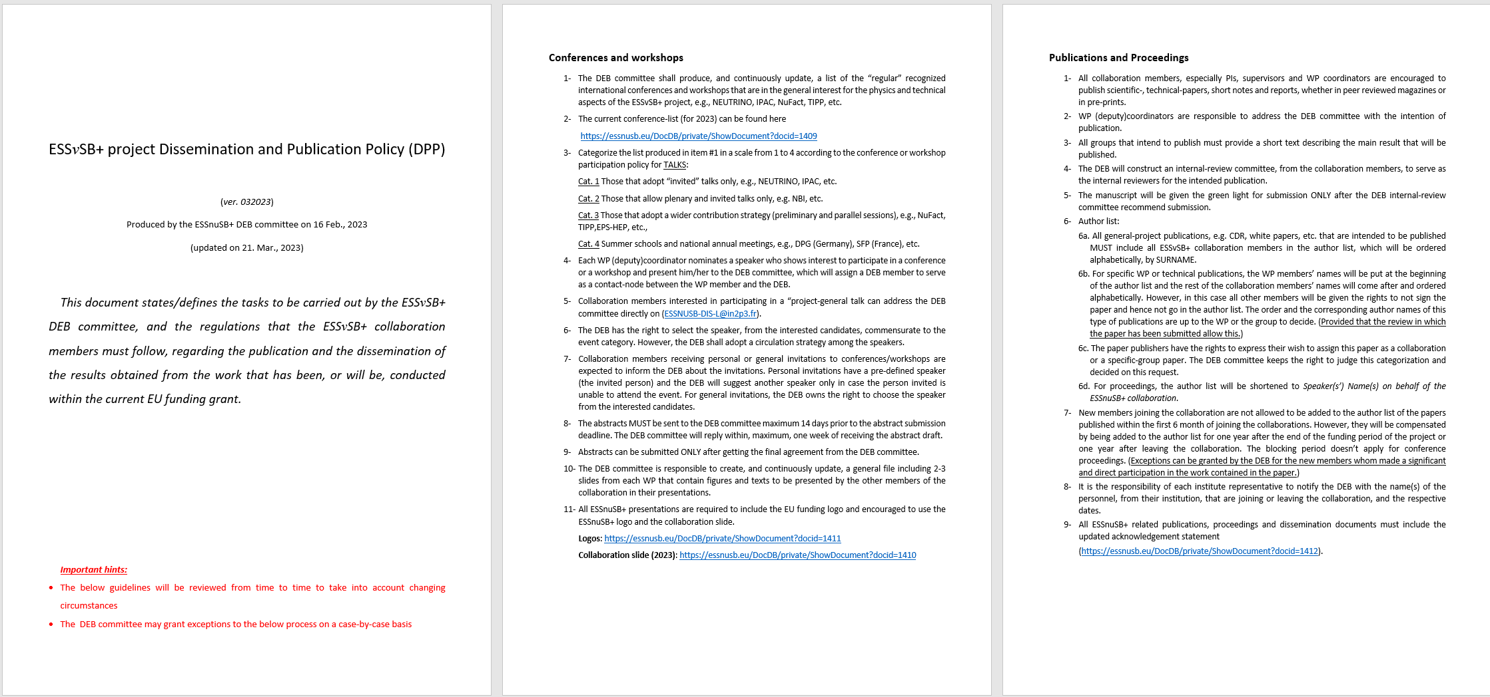
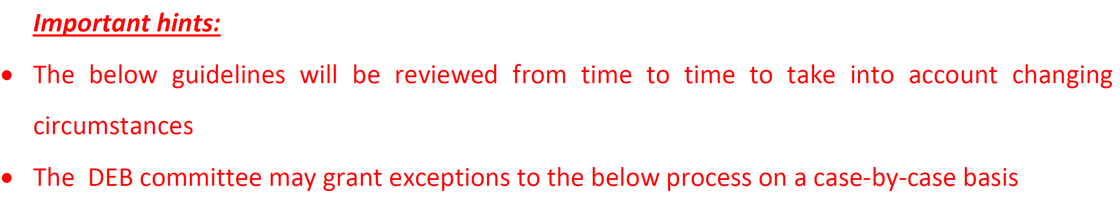
DEB activities in 2023
ESSnuSB+ Dissemination and Publication Policy (DPP)
Please read it carefully and get yourself familiar with the project regulations before submitting abstracts to conferences or publications

Slide 5
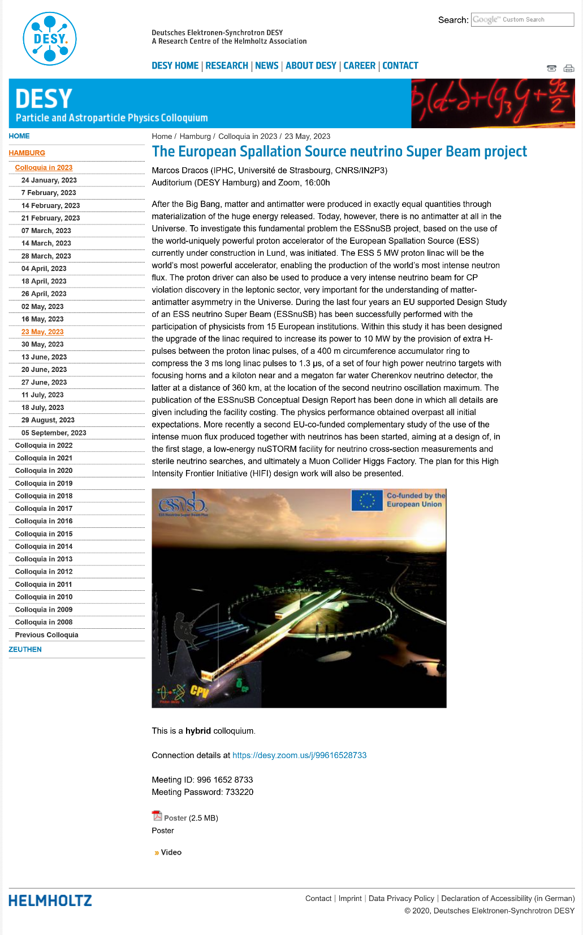
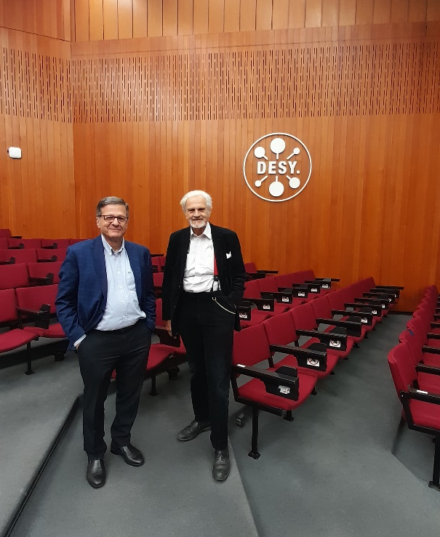
DEB activities in 2023
Special colloquium in DESY (23 May 2023)
Marcos gave a ~ 60 minutes presentation on the project
Followed by a dedicated meeting, Marcos, Tord and tamer, with Prof. Beate Heinemann, the head of the particle physics department of the DESY laboratory in Hamburg and member of the P5 Committee (Particle Physics Projects Prioritization Panel).
➔ Minutes of the meeting can be found here

Slide 6
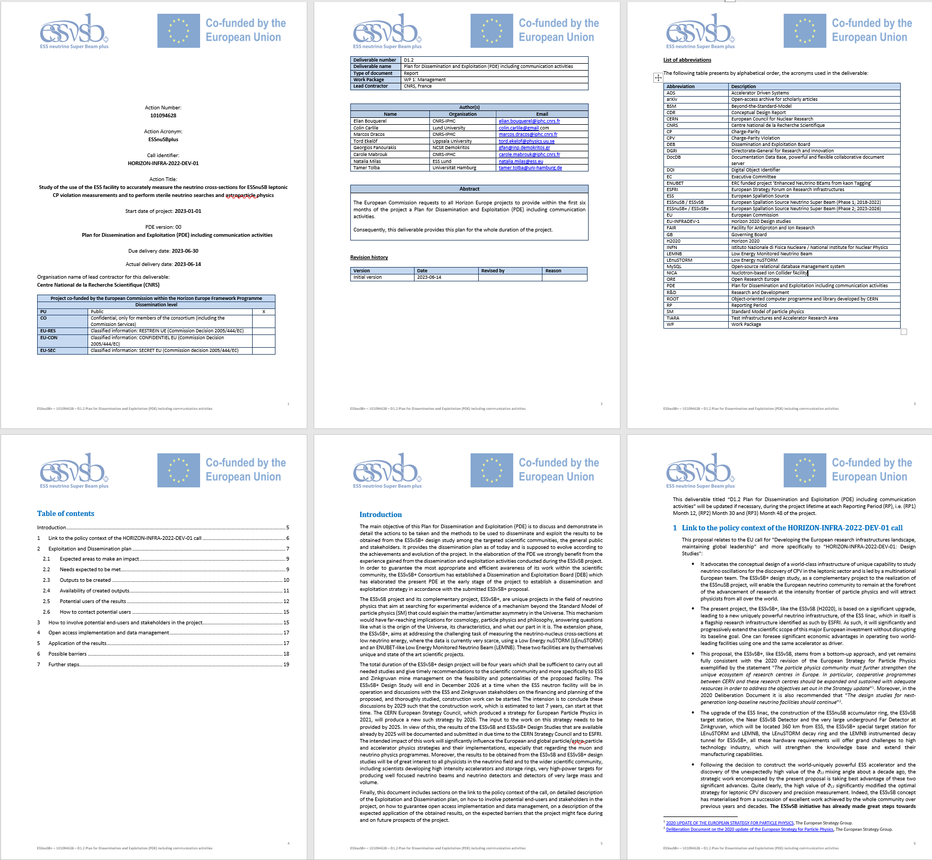

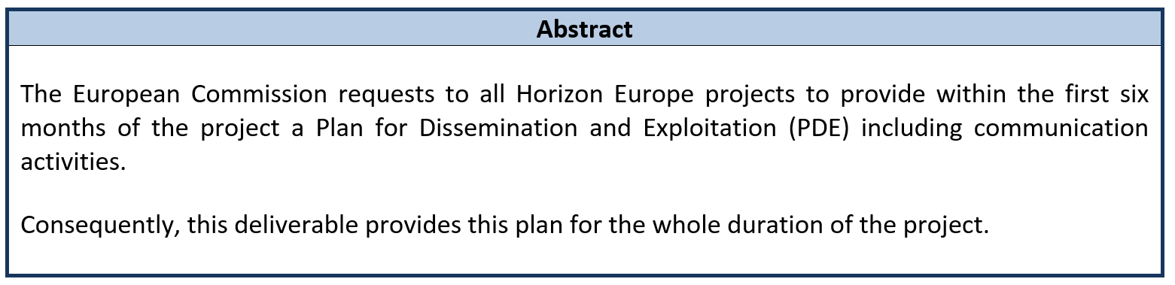
DEB activities in 2023
Deliverable D1.2: Plan for dissemination and exploitation including communication activities
Submitted on 15 June 2023

Slide 7
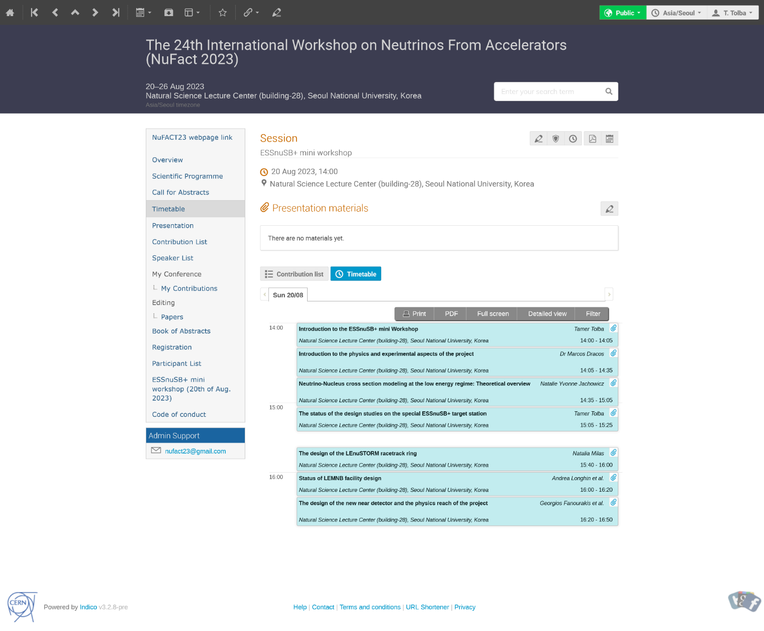
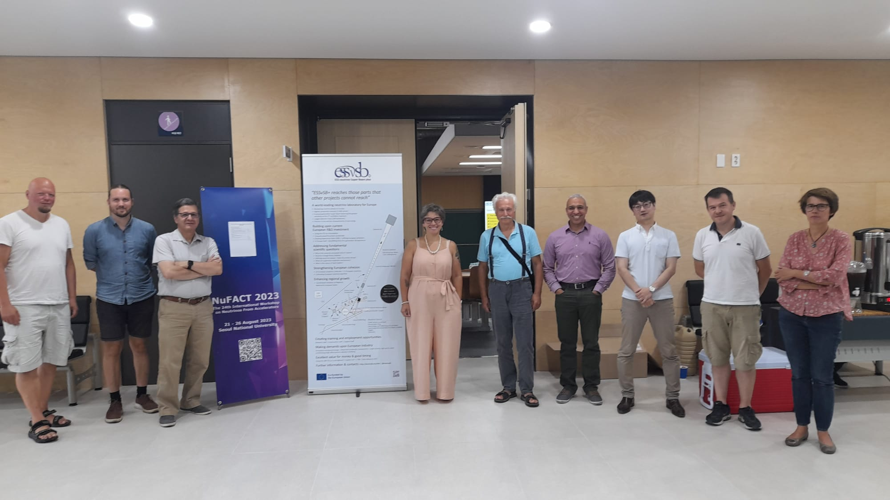
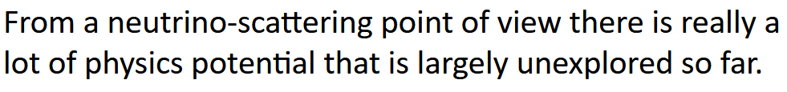
DEB activities in 2023
ESSnuSB+ mini-workshop in NuFact2023
Conducted on 20 August 2023
Prof. Natalie Jackowicz (Gent University)
The workshop has been referred to by several speakers during the main NuFcat2023 workshop

Slide 8
DEB activities in 2023
DEB meetings:
1st DEB (kick off) meeting, held on 26 & 30 Jan. 2023
2nd DEB meeting, held on 08 June 2023
3rd DEB meeting, held on 04 Oct. 2023
4th DEB meeting, held on 19 Oct. 2023 (during the ESSnuSB+ 1st annual meeting)

Slide 9
ESSnuSB+ participations in 2023
Conferences
Workshops

Slide 10
FOLLOW-UP OF ABSTRACT SUBMISSIONS (updated 14/09/2023)
 | Accronym | Conference | Date of the event | Abstract submission deadline at the conference | Type of Abstract | Approval by the organizers | Proposed author | Submitted | Title | website | Proceeding | Carbon Footprint
1 | CP2023 | International workshop on the Origin of Matter-Antimatter Asymmetry, Les Houches, France | 12-17 Feb. 2023 | 09.12.2022 | Talk | yes | Monojit Gosh, WP5 | yes | Measuring δCP and constraining lepton flavour models at ESSnuSB | https://indico.in2p3.fr/event/27893/ | No Proceeding | 0.45 t CO₂
2 | DPG2023 | German Physics Sciety spring meeting, Dresden, Germany | 20-25 March 2023 | 15.12.2022 | Talk | yes | Tamer Tolba | yes | The ESSvSB(+) design study: Achievements and Prospects | https://skm23.dpg-tagungen.de/ | No Proceeding | 0.008 t CO₂
3 | KITP2023 | KITP Muon Collider Workshop, University of California, Santa Barbara, USA | 27 Feb. - 10 Mar. 2023 | Invited only | Talk | yes | Marcos Dracos | yes | The European Spallation Source neutrino Super Beam and muon synergies | https://www.kitp.ucsb.edu/activities/muoncollider-m23 |  | 3.5 t CO₂
4 | ICPTI2023 | International Conference on the Physics of the Two Infinities, Kyoto, Japan | 27-30 Mar. 2024 | 19.02.2023 | Invited Talk | yes | Marcos Dracos | yes | The European Spallation Source neutrino Super Beam project | https://indico.in2p3.fr/event/28466/ | No Proceeding | 3.2 t CO₂
5 | IPAC2023 | International Particle Accelerator Conference, Venice, Italy | 7-12 May 2023 | 07.12.2022 | Poster | yes | Tamer Tolba | yes | The ESSvSB+ Project | https://www.ipac23.org/ | Published T. Tolba et al., JACoW IPAC2023 (2023) 911 – 914 | 0.01 t CO₂
6 | Blois 2023 | Particle Physics and Cosmology, Blois, France | 14-19 May 2023 | 01.04.2023 | Talk | yes | Eric Baussan | yes | The ESSvSB+ Project | http://blois.in2p3.fr/2023/index.html |  | 0.0 t CO₂
7 | DESY colloquium2023 | DESY Particle and Astroparticle Physics Colloquia, Hamburg, Germany | 23 May 2023 | Invited only | Talk | yes | Marcos Dracos | yes | The European Spallation Source neutrino Super Beam project | https://physikseminar.desy.de/hamburg/colloquia_in_2023/23_may_2023/ | No Proceeding | 0.38 t CO₂
8 | Muon4Future | Muon4Future workshop, Venice, Italy | 29-31 May 2024 | Invited only | Invited Talk | yes | Marcos Dracos | yes | Muon activity at the ESS facility | https://agenda.infn.it/event/33270/ | in progress | 0.008 t CO₂
9 | Fysikdagarna 2023 | The conference of the Swedish Physical Society, Stockholm, Sweden | 14-16 June 2023 | 05.05.2023 | Talk | yes | Maja Olvegård | yes | The nuSTORM project in ESSnuSBplus | https://indico.fysik.su.se/event/7762/ | No Proceeding | 0.0 t CO₂
10 | CRETE2023 | The 2023 International Conference on Applications of Nuclear Techniques, Crete, Greece | 18-24 June 2023 | 28.02.2023 | Talk | yes | Marcos Dracos | yes | The physics performance of the European Spallation Source neutrino Super Beam | https://www.creteconf.org/ | not submitted | 0.65 t CO₂
11 | NSLIE2023 | Neutrino Scattering at Low and Intermediate Energies 2023, Mainz, Germany | 26-30 June 2023 | Invited only | Talk | yes | Joakim Cederkall | yes | The ESSnuSB project | https://indico.mitp.uni-mainz.de/event/324/ |  | 0.45 t CO₂
12 | WIN2023 | The 29th International Workshop on Weak Interactions and Neutrinos, Zhuhai, China | 3-8 July 2023 | 31.05.2023 | Talk | yes | Tamer Tolba | yes | The European Spallation Source neutrino Super Beam plus Project | https://indico.ihep.ac.cn/event/18269/ | in progress | 3.5 t CO₂
13 | NuIF2023 | 19th Rencontres du Vietnam, Neutrino Workshop at IFIRSE, Quy Nhon city, Vietnam | 16-19 July 2024 | 10.06.2023 | Invited Talk | Not yet | Budimir Kliček | Not Yet | Neutrino oscillation prospects with ESSnuSB | https://ifirse.icise.vn/nugroup/nuworkshop2023/index.html |  | 2.7 t CO₂
14 | LP2023 (CANCELED) | 31st International Symposium on Lepton Photon Interactions at High Energies , Melbourne, Australia | 17-21 July 2023 | 25.03.2023 | Talk | yes | Tamer Tolba | yes | The European Spallation Source neutrino Super Beam plus Project | https://indico.cern.ch/event/1114856/
15 | ICRC2023 | The 38th International Cosmic Ray Conference (ICRC2023), Nagoya, Japan | 26 July - 3 Aug. 2023 | 20.02.2023 | poster | yes | Tsutomu Fukuda | yes | The European Spallation Source neutrino Super Beam project | https://www.icrc2023.org/ | in progress | 0.0 t CO₂
16 | NUFAC2023 | 24th Internartional Workshop on Neutrinos From Accelerators, Seoul, South Korea | 21-26 Aug. 2023 | 21.05.2023 | Talk | yes | Marcos Dracos and Karre Iversen | yes | ESSnuSB+ and summary of the mini workshop (satellite) Classification of muon- and electron neutrino events for the ESSnuSB Near Detector using Graph Neural Networks | https://indico.cern.ch/event/1216905/ | in progress in progress | 2.7 t*6 = 16.2 t CO₂
17 | ESSnuSB+ workshop | ESSnuSB+ dedictaed workshp in NuFact2023, Seoul, South Korea | 19-20 Aug. 2023 | Invited only | Talks | yes | Marcos Dracos, Tamer Tolba, Natalia Milas, Andrea Longhin, George Fanorakis, Kaare Iversen | yes | TBD | https://indico.cern.ch/event/1216905/timetable/#20230820 | 5 * in progress
18 | EPS-HEP2023 | European Physical Society Conference on High Energy Physics, Hamburg | 21-25 Aug. 2023 | 02.06.2023 | Talk | yes | Alessio Giarnetti | yes | ESSnuSB+ project: towards precision measurement of the CP violation at the second neutrino oscillation maximum | https://www.eps-hep2023.eu/ | in progress | 0.54 t CO₂
19 | TAUP 2023 | XVIII International Conference on Topics in Astroparticle and Underground Physics 2023, Vienna, Austria | 28 Aug. - 1 Sept. 2023 | 12.05.2023 | Talk | yes | Vidhya Thara Hariharan | yes | The European Spallation Source neutrino Super Beam plus Project | https://taup2023.hephy.at/ | in progress | 0.01 t CO₂
20 | Matter to the Deepest 2023 | Matter to the deepest: Recent developments in physics of fundamental interactions XLV international conference of theoretical physics (MTTD 2023), Ustroń, Poland | 17 - 22 Spet. 2023 | Invited only | Talk | yes | Monojit Gosh | yes | Present status and future prospects of neutrino oscillation experiments | https://indico.if.us.edu.pl/event/18/ | in progress | 0.34 t CO₂
21 | HB2023 | 68th ICFA Advanced Deam Dynamics Workshop on High-Intensity and High-Brightness Hadron Beams, Geneva, Switzerland | 09-13 Oct. 2023 | 15.07.2023 | Talk | yes | Natalia Milas | yes | TBD | https://indico.cern.ch/event/1138716/ |  | 0.62 t CO₂
22 | ESSnuSB+ annual meeting | ESSnuSB+ first collaboration meeting, TBD | 16-19 Oct. 2023 | No dealline | Talks |  | all ESSnuSB+ members |  |  | https://indico.cern.ch/event/1309436/sessions/502888/#20231019 | No Proceeding
23 | NuTel2023 | The XX International Workshop on Neutrino Telescopes, Venice, Italy | 23-27 Oct. 2023 | 31.05.2023 | Invited Talk | yes | Tord Ekelöf | yes | TBD | https://agenda.infn.it/event/33107/ |  | 0.62 t CO₂
24 | BSM2023 | Beyond Standard Model: From Theory to Experiment, Hurghada, Egypt | 06-09 Nov. 2023 | 15.09.2023 | Talk | yes | Tamer Tolba | yes | Search for the leptonic CP violation with the ESSnuSB(+) project | https://indico.cern.ch/event/1258407/ |  | 1.9 t CO₂

Slide 11



Some statistics on 2023 participations
Personnel participations in 2023
11 PIs
1 postdoc
2 PhD students
23 participations in 2023
4 invited talks
16 plenary talks
2 posters
1 ESSnuSB+ workshop
WP participations in 2023
WP1
WP2
WP3
WP4
WP5
WP6
Different dissemination criteria!!
Next year more students and postdocs must be encouraged to participate in international conferences!

Slide 12
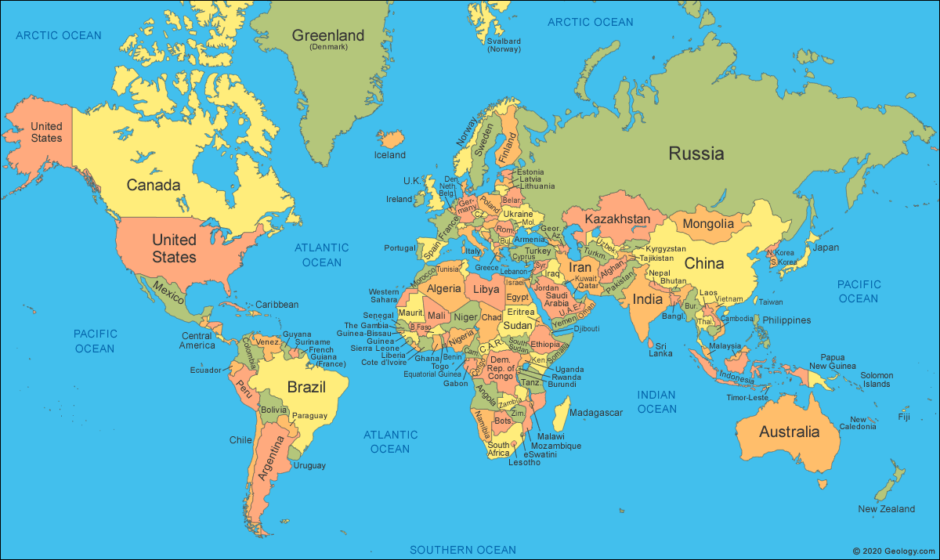

ESSvSB+ conference attendance coverage

Slide 13
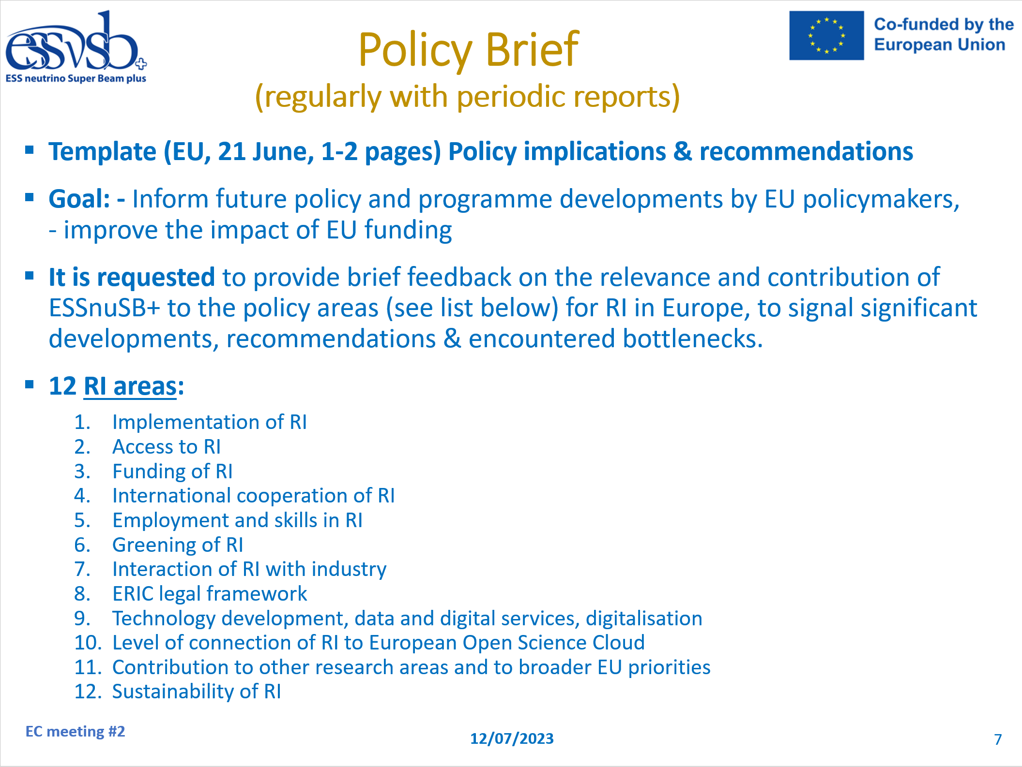
ESSnuSB+ conference participation Carbon footprint in 2023
The World Resources Institute defines carbon budget as the “amount of carbon dioxide emissions we can emit while still having a likely chance of limiting global temperature rise to 2°C above pre-industrial levels”
The latest Intergovernmental Panel on Climate Change (IPCC) claims that for our planet to remain below this threshold the world has a set amount of carbon emissions left to expend. Our global carbon budget stands at 750 billion tonnes of CO₂ until 2050, and if we divide up this amount of carbon emissions equally between every person on earth (a projected 8.8 billion) over the next 30 years, each individual is limited to 2.8 tonne/year (or 1.5 tonnes/year for 1.5 °C).
Marcos Dracos
(EC meeting general information (July 2023))
https://essnusb.eu/DocDB/private/ShowDocument?docid=1541
ESSnuSB+ conference participation footprint
(calculated by myclimate*)
All events (including trains, i.e. even within EU)
35 t CO₂ / 83 persons ~ 0.4 t CO₂/p/2023
*Calculation principles
The myclimate flight calculator determines the quantity of CO₂ emissions that an aeroplane gives off per passenger for a given flight distance. Nitrogen compounds and aerosols are also included and converted into CO₂. The calculation is based on average consumption data for typical short-haul and long-haul aeroplanes. The calculation also takes into account whether you are flying economy, business or first class.
ESSnuSB+ preserved the greening principle of the EU
policy for its dissemination activities in 2023

Slide 14
Publications in 2023
Publications
1- Universe 9, (2023) 347 (Budimir et al.)
“The ESSnuSB Design Study: Overview and Future Prospects
2- arXiv:2310.10749v1 (2023) (https://arxiv.org/abs/2310.10749) (Monojit et al.)
“Study of non-standard interaction mediated by a scalar field at ESSnuSB experiment”
Proceedings
1- T. Tolba et al., JACoW IPAC2023 (2023) 911 – 914
“The ESSvSB+ Project”
2- T. Tolba and E. Baussan, NuFact2022, Phys. Sci. Forum 8 (2023) 57
“ESSνSB+ Target Station”
3- Six conferences’ proceedings are in progress

Slide 15
2024 Conferences
31th International Conference on Neutrino Physics and Astrophysics (Neutrino 2024)
June 16-22, 2024, Milano, Italy
The 42nd International Conference on High Energy Physics (ICHEP2024)
Jul. 17-24, 2024, Prague Congress Centre, Prague, Czechia
Workshop Neutrino Frontiers
Jun 25 – Jul. 19, 2024, Galileo Galilei Institute Firenze, ITALY

