Slide 1
How to get ESSnuSB included on the ESFRI list in 2026
ESFRI = The European Strategy Forum on Research Infrastructures
Tord Ekelof
Uppsala University

Slide 2
ESFRI about itself:
“Since 2016 ESFRI has introduced in its Roadmaps the Landscape Analysis which provides an overview of the European RI ecosystem by identifying the main Research Infrastructures operating transnational access in Europe, in all fields of research, and major new or ongoing projects, as well as an outlook to the global landscape of relevance. The Landscape Analysis has progressively (2018, 2021) evolved towards a more complete and strategic document including trend analysis and the first examples of RIs services and their impacts in specific areas.
In order to underline the strategic relevance of the Landscape Analysis, ESFRI has decided to de-couple the Landscape Analysis from the Roadmap. ESFRI will publish a more strategic Landscape Analysis report in 2023, which must provide the framework for the next ESFRI Roadmap in 2026 and promote the development of new research infrastructure services, including, when needed, infrastructure clustering for pan-European thematic or interdisciplinary services.”

Slide 3
The latest ESFRI list of Projects (=proposals) and Landmarks (=existing research infrastructures) are available at: https://roadmap2021.esfri.eu/projects-and-landmarks/view-the-table
The ESFRI Forum, or Committee, is composed of delegates from the European national authorities. The list om these delegates is available at: https://www.esfri.eu/people?qt-people=1#qt-people
The ESFRI forum has 5 Strategy Working groups described at: https://www.esfri.eu/working-groups
These groups provides input to the ESFRI Committee for the Landscape Analysis

Slide 4
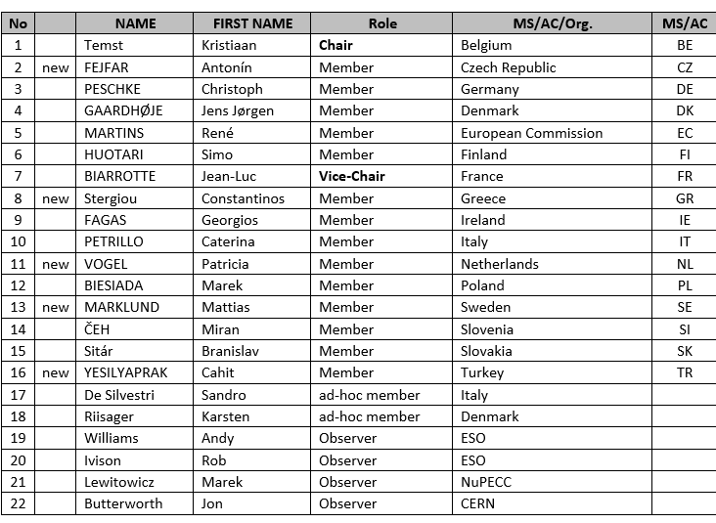
The members of the Strategy Working Group on Physical Sciences and Engineering are:

Slide 5
In February 2023 the following “communities” we requested to answer a
ESFRI Questionnaire by April 2023:
APPEC Consortium
ARIE - Analytical Research Infrastructures in Europe
ASTRONET
CESAER
EASSH - European Alliance for Social Sciences and Humanities
EOSC Association
ERIC Forum
ESUO - European Synchrotron and Free Electron Laser Users Organisation
EU-LIFE
Europlanet AISBL
GÉANT
LEAPS - League of European Accelerator-based Photon Sources
LENS - League of advanced European Neutron Sources
LERU
Science Europe

Slide 6
The ESFRI questionnaire
1. Which are the services your RI offers? (Please add any relevant documentation/reports for clarification and additional information. You can upload any relevant file using the last question [No. 11]) (5000 characters)
2. Who are the main users of the services offered? (3000 characters)
3. Which specific future developments do you envisage in your RI? Can you describe the scientific trends and relevant future developments? (3000 characters)
4. Can you list some of the examples (scientific, societal, economic) of impacts your RI has? (Please add any relevant documentation/reports for clarification and additional information. You can upload any relevant file using the last question [No. 11]). (3000 characters)
5. How does your RI respond (offer help and support the development of solutions) to current and arising crises (natural and man-made)? (3000 characters)
6. How is your RI impacted by the crises (inflation, energy & supply challenges, others)? (3000 characters)

Slide 7
7. How does your RI take on:
- Green transition
- Digital transition
Describe, how you manage these transitions as well as the challenges/needs that you are facing. (5000 characters)
8. Does your RI contribute to Horizon Europe Missions? Can you describe the contribution or comment HEU Missions? Do you have specific proposals that would enable you to support the missions better? (3000 characters)
9. Does your RI contribute to EU partnerships? Please list the partnerships and explain the type of involvement. (See 2. Candidates for European Partnerships on: https://research-andinnovation.ec.europa.eu/system/files/201912/ec_rtd_orientations-he-strategicplan_
122019.pdf. (3000 characters)
10. Open question: Would you like to add anything that you consider relevant regarding your RI and the specific domain or cross-domains? (3000 characters)
11. Please, add any relevant supporting documentation for information and clarification. Upload maximum 12 files. Supported types are: pdf, doc, docx, xlsx, png, jpeg, jpg under 10 ΜB each.

Slide 8
The procedure for proposing ESSnuSB to be included on the 2026 ESFRI list
The procedure to establish the 2026 ESFRI list will start in autumn 2024, after that the Landscape has been published, by a call from ESFRI for proposals of research infrastructures to be included in the 2026 ESFRI list. These proposals shall be made on a template form that does not yet exist but which will be made available at the time of the call. The last time such a call was made was in 2021 and the form to be used for the 2026 ESFRI list will probably be similar to the rather extensive form made available for the 2021 call, which can be found at https://ec.europa.eu/info/funding-tenders/opportunities/docs/2021-2027/horizon/temp-form/af/af_he-csa_en.pdf

Slide 9
The ESFRI Committee will receive proposals for which proposed research infrastructures to include in the 2026 ESFRI list from ESFRI’s 5 different Strategy Working Groups, of which that on Physical Sciences and Engineering is one. The ESSnuSB community therefore needs to identify for each member country of ESSnuSB the national member of that group.
The decision on which infrastructures shall appear on the 2026 ESFRI list will be taken by the ESFRI committee in end of 2025/the beginning of 2026 on the basis of the application, the input from its five Strategy Working Groups and from the Implementation Group.
The task of the Implementation Group, chaired by Janette Ridder-Neuman, is to evaluate the financing information provided by the communities proposing new research infrastructures for each of the respective research infrastructures. The requirement for this committee to recommend to the ESFRI Committee that a proposed research infrastructure be listed on the ESFRI list is that by 2026 there be at least 3 EU countries committing to contribute enough financing to cover a satisfactory part of the investment cost of the infrastructure in question.

Slide 10
As I understood from my discussion in Tenerife, “a satisfactory part” would be something like of the order 1/4 of the total investment cost. In the report on the ESSnuSB Conceptual Design available at https://arxiv.org/pdf/2206.01208.pdf the investment cost for ESSnuSB is estimated at ca 1380 M€ to be provided over the construction period of ca 10 years, i.e. 138 M€/year ( cf. CERNs yearly budget was 1405 MCHF in 2022) . A quarter of this is 35 M€/year and a third of that 12 M€/year. If would have 12 ESSnuSB member countries, 12 M€/year would also be the average yearly construction budget to be provided by one country. Now, the estimate of 1380 M€ is, as we have seen during this weeks collaboration meeting, not the final estimate of what the ESSnuSB investment cost will be.
I believe that the most critical and challenging task that the ESSnuSB community now has is to identify these three countries, one of which must be Sweden as host country of the infrastructure, and to get some credible commitment before 2026 from their governments to provide financing that together will be enough to cover a satisfactory part of the infrastructure investment cost. My recommendation is that ESSnuSB now make requests to the relevant authorities (national research councils, ministries of research…) in each ESSnuSB member country to get the opportunity to explain this situation to the relevant authority in the respective country.

Slide 11
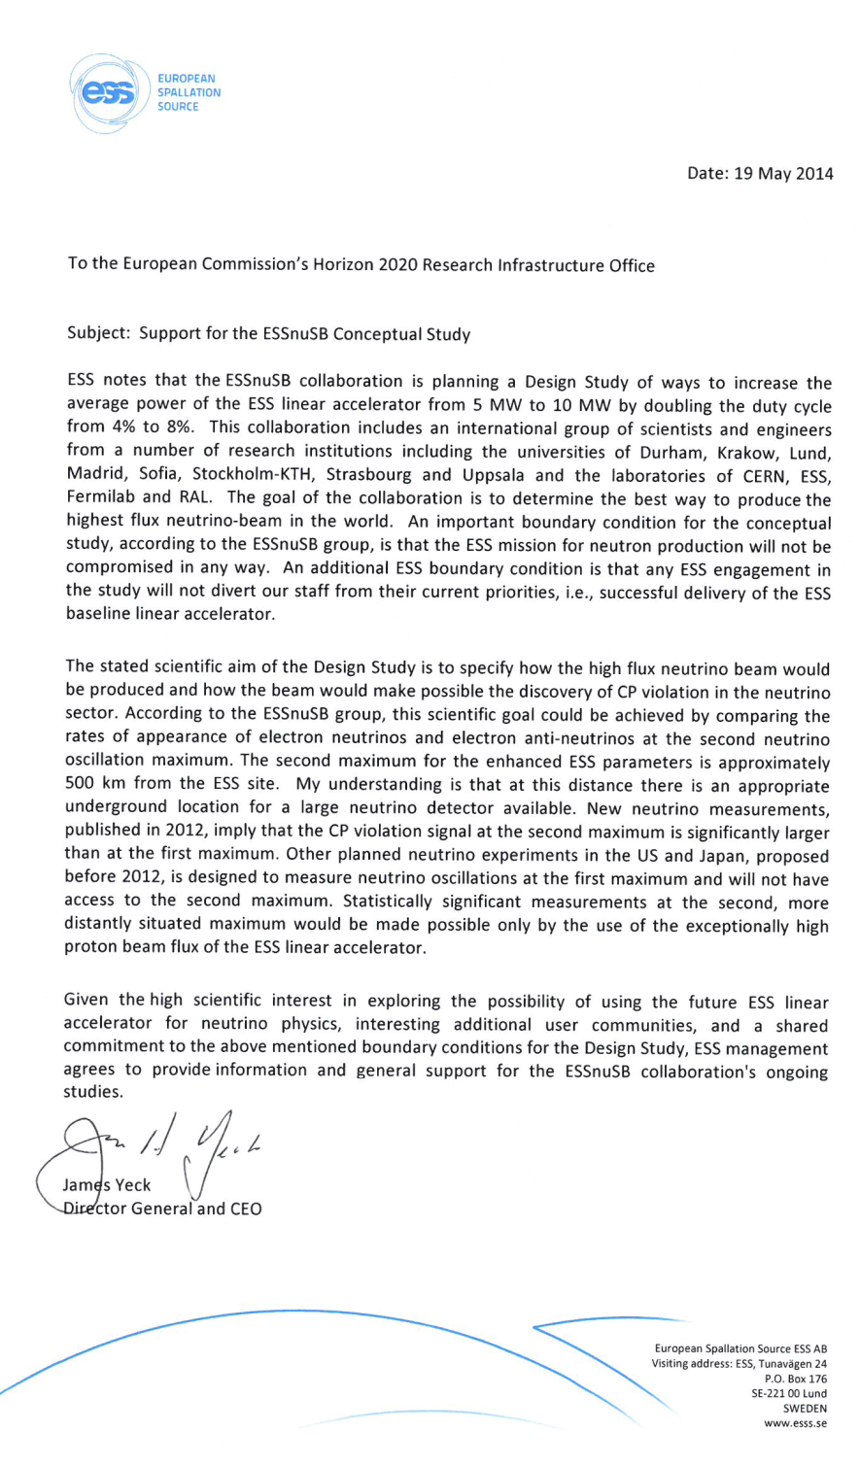
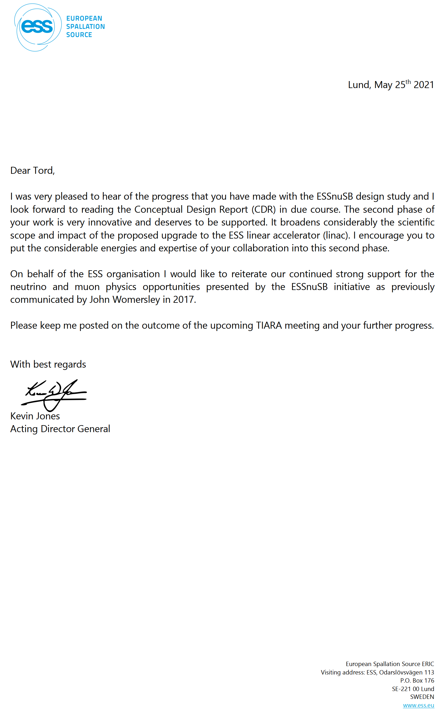
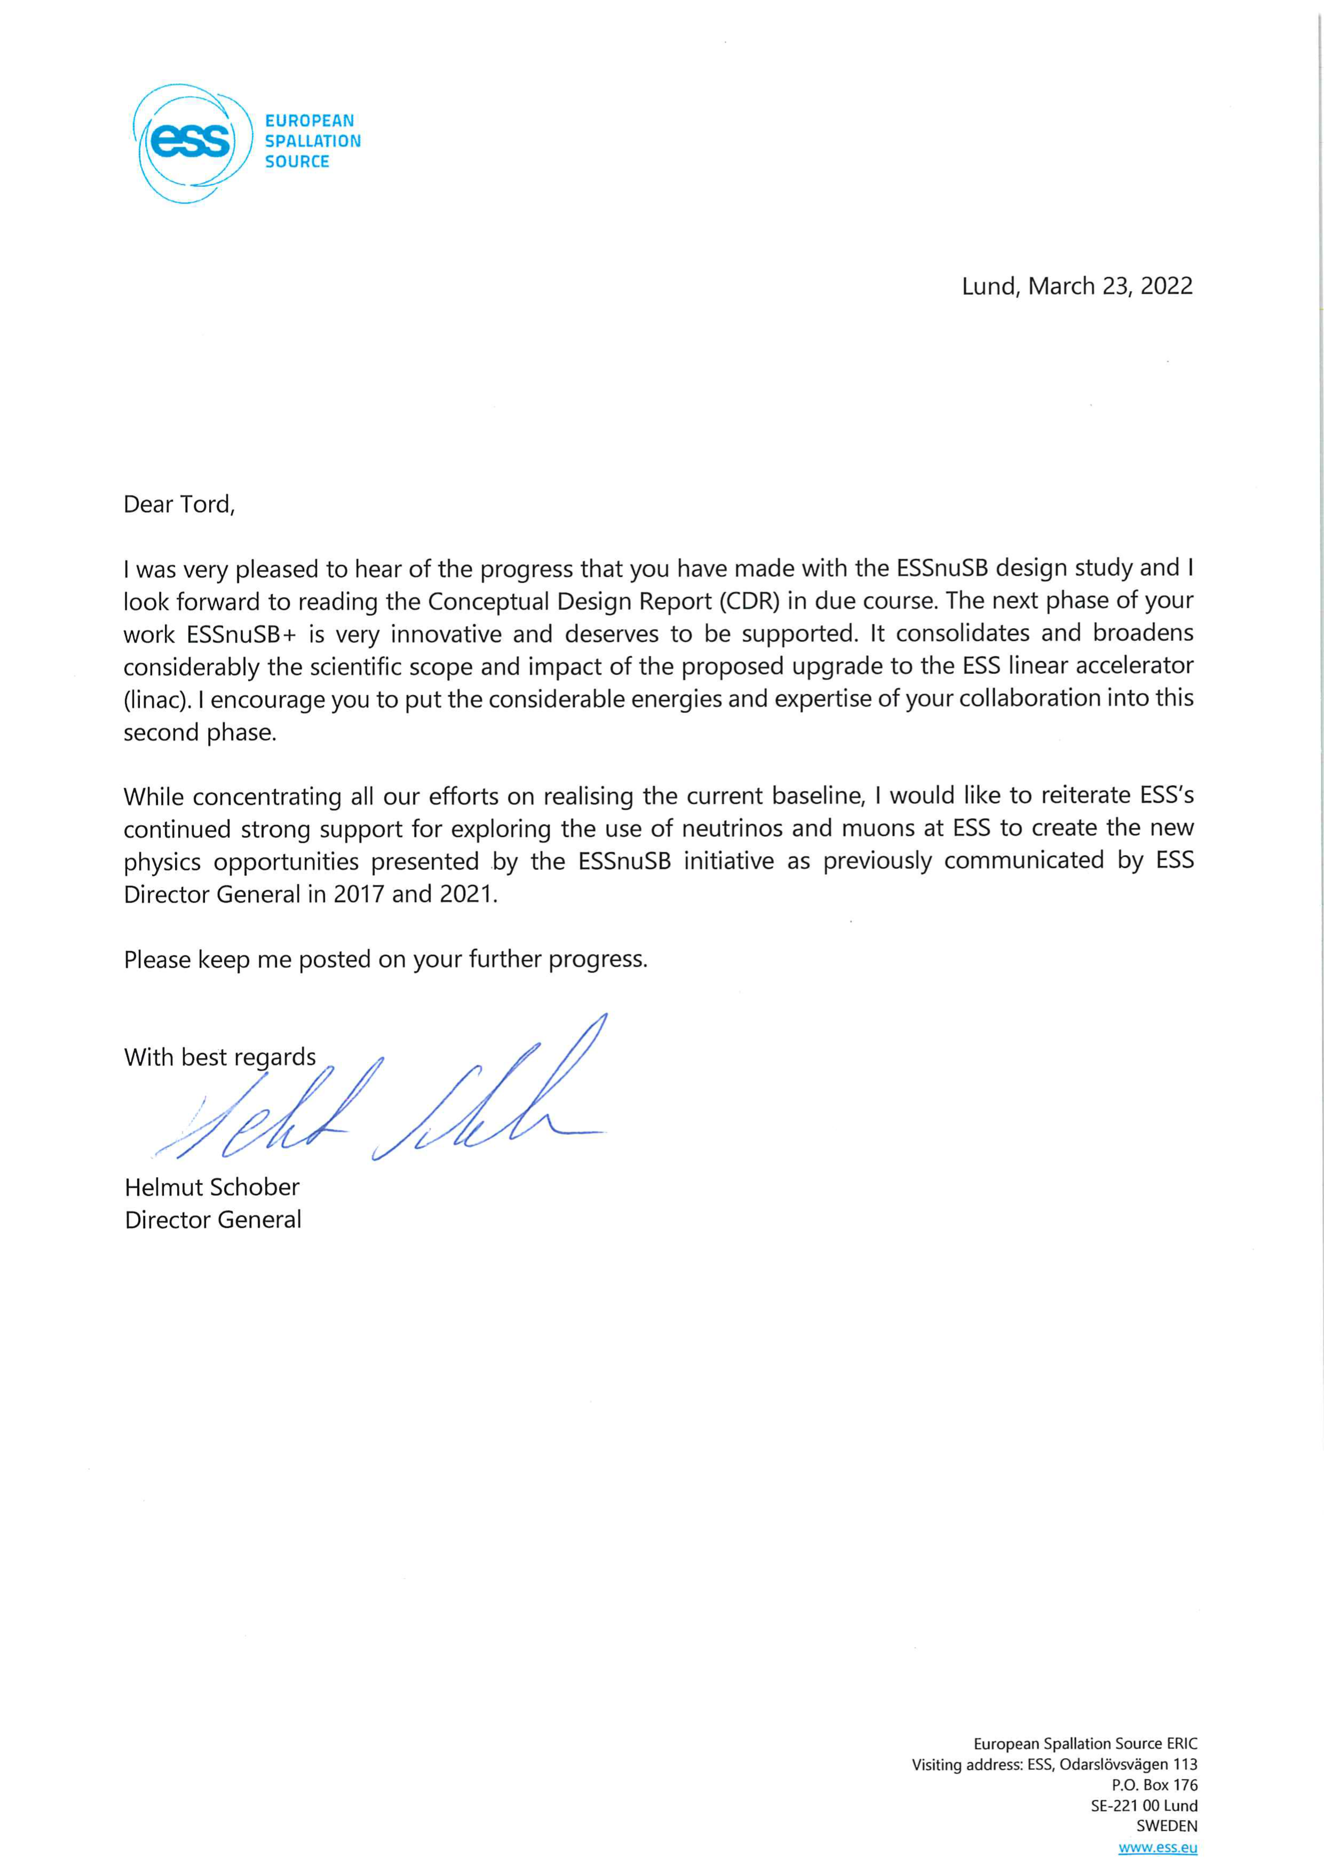
ESSnuSB support letters from 4 ESS Director Generals:
Jim Jeck in 2014
John Womersly in 2017
Kevin Jones in 2021
Helmut Schober in 2022
Helmut Schober: ”I would like to reiterate ESS’s continued strong support for exploring the use of neutrinos and muopns
at ESS to create the new physics opportunities by the ESSnuSB initiative as previousely communicated by ESS Director
Generals in 2014- 2021.”

Slide 12
EU has provided support to the project of building a long baseline neutrino facility in Europe since nearly 20 year by funding during this period a long series of design studies: CARE/BENE, EURONU, LAGUNA, LAGUNA-LBNO, EUCARD, COST CA15139, ESSnuSB and ESSnuSB+ .
ESSnuSB has the strong support of the ESS European Research Infrastructure Consortium (ERIC) documented in recommendation letters from its four Director Generals since 2014. ESSnuSB also has the support of the the Zinkgruvan Mine Manager as witnessed by his attendance at this weeks ESSnuSB yearly meeting.
Even so, the argument is sometimes made that Hyper-K and DUNE may discover leptonic CP violation before ESSnuSB and that this represents a risk for ESSnuSB to fail its purpose. My answer to that erroneous argument is the following:
Violation of CP symmetry in was discovered in 1962, so CP symmetry is not a conserved symmetry of Nature, a fundamental discovery worth a Nobel prize. The discovery was made in the quark sector. It would be surprising if in the lepton sector CP is conserved. But it will not be possible to demonstrate that there is no CP symmetry violation in the leptonic sector if this were to be the case, because the violation can always be small enough for the measurements not to see it

Slide 13
Hopefully the lepton CP violation is large enough for the currently planned long-baseline projects to detect it (in my view this detection will not be a ‘discovery’ like the 1962 first detection of CP violation in Nature was) and to measure its value, the CP phase angle.
If so, it will be very important to make a measurement with the highest possible precision. There are several models that describe the matter-antimatter asymmetry in Universe as well as models that describe the origin of flavours and they all predict some specific value for the leptonic CP angel.
Measuring this angle with order 3 times higher precision (standard error below 8° for all CP angles like ESSnuSB rather than below 20°-25° for all CP angles like DUNE and Hyper-K – see attached graph) will represent a decisive advantage when aiming at confirming which of the various matter-antimatter models and which of the flavour models is valid.

Slide 14
ESSnuSB in the international context – precision in δ_{CP}
ESSnuSB 10 years
DUNE 10 years yellow curve
HyperKamiokande 10 years

Slide 15
In conclusion I recommend
1. That the ESSnuSB GB members in each country agree one contact person who will contact the national delegate of the Strategy Working Group on Physical Sciences and Engineering (SWGPSE see slide 4) and informs this delegate of the ESSnuSB project and our plan to propose to be introduced as a Project on the ESFRI List in 2026 and ask for the delegates support for that proposal.
2. That the ESSnuSB Management provide answers to the ESFRI Questionnaire for Research Infrastructures and submit these answers to the Chair of the SWGPSE, Christiaan Temst, by latest in the second week of November. For this we invite all GB members to provide their proposals for answers to the 10 questions in the questionnaire. Please copy the 10 questions on slide 7 and 8 to an email, write you proposed answers after each question and mail the result to me, Marcos and Carole no later than next Friday 27 October using “ESFRI Questinnaire” as email subject.

Slide 16
Thank you!

