Slide 1
Update on the status of the ²⁰⁵Tl(n,γ) cross section measurement
A. Casanovas¹, A.Tarifeño-Saldivia¹, F. Calviño¹, C. Domingo-Pardo², E. Maugeri³, V. Alcayne, V. Babiano, J. Lerendegui, C. Guerrero and the n_TOF Collaboration
¹ Universitat Politècnica de Catalunya (UPC), Barcelona, Spain
² Instituto de Fisica Corpuscular (CSIC-Universitat de Valencia), Valencia, Spain
³Paul Scherrer Institute, Switzerland

Slide 2
Outline of the presentation
Reminder of the motivations for the measurement
Report of the signal analysis work (still ongoing)
Calibrations with simulations
Notes:
I will start with an Introduction part, where I will describe the astrophysical motivations for this measurement and I will also give a brief description of the neutron capture process.
In the second part I will explain the measurement tech. and describe the facility where the experiments were performed and the experimental setup
Then I will describe some of the important aspects of the measurement and the analysis procedure of the 203Tl measurement, including the most relevant results obtained
I will do the same for the 204Tl measurement
And finally I will summarize the results, with

Slide 3
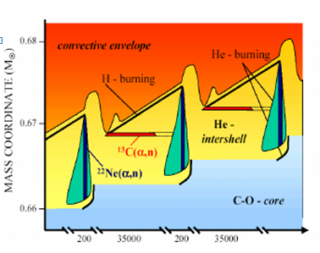
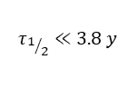
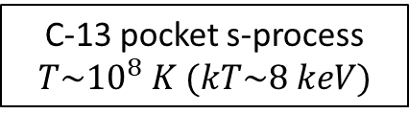
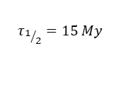
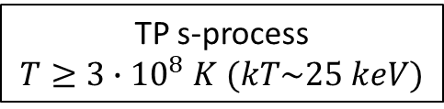
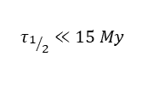
The ²⁰⁵Pb-²⁰⁵Tl decay system
²⁰⁵Tl is the most abundant (71%) stable (at earth) thallium isotope (Z=81)
Already measured at n_TOF(C. Domingo-Pardo et al.,
Phys. Rev. C 75, 015806 (2007))
Recently measured! Final results in the near future
After s-process
s-only
 | ²⁰⁴Pb | ²⁰⁵Pb | ²⁰⁶Pb
 | ²⁰³Tl | ²⁰⁴Tl | ²⁰⁵Tl | ²⁰⁶Tl
EPJ Web of Conferences 279, 06010 (2023)
(n,γ)
(n,γ)
C-13 pocket s-process
$$T\sim {10}^{8} K (kT\sim 8 keV)$$
$$τ_{1/2}≪15 My$$
β⁻
$$τ_{1/2}=15 My$$
β⁻
EC
s-process flow
TP s-process
$T≥3∙{10}^{8} K$ $(kT\sim 25 keV)$
(n,γ)
(n,γ)
(n,γ)
$$τ_{1/2}≪3.8 y$$
Already measured at n_TOF (A. Casanovas Ph.D. thesis (2020), submitted to PRL)
The ²⁰⁵Pb/²⁰⁴Pb ratio could be used as a “chronometer” of the s-process^{1,2,3}
  Time elapsed since the last injection of main s-process products into the pre-solar nebula
AGB (red giant) time evolution
Stellar effects on ²⁰⁵Pb: at s-process sites temperature, EC decay is so strongly enhanced that its survival is compromised
Activation of the bound state β decay of ²⁰⁵Tl
1. K. Yokoi et al., The production and survival of Pb-205 in stars, and the ²⁰⁵Pb/²⁰⁵Tl s-process chronometry, Astronomy and Astrophysics 145, 339-346 (1985)
2. R.G.A. Baker et al. , The thallium isotope composition of carbonaceous chondrites — New evidence for live ²⁰⁵Pb in the early solar system, Earth and Plan. Sc. Lett (2010)
3. Mowlavi, N., Goriely, S., Arnould, M., The survival of ²⁰⁵Pb in intermediate-mass AGB stars, Astron. Astrophys. 330, 206–214 (1998)
Notes:
One of the main points of interest of this región is that 204Pb and 205Pb are s-only […] , and on top of that, Pb5 is radiaoctive blablá
But there is a problem… during the first stage of s-process nucleosynthesis, where neutrons are released through the reaction c13na
However, during the second stage, during the recurrent TP, T rises due to flash He burning, and neutrons are released… The high T activates the decay…
A part from that, it is worth mentioning that most reactions affecting the Pb5 abundance have already been measured

Slide 4
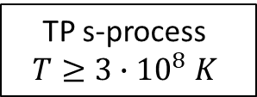
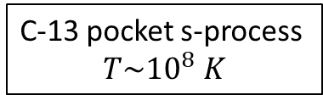
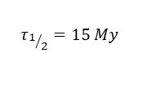
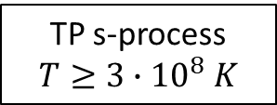
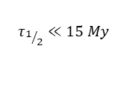
Main ideas
²⁰⁵Tl is the most abundant (71%) stable (at earth) thallium isotope (Z=81)
Already measured at n_TOF(C. Domingo-Pardo et al.,
Phys. Rev. C 75, 015806 (2007))
 | ²⁰⁴Pb | ²⁰⁵Pb | ²⁰⁶Pb
 | ²⁰³Tl | ²⁰⁴Tl | ²⁰⁵Tl | ²⁰⁶Tl
C-13 pocket s-process
$$T\sim {10}^{8} K$$
s-only
The ²⁰⁵Pb/²⁰⁴Pb ratio has the potential to be used as a “chronometer” of the s-process
(n,γ)
(n,γ)
$$τ_{1/2}≪15 My$$
β⁻
$$τ_{1/2}=15 My$$
β⁻
TP s-process
$$T≥3∙{10}^{8} K$$
EC
s-process flow
(n,γ)
(n,γ)
(n,γ)
The ²⁰⁵Tl(n,γ) capture reaction, by affecting the abundance of ²⁰⁵Tl, could play a relevant role in the final abundance (and survival) of ²⁰⁵Pb
$$τ_{1/2}≪3.8 y$$
After s-process
Already measured at n_TOF (A. Casanovas Ph.D. thesis, 2018)
Stellar effects on ²⁰⁵Pb: at s-process sites temperature, EC decay is so strongly enhanced that its survival is compromised
AGB (red giant) time evolution
A precise knowledge of this cross section is also important to complete the analysis of the ²⁰⁴Tl branching point
Activation of the bound state β decay of ²⁰⁵Tl
The ²⁰⁵Pb/²⁰⁴Pb ratio could be used as a “chronometer” of the s-process^{1,2,3}
  Time elapsed since the last injection of main s-process products into the pre-solar nebula
1. K. Yokoi et al., The production and survival of Pb-205 in stars, and the ²⁰⁵Pb/²⁰⁵Tl s-process chronometry, Astronomy and Astrophysics 145, 339-346 (1985)
2. R.G.A. Baker et al. , The thallium isotope composition of carbonaceous chondrites — New evidence for live ²⁰⁵Pb in the early solar system, Earth and Plan. Sc. Lett (2010)
3. Mowlavi, N., Goriely, S., Arnould, M., The survival of ²⁰⁵Pb in intermediate-mass AGB stars, Astron. Astrophys. 330, 206–214 (1998)
Notes:
Now I’ll will focus on the tl and pb isotopes, and describe the nucleosynthesis process over time in this region. […] During h-Shell burning in AGB stars, neutrons are produced by the reaction c13 blablá
This decay process bounds the 205Pb abundance to the 205Tl abundance

Slide 5
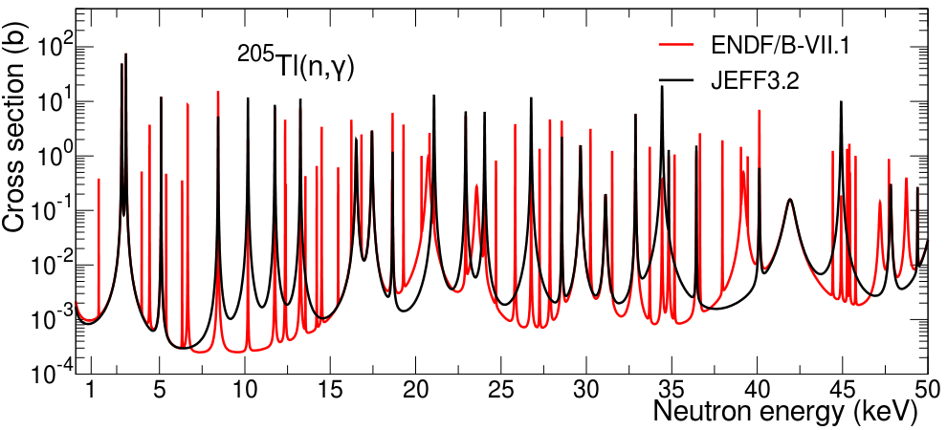
Status of the data for ²⁰⁵Tl(n,γ) : cross section
Only one previous measurement: R. L. Macklin and R. R. Winters, Stellar neutron capture in the thallium isotopes, Astrophys. J. 208, 812 (1976)
  Experimental capture cross section or resonance parameters never published
  Related EXFOR data: only resonance kernels, no uncertainties, up to 102 keV
  Explicit correction factor for systematic error at ORNL: not known (0.95 for ²⁰³Tl)
Most recent evaluations show important discrepancies:
Notes:
Issues , not problems

Slide 6
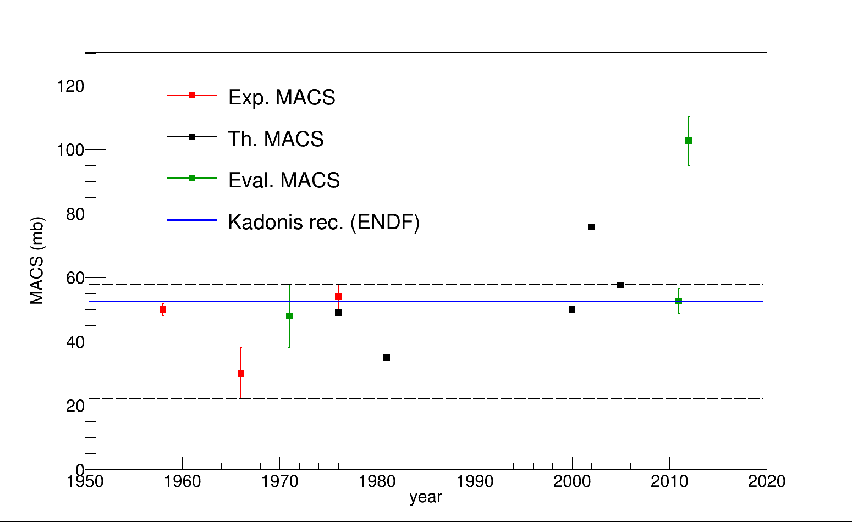
Status of the data for ²⁰⁵Tl(n,γ): MACS
MACS at 30 keV comparison:
  Kadonis reference value: 52.6 ± 3.9 mb (ENDF evaluation)
  Examination of ENDF data suggests it is based on 1976 ORNL measurement
  No direct uncertainty assessment in the whole energy range (8 keV to 50 keV)
JEFF 3.2 (!)
²⁰⁵Tl(n,γ)
Macklin&Winters (1976)
+10%
-60%
Activation measurements
ENDF/B-VII.1
Estimation of the uncertainty in the accuracy of the MACS
MACS range variation over reference (+10% to -60%)
Notes:
We selected this range as rapresentative of the uncertainty in the accuracy of the macs

Slide 7
Main points
From the current status of the data a +10% to -40% uncertainty in the value of the ²⁰⁵Tl(n,γ) is assumed
This leads to an approx. 40% global uncertainty in the ²⁰⁵Pb/²⁰⁴Pb ratio only due to this reaction
Goal: increase precision and accuracy of ²⁰⁵Tl(n,γ) to reduce the uncertainty in the ²⁰⁵Pb/²⁰⁴Pb ratio

Slide 8
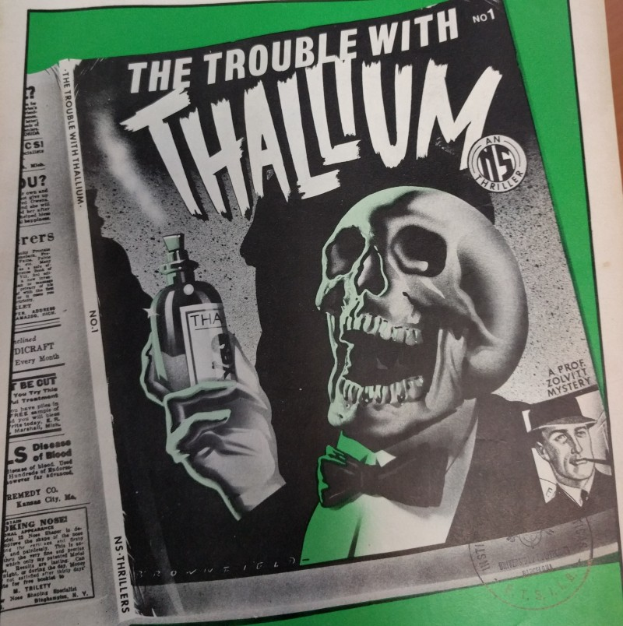
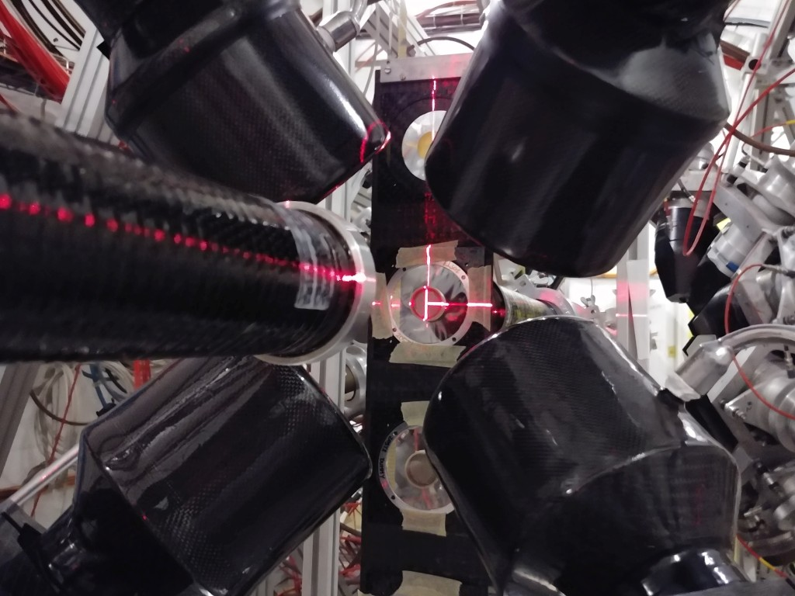

²⁰⁵Tl(n,γ) measurement: sample issue
Acquired “pure” sample was heavily contaminated with bromine
A new, on-the-go sample of natural thallium was produced
in a few days thanks to our PSI colleagues (E. Maugeri’s team)
  3.7 g of natural thallium, of which 2.6 g is ²⁰⁵Tl
  Same diameter, similar thickness
This sample luckily had no bromine
  (or an undetectable amount)
As nat. Tl, sample contains also 29% of ²⁰³Tl
Resonance spacing of Tl isotopes resonances is high $→$“easier” to separate them
²⁰³Tl was measured in 2015, resonance information up to 25 keV
Higher energy results could be used to complete ²⁰³Tl(n,γ) analysis of 2015 measurement (to be carefully studied)
Meas. Setup: standard C₆D₆ Legnaro detectors, “old” PMT

Slide 9
Measurement summary
TOTAL | 2.508E+18
Assigned | 2.60E+18
Sum on good targets: | 1.853E+18
Sum backgrounds: | 4.315E+17
Sum useful data: | 2.284E+18
Sum Tl-nat 99%: | 1.613E+18
Sum Tl-nat 99% filters: | 1.09E+17
Sum dummy: | 2.322E+17
Sum dummy filters: | 6.743E+16
Total dummy: | 2.996E+17
Sum Gold: | 1,314E+17
Sum Pb-nat: | 4.753E+16
Sum Pb-nat filters: | 4.403E+16
Total Pb-nat | 9.156E+16
Sum empty: | 4.036E+16
Sum Br cont. thick: | 1.822E+17
Sum Br cont. thin: | 4.165E+16
Sum contaminated: | 2.238E+17
2·10¹⁸ protons approved
1.7·10¹⁸ allocated

Slide 10
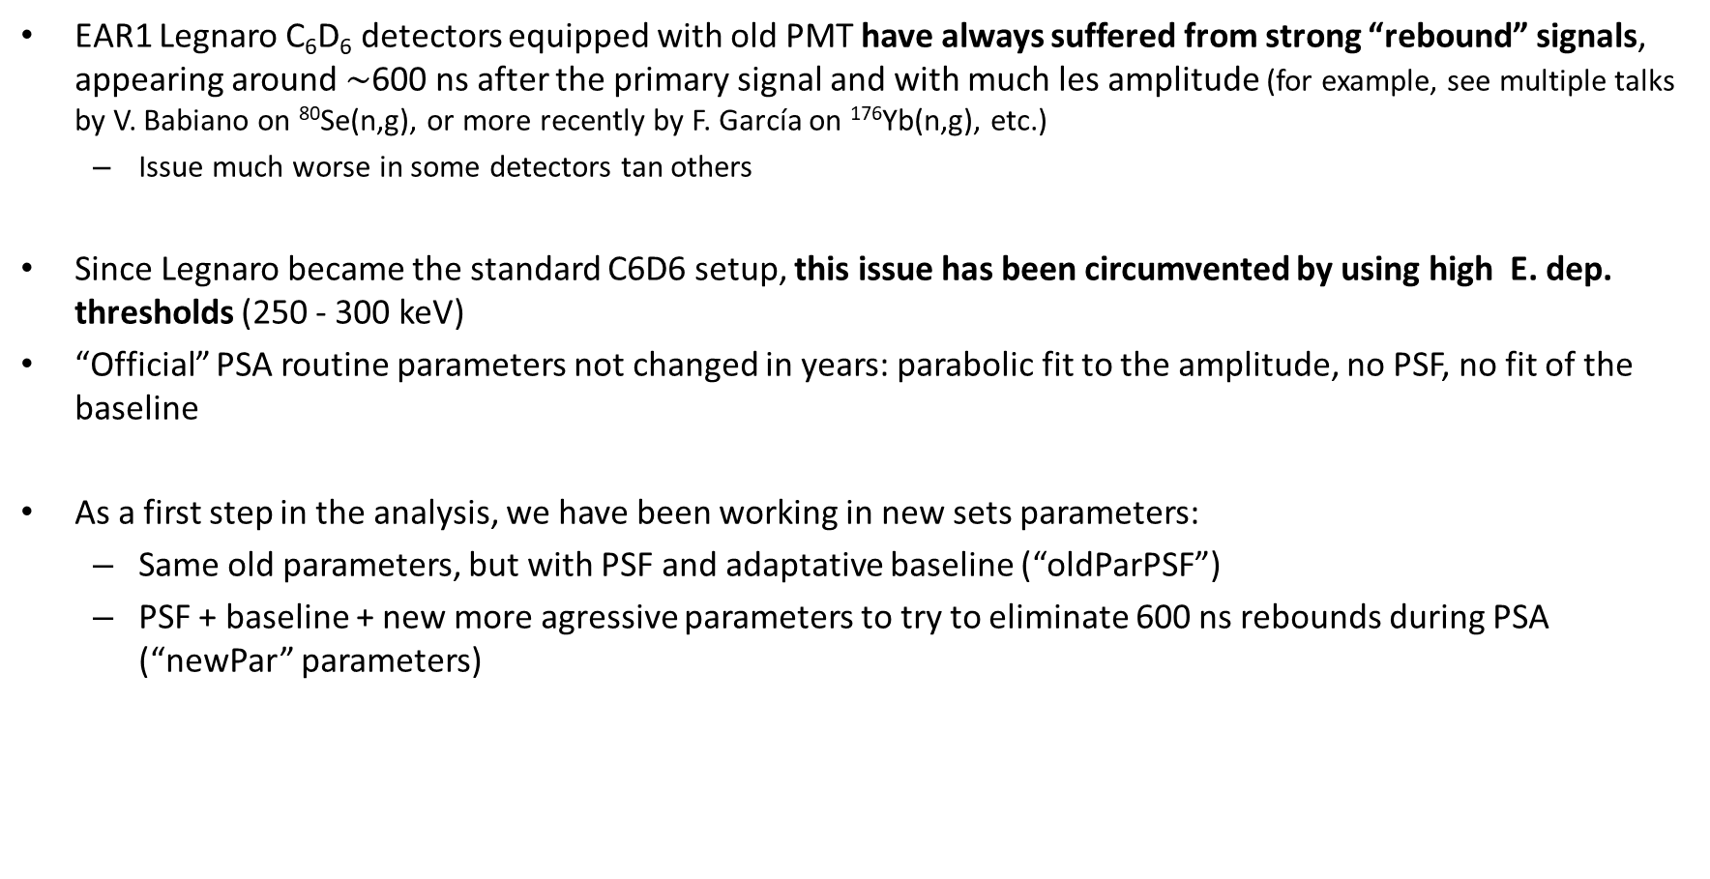
First steps: signal analysis
EAR1 Legnaro C₆D₆ detectors equipped with old PMT have always suffered from strong “rebound” signals, appearing around $∼$600 ns after the primary signal and with much les amplitude (for example, see multiple talks by V. Babiano on ⁸⁰Se(n,g), or more recently by F. García on ¹⁷⁶Yb(n,g), etc.)
  Issue much worse in some detectors tan others
Since Legnaro became the standard C6D6 setup, this issue has been circumvented by using high E. dep. thresholds (250 - 300 keV)
“Official” PSA routine parameters not changed in years: parabolic fit to the amplitude, no PSF, no fit of the baseline
As a first step in the analysis, we have been working in new sets parameters:
  Same old parameters, but with PSF and adaptative baseline (“oldParPSF”)
  PSF + baseline + new more agressive parameters to try to eliminate 600 ns rebounds during PSA (“newPar” parameters)

Slide 11
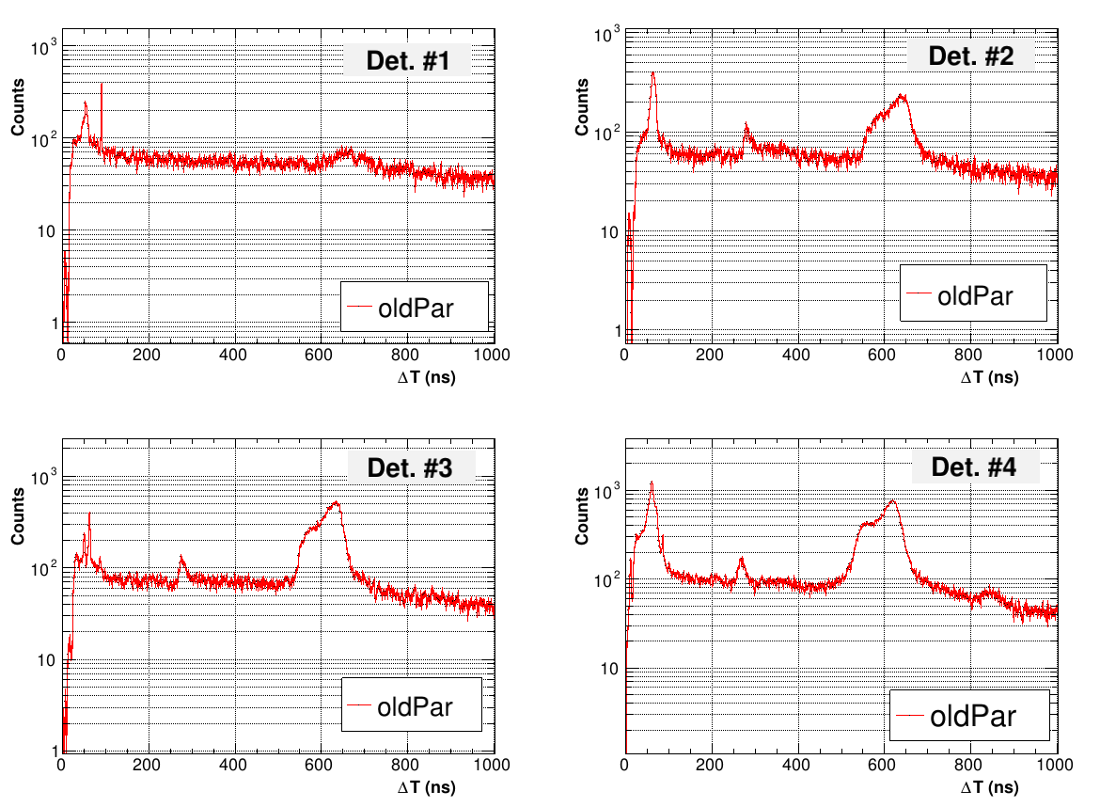
ΔT between consecutive signals (E.dep. th = 120 keV)

Slide 12
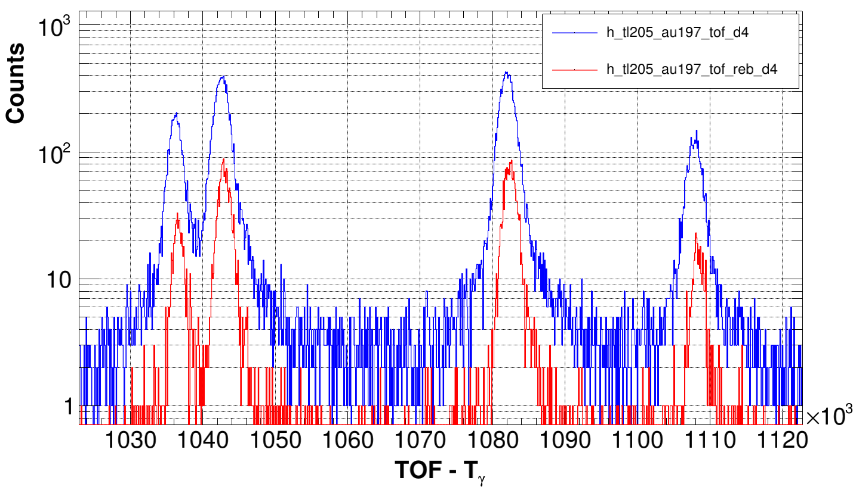
Rebounds in data (E. dep. = 120 keV)
Rebound is artificial contribution to resonance integrals
Can lead even to false double structures

Slide 13
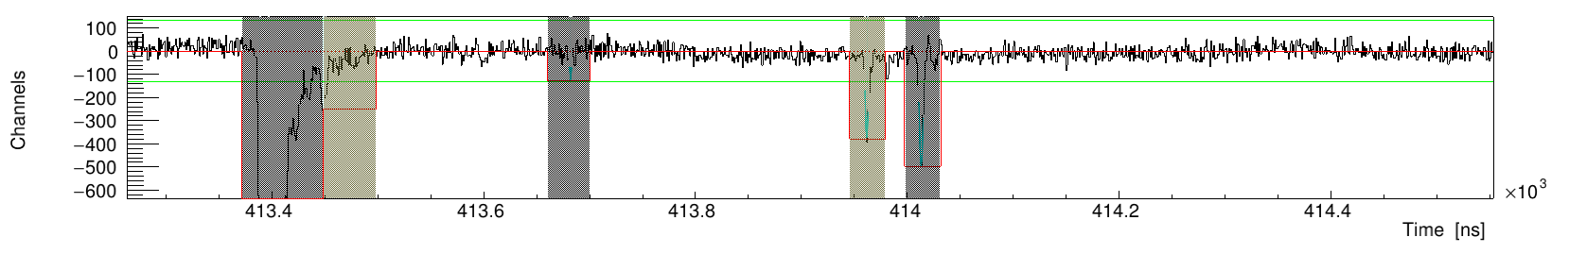
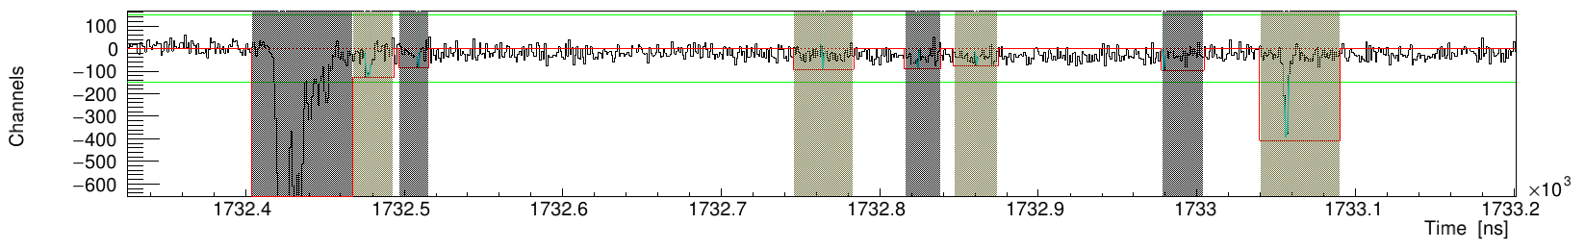
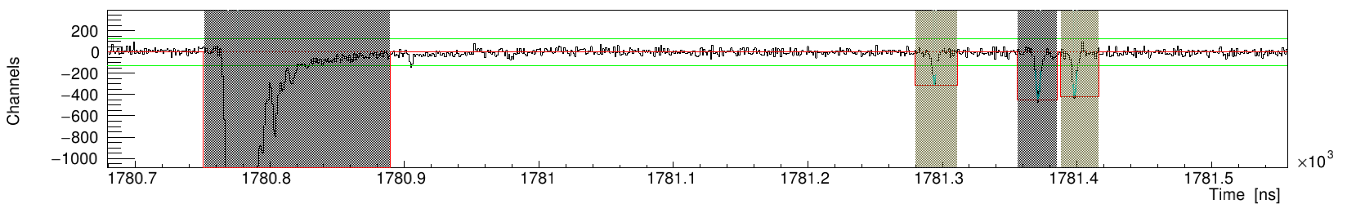
Old PSA parameters and rebounds

Slide 14
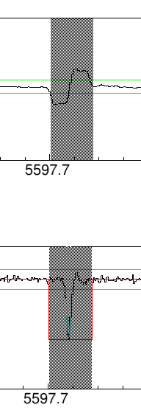
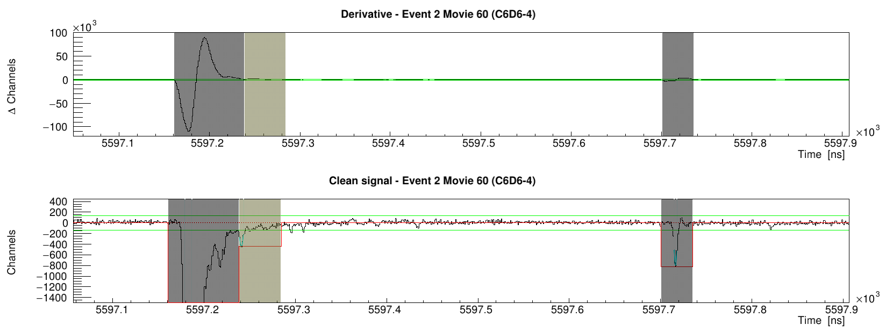
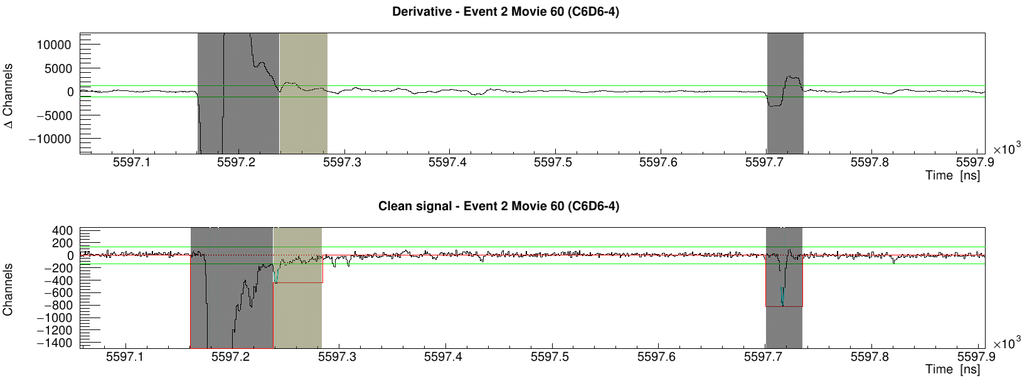
Old PSA parameters and rebounds

Slide 15
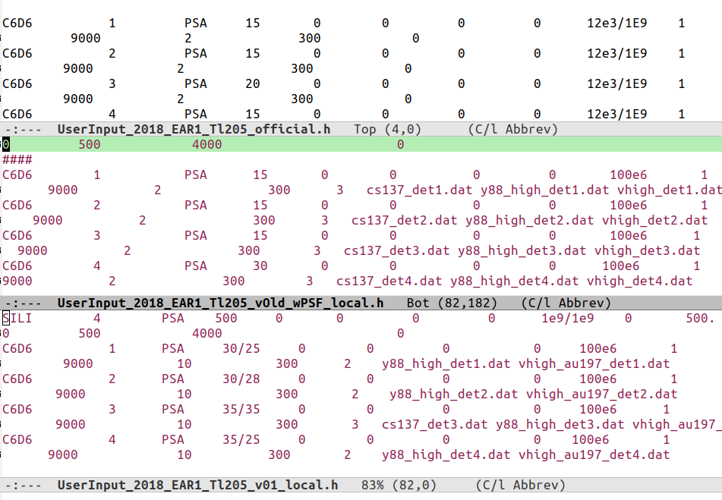
Old vs new parameters
Derivative step
Threshold in derivative

Slide 16
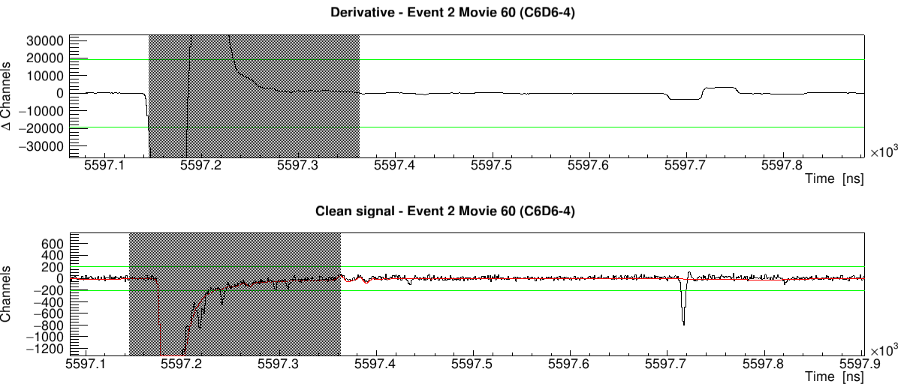
New PSA parameters (first version)
New parameters: increase in step size and derivative threshold
Goal: eliminate rebounds while keeping signals of similar amplitude

Slide 17
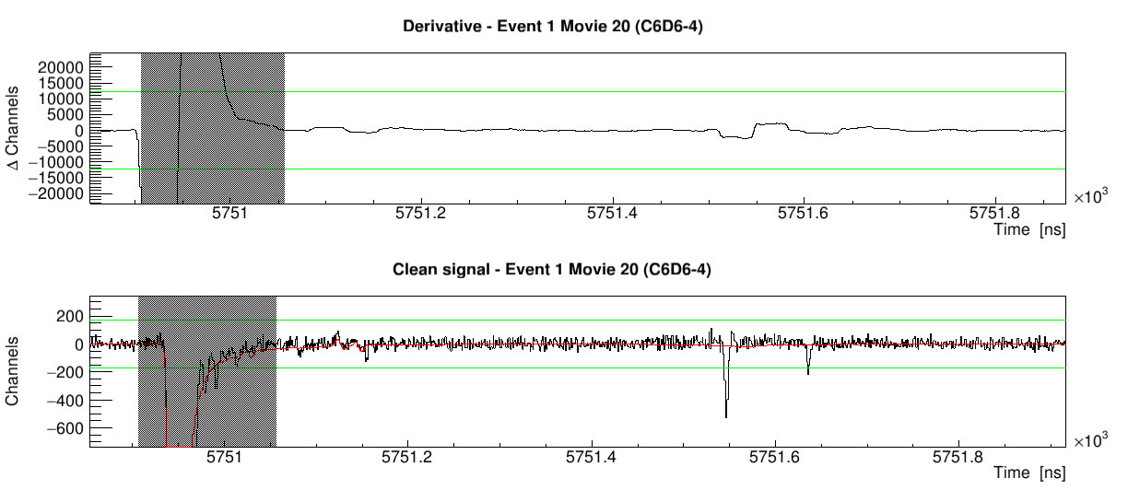
New PSA parameters (first version)
New parameters: increase in step size and derivative threshold
Goal: eliminate rebounds while keeping signals of similar amplitude

Slide 18
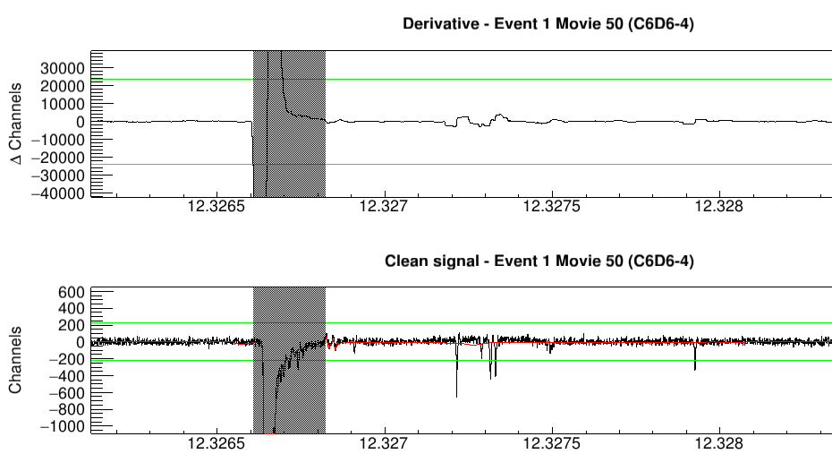
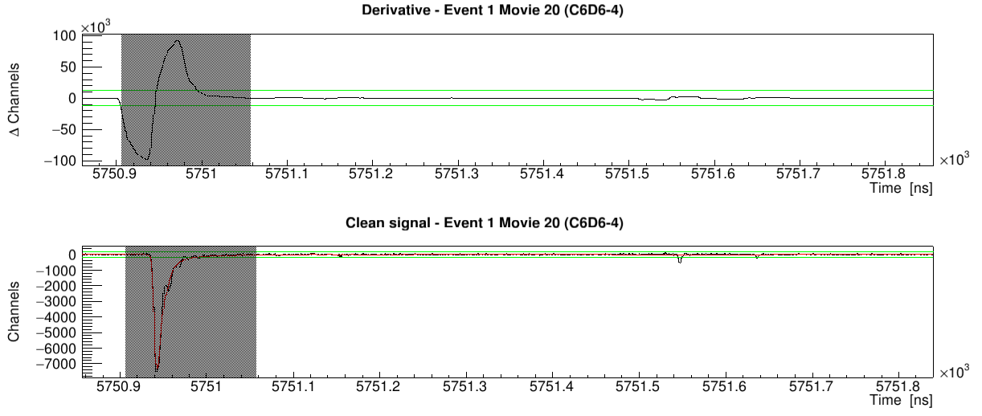
New PSA parameters (first version)
New parameters: increase in step size and derivative threshold
Goal: eliminate rebounds while keeping signals of similar amplitude

Slide 19
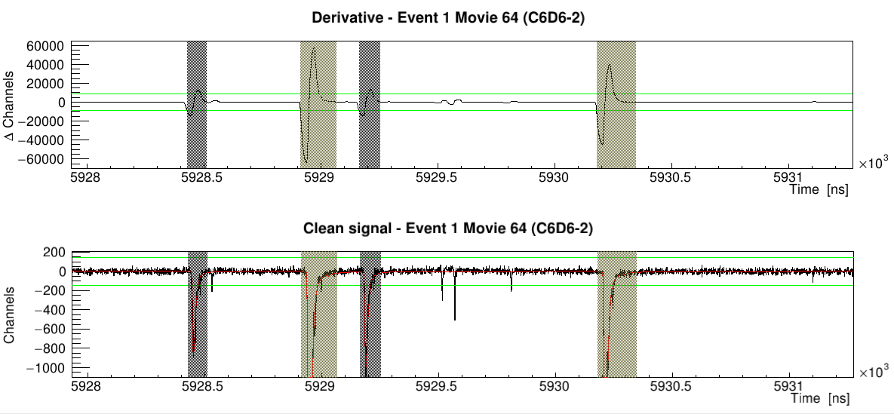
New PSA parameters (first version)
New parameters: increase in step size and derivative threshold
Goal: eliminate rebounds while keeping signals of similar amplitude

Slide 20
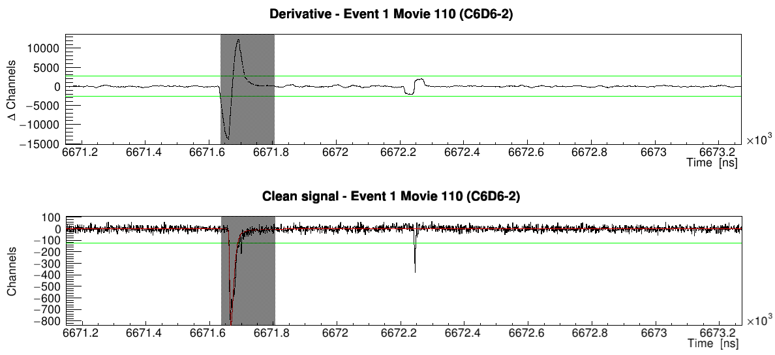
New PSA parameters (first version)
New parameters: increase in step size and derivative threshold
Goal: eliminate rebounds while keeping signals of similar amplitude

Slide 21
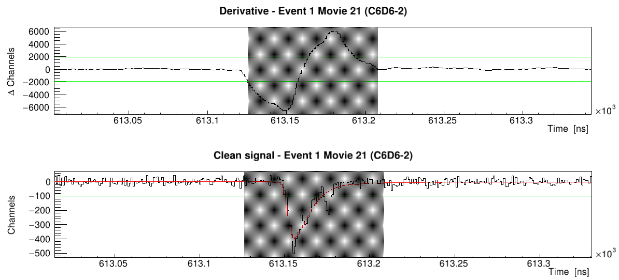
New PSA parameters (first version)
New parameters: increase in step size and derivative threshold
Goal: eliminate rebounds while keeping signals of similar amplitude

Slide 22
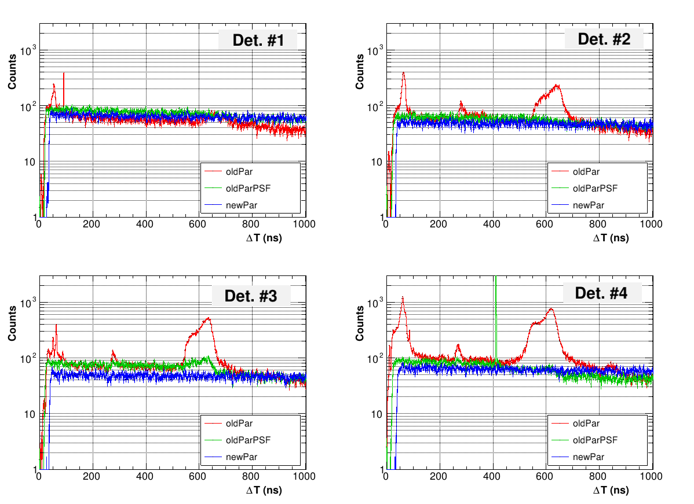
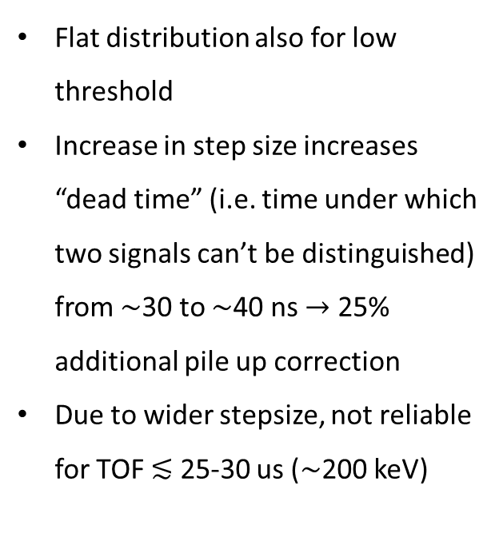
ΔT between consecutive signals: th=120 keV
Flat distribution also for low threshold
Increase in step size increases “dead time” (i.e. time under which two signals can’t be distinguished) from $∼$30 to $∼$40 ns $→$ 25% additional pile up correction
Due to wider stepsize, not reliable for TOF $≲$ 25-30 us ($∼$200 keV)

Slide 23
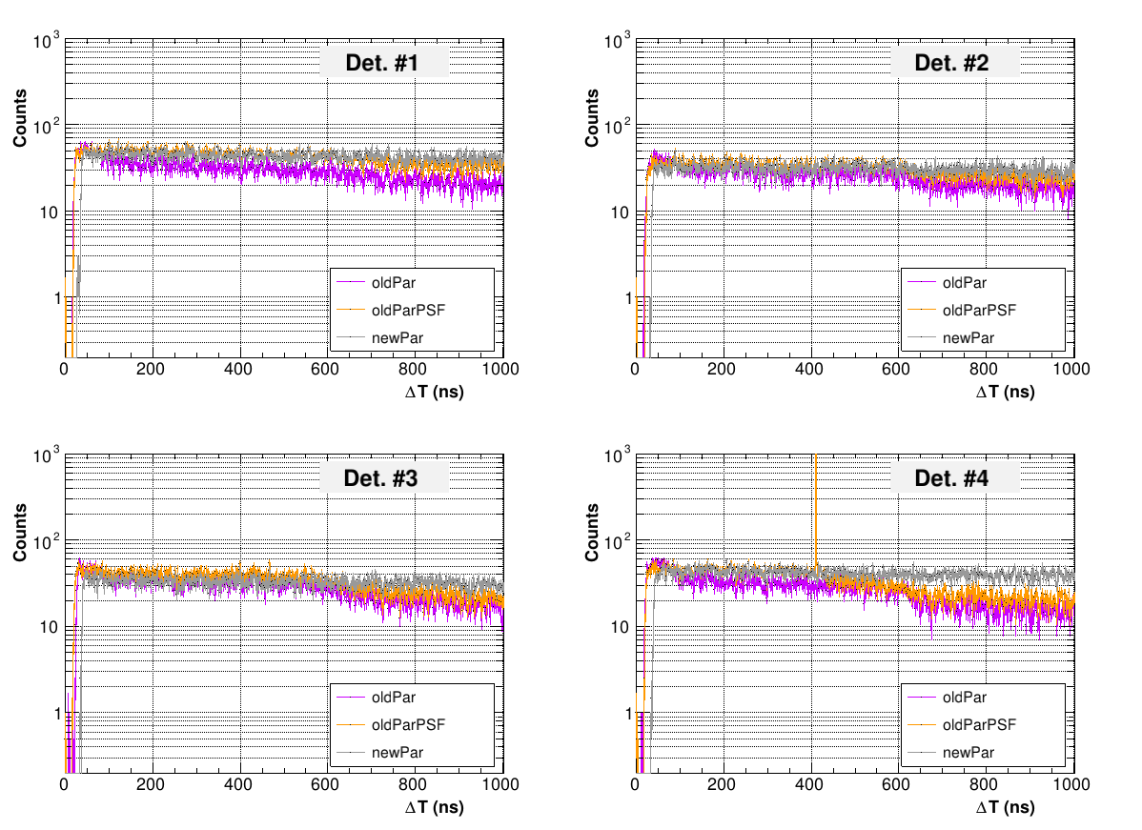
ΔT between consecutive signals: th=250 keV
Flat distribution also for low threshold
Increase in step size increases “dead time” (i.e. time under which two signals can’t be distinguished) from $∼$30 to $∼$40 ns $→$ 25% additional pile up correction
Due to wider stepsize, not reliable for TOF $≲$ 25-30 us ($∼$200 keV)

Slide 24
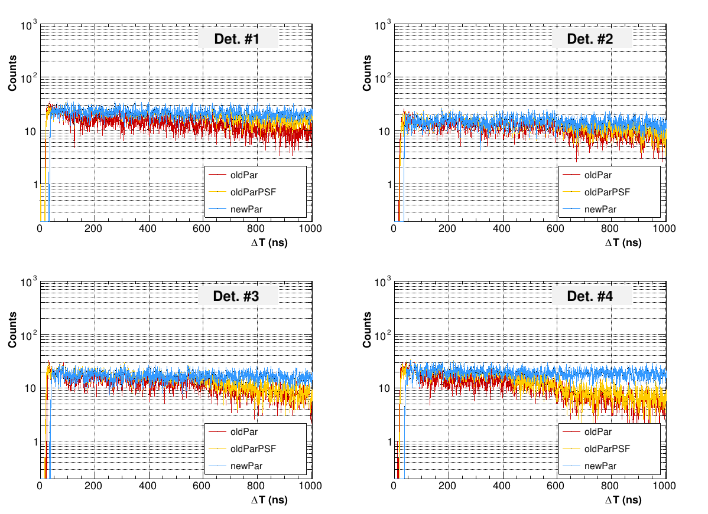
ΔT between consecutive signals: th=600 keV
Flat distribution also for low threshold
Increase in step size increases “dead time” (i.e. time under which two signals can’t be distinguished) from $∼$30 to $∼$40 ns $→$ 25% additional pile up correction
Due to wider stepsize, not reliable for TOF $≲$ 25-30 us ($∼$200 keV)

Slide 25
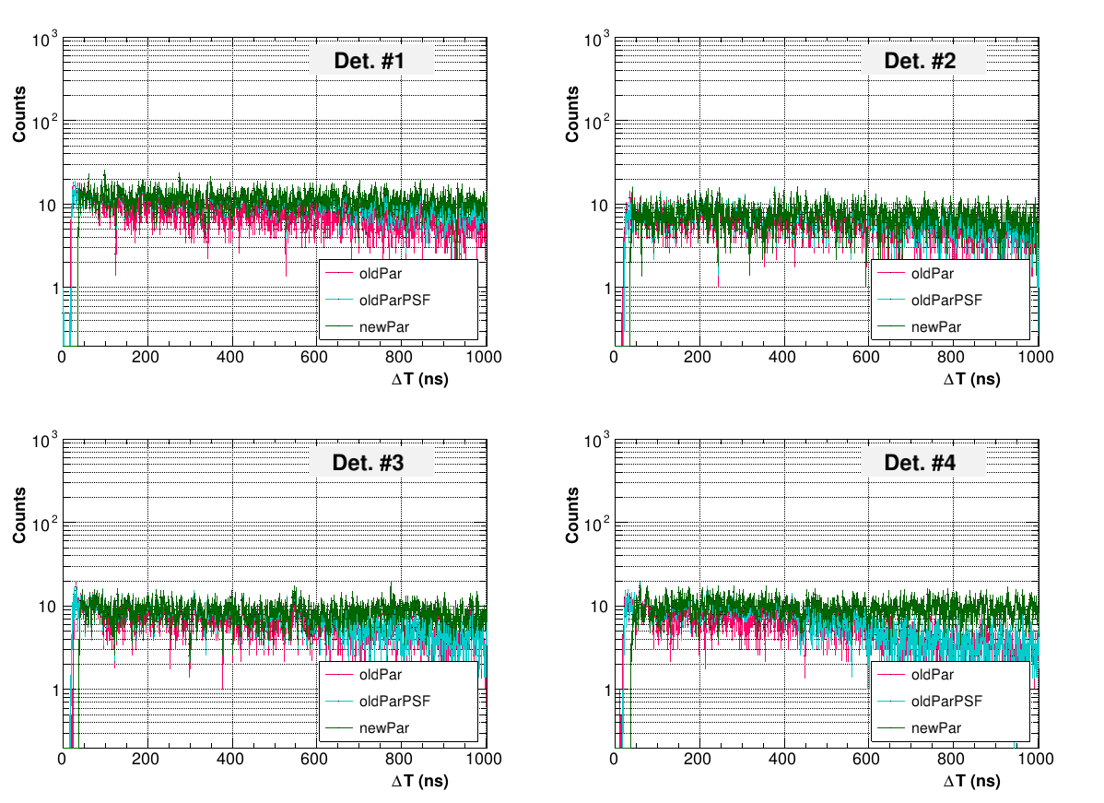
ΔT between consecutive signals: th=1000 keV
Flat distribution also for low threshold
Increase in step size increases “dead time” (i.e. time under which two signals can’t be distinguished) from $∼$30 to $∼$40 ns $→$ 25% additional pile up correction
Due to wider stepsize, not reliable for TOF $≲$ 25-30 us ($∼$200 keV)

Slide 26
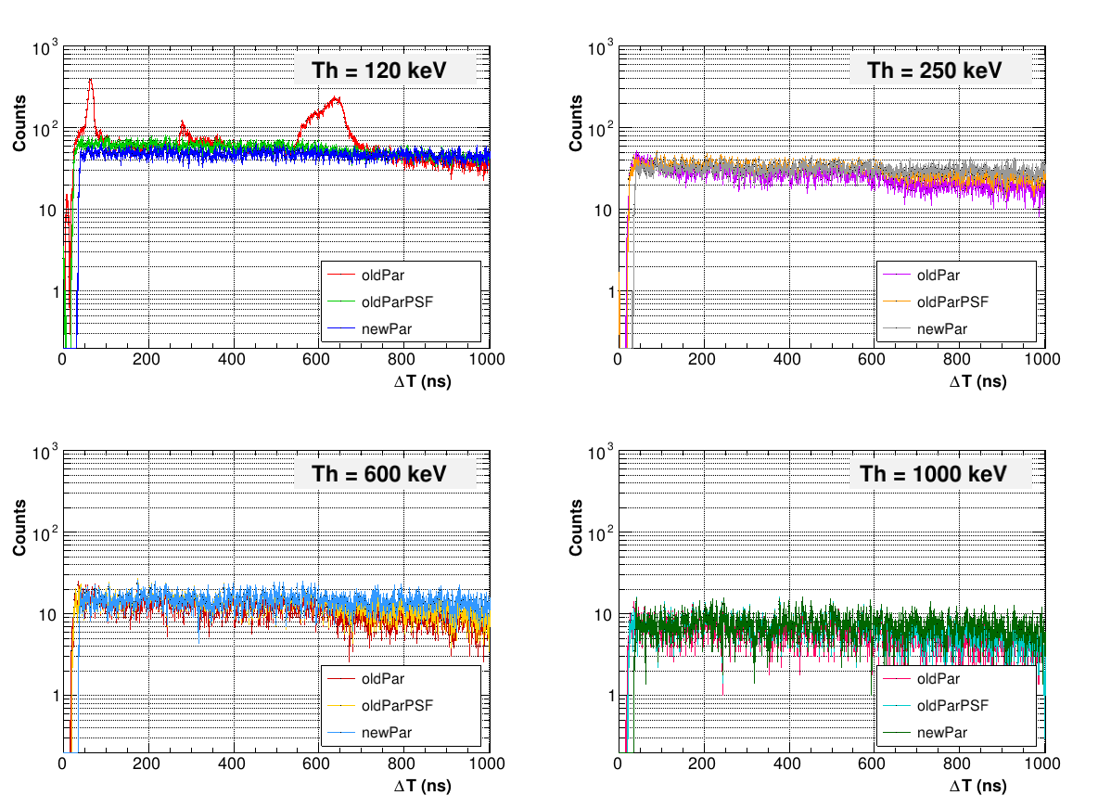
ΔT between consecutive signals: same detector
L6D6-2-C

Slide 27
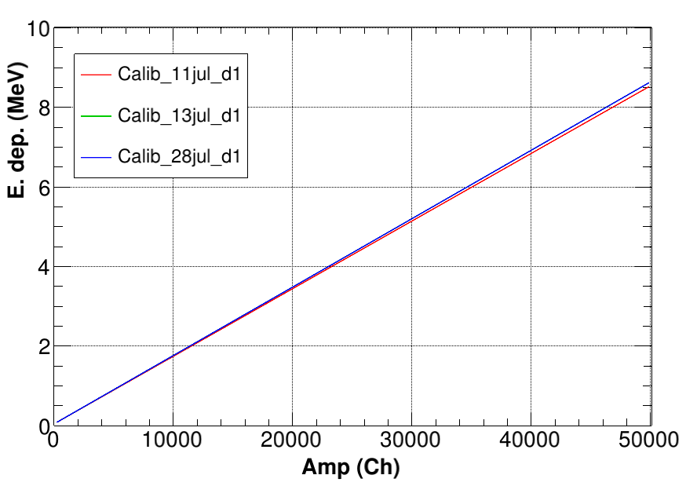
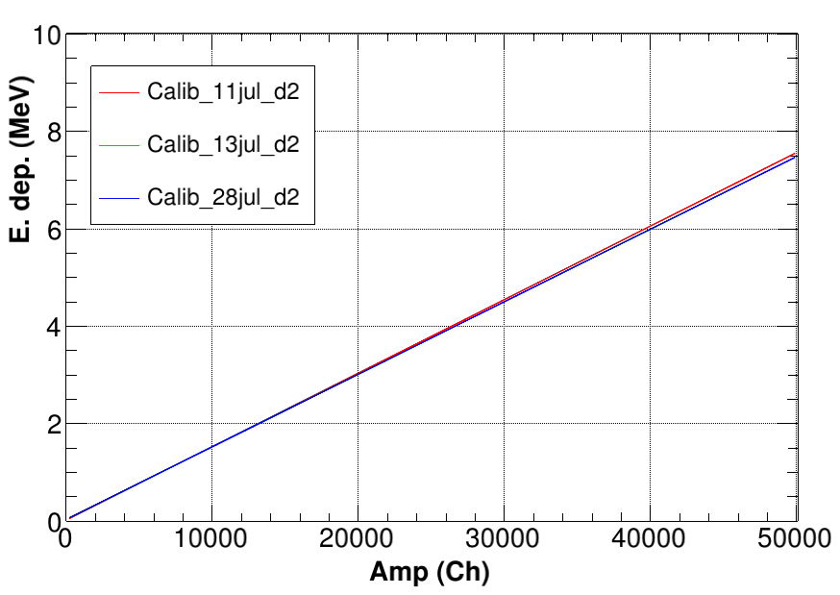
Calibrations with simulations
Linear or double linear calibrations provide a satisfactory agreement with sources for all detectors
Overall very good gain stability (±1-2%) along the measurement

Slide 28
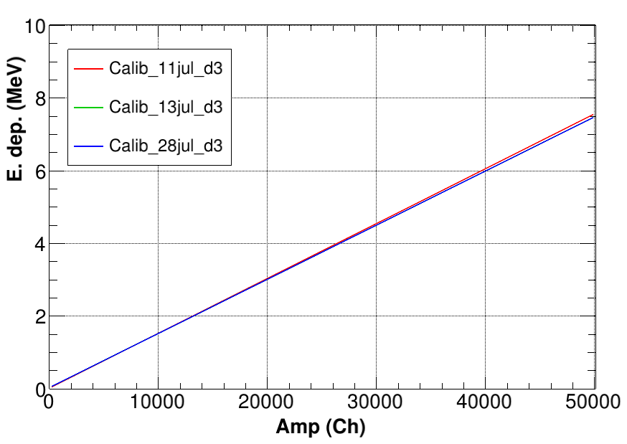
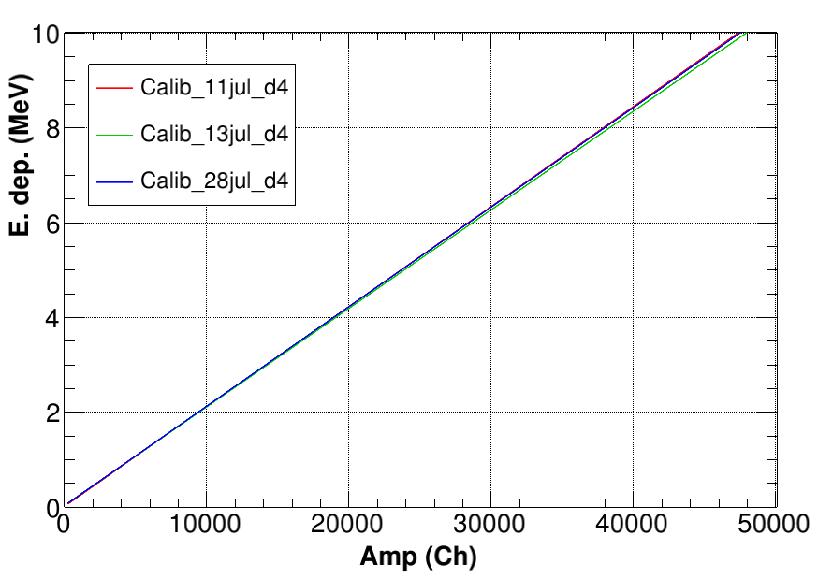
Calibrations with simulations
Linear or double linear calibrations provide a satisfactory agreement with sources for all detectors
Overall very good gain stability (±1-2%) along the measurement

Slide 29
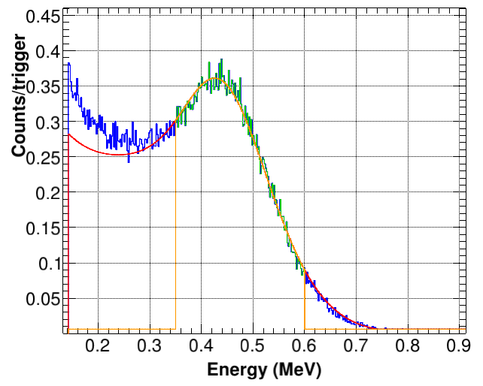
Calibrations with simulations
Linear or double linear calibrations provide a satisfactory agreement with sources for all detectors
Overall very good gain stability (±1-2%) along the measurement
Example L6D6 1-G: Good agreement with a single linear calib for Cs-137 (0.662 MeV)

Slide 30
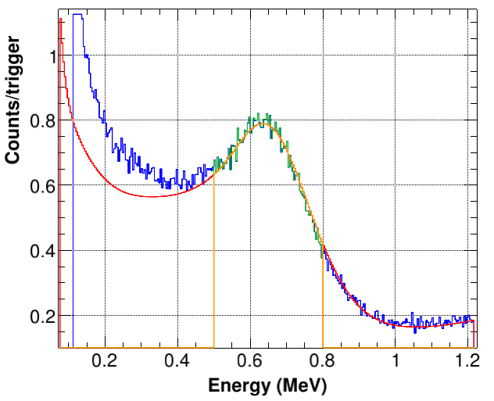
Calibrations with simulations
Linear or double linear calibrations provide a satisfactory agreement with sources for all detectors
Overall very good gain stability (±1-2%) along the measurement
Example L6D6 1-G: Good agreement with a single linear calib for Y-88 (0.898 MeV)

Slide 31
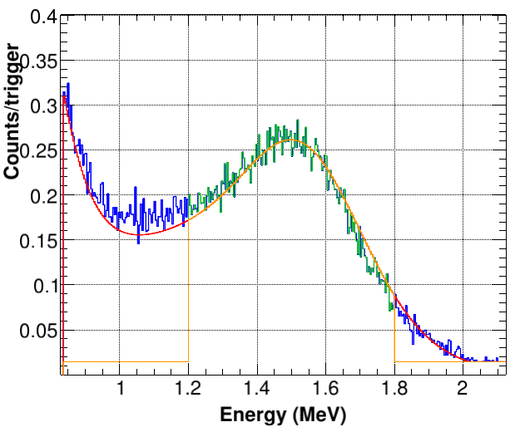
Calibrations with simulations
Linear or double linear calibrations provide a satisfactory agreement with sources for all detectors
Overall very good gain stability (±1-2%) along the measurement
Example L6D6 1-G: Good agreement with a single linear calib for Y-88 (1.8 MeV)

Slide 32
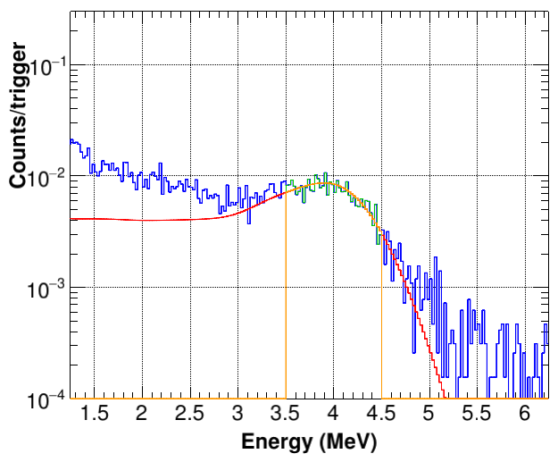
Calibrations with simulations
Linear or double linear calibrations provide a satisfactory agreement with sources for all detectors
Overall very good gain stability (±1-2%) along the measurement
Example L6D6 1-G: Good agreement with a single linear calib for AmBe (4.43 MeV)

Slide 33
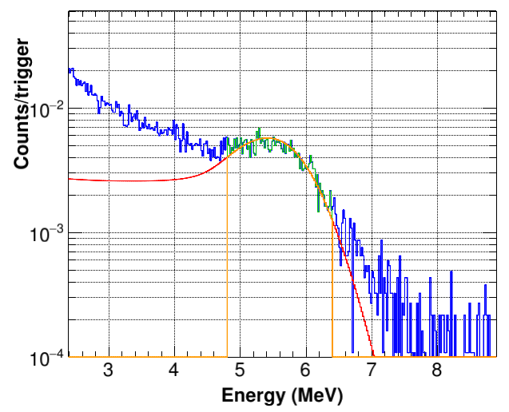
Calibrations with simulations
Linear or double linear calibrations provide a satisfactory agreement with sources for all detectors
Overall very good gain stability (±1-2%) along the measurement
Example L6D6 1-G: Good agreement with a single linear calib for CmC source (6.12 MeV)

Slide 34
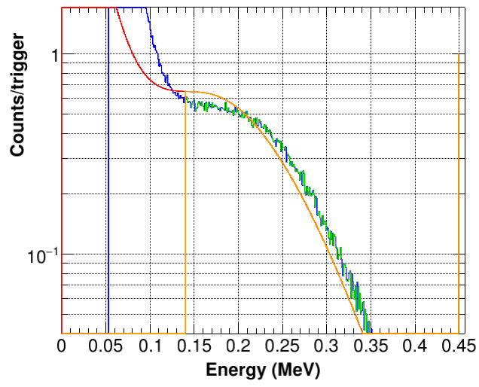
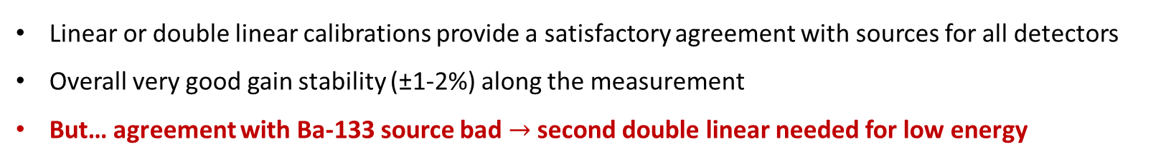
Calibrations with simulations
Linear or double linear calibrations provide a satisfactory agreement with sources for all detectors
Overall very good gain stability (±1-2%) along the measurement
But… agreement with Ba-133 source bad $→$ second double linear needed for low energy

Slide 35


Calibrations with simulations
Linear or double linear calibrations provide a satisfactory agreement with sources for all detectors
Overall very good gain stability (±1-2%) along the measurement
Second linear at low E. dep. (<400 keV) for det. 1 and 3 $→$ Ba-133 source calibration very important (few gamma rays below 300 keV)

Slide 36

Ratios between resonance integrals
Ratios obtained for four Au resonances (4.9 eV, 60 eV, 79 eV, 110 eV) for each threshold and detector
L6D6-1-G

Slide 37

Ratios between resonance integrals
Ratios obtained for four Au resonances (4.9 eV, 60 eV, 79 eV, 110 eV) for each threshold and detector
L6D6-3-D

Slide 38

Ratios between resonance integrals
Ratios obtained for four Au resonances (4.9 eV, 60 eV, 79 eV, 110 eV) for each threshold and detector
L6D6-4-D

Slide 39
Summary and outlook
A fine tuning of the PSA values should allow for a “clean” elimination of the rebounds, while allowing to keep the threshold in deposited energy as low as possible
Work still in progress
  Check comparison signal Area-amplitude ratio, C6D6 low amplitude signal high dispersion in shape
I warmly encourage everyone working on C6D6 data analysis to play with the PSA and provide new (and possible) better parameters
Detector calibrations with simulations confirm very stable and linear behaviour of the four detector
Next meeting: analysis should be in advanced stage

