Slide 1


Measurement of neutron capture cross sections at stellar energies at the n_TOF NEAR Station
R. Dressler, E. Maugeri, D. Rochmann, D. Schumann, Z. Talip,
M. Barcak, A. Manna, A. Mengoni, N. Patronis, E. Stamati,
and the n_TOF Collaboration

Slide 2
Solar System Abundances
A. Arcones. F. Thielemann: Astron Astrophys Rev 31 (2023) 1

Slide 3
Nucleosynthesis Mechanisms
M. Wiescher, F. Käppeler, K. Langanke: Annu. Rev. Astro. Astrophys. 50 (2012) 165

Slide 4
Status MACS at KADoNiS
I. Dillmann et al.: Eur. Phys. J. A 59 (2023) 105

Slide 5
Uncertainties of MACS in KADoNiS
Karlsruhe Astrophysical Database of Nucleosynthesis in Stars (KADoNiS)
https://exp-astro.physik.uni-frankfurt.de/kadonis1.0/KADoNiS database

Slide 6
Uncertainties in s-process Nucleosynthesis in low-mass Stars
G. Cescutti et al.: MNRAS 478 (2018) 4101

Slide 7
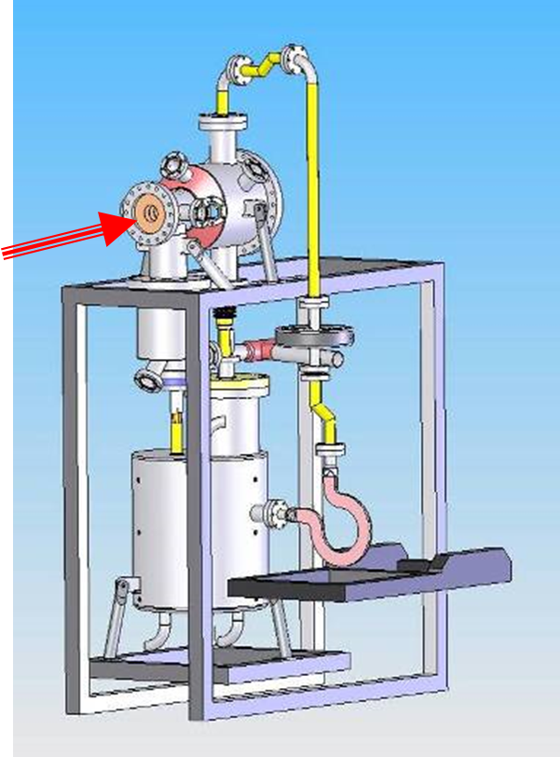
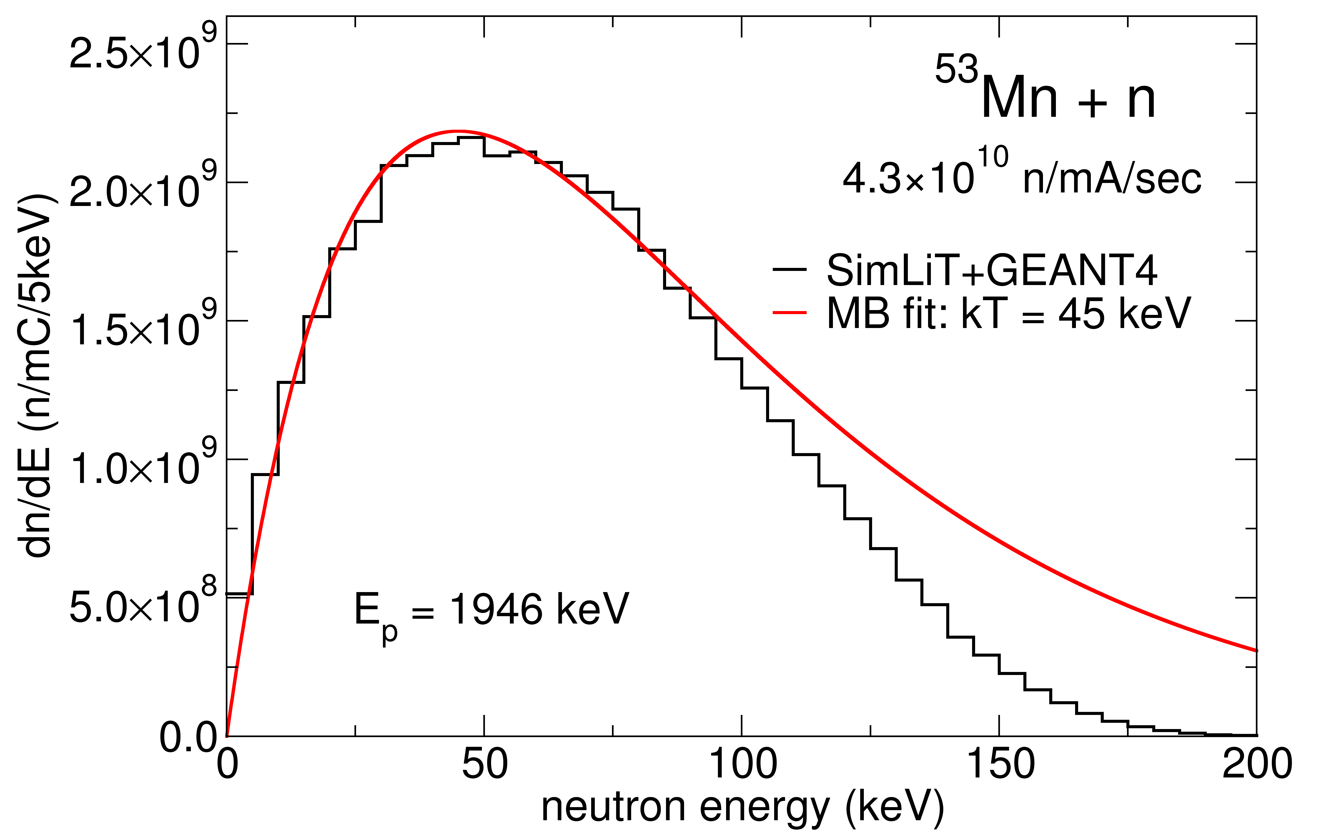
LiLiT Souce at SARAF (Soreq)
SARAF | Proton Energy [MeV] | Proton Current [mA] | Neutron Energy [MeV]
Phase-I | 1.9 - 3.0 | 10 - 20 | 0 - 1
Phase-II | 20 - 30 | 1 - 3 | 1 - 30
M. Friedman, et al.:
Nucl. Instr. Methods A 698 (2013) 117
M. Tessler, et al.:
Phys. Lett. B 751 (2015) 418

Slide 8
Frankfurt neutron source FRANZ
Facility | Flux [n/cm²/s] | Neutron Energy [keV]
FZ Karlsruhe | 1×10⁴ | 1 - 200
LiLiT Phase I | 5×10⁵ | 1 - 200
FRANZ design | 1×10⁷ | 1 - 200 (500)
a-NEAR @ n_TOF | 6×10⁷ ??? | 0.1 - 100
Suha Alzubaidi et al.: Eur. Phys. J. Plus 131 (2016) 124

Slide 9
B₄C filtered neutron field at NEAR

Slide 10
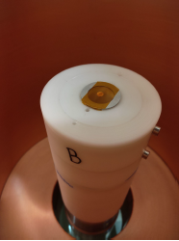
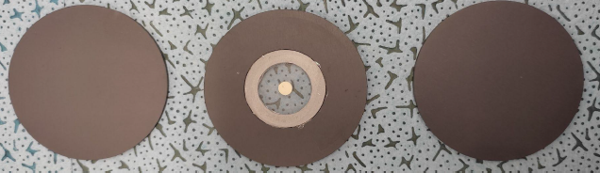
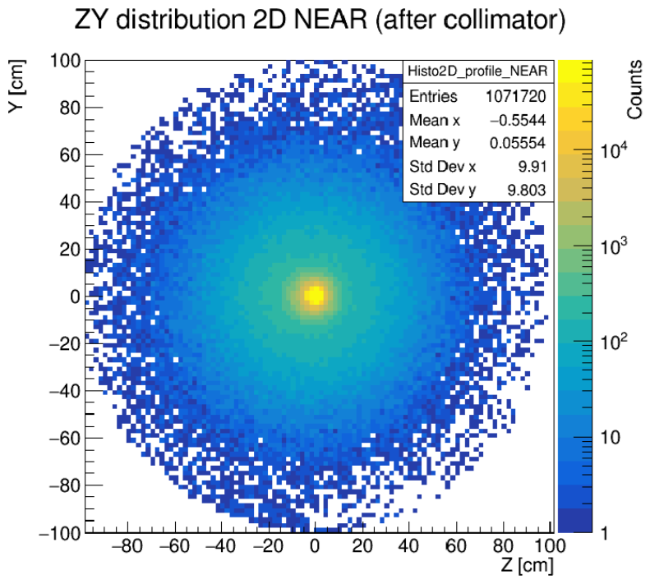
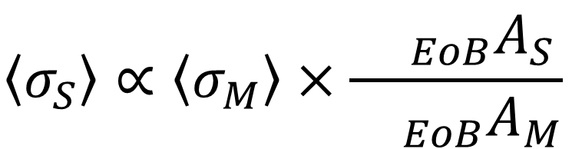
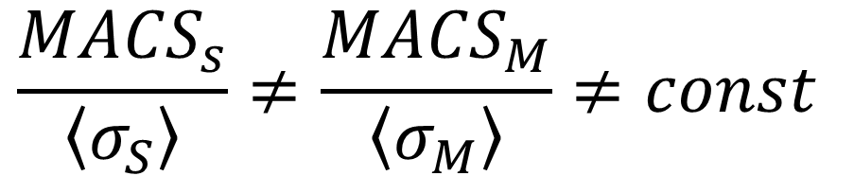
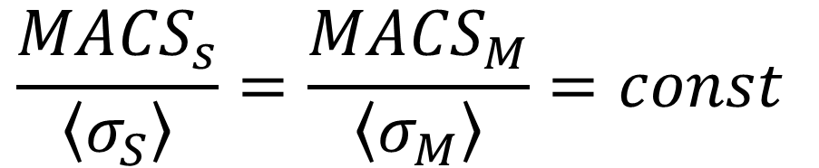
Experimental Procedure
⁵³Mn sample
Mawellian Averaged
Cross-Section
Spectrum Averaged
Cross-Section
$$\left\langle σ_{S}\right\rangle ∝\left\langle σ_{M}\right\rangle ×\frac{{}_{EoB}A_{S}}{{}_{EoB}A_{M}}$$
$$\frac{{MACS}_{s}}{\left\langle σ_{S}\right\rangle }=\frac{{MACS}_{M}}{\left\langle σ_{M}\right\rangle }=const$$
$$\frac{{MACS}_{s}}{\left\langle σ_{S}\right\rangle }≠\frac{{MACS}_{M}}{\left\langle σ_{M}\right\rangle }≠const$$
Courtesy for pictures to M.E. Stamati, A. Manna, et al.

Slide 11
Intention of the Proposal to INTC
establish and validate a procedure for measurements using moderated neutron fields at the NEAR station
(continuation of the proposal INTC-P-623)
using well-suited isotopes as potential flux monitors
long enough half-lives of the activation products
no influence on experiments at EAR-1 and EAR-2
final goal determination of MACS of ⁹⁴Nb and ⁵³Mn
(complementary to INTC-P-577 and INTC-P-408)
embedded in the nuclear engineering master's program at the EPF-Lausanne and ETH-Zurich

Slide 12
Envisaged Isotopes for Measurements
isotope | MACS @ 30 keV KADoNiS 1.0 | half-life activ. product | expected activity per 10¹⁸ atoms and 10¹⁸ protons
⁴⁵Sc | 61.5(22) mb | 83.82 d | 0.5 Bq
¹⁴⁶Nd | 91.2(10) mb | 10.98 d | 40 Bq
¹⁷⁴Yb | 151.0(18) mb | 4.2 d | 350 Bq
¹⁸⁰Hf | 157.0(20) mb | 42.39 d | 85 Bq
¹⁸¹Ta | 766(15) mb | 114.43 d | 30 Bq
¹⁹⁷Au | 613(7) mb | 2.69 d | 25 kBq
¹⁶⁹Tm | 1070(65) mb | 128.6 d | 20 Bq
⁵³Mn | (132 mb) estim. | 313 d | 2.9 Bq
⁹⁴Nb | (397 mb) estim. | 35 d | 100 Bq

Slide 13
Measurement of neutron capture cross sections at stellar energies at the n_TOF NEAR Station
20 activation runs of 6 days each
distributed over approximately 3 years
corresponding to 15×10¹⁸ protons on the target
no interference with EAR1 and EAR2 experiments
no dedicated protons are requested
measurements embedded in nuclear engineering master program at the EPF-Lausanne and ETH-Zurich
All this is only feasible
after installing
a neutron moderator at NEAR
Thank you for your attention!

