Slide 1

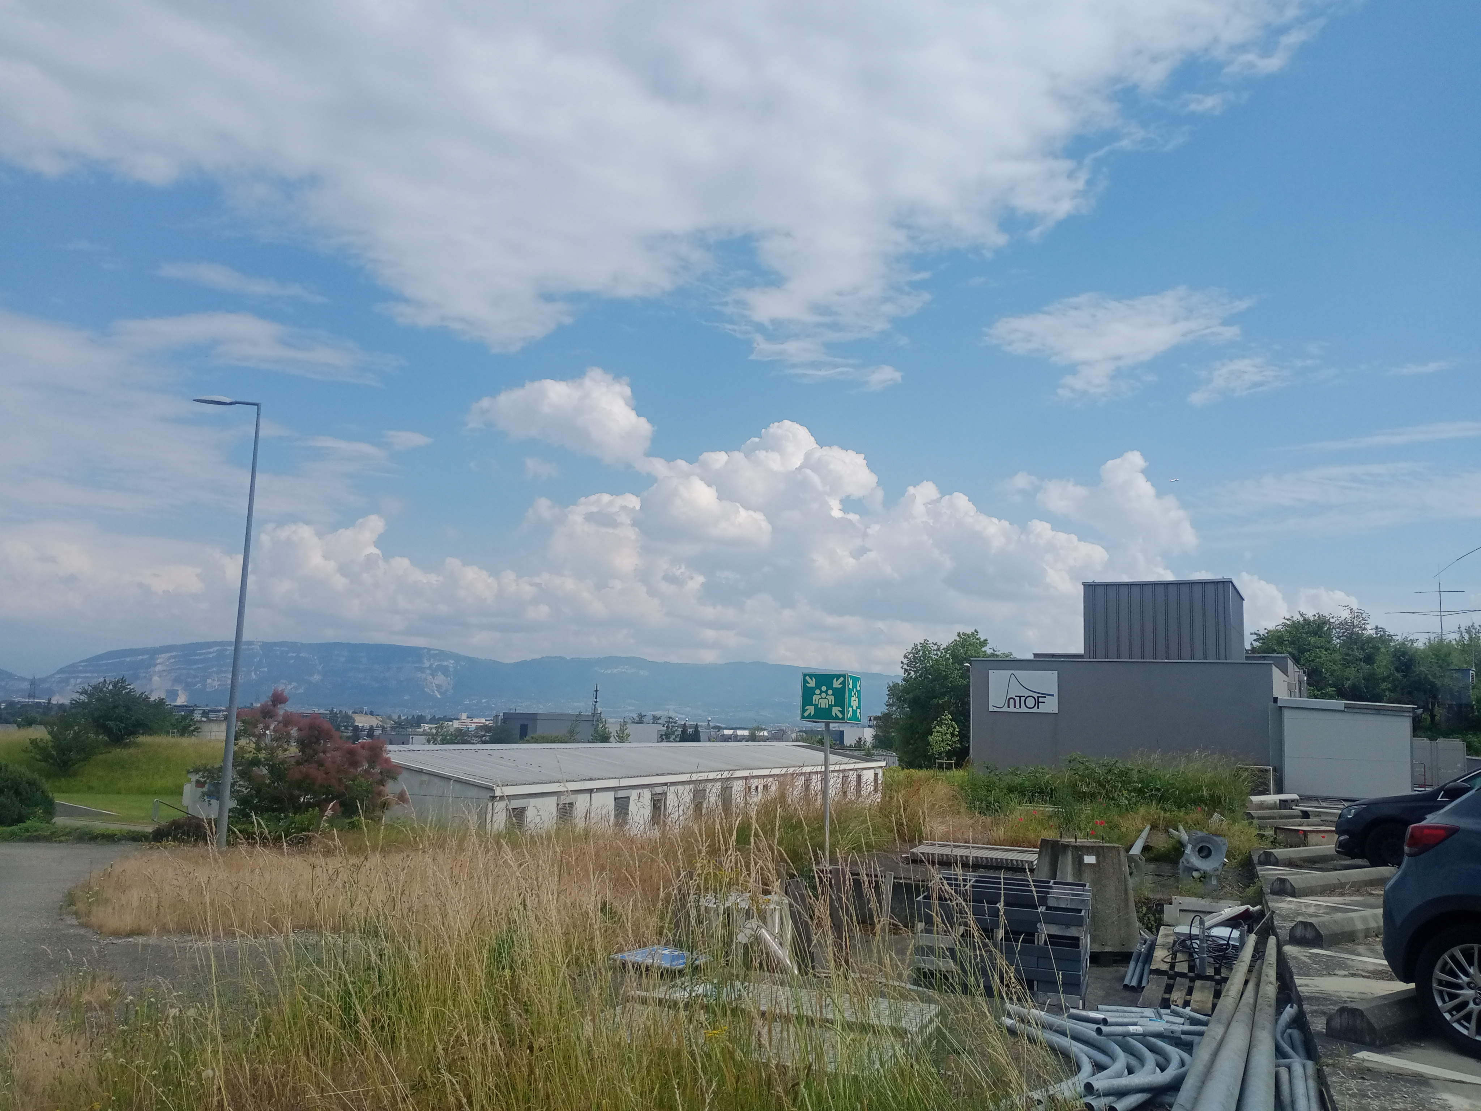
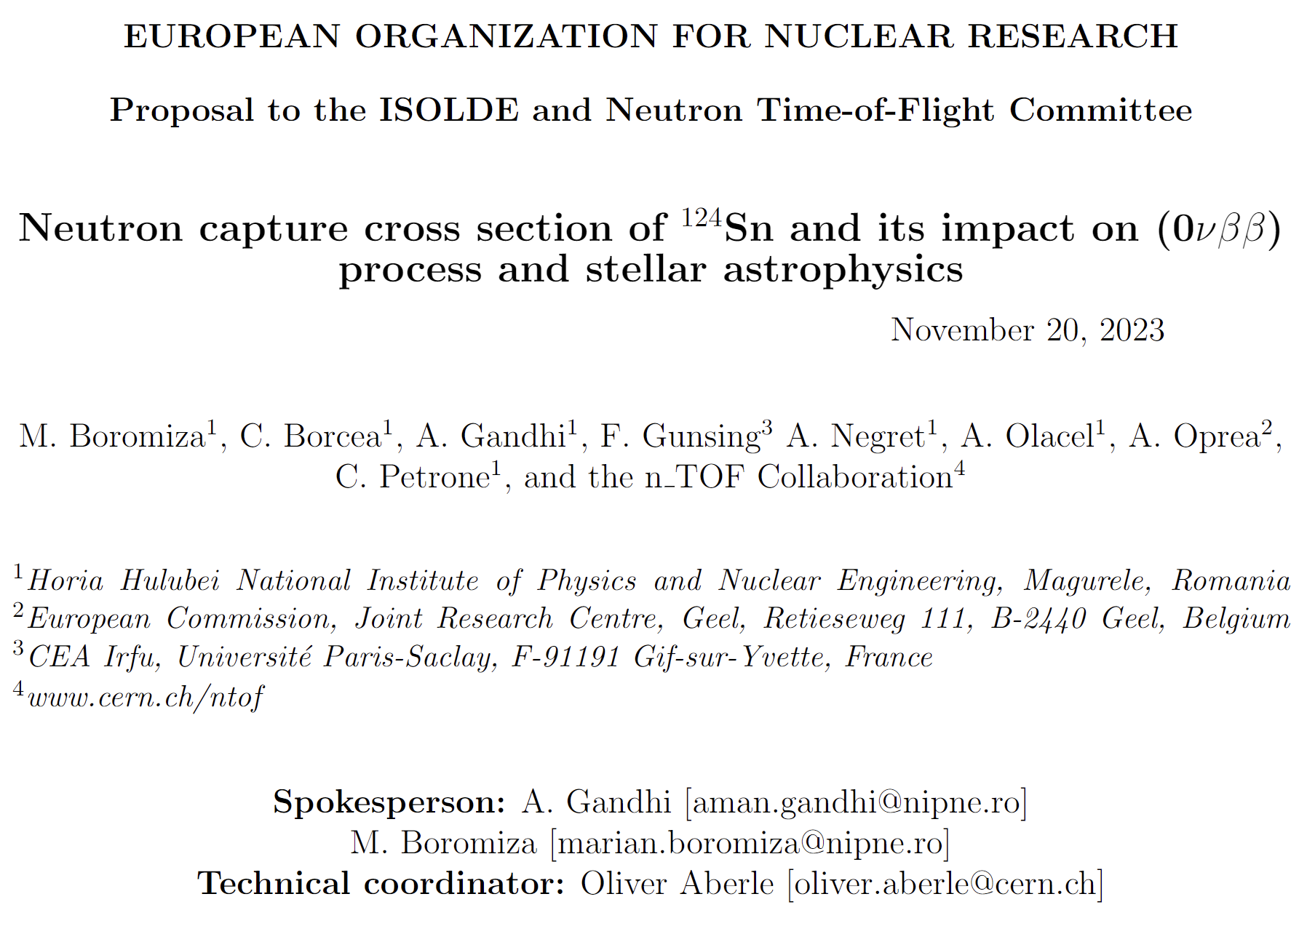


Neutron capture cross section of ¹²⁴Sn and its impact on (0νββ) process and stellar astrophysics
Horia Hulubei National Institute for R&D
in Physics and Nuclear Engineering
Aman Gandhi
Postdoctoral Research Assistant
IFIN-HH, Romania (n_TOF@CERN group)
Horia Hulubei National Institute for R&D
in Physics and Nuclear Engineering
1
Notes:
Good morning, everyone my name is Aman Gandhi. I am Post Doc student working in n_TOF CERN project at IFIN-HH, Romania.
Here I am presenting the draft proposal on measuring the “neutron capture cross section of ¹²⁴Sn and its impact on 0𝜈𝛽𝛽 decay and stellar astrophysics” on behalf of Romania n_TOF team. we are planning to submit this proposal in upcoming INTC in January, 2024.
This is collaborative list in presently and with this presentation we will like to offer all to welcome and to be part of this collaborative work and give your inputs for the goodness of this proposal.

Slide 2
Table of contents
Motivation-
Why do we need ¹²⁴Sn(n,γ) cross section data?
Proton requests-
To get enough neutrons ---> capture events?
Summary-
What we will get in the end?
Status of data-
Where are we?
Experimental details-
Where and How ¹²⁴Sn(n,𝛾) will be measured?
2

Slide 3
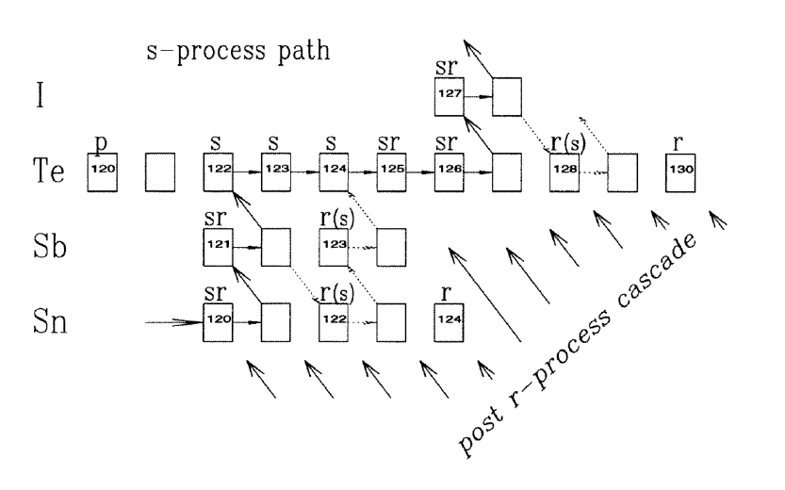
Motivation-
Why do we need ¹²⁴Sn(n,γ) cross section data?
Background assessment of 0νββ decay experiments
s-r process nucleosynthesis modeling
Background: Neutrons
MACS estimation for r-only nuclei
Cosmogenically- produced neutrons
Rocks [^{nat}Th, ^{nat}U]
(α,n)-produced neutrons
Aharmim, B., et al. Physical Review D 100.11 (2019): 112005.
M. Arnould, K. O. H. J. I. Takahashi,Reports on Progress in Physics 62.3 (1999): 395
3
Notes:
Neutrons produced in nuclear interactions initiated by cosmic-ray muons present an irreducible background to many rare-event searches, even in detectors located deep underground

Slide 4
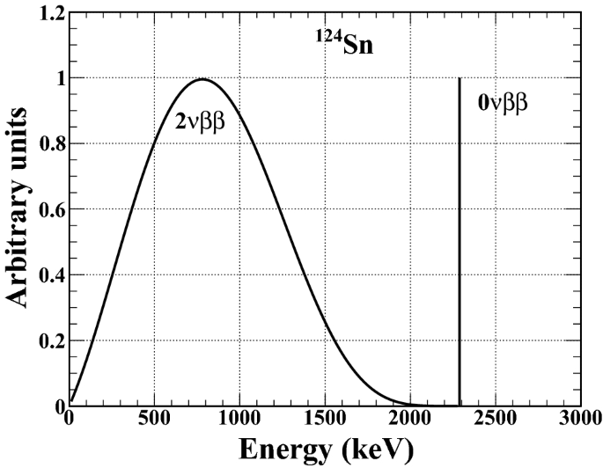
Motivation-
Background assessment of 0νββ decay experiments
Worldwide experiments done or planned for neutrinoless double-β decay studies for ¹²⁴Sn ----> ¹²⁴Te:
India
¹²⁴Sn is one of the neutrinoless double beta decay (0νββ) candidates
To measure this decay process is to measure the 0νββ decay peak which is at an energy equal to the Q-value of the process, i.e., 2292.7 (4) keV
0νββ is a second order weak interaction process and the event rates are very low since T_{1/2} > 10²¹ y -> the neutron-induced background is a big limiting factor**
Such measurements are extremely sensitive to background signals which can mimic the signal of interest: the neutron-induced background can produce γ-ray events in and around the region of interest (ROI) i.e., the Q-value region
South Korea
In future
Lab: Indian Neutrino Observatory (INO)
Lab: YangYang Underground Laboratory (Y2L)-2009
Detector: Sn cryogenic superconducting bolometer (TIN.TIN -The India based TIN detector)
Detector : tin-loaded liquid scintillator for an active source-detector technique
Nanal, Vandana.EPJ Web of Conferences, EDP Sciences 66 (2014)
Hwang, M. J., et al., Astroparticle Physics 31.6 (2009): 412-416.
Singh, M.K., et al. Indian J Phys 94, 1263–1270 (2020).
*Dawson, J., et al., Physical Review C 78.3 (2008): 035503
*Gupta, G., et al., Applied Radiation and Isotopes 158 (2020): 108923
4
Notes:
Neutrinoless double beta (0νββ) decay is an exotic decay mode never observed experi-
mentally but energetically allowed for all isotopes that are stable (or highly suppressed)
against the single beta decay mode. If it exists, this will clarify a long-standing open
question in elementary particle physics related to the Majorana or Dirac nature of the
neutrino

Slide 5
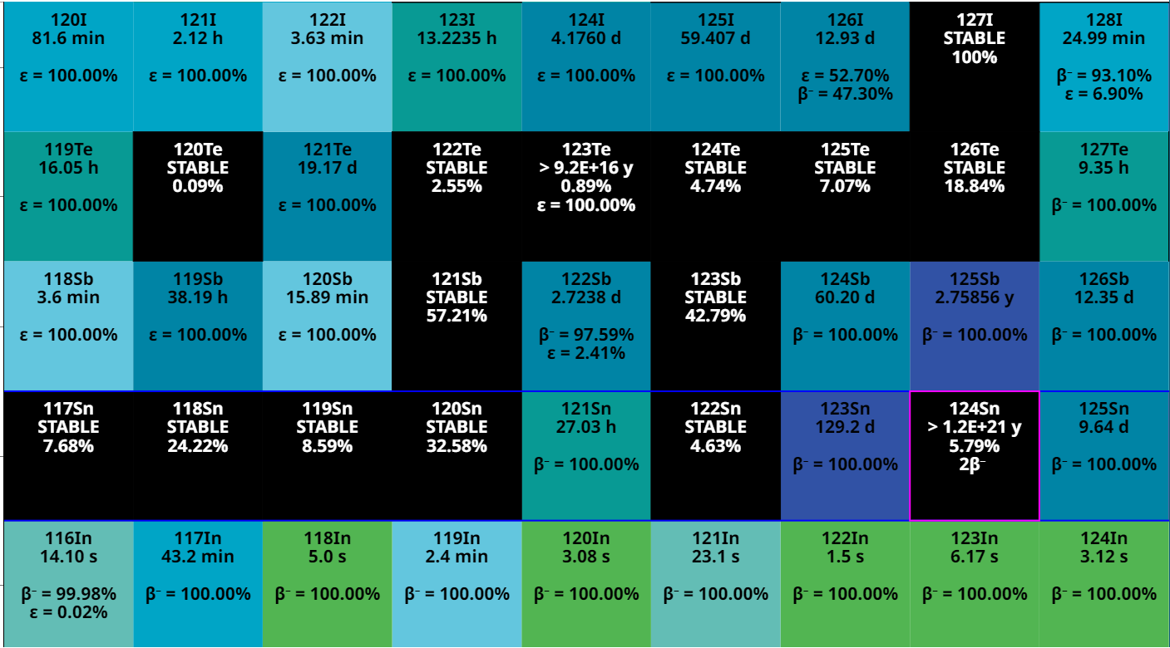
Motivation-
Background assessment of 0νββ decay experiments
Gammas following neutron capture on ¹²⁴Sn can mimic the 0νββ decay signal
Literature* shows that, after bombarding a ¹²⁴Sn sample with a neutron thermal flux and measuring the offline/delayed γ-rays following neutron capture and subsequent beta decays with a HPGe detector, a strong summing peak of 2288.2 keV has been observed*
52
β⁻
protons
2β⁻
β⁻
50
(n,γ)
S_{n}(¹²⁵Sn) = 5733.50(20) keV
Q_{2β-}= 2292.7 (4) keV
*Gupta, G., et al., Applied Radiation and Isotopes 158 (2020): 108923
*Gupta, G., et al., Applied Radiation and Isotopes 158 (2020): 108923
72
neutrons
74
5
Notes:
From the measured yield in the ROI near Qββ( 124Sn), it is estimated that prolonged exposure to neutron flux exceeding 3 x 10^5 n/cm2 /s can be a significant concern for the background

Slide 6
Motivation-
s-only
s-r
p-only
s-r process nucleosynthesis modeling
Several neutron-rich stable isotopes in the A=124 mass region, including ¹²⁴Sn, are not reached by the s-process because of their short-lived neighbours. ¹²⁴Sn is synthesized by the r-only neutron capture process
To better quantify the solar system s-process-generated abundance of ‘Te’ stable isotopes, which also have r-process contributions, using stellar models requires, among other things, reliable and low uncertainty Maxwellian Averaged Cross Sections (MACS) for ¹²⁴Sn
52
β-
β-
protons
(n,γ)
β-
50
(n,γ)
68
neutrons
r-only
74
M. Arnould, K. O. H. J. I. Takahashi,Reports on Progress in Physics 62.3 (1999): 395
6
Notes:
Relation between s and r process. This study will help in that. Bottelnecks which are characterized by particularly small cross sections.

Slide 7
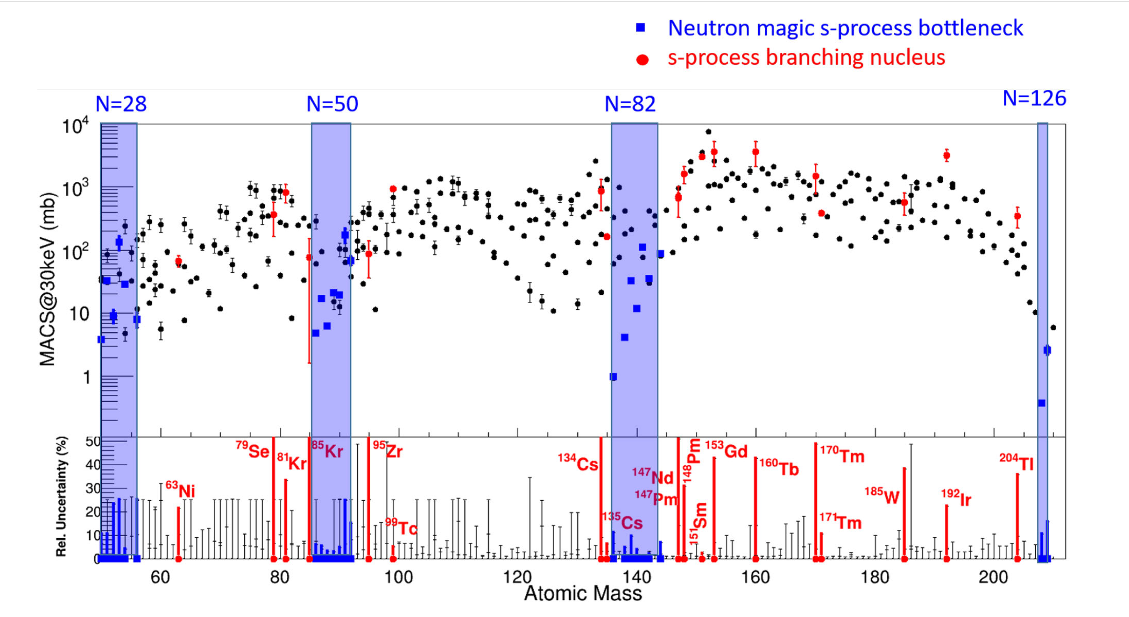
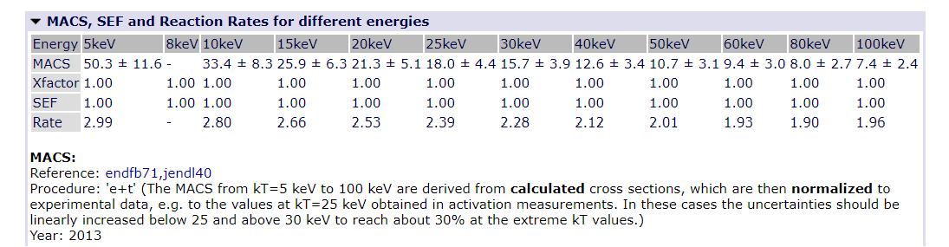
Present status of ¹²⁴Sn(n,γ) MACS data - where are we?
MACS status in kadonis1.0 (2013) database:
Recommended value (Total MACS): 15.7 ± 3.9 mb (24%)
Partial cross section to isomer: 9.79 ± 0.11 (1.12%)
Experimentally-extracted MACS:
V. Timokhov et al., (1989): @30 keV: 16.0 ± 2.4 mb (15%)
W. Stadler, Diploma Thesis TUV, (1998):
@25 keV: 11.25 ± 0.13 (1.15%)-Partial cross section to ^{125m}Sn:
@52 keV: 9.33 ± 0.16 (1.71%)-Partial cross section to ^{125m}Sn:
Extrapolated values to: 5 keV & 100 keV:
¹²⁴Sn
Domingo-Pardo, C., Babiano-Suarez, V., Balibrea-Correa, J. et al.,
Eur. Phys. J. A 59.8 (2023)
https://exp-astro.de/kadonis1.0/selementquery.php?isotope=124Sn
7
Notes:
Its not in under blue column but yes cross section is very small for 124Sn so it should be measured precise so that modelling of set

Slide 8
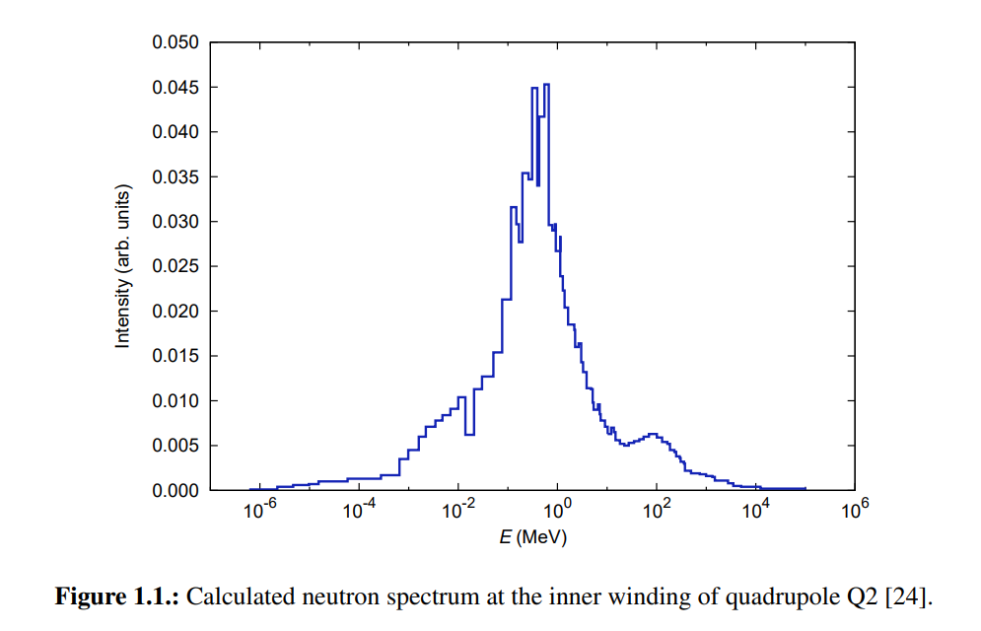
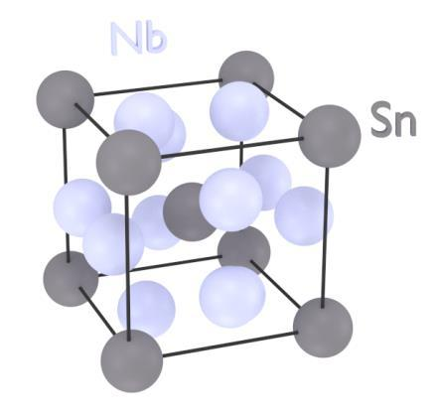
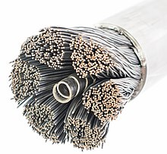
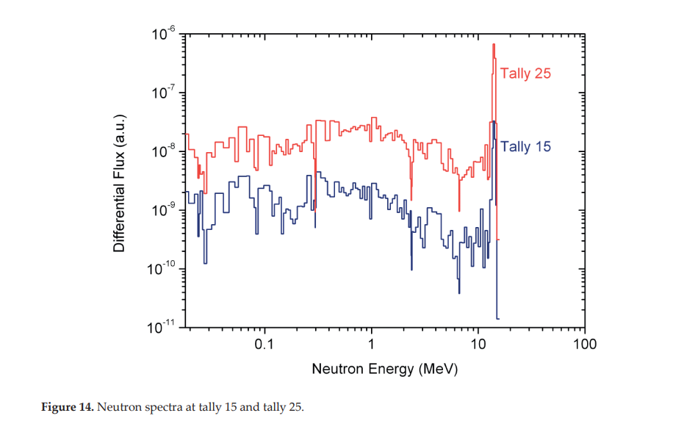
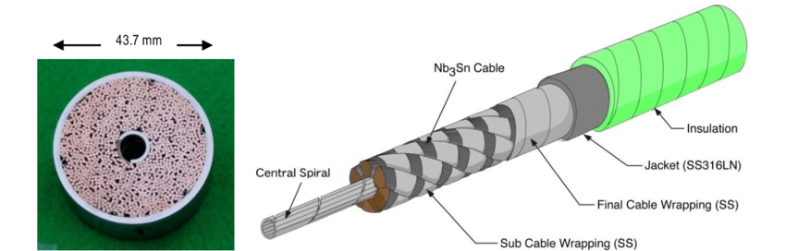
Additional Motivation-
LHC
Nb₃Sn* compound is a component of the super-conducting wires used in the electromagnets surrounding the hot plasma during the ITER fusion experiment, or in the beam guiding system of the LHC & FCC @CERN**
These super-conducting magnets are exposed to a very intense neutron field coming from hot plasma or LHC interaction point
The initial neutron flux has energies in the MeV region (see figure) but after thermalization these neutrons can be captured
Due to large radiation sensitivity of Nb₃Sn superconducting state, it is essential to examine how its superconducting properties are affected by radiation damage, in particular, by the neutron capture channel on ¹²⁴Sn
Baumgartner, Thomas. Effects of fast neutron irradiation on critical currents and intrinsic properties of state-of-the-art Nb₃Sn wires. na, 2013.
Image by Charlie Sanabria is licensed under a Creative Commons Attribution 4.0 International License. Based on a work at https://nationalmaglab.org/.
ITER
*Nishimura, A., et al., Superconductor Science and Technology 32.2 (2019): 024004
Takahashi, Y., et al. T 23rd IAEA Conference. 2010.
**Baumgartner, Thomas, et al. Superconductor Science and Technology 27.1 (2013): 015005.
Krasilnikov, Vitaly, MunSeong Cheon, and Luciano Bertalot. Advanced Technologies and Applications of Neutron Activation Analysis (2019): 71-87.
8
Notes:
vFig. 1 Nb 3 Sn cable-in-conduit type conductor with central spiral for ITER toroidal field coils.

Slide 9
Present status of ¹²⁴Sn(n,γ) cross section data - where are we?
(n,γ)
(n,tot)
By Fukuta (1963) and Adamchuk (1965)
R.P available in Mughabghab (2018)
A. Kimura et al., EPJ Web of Conferences 146, 11031 (2017) in ANNRI at MLF/J-PARC (ND2016 proceedings)
9
Notes:
High resolution in RRR data are required to map up this resonances.

Slide 10
Present status of ¹²⁴Sn(n,γ) cross section data - where are we?
(n,γ)
A. Kimura et al., EPJ Web of Conferences 146, 11031 (2017) in ANNRI at MLF/J-PARC (ND2016 proceedings)
10
Notes:
High resolution in RRR data are required to map up this resonances.

Slide 11
Present status of ¹²⁴Sn(n,γ) cross section data - where are we?
100%
11
Notes:
Elastic to capture ratio same also has been seen in 140Ce experiment. his was also the case for a previous experiment at n TOF dedicated to the neutron
capture channel on 140Ce

Slide 12
Experimental Details-
Where & How the ¹²⁴Sn(n,𝛾) cross section will be measured ?
EAR1 or EAR2 ?
Depends on neutron energy resolution of EAR1 versus EAR2
Depends on the mass & enrichment of sample
12

Slide 13
Experimental Details-
EAR1 or EAR2 – Neutron Energy resolution?
Table: Average distance in-between resonances and energy resolution at EAR1 versus EAR2:
Neutron Energy range | No. of resonances (ENDF/B-VIII.0) | Avg. distance between Capture Resonances | Energy resolution in EAR1 * | Energy resolution in EAR2 *
50 eV to 10 keV | 7 | 1200 eV | 10 eV | 200 eV
10 keV to 100 keV | 67 | 1300 eV | 300 eV | 3000 eV
100 keV to 200 keV | 68 | 1500 eV | 800 eV | -
200 keV to 314 keV | 47 | 2400 eV | 1200 eV | -
To resolve up to 10 keV
*Guerrero, C., et al. The European Physical Journal A 49 (2013): 1-15.
*Lerendegui-Marco, J., et al. The European Physical Journal A 52 (2016): 1-10.
To resolve up to 100 keV
13
Notes:
Upto 100 keV the resolution at ear1 is 290 eV and 100 keV to 1000 keV it is 5300 eV
On the contrary, in EAR2 the effect of the resolution function is much larger, reaching approximately 2% at thermal neutron energy

Slide 14
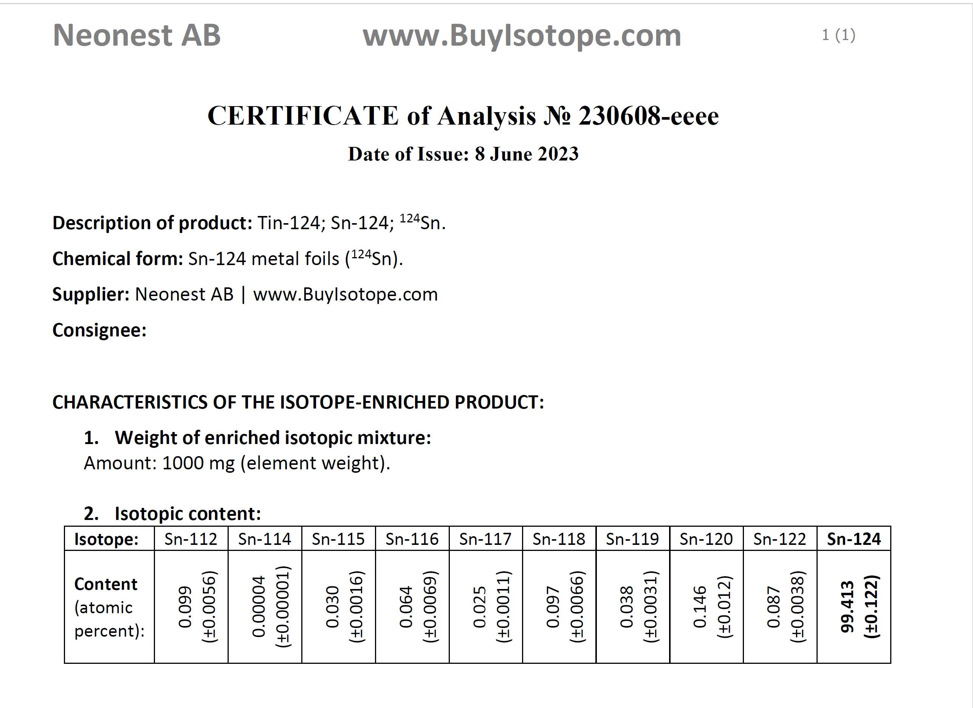
Experimental Details-
^{nat}Sn or Enriched ¹²⁴Sn – Why enriched sample?
Enriched ¹²⁴Sn
^{nat}Sn
10K euro
Fig.: Comparison of ¹²⁴Sn resonances (in black) with the resonances from other Sn isotopes
Fig.: Capture cross section scaled to sample content in ¹²⁴Sn sample
14
Notes:
833 bpd

Slide 15
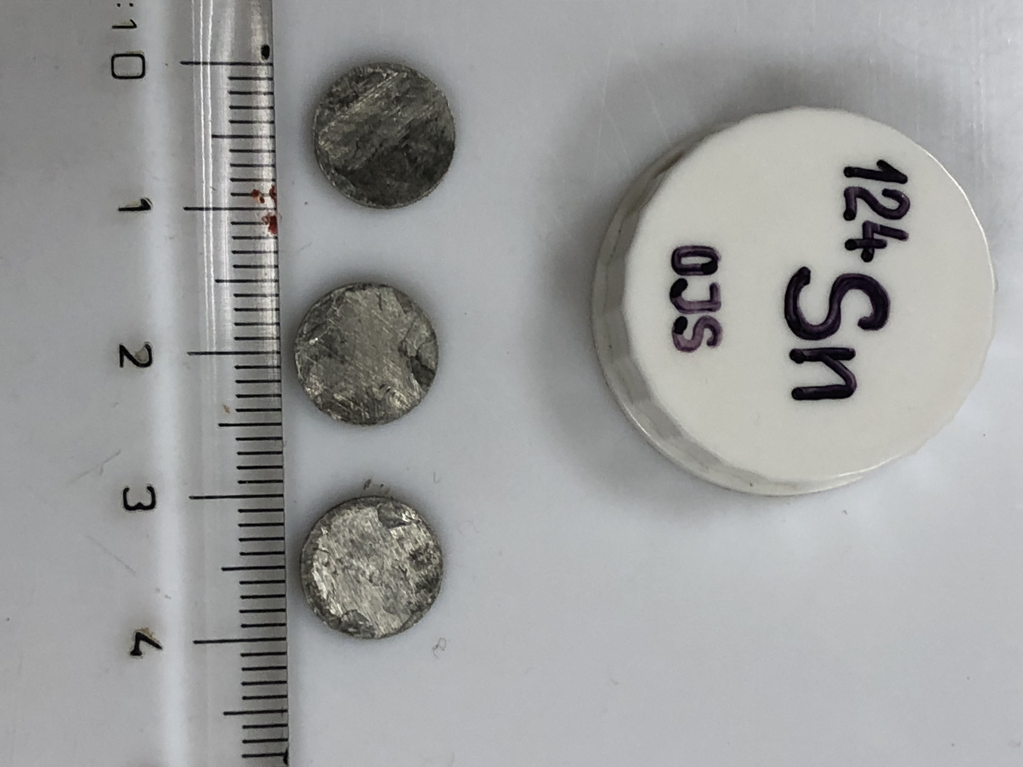
Experimental Details-
EAR1 or EAR2 – sample mass?
In EAR2 : 1.0 g sample
In EAR1 : 3.0 g sample
RRR up to 10 keV only
No MACS at high energy
RRR up to, probably, 100 keV
MACS @ 100 keV
15
Notes:
833 bpd

Slide 16
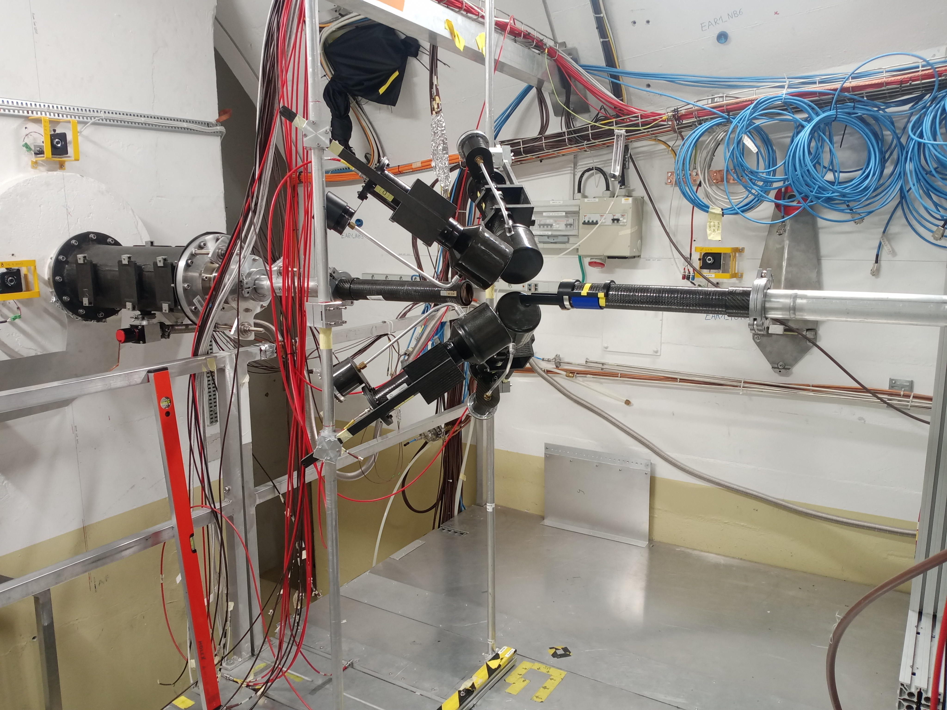
Experimental Details [EAR1]-
How will ¹²⁴Sn(n,𝛾) be measured in EAR1?
We hope to measure the thermal-to-500 keV range
We will use 3.0 g of enriched material (~99.4% of ¹²⁴Sn) to lower as much as possible the contamination from other isotopes
Setup of four C₆D₆ detectors (At what distance?)
We will also measure a ^{nat}Sn, ¹⁹⁷Au, ^{nat}C, ^{nat}Pb and a Dummy/Empty
Four C₆D₆ setup at EAR1 used in ³⁰Si(n,γ) experiment
16
Notes:
Enriched sample bcoj in natural overlap resonance from other isotopes

Slide 17
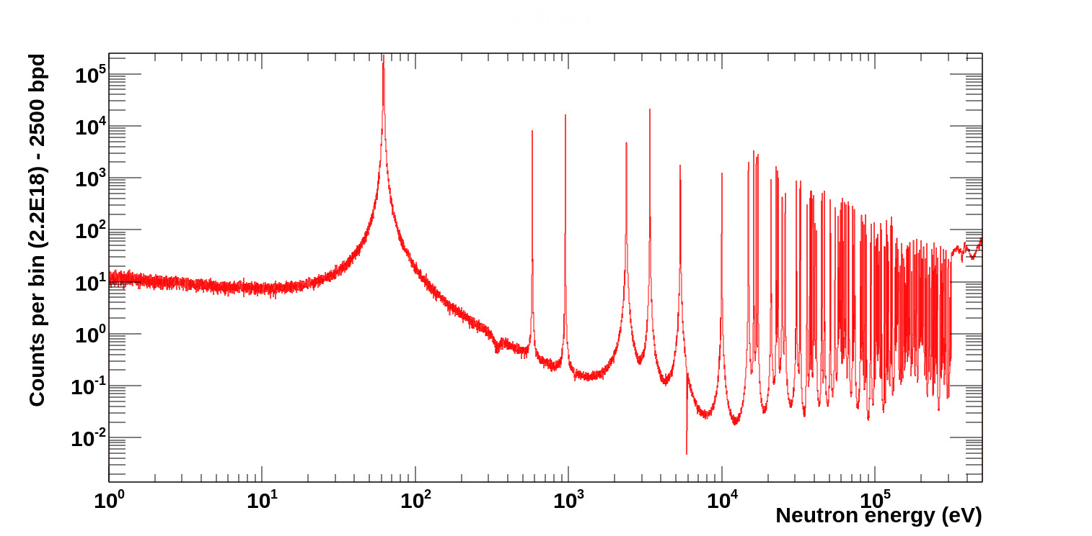
Proton Requests [EAR1]-
Counts estimation using Transport Code (TC):
Input parameters:
¹²⁴Sn(n,γ) cross section : ENDF/B-VIII.0 evaluation
Atoms/barn: 0.00464
(3 g weight and a disk: 2 cm diameter)
Hbins: 13750 in Energy(eV) range from 10⁰ to 5e10⁵
bpd: 2500
efficiency: 8%
~2.0% for each C₆D₆ at ~9cm
17

Slide 18
Proton Requests [EAR1]-
For ¹²⁴Sn and ^{nat}Sn: ~2.2x10¹⁸ protons and ~0.5x10¹⁸ protons, respectively
For normalisation and background (dummy) estimation: ~0.2x10¹⁸ protons and ~0.8x10¹⁸ protons, respectively
In total: ~3.7x10¹⁸ protons with the rate estimation 1.0x10¹⁷ proton per day (~37 days beam time)
18

Slide 19
Experimental Details [EAR2]-
How will ¹²⁴Sn(n,𝛾) be measured in EAR2?
We hope to measure the thermal-to-10 keV range
We will use 1.0g of enriched material (~99.4% of ¹²⁴Sn) to lower as much as possible the contamination from other isotopes
Setup of array of nine sTED and two C₆D₆ detectors
We will also measure a ^{nat}Sn, ¹⁹⁷Au, ^{nat}C, ^{nat}Pb and a Dummy/Empty
Array of sTED and C₆D₆ setup at EAR2 used in ¹⁶⁰Gd(n,γ) experiment
19
Notes:
Enriched sample bcoj in natural overlap resonance from other isotopes

Slide 20
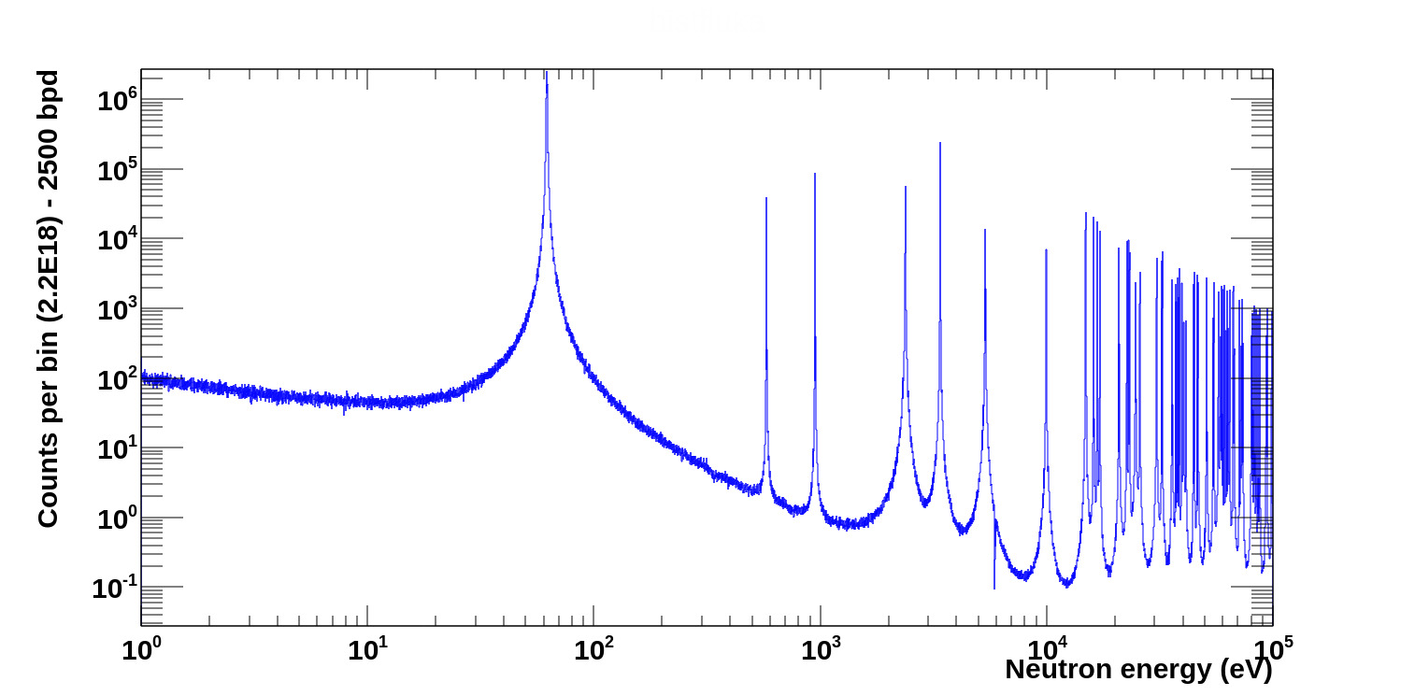
Proton Requests [EAR2]-
Counts estimation using Transport Code (TC):
Input parameters:
¹²⁴Sn(n,γ) cross section : ENDF/B-VIII.0 evaluation
Atoms/barn: 0.001547
(1.0 g weight and disk: 2 cm diameter)
Hbins: 12500 in Energy (eV) range from 10⁰ to 10⁵
bpd: 2500
efficiency: 4.5%
~0.5% for each sTED [9 detector] at ~5 cm
20

Slide 21
Proton Requests [EAR2]-
For ¹²⁴Sn and ^{nat}Sn: ~2.2x10¹⁸ protons and 0.5x10¹⁸ protons, respectively
For normalisation and background (dummy) estimation: ~0.2x10¹⁸ protons and 0.8x10¹⁸ protons, respectively
In total: ~3.7x10¹⁸ protons with the rate estimation 1.0x10¹⁷ proton per day (~37 days beam time)
21

Slide 22
EAR1 vs EAR2 – 2.2x10¹⁸ proton flux (22 days) on ¹²⁴Sn
In EAR2 : 1.0 g sample
In EAR1 : 3.0 g sample
10 times more
22
Notes:
833 bpd

Slide 23
Summary-
Motivation:
0νββ, Nuclear Astrophysics, and Nb₃Sn semiconductor
Proposal [proton requests]:
Case 1: EAR1-3.0g 37 days
Case 2: EAR2-1.0g 37 days*
Status of data:
No high resolution ToF neutron capture data exist to map out CN resonances (only very short flight path ~2 m data were reported)
There is only a single transmission measurement reported in EXFOR which extracted resonance parameters (10 keV to 320 keV)
Energy range: Thermal to 500 keV | Thermal to 300 keV
Sample | Protons
¹²⁴Sn | 2.2x10¹⁸
^{nat}Sn | 0.5x10¹⁸
C, Pb, Dummy | 0.8x10¹⁸
Au | 0.2x10¹⁸
Total | 3.7x10¹⁸
Energy range: Thermal to 10 keV | Thermal to 20 keV
Sample | Protons
¹²⁴Sn | 2.2x10¹⁸
^{nat}Sn | 0.5x10¹⁸
C, Pb, Dummy | 0.8x10¹⁸
Au | 0.2x10¹⁸
Total | 3.7x10¹⁸
Experiment goals:
* 10 times more statistics than EAR1
To provide reliable, low uncertainty and high resolution neutron capture ToF data from thermal to 500 keV
To provide lowered-uncertainty (ideally 5-10%) neutron capture data for the MACS from kT=5 keV to (ideally) 100 keV relevant for modelling the s & r-process in the A=124 mass region
To better understand the neutron-induced background for neutrinoless double beta decay (0νββ) experiments
Very optimistically, to at least partially clarify the differences between the different evaluations
23

Slide 24

Thanks
Do you have any questions?
aman.gandhi@nipne.ro
https://www.nipne.ro/proiecte/pn3/ntof/
https://www.nipne.ro/
Contact Us
Address: Str. Reactorului no.30, P.O.BOX MG-6, Bucharest - Magurele, ROMANIA
Phone: +(4021) 404.23.00
Fax: +(4021) 457.44.40

Slide 25
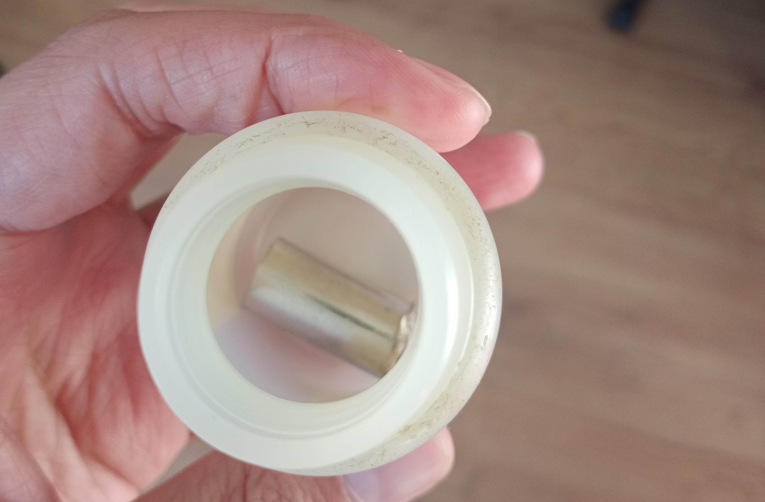
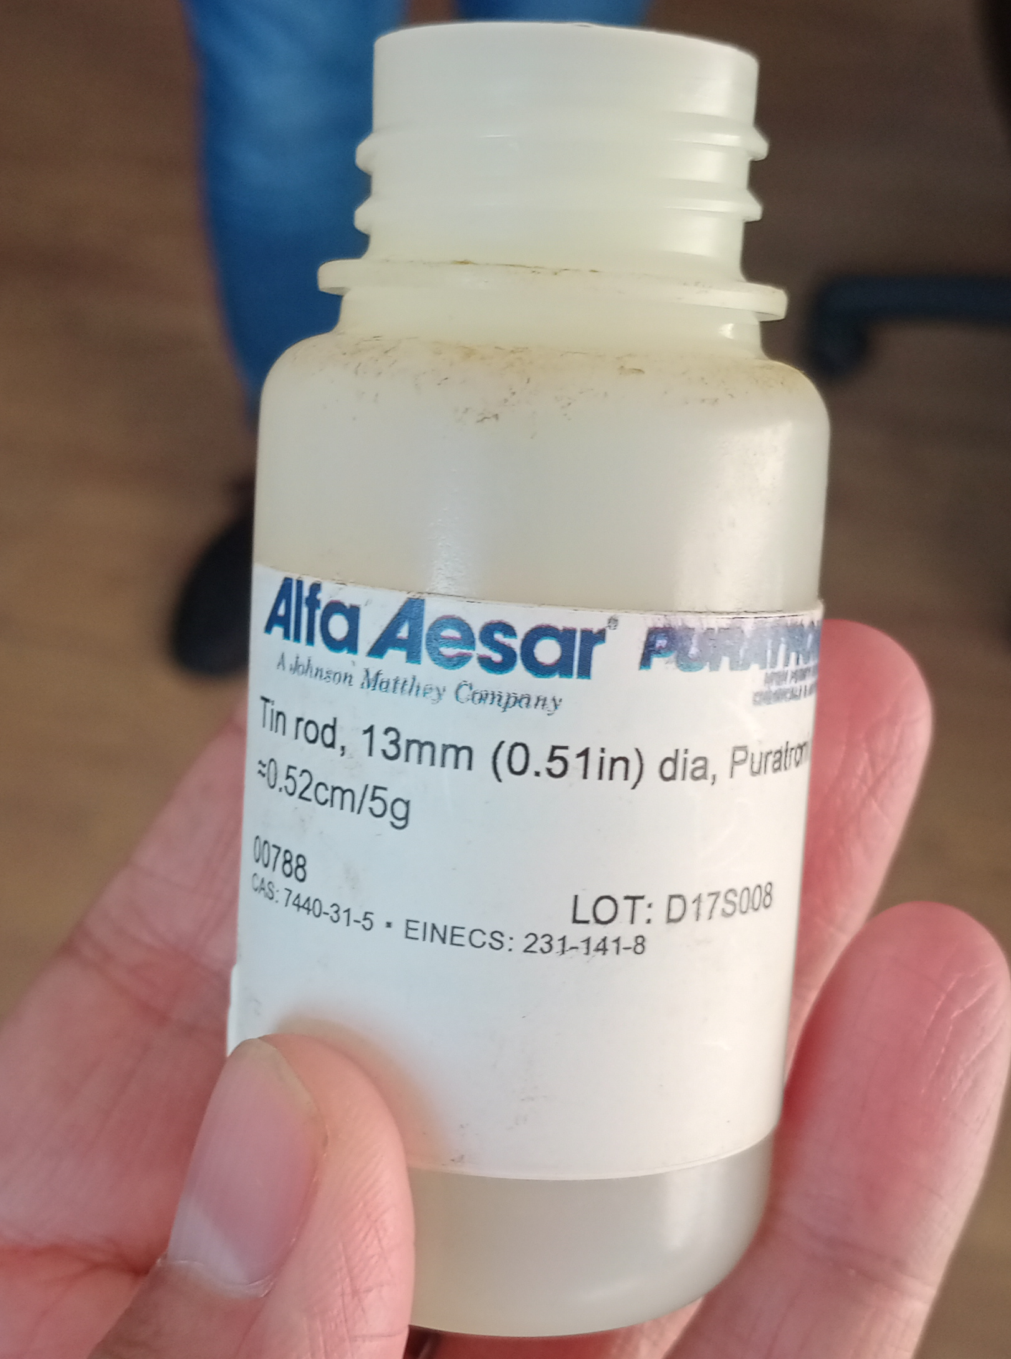
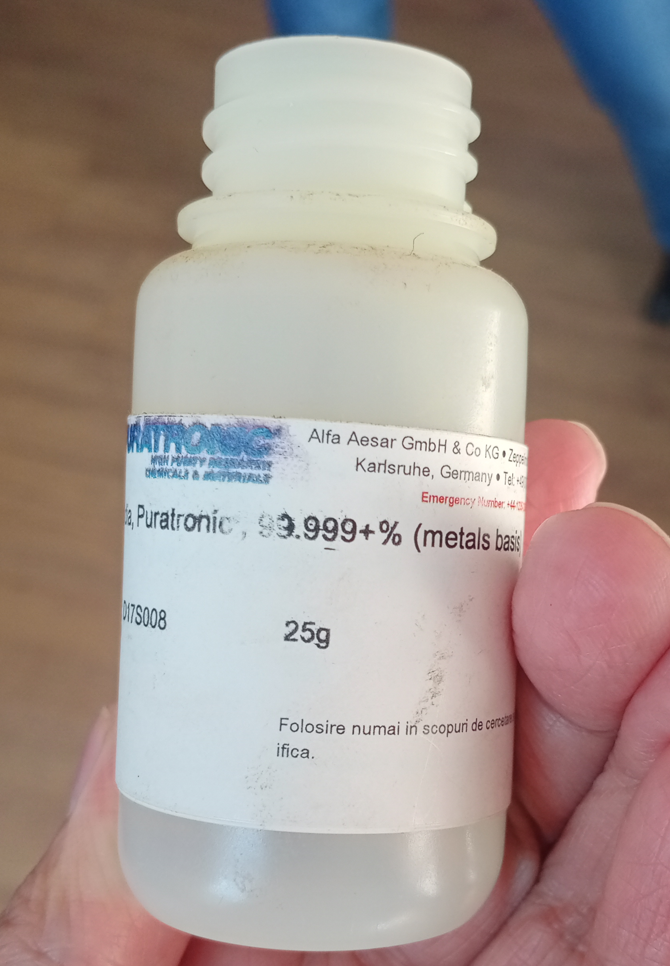
^{nat}Sn
Available to use for n_TOF measurement from Czech group
Available to use for n_TOF measurement from IFIN-HH Target lab
Nuclear Physics Institute, Czech Academy of Sciences (Tomandl/ marek]

Slide 26
Backup-slide
Summary of presentation:
1. 0vBB (cosmic ray-rocks-neutron-thermal-capture-124Sn-gammas-mimic-Q-value-ROI-delayed-prompt-probality-yield of such gammas rays-capture cross section)
2. Astrophysics-r-only- proton shell closure-small cross section-contribution of r-only abundance in 125-126Te stable isotope-precise MACS-only experiment MACS @30 kT [tof], 25kT, 52kT [activation]-r-only-means high temp-means higher neutron energies-100 kT-extrapolated 5 kT to 100 kT-motive to provide experiment capture cross section precise-which help in get precise experiment extracted MACS.
3 Additional motivation-Nb3Sn-super semiconductor-facilities like ITER-radiation damage-fast neutrons-thermalised-capture channel can help
4. Status of data: thermal energy (activation)-above 10 keV (activation and TOF both)-TOF with short flight path-latest JPARC-at 62 eV through gamma spectroscopy-transmission data reported above 10 keV up to 320 keV-less than 10 keV unpublished 1962-Mughlabad 1973-so new precise TOF resolved resonance region data helps in map out the CN resonance-also which help further in estimating the precise MACS-
5. ENDF status: comparison between different evaluation-two problem-first in between the resonance-100% difference-same in peak height difference in the RRR <10 keV
6. EAR1 versus EAR2-depend on energy resolution available in both Areas- Natural versus Enriched (or mass)-EAR1(up to 100 keV)-EAR2 (up to 10 keV)-3g for EAR1-1g for EAR2-enriched by 98%
7. How to measure-C6D6 in EAR1- as elastic to capture ratio is of the order 3 difference--sTED & C6D6-for both to reduce signal to background and elastic channel background-
8. Proton request: EAR1 (35 days beam time)- EAR2-(35 days beam time)-for 124Sn and normalization and background
9. Counts comparison between EAR1 (3g) and EAR2(1g)
10. Summary-Precise neutron capture data from thermal to 500 keV (included RRR data)-Precise MACS extraction from 5 kT to 100 kT- improve or solve the difference between evaluations-help the 0vBB community-background assessment

Slide 27
Er (eV) | Dist. (eV)
62 | 517
579 | 371
950 | 1430
2380 | 1010
3390 | 1970
5360 | 4610
9970 | 4892
14862
Er(keV) | Er (keV) | Dist. (keV) | Dist. (eV)
14.862 | 14.977 | 0.115 | 115
14.977 | 16.138 | 1.161 | 1161
16.138 | 16.745 | 0.607 | 607
16.745 | 17.18 | 0.435 | 435
17.18 | 20.913 | 3.733 | 3733
20.913 | 22.621 | 1.708 | 1708
22.621 | 23.032 | 0.411 | 411
23.032 | 23.238 | 0.206 | 206
23.238 | 23.305 | 0.067 | 67
23.305 | 24.731 | 1.426 | 1426
24.731 | 25.829 | 1.098 | 1098
25.829 | 30.628 | 4.799 | 4799
30.628 | 32.383 | 1.755 | 1755
32.383 | 32.497 | 0.114 | 114
32.497 | 35.848 | 3.351 | 3351
35.848 | 35.906 | 0.058 | 58
35.906 | 37.358 | 1.452 | 1452
37.358 | 37.883 | 0.525 | 525
37.883 | 38.159 | 0.276 | 276
38.159 | 38.561 | 0.402 | 402
38.561 | 39.518 | 0.957 | 957
39.518 | 39.556 | 0.038 | 38
39.556 | 40.344 | 0.788 | 788
40.344 | 41.301 | 0.957 | 957
41.301 | 44.577 | 3.276 | 3276
44.577 | 44.906 | 0.329 | 329
44.906 | 44.979 | 0.073 | 73
44.979 | 46.504 | 1.525 | 1525
46.504 | 46.676 | 0.172 | 172
46.676 | 50.854 | 4.178 | 4178
50.854 | 51.036 | 0.182 | 182
Er(keV) | Er (keV) | Dist. (keV) | Dist. (eV)
51.036 | 54.641 | 3.605 | 3605
54.641 | 54.834 | 0.193 | 193
54.834 | 57.463 | 2.629 | 2629
57.463 | 58.617 | 1.154 | 1154
58.617 | 59.468 | 0.851 | 851
59.468 | 59.68 | 0.212 | 212
59.68 | 60.133 | 0.453 | 453
60.133 | 60.82 | 0.687 | 687
60.82 | 61.845 | 1.025 | 1025
61.845 | 62.953 | 1.108 | 1108
62.953 | 63.257 | 0.304 | 304
63.257 | 64.413 | 1.156 | 1156
64.413 | 66.784 | 2.371 | 2371
66.784 | 66.951 | 0.167 | 167
66.951 | 67.422 | 0.471 | 471
67.422 | 71.05 | 3.628 | 3628
71.05 | 72.12 | 1.07 | 1070
72.12 | 73.066 | 0.946 | 946
73.066 | 73.717 | 0.651 | 651
73.717 | 80.261 | 6.544 | 6544
80.261 | 80.403 | 0.142 | 142
80.403 | 81.447 | 1.044 | 1044
81.447 | 82.784 | 1.337 | 1337
82.784 | 82.927 | 0.143 | 143
82.927 | 84.24 | 1.313 | 1313
84.24 | 84.457 | 0.217 | 217
84.457 | 86.051 | 1.594 | 1594
86.051 | 86.108 | 0.057 | 57
86.108 | 87.472 | 1.364 | 1364
87.472 | 87.602 | 0.13 | 130
87.602 | 93.261 | 5.659 | 5659
93.261 | 93.576 | 0.315 | 315
93.576 | 94.144 | 0.568 | 568
94.144 | 98.646 | 4.502 | 4502
98.646 | 99.236 | 0.59 | 590
99.236 | 0 |  | 1278.394
Distance between capture resonances
Backup-slide

Slide 28
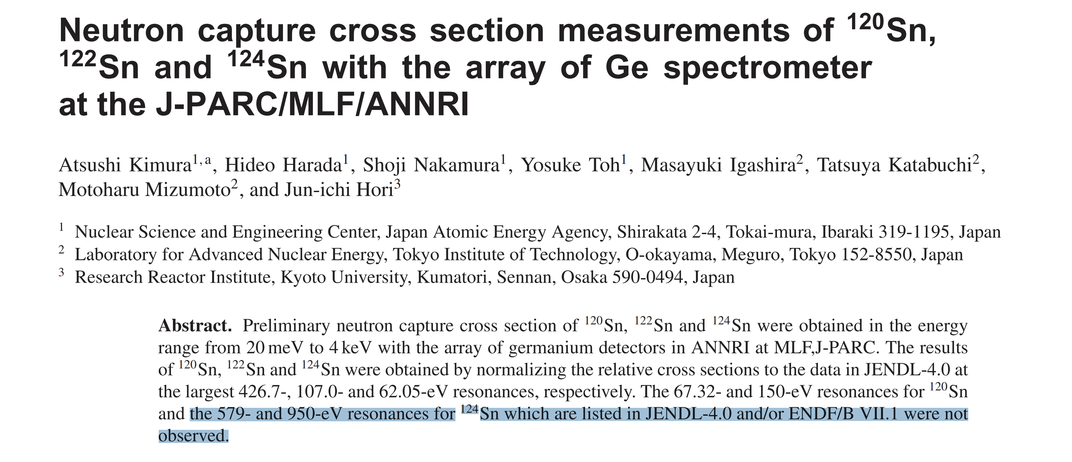
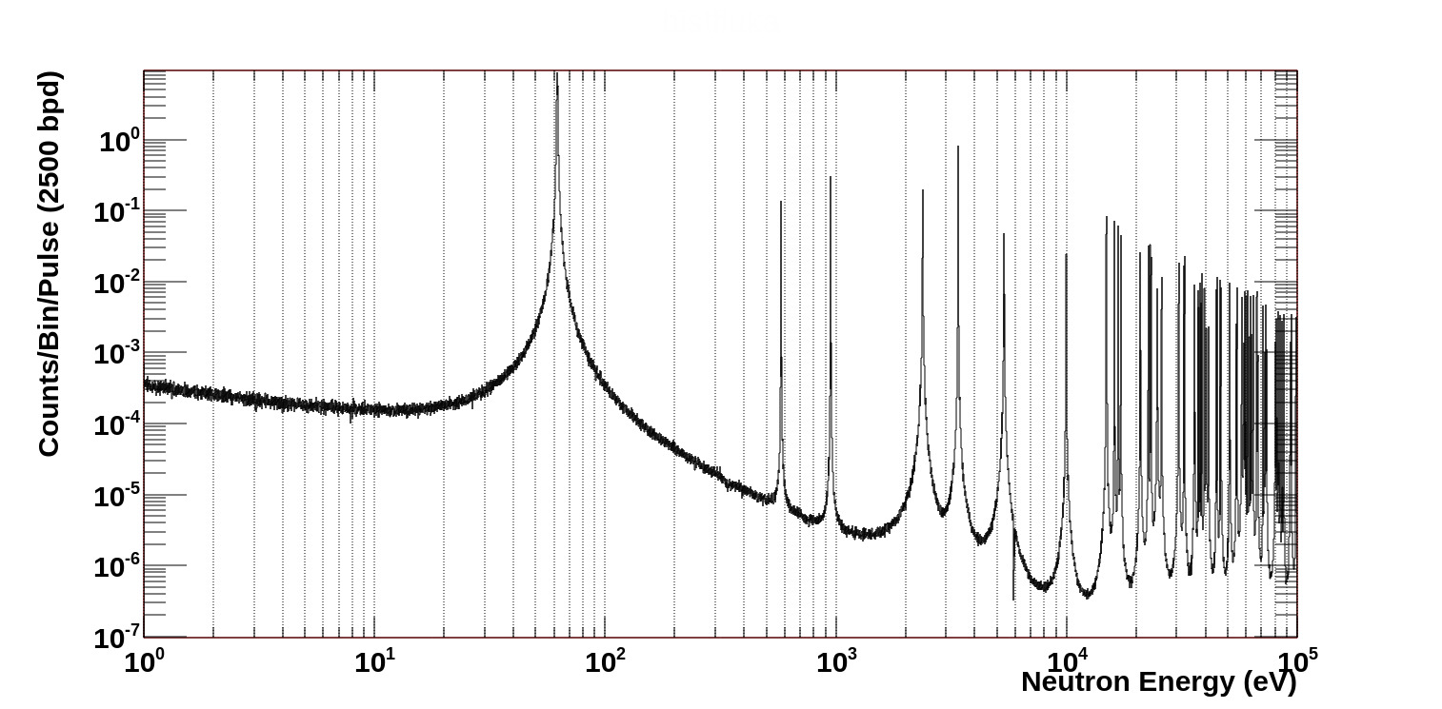
Backup-slide
Experimental Details-
EAR1 or EAR2 – sample mass?
In EAR2 : 1.0 g sample
In EAR1 : 1.0 g sample
No. of Proton pulses in 30 days: 3.2E+18
15

Slide 29
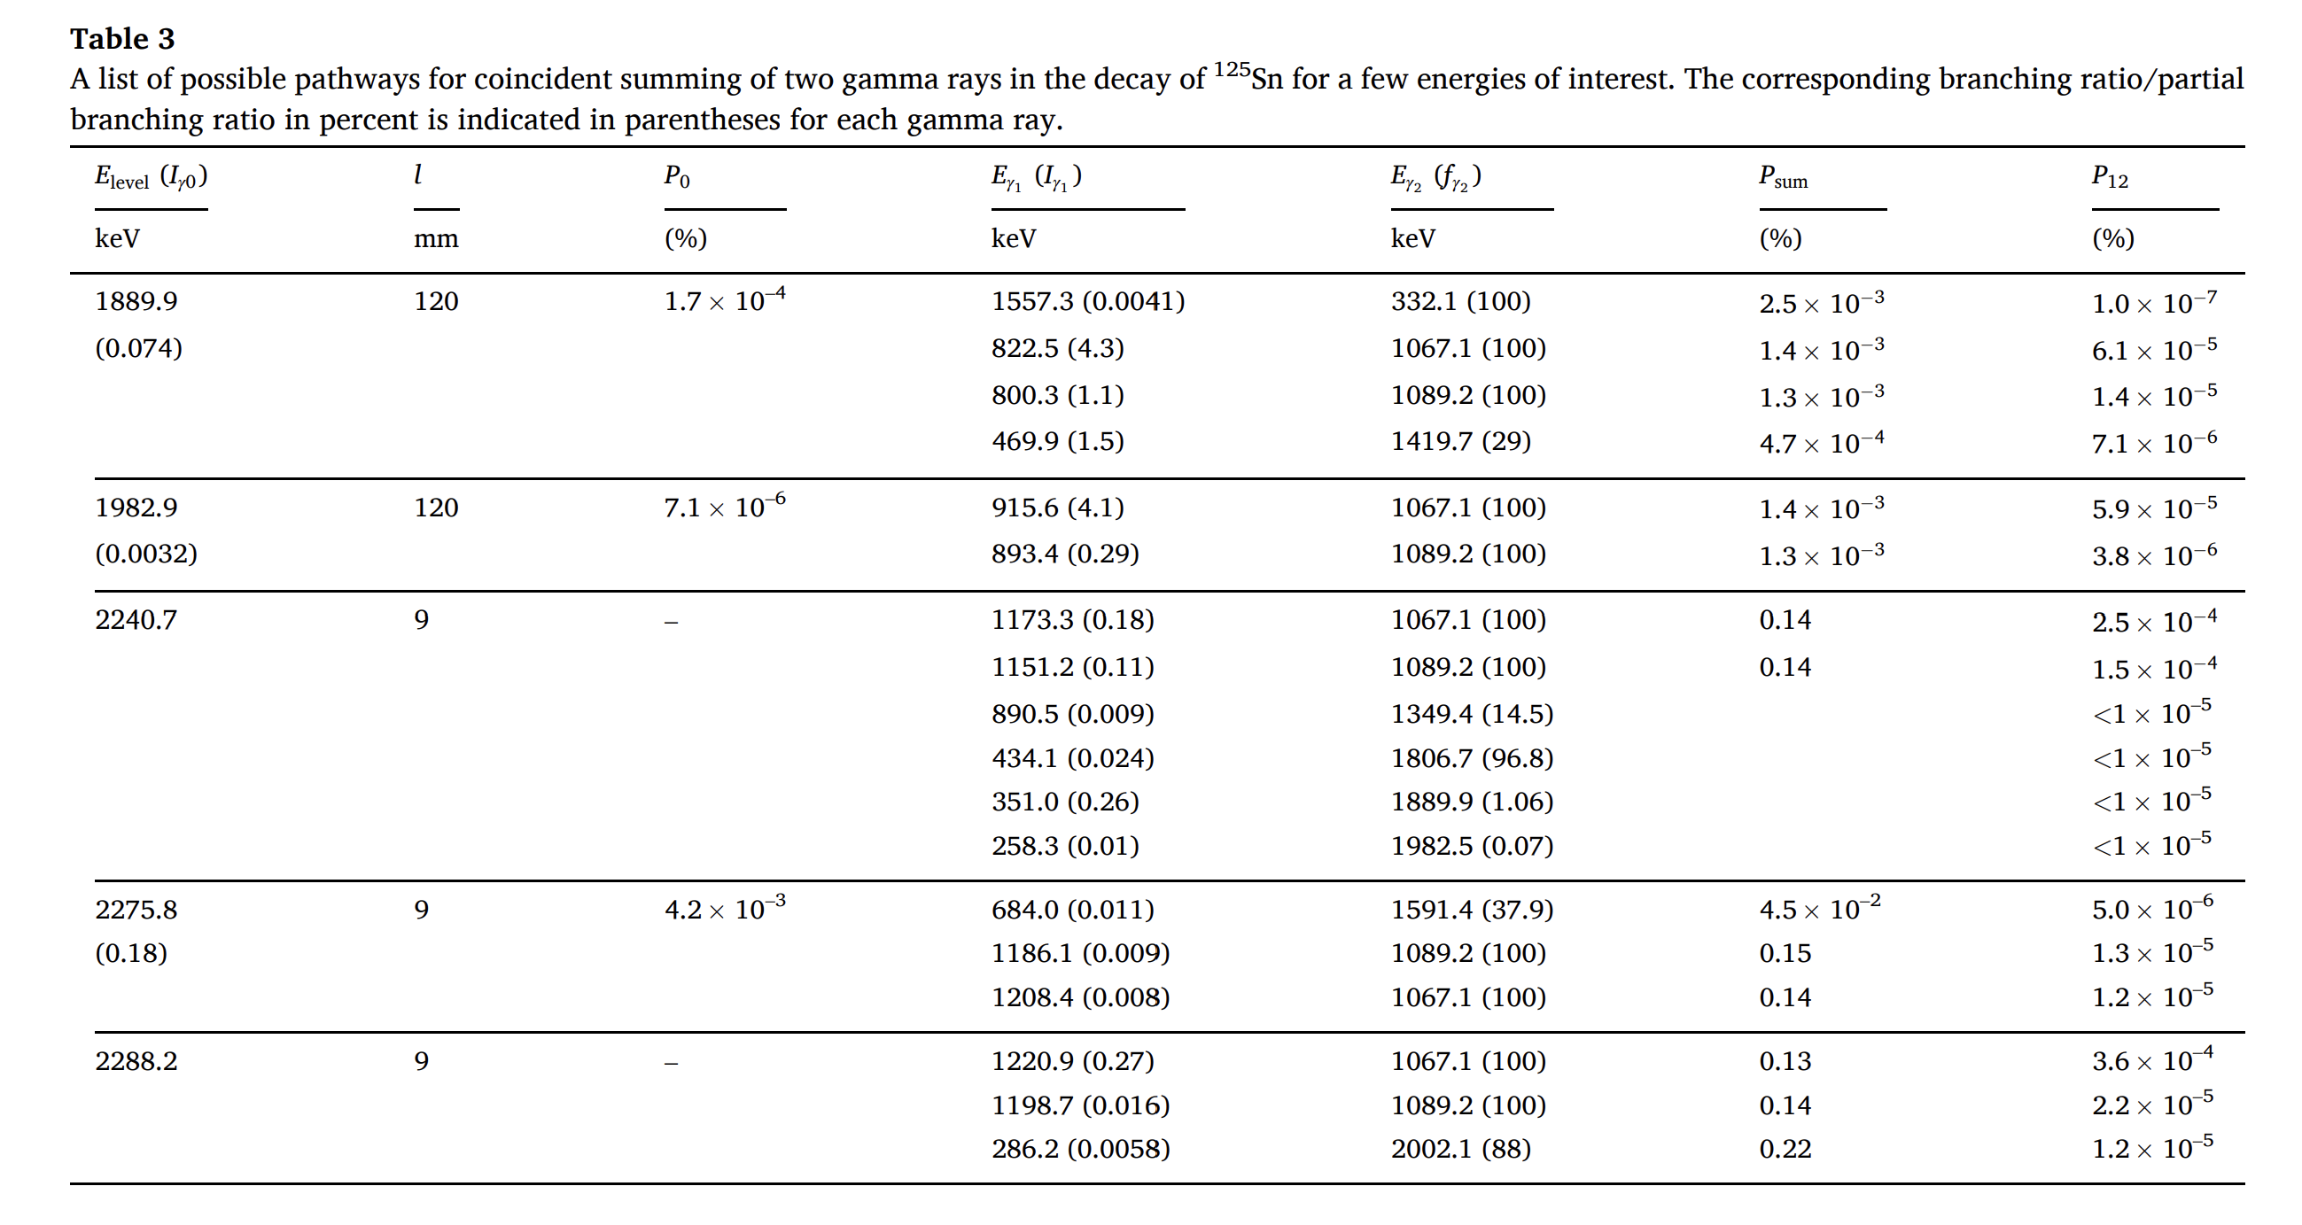
Backup-slide
*List of coincidence gamma rays coming due to neutron capture which can mimic in ROI for 0vBB experiment
Notes:
From the measured yield in the ROI near Qββ( 124Sn), it is estimated that prolonged exposure to neutron flux exceeding 3 � 10 5 n/cm2 /s can be a significant concern for the background

Slide 30
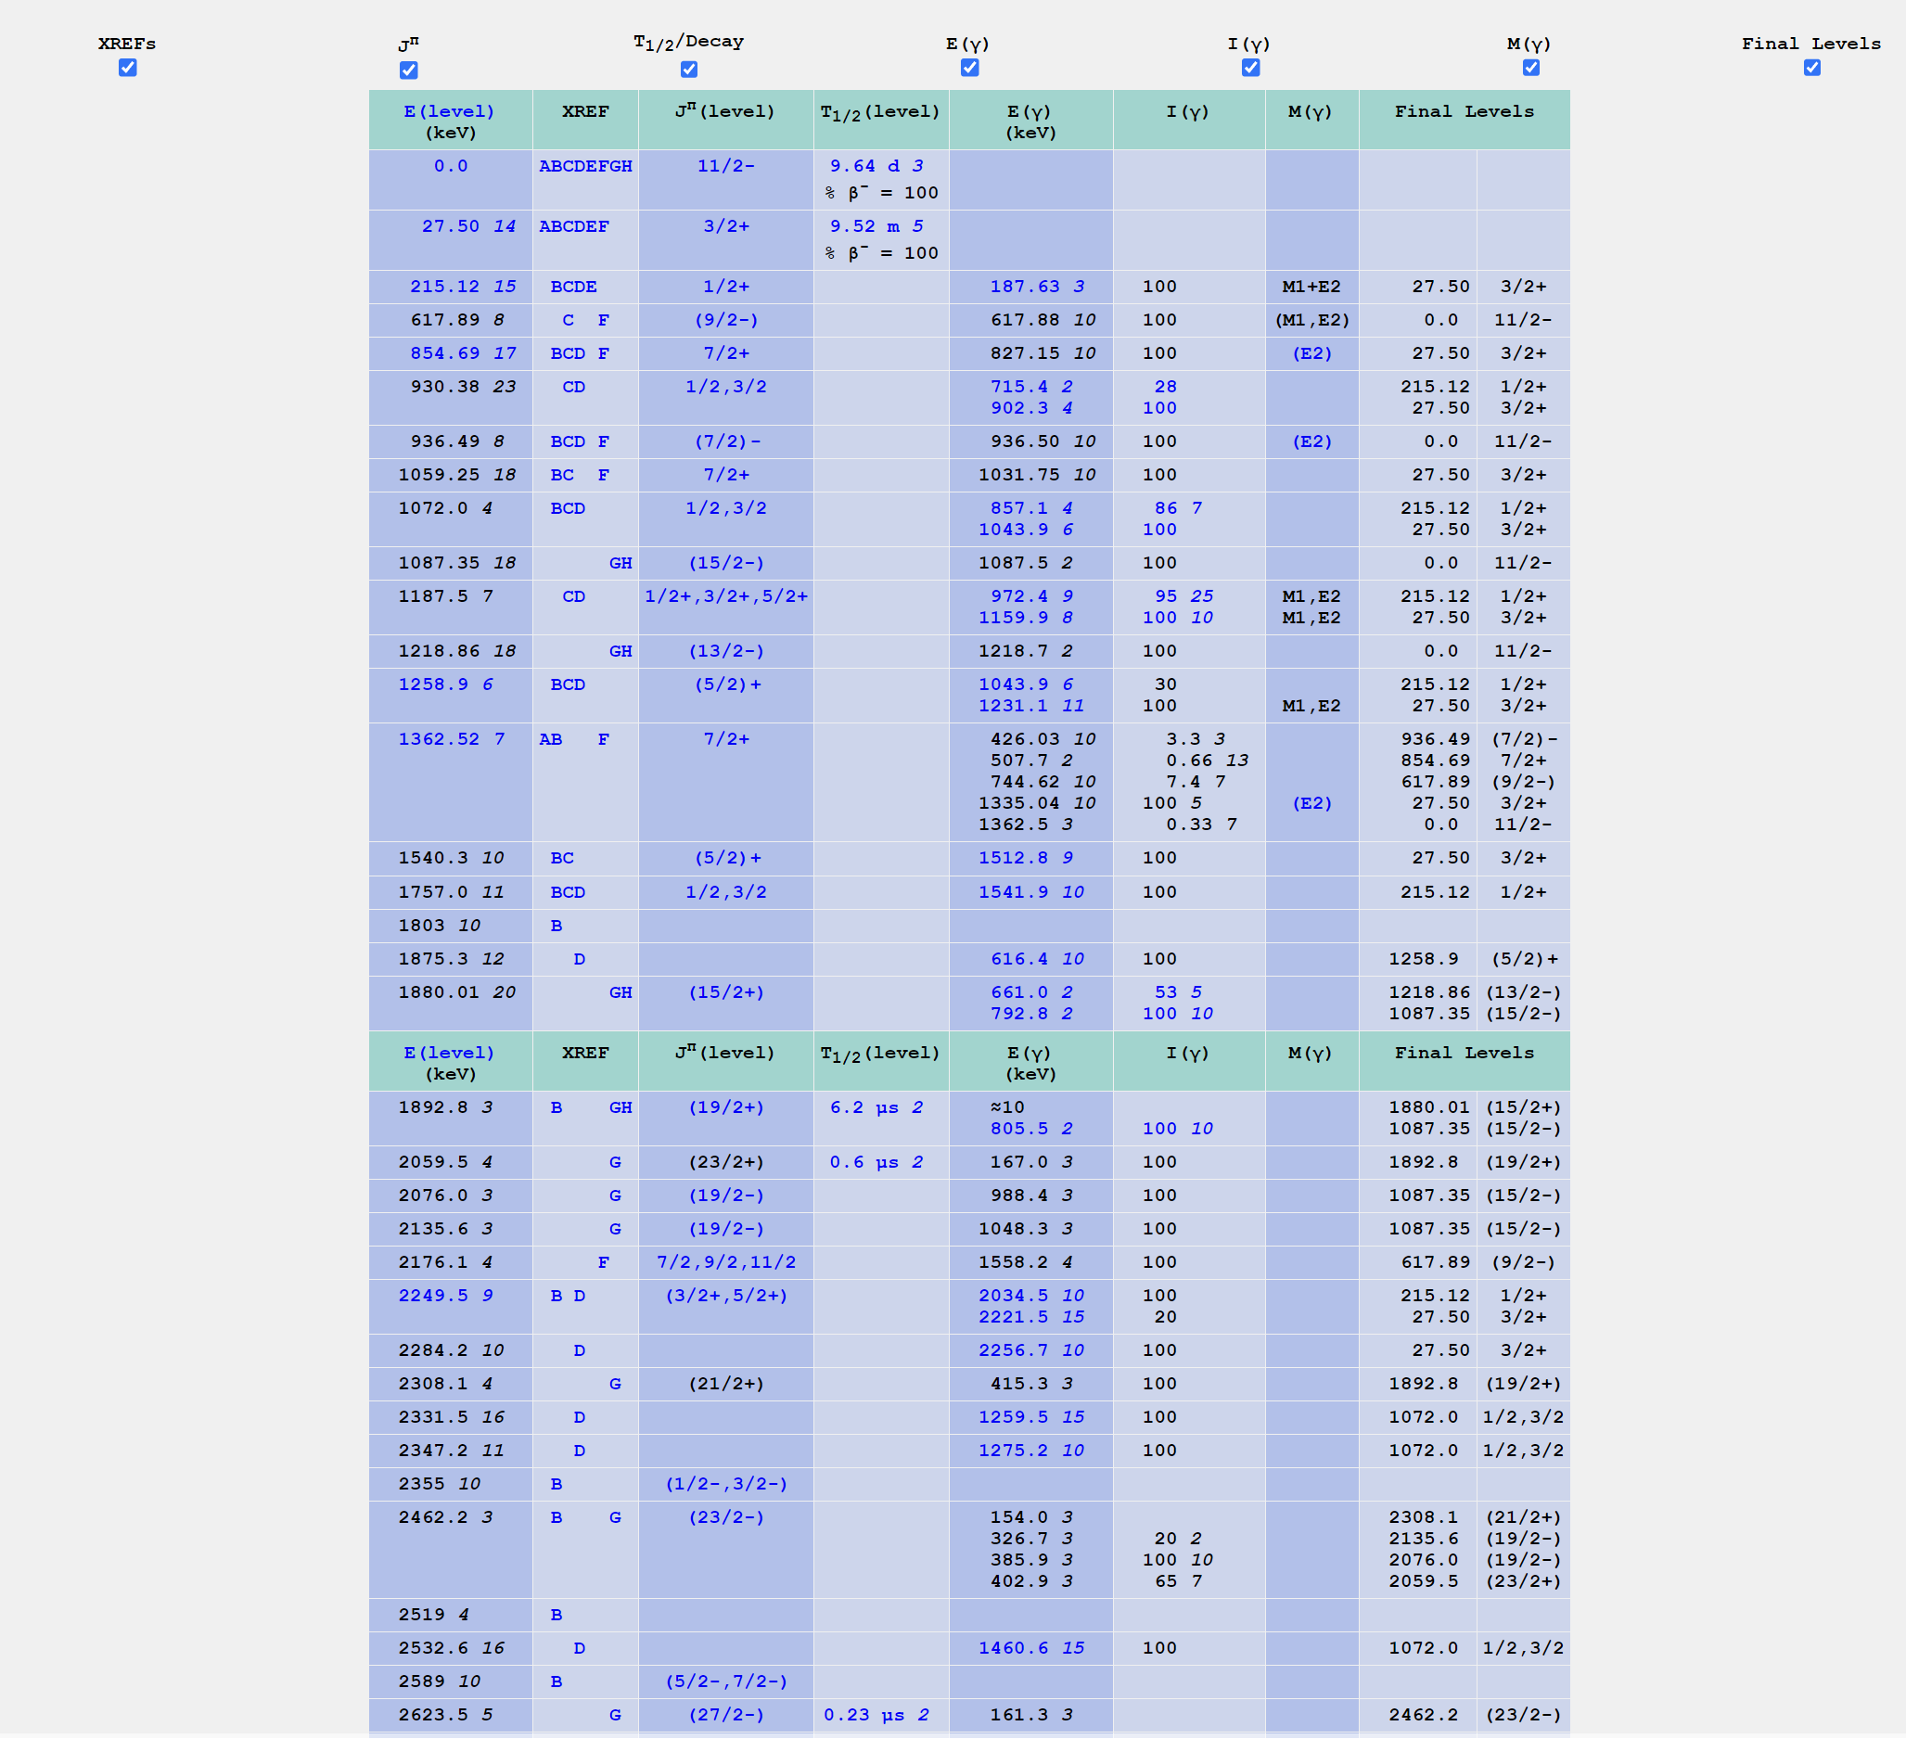
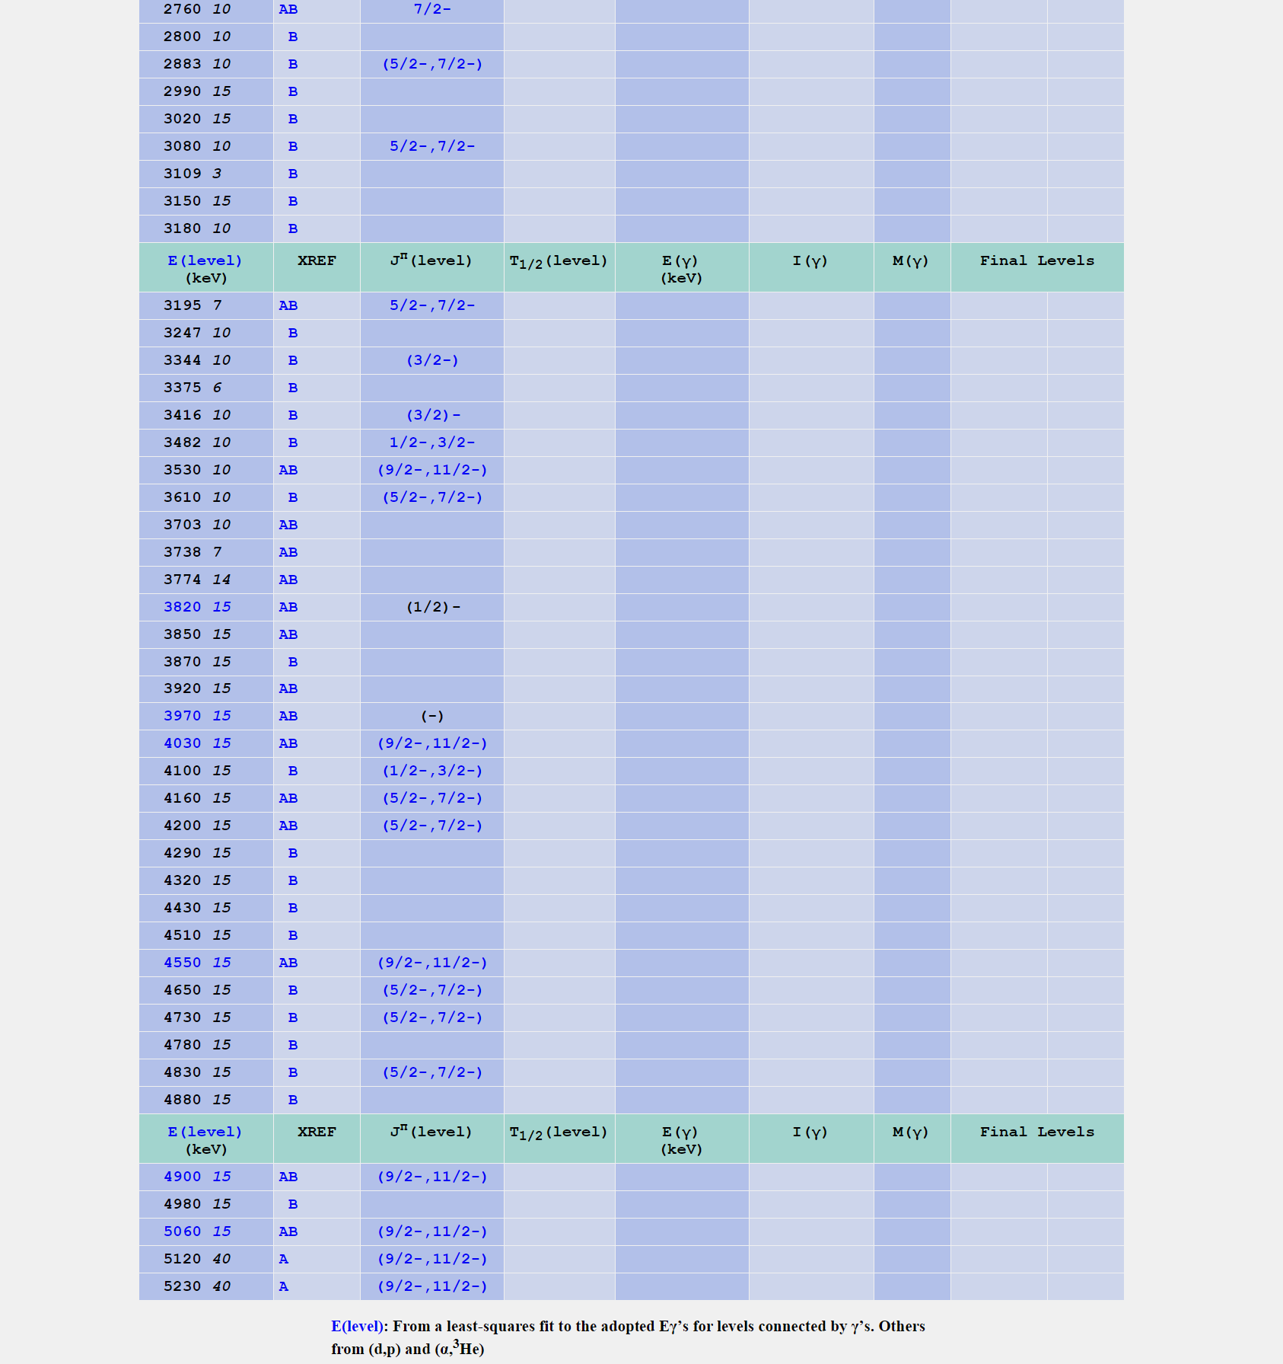
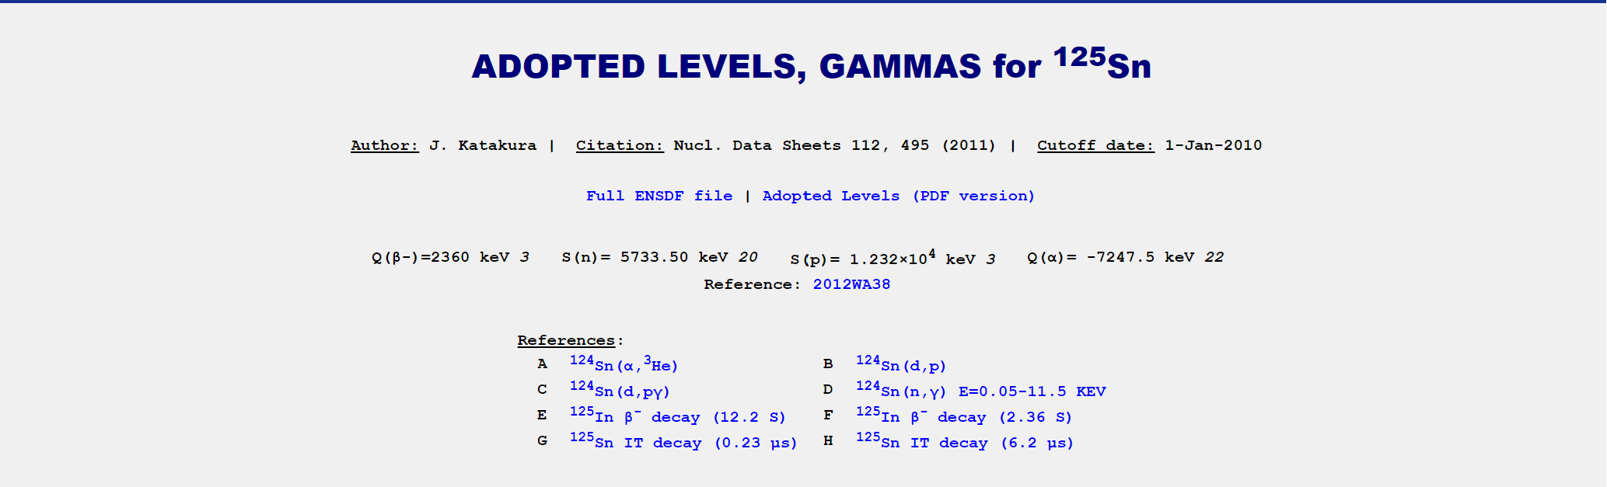
Backup-slide

Slide 31
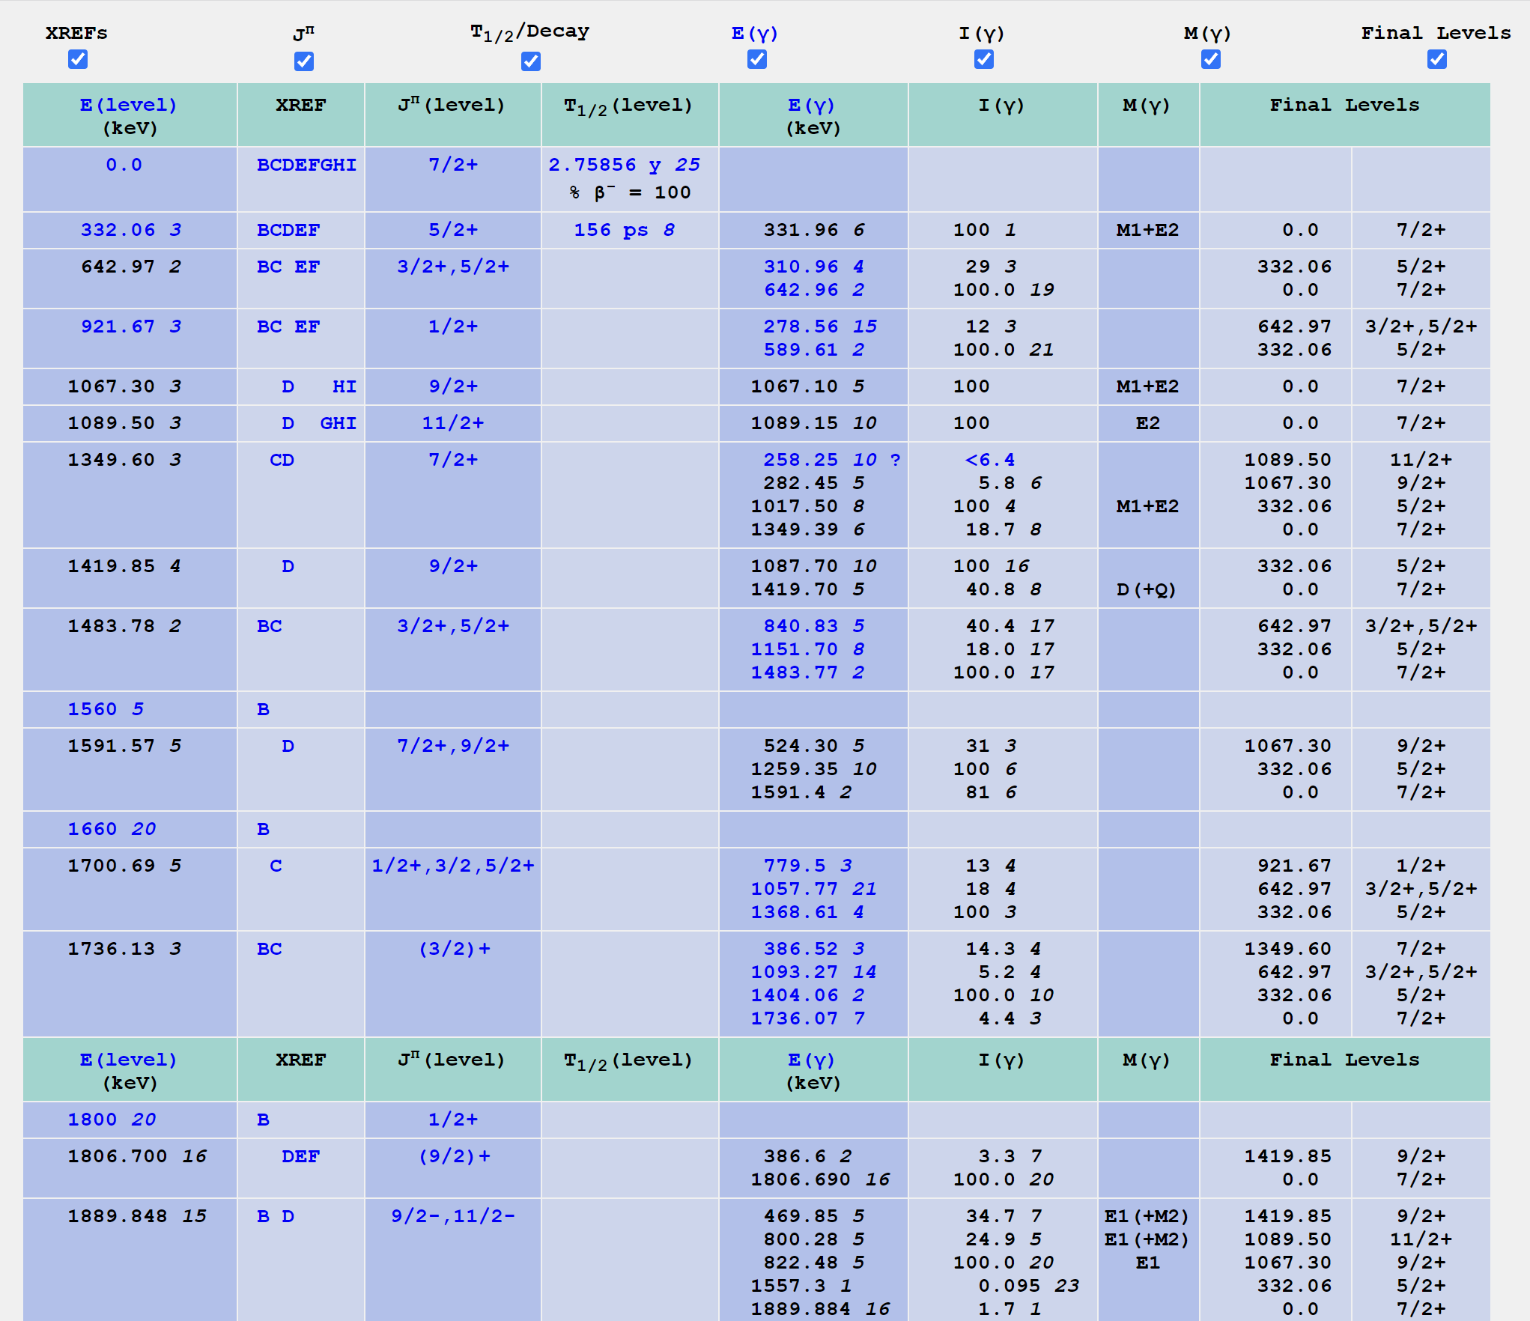
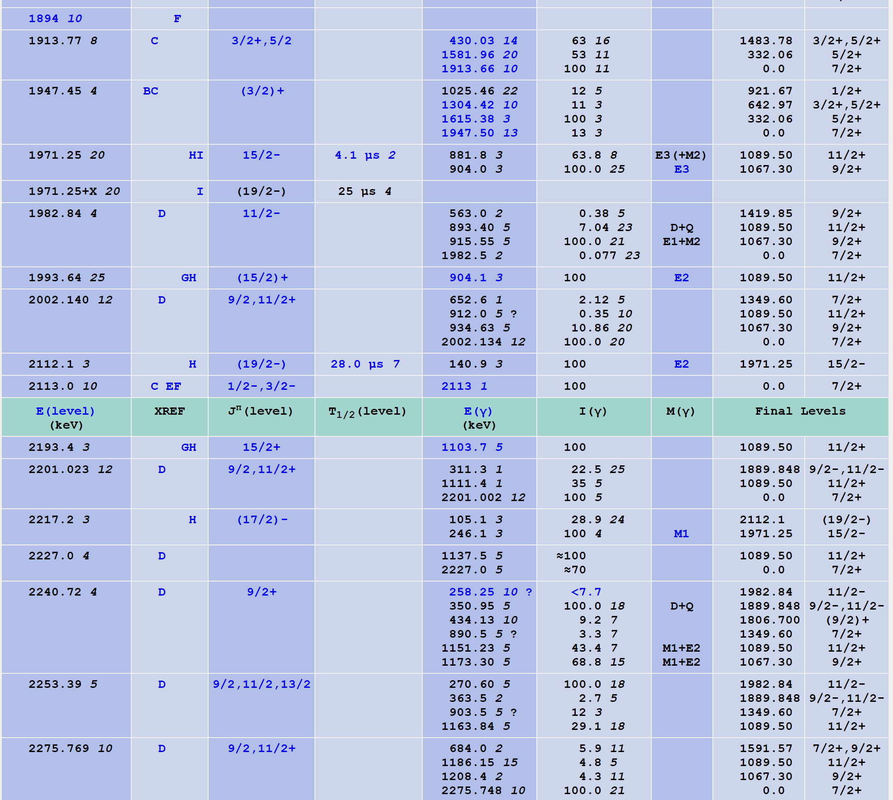
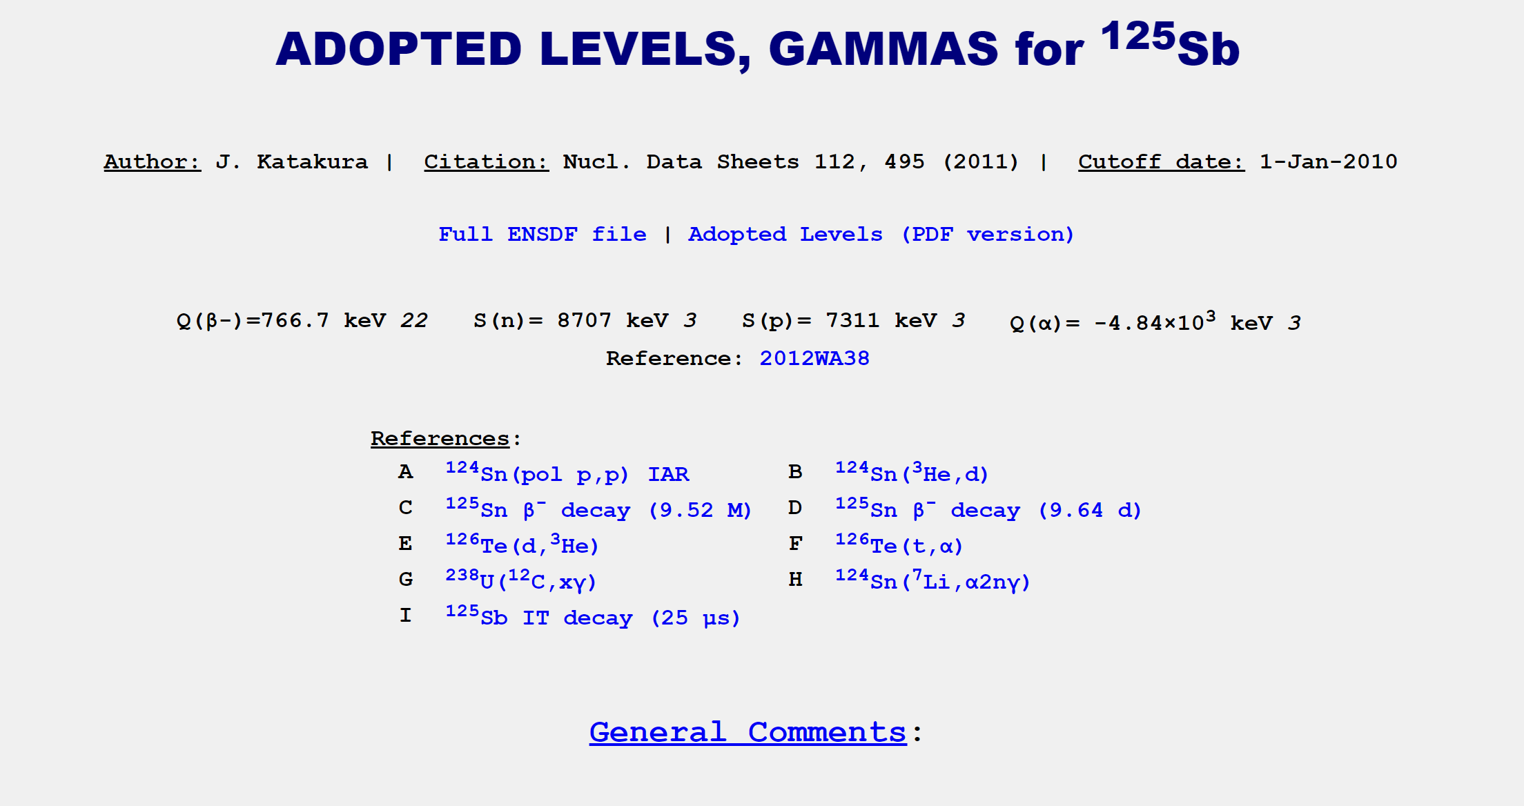
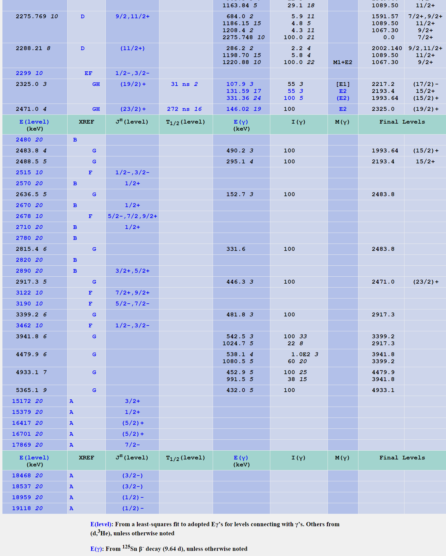

Slide 32
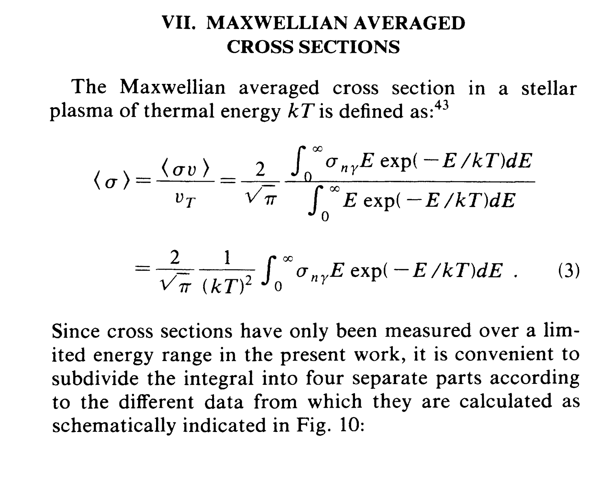
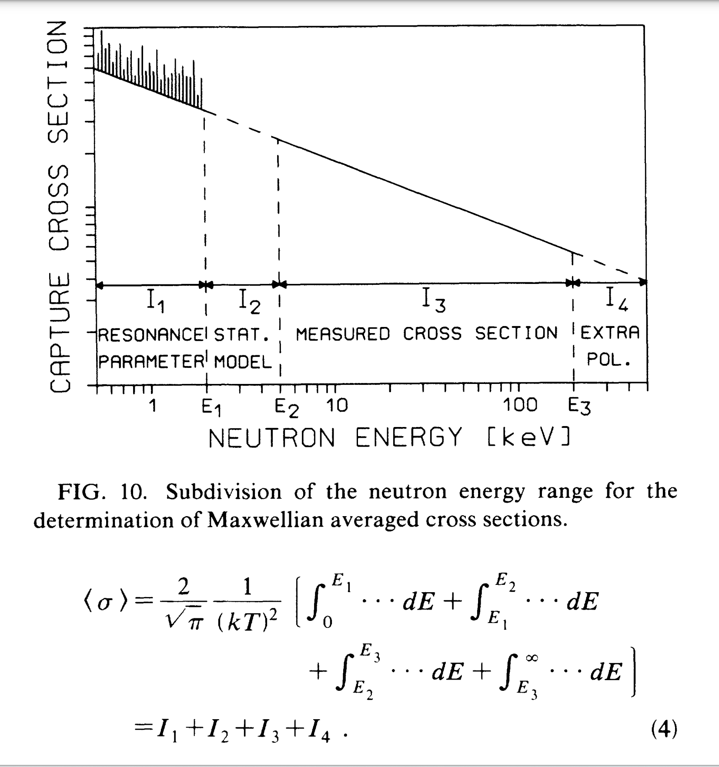
Backup-slide
https://journals.aps.org/prc/pdf/10.1103/PhysRevC.42.1731
K. Wisshak, F. Voss, F. Käppeler, and G. Reffo
Phys. Rev. C 42, 1731 – Published 1 October 1990

Slide 33
Backup-slide

Slide 34
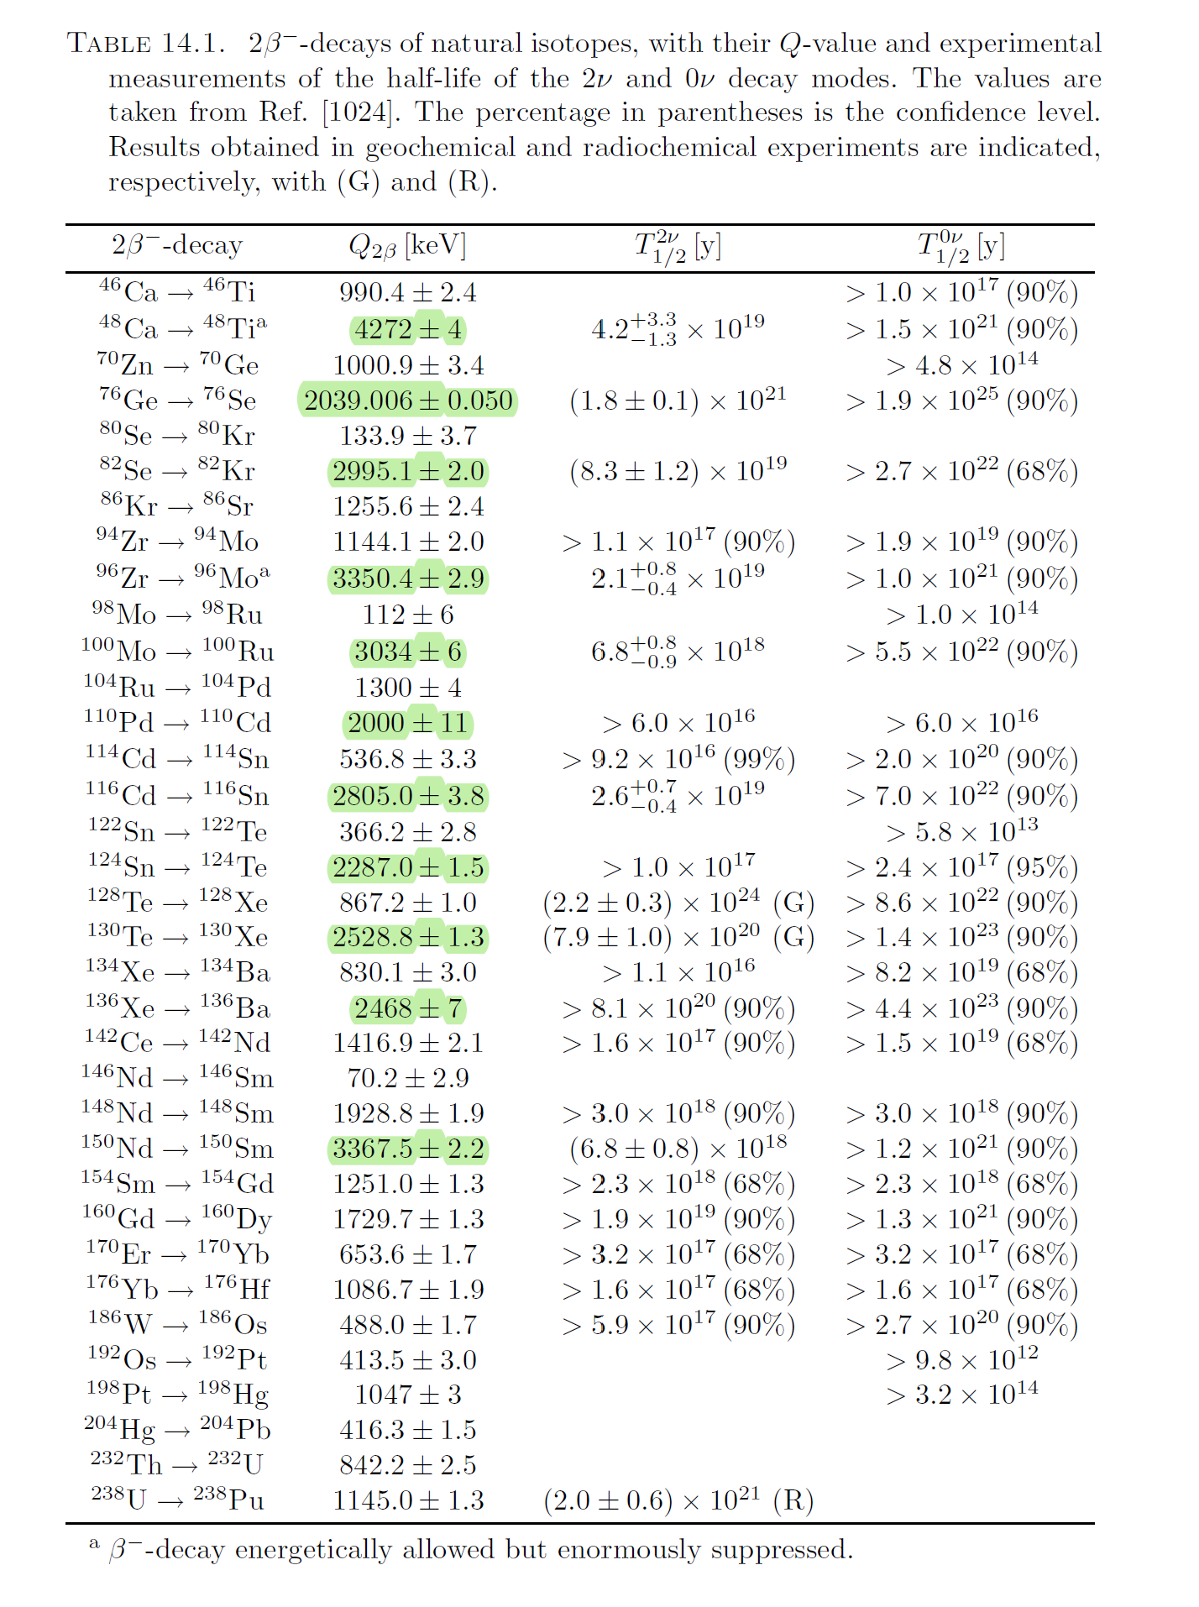
Backup-slide
Giunti, Carlo, and Chung W. Kim. Oxford university press Book, (2007). https:
//doi.org/10.1093/acprof:oso/9780198508717.001.0001

Slide 35
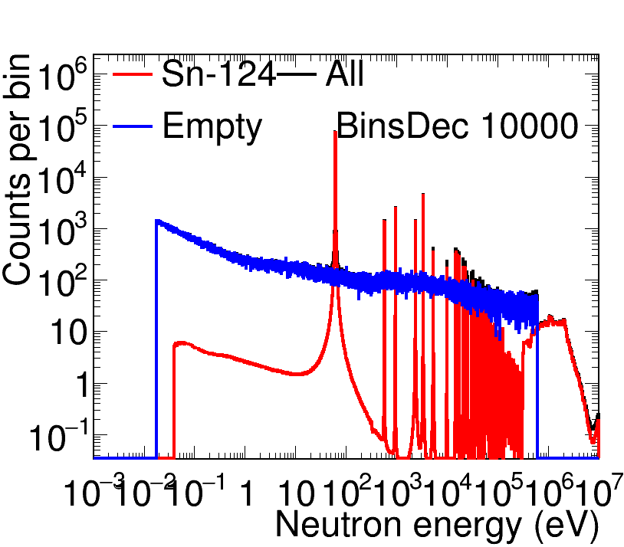
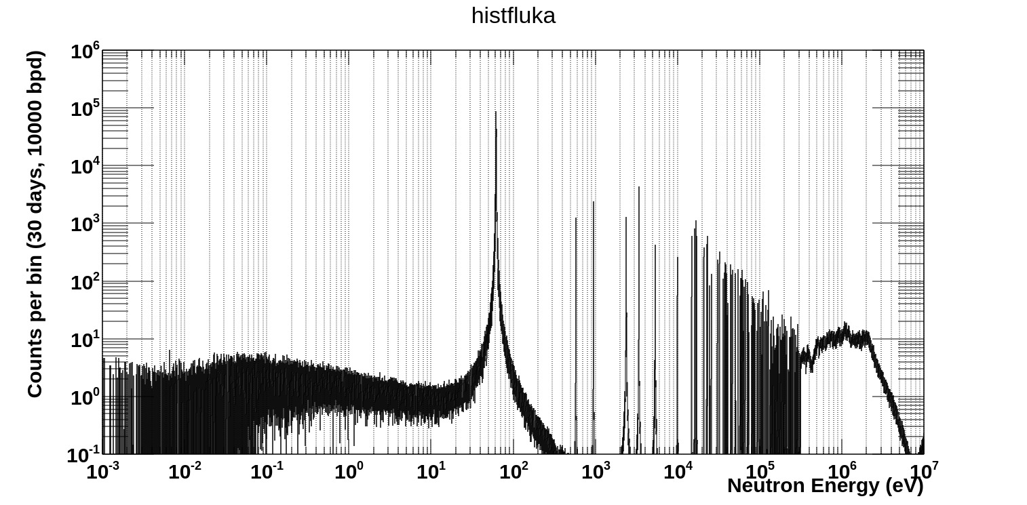
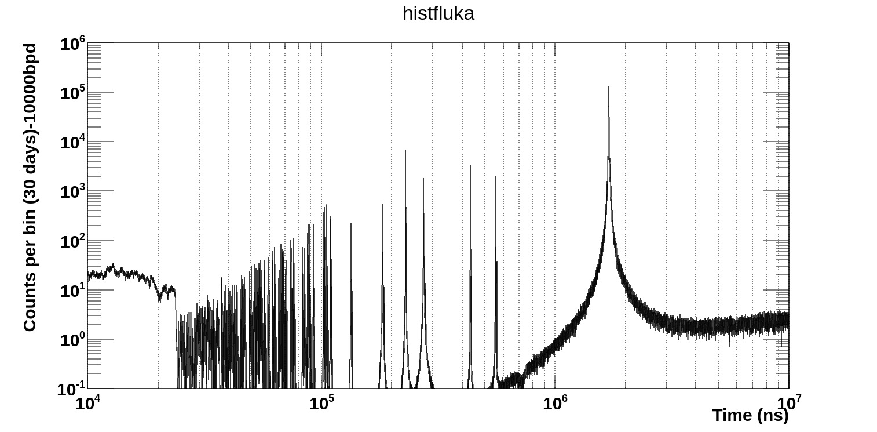
124Sn EAR-1
Backup-slide

Slide 36
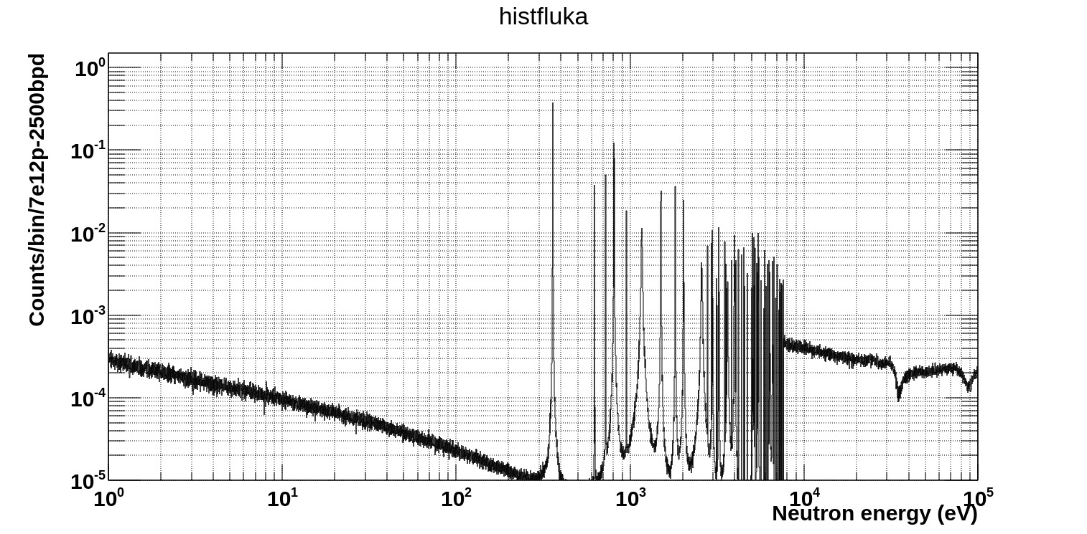
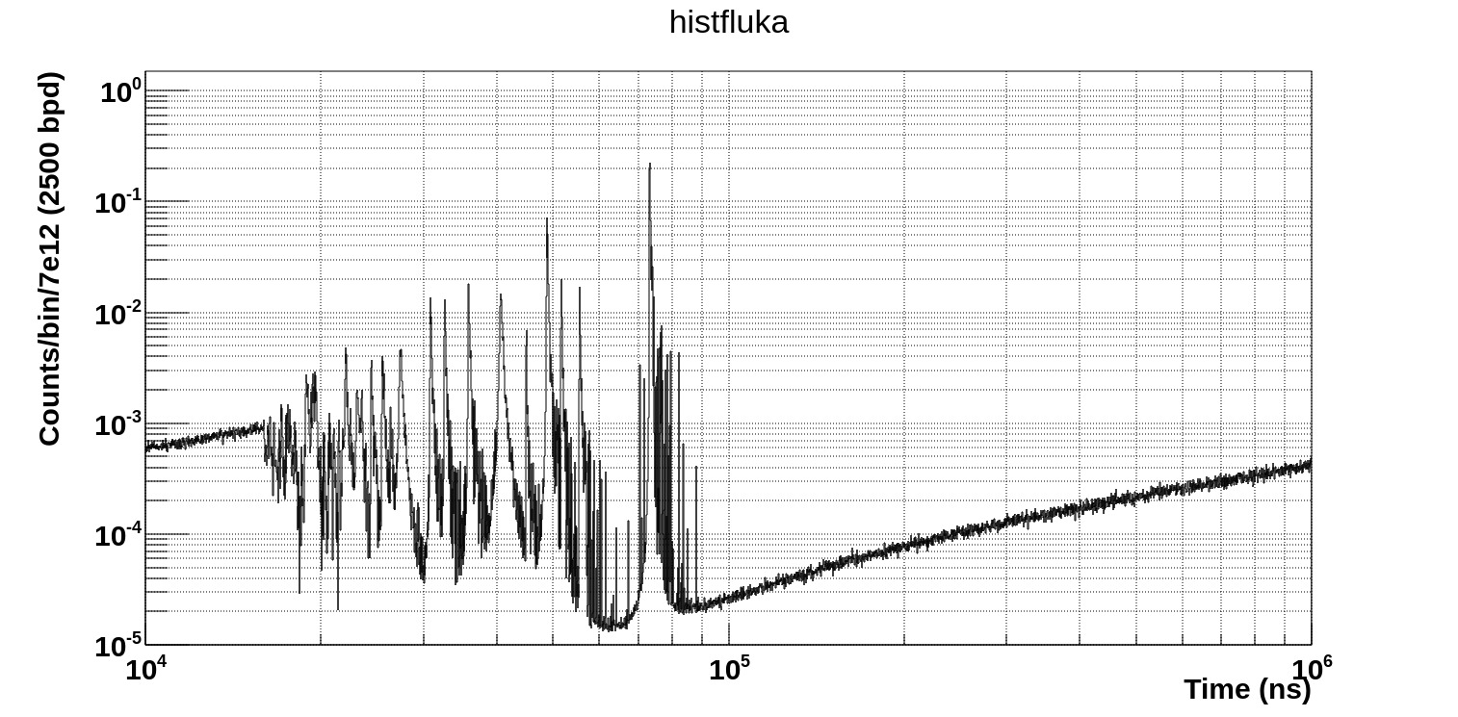
Backup-slide
146Nd-EAR2

Slide 37
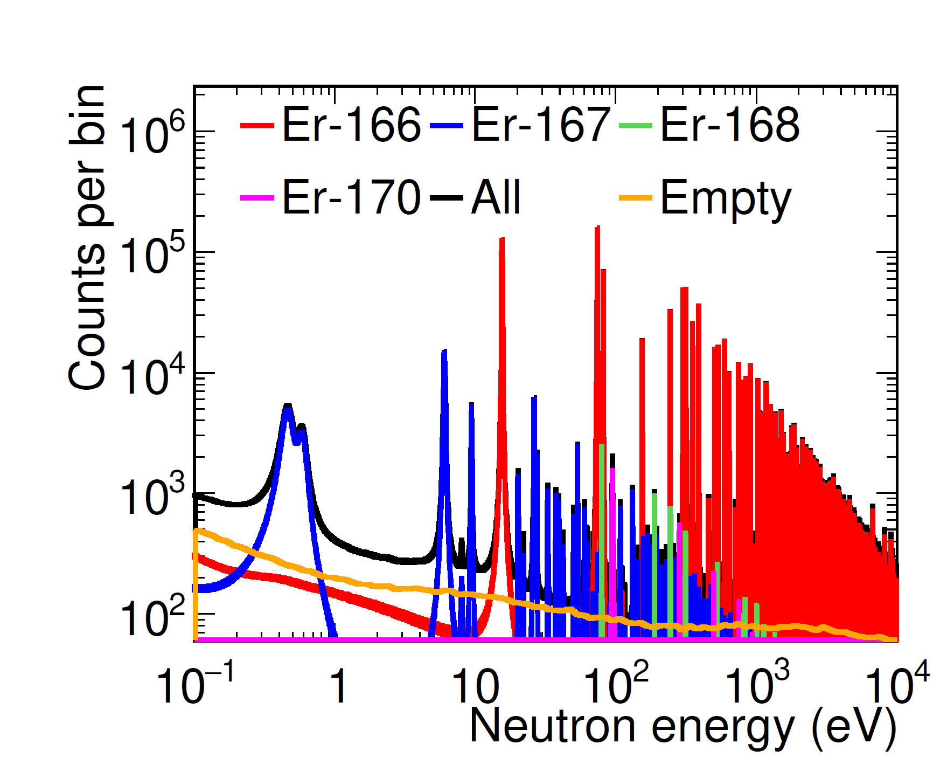
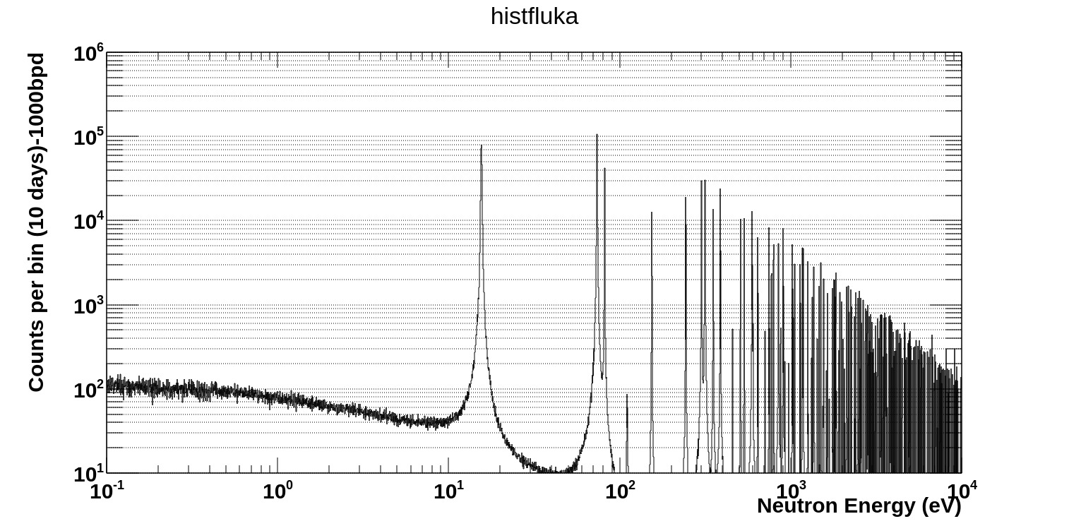
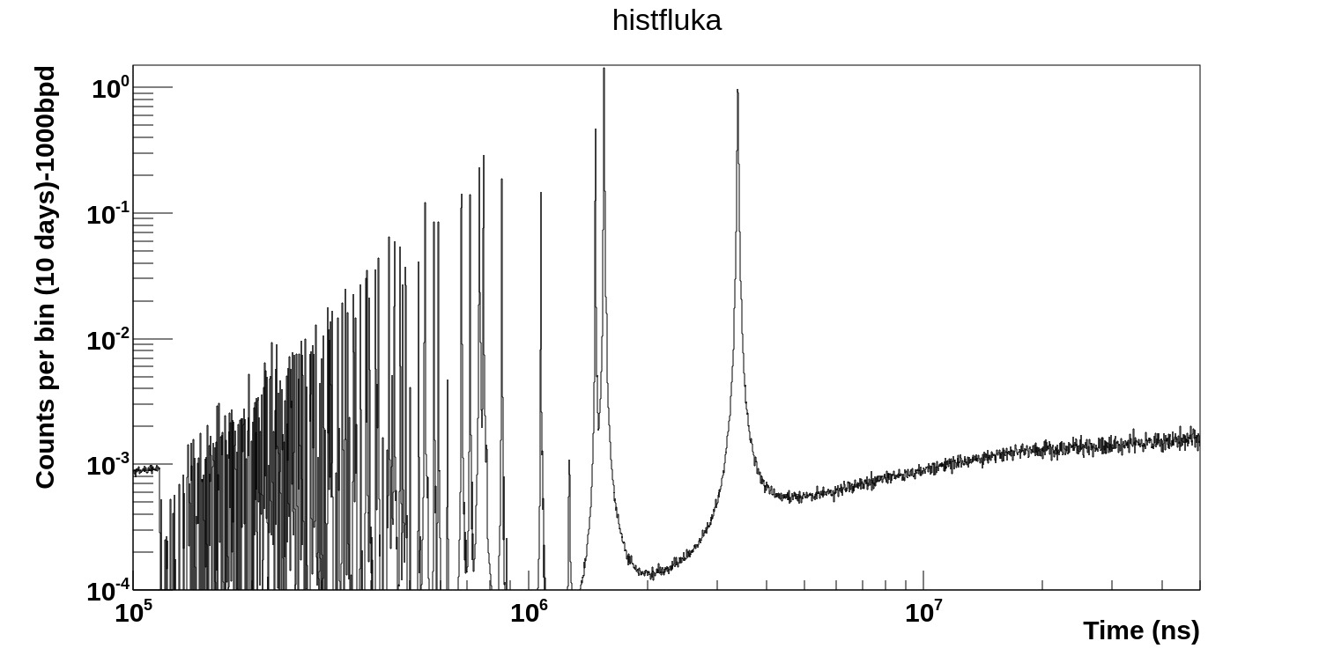
Backup-slide
166Er-EAR1

Slide 38
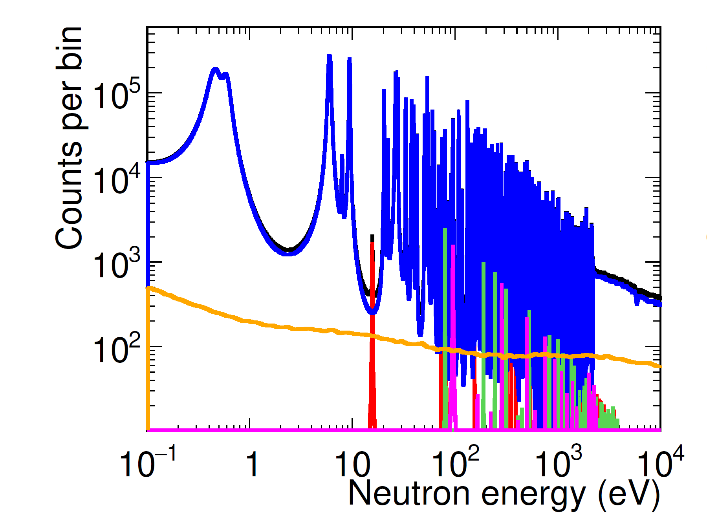
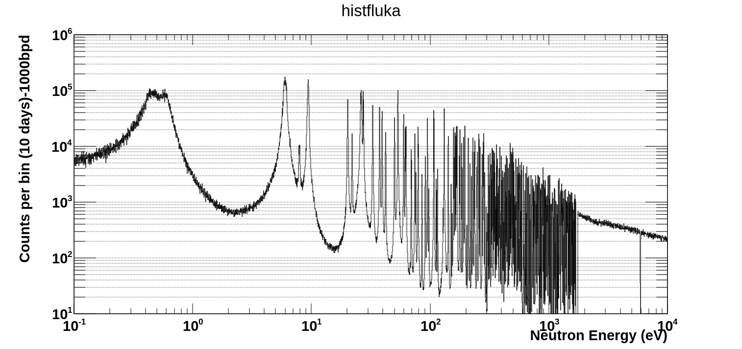
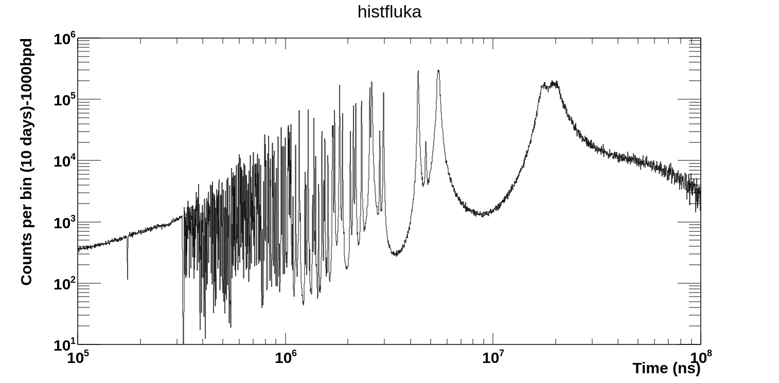
Backup-slide
167Er-EAR1

Slide 39
Backup-slide
SIMON
C6D6
BD
Complimentary or test experiment with an array of both C6D6 and HPGe/Labr3 for getting the capture events(C6D6) and capture cascade event in HPGe together.
Neutron beam
Sample

Slide 40
Backup-slide
Question to be discuss:
At what distance? What efficiency?)
Anisotropy
Amount of sample
Experimental area
Offline without beam measurement for isomers
Negligible contribution from contamination of other isotopes impurities

Slide 41
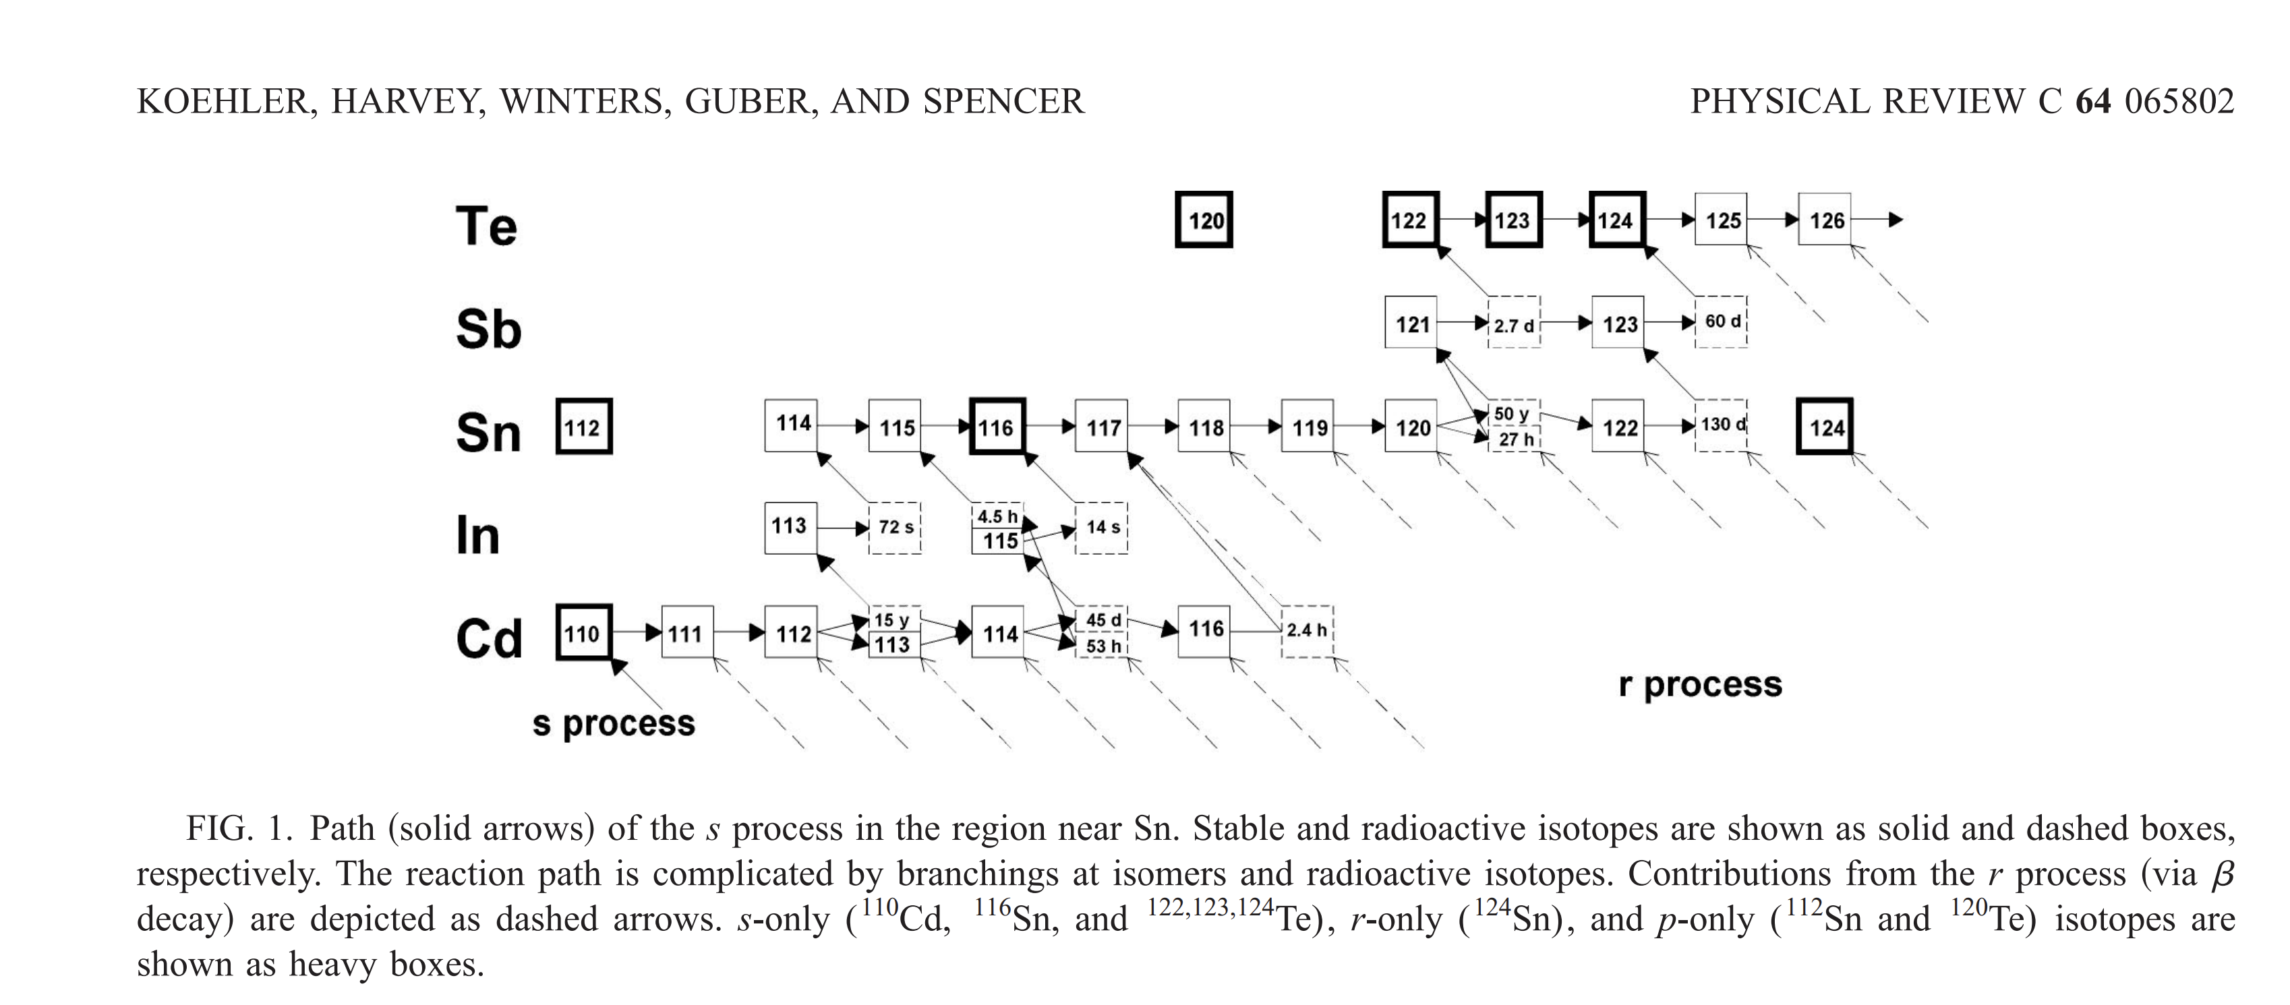
Backup-slide

Slide 42
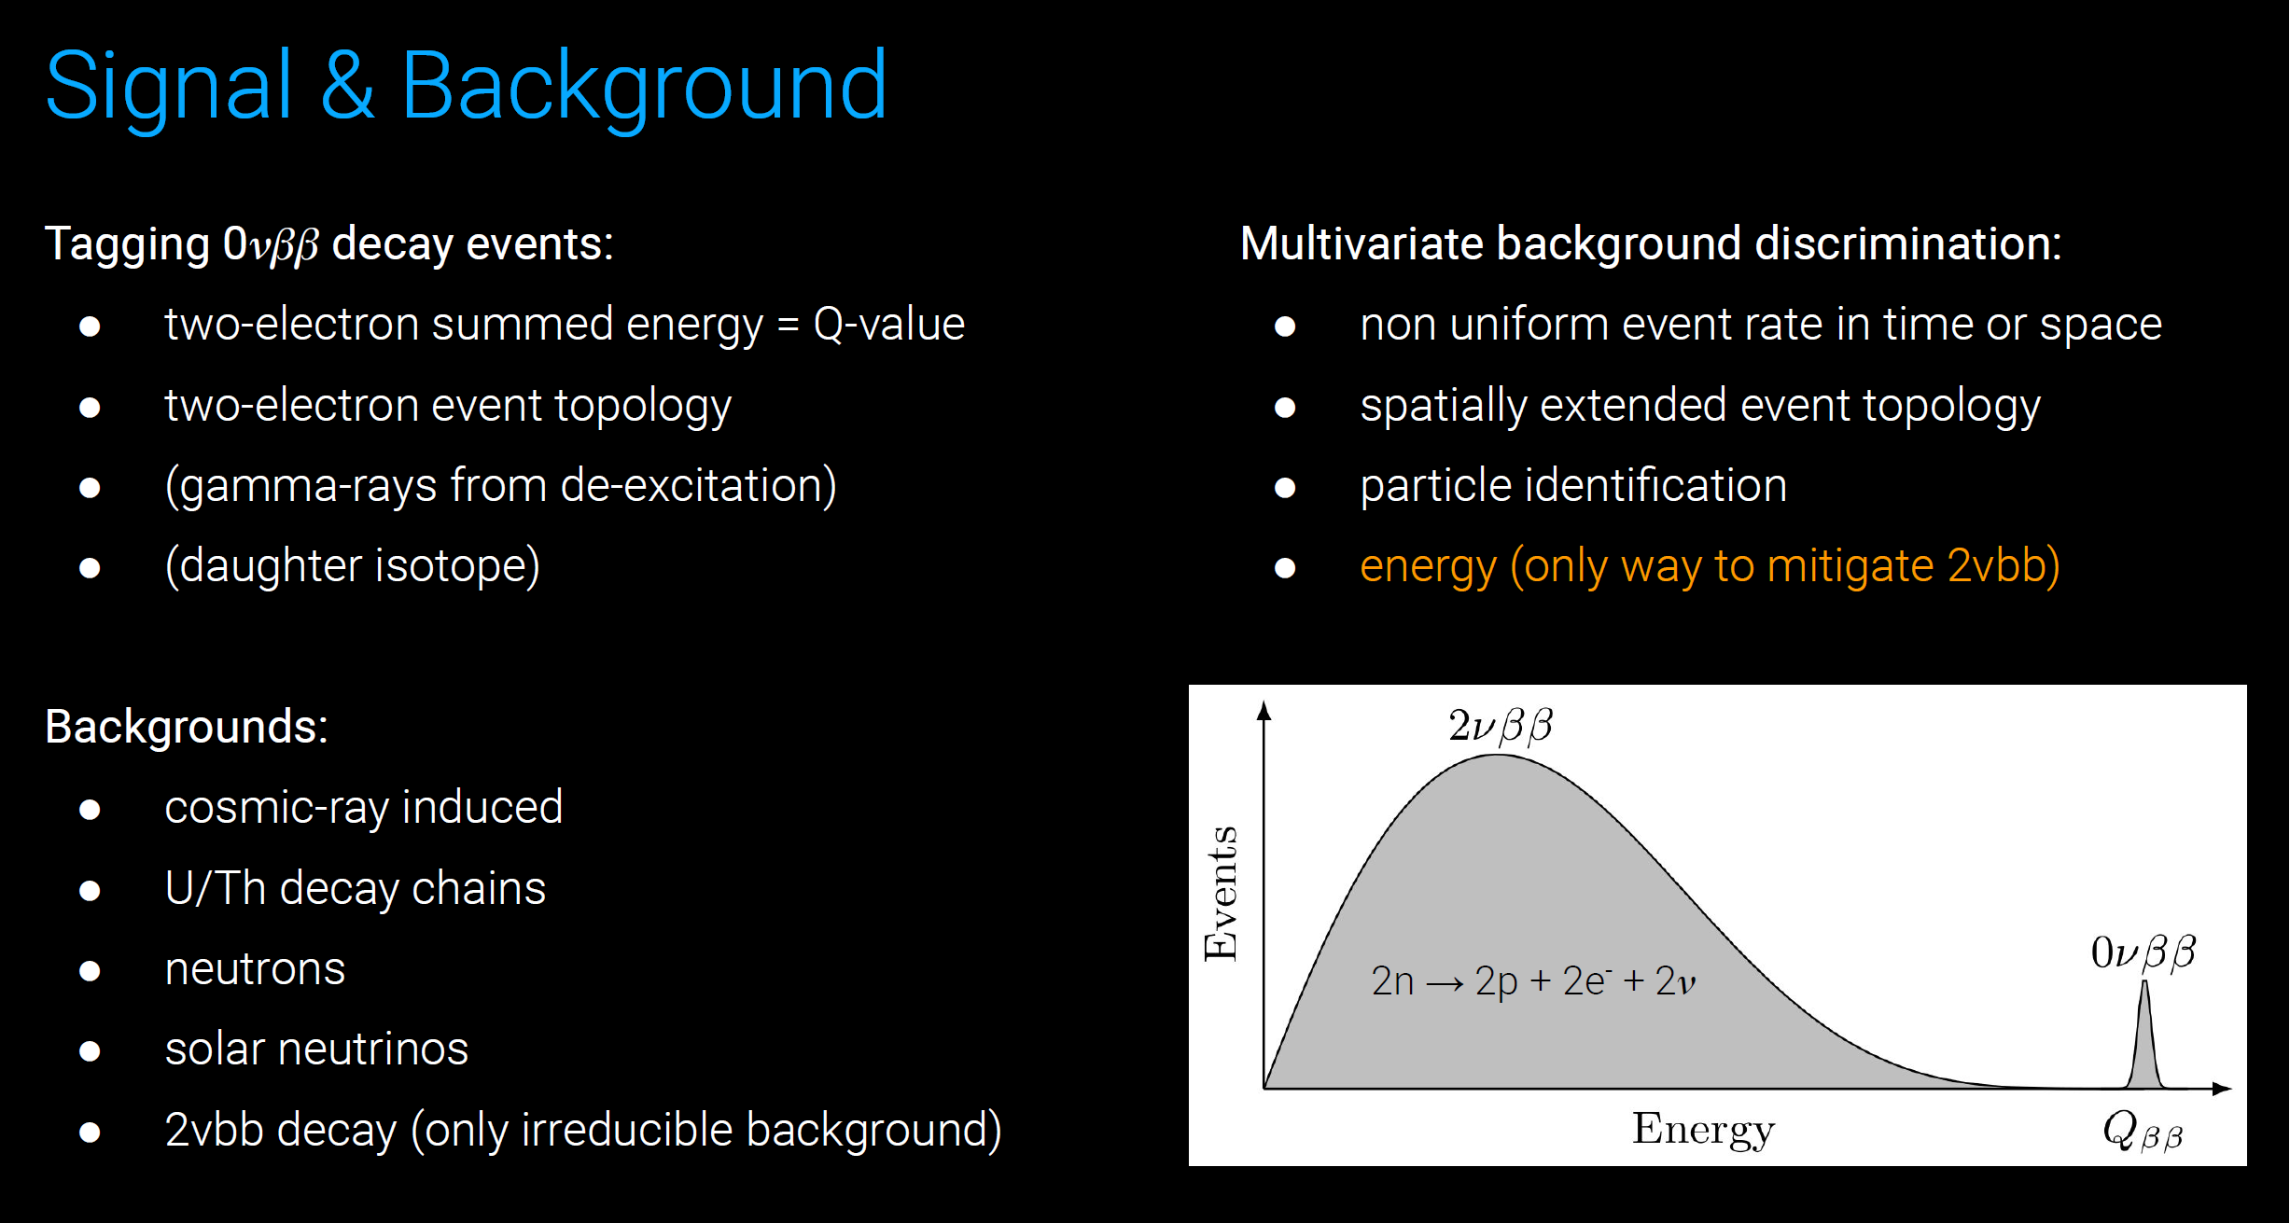
Backup-slide
Credit: Matteo Agostini
STFC Ernest Rutherford Fellow at UCL

Slide 43
Backup-slide
¹²⁴Sn(n,γ) experimental proposal
one of the few candidate for observing neutrinoless double beta decay (0νββ)
the solar system s-process abundance from the stellar model of Te stable isotopes which also have the contribution of r-process
M. Arnould, K. O. H. J. I. Takahashi,Reports on
Progress in Physics 62.3 (1999): 395
*Comparison of resonance from other Sn isotopes which can contribute more in the 124Sn resonance region.
*140Ce and 124Sn elastic cross section comparison.

Slide 44
Backup-slide
LHC
ITER
¹²⁴Sn(n,γ) experimental proposal
one of the few candidate for observing neutrinoless double beta decay (0νββ)
the solar system s-process abundance from the stellar model of Te stable isotopes which also have the contribution of r-process
M. Arnould, K. O. H. J. I. Takahashi,Reports on
Progress in Physics 62.3 (1999): 395
*Baumgartner, Thomas. Effects of fast neutron irradiation on critical currents and intrinsic properties of state-of-the-art Nb3Sn wires. na, 2013.
*Krasilnikov, Vitaly, MunSeong Cheon, and Luciano Bertalot. "Neutron activation system for ITER tokamak." Advanced Technologies and Applications of Neutron Activation Analysis (2019): 71-87.

Slide 45
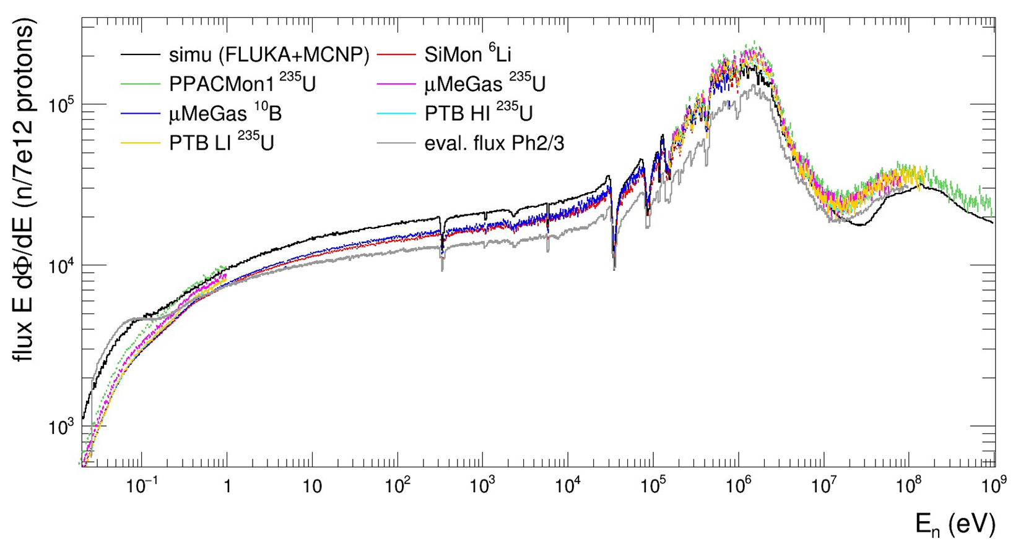
Backup-slide
proton beam momentum | 20 GeV/c
intensity (dedicated mode) | 8.5 x 10¹² protons/pulse
repetition frequency | 1 pulse/1.2s
pulse width | 6 ns (rms)
n/p | > 300
lead target dimensions | 40x46x63 cm³
cooling & moderation material | N₂ & H₂O (borated)
moderator thickness in the exit face | 5 cm
neutron beam dimension in EAR-1 (capture mode) | 2 cm (FWHM)
Neutron Energy range | Energy Resolution
50 eV to 10 keV | 200 eV
10 keV to 100 keV | 3000 eV
100 keV to 200 keV | ear2
200 keV to 314 keV

