Slide 1

Welcome to the General n_TOF Meeting 2023
in Valencia!
22-24 November, 2023
https://indico.cern.ch/e/ValenciaNTOF2023

Slide 2


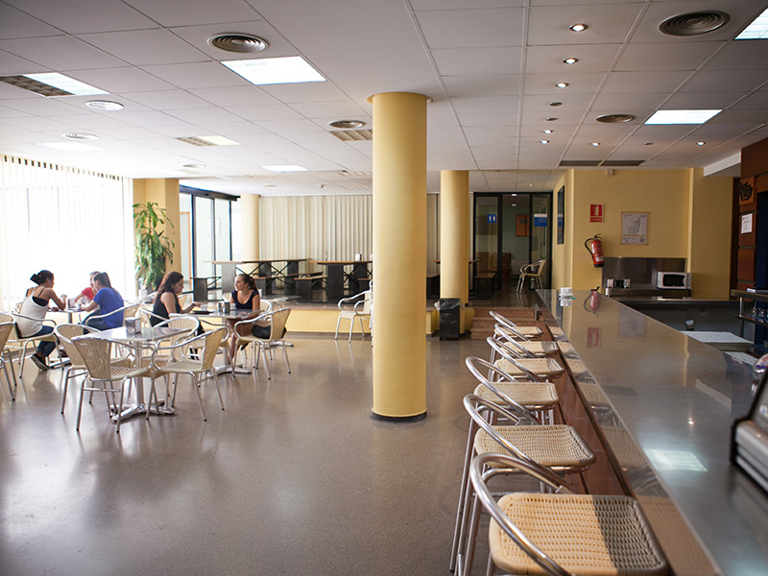
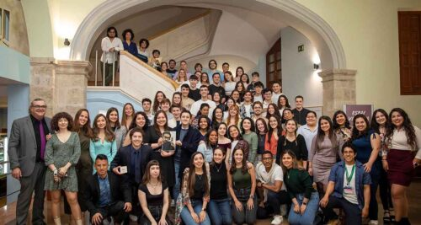
Some logistics
101 registered participants! 78 in person + 23 online
Separate room available Sala Seminario I (small meetings, or to work on your presentation)
For people having Lunch at the Colegio Mayor
  Menu costs 8.35€/person/day
  Purchase tickets (cash) at the cafeteria, the earlier the better
EDUROAM connection available
Group Photo: Thursday 13:30 @ Hall of CMRP
Social Dinner: Thursday 20:30 @ TRIA Restaurant (40€/person, not sponsored)
Upload slides to indico on time! Avoid delays!
22-24 November, 2023
https://indico.cern.ch/e/ValenciaNTOF2023

Slide 3


Thanks to local team:
Thanks to sponsors:
Bernardo Bernardino Gameiro
César Domingo Pardo
Gabriel de la Fuente Rosales
Ion Ladarescu
James Hallam
Javier Balibrea Correa
Jorge Lerendegui Marco
José Luis Taín Enríquez
Victor Babiano Suarez
Enjoy your stay in Valencia!
IFIC (CSIC-University of Valencia)
Colegio Mayor Rector Peset, University of Valencia
22-24 November, 2023
https://indico.cern.ch/e/ValenciaNTOF2023

