Slide 1


Benchmarking Distributed Analysis at the Jülich HPC Center
Joseph Boulis
Axel Naumann, Maria Girone
23/08/2023
1

Slide 2



Introduction & Background
HEP huge amount of data
Advancement of grid computing & European HPCs
RDataFrame
23 August 2023
Joseph Boulis | Benchmarking Distributed Analysis at the Julich HPC Center
‹#›

Slide 3



Objective
program.py
df = RDataFrame(...)
Performance Metrics
High Performance Computing Center
23 August 2023
Joseph Boulis | Benchmarking Distributed Analysis at the Julich HPC Center
‹#›

Slide 4








Architecture
Submit jobs
dask
program.py
scheduler
Pull metrics
PromQL
Jülich HPC Center /
CERN HPC-Batch Cluster
23 August 2023
Joseph Boulis | Benchmarking Distributed Analysis at the Julich HPC Center
‹#›

Slide 5


Julich HPC computing nodes (JURECA)
X2
VERSION="8.8 (Green Obsidian)"
Model Name: AMD EPYC 7742
Cores: 64
Total: 128 cores
23 August 2023
Joseph Boulis | Benchmarking Distributed Analysis at the Julich HPC Center
‹#›

Slide 6

CERN HPC computing nodes (HPC-Batch)
X2
Model Name: AMD EPYC 7302
Cores: 16
Total: 32 cores
VERSION: 8
23 August 2023
Joseph Boulis | Benchmarking Distributed Analysis at the Julich HPC Center
‹#›

Slide 7
Root Installation
Environment variable:
EXTRA_CLING_ARGS="-O2" → Gives more performance with jitted code
Build Options:
-Dminimal=ON
-Dpyroot=ON
-Ddataframe=ON
-Dxrootd=ON
-DCMAKE_BUILD_TYPE=Release
-Dimt=ON"
Libraries Versions:
ROOT : Master
dask : 2023.7.0
dask-core : 2023.7.0
dask-jobqueue : 0.8.2
23 August 2023
Joseph Boulis | Benchmarking Distributed Analysis at the Julich HPC Center
‹#›

Slide 8
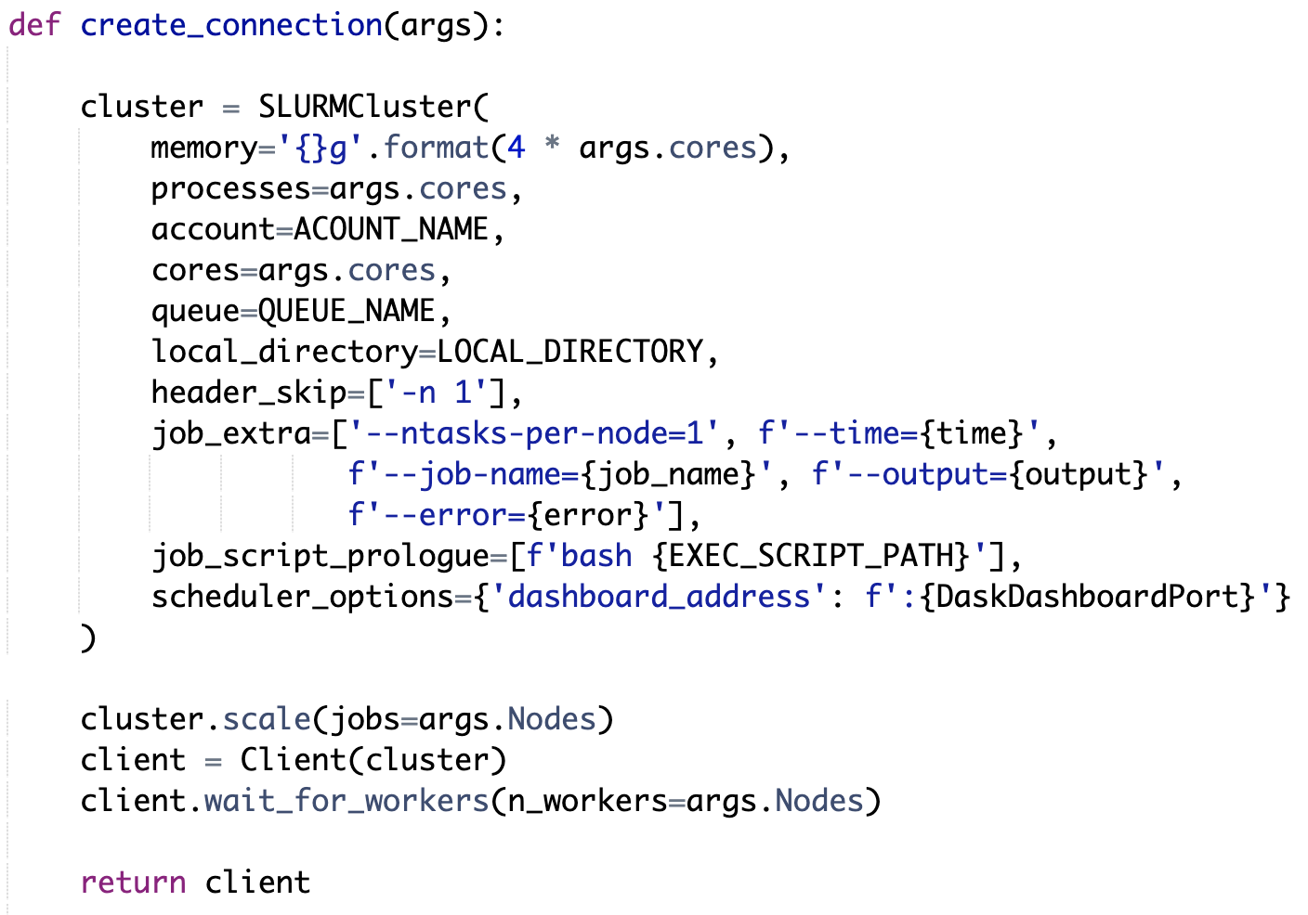
Dask & Slurm
Submit jobs
(batch script)
dask
Memory
Number of cores
User name
Partition name
Path to logs/
Bash scripts to execute on computer node
No. nodes to allocate
Configuration:
Avoid including queuing time in runtime
23 August 2023
Joseph Boulis | Benchmarking Distributed Analysis at the Julich HPC Center
‹#›

Slide 9

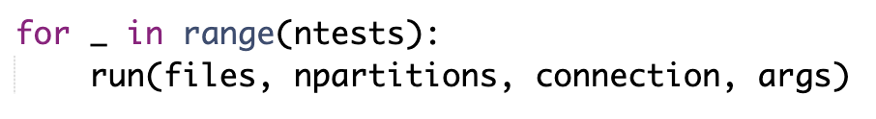
Distributed RDataFrame
Run the benchmark code (no changes needed)
23 August 2023
Joseph Boulis | Benchmarking Distributed Analysis at the Julich HPC Center
‹#›

Slide 10
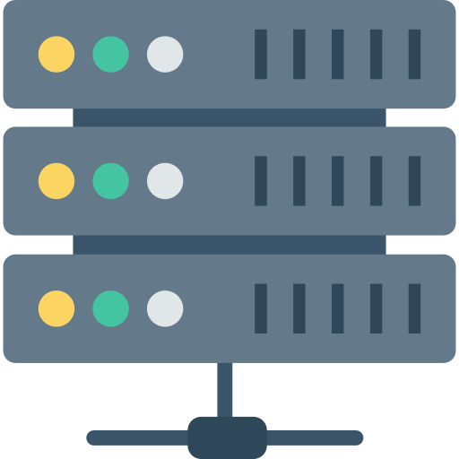



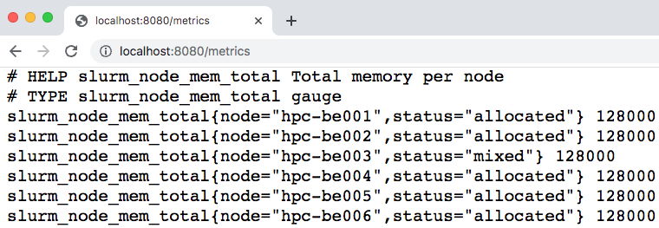
Prometheus Scraping
http://10.32.2.55
Prometheus config file
HTTP request
Get: http://10.32.2.55:8080/metrics
Scheduler node
Get: http://10.32.2.55:9100/metrics
Node Exporter
:9100
Get: http://10.32.2.55:port/metrics
scraping
SLURM Exporter
:8080
Metrics in HTML page
HTTP response
Dask Dashboard
Time Series DB
Time
CPU usage {instance=”10.13.2.55:40367”}
2023-08-15 02:57:30
1.47
2023-08-15 02:57:30
28.5
2023-08-15 02:58:00
98.9
Metrics at a specific time stamp
23 August 2023
Joseph Boulis | Benchmarking Distributed Analysis at the Julich HPC Center
‹#›

Slide 11


Scraping N nodes
HPC
Shared Storage
Scheduler node
Node Exporter
scraping
SLURM Exporter
Time Series DB
Dask Dashboard
23 August 2023
Joseph Boulis | Benchmarking Distributed Analysis at the Julich HPC Center
‹#›

Slide 12
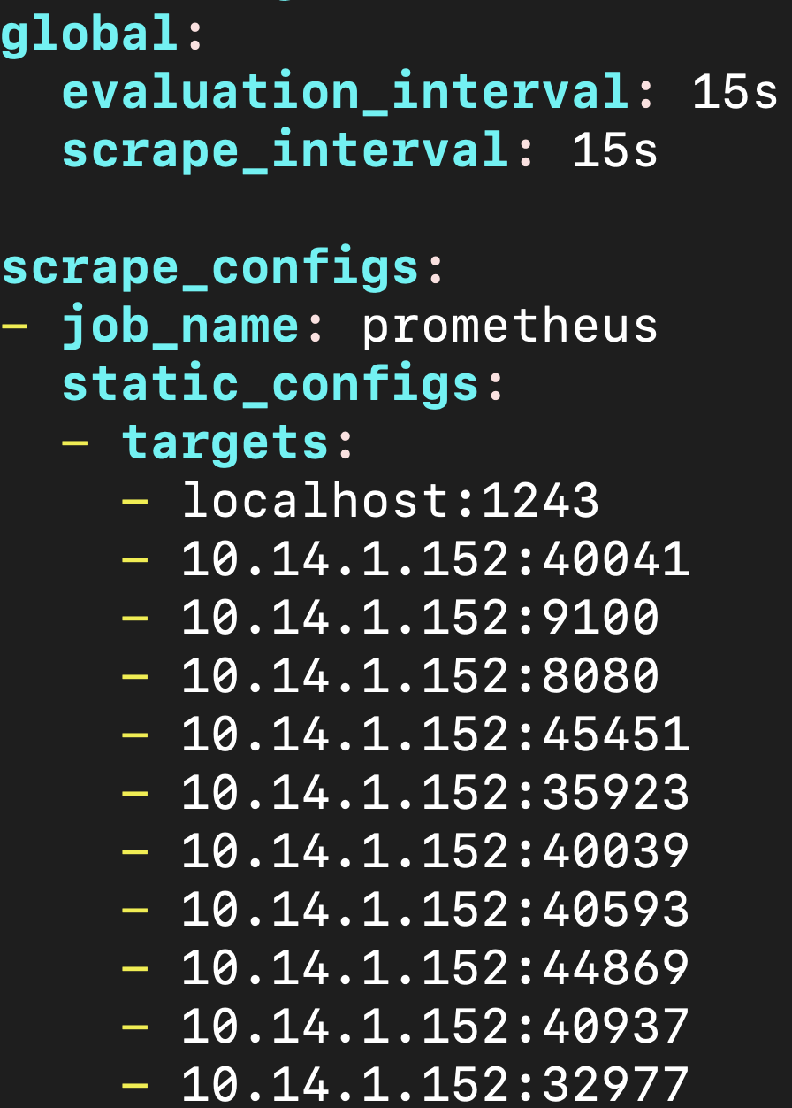


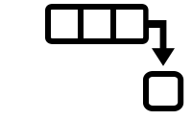
Scraping configuration
prometheus.yml
Sending scrapes frequently overloads slurmctld
Sending scrapes every 15s
Exporters
slurmctld
POST request
requests.post("http://localhost:9090/-/reload")
Programmatically get endpoints
dask
23 August 2023
Joseph Boulis | Benchmarking Distributed Analysis at the Julich HPC Center
‹#›

Slide 13
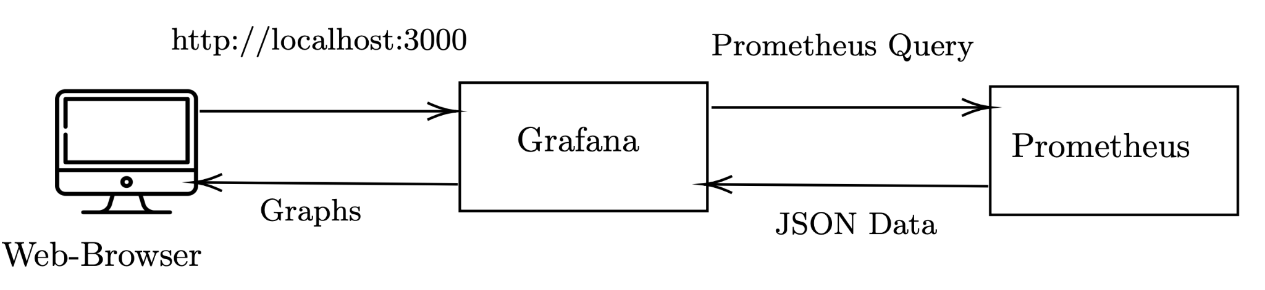
Visualize Data
23 August 2023
Joseph Boulis | Benchmarking Distributed Analysis at the Julich HPC Center
‹#›

Slide 14
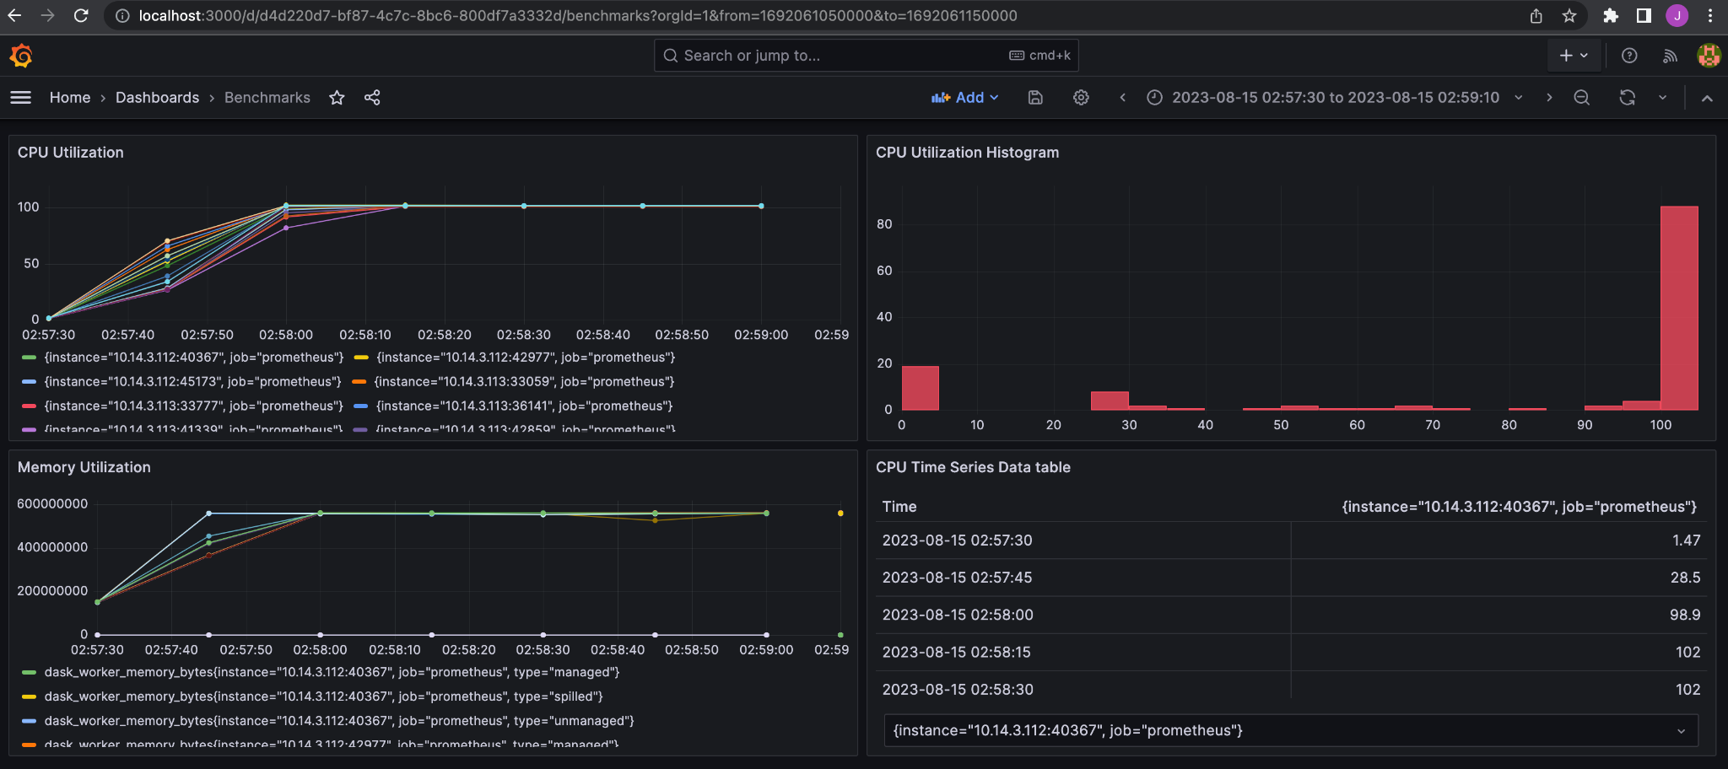
Grafana Dashboard
CPU Utilization
CPU Utilization Histogram
Memory Utilization
23 August 2023
Joseph Boulis | Benchmarking Distributed Analysis at the Julich HPC Center
‹#›

Slide 15
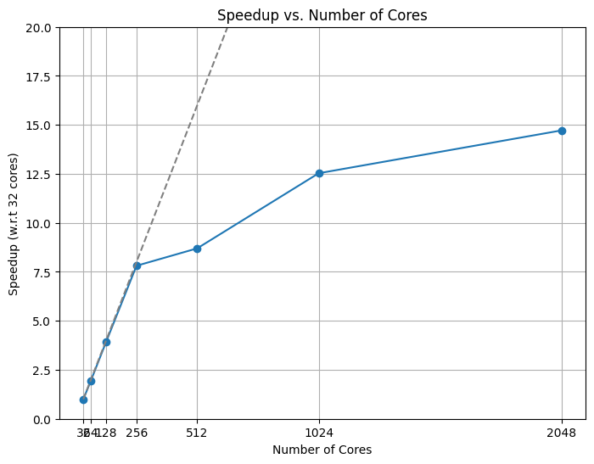
Benchmarking
Ideal Case:
Different physics events are statistically independent.
Parallelising the computation on different data chunks is a valid approach.
Benchmark:
Fix data, vary core count
8 TB data
Increasing nodes from 2 to 64
Julich Computing Center
1 node = 64 cores
23 August 2023
Joseph Boulis | Benchmarking Distributed Analysis at the Julich HPC Center
‹#›

Slide 16
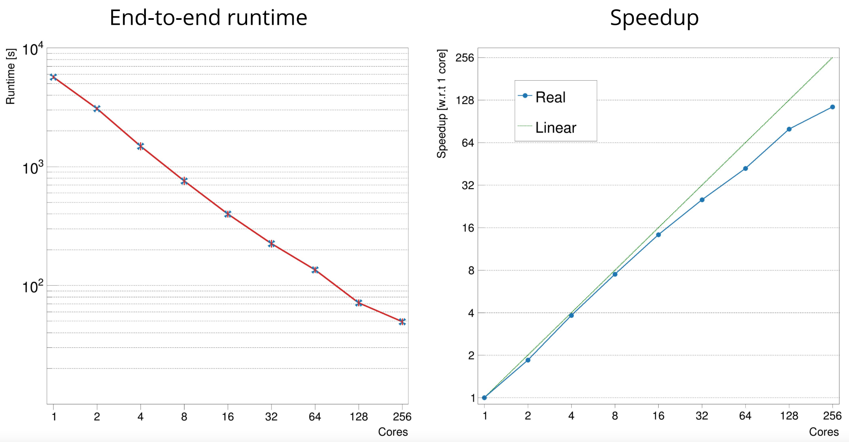
Previous Results
Reference: https://link.springer.com/article/10.1007/s10723-023-09645-2
23 August 2023
Joseph Boulis | Benchmarking Distributed Analysis at the Julich HPC Center
‹#›

Slide 17



1
Shared Storage vs Local SSD
23 August 2023
Joseph Boulis | Benchmarking Distributed Analysis at the Julich HPC Center
‹#›

Slide 18
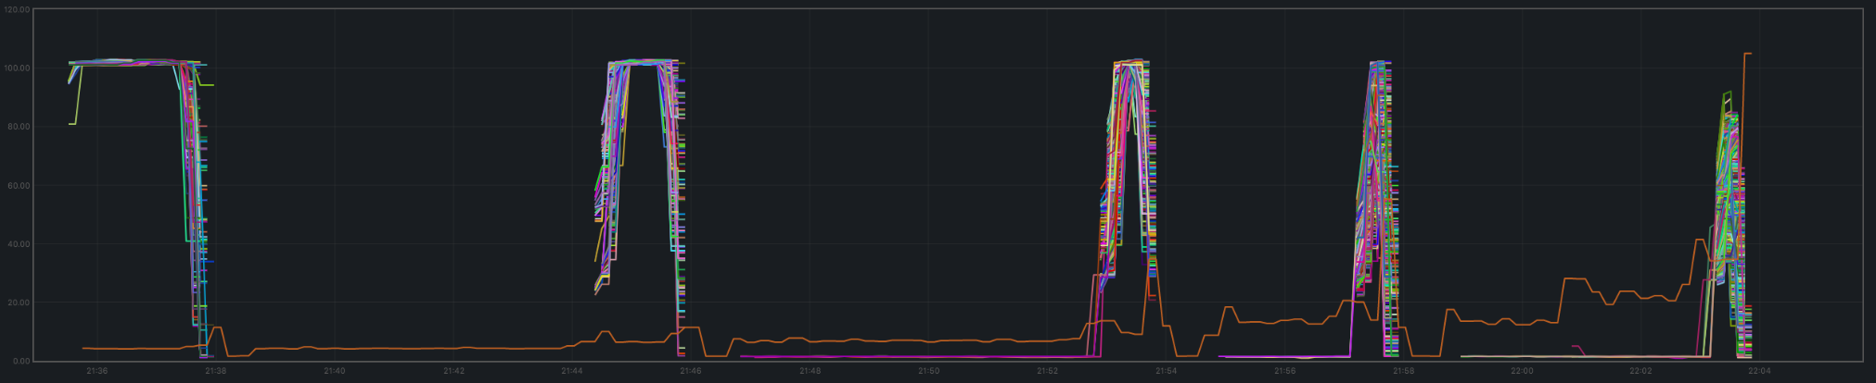
2
Underutilizing resources (Few Data)
Data size: 8 TB
Benchmark: df102
HPC: JURECA
CPU utilization vs time
Core count: 128
CPU time (>80%): 9.3m
Core count: 256
CPU time (>80%): 36s
Core count: 512
CPU time (>80%): 17s
Core count: 1024
CPU time (>80%): 10s
Core count: 2048
CPU time (>80%): 8s
BUT
Solution:
Increase Data!
Too long time
Fix data per core
Double data for doubling core count
23 August 2023
Joseph Boulis | Benchmarking Distributed Analysis at the Julich HPC Center
‹#›

Slide 19
Results (local data)
Benchmark: df102
HPC: JURECA
Core count | Data Size | Avg Runtime (s)
128 | 1 TB | 147.330747
256 | 2 TB | 151.402133
512 | 4 TB | 151.801192
1024 | 8 TB | 152.670302
2048 | 16 TB | 154.044167
?
?
?
?
?
23 August 2023
Joseph Boulis | Benchmarking Distributed Analysis at the Julich HPC Center
‹#›

Slide 20
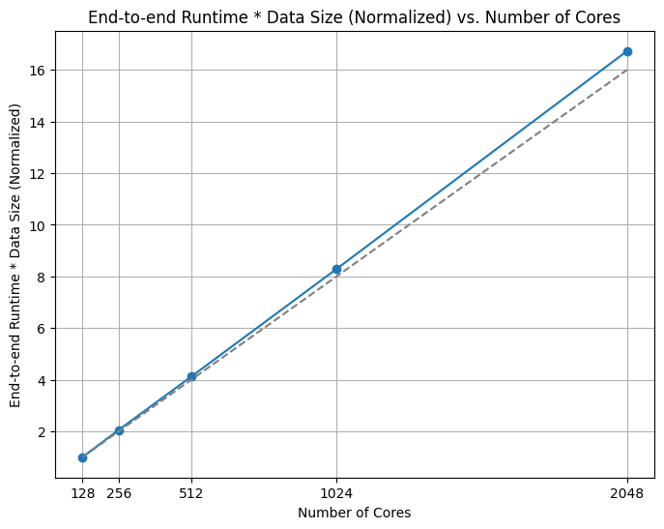
Results (local data)
Benchmark: df102
HPC: JURECA
1: 128 nodes @ 1 TB
23 August 2023
Joseph Boulis | Benchmarking Distributed Analysis at the Julich HPC Center
‹#›

Slide 21

Results (Remote Data)
Disclaimer
Benchmark: df102
HPC: CERN HPC (photon)
This test was conducted by remotely fetching the same file multiple times asynchronously
 | Without Async Prefetching | With Async Prefetching
Total runtime in sec (64 cores, 1TB) | 782.4957950115204 | 511.76918387413025
Total runtime in sec (128 cores, 2TB) | 565.8549840450287 | 521.8195469379425
Average CPU usage | 57% | 63%
23 August 2023
Joseph Boulis | Benchmarking Distributed Analysis at the Julich HPC Center
‹#›

Slide 22
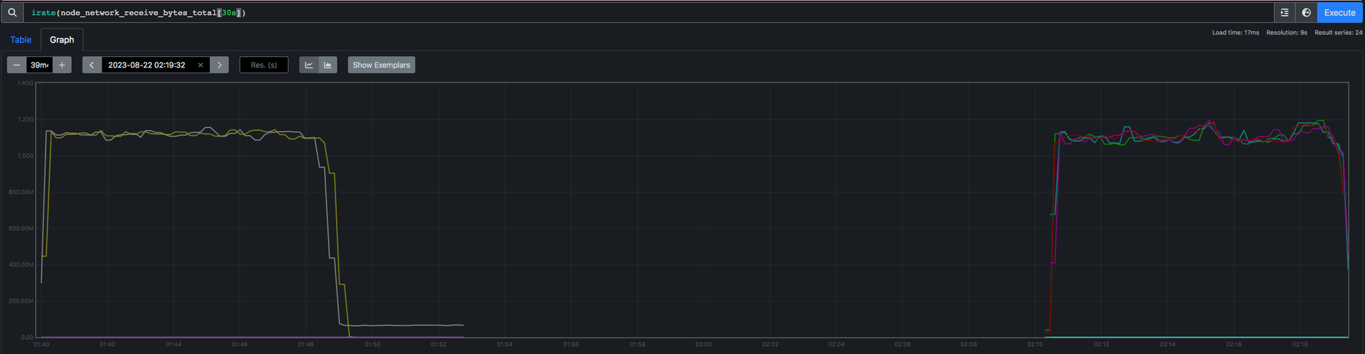
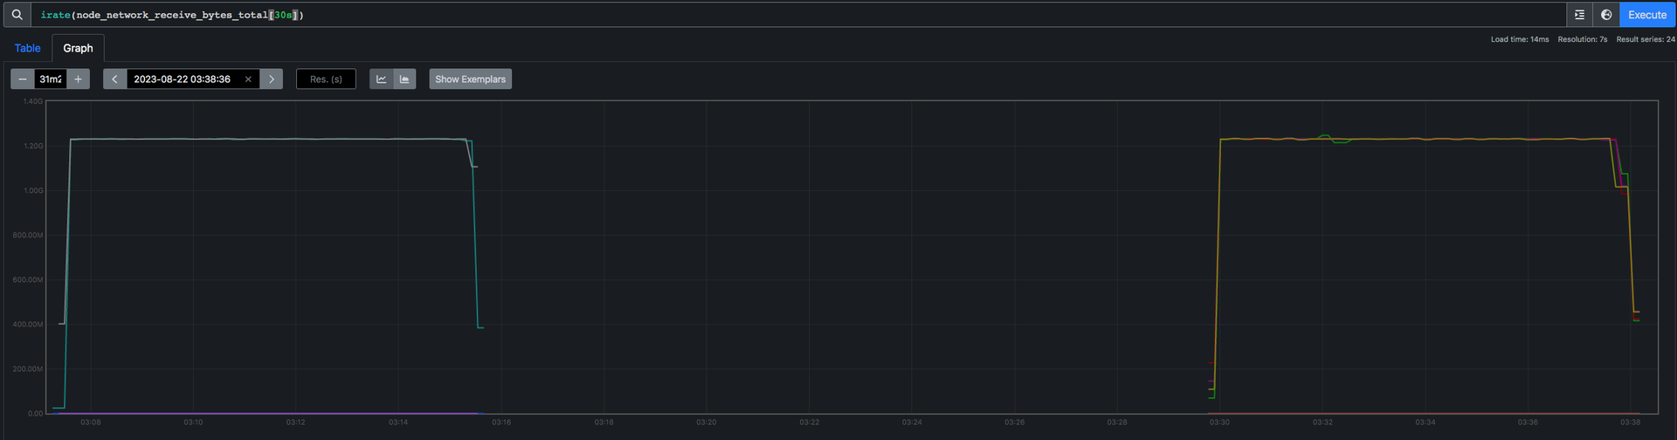
Results (Remote Data)
Node network received bytes vs time
Without Async Prefetching
With Async Prefetching
23 August 2023
Joseph Boulis | Benchmarking Distributed Analysis at the Julich HPC Center
‹#›

Slide 23
Conclusion
Fully automated end-to-end installation and benchmarking.
Added more useful metrics.
Written generic bash scripts that can be used on any HPC.
Enhanced the visualization and storage of benchmarking results persistently.
23 August 2023
Joseph Boulis | Benchmarking Distributed Analysis at the Julich HPC Center
‹#›

Slide 24

Thank You!
Questions?
joseph.boulis@cern.ch
jboulis@uwaterloo.ca
23 August 2023
Joseph Boulis | Benchmarking Distributed Analysis at the Julich HPC Center
‹#›

