Slide 1


HZB Proposals for EUCARD2 Research
V1.0
O. Kugeler | HZB | oliver.kugeler@helmholtz-berlin.de
T. Kamps | HZB | kamps@helmholtz-berlin.de

Slide 2
HZB Proposals
SC thin films testing
Cavity tuner development
Emmittance compensation
Cathode research
New within
EuCARD
Continue
EuCARD1

Slide 3
(1) Characterisation of superconducting thin films optimized for high Q₀ applications
In cavities for superconducting CW Linacs, minimizing residual losses (high Q₀) is the primary objective rather than achieving high accelerating gradients as in pulsed machines. The cryoplant is the cost driver in a CW-machine and doubling Q₀ implies halving the required cryo-power. Therefore it is highly desirable to search for alternatives to niobium for CW-superconducting cavities.
New proposal within EUCARD framework
Aim is the production and RF-testing of superconducting thin-film samples. Candidates are Nb₃Sn, MgBr₂, NbN, NbTi, multilayer-coated niobium, etc. A new RF testing apparatus with sub-Nanoohm resolution based on the CERN quadrupole resonator design is presently being developed at HZB.
Partners: CERN, IPJ Swierk, labs with HIPIMS sputtering facilities, lab that has the ability to produce thin multilayers of superconductors and dielectrics
Work: Performance of RF measurements with test-apparatus, materials characterisation with synchrotron radiation and/or neutrons, commission improved test-apparatus based on experience gained with HZB testing system
Timeline: Distribute candidate systems among participants, initiate deposition perform 2-4 measurement cycles per year
Cost: 2 FTE years 150k, 2nd prototype 50k, cryo-compatible field measurement setup 20k → Total 220k
Notes:
Background: CW-linacs require large amount of cryo-power. Cryo-plant is THE cost-driver. Therefore for CW-machines the focus shifts from achieving high gradients towards high quality factors or low surface resistances.
Possible candidates are these materials …. Very promising multilayer samples
Focus is on Sub-Nanoohm range. This is hard to achieve, since a test apparatus will be made of niobium and if we put a sample into a cavity, we will always have the losses from the cavity walls that are higher than losses at the sample if we have a better material.
Methode of choice is an apparatus simular to the CERN quadrupole resonator

Slide 4
Thin film characterisation
Thin film test stand
resonator loop to focus magnetic fields on sample
operation in higher order mode
Calorimetric measurement
B-field focused on sample by resonator loops operated in quadrupole mode
Until 2013: Build complementary apparatus at HZB with sub-Nanoohm resolution
Addtional diagnostics available at HZB
Soft x-ray spectroscopy
Electron spectrocopy
Neutron diffraction
NMR spectroscopy
Quadrupole resonator at CERN
Notes:
The idea was to give up the cavity shape of an accelerating structure. This allowed for a focussing of magnetic fields on the sample, as can be seen from this picture.
Pair of ring with circumference of one or an integer number of wavelengths. Operated in quadrupole mode (prevent fields from penetrating into the coaxial slit that seperates the sample from the cavity walls.
Measurement is purely calorimetric: A heater is used to produce the same field as the RF, (substitution method) temperature increase is used to compare both heating methods. Precision is derived from the precision of the heater and the thermocouple.
A follow-up design based on the CERN experiences is presently being devloped at HZB.
From 2013 on we expect the first prototype being functional.

Slide 5
(2) Impact of high-current operation on cavity tuner design and microphonics compensation
High current superconducting CW-Linacs require heavy HOM-damping. Waveguide absorbers attached to the cavity beam-pipe are one promising solution. However, they necessitate a coaxial tuner - like the INFN blade tuner - and complicate the fast tuning mechanism by increasing the total moving mass. Since cavities are operated at low bandwidths application microphonics compensation method is needed.
New proposal within EUCARD framework
Aim is the optimization of the tuner design for the increased dynamic load due to waveguide HOM absorbers and the demonstration of microphonics compensation with piezos.
Partners: HZB, INFN-Milano, anybody interested in HOM-damped CW-cavities
Work: Electromechanical simulation of engineering design based on blade tuner, manufacture and test of tuner prototype
Timeline: Engineering design M3, prototype manufacture and cavity mounting M12, second prototype manufacture and mounting M21, demonstration of microphonics compensation M24
Cost: 1.0 FTE years 75k, 2 prototypes 60k, sum 135k

Slide 6
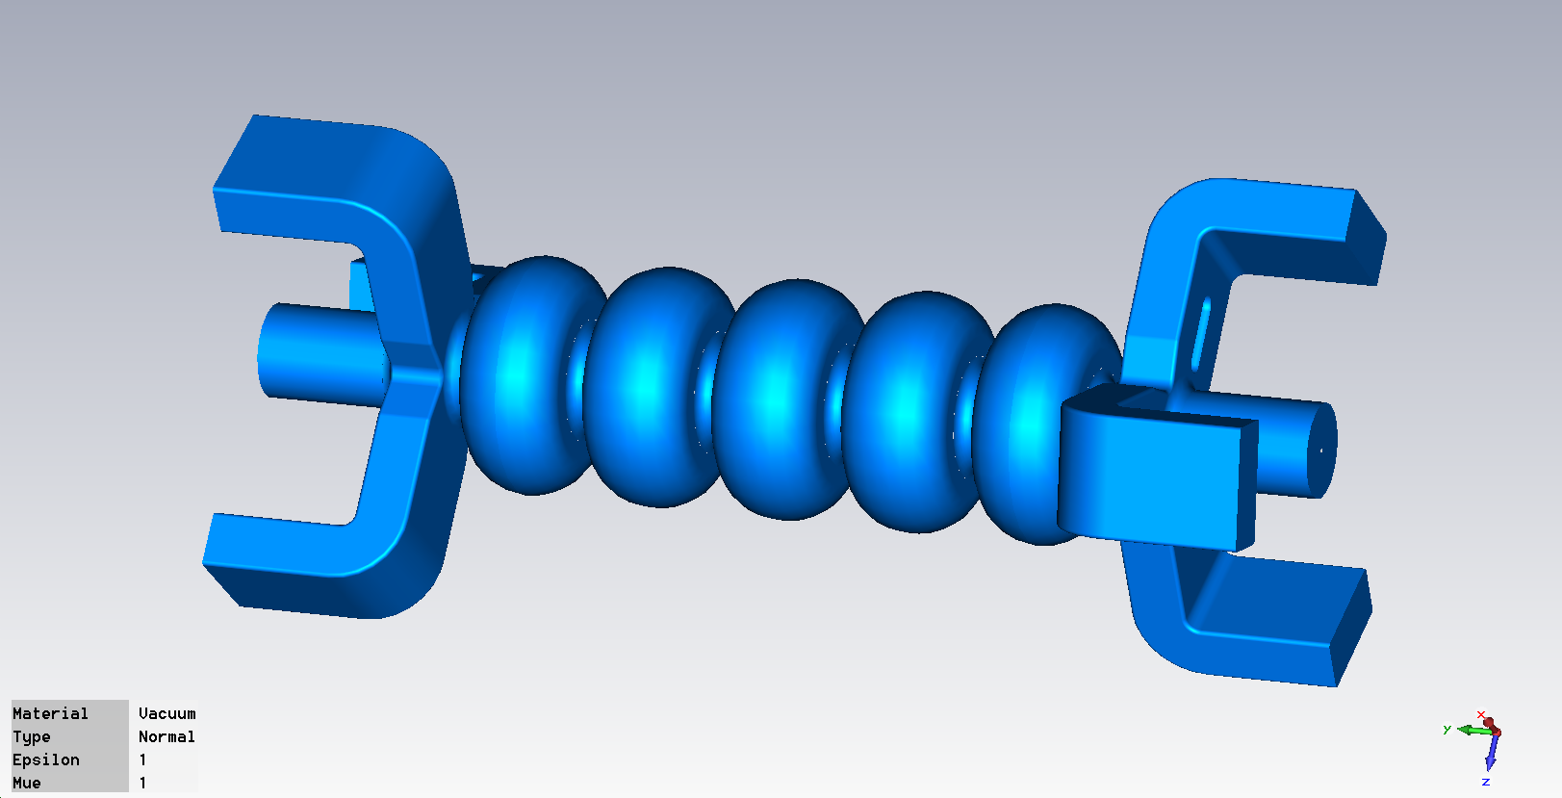
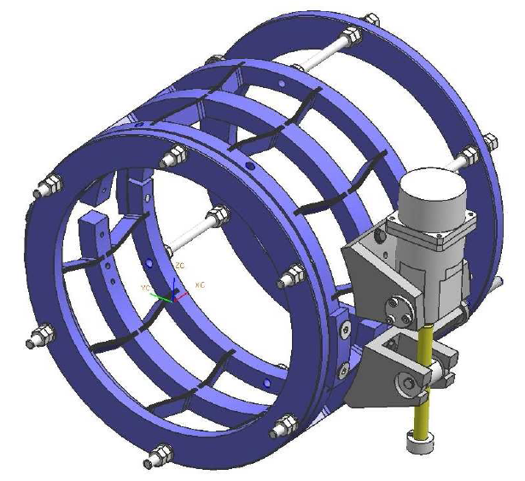
Technical concepts
Waveguide HOM-absorbers
attached to cryostat walls
Jlab cavity design with HOM-dampers
INFN coaxial blade tuner

Slide 7
Transfer function due to increased moving mass
Second resonance
Typical TESLA
resonance
Increased mass

Slide 8
Solution and Work
Resonance frequency of an oscillator
spring constant
moving mass
When mass is increased, need to increase spring constant to
obtain higher resonance frequency
Increase cavity stiffness
Work:
ANSYS-simulation of stiffness requirements
Adapt blade tuner design by INFN Milano
Manufacture tuner
Tuner testing at HOM damped cavity in HoBiCaT

Slide 9
(3) Joint design study on emittance compensation schemes for SRF guns
Emittance performance in RF photoinjectors is achieved by emittance compensation process, delicate interplay between RF acceleration and focusing in cavity and successive focusing with solenoidal magnet
During EUCARD, HZDR and HZB implemented slice emittance measurement by zero-phasing at the ELBE linac (EUCARD WP10.7). This proposal continues this successful activity as slice diagnostics is required to verify the emittance compensation process.
The aim here is a joint design study for emittance compensation focused on superconducting solenoidal magnets, including quad and skew-quad fields (→ see LCLS gun) as the base line and on a RF based (additional TE mode) magnetic field in the cavity as a second alternative method.
Partners: HZB, HZDR, anybody interested in beam dynamics
Work: Physics and engineering design, purchase and test of prototype
Timeline: Physics design M6, engineering M9, prototype test report M18, implementation in gun M24, report on RF based methods M36
Cost: 1.5 FTE years 112 k, 1 prototype 50k, cryo-compatible field measurement setup 20k → Total 195k

Slide 10
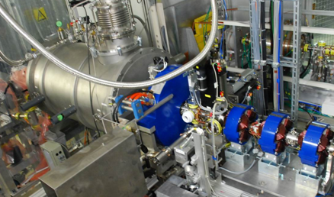
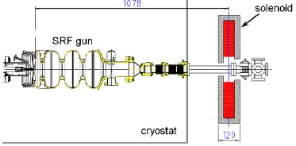

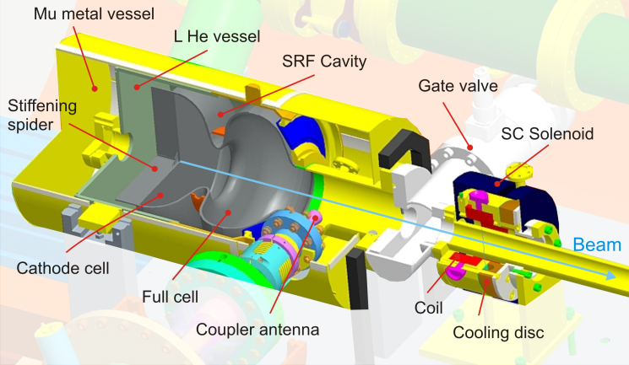
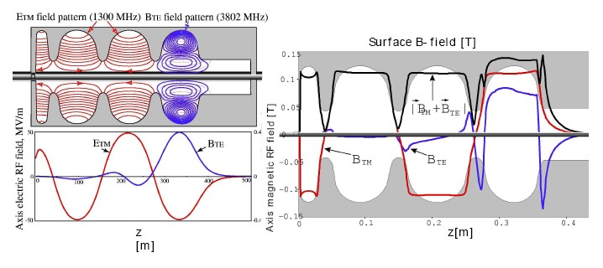
(3) Joint design study on emittance compensation schemes for SRF guns
Present situation at SRF gun of HZDR: large normal-conducting magnet outside cryovessel
Emittance compensation, balanced interplay between RF cavity and solenoid
Option: Place SC solenoid of HZB design close to SRF cavity
Option: Include cavity with HOM focusing
Courtesy D. Janssen/V. Volkov
Notes:
Setzt Dresden Kollaboration fort:
Slice Emittanz Messung war EUCARD1
Nun Optimierte Emmitanzkompensation EUCARD2
Verbessertes Fokussiersystem, realisiert durch
(a) Optimierung des supraleitenden Solenoiden: Optional Quadrupol und Skewed quadrupole (turned axially by 45°) -> Kompensation von Feldfehlern des Solenoiden
(b) Quadrupol TE Mode in der letzten Cavity Zelle (longitudinale B Komponente)
(b2) Quadrupol TE Mode in seperater Cavity
Anfang schon im EUCARD1 aber langfristig
Hardwareerweiterung notwendig (noch nicht definiert)

Slide 11
(4) EU networking activities and studies on advanced photocathodes for SRF guns
Photocathode crucial to performance of any photoinjector, together with drive laser and cavity responsible for current, emittance, initial pulse length. Requirements differ from short-pulse, low emittance for FELs to high average current for ERLs.
This continues the Pb cathode activity in WP 10.4 by IPJ Swierk, DESY and HZB
Aim of the proposal is to evaluate current and promising cathode solutions for SRF guns in laboratotory and operational environment
Partners: HZB, HZDR, IPJ Swierk, DESY, Daresbury, U Mainz, anybody interested in high performance photocathodes
Work: Test SC Pb cathode at synchrotron radiation lab and in SRF gun setup, design and engineering cathode insert with diamond amplifier cathode (DAC, → see BNL), test DAC in lab and in DC/SRF gun setup
Timeline: Pb cathode test report M9, DAC cathode insert engineering design M12, DAC insert lab test report M18, DAC test in SRF gun M36
Cost: 2 FTE years 150k, two DAC prototypes 20k, DAC implementation in gun 30k → 200k

Slide 12
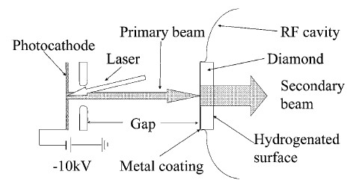
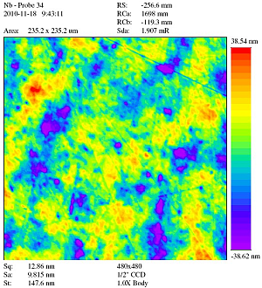
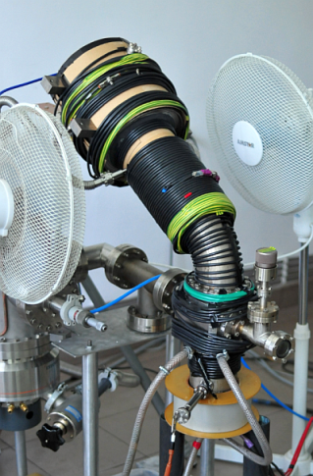
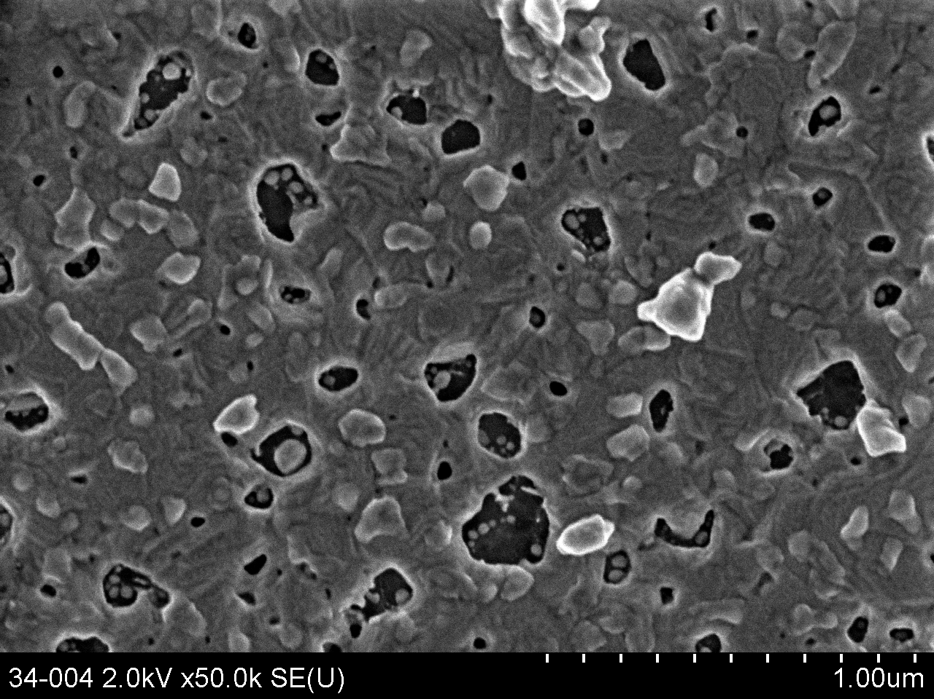
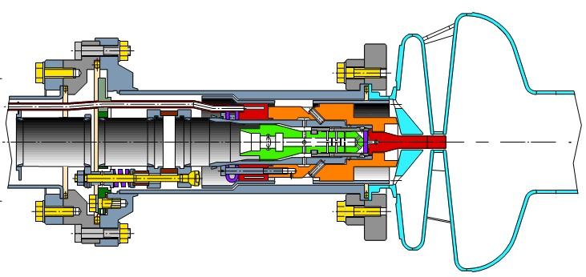
(4) EU networking activities and studies on advanced photocathodes for SRF guns
Solution for FELs and short pulse sources →
Nb/Pb hybrid SRF gun, joint development of DESY, IPJ, HZB, DESY, BNL, JLAB
Option for high average current ERLs → implementation of DAC in SRF gun
polish and surface analysis at HZB
build Nb plugs at HZDR
X. Chang et al, PRL 105, 164801 (2010)
SEM/EDX at HZB/FHI
coat Pb at IPJ
beam experiment at
HZB and HZDR
Courtesy V. Volkov
Notes:
Photokathodenentwicklung
Bezug EUCARD -> 10.4
Was ist die richtige Kathodenlösung für SRF-GUns? Für FELs …. Und für ERLs, die hohe Strahlqualität erzeugen sollen.
(a) Bleikathode = FEL-Lösungskanditat, geringer mittlerer Strom, kurze Pulse möglich
GUT: wenige Komponenten, Pb ist Supraleiter, kein Insert, kein Notch => deswegen für hohe Peakfelder geeignet
(b) Für ERL: brauche hohen mittleren Strom UND hohe Strahlqualität
BNL schlägt diamond amplifier cathode vor
Wir wollen diese Kathode übernehmen und schauen, ob wir sie im Hinblick auf die Strahlqualität benutzen können (BNL hat kleinere Anforderungen in dieser Richtung)

Slide 13
Cost matrix
Task | Man power | Equipment | Total
Thin films | 2 FTEy 150 k€ | 70 k€ | 220 k€
Tuner development | 1 FTEy 75 k€ | 60 k€ | 135 k€
Emittance compensation | 1.5 FTEy 112k€ | 70 k€ | 182 k€
Photocathodes | 2 FTEy 150 k€ | 50 k€ | 200 k€
 |  |  | 737 k€

Slide 14
Abstracts

Slide 15
(1) Characterisation of superconducting thin films optimized for high Q₀ applications
In cavities for superconducting CW Linacs, minimizing residual losses (or obtaining a high quality factor Q₀) is the primary objective rather than achieving high accelerating gradients as in pulsed machines. The cryo-plant is the cost driver in a CW machine and doubling Q₀ implies halving the required cryo-power and thus the costs. In niobium, the typical value for 1.3 GHz cavities at 1.8 K is Q₀=3 x 10¹⁰.
From this perspective it is highly desirable to put more effort into the search for alternatives to bulk niobium as cavity material. The focus here is on thin films, since thin films are less susceptible to flux pinning of residual ambient magnetic fields. Also, recent development in deposition technology – like in HIPIMS – have opened pathways towards cleaner films and thus lower surface resistances. A further interesting perspective for pushing the limits of CW-Linacs is the improvement of Q₀ by multilayer dielectric/superconductor coatings on a niobium substrate [1].
A test apparatus to measure thin film samples based on the CERN quadrupole resonator design is presently being developed at HZB. This device aims at sub-Nanoohm resolution. It will be integrated into the dedicated SRF-testing facility HoBiCaT and take advantage of the infrastructure, in particular the ability to supply superfluid Helium below 1.5 K.
The proposed work includes
[1] A. Gurevich, Appl. Phys. Lett. 88, 012511 (2006)

Slide 16
(2) Impact of high-current operation on cavity tuner design and microphonics compensation
HZB, INFN-Milano
Superconducting high current CW-Linacs require heavy HOM-damping which can be achieved by ferrite absorbers in dedicated beam pipe sections (Cornell) or with waveguide absorbers (JLab). The latter solution is favored for the ERL main LINAC cavities that are presently being developed for the BERLinPro project at HZB. However, it imposes an increased dynamic mechanic load on the tuner which is particularly critical for microphonics compensation. Furthermore, since both ends of a cavity-tank are equipped with waveguide dampers, a coaxial tuning solution, as realized by the INFN blade-tuner, is called for. Tests with a conventional blade-tuner that was loaded with a comparably heavy mass (a SQUID current monitor) at the moving end have resulted in a significant reduction of the lowest mechanical resonance of the system, right into the particularly critical frequency range of the cavity bandwidth.
For the usability of a coaxial tuner in such an environment, the cavity-tank-tuner system has to be stiffened. In a first step, mechanical simulations need to be performed (by HZB) in order to obtain a minimum stiffness value for the cavity. Then the original blade tuner design will be adapted (by INFN) and a prototype will be manufactured. The prototype will be mounted onto the prototype of the LINAC cavity and tested in HoBiCaT. Sufficient tuning range and feed-forward microphonics compensation need to be demonstrated there.

Slide 17
(3) Joint research study on emittance compensation schemes for SRF guns
(HZB, HZDR and open to parties interested in beam dynamics)
Emittance performance in RF photoinjectors can be achieved by the emittance compensation process. In this process, space charge and rf-induced increase of emittance is counteracted by solenoidal and RF magnetic focusing. This scheme has been successfully applied to numerous NCRF photoinjectors (see FLASH, LCLS, LANL RF guns) leading to extremely high peak beam brightness. In this type of photoinjector, the main solenoid is pulled over the accelerating RF cavity. Applying this scheme directly to a SRF gun would result in severe Q degradation of the cavity due to the increased presence of magnetic flux density on the superconductor.
The aim of this project is to investigate options to apply emittance compensation to SRF guns by using external solenoidal magnets with appropriate shielding, higher order magnets and RF based methods using additional TE-modes in the gun cavity or in a separate cavity. During the project we want to develop prototype magnets and RF devices and test these in operational SRF guns.
Successful emittance compensation can only be verified with slice diagnostics, which has been studied during EuCARD in WP10.7 by HZB and HZDR. In this sense, the proposed activity is a continuation of the work carried out in EuCARD.
The work includes physics and engineering design of solenoidal magnets, purchase and test of prototypes with test equipment and with operational SRF guns. In addition we want to perform RF and beam dynamics studies of RF based methods.

Slide 18
(4) EU networking activities and studies on advanced photocathodes for SRF guns
(HZB, HZDR, DESY, IPJ and parties interested in photocathodes)
The photocathode is crucial to the performance of any type of DC, NCRF or SRF photoinjector. Together with the drive laser and the cavity the initial beam parameters are made at the cathode. The requirements on these beam parameters differ greatly depending on the specific application the accelerator is driving. The scope spans from ultra-short, high peak current and low emittance bunches for FELs to low emittance and high average current beams for ERLs.
The aim of this project is to evaluate actual and promising cathode solutions for SRF guns. This includes the Pb/Nb hybrid cavity solution, which has been studied during EuCARD in WP10.4. We want to continue this activity by performing operational tests in SRF guns with the Pb cathode. In addition, synchrotron radiation based techniques will be used to study Pb cathode film before and after use in the SRF gun environment.
An interesting option for a cathode able to generate high average current beams is the diamond amplifier cathode (DAC) as proposed by BNL for the 500 mA ERL project. We want to study the application of the DAC to the SRF guns. The initial steps include physics and engineering design of a suitable cathode cell which contains the DAC. This cell will then be tested in laboratory and inside SRF gun setups to study the beam parameters from the DAC and compatiblity with high average power RF operation. The aim is to explore the short-pulse low emittance regime.

Slide 19
Questions
What are the aims of EuCARD2?
What is our strategy? How many projects/money do we want to apply for?
What is the timeline of EuCARD2?
(Starting date 2014, direct succession to EuCARD1 ending in 2013?)
How much money is available?
How many partners are involved?

