Slide 1


IDS-NF: RF R&D ideas:
K. Long, 21 April, 2011
Notes:
Note: remove EUROnu logo if not directly receiving support from EUROnu

Slide 2
Neutrino Factory:
IDS-NF: RF R&D ideas:

Slide 3
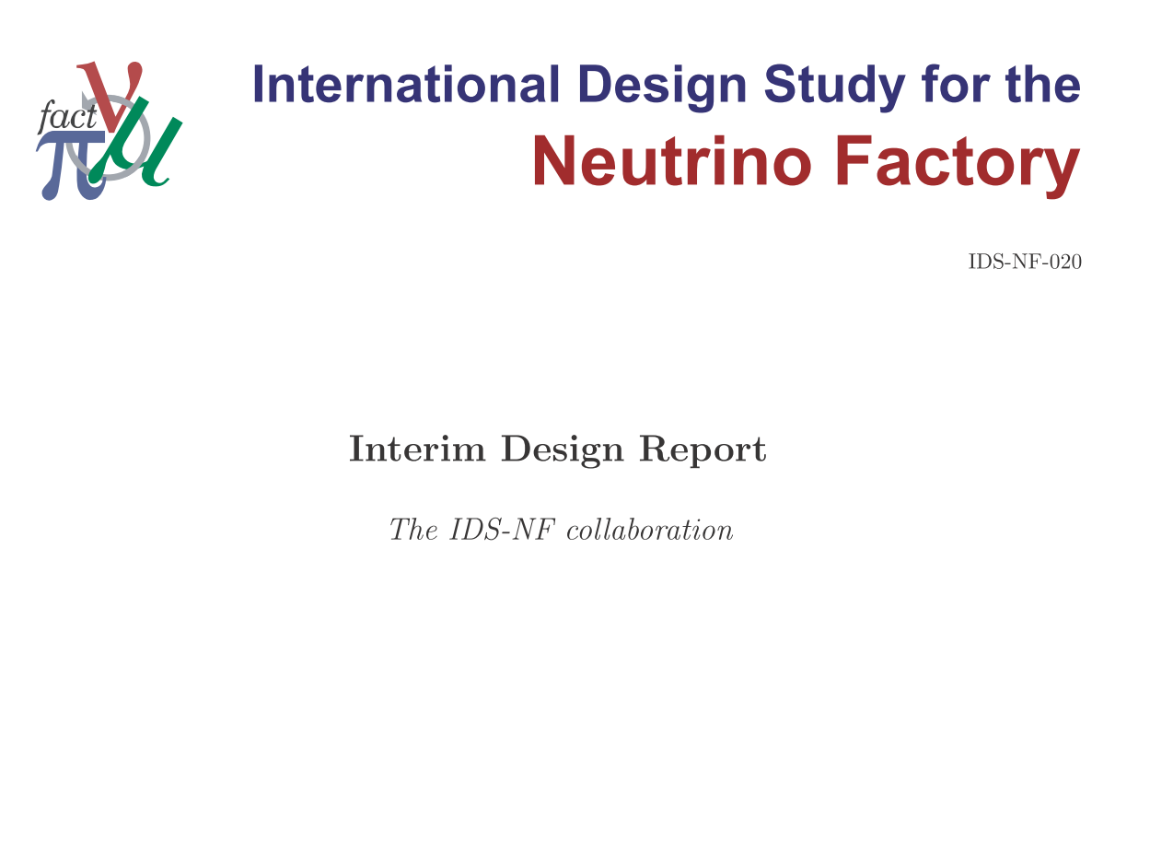
Available from IDS-NF site: https://www.ids-nf.org/

Slide 4
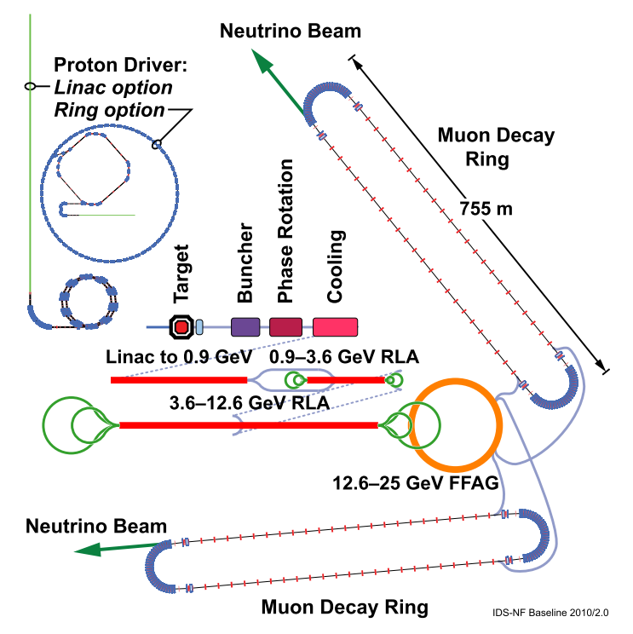

Slide 5
Muon front-end:
RF required for:
  Bunching
  Phase rotation
  Cooling

Slide 6
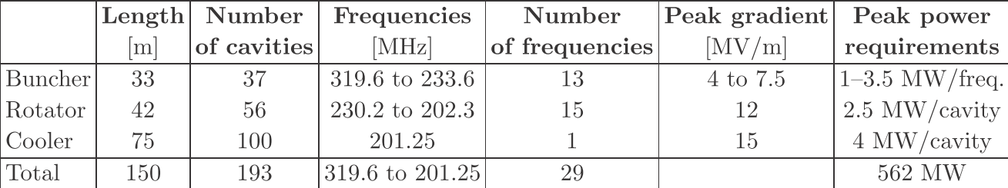
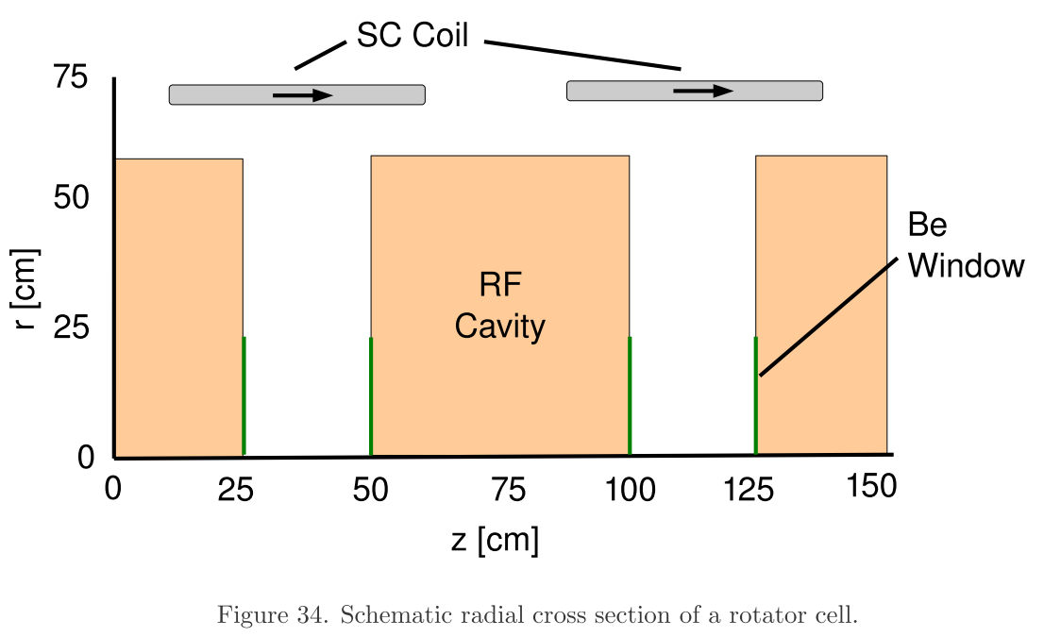
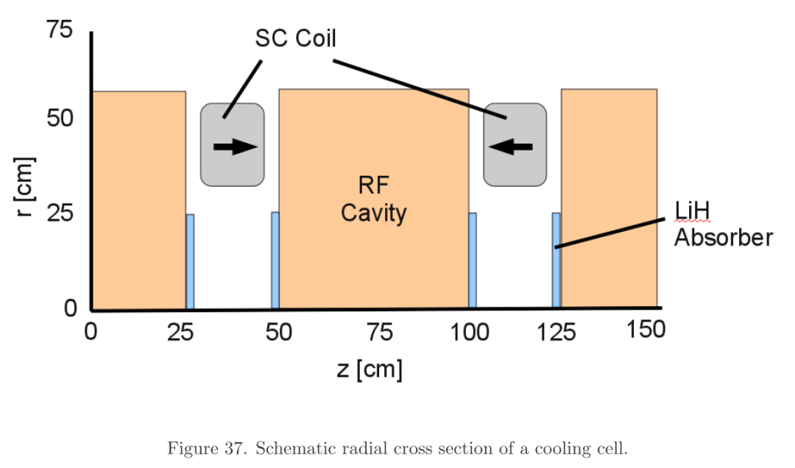
Muon front-end: RF requirements:
Large number of high-gradient, normally conducting cavities
  Normal: operation in magnetic field

Slide 7
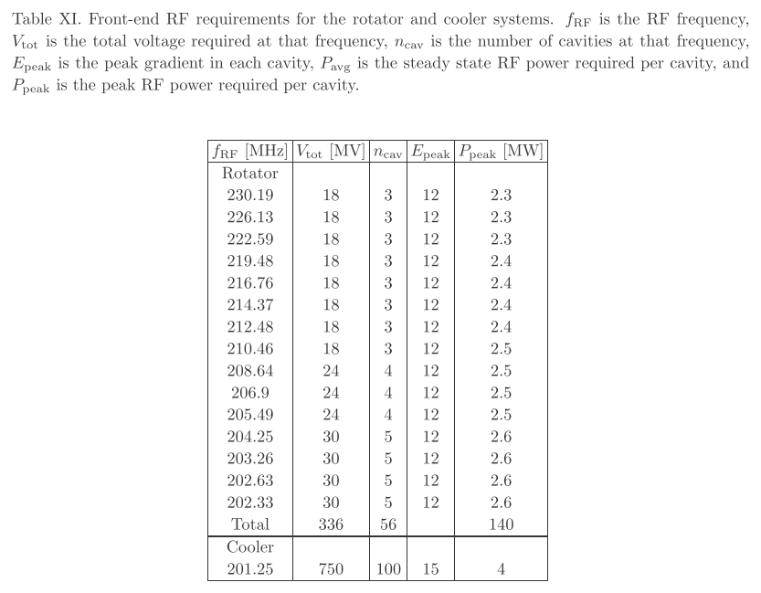
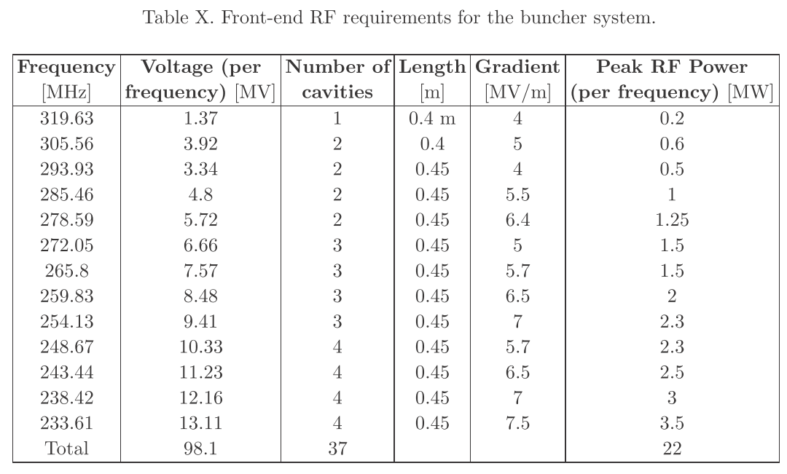
Muon front-end: summary:

Slide 8
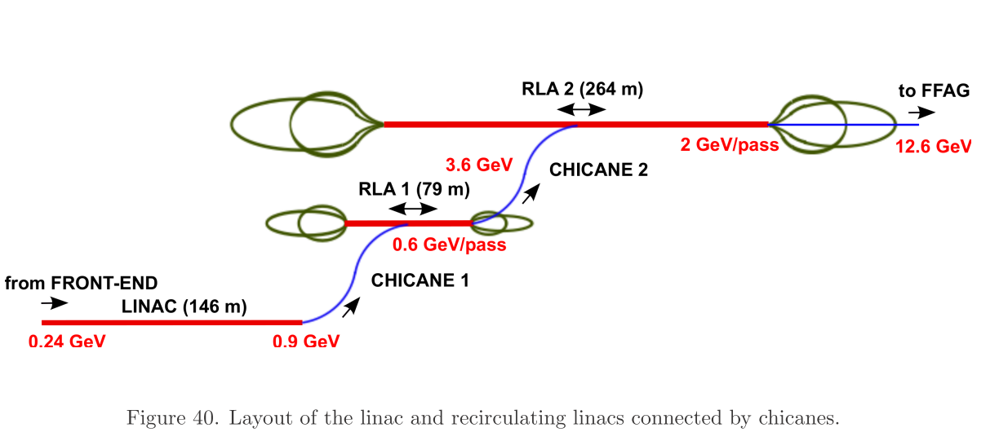
Muon linac and RLAs:
Linac and RLAs:
  Solenoid focusing
  Superconducting (Nb on Cu) 201.25 MHz cavities

Slide 9
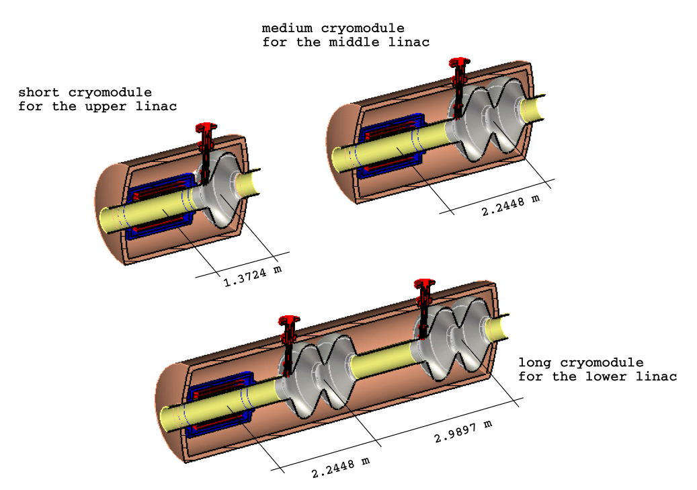
Muon linacs and RLAs:

Slide 10
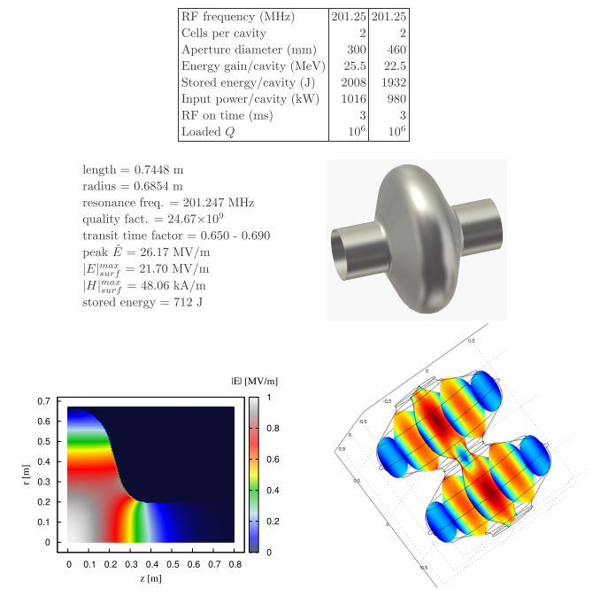
Muon linacs and RLAs:

Slide 11
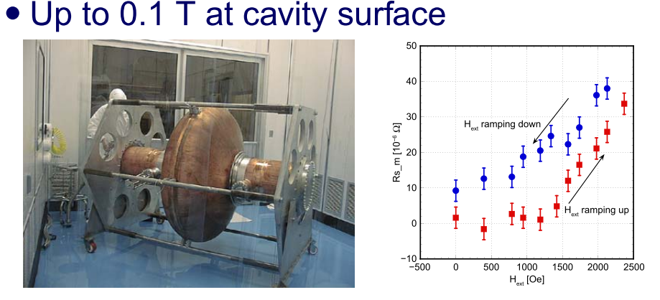
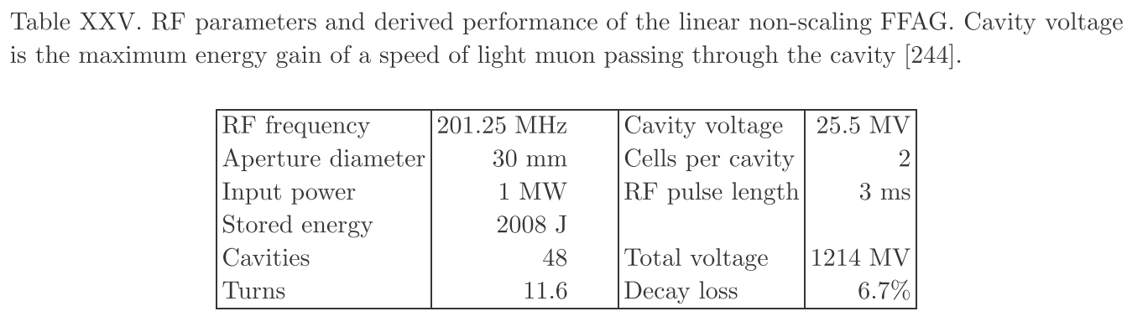
Muon FFAG:

Slide 12
Issues:
IDS-NF: RF R&D ideas:

Slide 13
MuCool: RF breakdown in magnetic field:
Principal issue for cooling channel:
  Gradient required in baseline cooling channel:
    15 MV/m from 201MHz cavities
MuCool: study breakdown in presence of magnetic field
  805 MHz:
    Reduction of factor
    of ~2 in max. gradient
  201 MHz:
    In absence of B have
    achieved 20 MV/m
      Test in magnetic
      field planned

Slide 14
Mitigation of RF gradient risk:
Various options being considered:
  Modified lattices, magnetic return, bucking coils, gas filled cavities…
  Studies emphasise:
    Priority: expedite MICE and MuCool programmes!

Slide 15
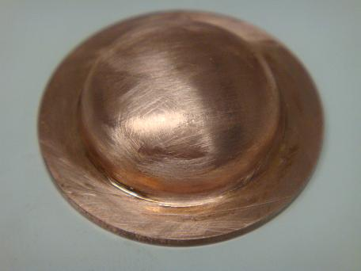
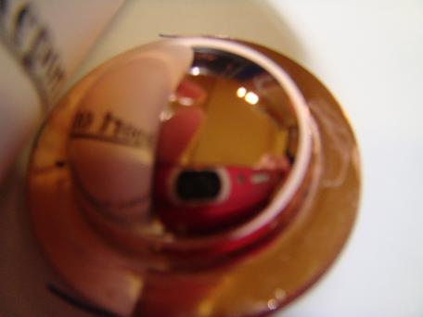
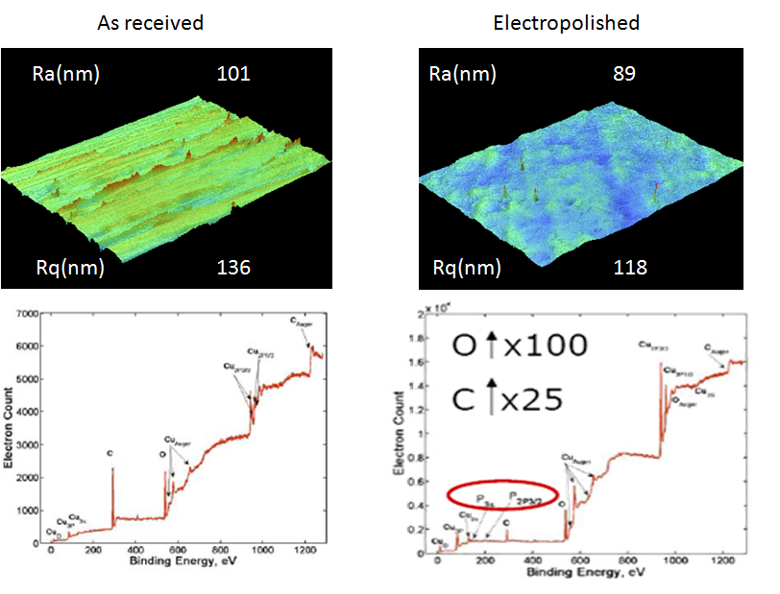

Slide 16
Superconducting: anomalous Q slope:
Samples made by CERN tested at Lancaster

Slide 17
Issues:
Development of techniques for manufacture of high-gradient RF cavities at ~200 MHz:
  Normal and superconducting ...
What determines maximum gradient
within and in the absence of magnetic field?
  Surface texture
  Surface quality (grain structure, impurities, etc.)
  Processes in manufacture
What are the manufacturing procedures required to deliver specified resonator with 90% confidence?

Slide 18
Constituency:
IDS-NF: RF R&D ideas:

Slide 19
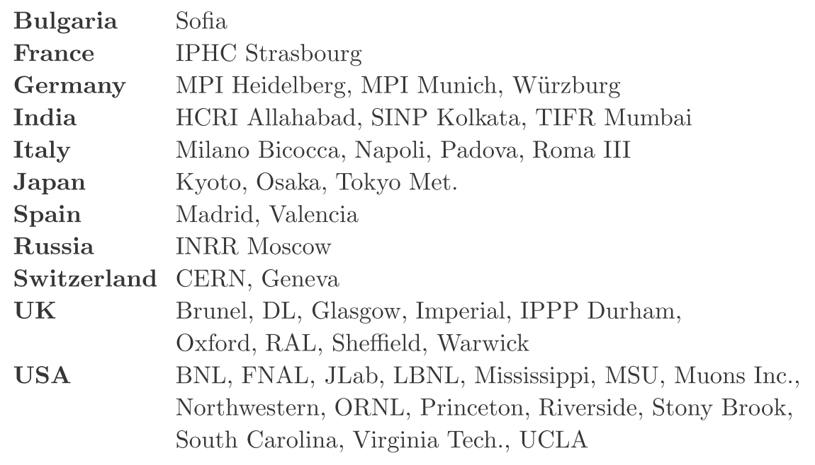
IDS-NF and EUROnu:
Note also of benefit to systems that require large longitudinal acceptance.

Slide 20
MICE:

Slide 21
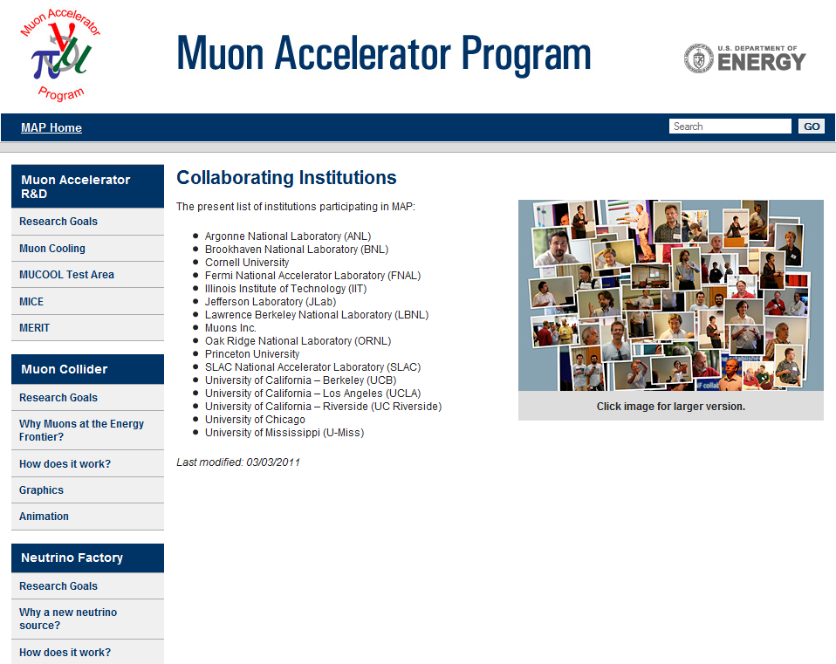
Programme complementary to and in
collaboration with MuCool.
Leverage expertise, resources,
parallel working.

Slide 22
Possible programme:
IDS-NF: RF R&D ideas:

Slide 23
Outline programme:
Basic physics/bench-top programme to:
  Identify critical parameters that determine break down potential:
    Normal and superconducting
    In presence of magnetic field and in its absence
  Understand how steps in manufacturing processes affect critical parameters:
    Forming
    Surface preparation
Demonstration of techniques developed:
  Linac (or FFAG) cryomodule
  Cooling lattice cell or stand alone test rig
  Longer timescale—proof of success:
    Full demonstrator test rig:
      Cavity or cavities from the procedures developed above; power sources (diacrode) developed from within TIARA
        Could be at the ICTF or at CERN; or warm cavity at ICTF and cryo-module at CERN

