Slide 1
1
Follow-up items from mid-term review
Frank Zimmermann
FCC-ee Optics Design Meeting, 31 August 2023

Slide 2
D5.1-D5.6, D6.2-D6.3 handed over to John Poole & Panos Charitos for polishing.
They will be presented this afternoon to SAC experts.
Feedback and discussions between SAC and FCC technical contacts in the following two weeks. Follow up meeting after 2 weeks.
All documents will be frozen end of September
16-18 October SAC & CRP will meet at CERN

Slide 3
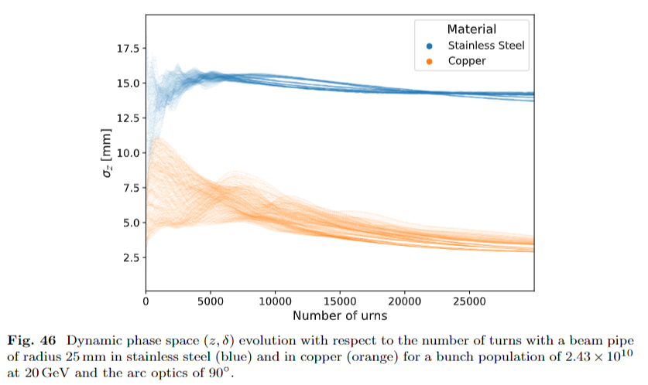
Booster optics – baseline optics, performance ?
# sextupole magnets, # sextupole families circumference ? (=collider ?)
vacuum chamber stainless without copper lamination ! acceptable for collective effects? vacuum ? beam pipe radius ?
A. Ghribi

Slide 4
beam-based alignment or movers trim coils or movers ? which trim coils are part of the baseline ? which trim power supply stability (10⁻⁴ !) performance
BBA for BPM resolution of 0.05 micron ~worse than 1 micron; method important polarisation tuning 200 μm BPM alignment errors in the past, not 0.1 μm ?!

Slide 5
do we need two BPMs per quadrupole?
BPM
BPM
BPM
orbit response to quad change Δk → beam offset at each quadrupole
system is linear
together with nearby BPM readings, and if necessary iteratively,
we should be able to infer the trajectory slope (and the change of slope) at each quadrupole

Slide 6
optics measurements with pilot bunches 1 !?! with colliding bunches ??

Slide 7
collimator materials and collimator design alternatives to MoGr? radiation level in the tunnel

Slide 8
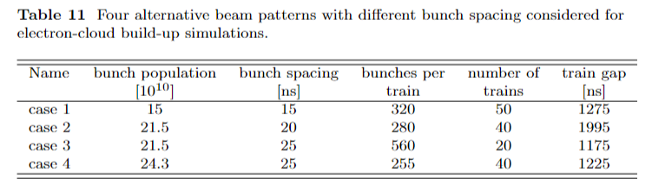
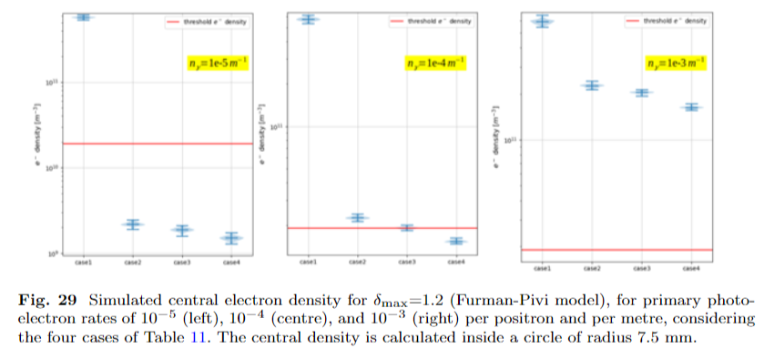
electron cloud how do we suppress the photoelectrons 100x more efficiently than KEKB or SuperKEKB?
T. Raubenheimer
F. Yaman
antechamber
>99.9% efficient
antechamber
>99% efficient
antechamber
>90% efficient
measured KEKB/SuperKEKB efficiency ~75-80%

