Slide 1
BNL/CERN discussion
Accelerator aspects (energy and intensity control)
19 July 2023
E. P. Johnson, M. Fraser, R. Garcia, K. Bilko, A. Waets, N. Emriskova, M. Delrieux, D. Cotte, I. Ruiz

Slide 2
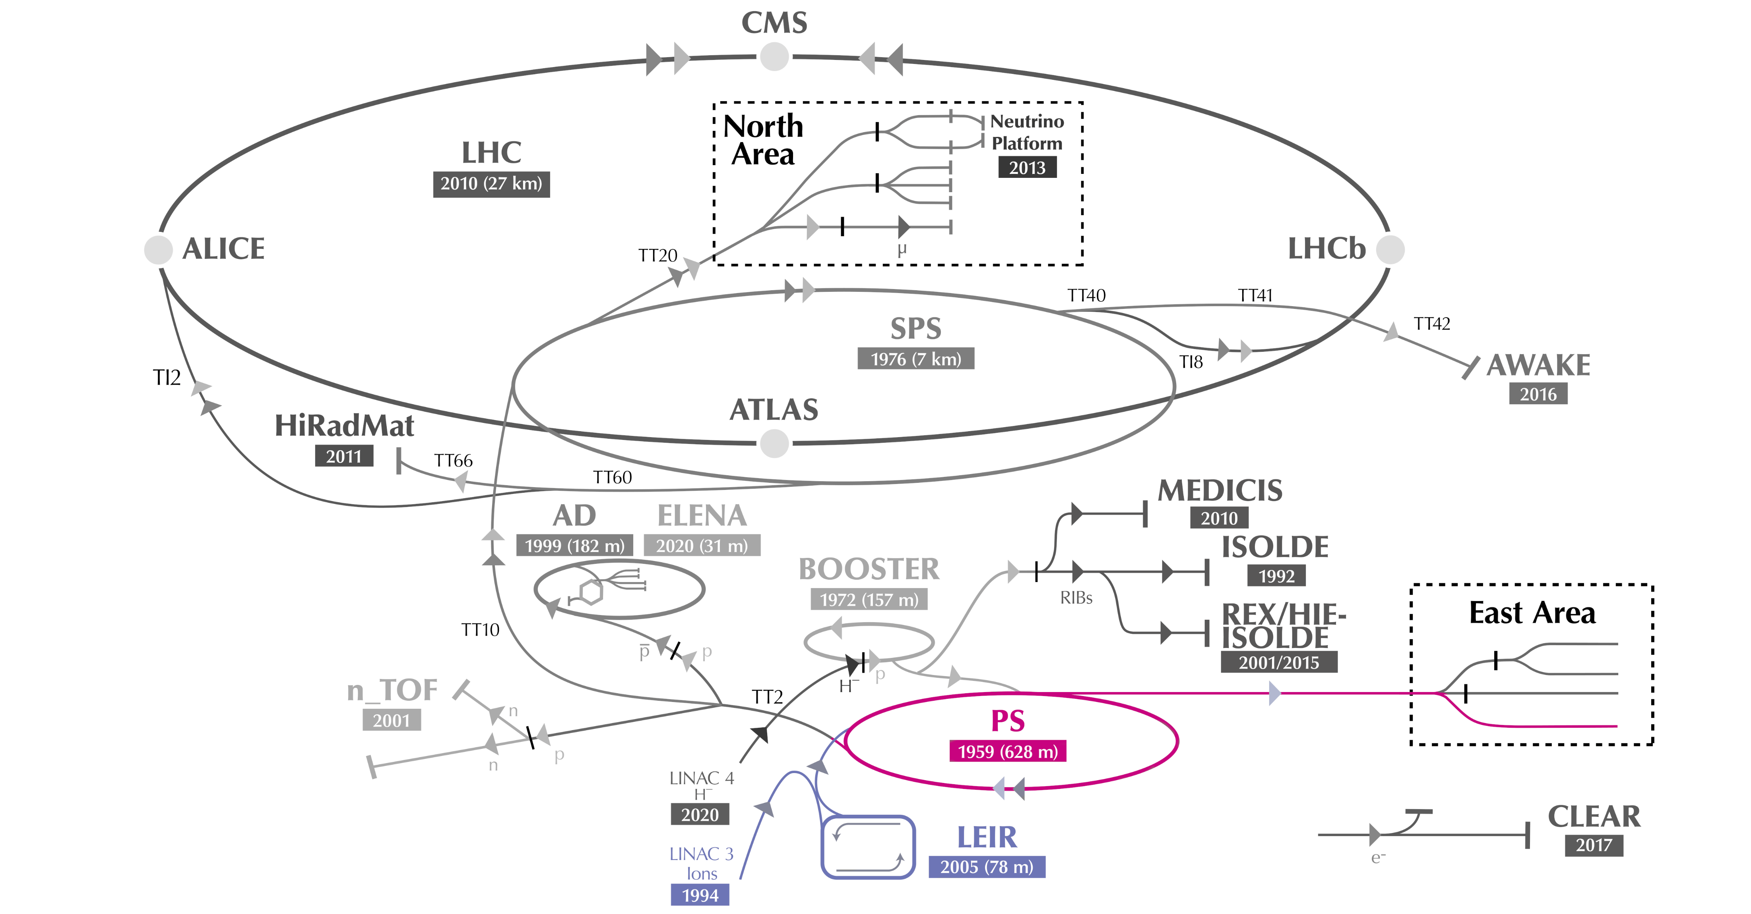
How the PS delivered Pb beam for CHIMERA ?
Energy
Intensity
Spill time profile

Slide 3
Energy
Energy control, stripping and energies used in 2022

Slide 4
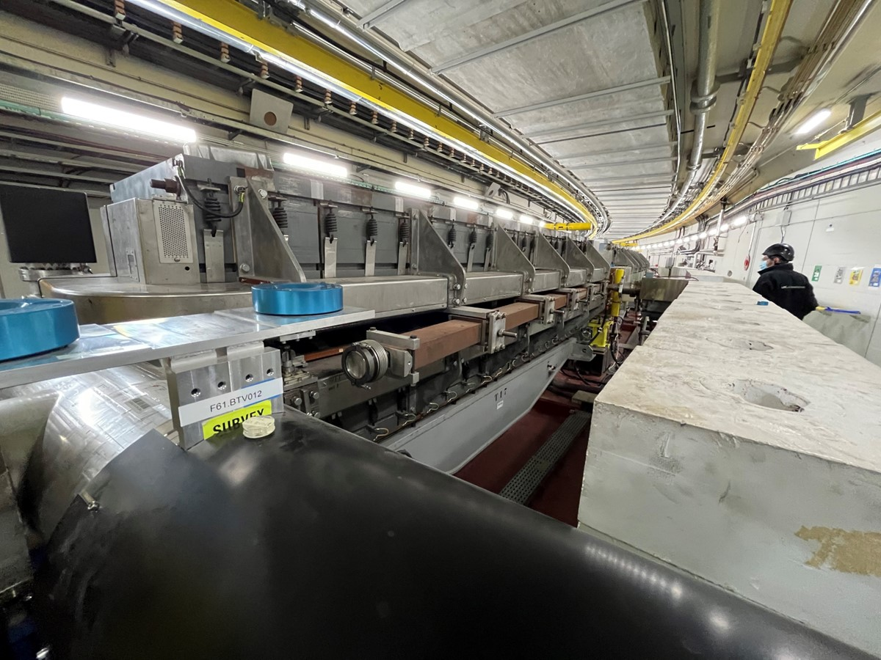

Slide 5

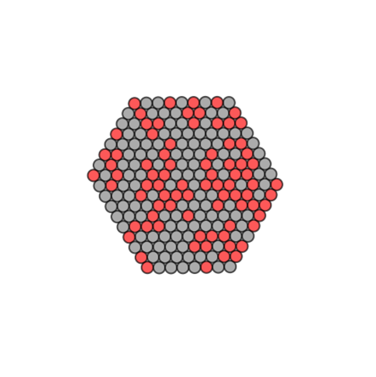
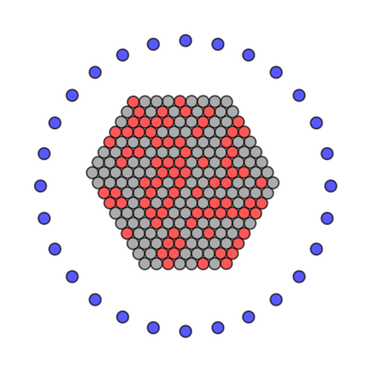
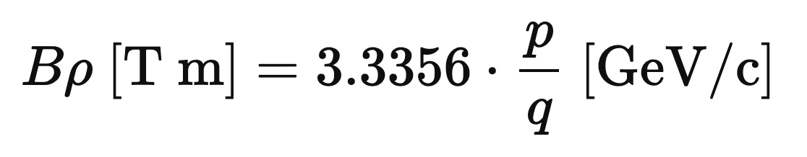
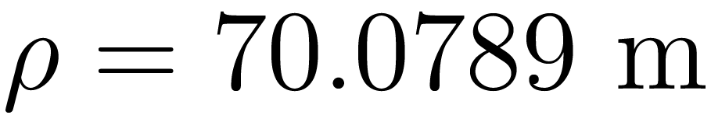
Ion beam
q = 54
q = 82
Accelerate partially stripped Pb54+ (28e-) in PS
  Isotope A=208=82p+126n
Fully stripped lead ion Pb82+ beam
  In transfer line: lower rigidity → requires less B-field
Charge

Slide 6
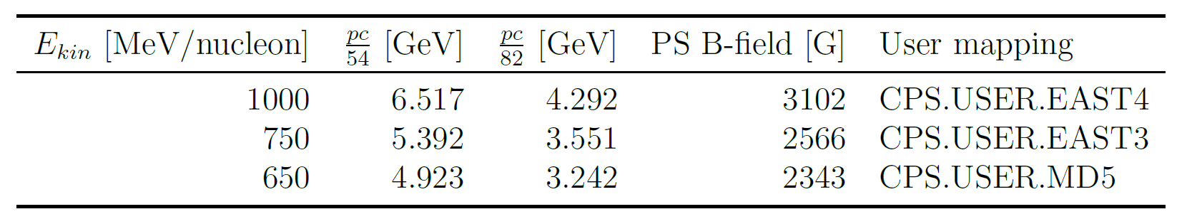

Energies
For 2022 run three energies selected
Large spacing in LET
  Trade-off between lower energies and intensities (transmission/instrumentation vis.)
  Partially stopped by degraders
Kinetic energies at target are lower
  interaction with vacuum windows, instruments and air molecules

Slide 7
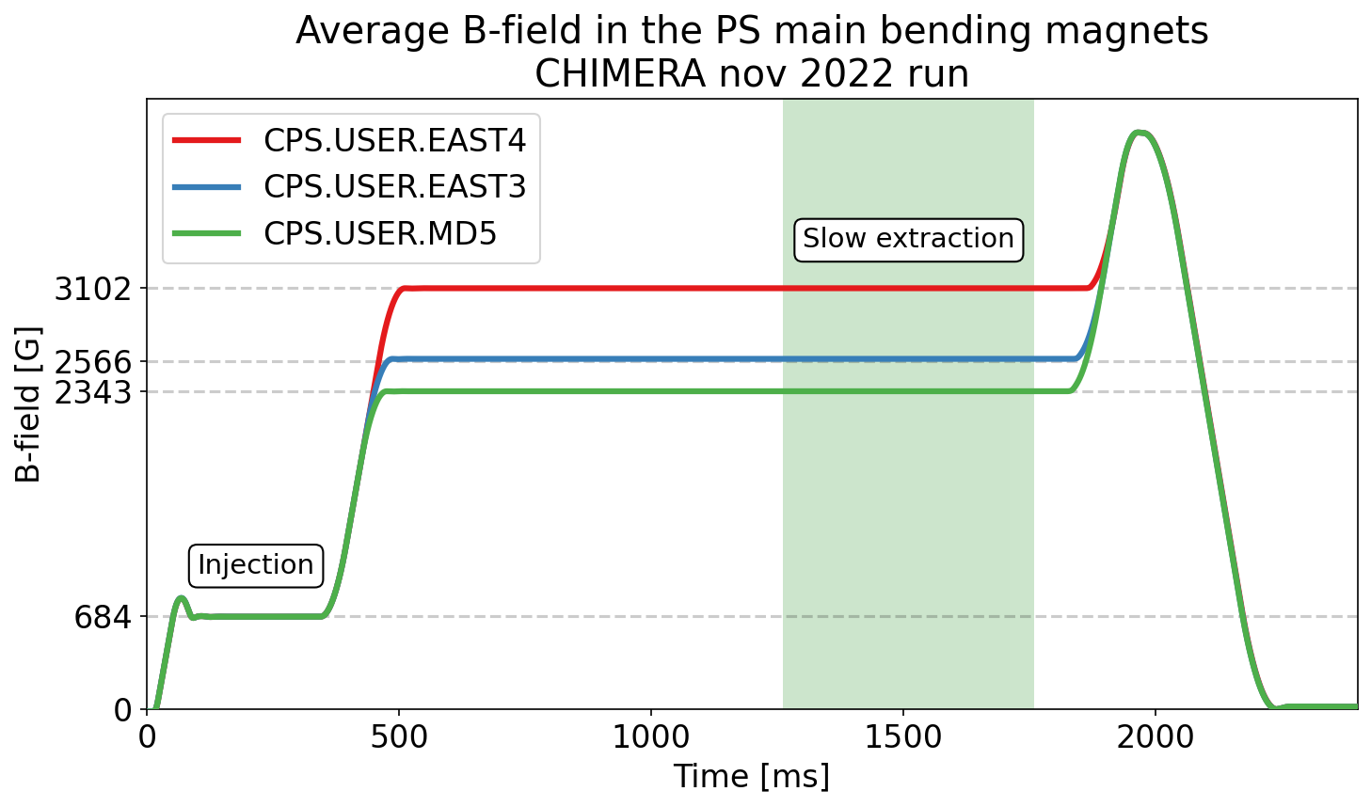


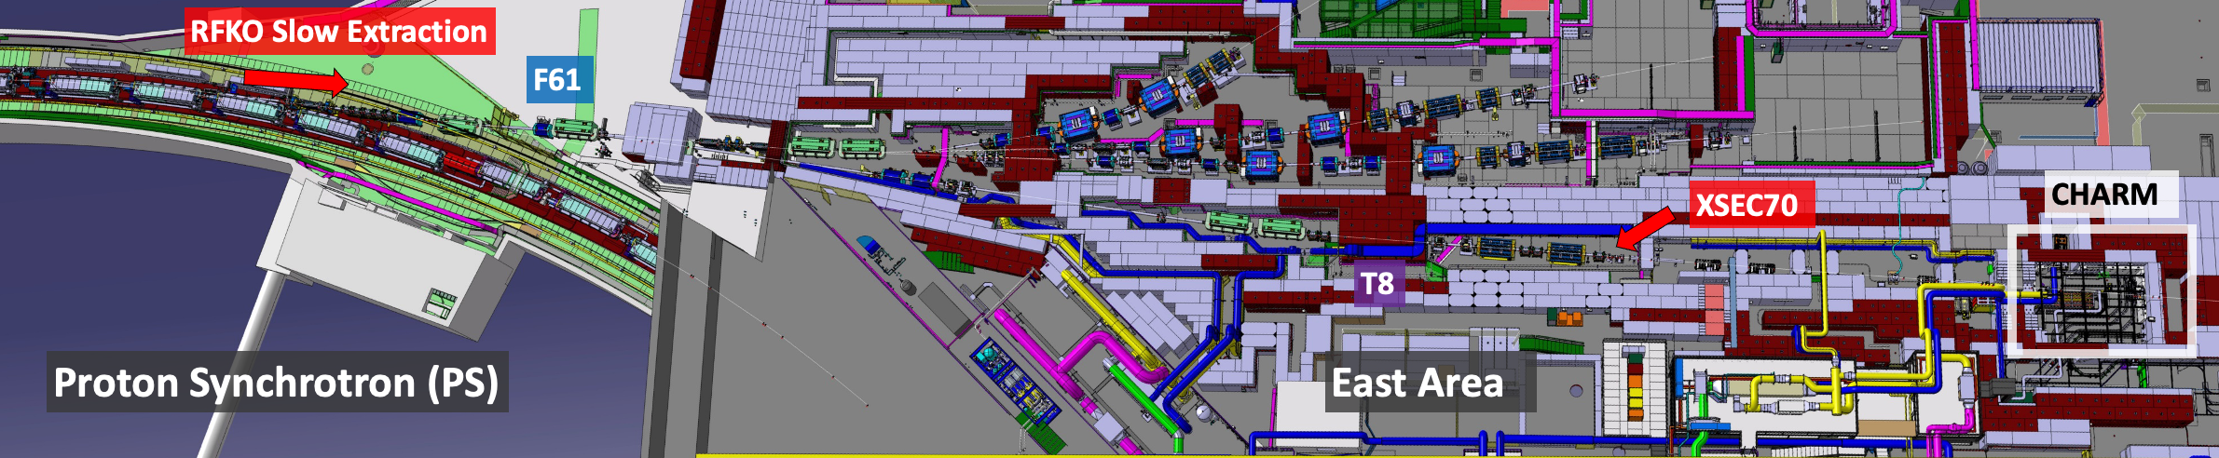


Energy control
Energy controlled via PS B-field
  Single knob
  Rigidity propagated to transfer line (dipole, quadrupole)
B-field
$$p$$
$$p_{stripped}$$
Notes:
Mention: hand-scaling, non-linear transfer function, non-PPM
LEQ = Low Energy Quadrupoles
QSE = Quadrupole for Slow Extraction

Slide 8
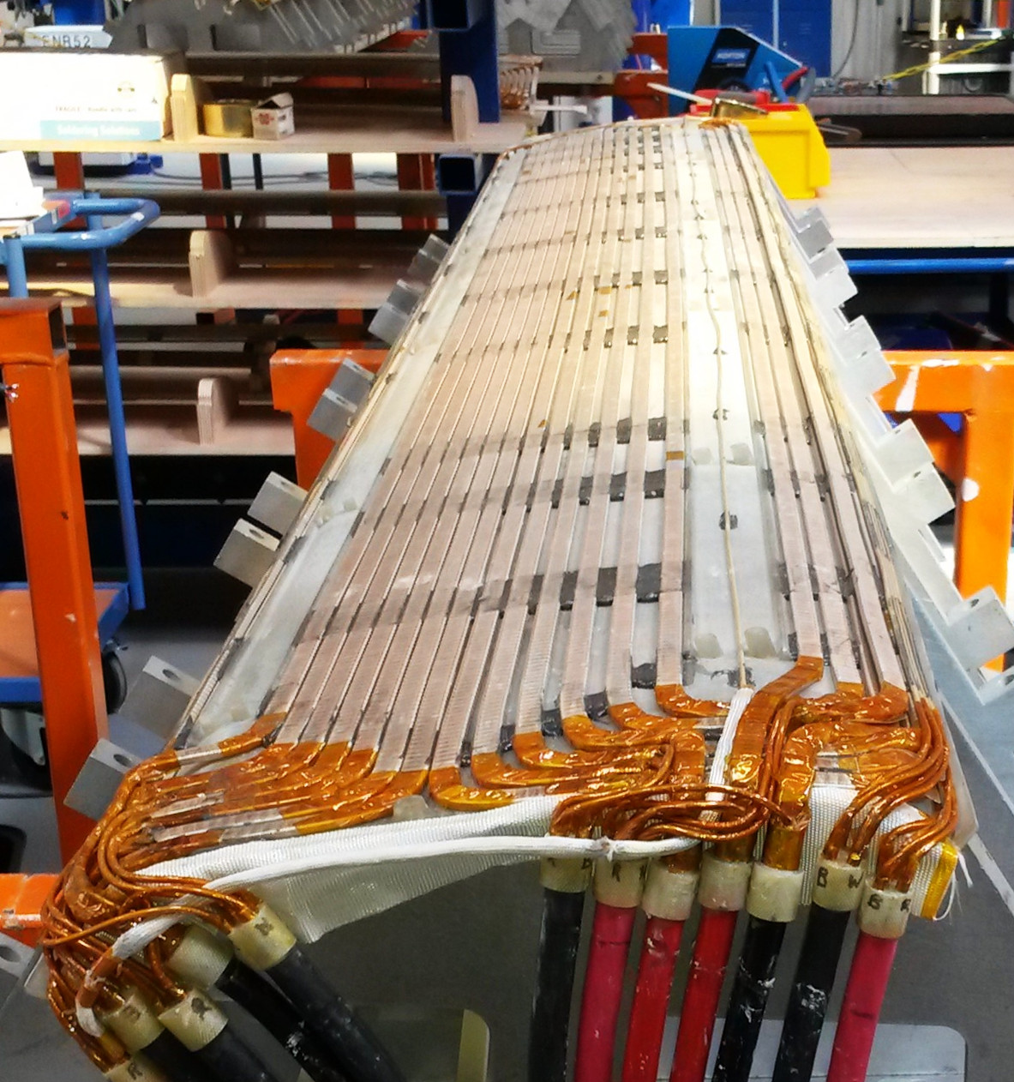

PFW
Ion cycle improvement
  Switching off PFW for low energy beams (<2GeV/n)
    Strong non-linear component
    Allowed scaling of the PS
    Tune reached and controlled with LEQ + QSE
Closed block
Open block
Notes:
Mention: hand-scaling, non-linear transfer function, non-PPM
LEQ = Low Energy Quadrupoles
QSE = Quadrupole for Slow Extraction

Slide 9
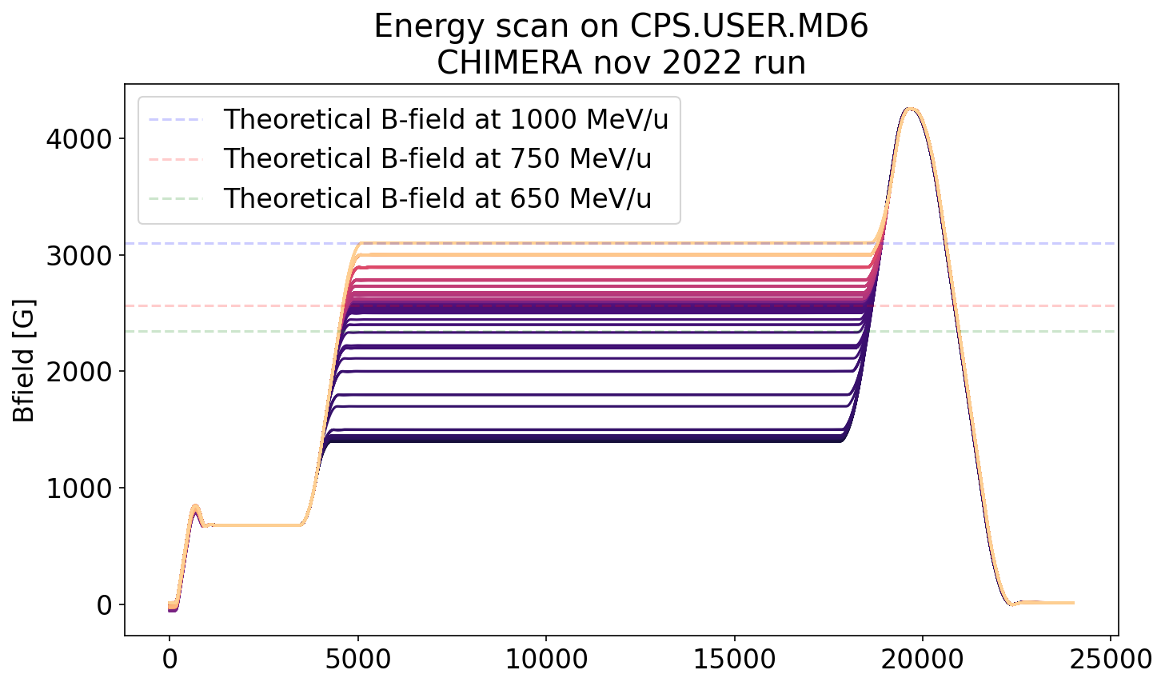
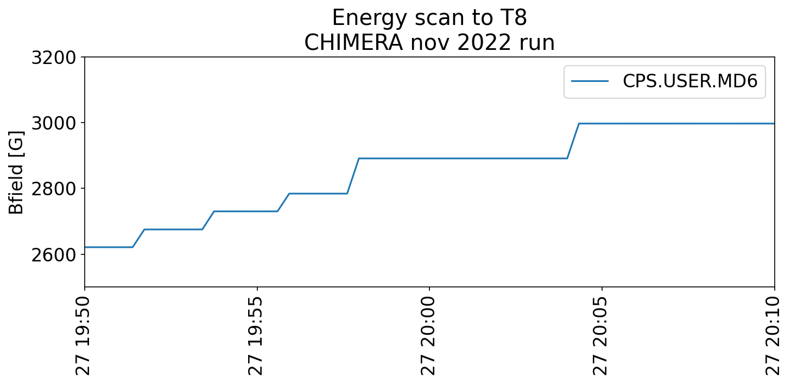

Active change of the primary beam energy
Dedicated energy scan on the CHARM diode with 775, 800, 825, 850, 900 MeV/u
  < 30 sec to change energy
Will be focus of 2023 (instead of 3 discrete energies)
  Removes need for several users
Lowest energy ?
  Matter interaction ?
  Vacuum pipe installation in T8 ?
  Degrader system before target ?

Slide 10
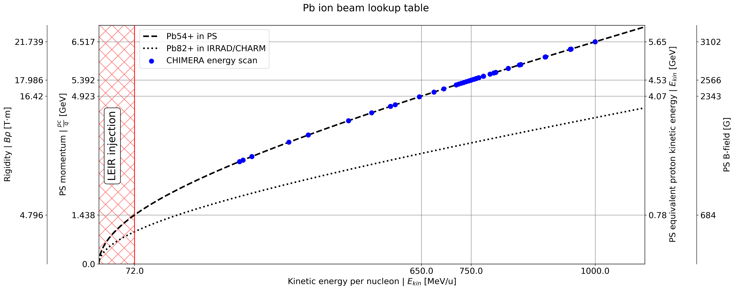
Energy scan to East Dump

Slide 11
Intensity
Energy
Intensity
Spill profile
RFKO, intensity measurement and gain setting

Slide 12
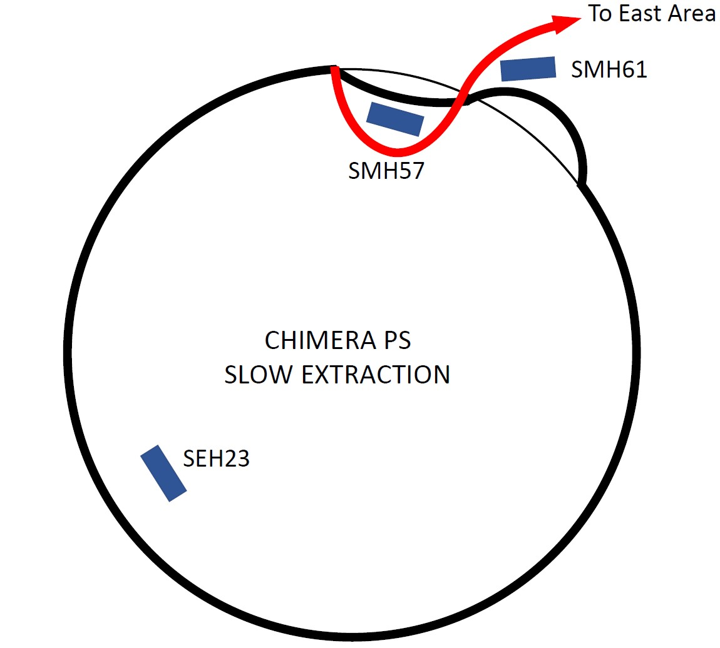
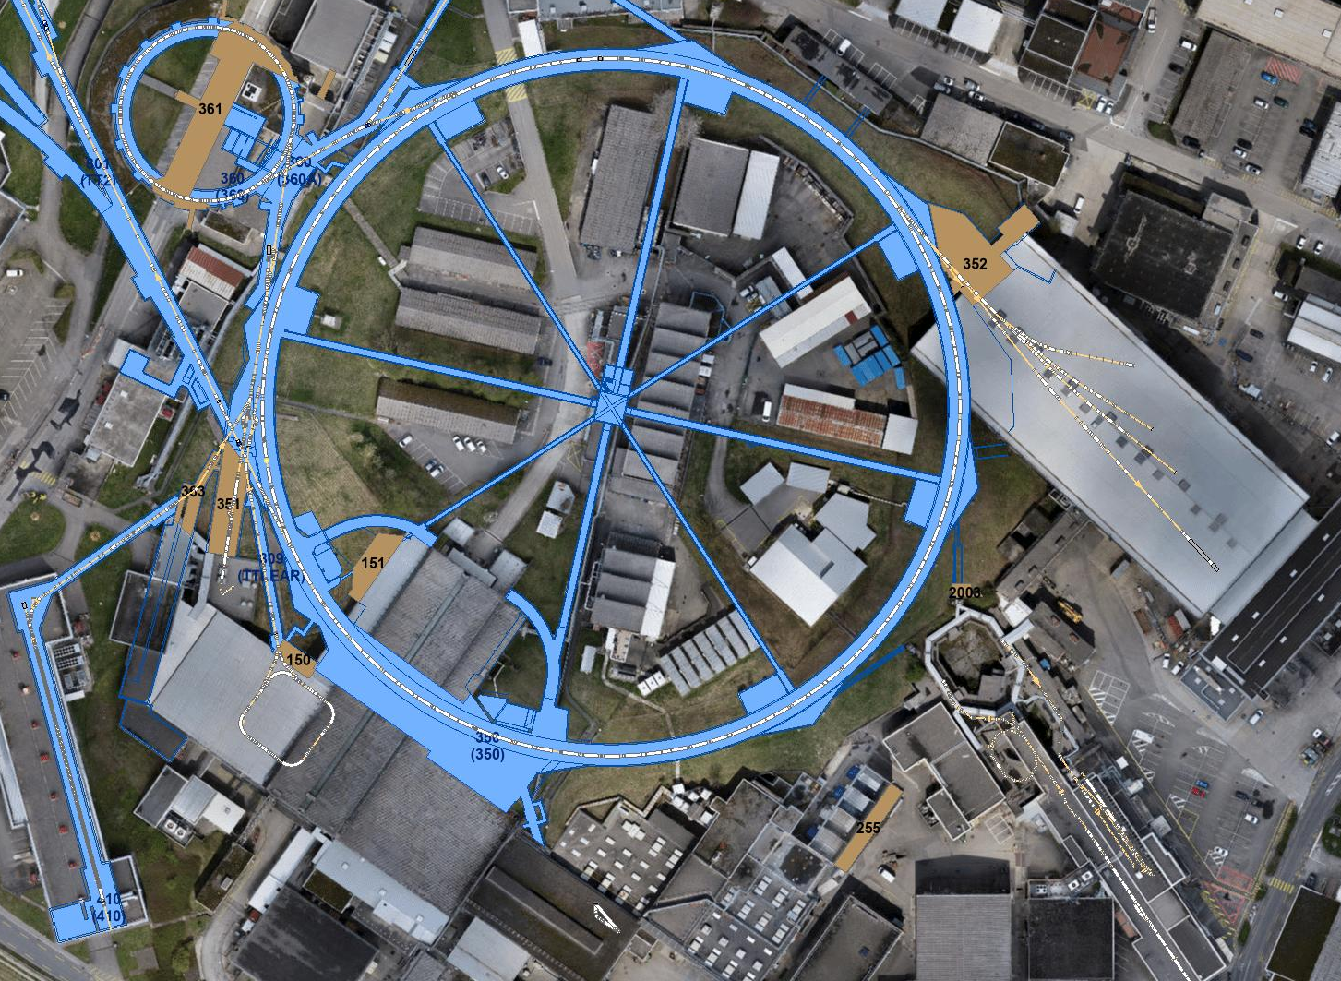
Slow extraction (SX)
Uses magnetic septum SMH57 and SMH61
Amplitude growth done with third order integer resonance and SX

Slide 13
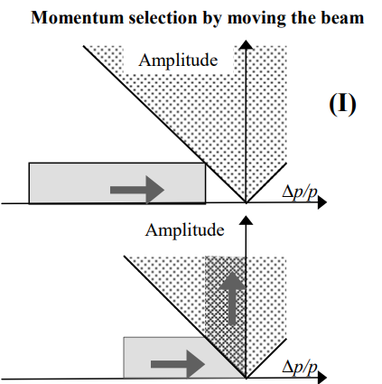
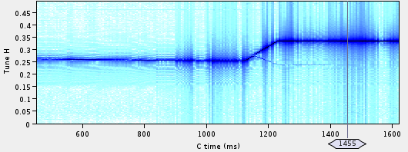
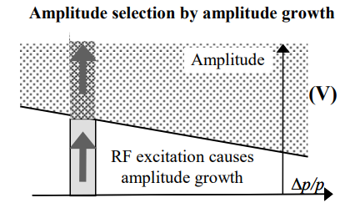
Iteration on SX
Change tune Q with PFW, QSE, LEQ
  OK for high energy beams (5.3 GeV/u)
  ≤ 2 GeV/u no PFW
  Bunch rotation (large dp/p)
  Flat QSE under resonance
  Ramp tune with LEQ
RF Knock Out
  Constant extracted beam optics
  RF Excitation with transverse damper
  No bunch rotation (small dp/p)
  More stable at different energy (no PFW and chirp on damper excitation freq)
  Easier control of the beam intensity (single knob)
Bare machine tune
Extraction

Slide 14
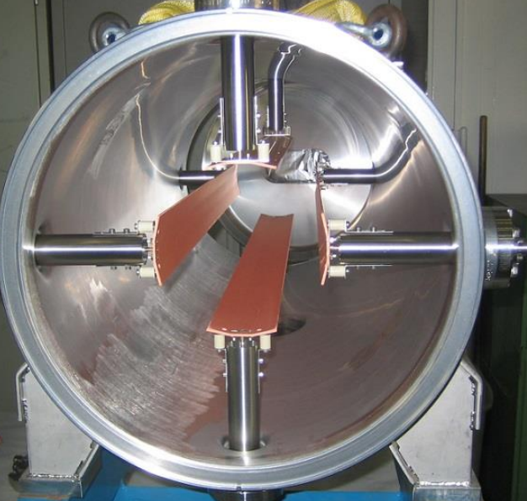
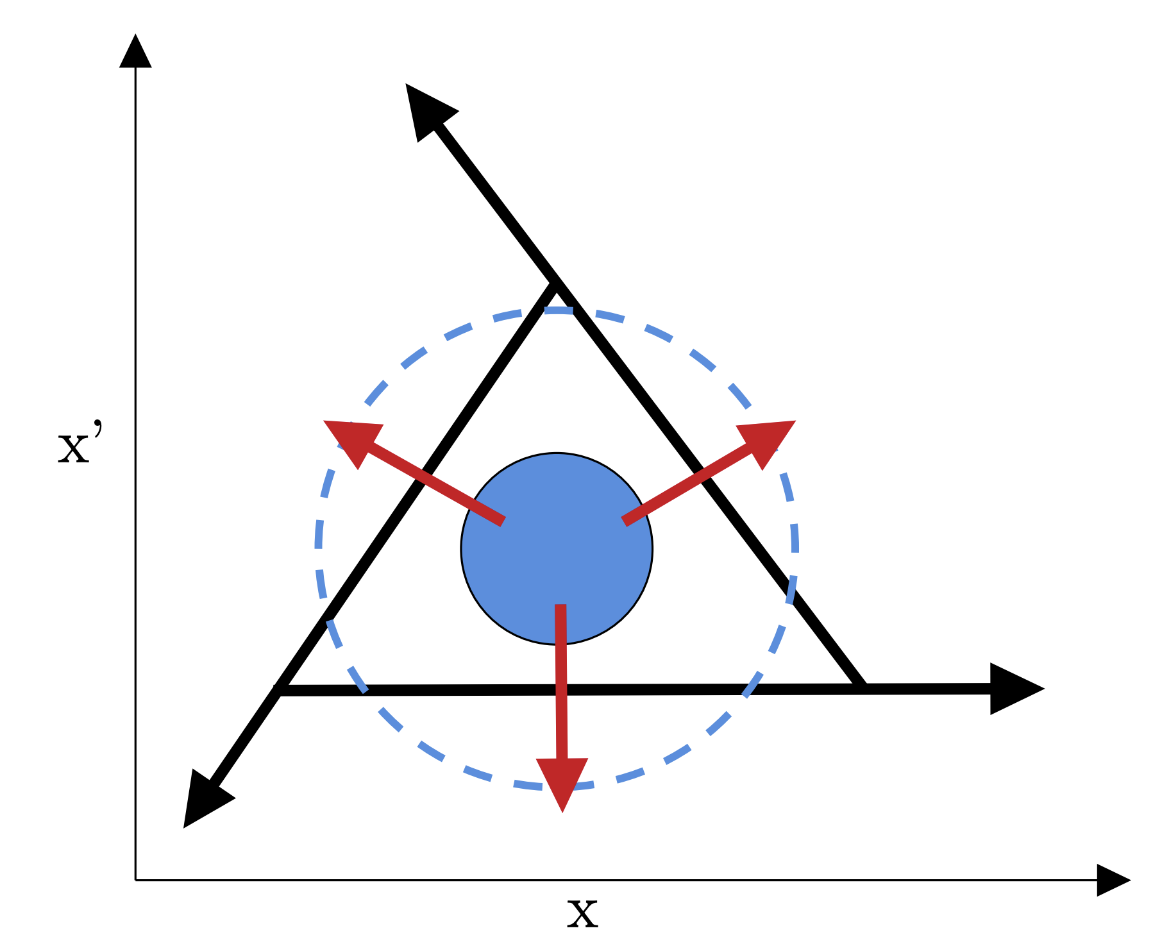
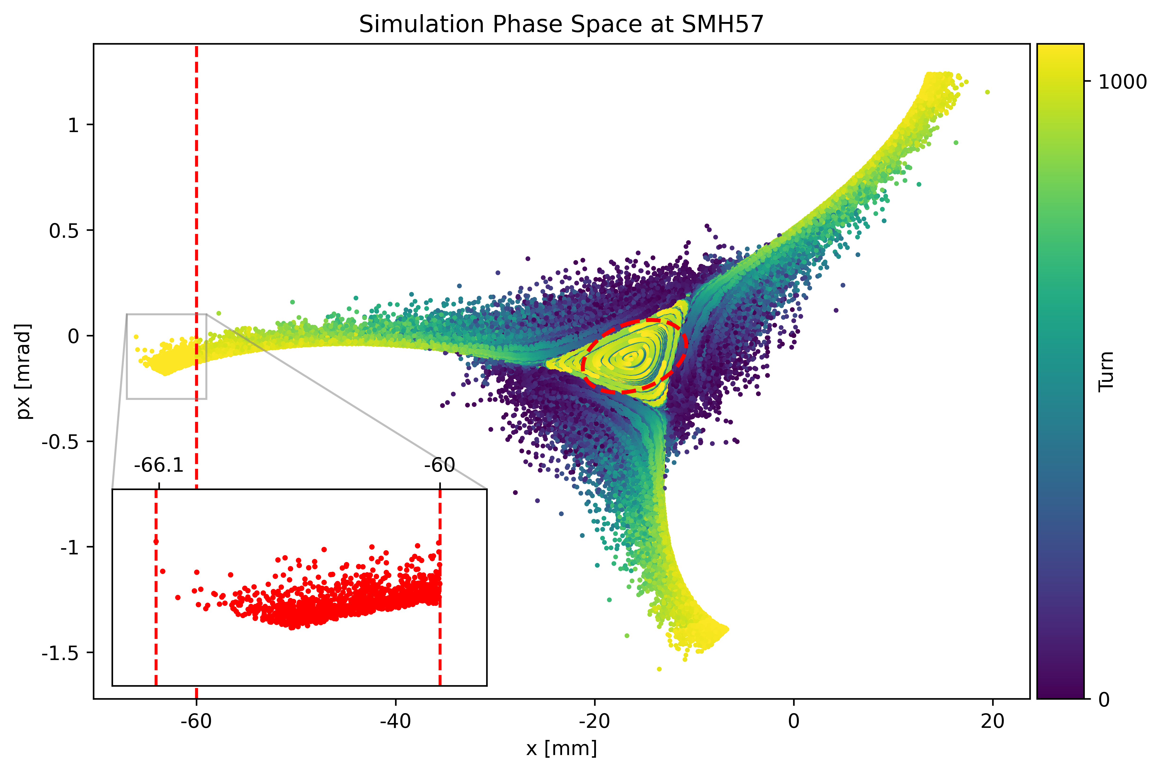
RFKO
Transverse Damper (exciter)
Emittance increase through RF excitation
T. Bass
Notes:
Chromaticity: tune dependence on momentum

Slide 15
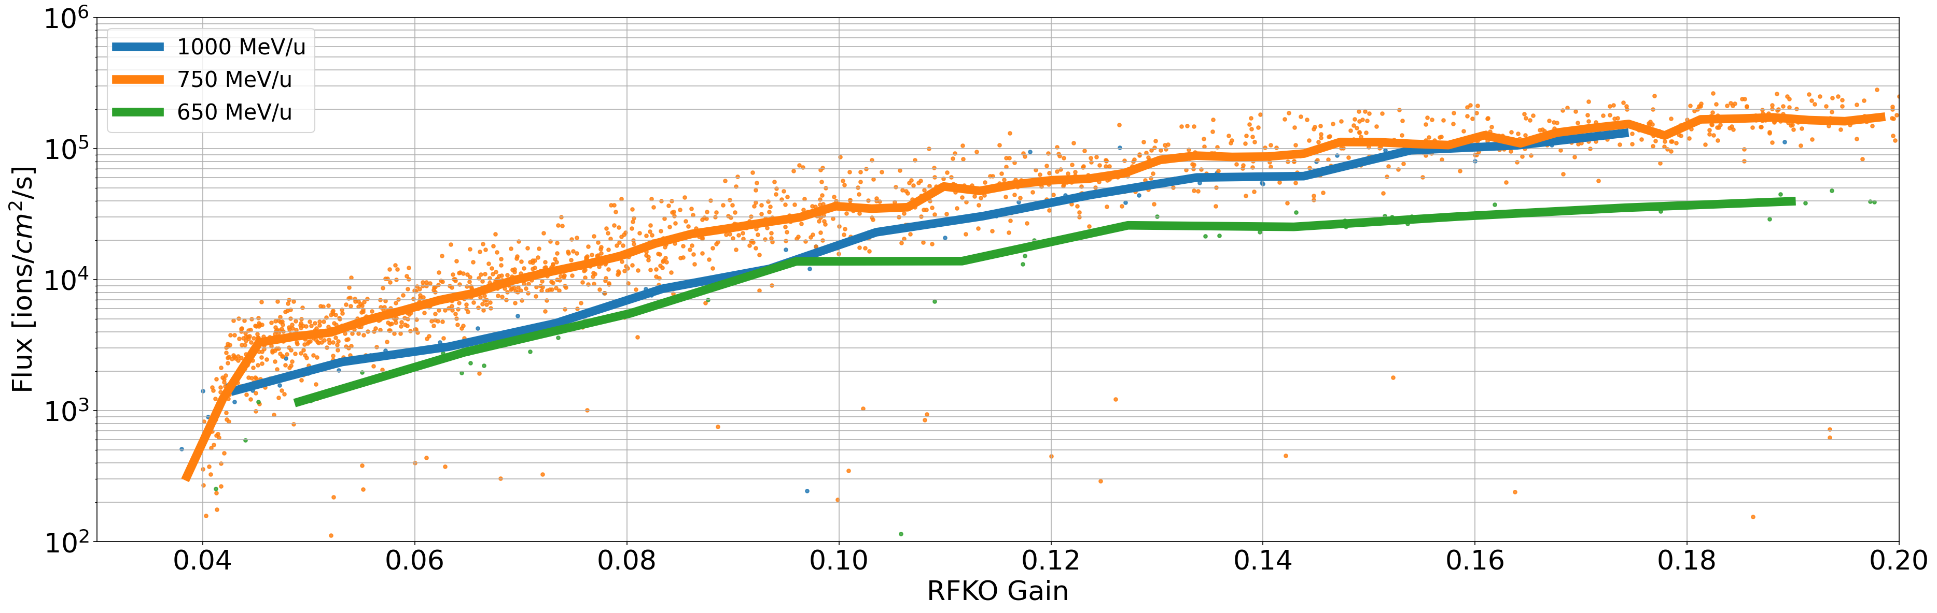
Intensity vs gain
Calibration with diode allows to convert from XSEC amplitude to ions/cm^2/spill
Flux ∝ to 1/momentum at certain gain
  650 MeV transmission (air interaction)?
Saturation at high gain
  Exponential + 2nd order
  Constant power TFB
XSEC70 intensity
Notes:
Mention: Reproducible intensity per gain

Slide 16
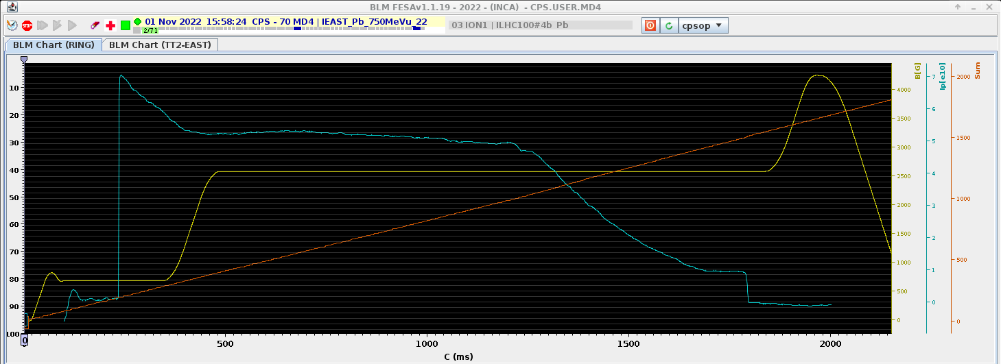
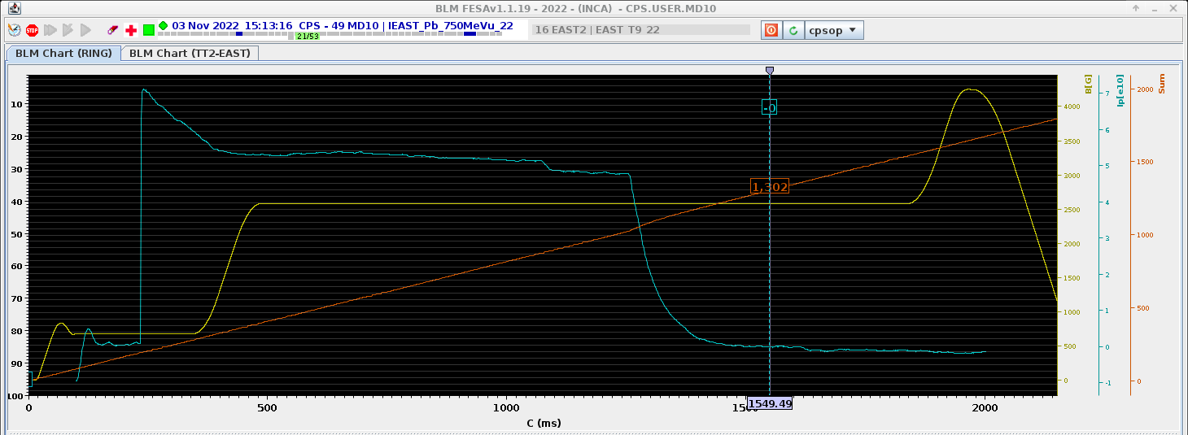
Intensity vs gain
Intensity in the PS as a function of RFKO gain
Low gain
High gain
Notes:
Mention: Reproducible intensity per gain

Slide 17
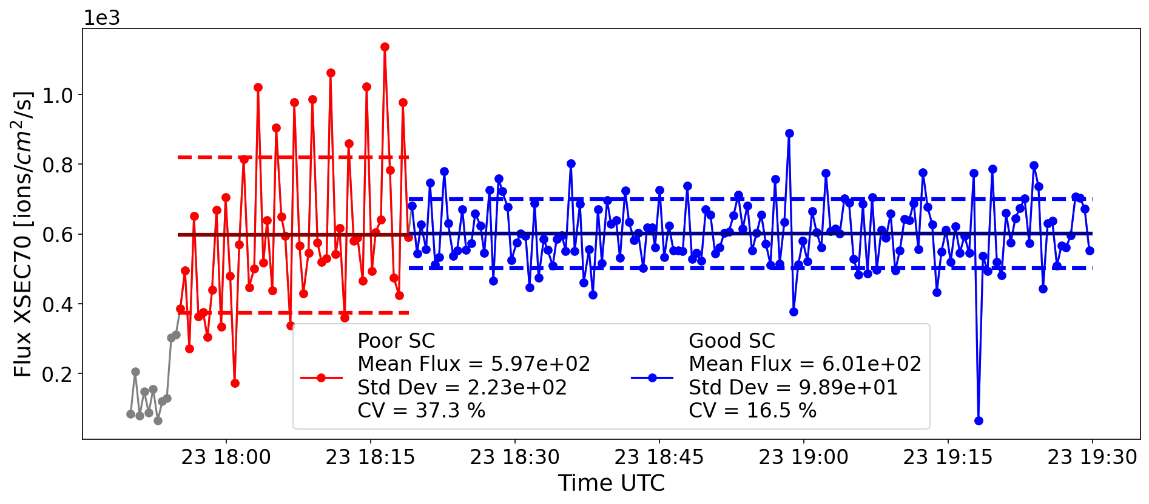

Challenge: Supercycle composition
Machine reproducibility is a challenge
Spike in intensity when different cycle is played
Degauss cycle not possible in PS
Careful programming of SC to minimise perturbation
B-train measurement system to help

Slide 18
Spill time profile
Energy
Intensity
Spill profile
Time structure, frequencies in the beam, spill-by-spill variability

Slide 19
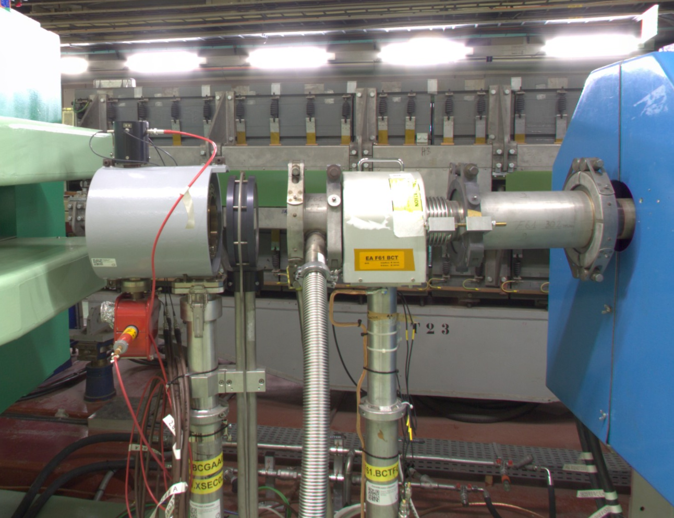
Spill time profile
> 7 instruments to measure spill time profile
Gas scintillator (BCGAA/BXSCINT)
XSEC 23/70/94
XION 71/94
Diode
(BLM, SRAM, …)
BCGAA023
XSEC023

Slide 20
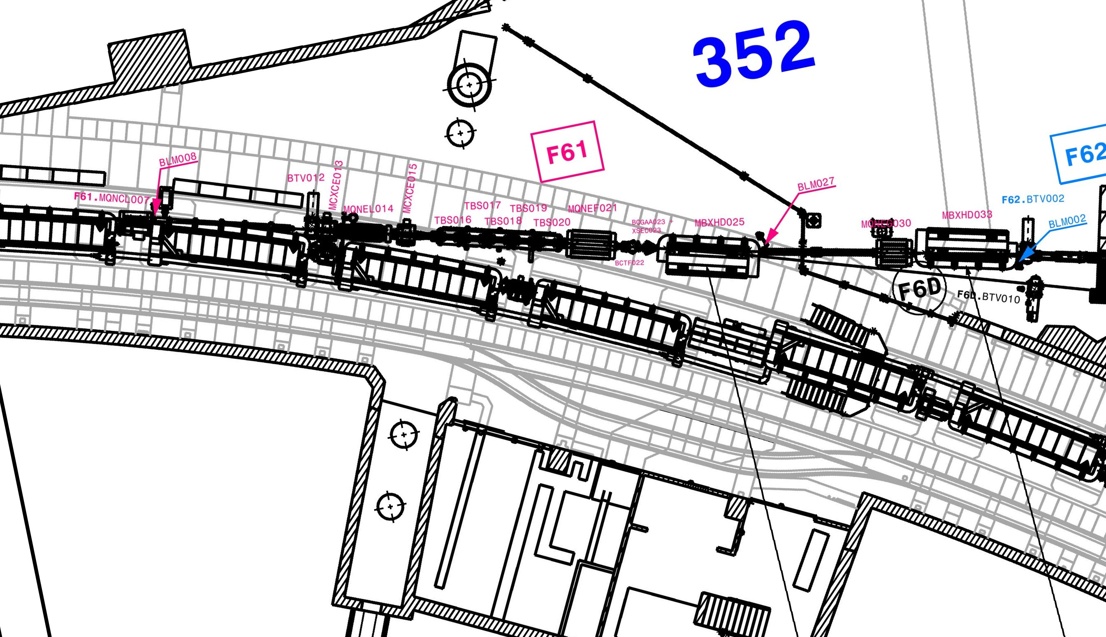
Instrument location

Slide 21
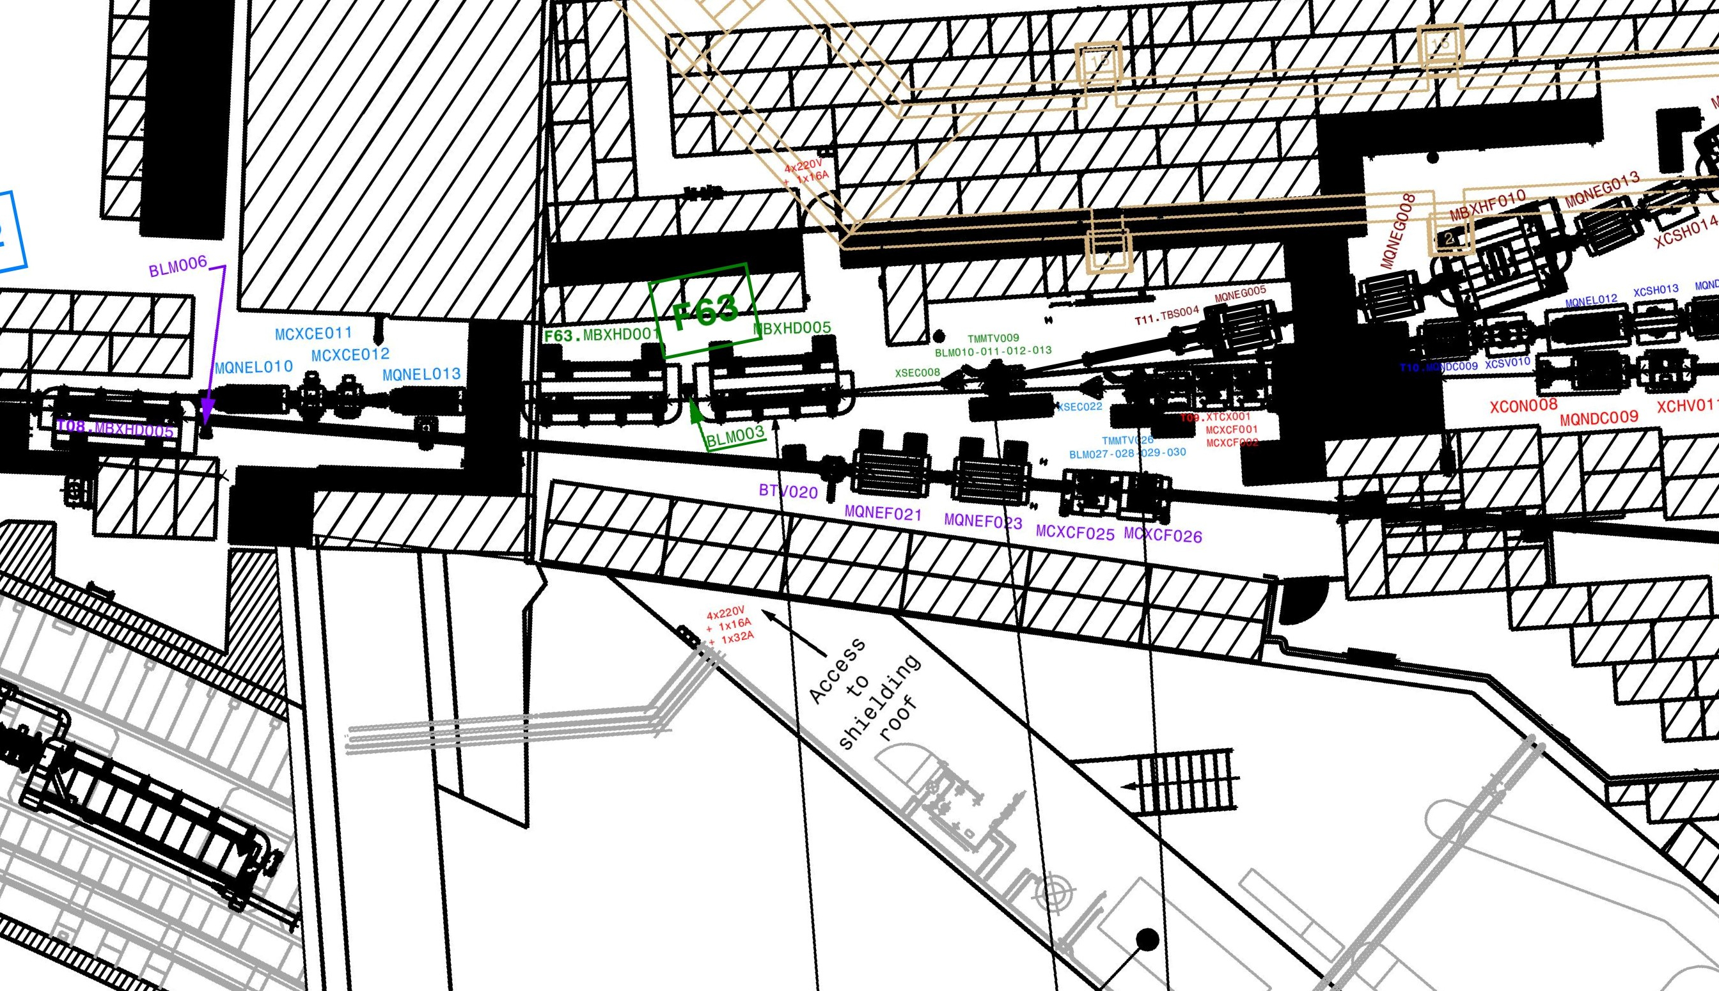

Slide 22
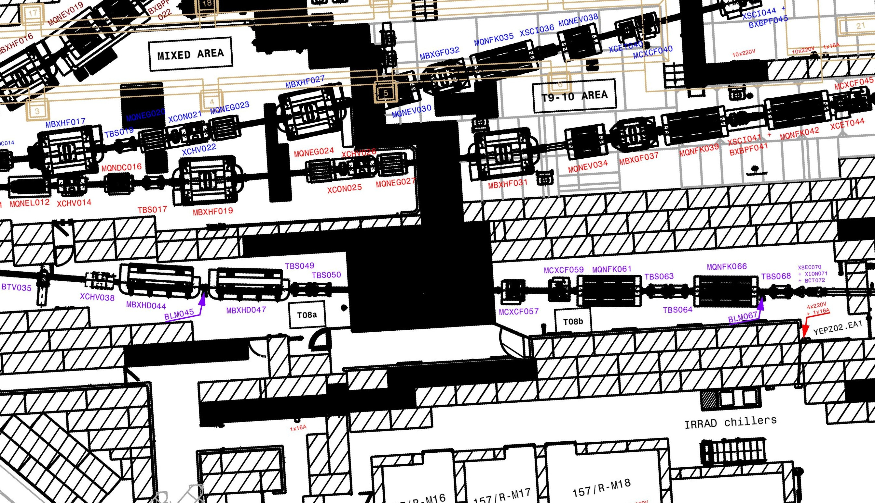

Slide 23
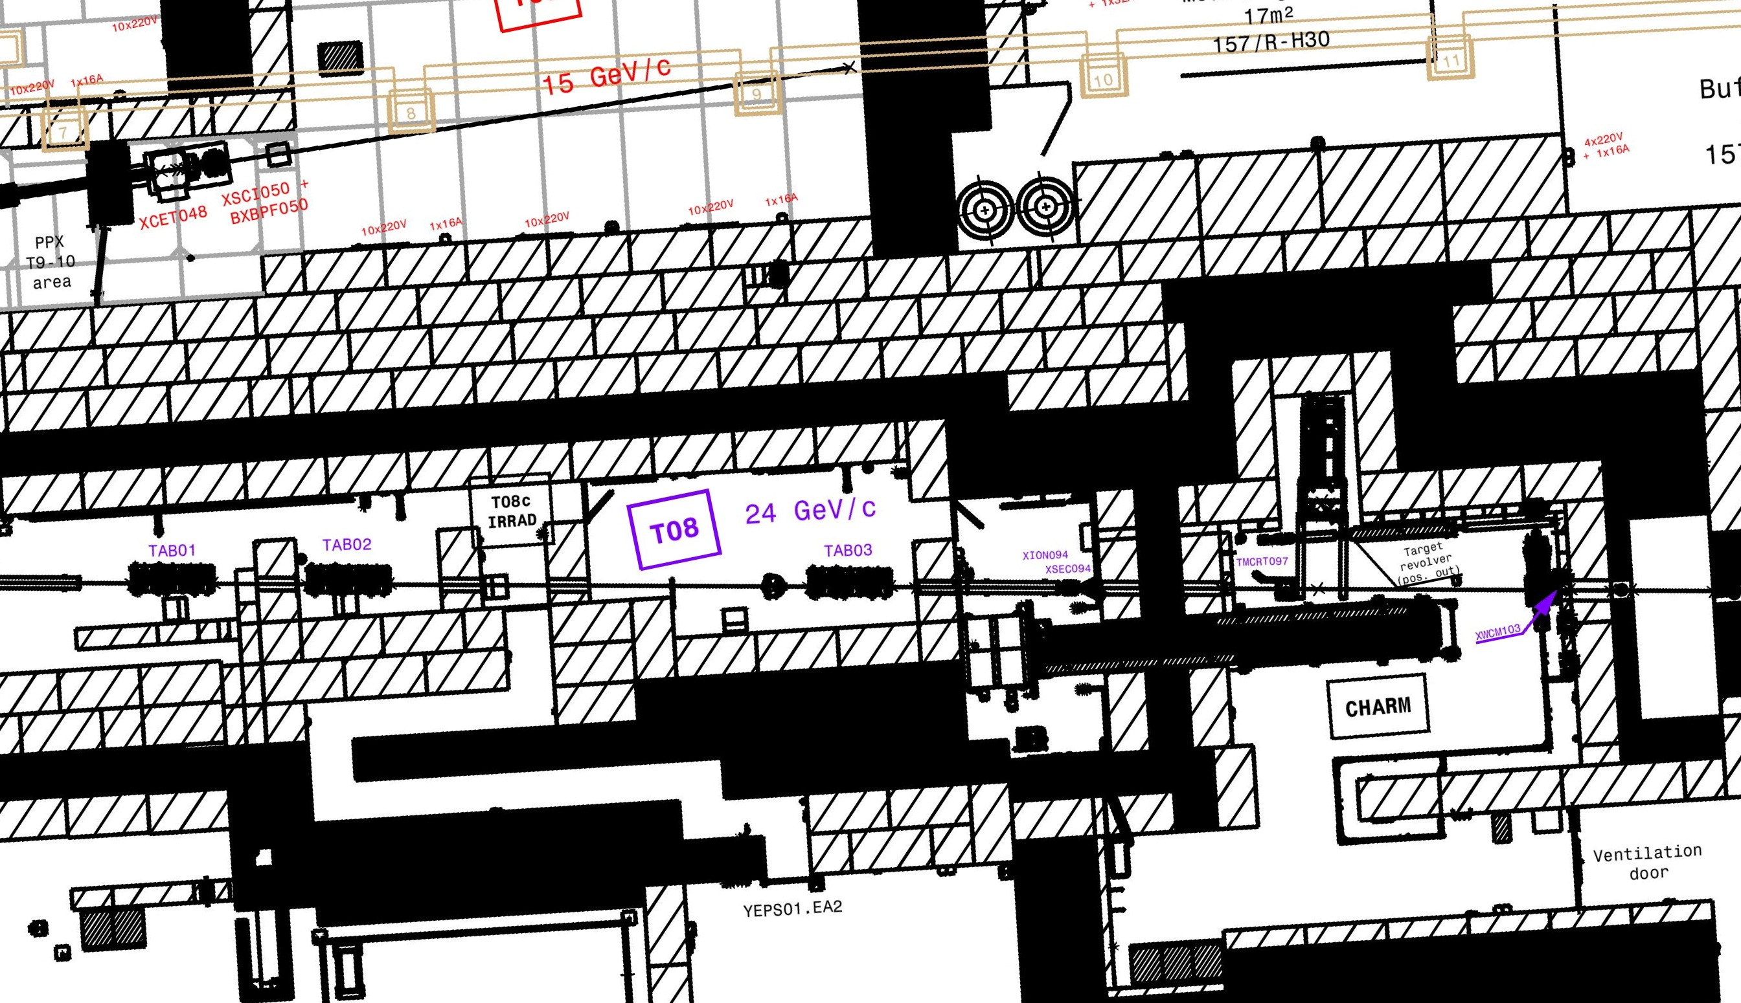

Slide 24
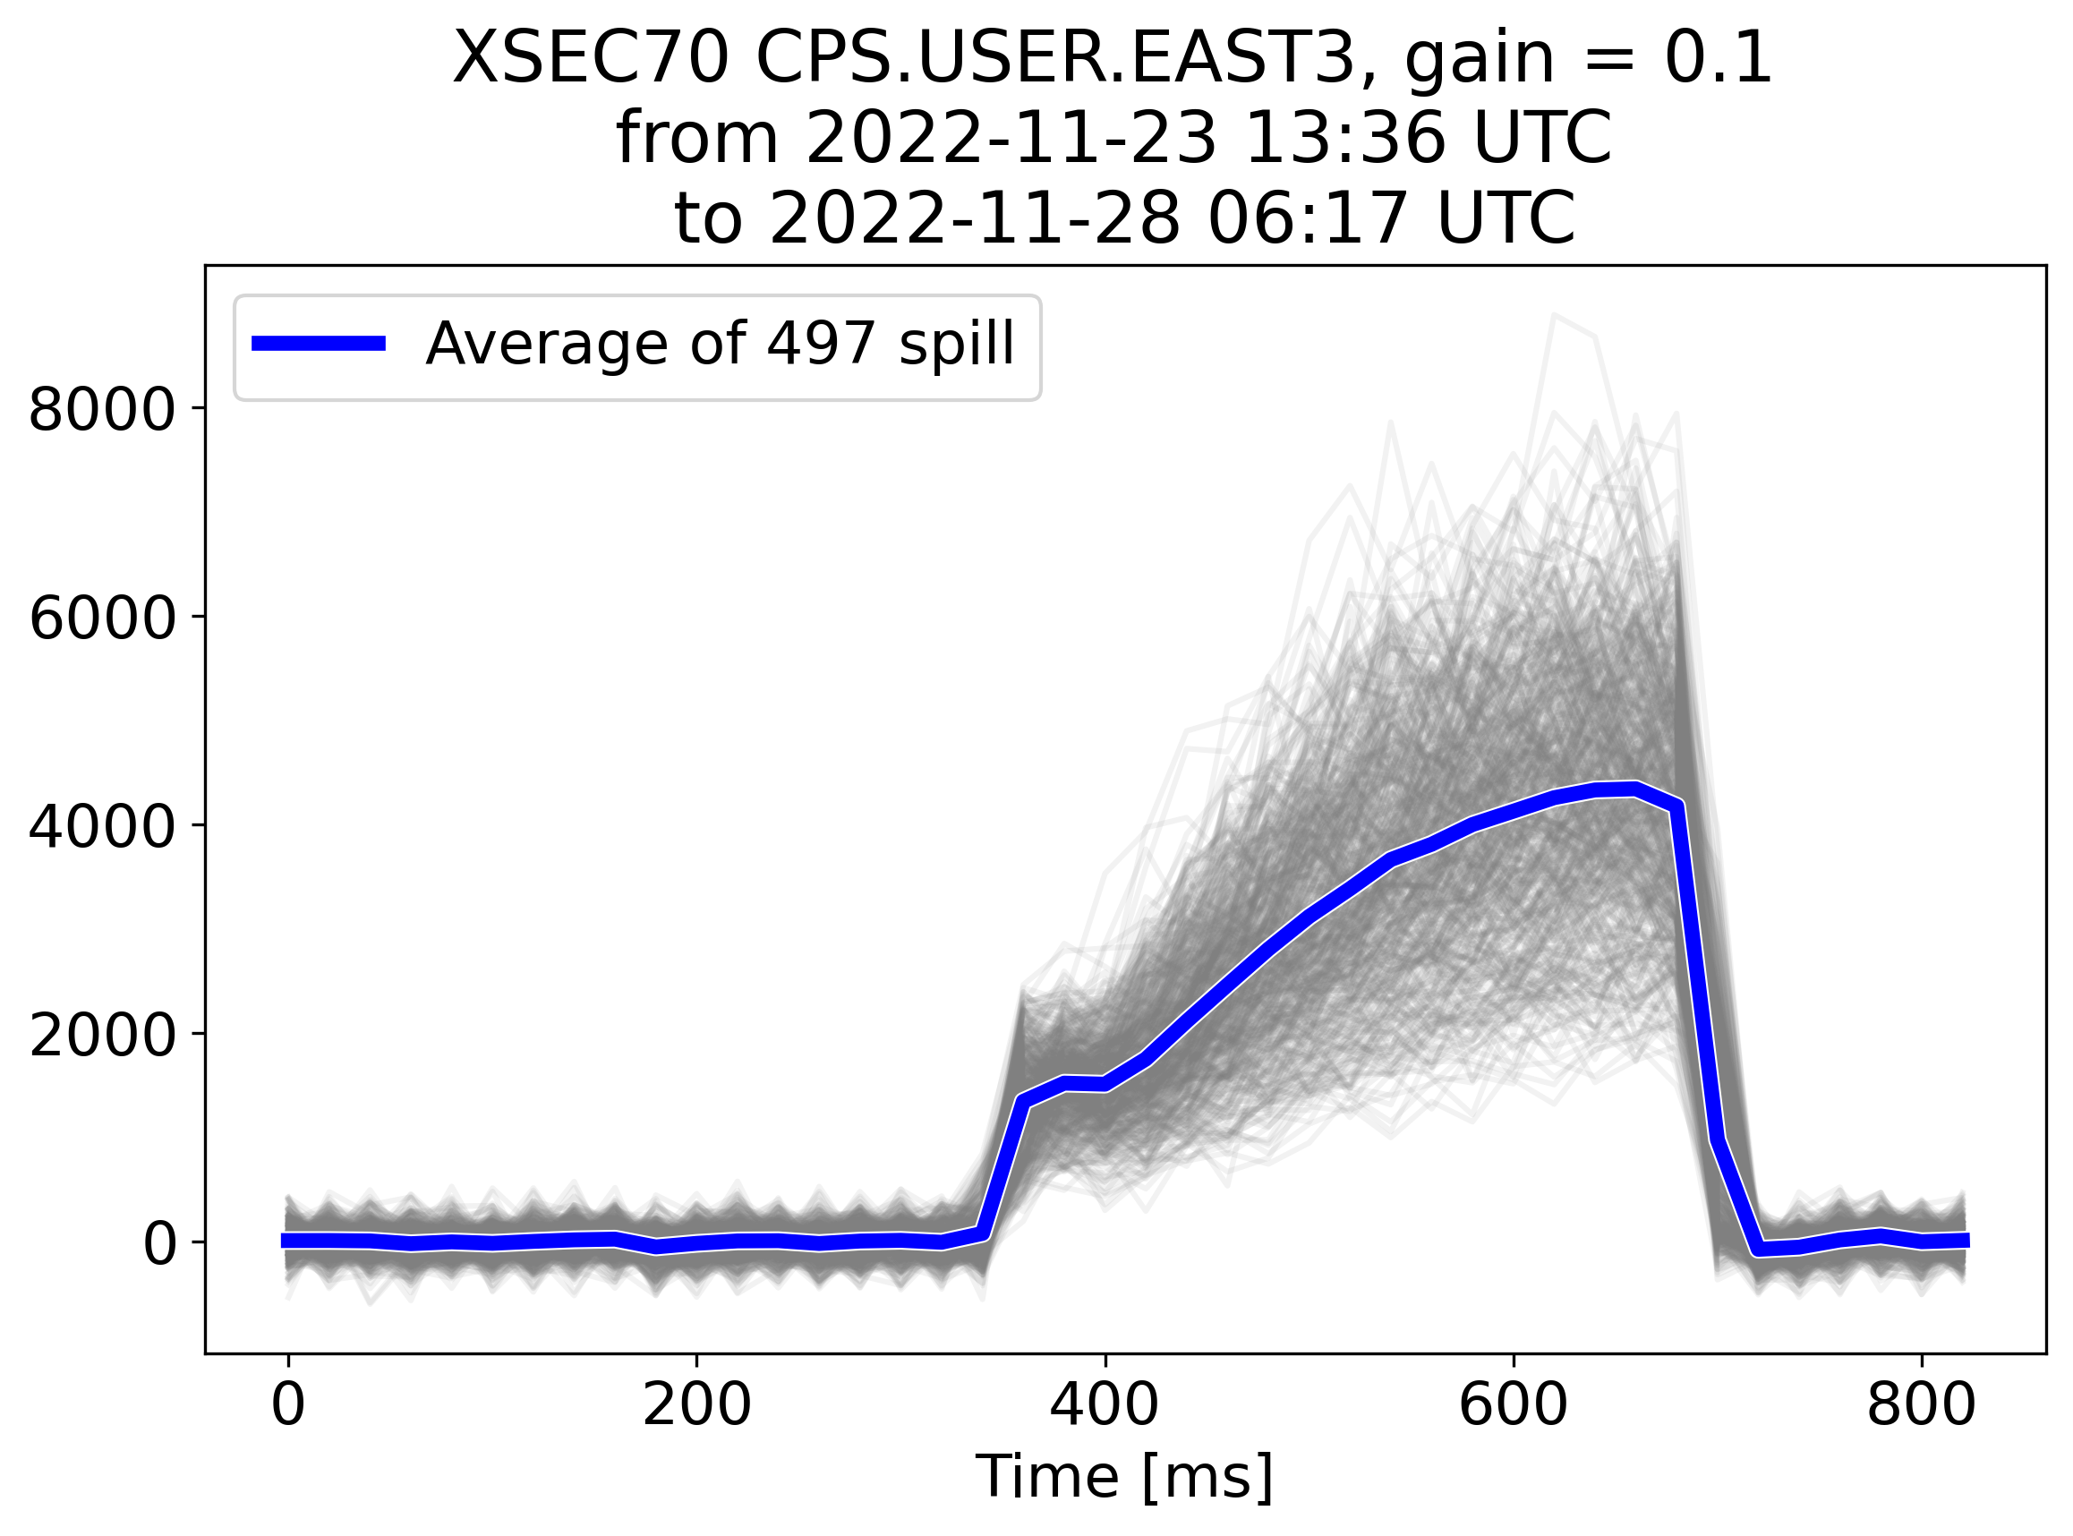
Spill profile
Time resolution:
  20 ms for XION, XSEC
  2-3 ms for Diode
  0.5 ms for BXSCINT
  Finer sampling possible with BXSCAL (0.3-0.04 ms) and white rabbit (not logged) in F61 and Diode up to 0.5 µs
Notes:
Mention that this is for a single gain and energy

Slide 25
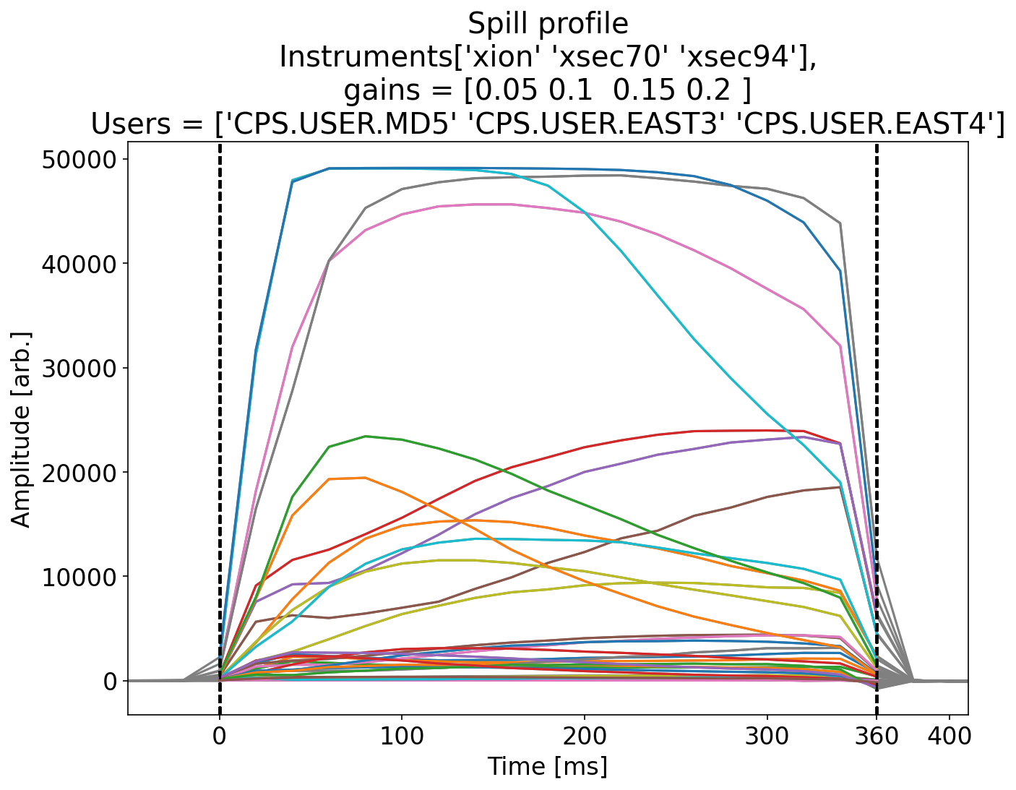
Spill time profile
Average time 360 ms
Longer spill time (~1000 ms) could be tested if needed
  Long flat top
  No bunch rotation
  Only GRPOS tune shift

Slide 26
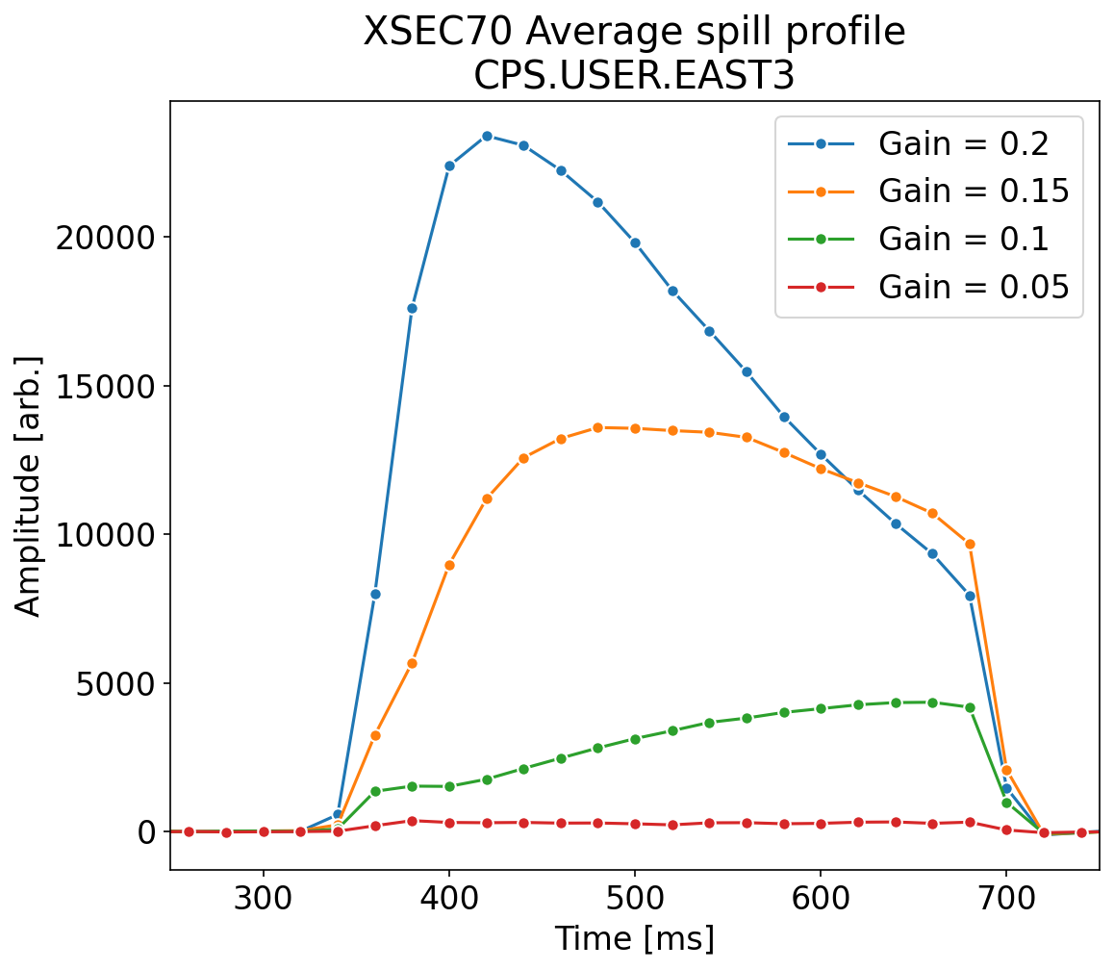


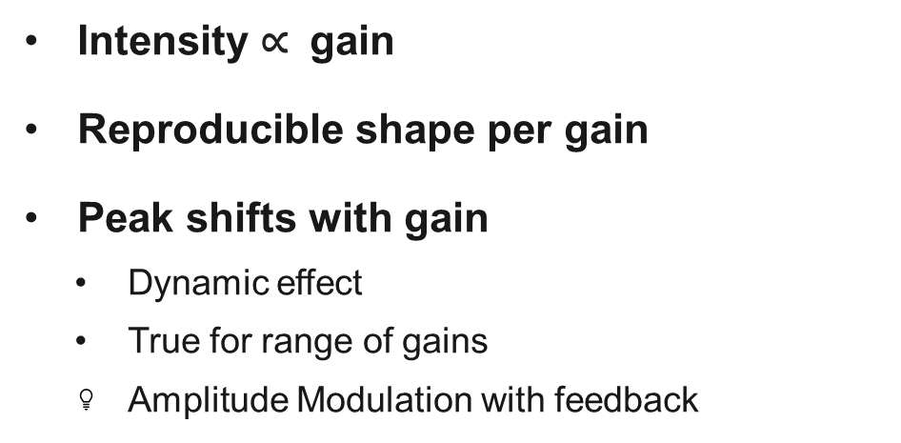
Comparison between gain
Intensity $\text{∝}$ gain
Reproducible shape per gain
Peak shifts with gain
  Dynamic effect
  True for range of gains
  Amplitude Modulation with feedback
$${gain}_{low}$$
$${gain}_{high}$$

Slide 27
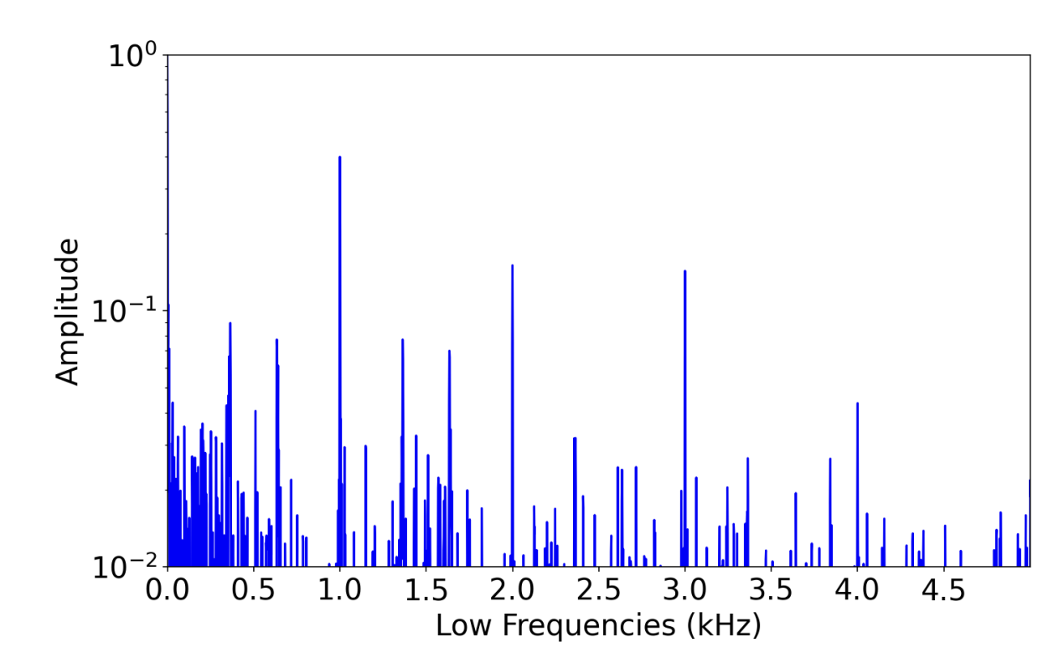
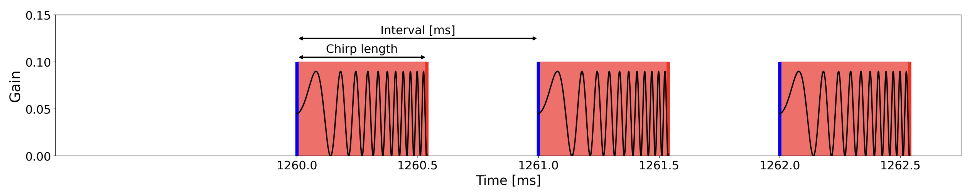
Spill structure
Slow and fast frequencies time structure
Slow because of RFKO technique
  Software limitation to max chirp rep rate of 1 ms intervals
  1 kHz

Slide 28
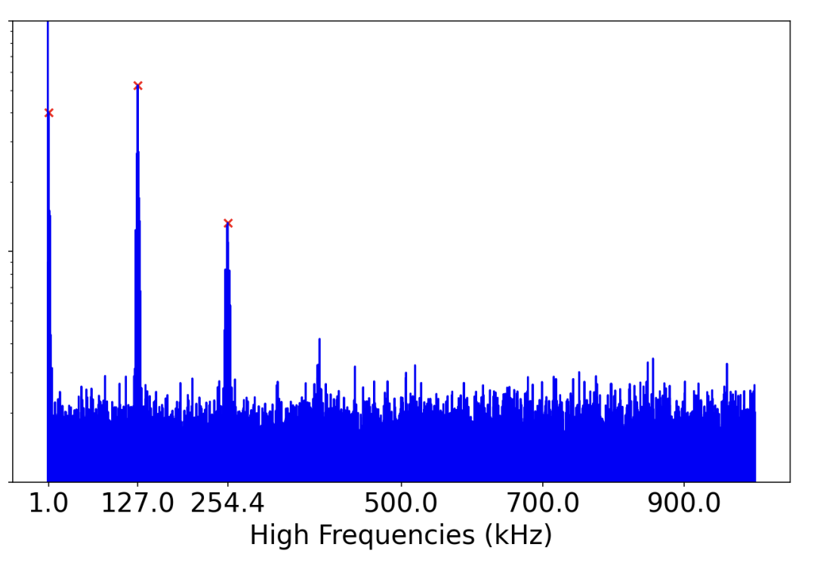
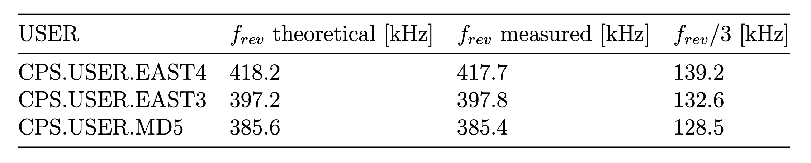
Spill structure
650 MeV/n
Fast spill structure at the fractional tune of third integer
  Frev/3
  ~ 130 kHz
  (beam still bunched and debunching during extraction)
Diode fast sampling rate
  0.5 µs

Slide 29
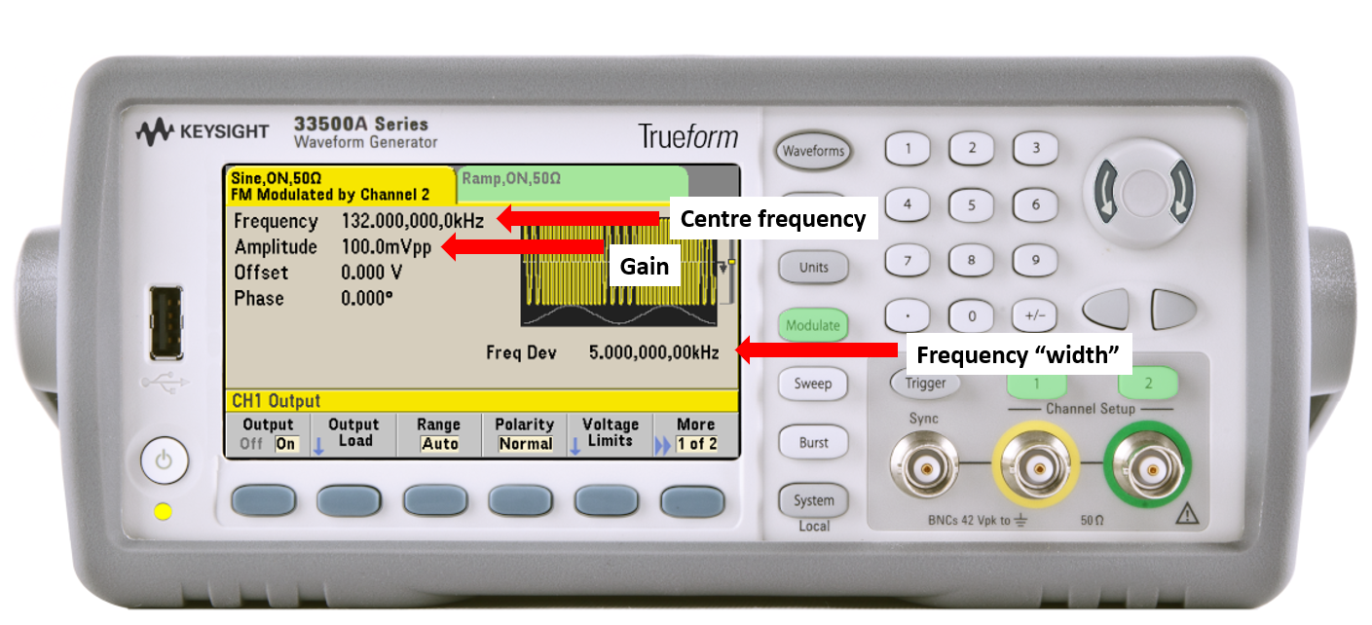
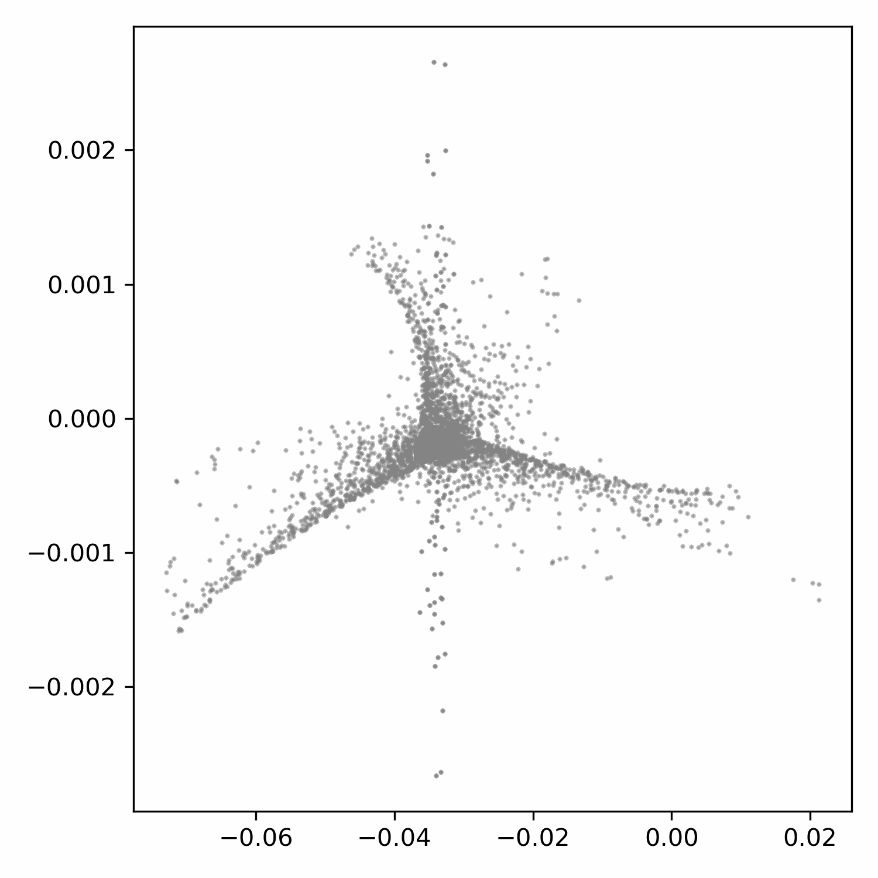
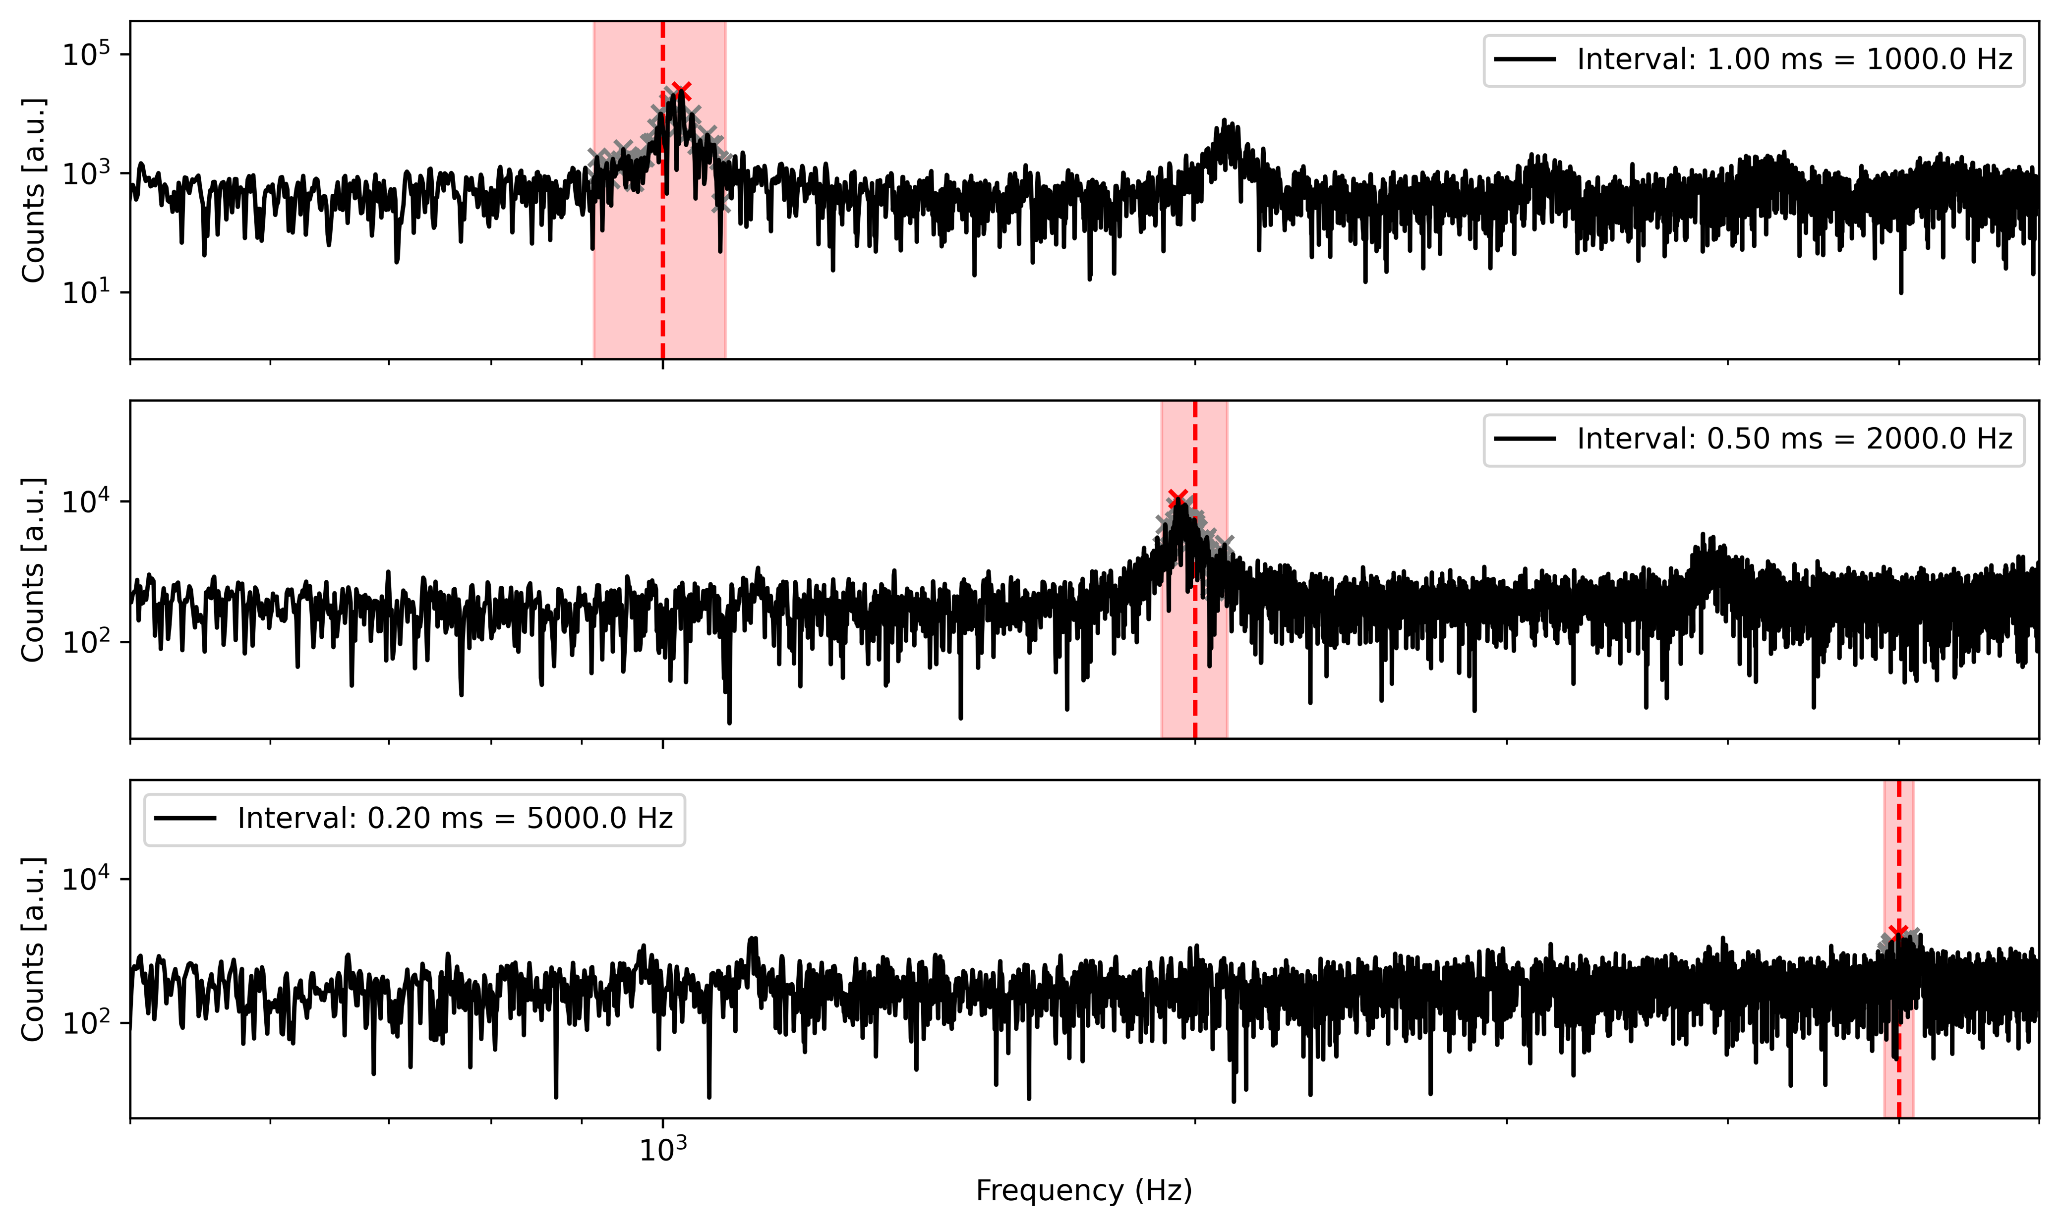
R&D
Remote app
  Send python commands
  Continuous chirp
Signal generator
Exploit low-pass filter effect of beam (transit time) by exciting at higher freq
Variable gain during spill
Transit time (10-100 turns)

Slide 30
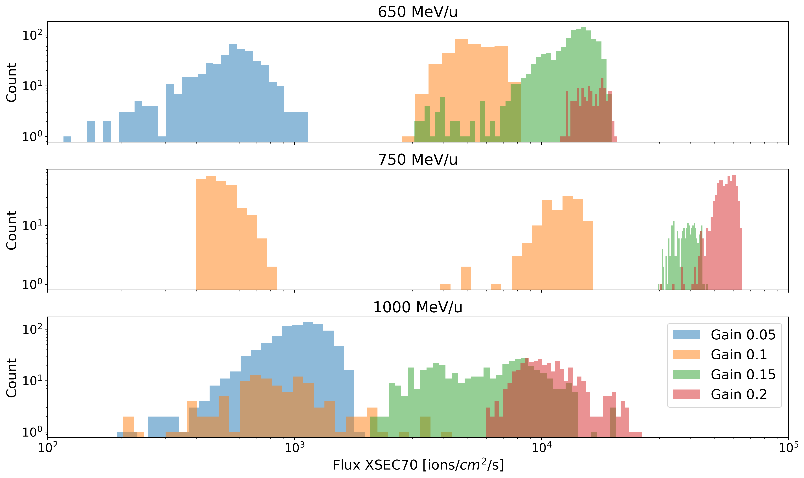
Spill-by-spill variability
Flux variation during Nov. 2022 run
  Instrumentation gain (not logged)
  Supercycle composition

Slide 31
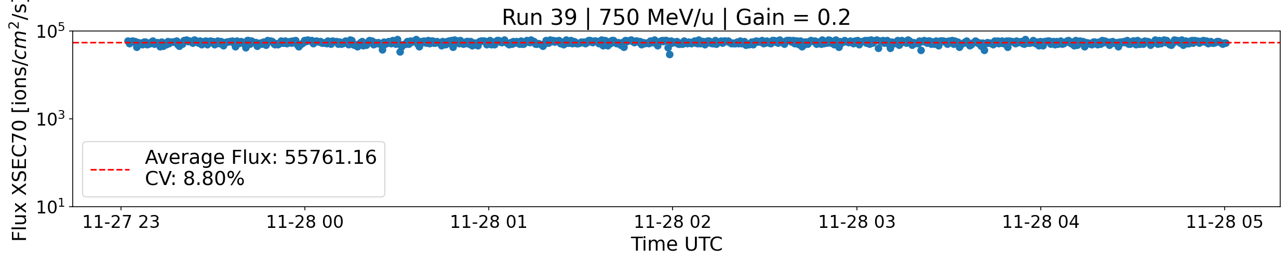

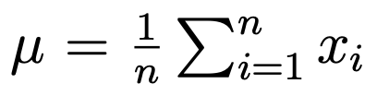
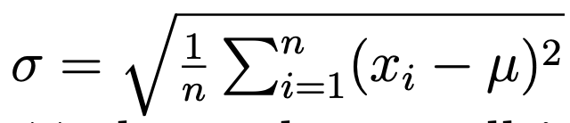
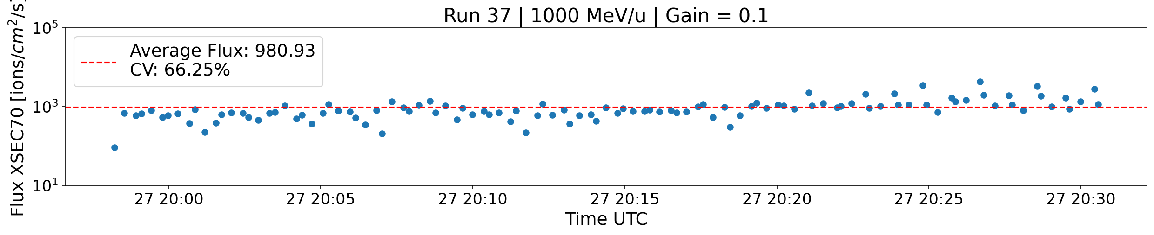
Spill-by-spill variability

Slide 32
Conclusion
Energy:
  Upgraded control system for energy scaling of PS and TL
Intensity:
  SX technique changed to RFKO
  Simple control with TFB voltage
Spill time profile:
  R&D for 2023
    Damping of the slow frequency by chirping faster
    Longer spill
    (Uniform spill with AM)

Slide 33

Questions
or comments

Slide 35
Extra slides

Slide 36
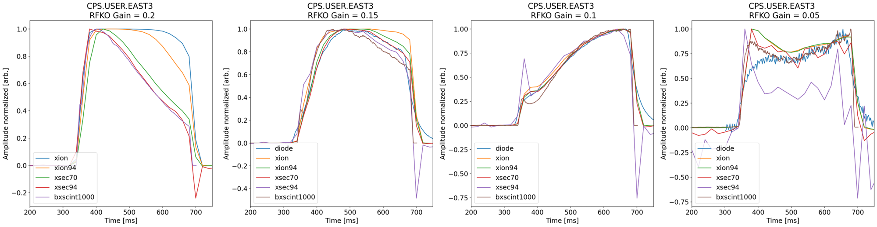
Instrument comparison
Good time profile agreement
XION saturates at > 0.1 gain

Slide 37
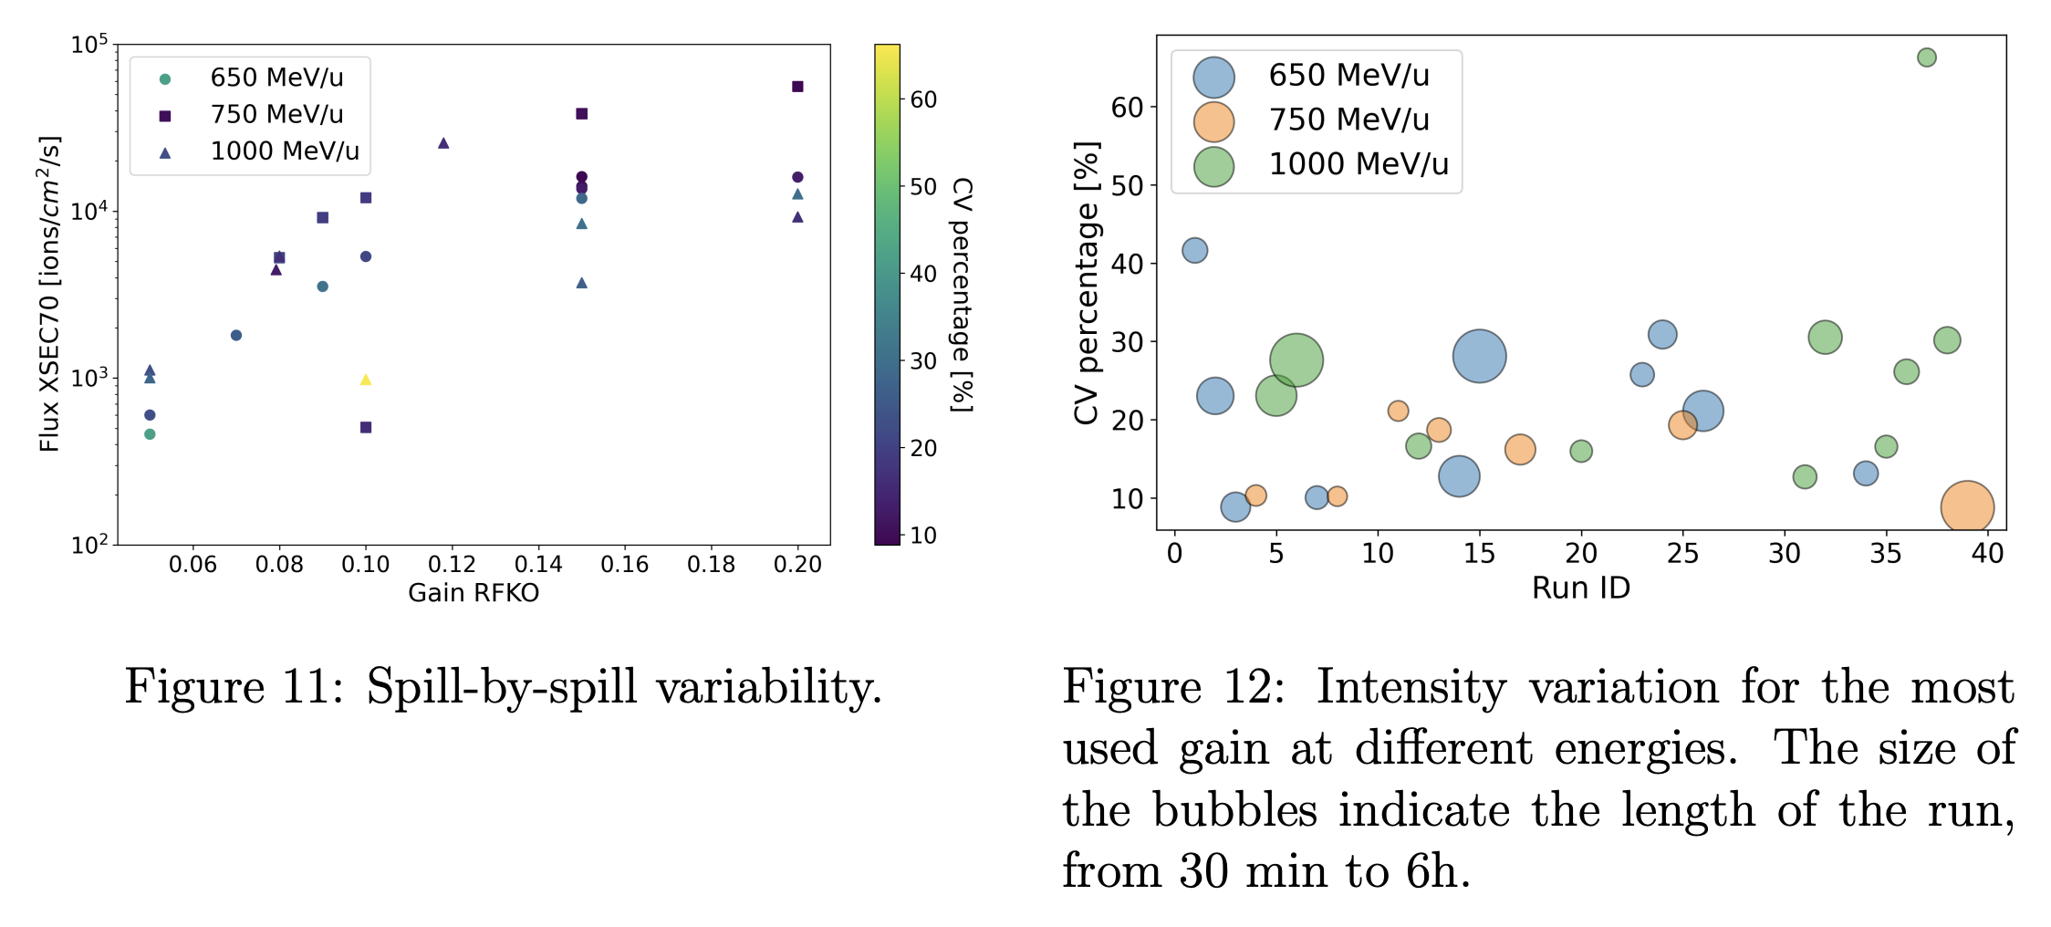
Spill-by-spill variability

