Slide 1
NSRL & RadNEXT
Facility Discussion
Trevor Olsen
Mike Sivertz
19 July 2023

Slide 2
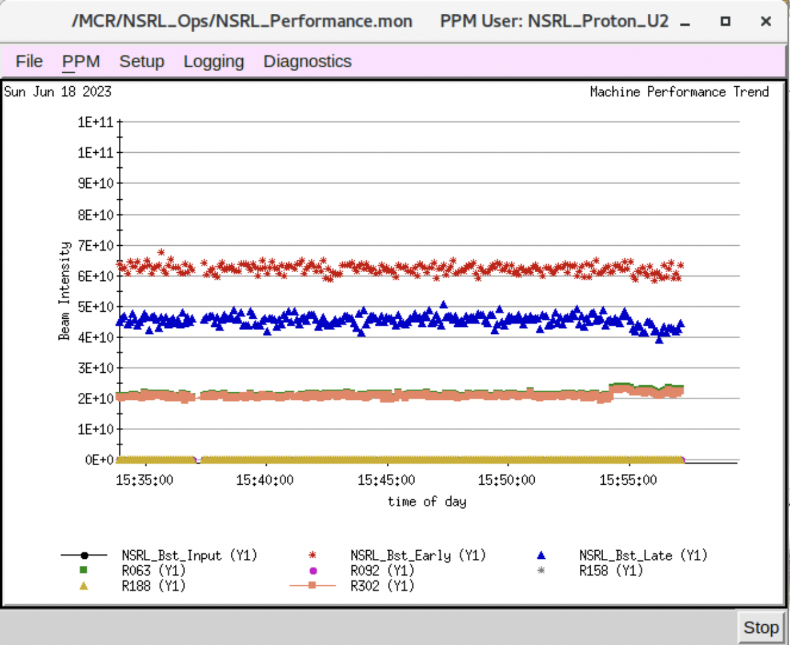
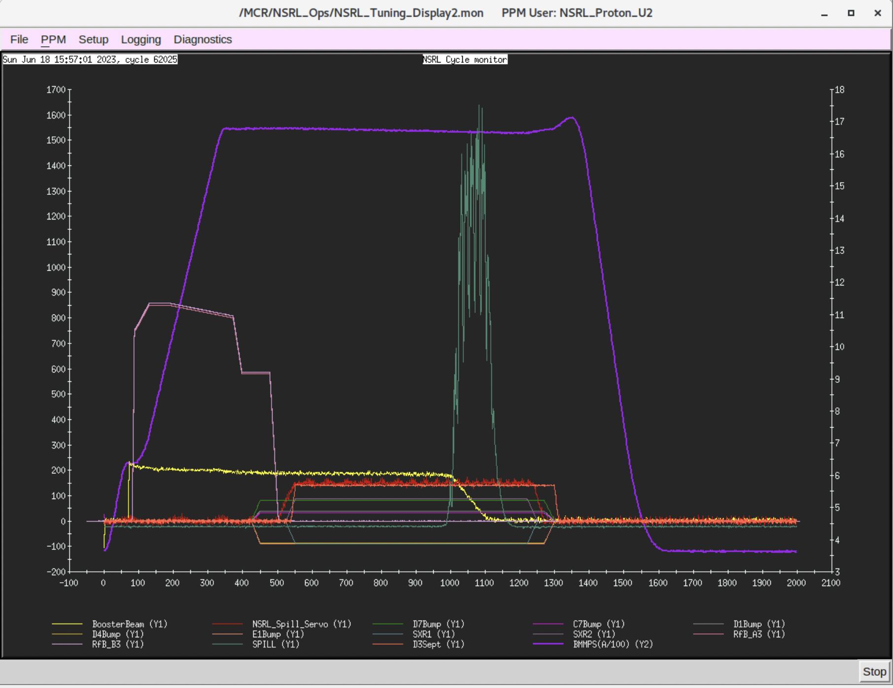
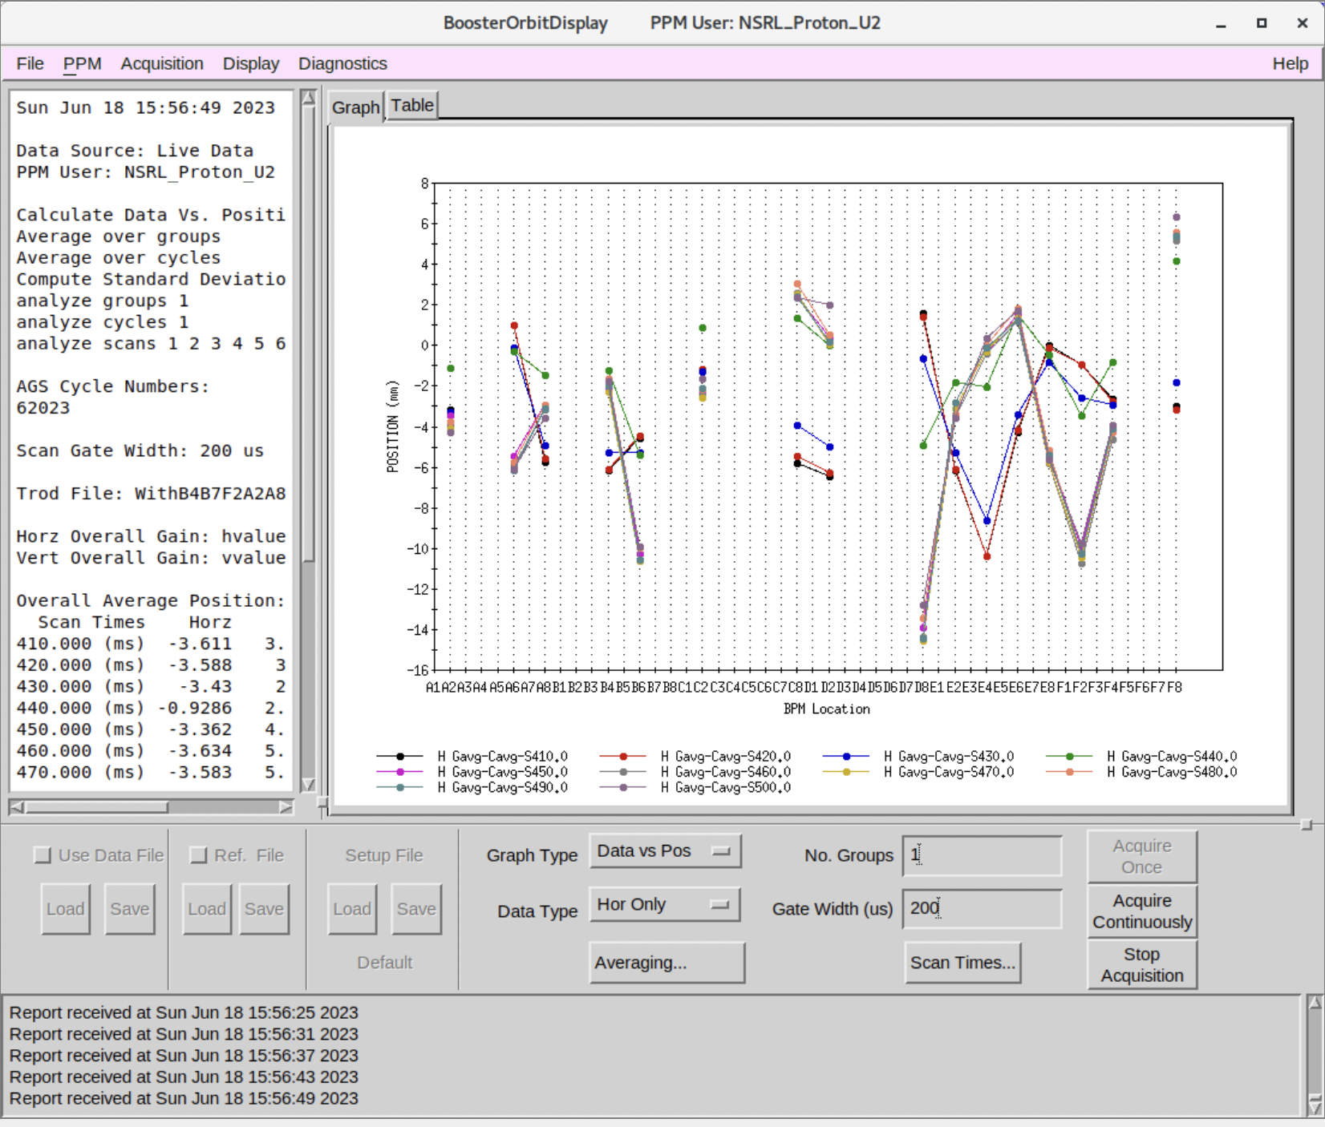
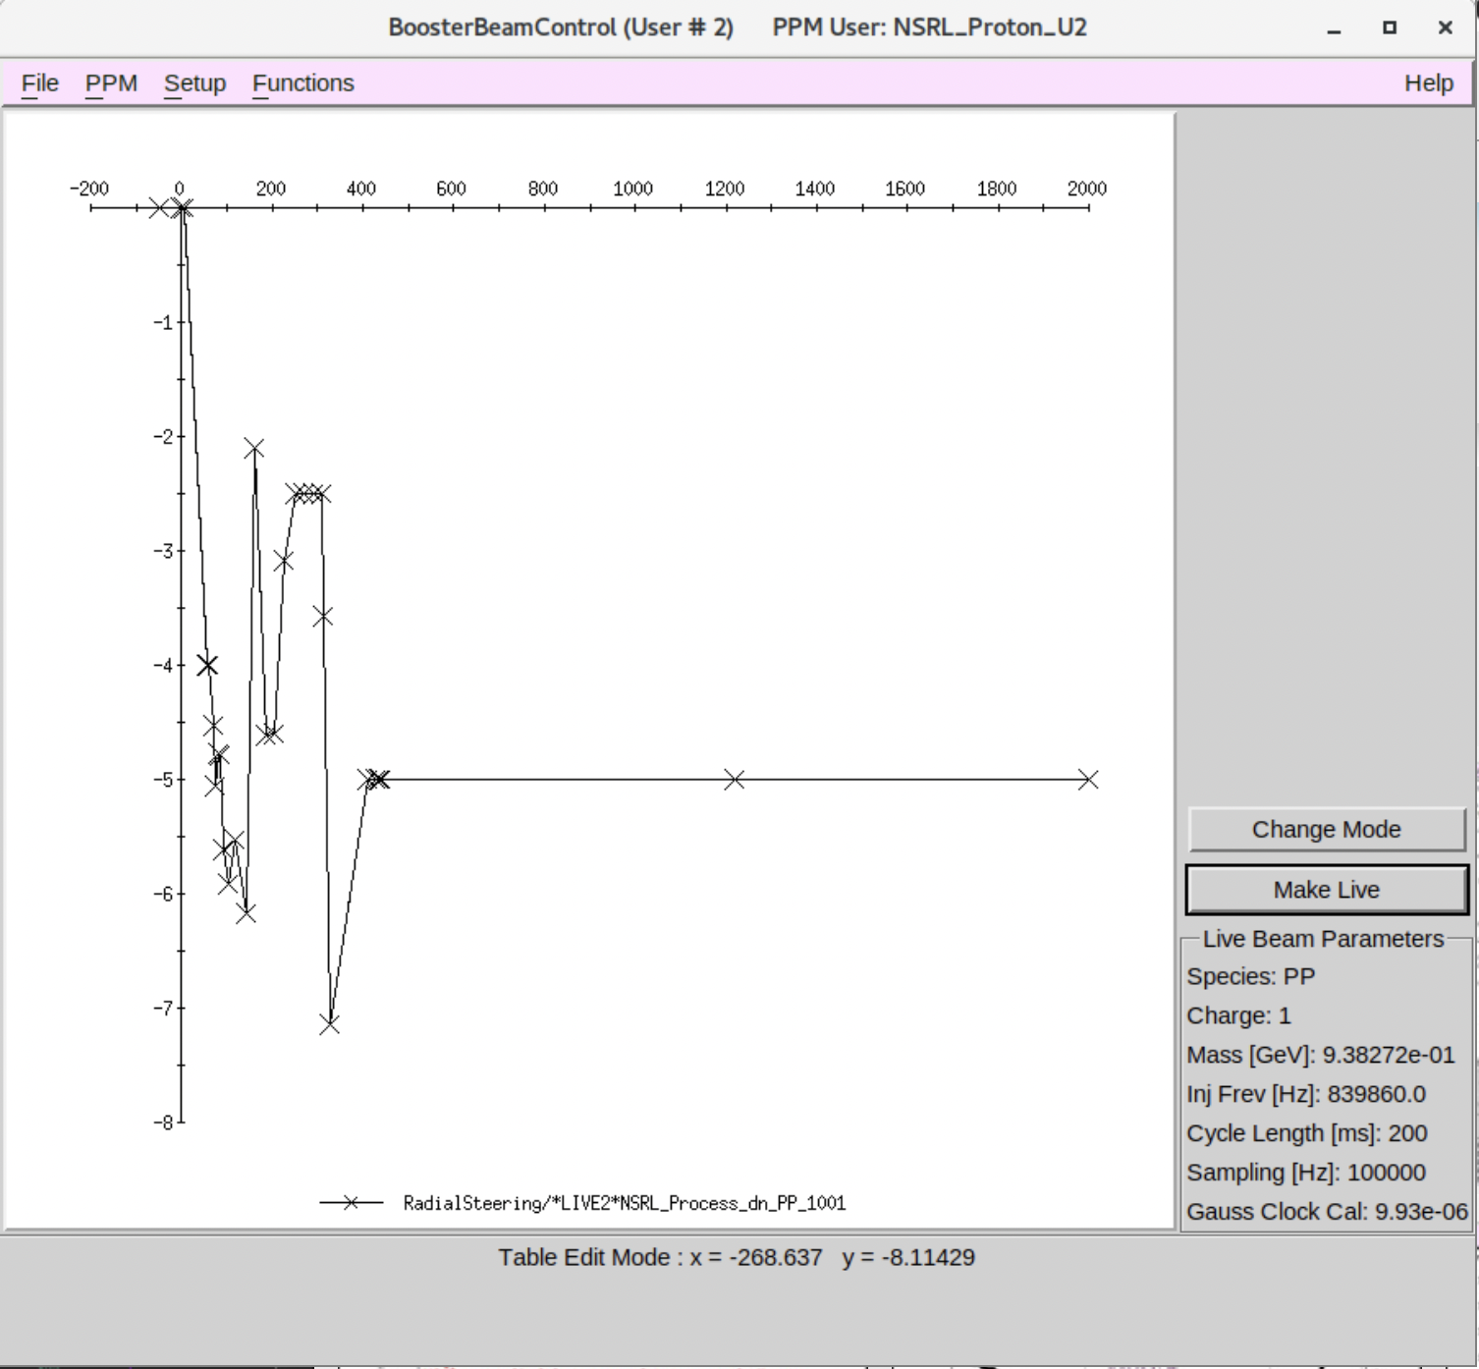

Slide 3
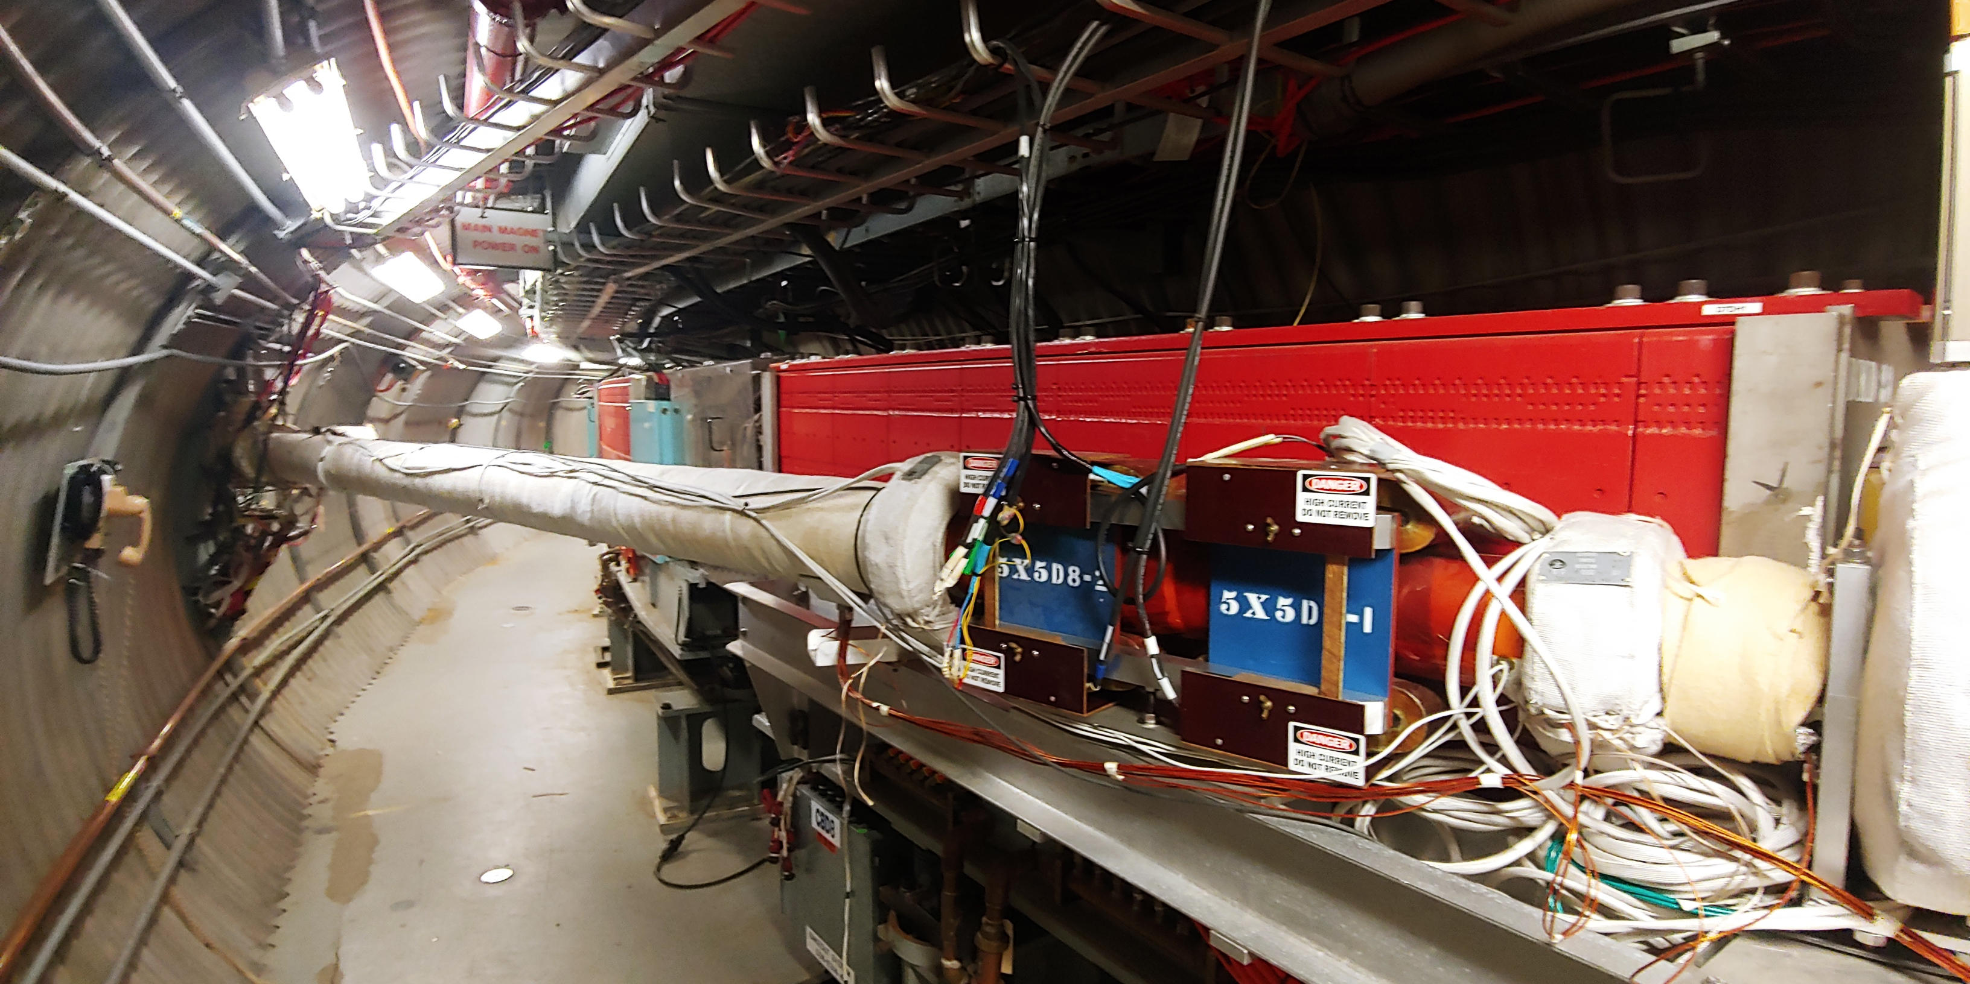
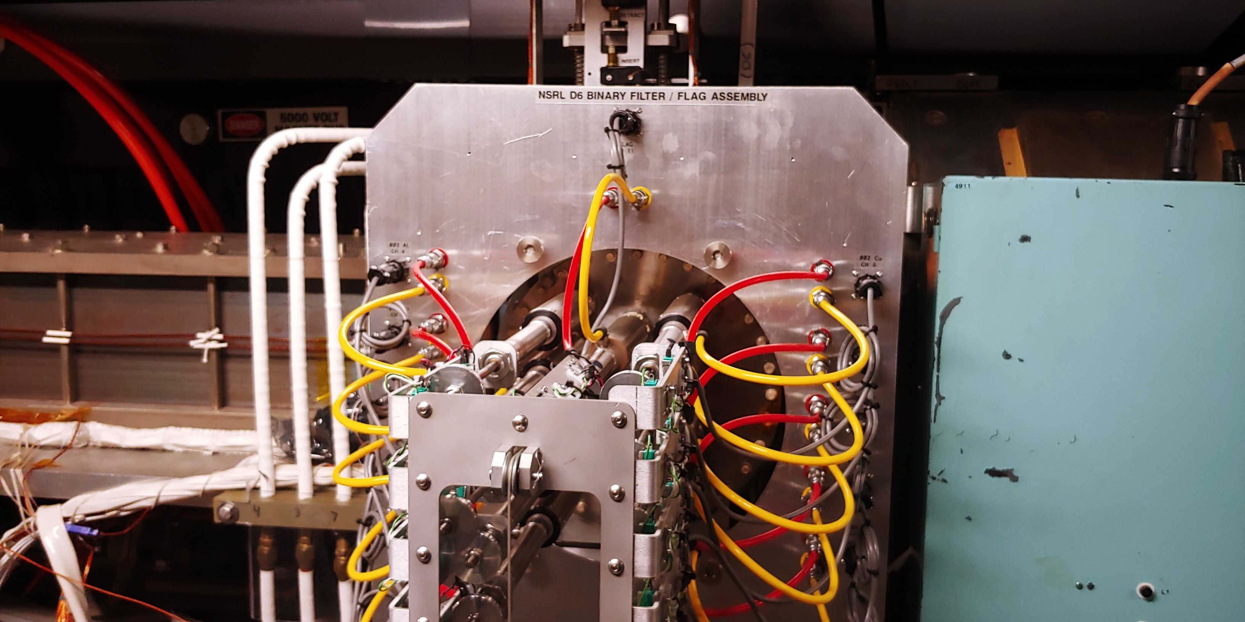
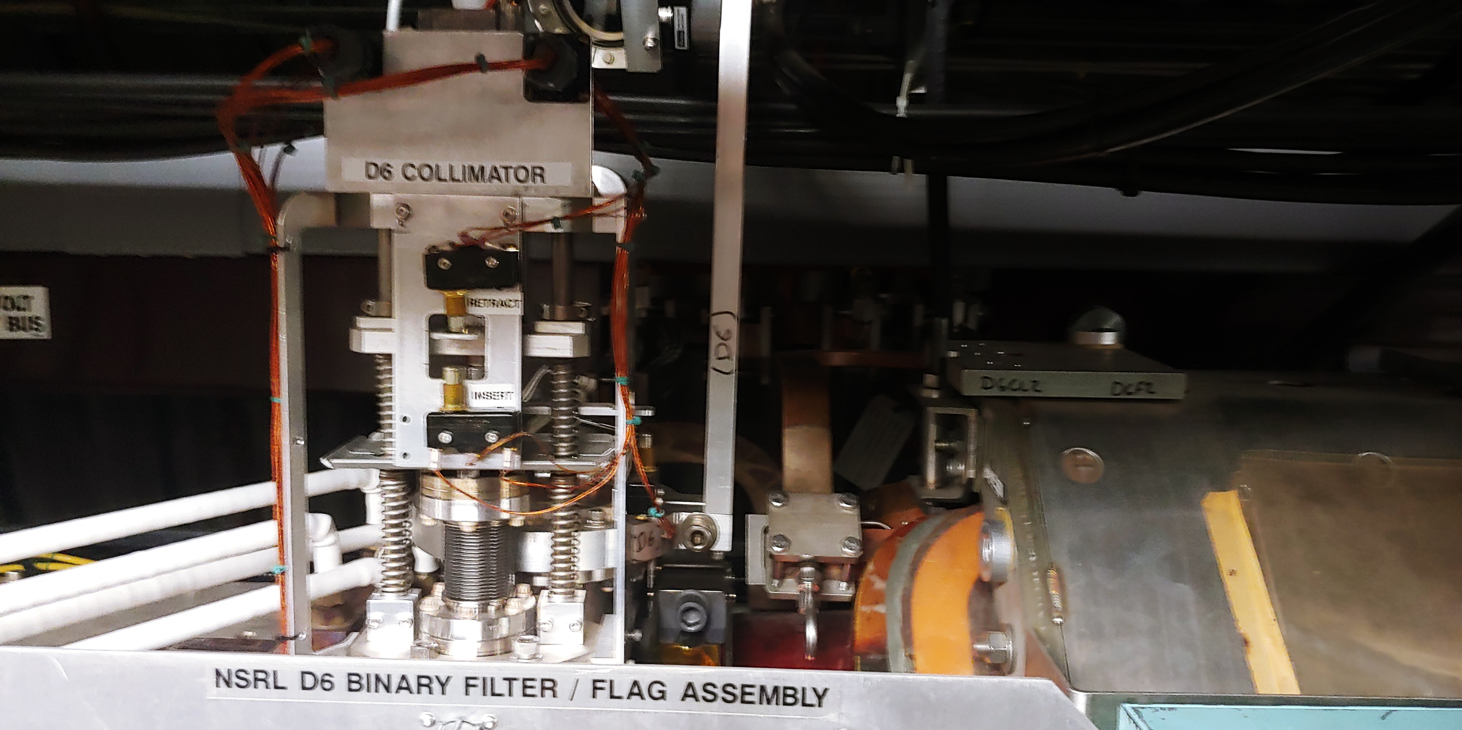
Booster to NSRL Extraction
Stripping foil:
NSRL beam line accepts fully stripped ions. Booster accelerates partially stripped beam.
Stripping foil in steps of 0.25 mils (imperial, 1/1000 of 2.54 cm) copper foils

Slide 4
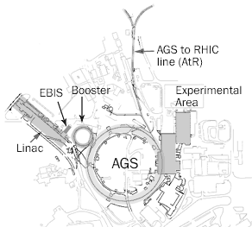
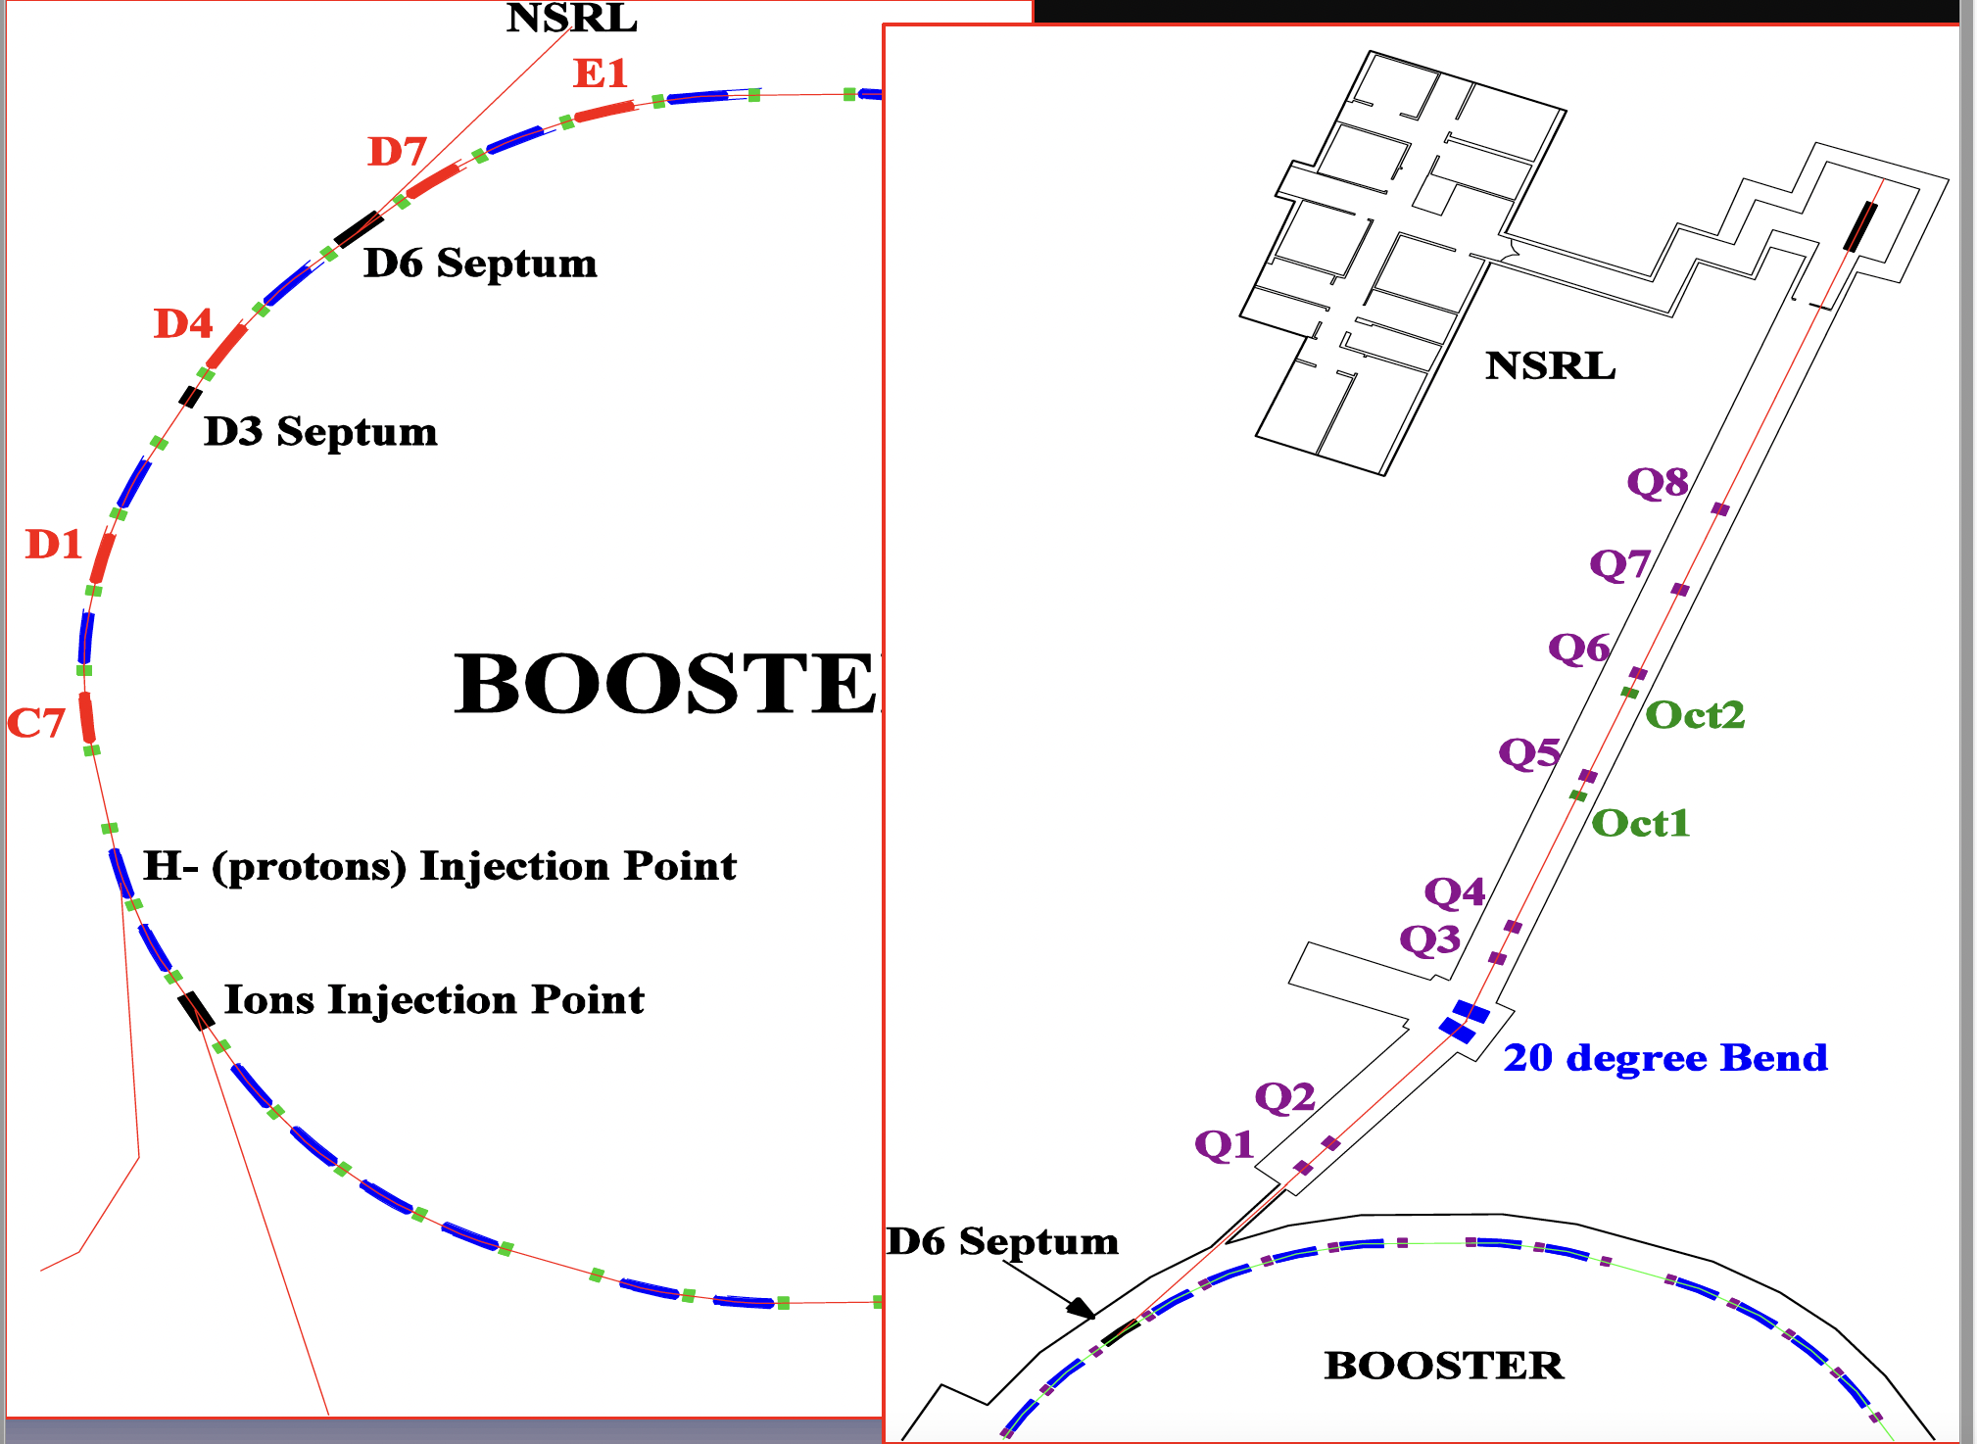
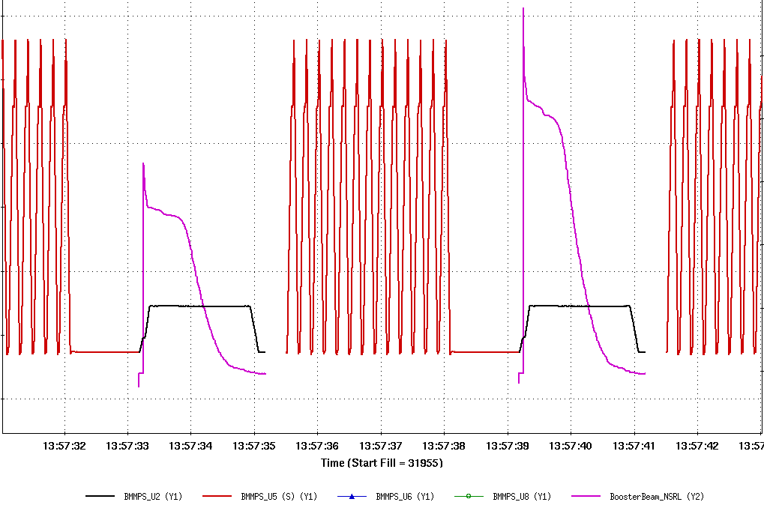
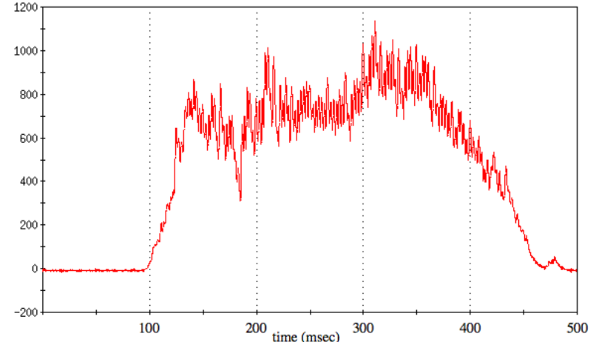

Slide 5
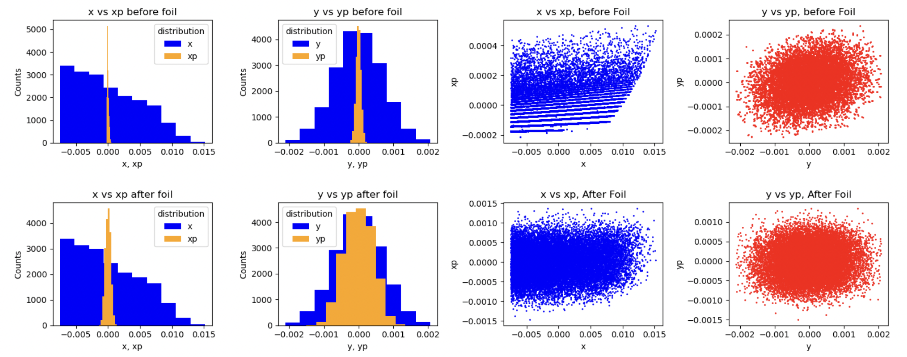
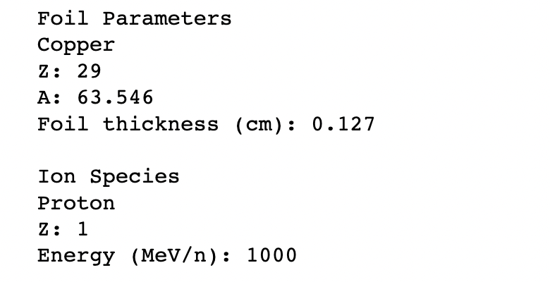
Stripping Foil Effect on Phase Space
Beam transverse phase spaces before and after foil

Slide 6
What accelerator operation resources are needed for BNL’s radiation effects testing programme and what are the heaviest accelerator operation overheads
Personnel and systems for power supplies, RF, vacuum, source machine, synchrotron operations, instrumentation, engineering
Specifically, we are most in need of power supplies, ps hardware (spares/repairs), and staff support for power supply issues
We also see a high amount of “machine setup” time (machine in use, but no user running) and operator time as a consequence of the high number of ion species we need to prepare.

Slide 7
Example of typical user run? Length of run, ions on target, energy changes, intensity changes, accesses needed, time to swap users?
Experimenters often run around 12-16 hours per day due to high demand and low availability. Asking for 1 day to 1 week at a time.
Typically ask for 4-5 different ions, spanning large dE/dx or focus on specifically 1 ion and spend the entire time on that
Users often request 1e7 ions/cm² fluence on one part
Intensity changes may be frequent until finding tolerance point e.g. starting low, 1e2 to 1e3 (ions/cm²)/spill, and increase to max intensity by asking for 2x, 5x or 10x steps
Accesses maybe on order of hourly or after every 1e7 run. They may take ~45 min accesses to change setups or as little as 10 mins to change board on same setup

Slide 8
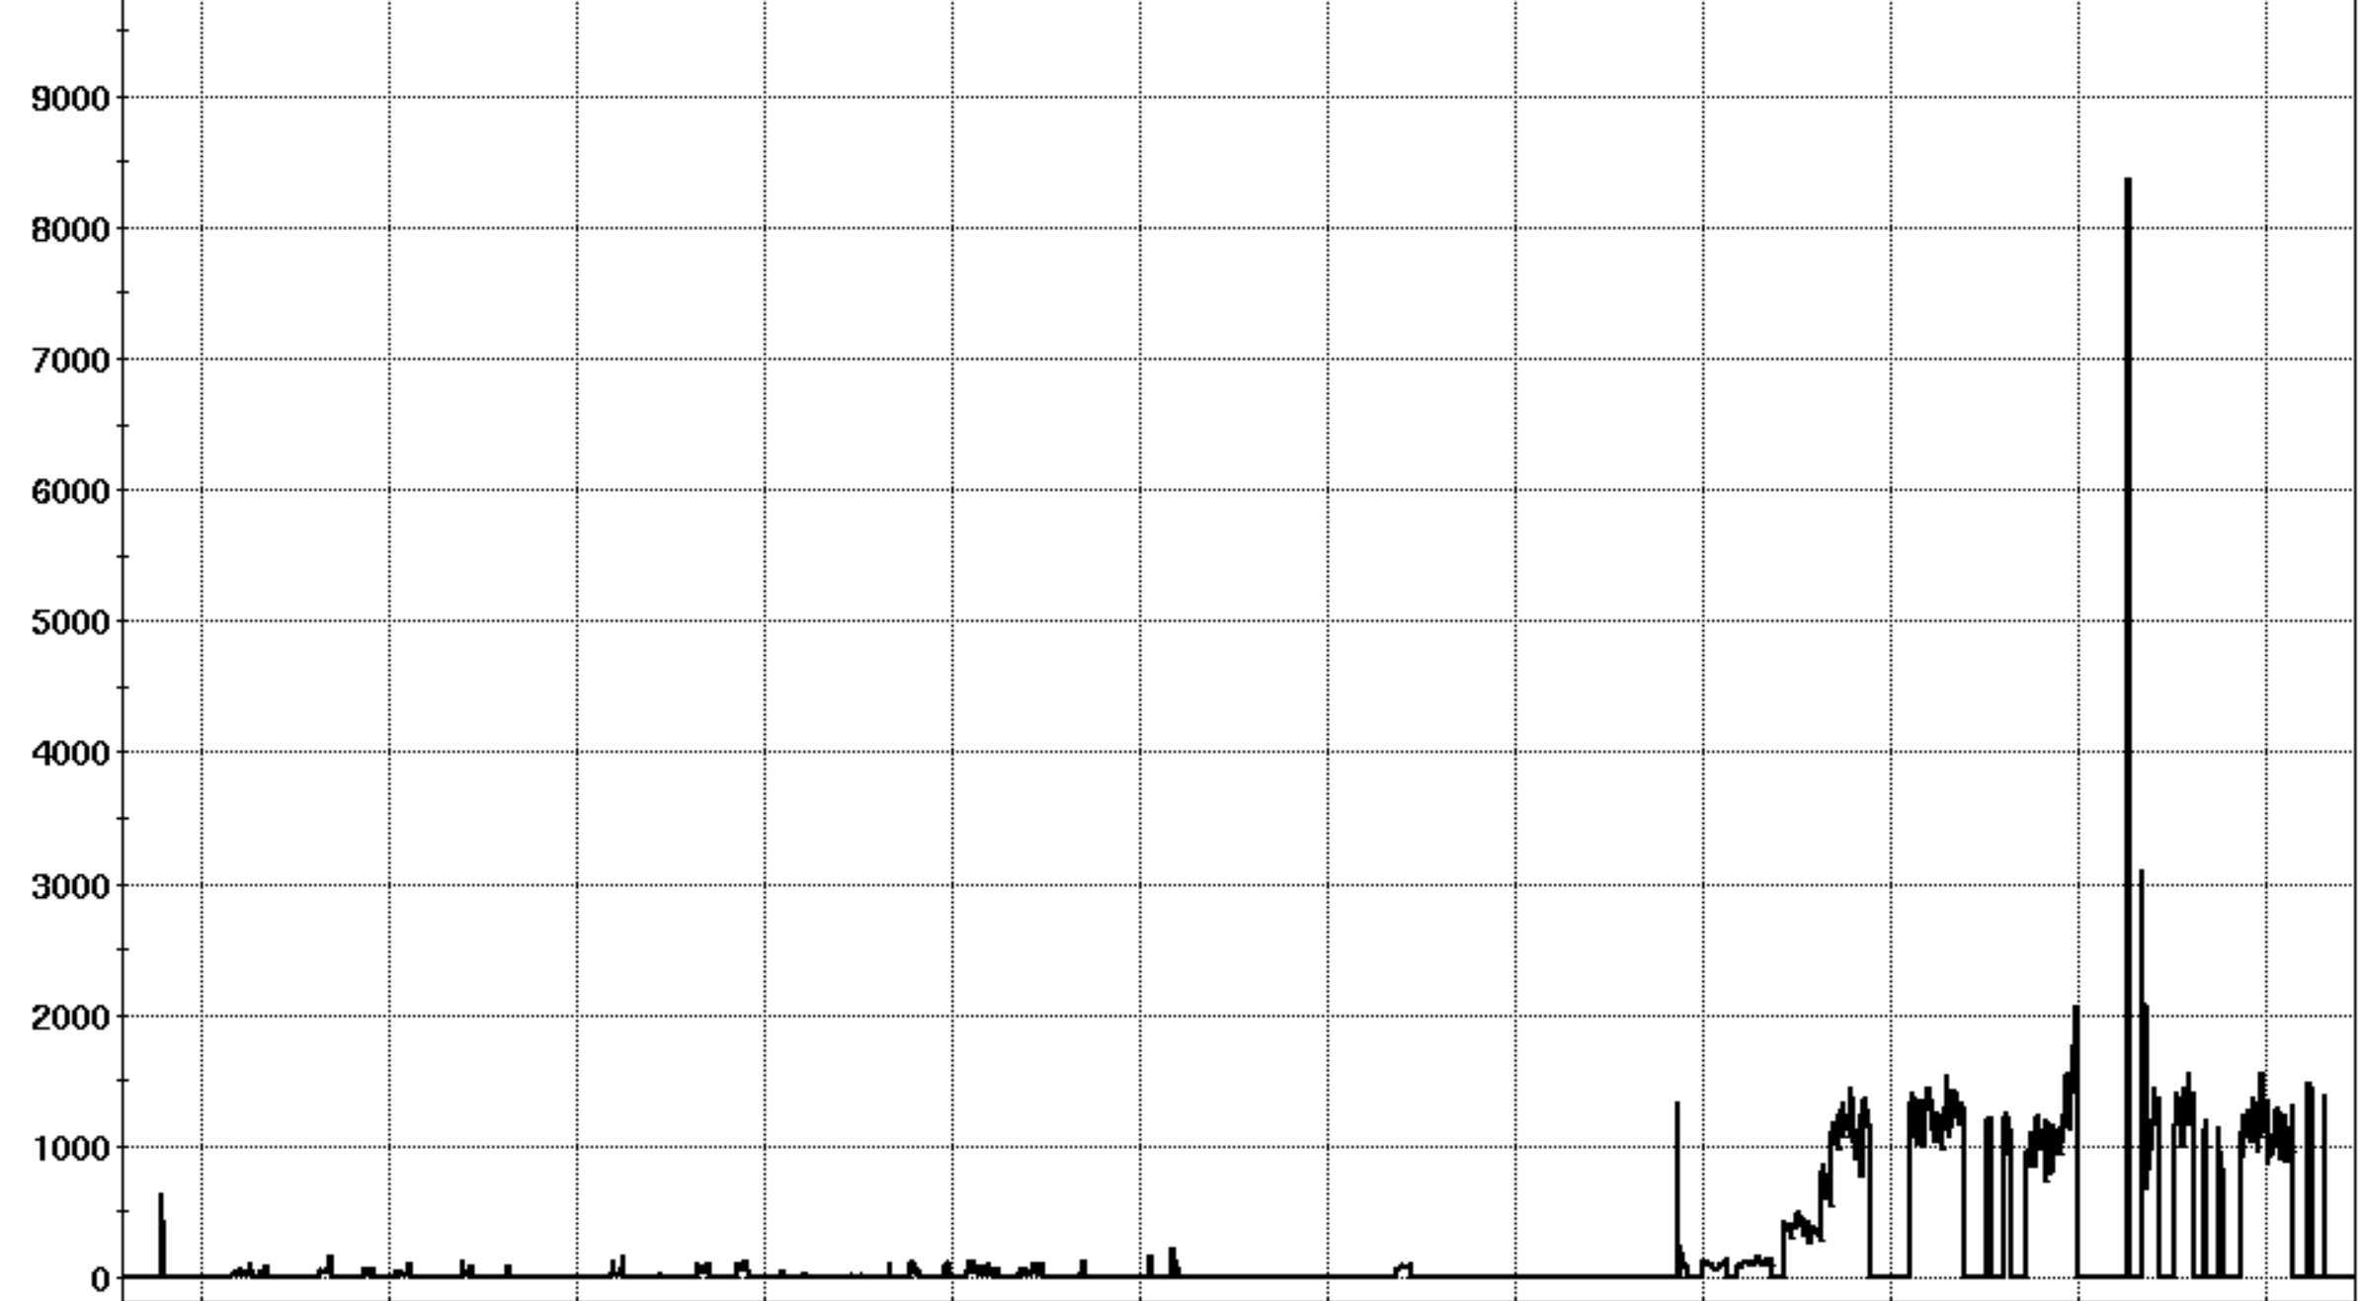
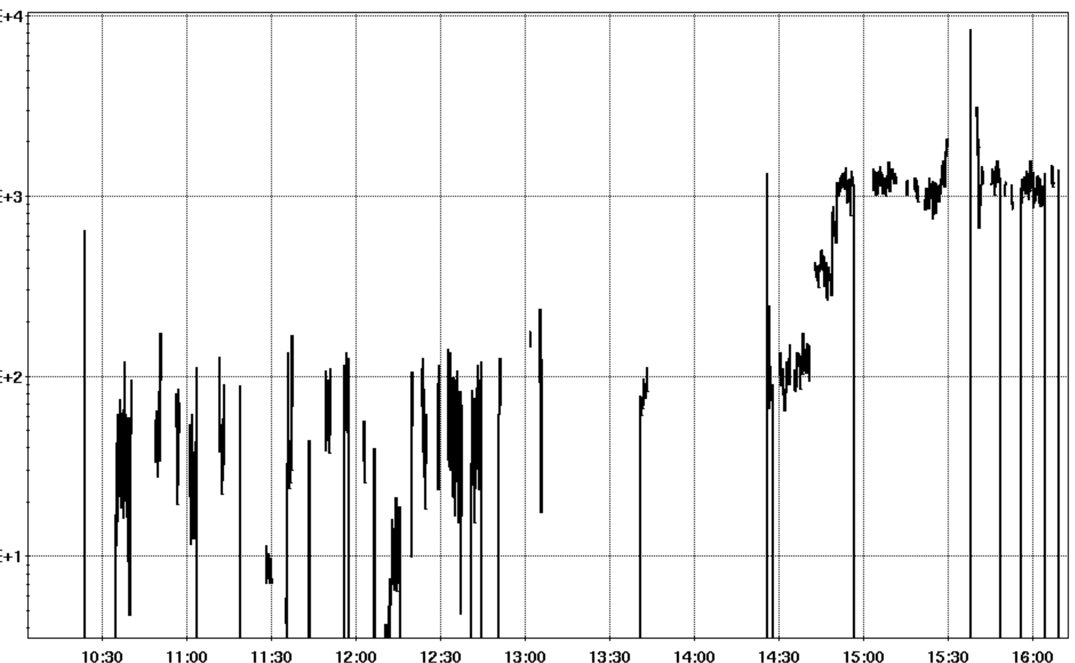
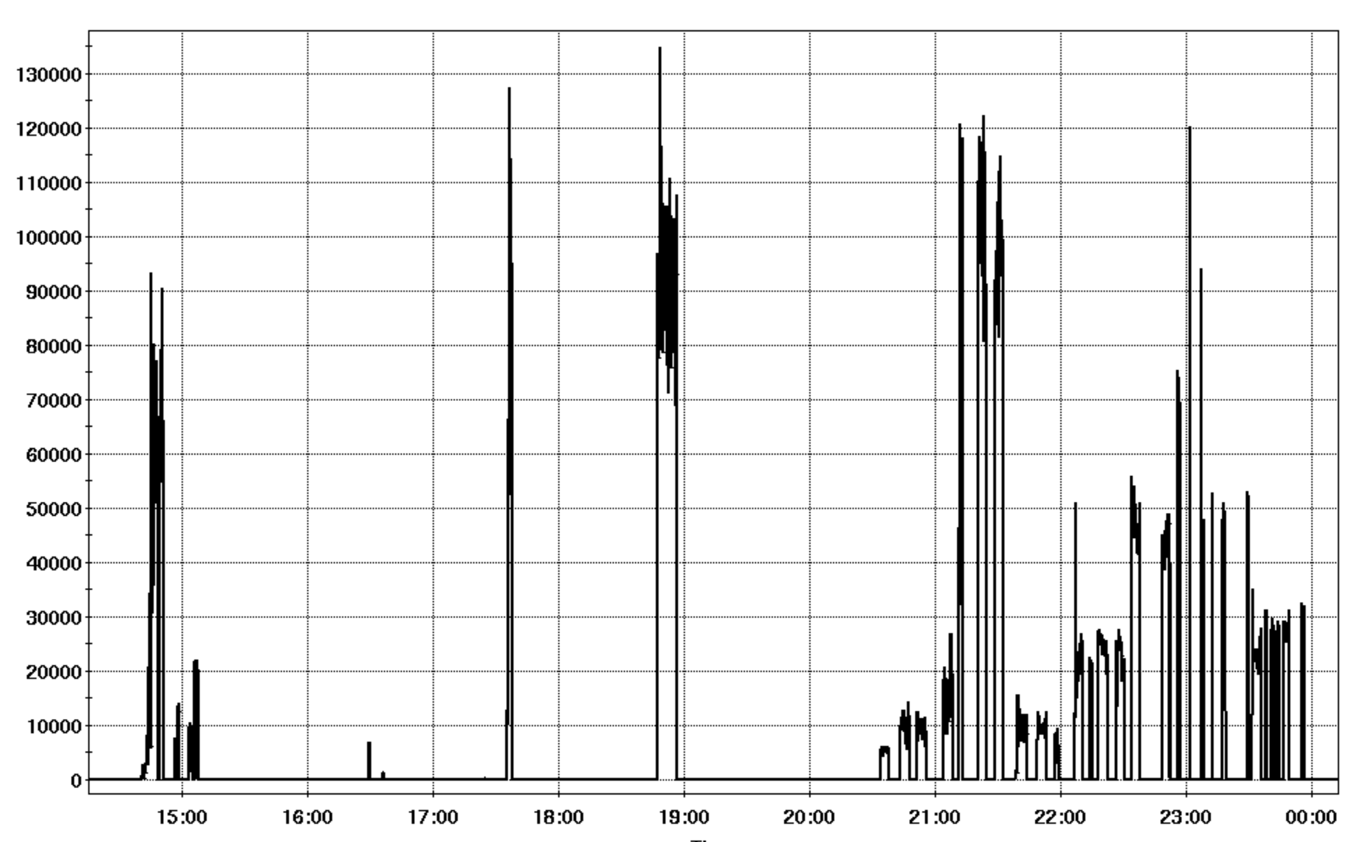
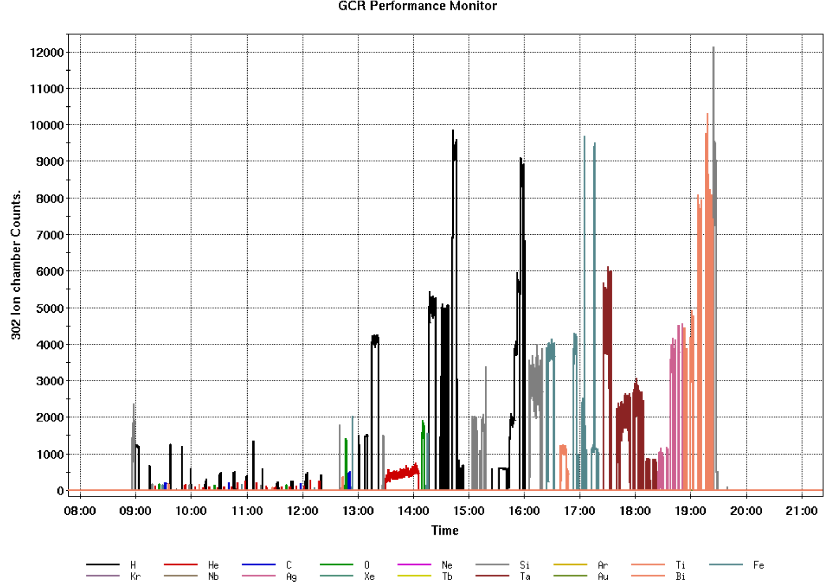
Example of typical user run? Length of run, ions on target, energy changes, intensity changes, accesses needed, time to swap users?

Slide 9
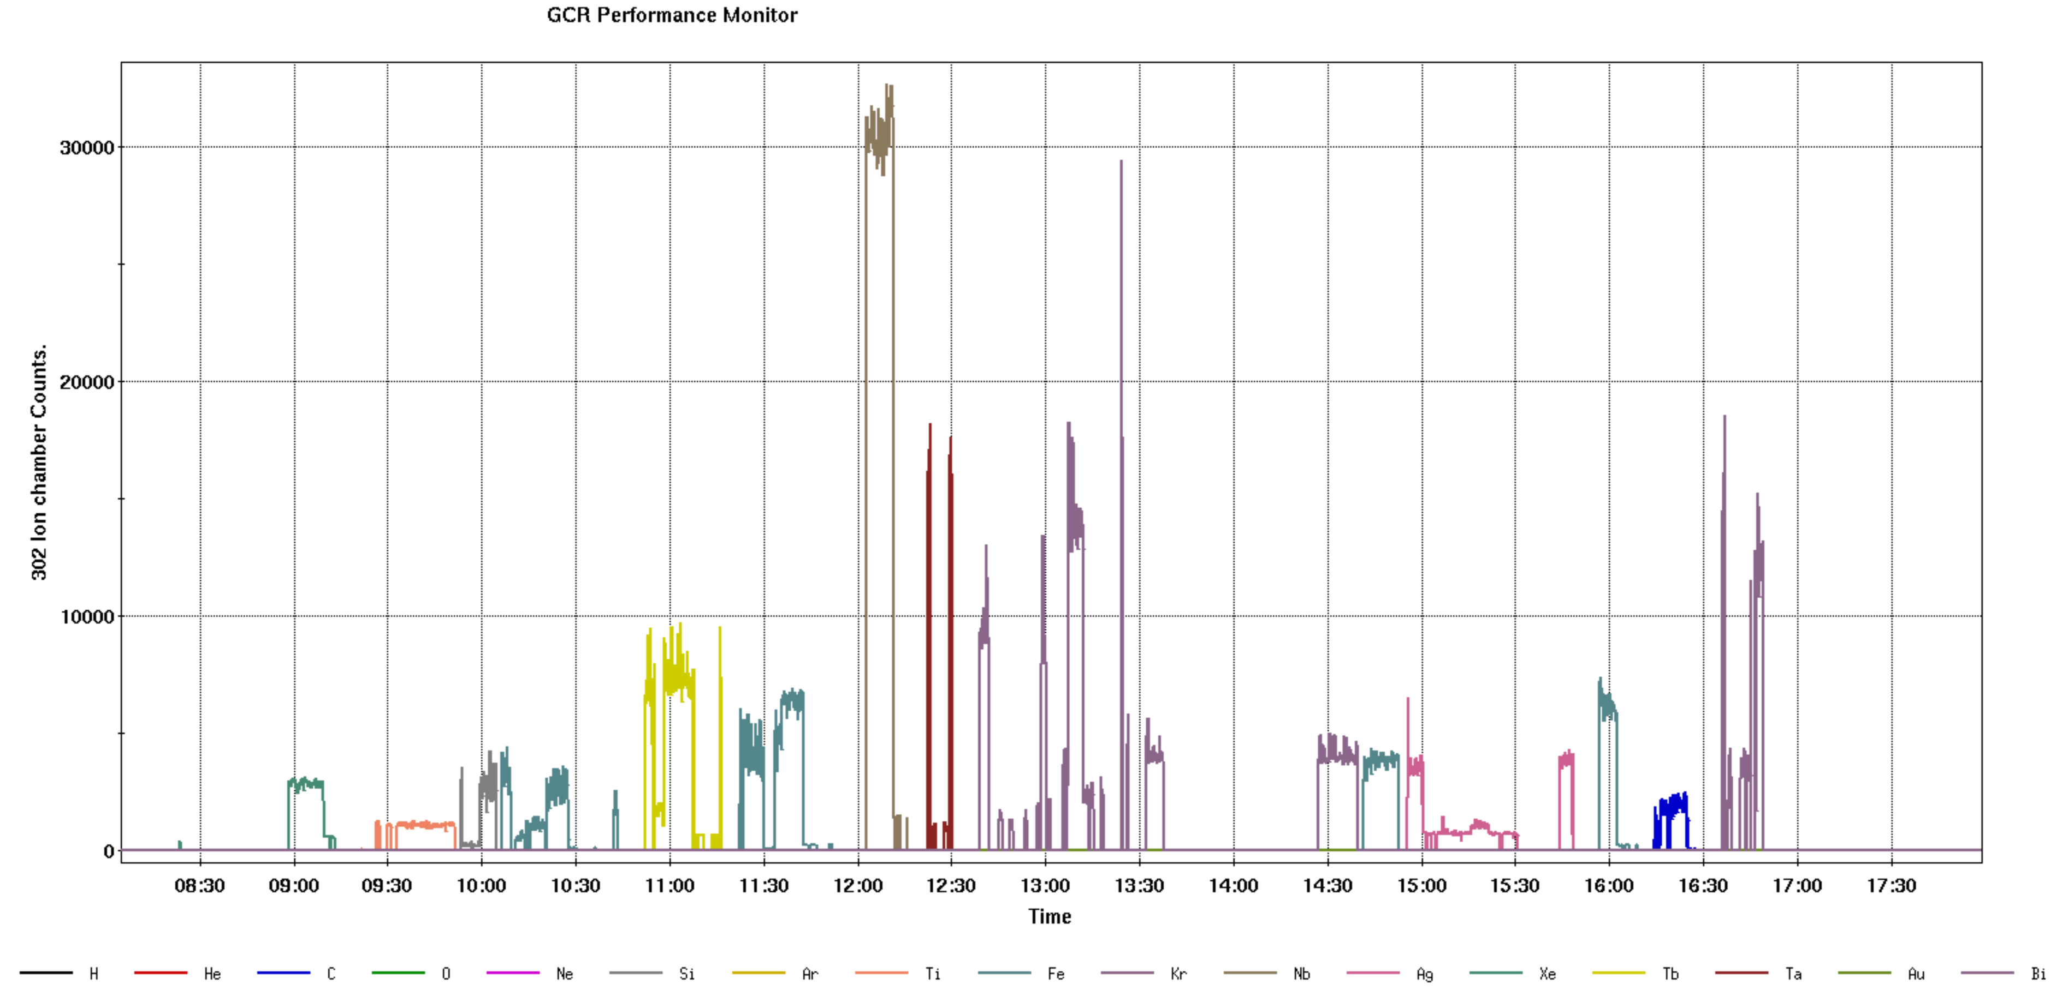

Slide 10
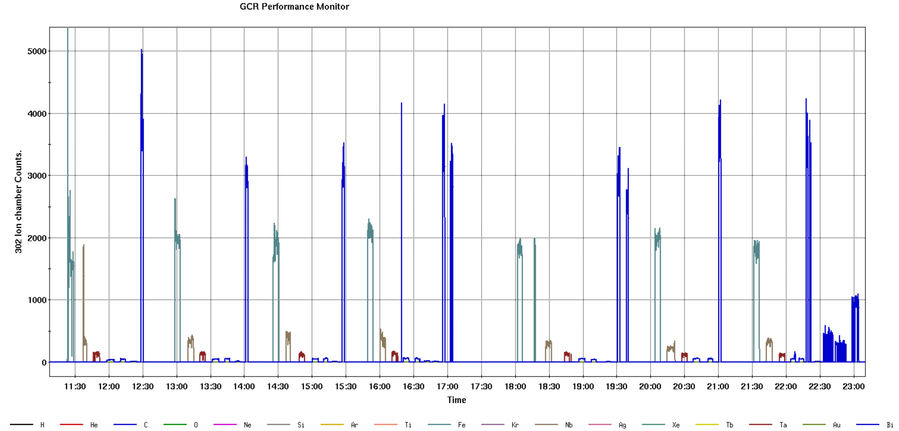
User cycling through Fe, Nb, Ta, Bi to hit LETs 2 to 30+ MeV/(mg/cm²)

Slide 11
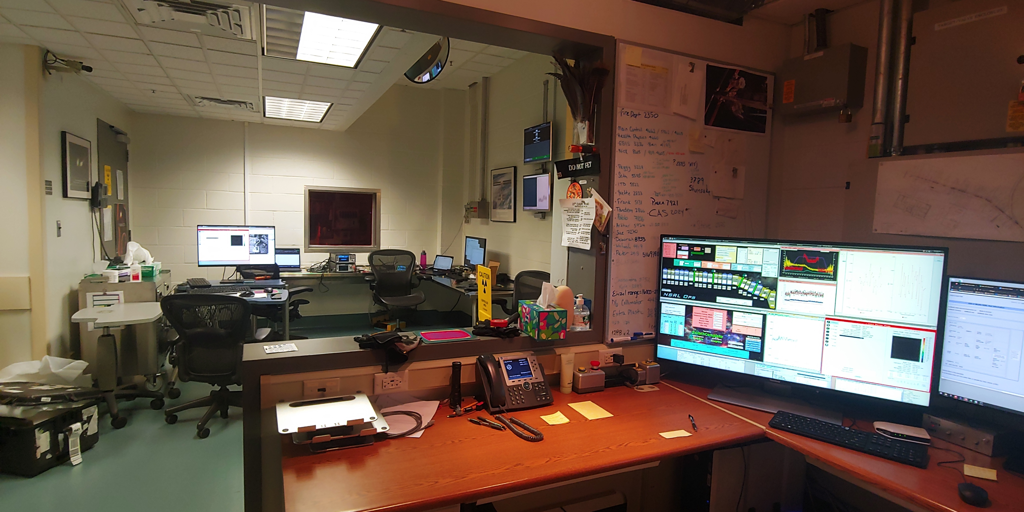
How do users interact with facility/beam operation crew? How do they request a change to parameters?
Users set up their test monitoring areas just across the room from our beam line controls area
This allows for easy communication when there are requests for intensity, energy, or ion species changes
In other facilities, they will need to call a control room for this
The dosimetry program lets users enable beam to reach total fluence, add comments, run numbers.
Hardware switches let them “pause/play” or “end run”
Having the users in the same general area as facility staff comes with the benefit of providing “quality-of-life” (restrooms, kitchen, low-noise) comforts that other facilities lack. Users comment that they much prefer testing here rather than in an industrial warehouse style facility.

Slide 12
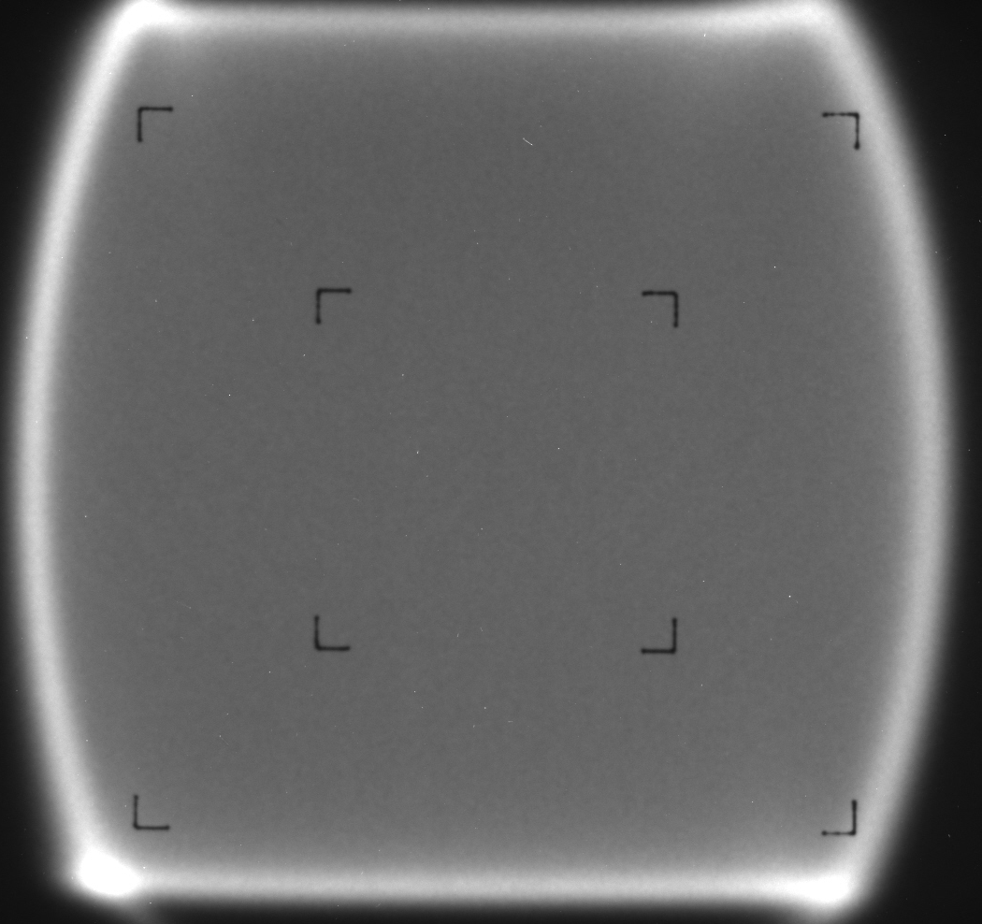
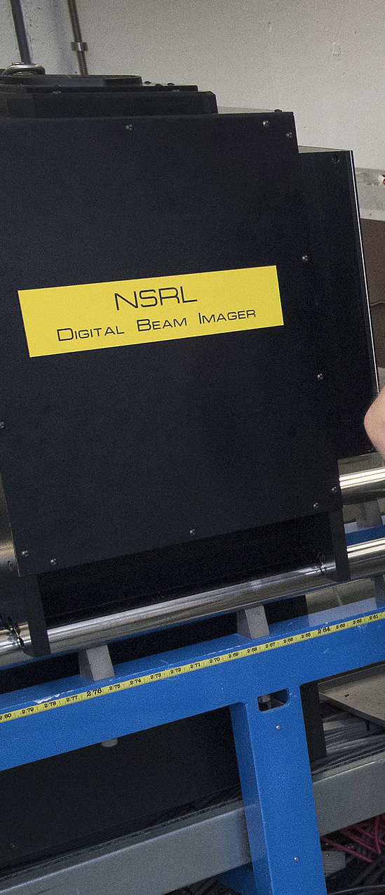
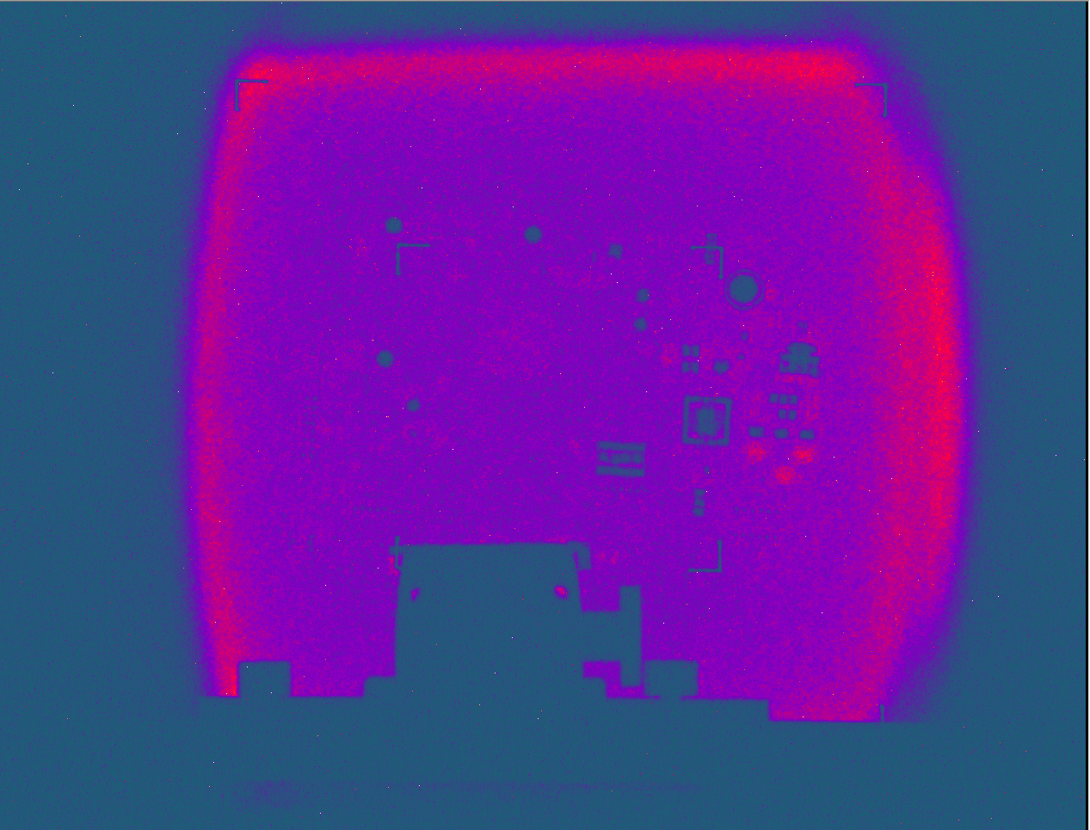
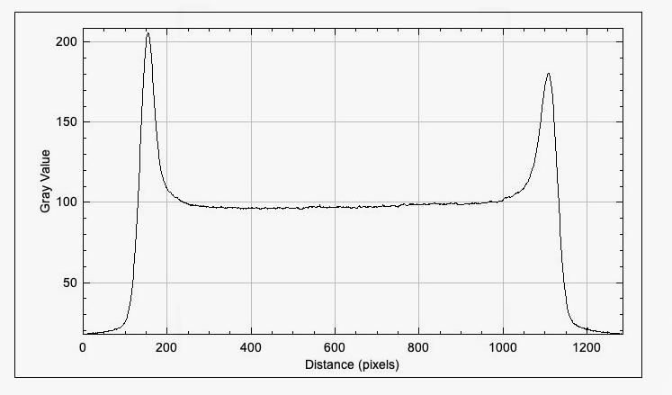
Tools developed to help operation?
Digital Beam Imager: ZnCdS:Ag film over beam area, double mirrors to periscope light into Hamamatsu ccd camera. Software reads in data and integrates image of full spill duration. Can observe beam size and DUT position readily.
Destructive to beam quality!

Slide 13
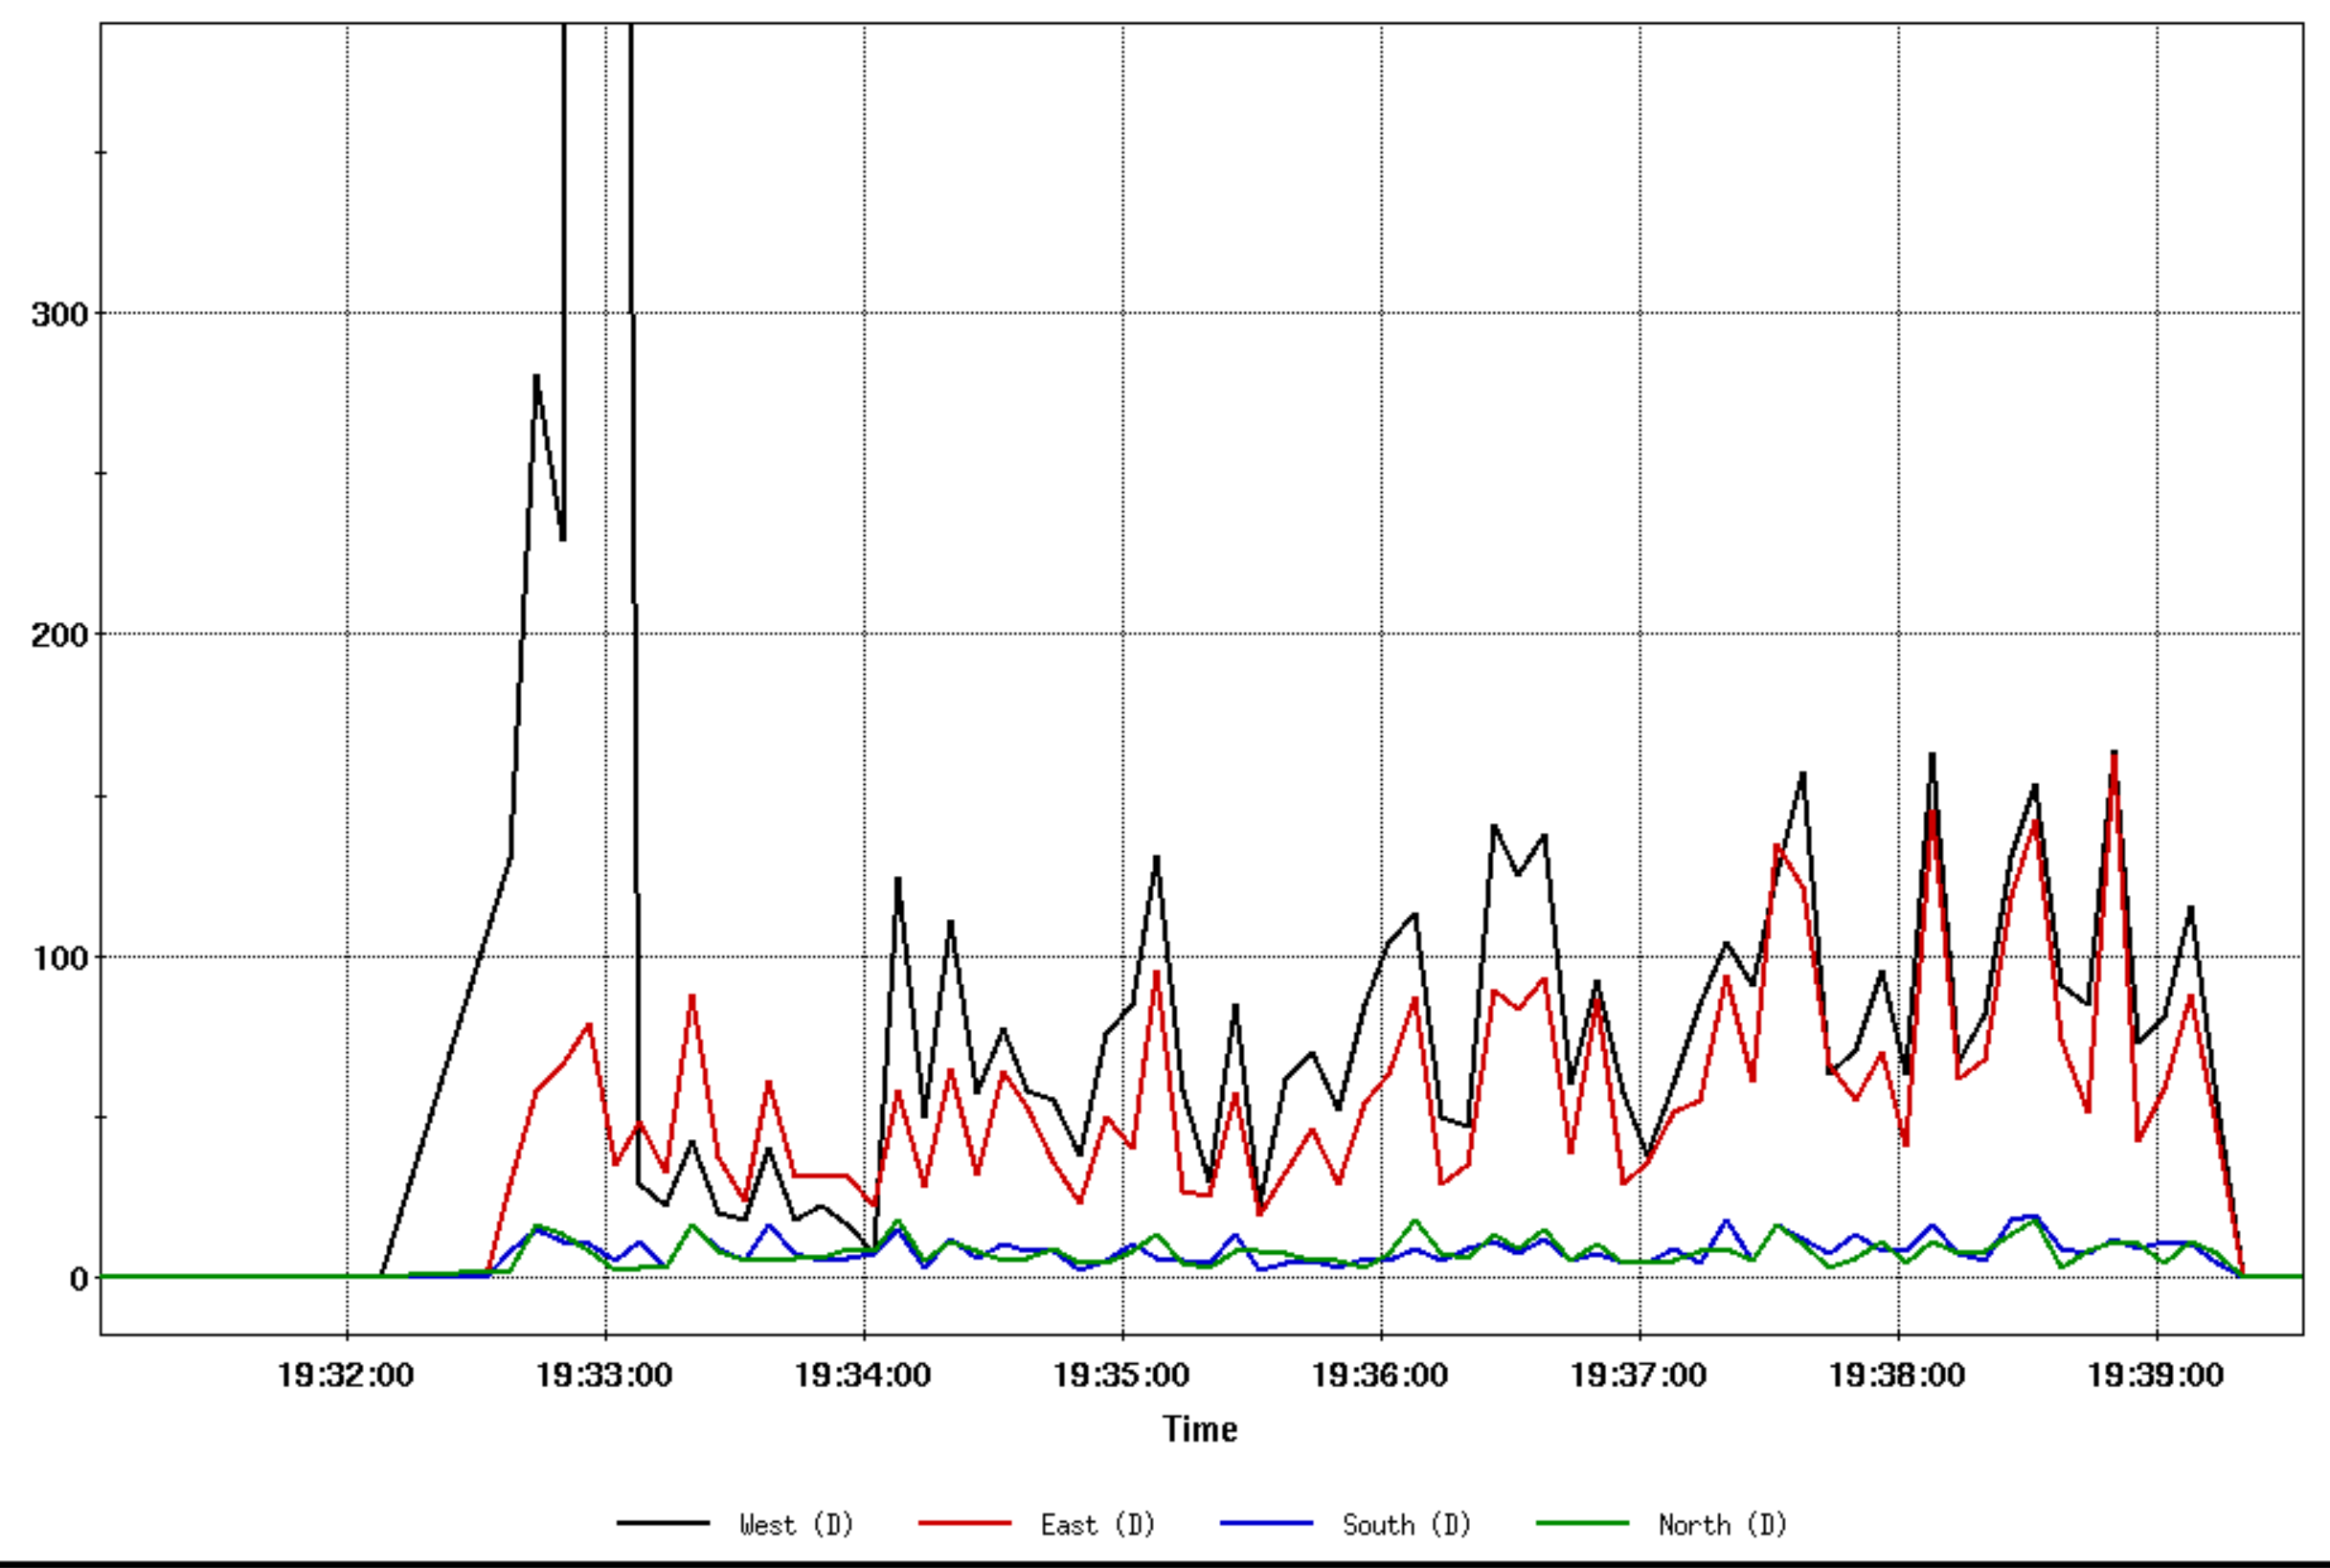
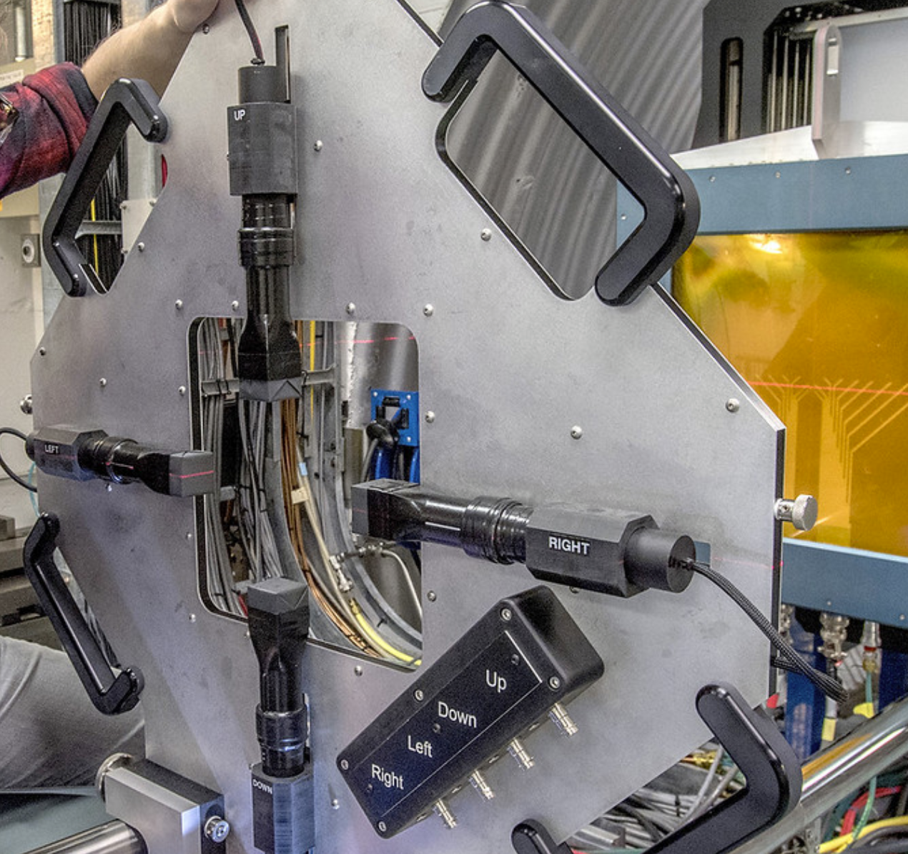
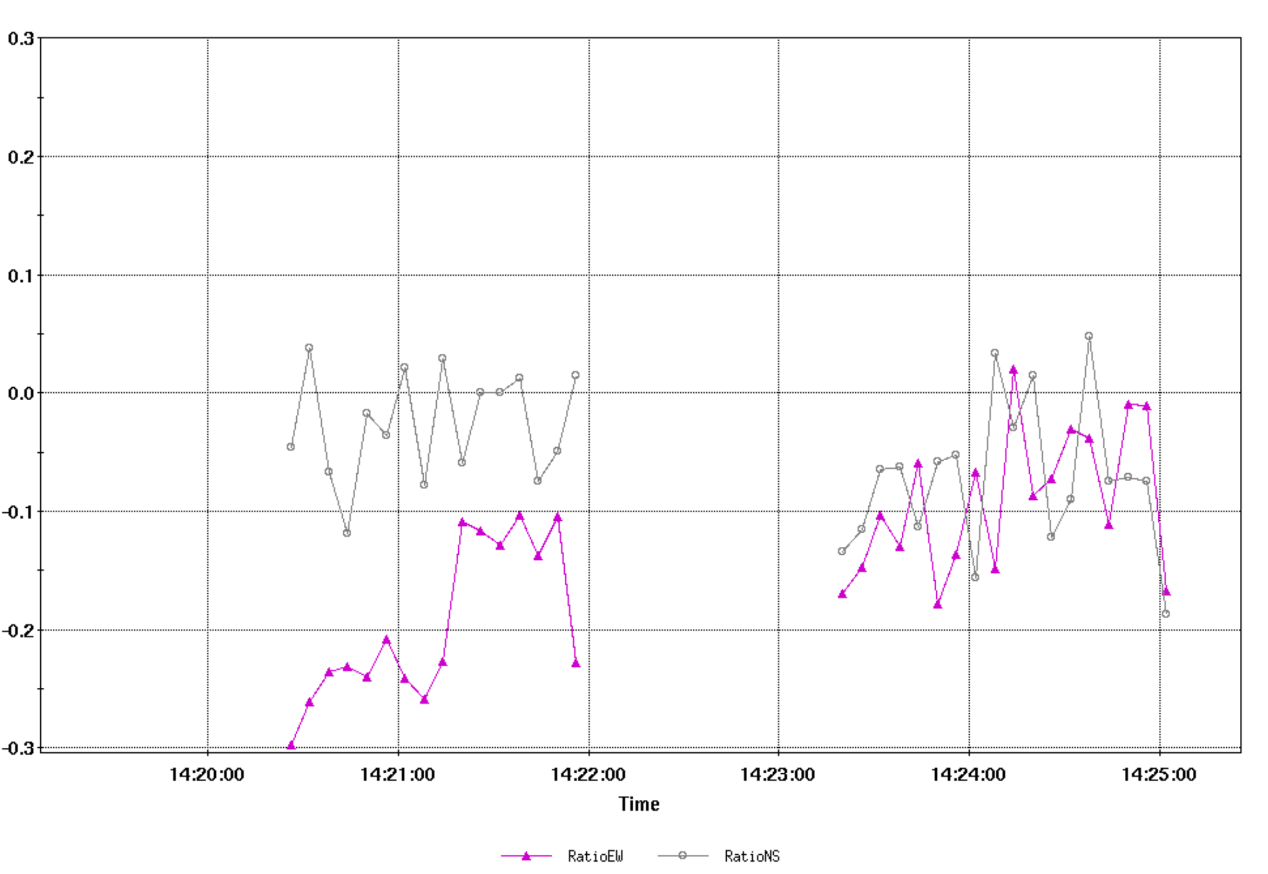
Tools developed to help operation?
Edge Counters: Four 1 cm² scintillators to balance beam intensity during low rates of beam when other instruments see too little signal to operate

Slide 14
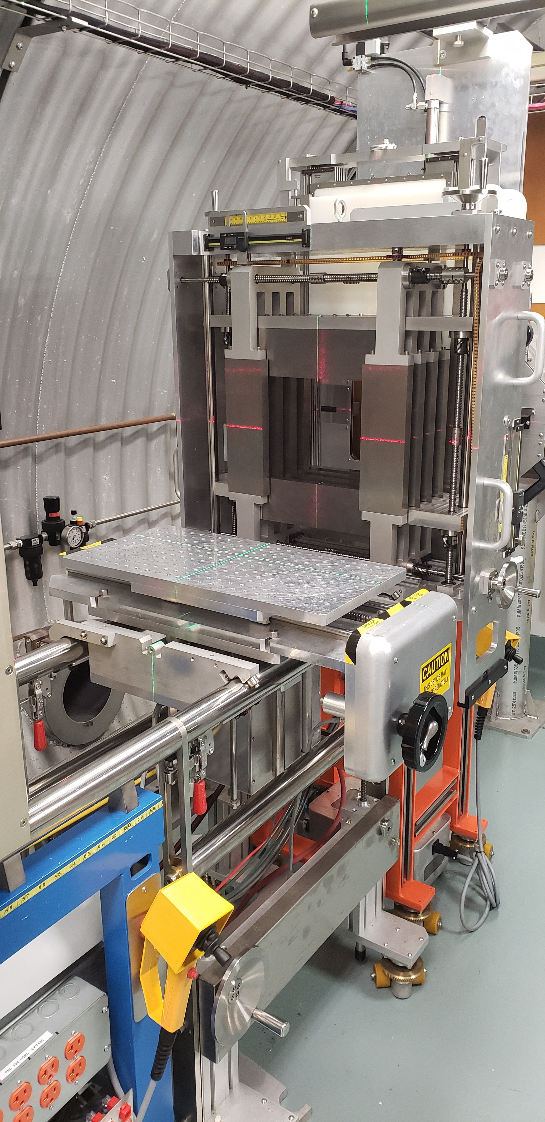
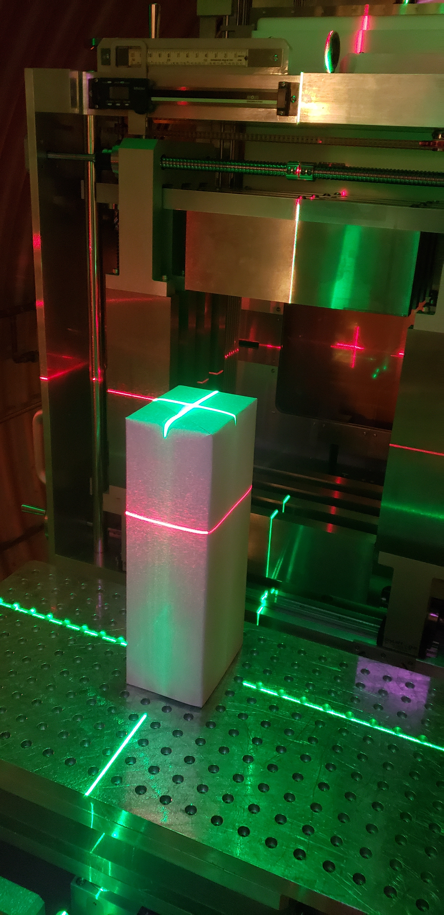
Tools developed to help operation? (for users)
Tungsten Collimator:
Heavy metal alloy (96% W) with hand crank adjustments and digital calipers to set beam area to specific sizes
Laser alignment system:
Aligning equipment on 3 axes of interest

Slide 15
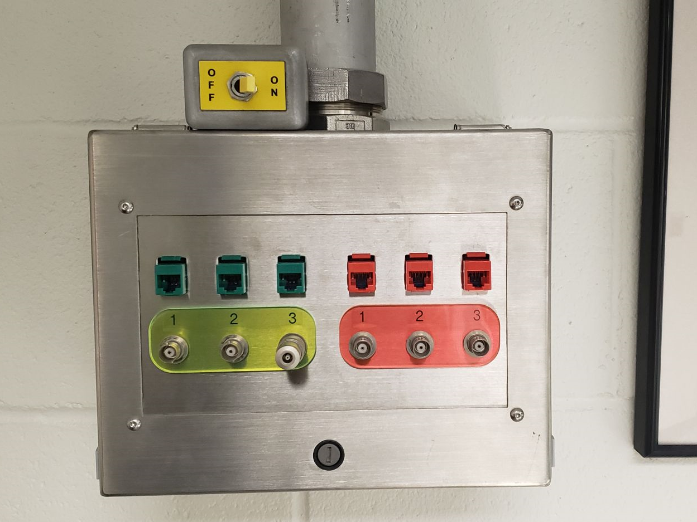
Tools developed to help operation? (for users)
Beam present signal:
A scintillator near the beam (but out of uniform area to not be destructive to beam quality) produces signal and this is processed into a TTL high signal that is sent to users either in the target room or at the user area
Beam off switch:
Our dosimetry control unit has set of cutoff or “clamp” inputs which check for 50Ω impedance or open circuit. This has a very fast cutoff response, but even without, users need this switch to stop beam during hardware errors. A physical switch is much preferred to a digital switch.

Slide 16
What are the most challenging user requests and common complaints?
Higher beam intensity
… we often suffer from low intensity from the source and when users run to 1e7/cm² it takes a long time (and therefore cost)
More beam time and faster scheduling turn-around
… since we schedule around NASA work, they complain it’s hard to get time when they need it
Continuous beam (longer spills)
… users complain about our ~10% duty factor

Slide 17
What user requests can’t be satisfied and why?
“Cocktail” beam, like LBL.
However, we have noticed contamination using Helium. Electronics testers have asked for our GCRSim
Stopping beam, like TAMU.
- We don’t like to prepare any base beam below 100 MeV/n (emittance blow-up causes poor uniformity in 20x20 squares)
Continuous beam, like any cyclotron.
Synchrotron cycle set by RHIC operations. Often 6.6 sec.
Spill is generally 350-400 ms in duration

Slide 18
Lessons learnt if the facility was to be setup again?
Put degrader in vacuum, upstream of the last bending magnet. Allows for removal of primary beam fragments and secondaries from degrader material.
However, this also means specifically tuning beam line after said bending magnets for every degrader settings requested. Also requires new calibrations for every degrader setpoint. This would be problematic with our current format where any step of degrader material can be made on-the-fly
Avoid recycling integrator dose read out (ours is vme-based). Many points of failure with readout cards and often acts as a black box between detector and program interface

Slide 19
Lessons learnt if the facility was to be setup again?
From a non-technical perspective:
Plan for more user staging area than expected. When we see multiple groups interested in arriving to unpack and set up equipment, we have to find places to put their egregious amount of pelican cases or shipping pallets.
And then we need to keep the equipment until activated materials are below background before we can ship off-site, so we find ourselves storing things in our biology labs

Slide 20
Figure of merits and beam quality tracking? How is this done at BNL for the external users?
Figures of merit/beam quality:
Beam uniformity
  ImageJ analysis of digital beam imager for 20x20 beams
  Large beams can be analyzed through pixel chamber readback
Intensity fluctuations
  Users receive spill logs of intensity fluctuations and we have compared these values to a live scintillator readout observing single digit discrepancies. This is likely a consequence of our dosimetry system’s background subtraction routine.
Dose reproducibility
  Beam cutoff is very fast (μs scale) since our irradiation control system sends a signal to the controls network and disables the “beam permit” in the booster. Beam sent to dump rather than extracted after that signal is received

Slide 21
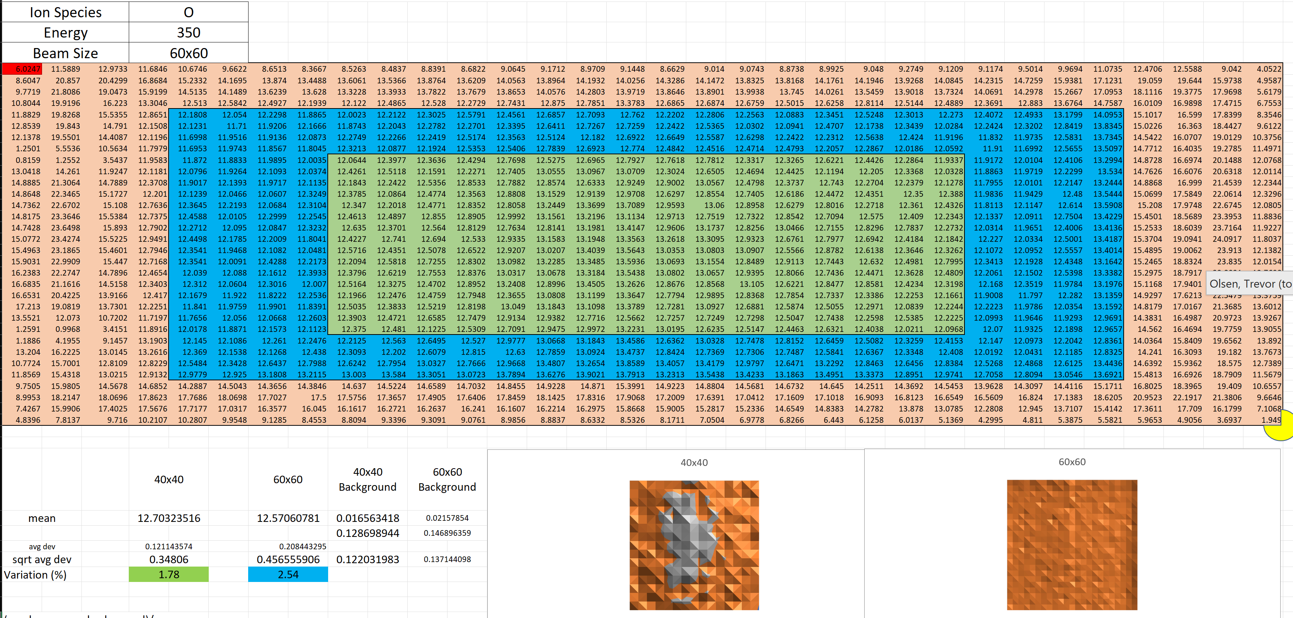
Figure of merits and beam quality tracking? How is this done at BNL for the external users?
Beam uniformity:
32 x 32 Pixel Chamber array readout can be analyzed and rms computed. This was done ahead of 2023 NASA biology work.

Slide 22
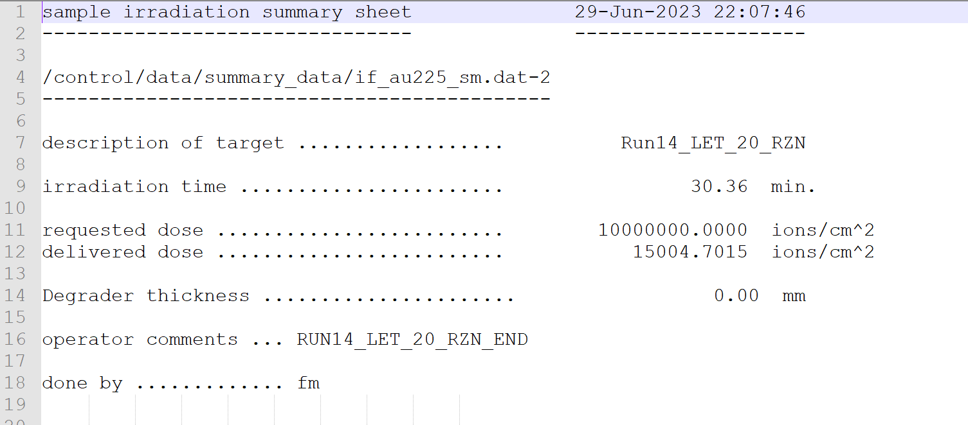
Figure of merits and beam quality tracking? How is this done at BNL for the external users?
User run summary files:

Slide 23
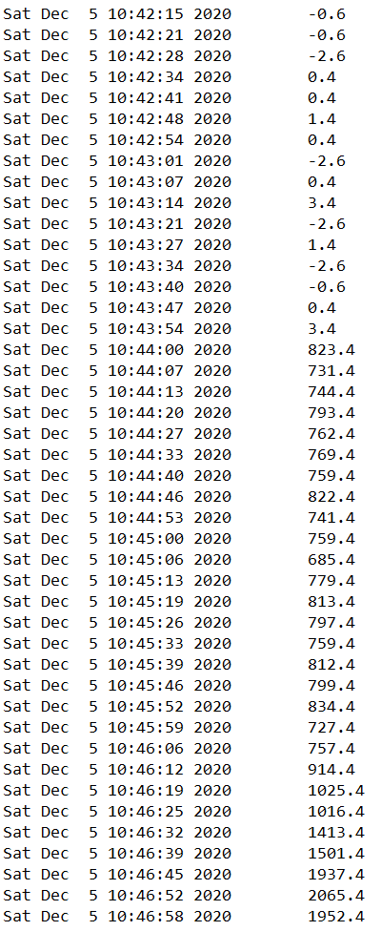
Figure of merits and beam quality tracking? How is this done at BNL for the external users?
User spill data:
Data is gathered and logged for every spill/cycle containing # of ions/cm² with a corresponding time stamp
Example of spill-by-spill data sent to user: Note time stamps occur with 6 or 7 second increments (6.6 second cycle time) Spills with no beam can show values above or below 0 due to detector sending signal which is roughly ±1 – 5 and then calibrated

