Slide 1





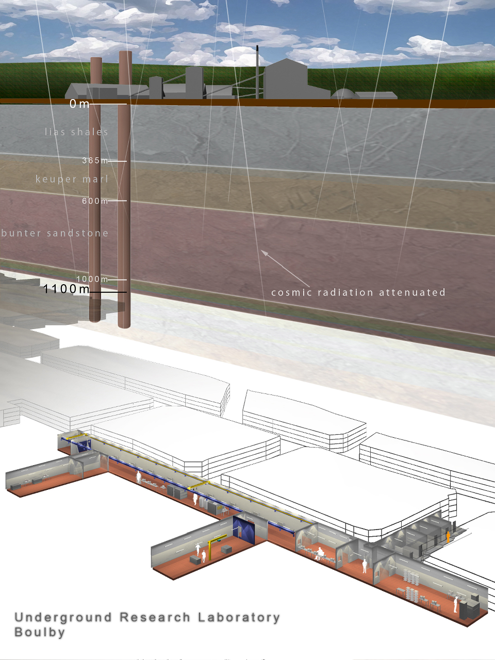
ZEPLIN-III SECOND SCIENCE RUN
Henrique Araújo
Imperial College London
on behalf of ZEPLIN-III Collaboration:
Edinburgh University (UK), Imperial College London (UK),
ITEP-Moscow (Russia), LIP-Coimbra (Portugal)
STFC Rutherford Appleton Laboratory (UK)
IOP2011 NPPD CONFERENCE
3-7 April 2011, University of Glasgow

Slide 2
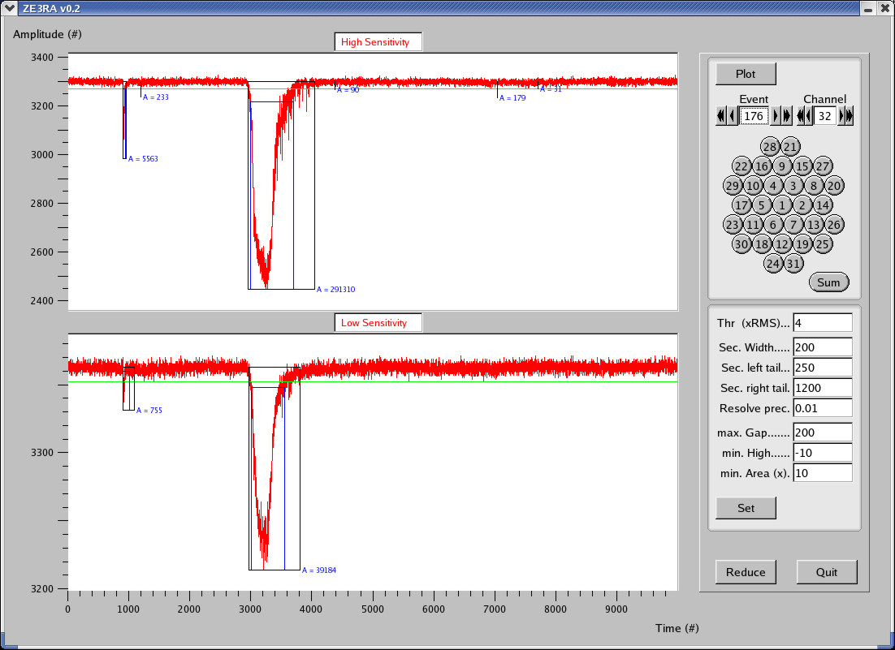
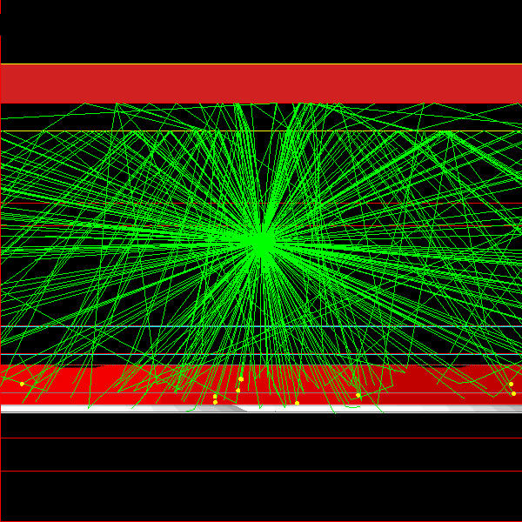
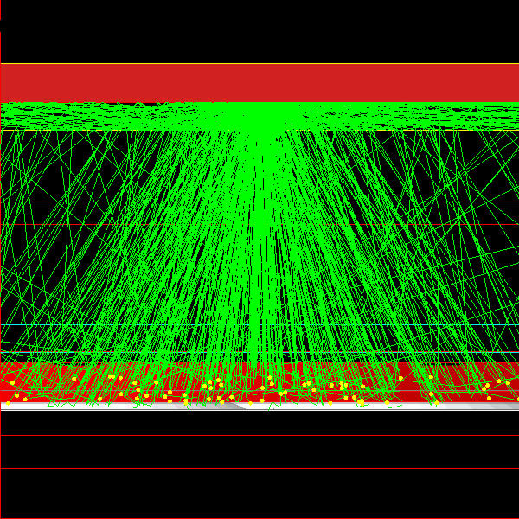
ZEPLIN-III: 2-phase xenon TPC
Readout of scintillation light and ionisation charge with array of 31 photomultipliers
Gaseous xenon
Liquid xenon
photomultipliers
S1
Sensitivity to single ionisation electrons!
Edwards et al., arXiv:0708.0768
S2
Primary Scintillation
Secondary Scintillation (electroluminescence)

Slide 3
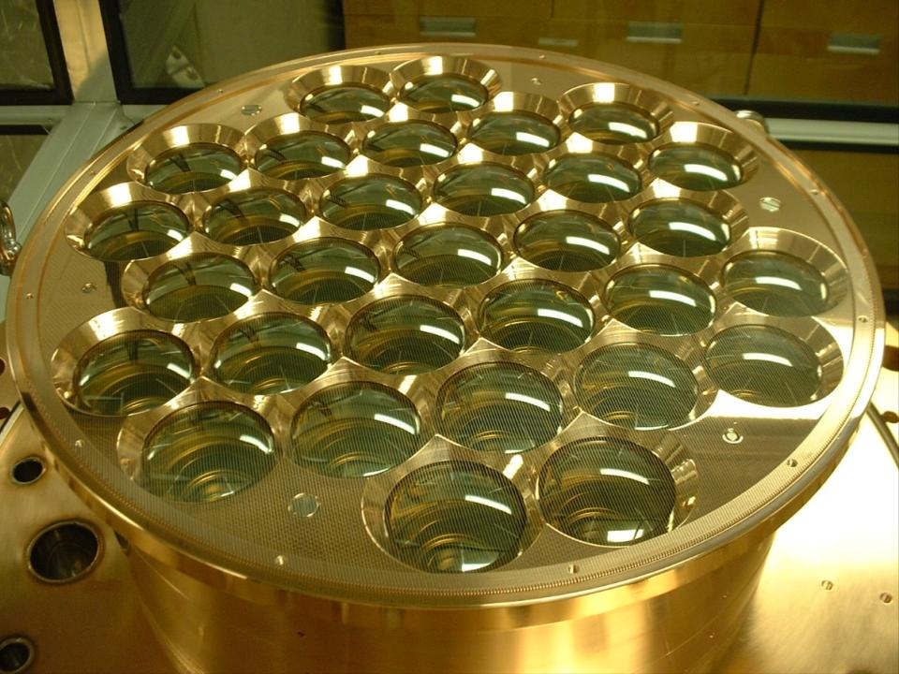
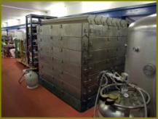
First science run
First science run at Boulby: 83 days in 2008
Strong constraints on WIMP-nucleon scattering cross-sections
  V. N. Lebedenko et al., Phys. Rev. D 80: 052010 (2009)
  Scalar cross-section excluded above 8.1x10⁻⁸ pb (90% CL) at 60 GeV/c²
  V. N. Lebedenko et al., Phys. Rev. Lett. 103: 151302 (2009)
  WIMP-neutron cross-section excluded above 1.9x10⁻² pb (90% CL)
  Akimov et al., Phys. Lett. B 692: 180 (2010)
  Explanation of DAMA with inelastic DM model ruled out at 87% CL
Phase-II upgrades commissioned in 2009/10
  New photomultiplier array (low background)
  New anti-coincidence veto (background reduction & diagnostic)
  New calibration hardware (reduction of systematics)
  System automation (underground effort, improved stability)
Second science run underway since Jun 2010

Slide 4
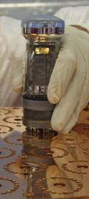
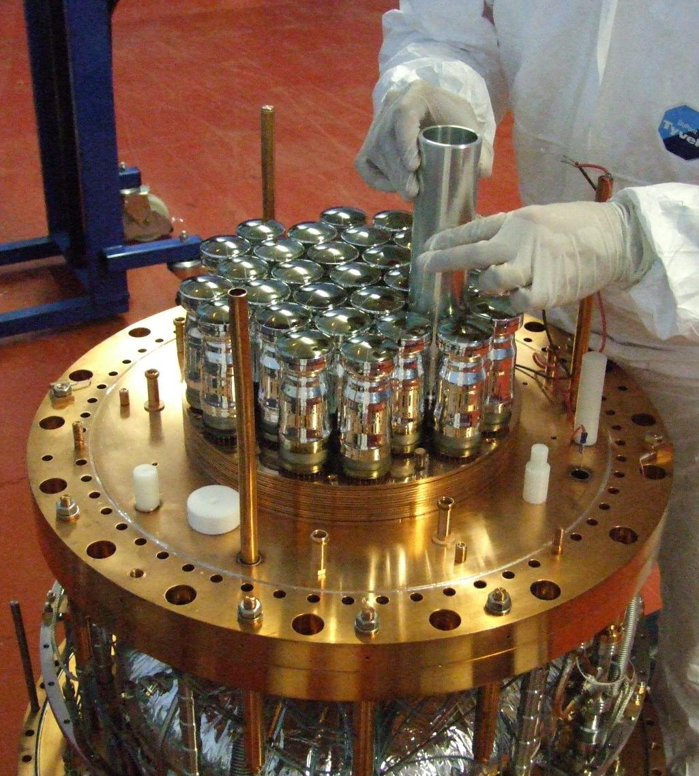
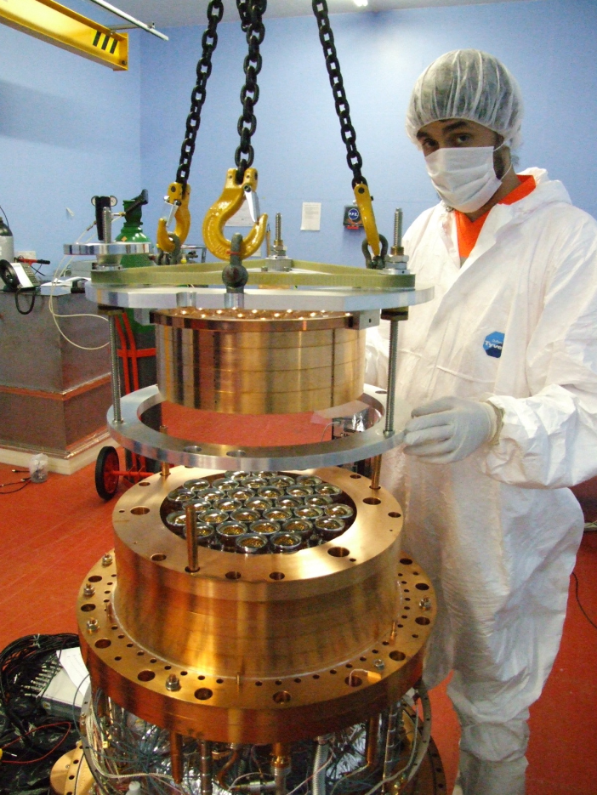
Photomultiplier upgrade
PMT gamma-rays limited sensitivity of first run by a large factor
Custom design for ultra low-background tubes, pin-by-pin compatible
Assembly onto ZEPLIN-III array in early 2010
Aiming for 30x reduction in radioactivity to <50 mBq/PMT

Slide 5
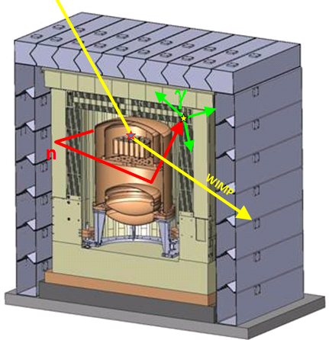
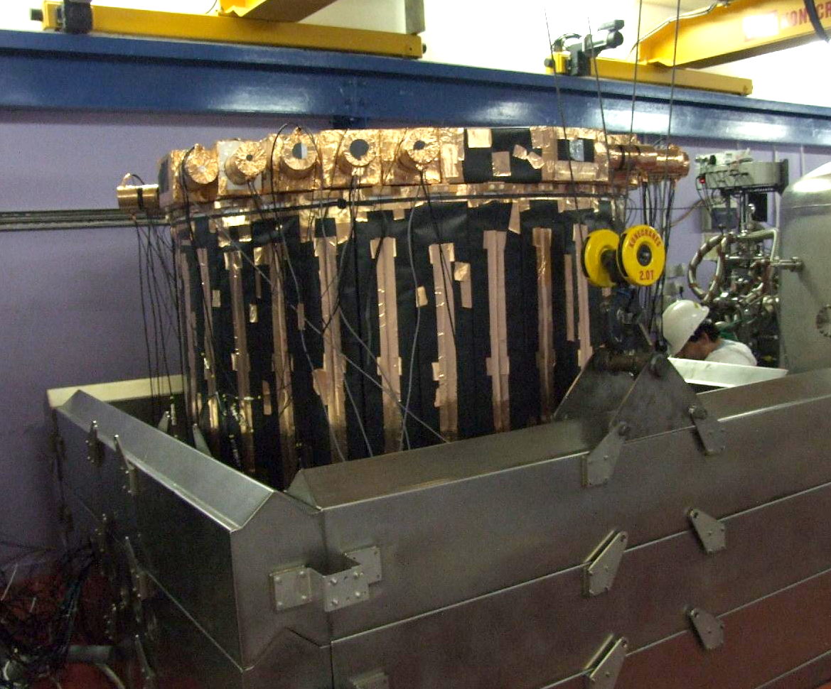
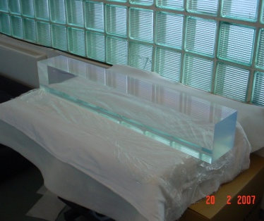
→ see talks by Chamkaur Ghag, Ant Hollingsworth & Lea Reichhart
Anti-coincidence (veto) detector
52-ch (~3π) veto detector replaces some hydrocarbon shielding around target
Inner gadolinium-loaded hydrocarbon surrounded by plastic scintillator
Delayed-coincidence detection of Gd-158 gammas (11 μs mean capture time)
60% neutron tagging, 28% gamma-ray tagging, important diagnostic tool

Slide 6
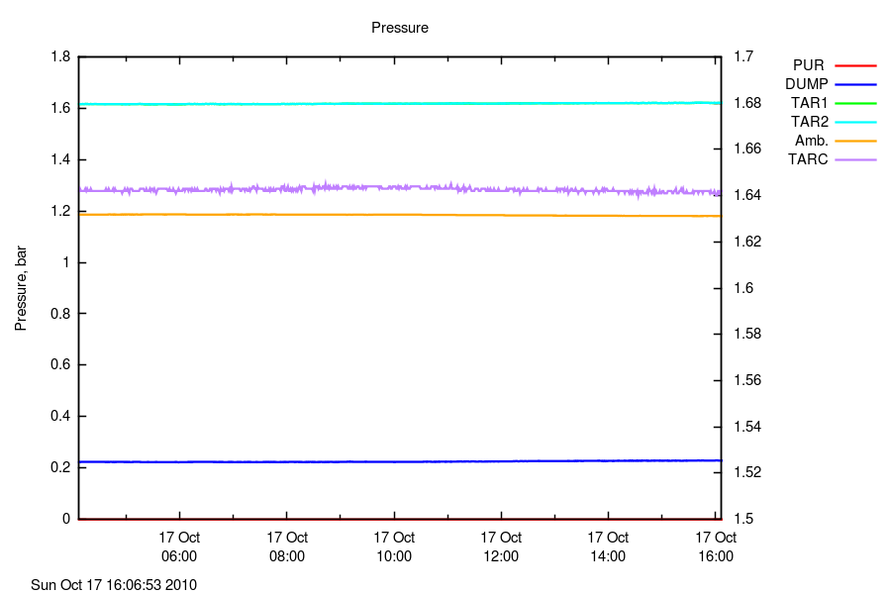
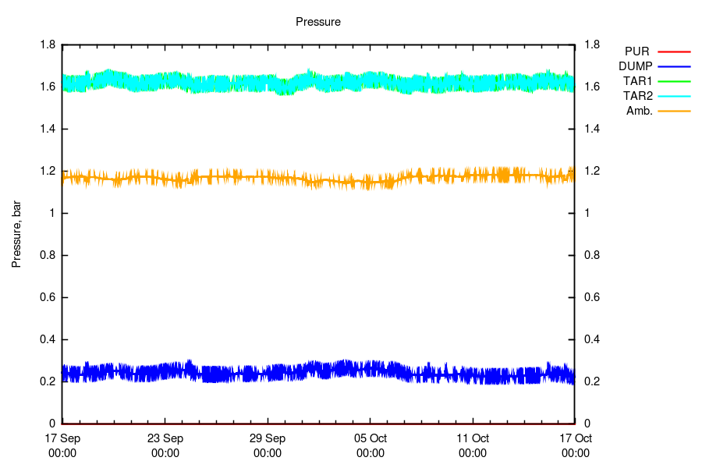
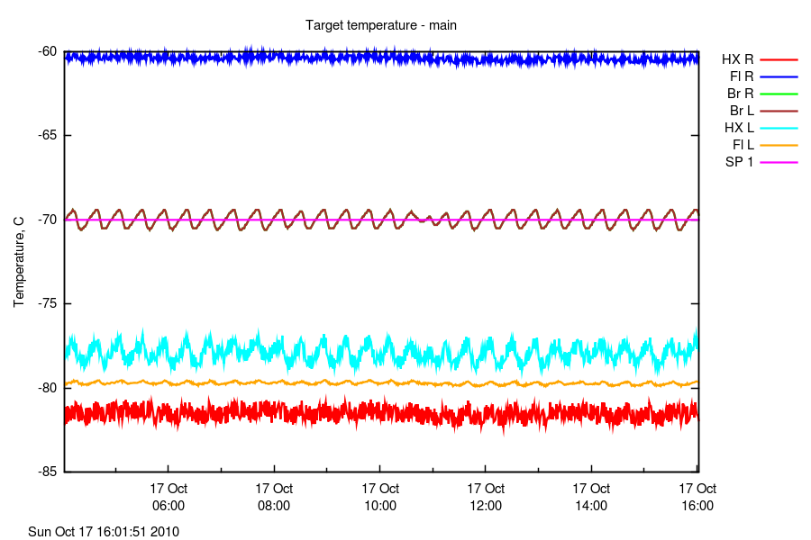
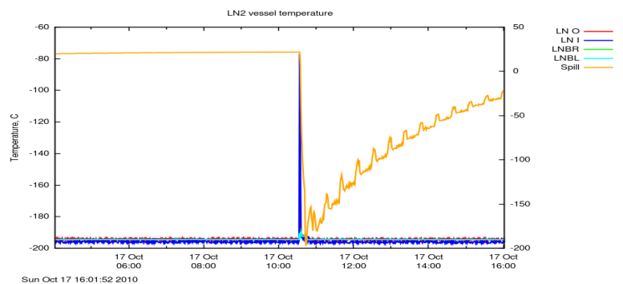
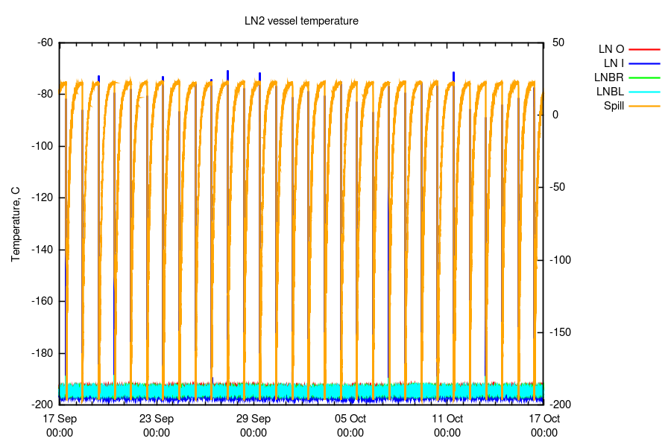
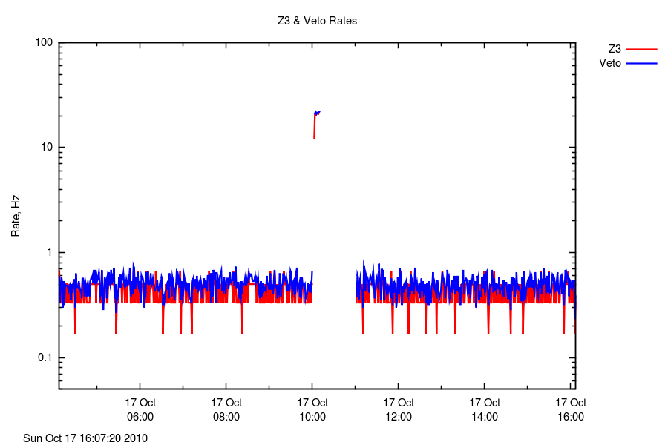
SSR OPERATIONS
12 hours
1 month
TARGET PRESSURES
GXe pressure
Xe pressure
environment
PRESSURE
LXe flange temperature
TARGET TEMPERATURES
target control temperature
reference
LN2 TEMPERATURES
10:30
LN₂ filling
daily LN₂ refill
LN2 TEMPERATURES
10:00
Co-57 cal
Z3/VETO COUNT RATE

Slide 7
Second science run goal

Slide 8
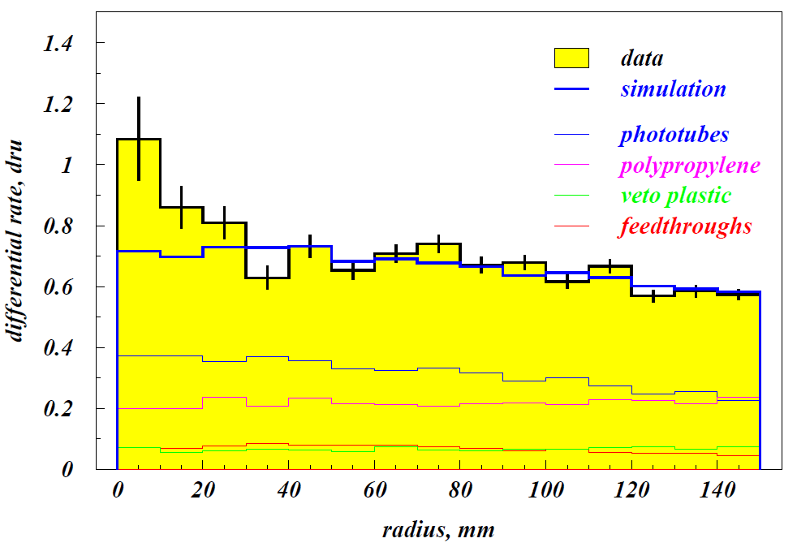
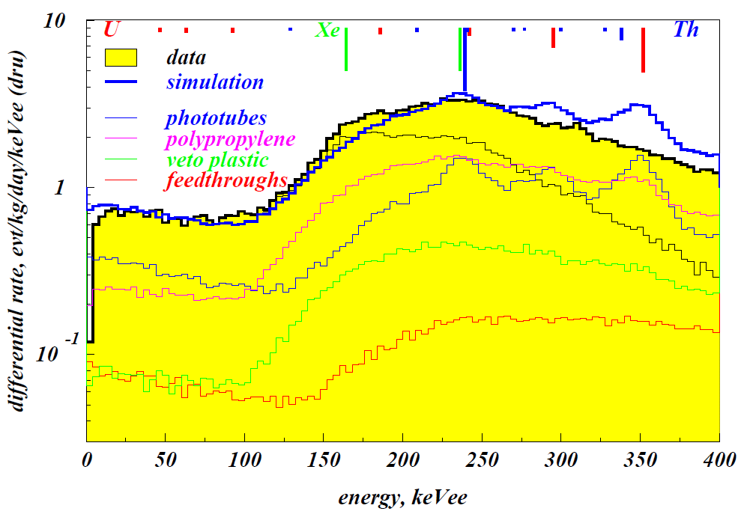
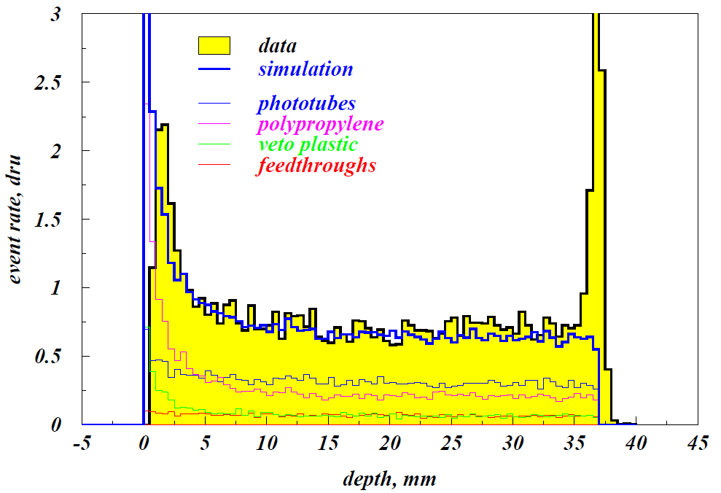
SSR e-recoil background
0.75 evt/kg/day/keVee
(20x lower than in first run)
Very good (absolute) agreement of energy and spatial distributions with component-level simulations
PMT array 35x lower background

Slide 9
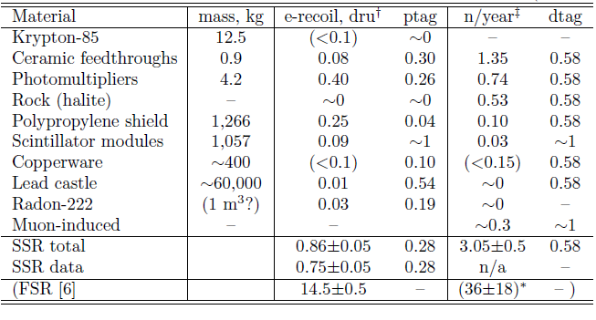
Background expectation in SSR dataset
Electron and nuclear recoil background rates
(5-50 keVnr in 6.5 kg fiducial, unity signal acceptance)
Background expectation in
1-year dataset, in a/c with veto
and realistic signal acceptance:
0.4±0.1 neutron scatters
2.4±0.2 electron recoils
  Main challenge is to achieve the same discrimination power as in FSR with new phototubes (poorer optical performance)

Slide 10
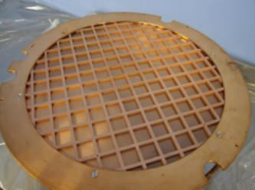
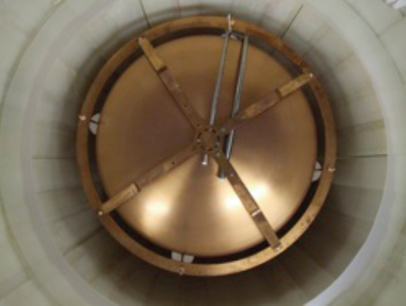
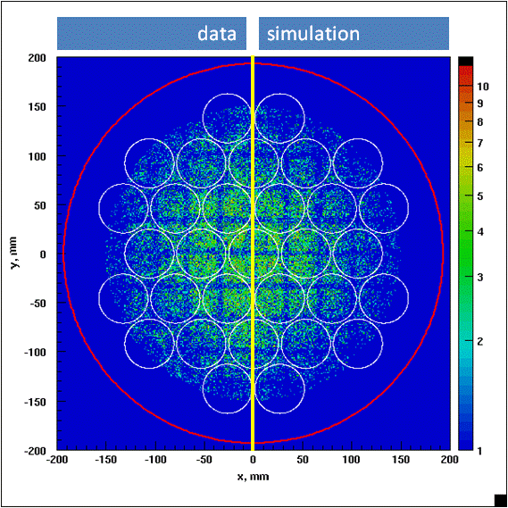
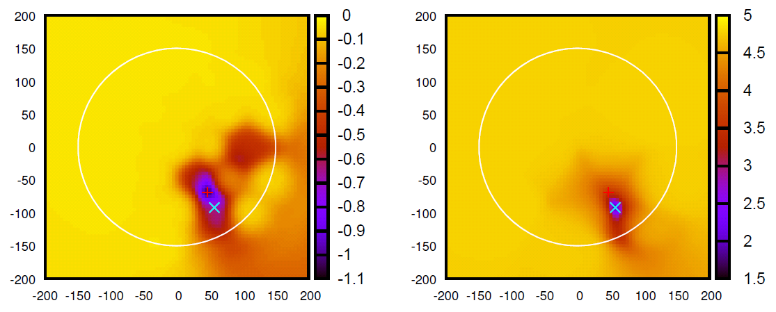
Vertex reconstruction
Light response functions reconstructed for all PMTs from calibration
This process automatically equalises (‘flat-fields’) the array
Depth (z coordinate) from drift time in liquid (to tens of μm)
Least squares fit to all channels simultaneously yields (E,x,y)
S2 reconstruction: 2 mm FWHM in horizontal plane for 122 keV
S1 reconstruction: 12 mm FWHM
Multiple scintillation, single ionisation (MSSI) events (‘living-dead’)
    Spatial χ² maps help identify multiple vertices in S1
S1 reconstruction
S2 reconstruction

Slide 11
Vertex reconstruction: improvements
8.3% FWHM for Co-57 gamma-rays, resolving fully 122.1 keV and 136.5 keV line

Slide 12
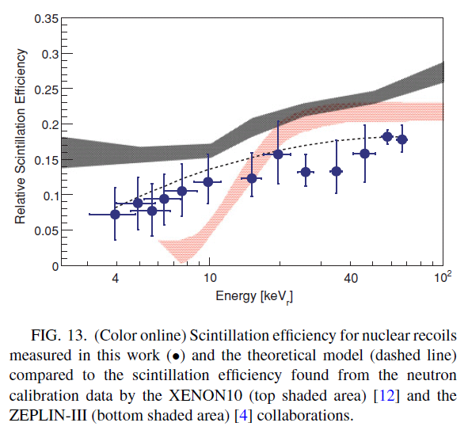
New L_{eff} Analysis
→ see talk by Alastair Currie
Scintillation efficiency for nuclear recoils relative to 122 keV gamma-rays
Threshold of LXe experiments is (was) at stake: significant systematic error
Direct measurements at neutron beam
Indirect measurements (fit to MC)
Previous ZEPLIN-III result showed
marked decrease at low energy,
contradicting other data (~constant)
Subsequent beam result from Yale
showed something else yet again!
New calibration and analysis with
improved software highlighted
issue with dual-range DAQ matching
See talk by A. Currie for new Leff and
impact on previous result
A. Manzur et al, PRC 81, 025808 (2010)

Slide 13
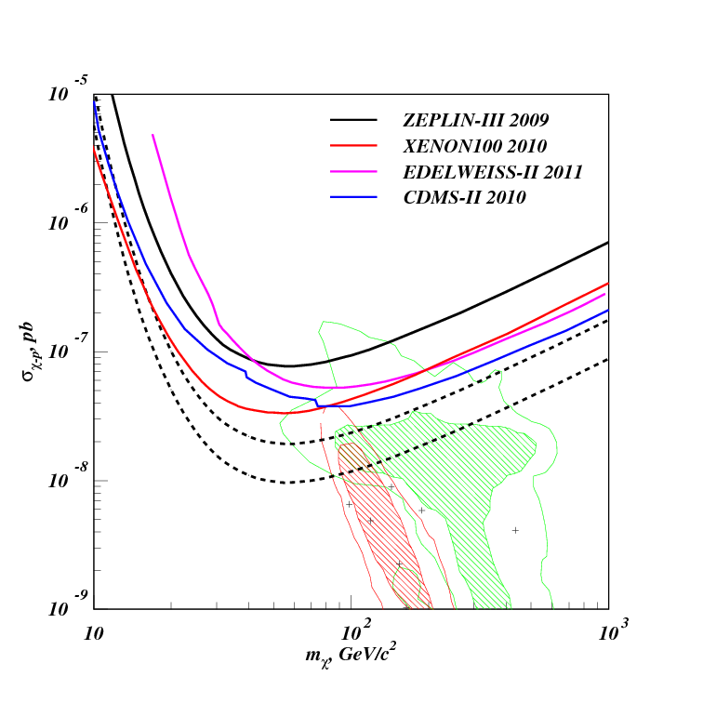
SSR sensitivity
From 2,000 kg*days raw fiducial exposure
(>11 month run)
CMSSM Buchmueller et al
CMSSM Trotta et al

Slide 14
Conclusions
Experiment upgraded very successfully:
  Background approximately 20 times lower
  New veto detector surrounding WIMP target
SSR data taking progressing with high duty cycle:
  Aim for 2,000 kg*days by end of May’11
Data analysis ongoing, still blind in signal region
Main challenges (MSSI events and poor PMT performance) being addressed by improved vertex reconstruction software
New measurements confirm more favourable L_{eff} at low energy
SI sensitivity could reach 1-2x10⁻⁸ pb/nucleon

