Slide 1
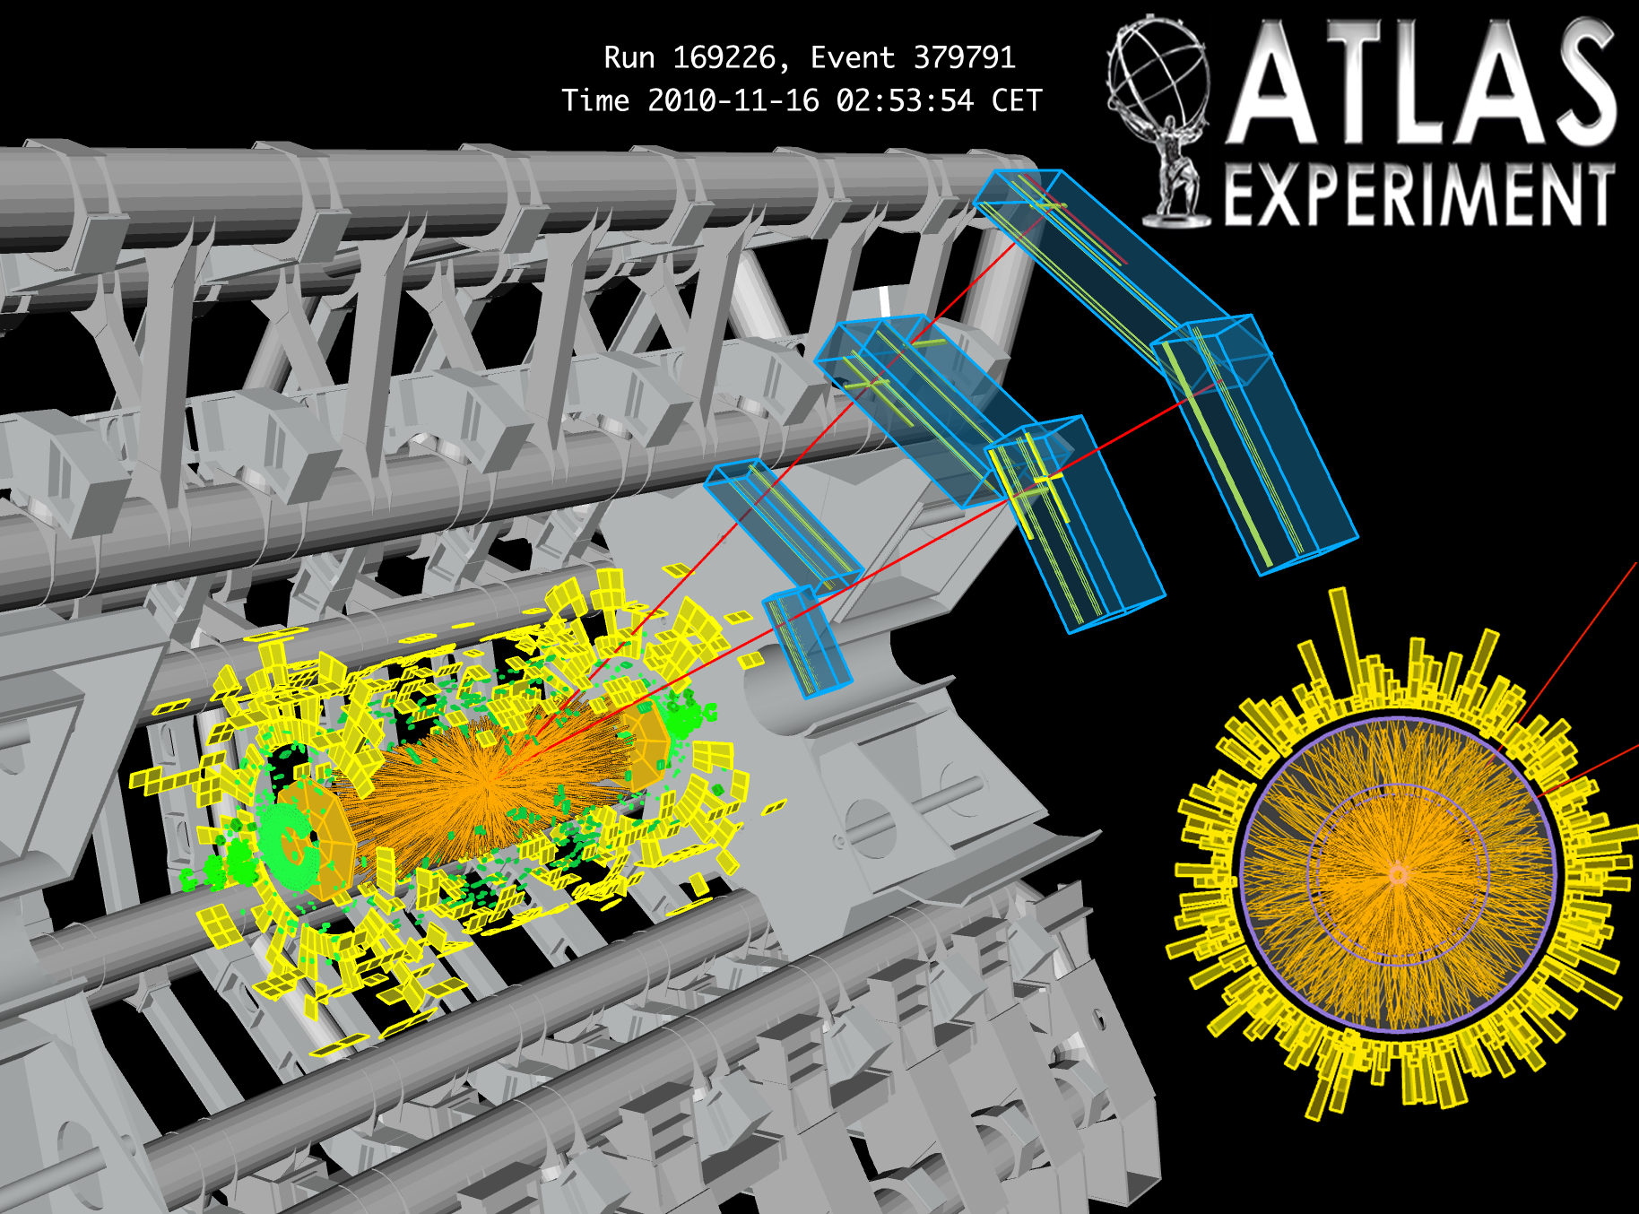
ATLAS: Recent Results and Future Prospects
Dan Tovey, University of Sheffield, on behalf of the ATLAS Collaboration

Slide 2
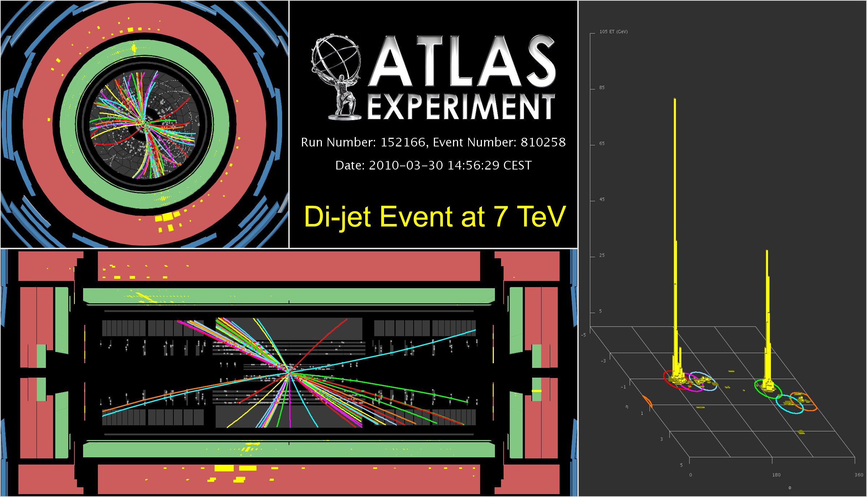
Overview of the ATLAS detector
Status of the experiment
Physics results from 2010
Prospects for 2011/12
30-3-2010:
1st fill at √s = 7 TeV
p_{T} (j₁) ~ 455 GeV
p_{T} (j₂) ~ 390 GeV
M (jj) ~ 800 GeV
Uncalibrated E
in event display

Slide 3

3000 physicists
38 countries
175 institutes
300 UK
14 institutes

Slide 4


Slide 5

The ATLAS Detector
Muon Spectrometer (|η|<2.7) : air-core toroids with gas-based muon chambers
Muon trigger and measurement with momentum resolution < 10% up to E_{μ} ~ 1 TeV
Length : ~ 46 m
Radius : ~ 12 m
Weight : ~ 7000 tons
~10⁸ electronic channels
3000 km of cables
3-level trigger
reducing the rate
from 40 MHz to
~200 Hz
Inner Detector (|η|<2.5, B=2T):
Si Pixels, Si strips, Transition Radiation detector (straws)
Precise tracking and vertexing,
e/π separation
Momentum resolution (η=0):
σ/p_{T} ~ 3.8x10⁻⁴ p_{T} (GeV) ⊕ 0.015
EM calorimeter: Pb-LAr Accordion
e/γ trigger, identification and measurement
E-resolution: σ/E ~ 10%/√E
HAD calorimetry (|η|<5)
Fe/scintillator Tiles (central), Cu/W-LAr (fwd)
Trigger and measurement of jets and missing E_{T}
E-resolution: σ/E ~ 50%/√E ⊕ 0.03

Slide 6
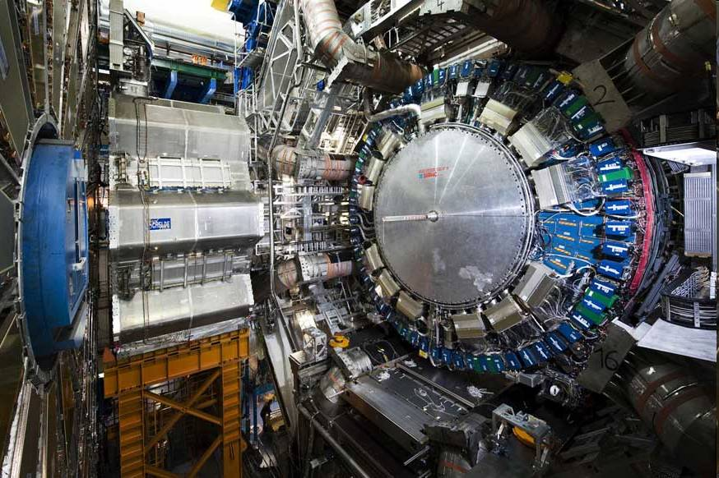

Slide 7
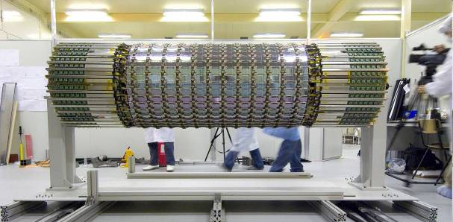
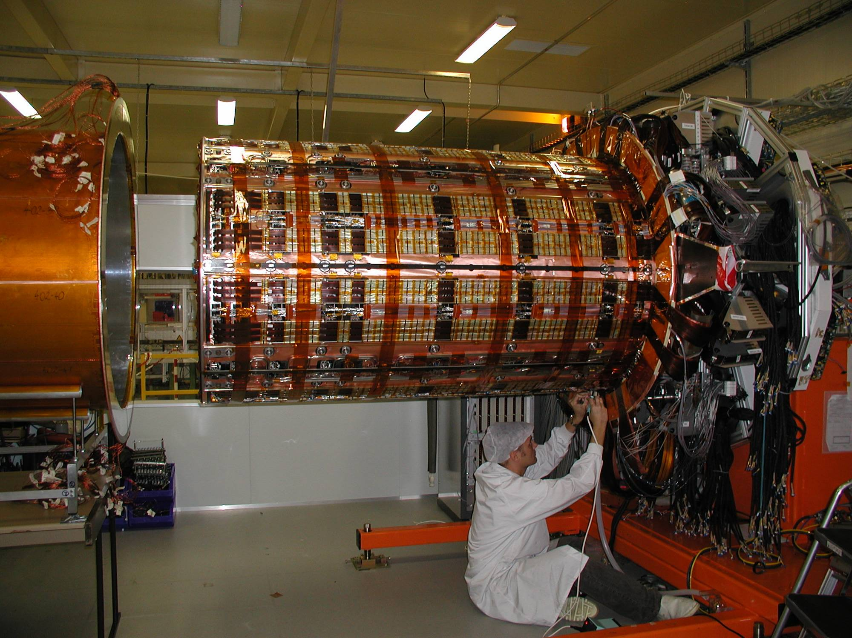
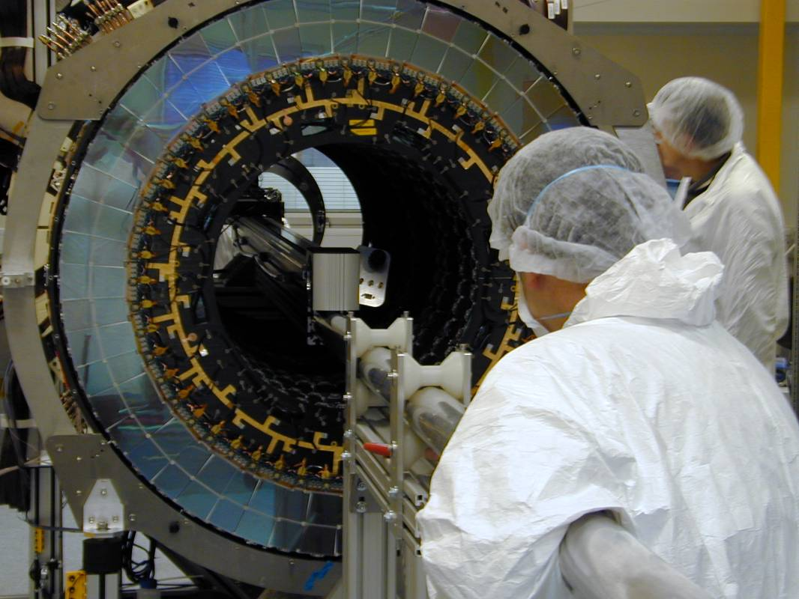
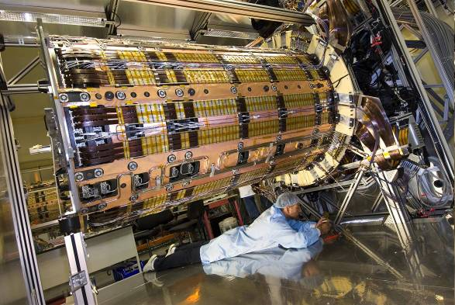
Semi-Conductor Tracker
Semi-Conductor Tracker (SCT)
Major UK contributions also to HLT, L1Calo, SW/Computing and magnets

Slide 8
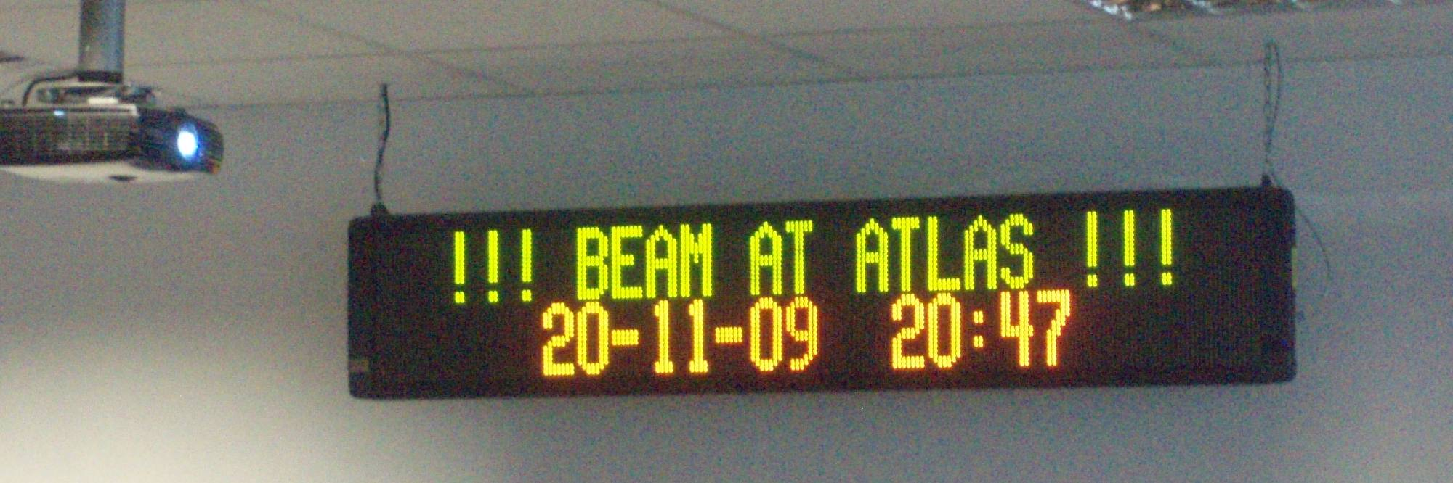
LHC Running
20 Nov – 23 Dec 2009:
  First pp physics run at √s = 900 GeV (few hours √s = 2.36 TeV)
30 March – 4 Nov 2010:
  LHC pp running at √s = 7 TeV
4 Nov 2010 – 6 Dec 2020:
  LHC Pb+Pb running at √s = 2.76 TeV/nucleon
13 March 2011: Restart pp physics √s = 7 TeV

Slide 9
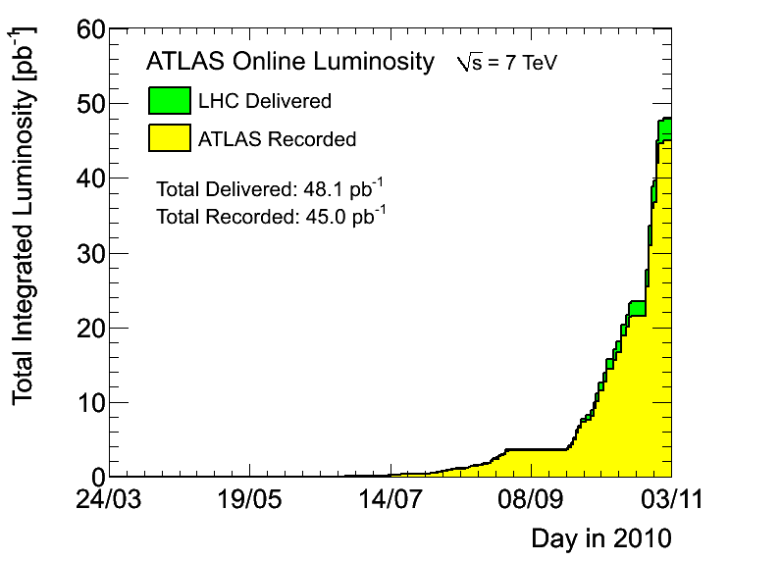
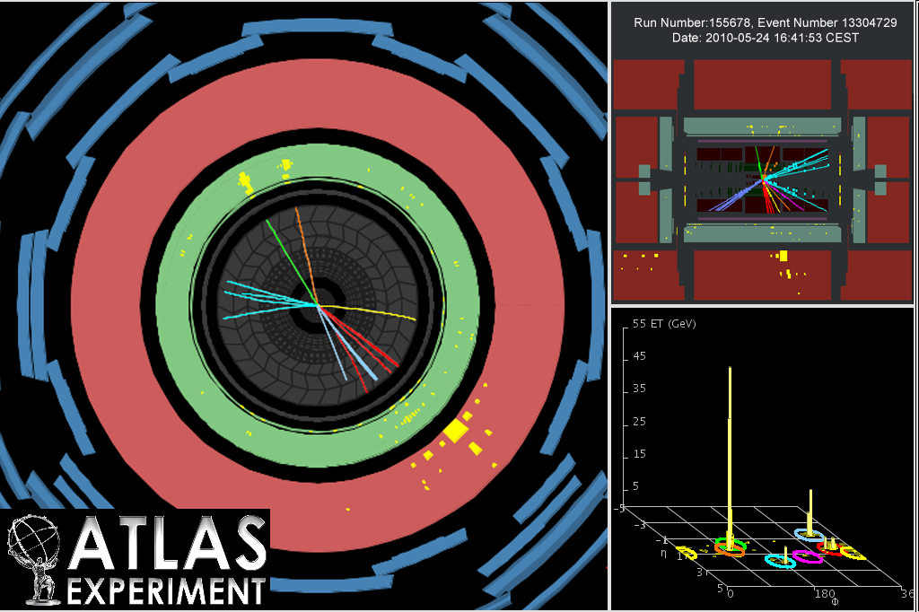
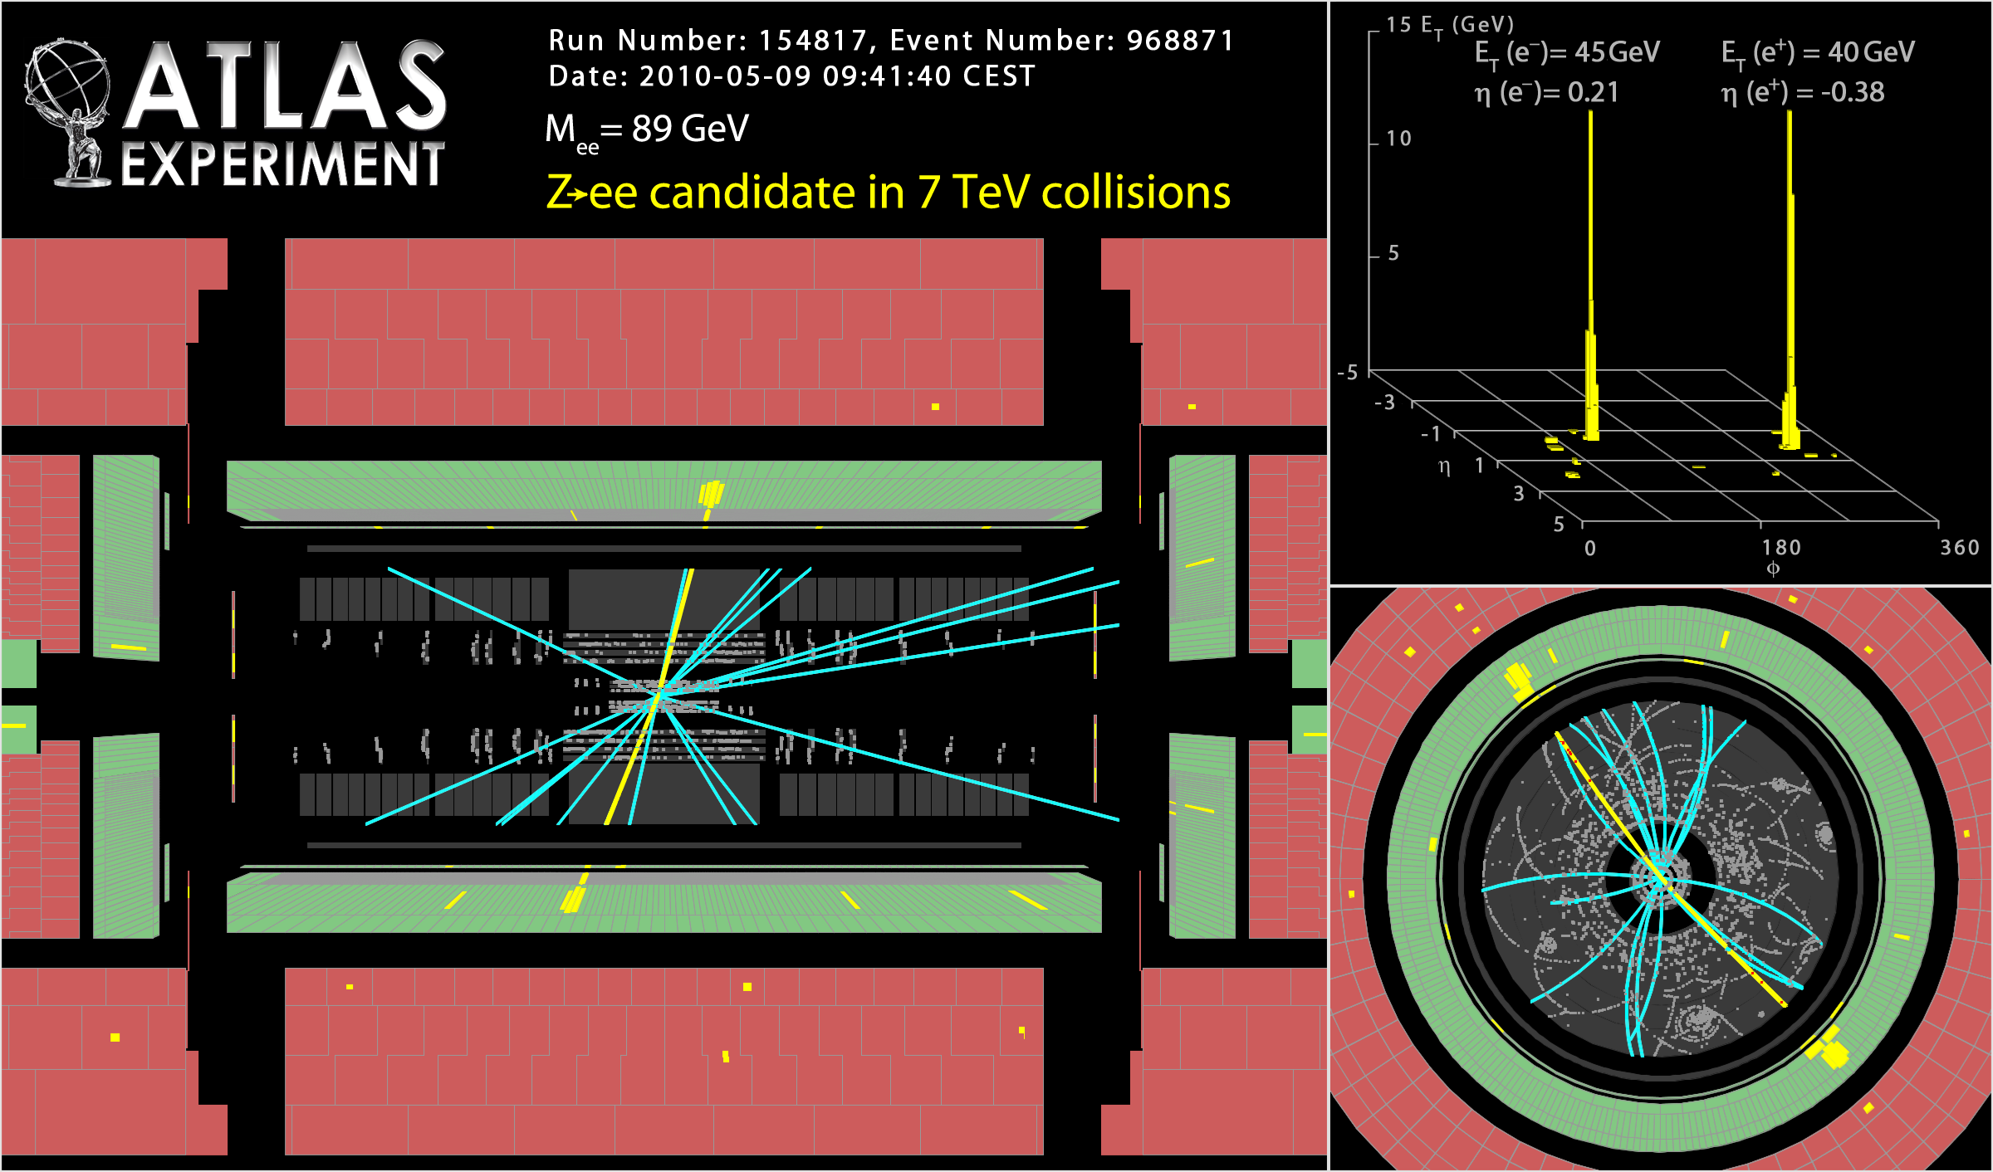
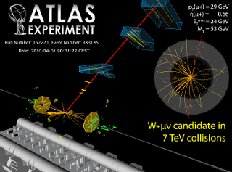
Luminosity 2010
1st top candidate
1st Z candidate
1st W Candidate
Maximum instantaneous luminosity: 2x10³² cm⁻² s⁻¹
Longest time of stable beams in one fill: 30.3 hours
Maximum integrated luminsity in one fill: 6304.62 nb⁻¹
Absolute luminosity uncertainty 3.4%

Slide 10
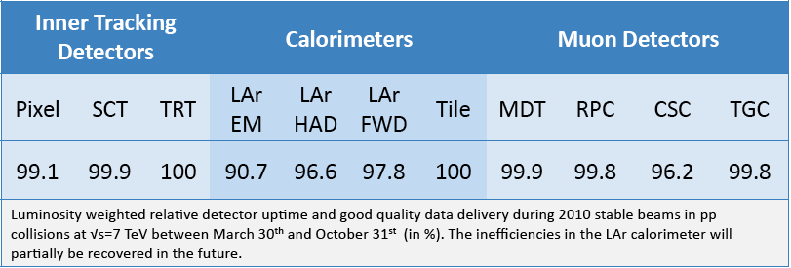
Detector Status 2010
2% average DAQ inefficiency due to ‘warm start’ not included
LAr inefficiency mostly due to isolated HV trips and noise bursts
CSC inefficiency due to 6/16 problematic chambers in one 3 day period

Slide 11
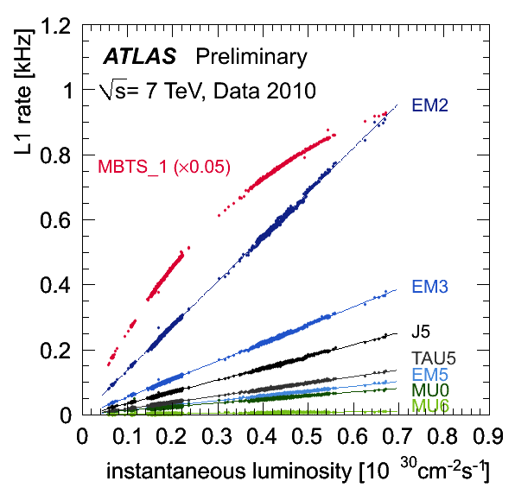
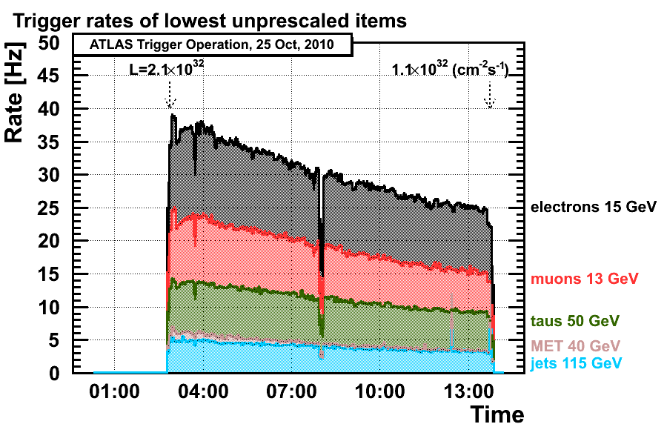
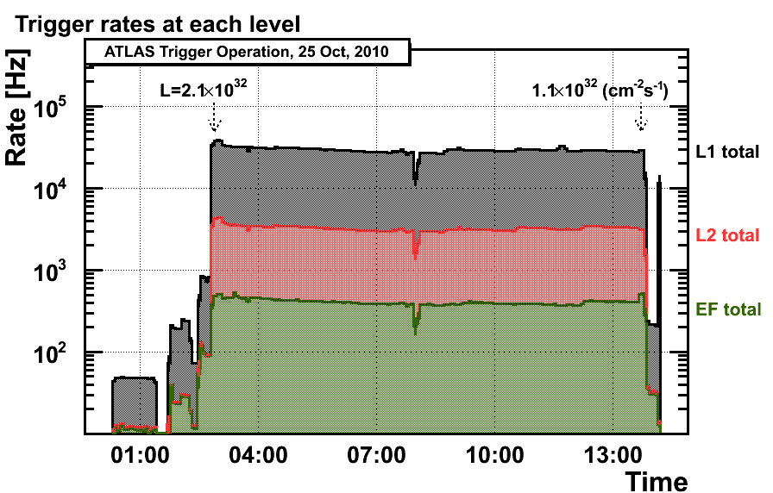
Trigger Performance 2010
L~10²⁷ cm⁻²s⁻¹ run without prescales
L>10²⁷ cm⁻²s⁻¹ prescale (only) minbias triggers
L>10²⁹ cm⁻²s⁻¹ activate HLT (L2 and EF)
300 Hz bandwidth split between physics
Challenging but hard work paid off!

Slide 12
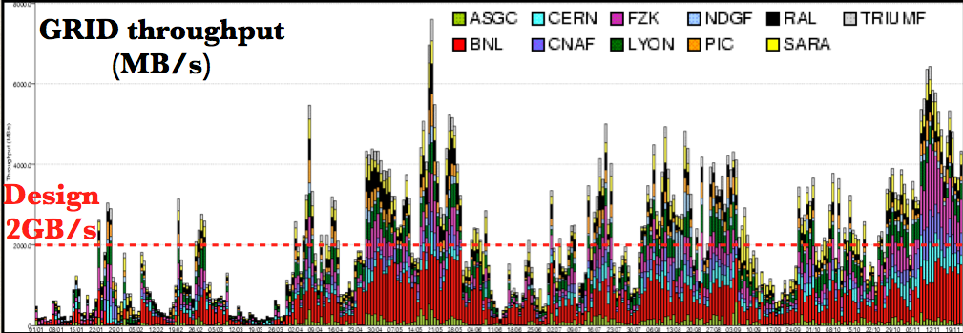
Grid Data Processing 2010
Start of pp running
Machine development
Heavy Ion running
Data distributed and processed via the Grid.
Large peaks exceeding design limit
Progress (performance, reliability) has been rapid

Slide 13
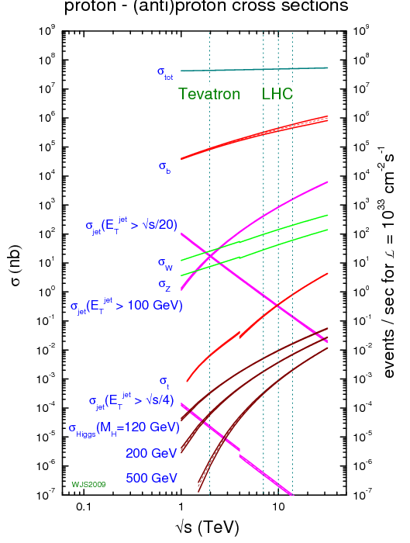
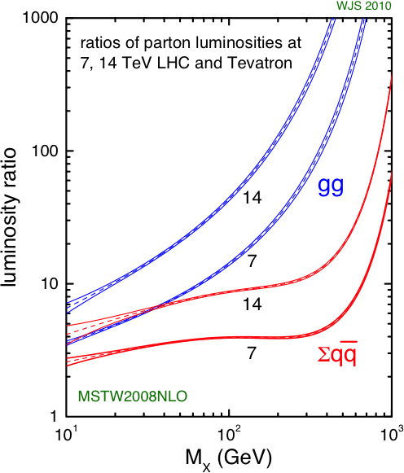
Why LHC?

Slide 14
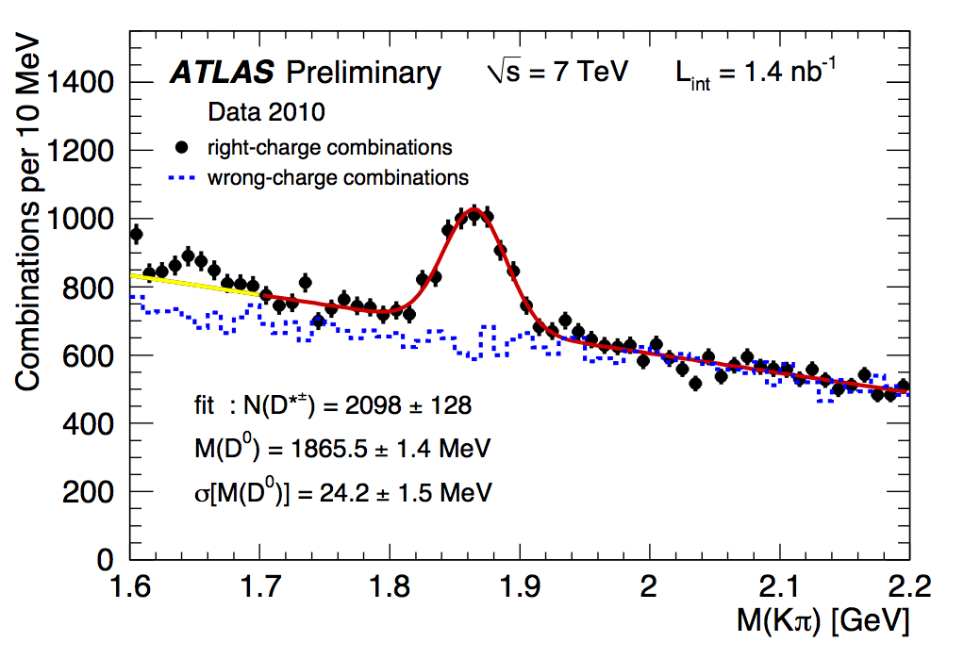
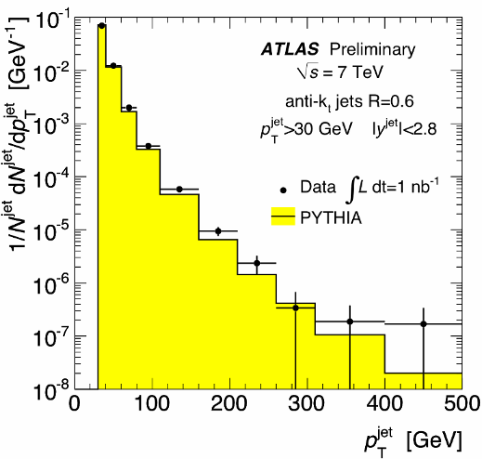
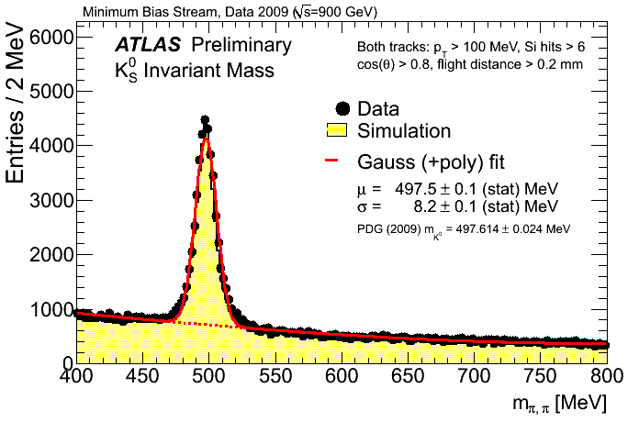
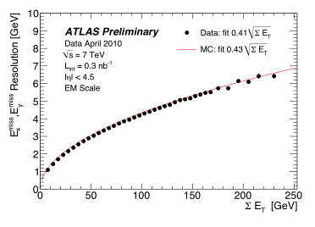
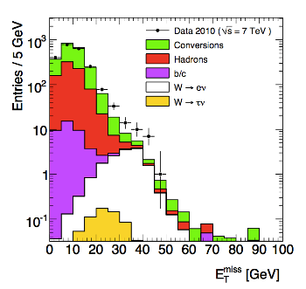
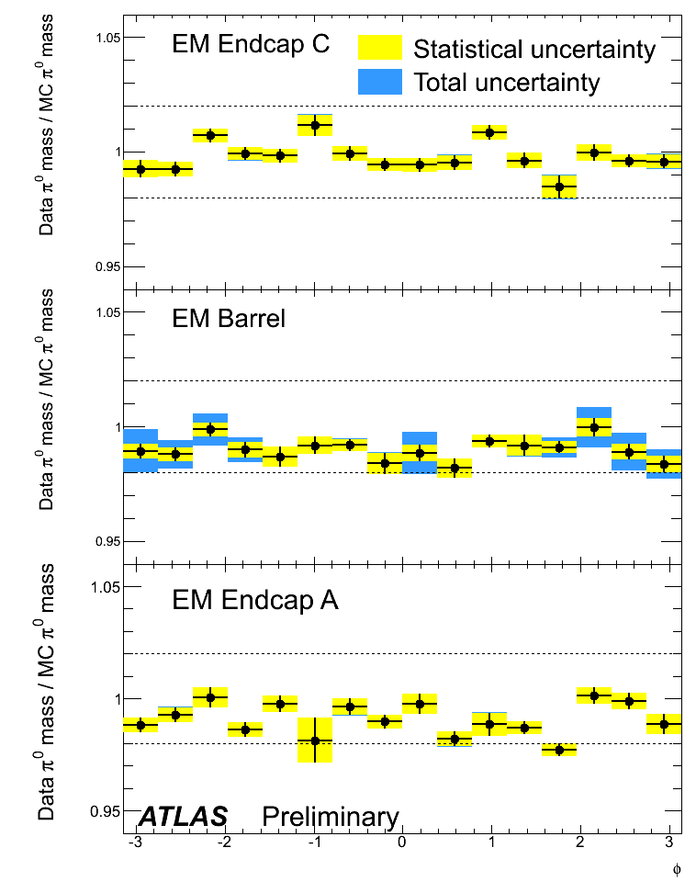
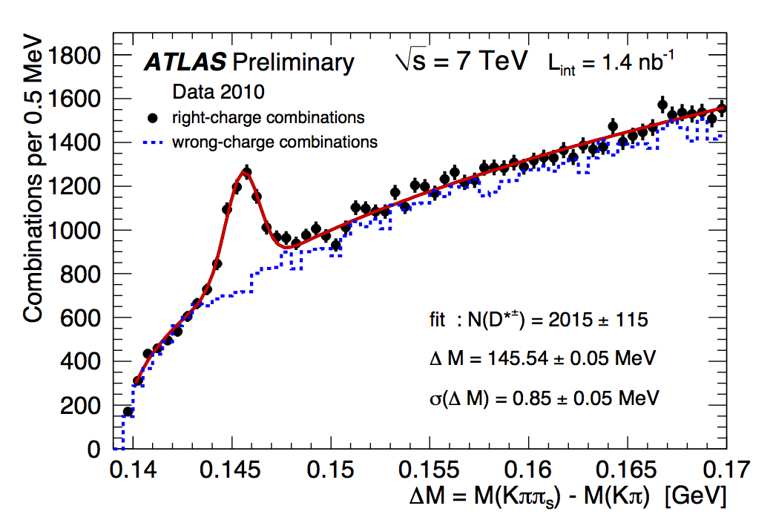
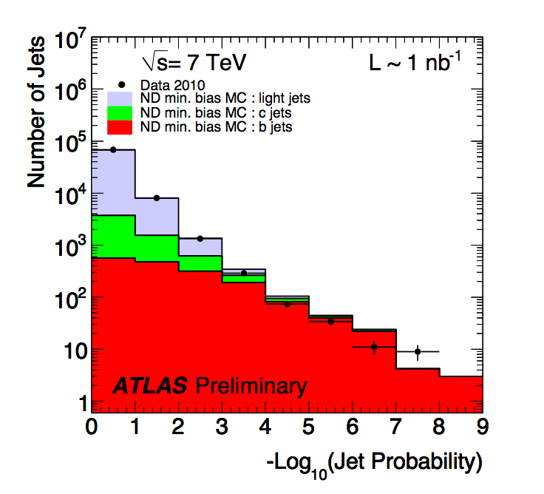
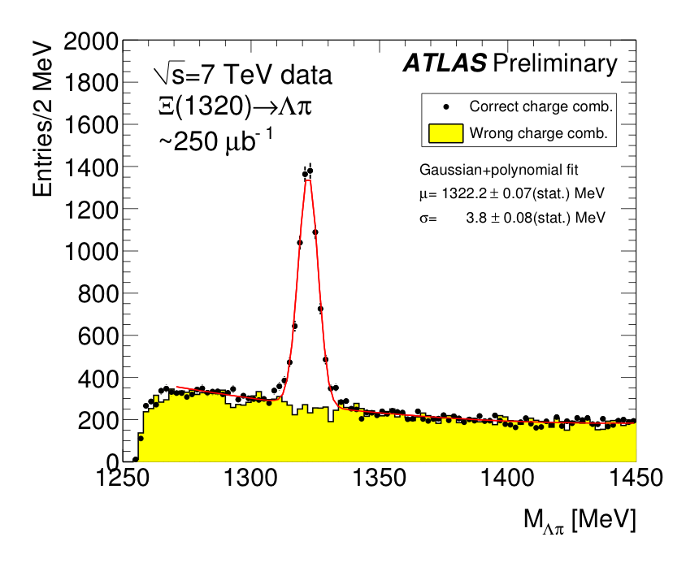
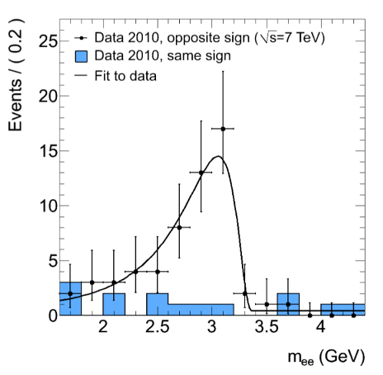
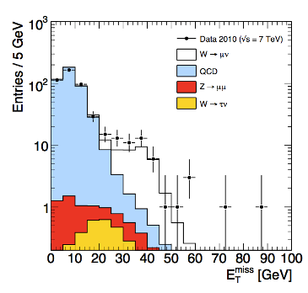
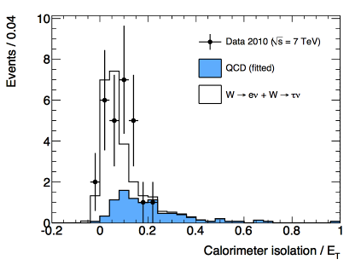
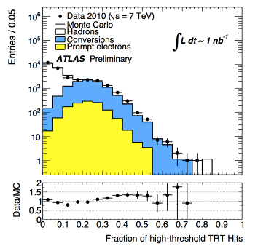
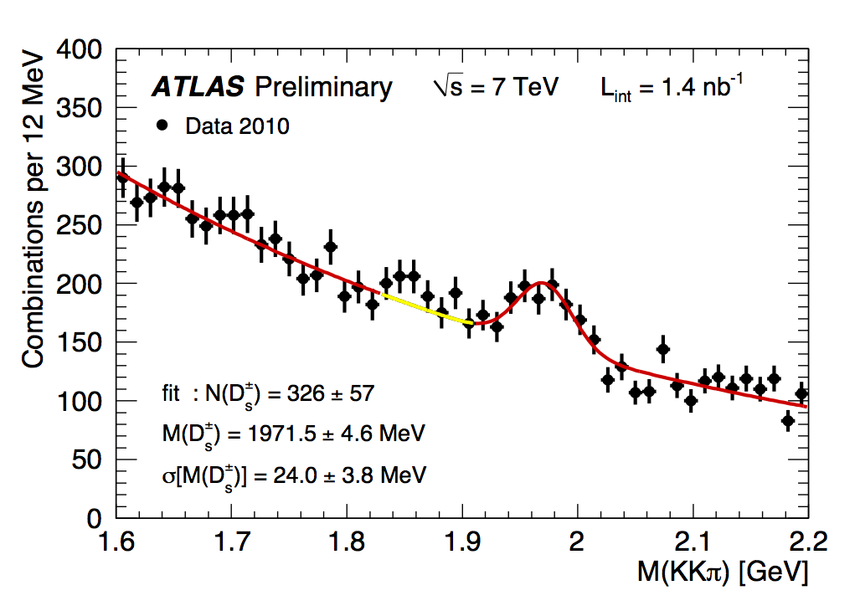
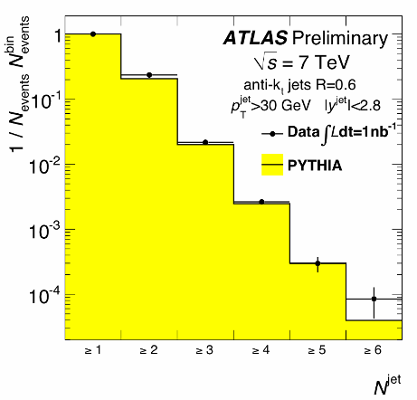
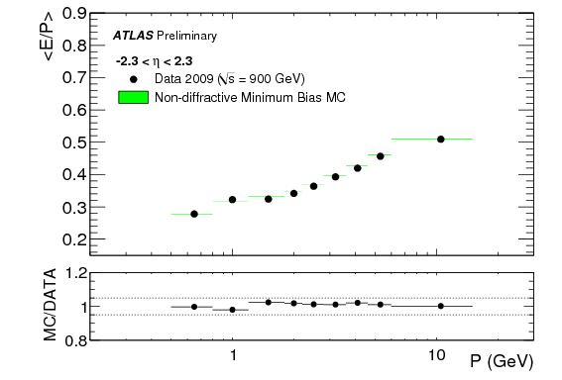
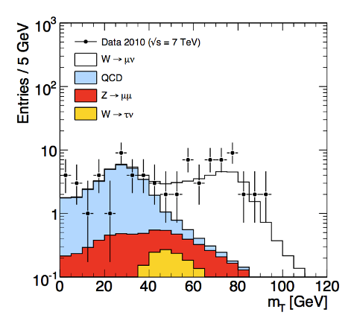
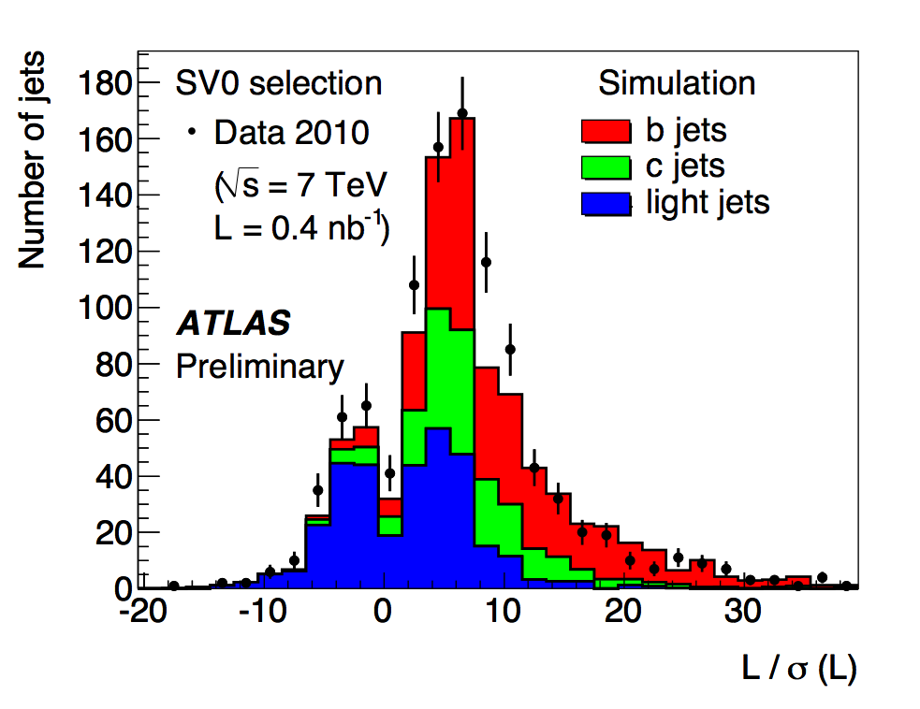
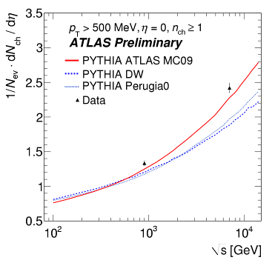
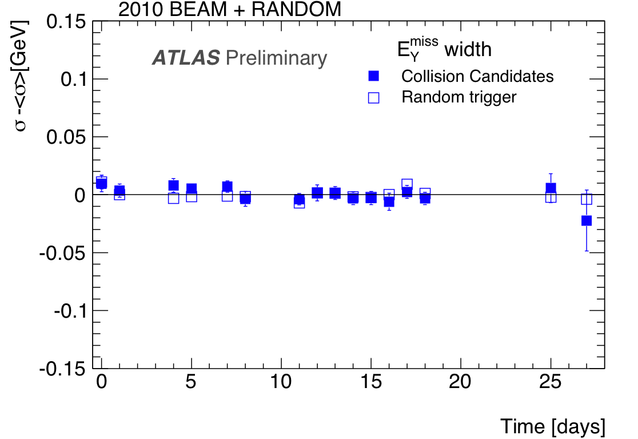
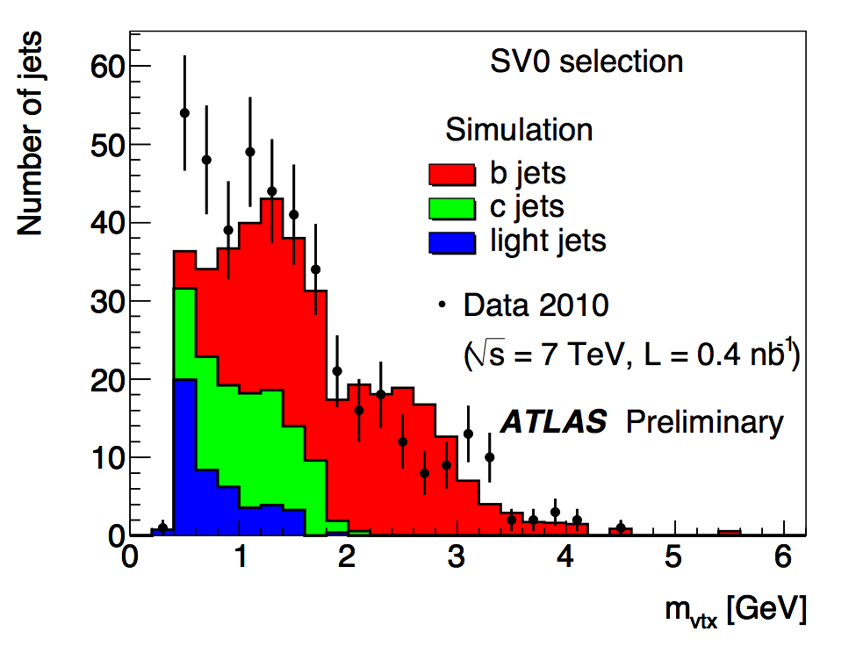
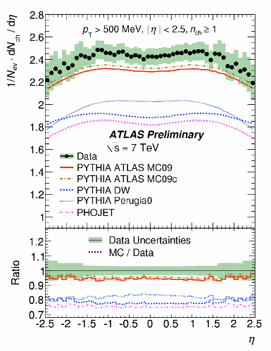
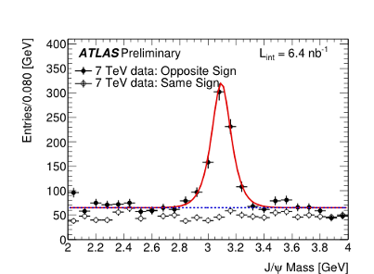
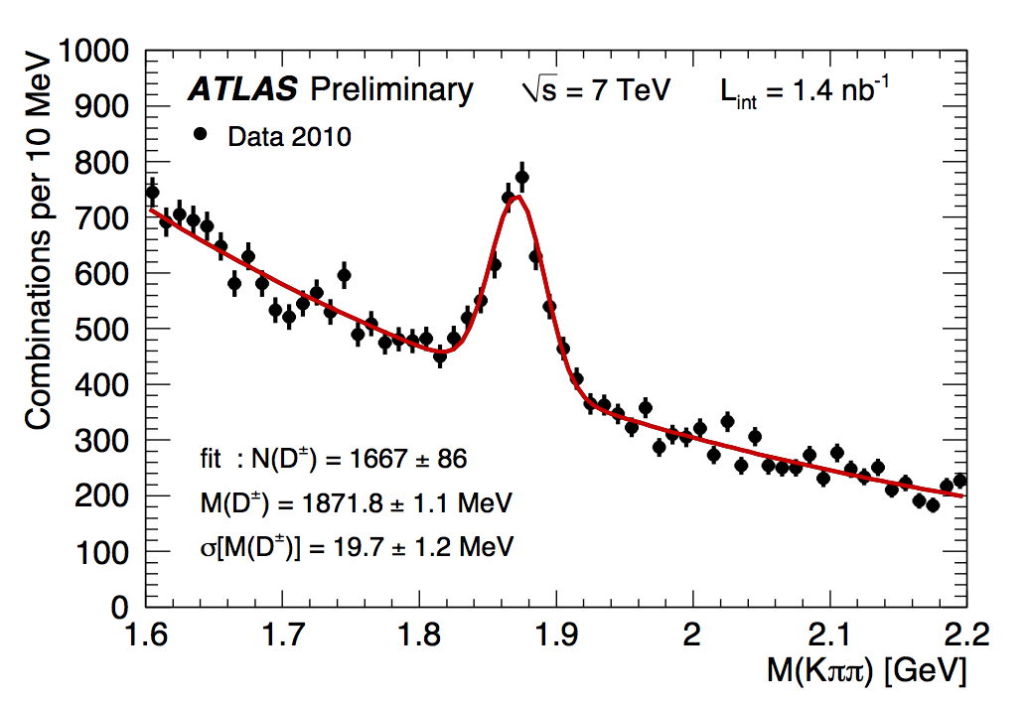
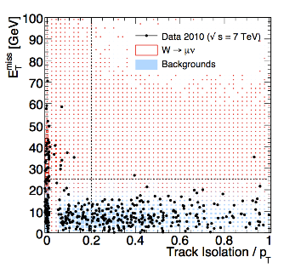
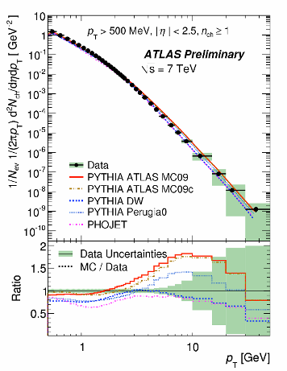
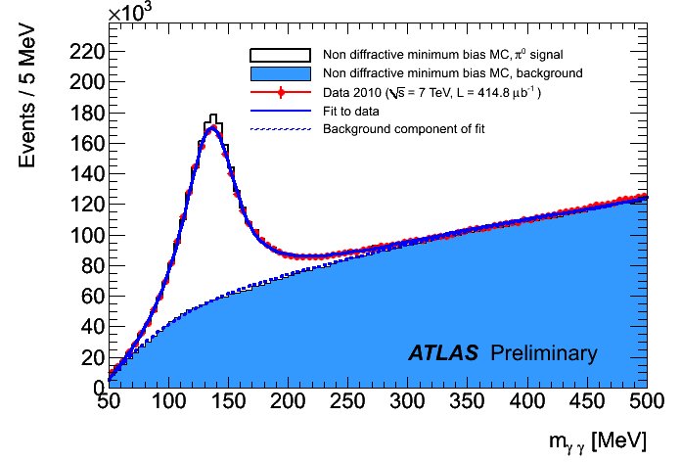
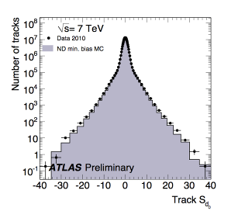
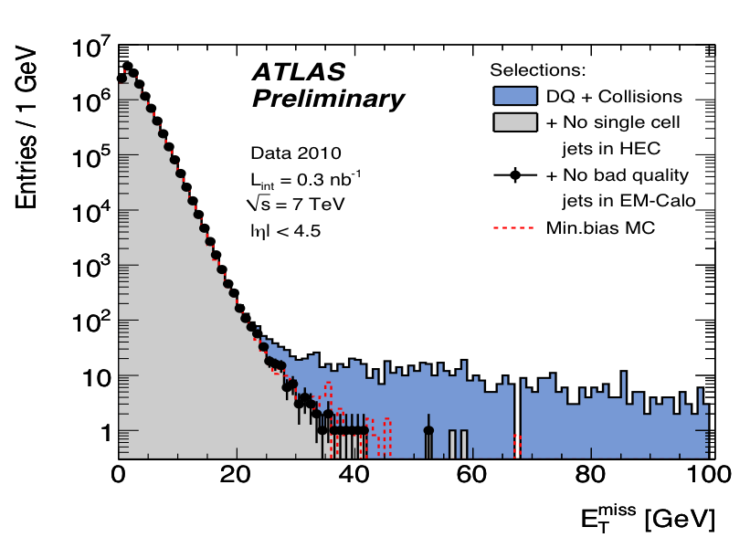
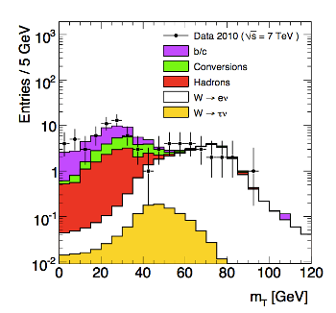
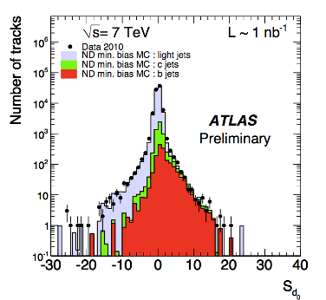


Selected Results
Many more results than I can possibly hope to show in 30 minutes …
More results and more details at:
https://twiki.cern.ch/twiki/bin/view/Atlas/AtlasResults
Many new / updated results for winter conferences

Slide 15



Minimum Bias with Tracks
Inclusive, model-independent measurement from inelastic events
Most recent results benefit from work to reduce track p_{T} threshold
  Greatly improves acceptance
Vital for understanding soft backgrounds to New Physics
arXiv:1012.5104 [hep-ex], accepted by New J. Phys

Slide 16

Eight Jets with p_{T}>60 GeV
Maximum jet p_{T} 70 GeV
Energies at EM-scale
16

Slide 17




(Multi-)Jet Cross Sections
Jets reconstructed with Anti-k_{T} algorithm, calibrated with simple η/p_{T}-dependent corrections from test-beam, track E/p, MC
  ~3(7)% JES uncertainty for p_{T} > 60(20) GeV central jets
Good agreement after unfolding with NLO pQCD predictions.
  LO 2→2 ME predictions less good
Valuable tools for PDF tuning
ATLAS-CONF-2011-047; ATLAS-CONF-2011-043

Slide 18



B⁰_{s}→J/ψ φ
ATLAS-CONF-2011-050
B⁰_{s}→J/ψ φ decays give access to B⁰_{s} CP-violating weak mixing phase
  Small (10⁻²) in SM ➔ BSM searches
B⁰_{d}→J/ψ K^{*0} valuable testing ground for measurements
  Similar topology and kinematics
  Larger cross section
Mass peaks consistent with PDG
ψ(2s)

Slide 19

W
Muon: 3 Pixel hits, 8 SCT hits, 17 TRT hits, 14 MDT hits, Z~0.1 mm from vertex,
ID-MS matching within 1 GeV, E_{T}^{miss} (calorimeter only) ~ 3 GeV
19

Slide 21





W/Z Cross Sections
Electroweak boson production important testing ground for QCD
Correlated uncertainties cancel in W/Z ratio
  Good agreement with NNLO predictions
η-dependent W charge asymmetry strongly constrains PDFs
ATLAS-CONF-2011-041; arXiv:1103.2929 [hep-ex]
21

Slide 22




More EW Measurements …
ATLAS-CONF-2011-042
Z/γ* + jets cross sections measured as functions of inclusive jet multiplicity and jet p_{T}
Good agreement with NLO pQCD predictions and extended LO MC matched to PS
ATLAS-CONF-2011-010; ATLAS-CONF-2011-045
Z→ττ reliably reconstructed in leptonic and semi-leptonic channels
  Important test of techniques for SUSY Higgs searches
22

Slide 23



Diboson Production
ATLAS-CONF-2011-013; ATLAS-CONF-2011-015
3σ observation of WW production in leptonic channel, σ consistent with NLO predictions
Wγ observation in agreement with predictions
First WZ and ZZ candidates
23

Slide 24

Top Quark Candidate in the Semi-Leptonic Channel

Slide 25
Top Quark Candidate in the Fully Leptonic Channel

Slide 26



Top Quark Properties
ATLAS-CONF-2011-033;
ATLAS-CONF-2011-040;
ATLAS-CONF-2011-027
Top pairs: Two complementary strategies
  Semi-leptonic decay mode: larger BR but more background
  Fully leptonic decay mode: smaller BR but cleaner
Data-driven background estimates
Cross section good agreement with NNLO QCD
First mass measurements → 4% uncertainty
First indication of single top production

Slide 27




SUSY Searches
Searches in (b-)jets + MET + 0/1/2/multi- leptons
  Sensitive to R-Parity conserving models (DM)
  Data-driven background estimates used extensively
Observations consistent with background
  Sets world’s best limits on m_{1/2} in mSUGRA/CMSSM models; m > 775 GeV for m_{squark}=m_{gluino}
Also first searches for stable hadronising particles
arXiv:1102.2357 [hep-ex];
arXiv:1102.5290 [hep-ex];
arXiv:1103.1984 [hep-ex];
arXiv:1103.4344 [hep-ex]
tanβ=3
tanβ=40

Slide 28



Exotics Searches
Many new search results significantly extending reach: no significant excesses seen
  Contact interactions, W’, quantum BH, large extra dimensions, stable ionising particles etc.
Some highlights:
  Dijet resonance search: excited quark mass limit 0.60 - 2.64 TeV excluded
  Dijet mass and angular distributions: quark compositeness scale Λ>9.5 TeV
  W’→lν with SM couplings m>1.5 TeV
  Z’ →ll in SSM model m > 1.05 TeV
arXiv:1103.1391 [hep-ex] ; arXiv:1103.3864 [hep-ex]; arXiv:1103.6218 [hep-ex]

Slide 29





Higgs Searches
ATLAS-CONF-2011-005; ATLAS-CONF-2011-024
First results of SM Higgs search in major channels
  ZZ→4l; ZZ→llqq; ZZ→llνν; WW*→llνν; γγ
H→WW*→llνν closest to existing Tevatron limits
  Combination of 0/1/2-jet channels
Also first results of SUSY Higgs search in H/A→ττ channel
29

Slide 30


Slide 31


Heavy Ions
PRL105, 252303;
arXiv:1012.5419 [hep-ex]
Some of the most exciting results of 2010 came in flurry of activity during / after the HI run
First observation of a centrality dependent dijet energy asymmetry and J/ψ suppression
Evidence for strong jet energy loss in a ‘hot dense medium’

Slide 32



Prospects for 2011/12
Best guess post-Chamonix
  2011: 2-3 fb⁻¹ (x50) at 7 TeV
  2012: ~10 fb⁻¹? (x200) at ≥7 TeV
2011: Should be able to:
  exclude SM Higgs to 95% ATLAS+CMS
  Make 5σ SUSY discovery to ~0.8 TeV
2012: Should be able to:
  Observe SM Higgs ~5σ ATLAS+CMS
  Make 5σ SUSY discovery to ~1.2 TeV

Slide 33



Slide 34

Summary
First year of high energy LHC data surpassed expectations
Remarkably smooth start-up of experiment and machine – testament to years of hard work
  Profound thanks to the machine for such rapid progress
Agreement between data and MC predictions astounding
  Result of hard work by theoretical community and developers of simulation tools
First SM results published, showing good agreement with latest theoretical N(N)LO predictions
First searches show no signs of new physics (yet) – limits already outstripping earlier expts
Next 2 years promise to revolutionise physics …
ATLAS reaches for the stars!

Slide 35
BACK-UP

Slide 36


1-lepton SUSY

Slide 37

Top

Slide 38

WW

Slide 39



H→WW→llnn/qq

Slide 40

SUSY Limits

Slide 41



Underlying Event
Measurement of charged particle activity with respect to leading hard track in event
Transverse region provides measure of underlying event activity
Current models under-estimate
arXiv:1012.0791 [hep-ex], submitted to PRD

Slide 42

Total Cross Section

Slide 43

Missing Transverse Energy
ATLAS-CONF-2010-039
ATLAS-CONF-2010-057
Sensitive to calorimeter performance (coherent noise, dead/hot cells, miscalibration, cracks etc.) and non-collision backgrounds ➔ strong test
Evolution of calibration schemes
Clean and stable
Normalized to data
Stat errors only
|y|<4.5
EM scale
EM scale
Local hadronic
topocluster calibration
Stability of σ (E_{y}^{miss}) distribution
vs time over 1 month: < 3%

Slide 44
Hadron Spectroscopy
Early K⁰_{s} → π⁺π⁻ observed in Dec 2009, a few days after first collisions
Ξ → Λπ
plots
PDG: 1321.32 GeV
p
Λ
π⁻
π⁻
Normalized to data
Stat errors only
Ξ⁻
Pixel dE/dx
p
Normalized to data
Stat errors only
K
Φ → K⁺K⁻
π
ATLAS-CONF-2010-032, ATLAS-CONF-2010-033, ATLAS-CONF-2010-023

