Slide 1

High intensity proton FFAG challenges
Suzie Sheehy
Research Fellow, ASTeC Intense Beams Group
suzie.sheehy@stfc.ac.uk
IoP NPPD Conference, 6th March 2011, Glasgow

Slide 2
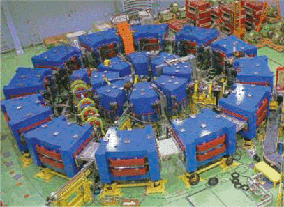
Motivation
Fixed field alternating gradient accelerators (FFAGs) for intense proton beams?
Fixed B field = high rep. rate & reliability
Many challenges!
    injection system
    mitigation of collective effects
    RF acceleration
The proton FFAG accelerator developed at Kyoto University Research Reactor Institute (KURRI), Japan

Slide 3
Overview
Quick intro to FFAGs
Recent developments
Challenges
    Lattice design
    Collective effects (space charge)
    Injection system
    RF acceleration
Summary

Slide 4
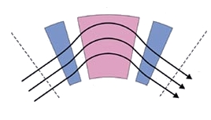
Intro to FFAGs
Break the scaling law?
Fixed-Field Alternating Gradient Accelerator
Two types: “scaling” and “non-scaling”
“a cyclotron with a field gradient”
Strong (AG) focusing in both planes*
Field scaling law (radius vs B field)
SCALING FFAG:
B field follows a scaling law as a function of radius - r^{k}
(k a constant “field index”)
Invented 1950s, e- (60’s) & proton built.
The proton FFAG accelerator developed at Kyoto University Research Reactor Institute (KURRI), Japan
Notes:
*for radial sector at least! Spiral sector FFAGs have gradient focusing in horizontal and edge focusing in vertical

Slide 5
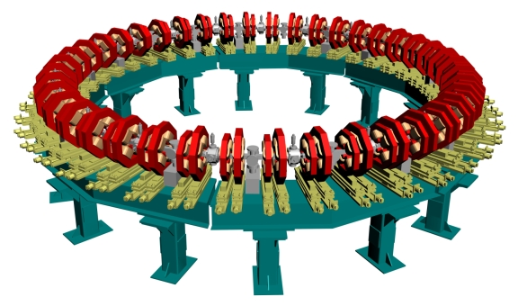
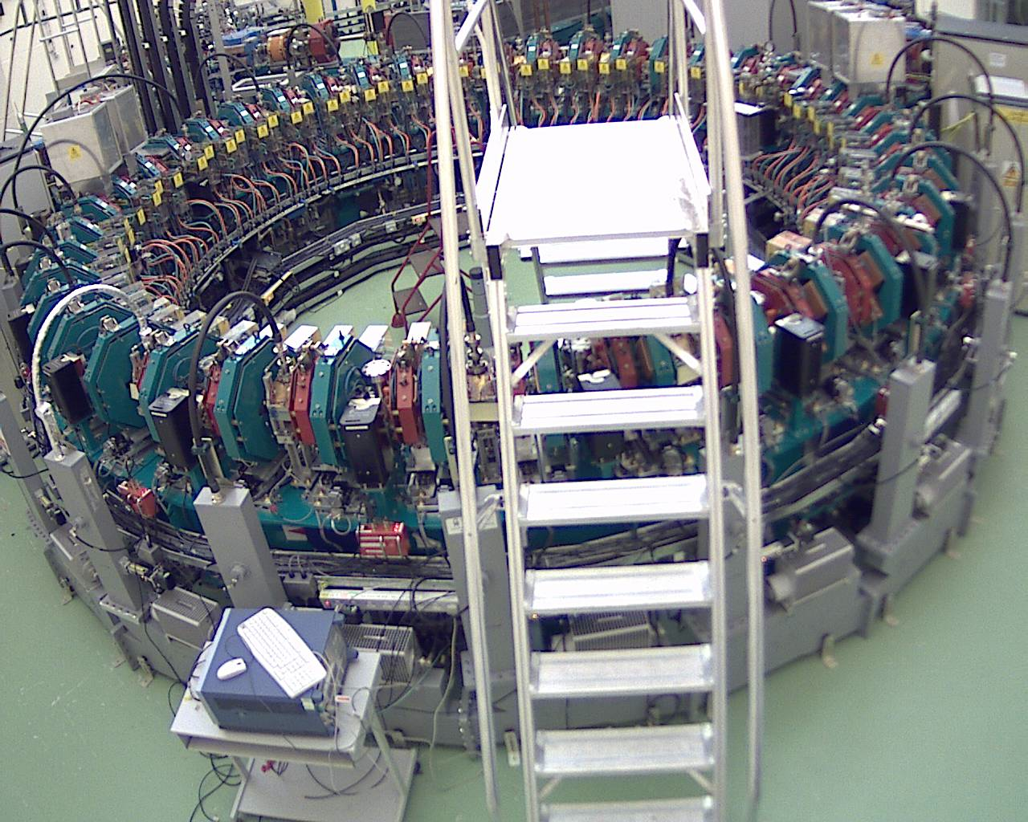
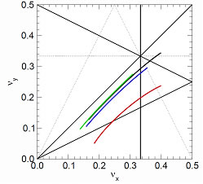
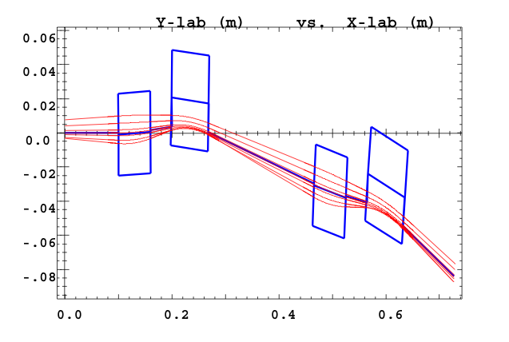
Linear ns-FFAGs
  Linear (quadrupole) field, compact magnet aperture. (1990s)
  Great for FAST acceleration.
  Tune variation, resonance crossing & complex dynamics
  See EMMA project (in commissioning)
  But: Resonances strong for modest acceleration (beam blow-up) & only small straight sections.
EMMA accelerator at STFC Daresbury Lab
Tune variation (crosses resonances)
Small(ish) aperture ~cm

Slide 6
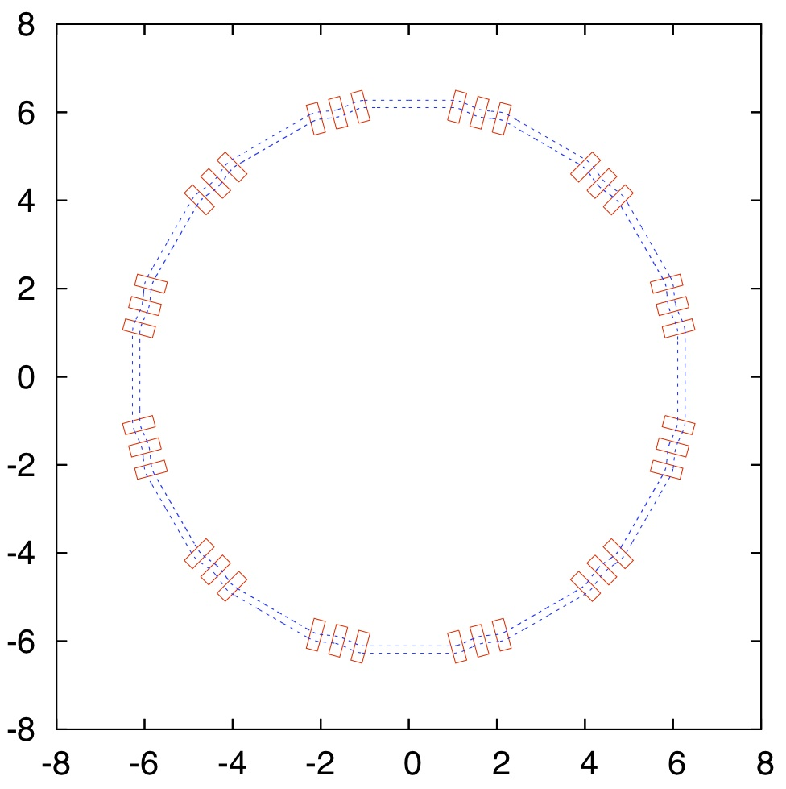
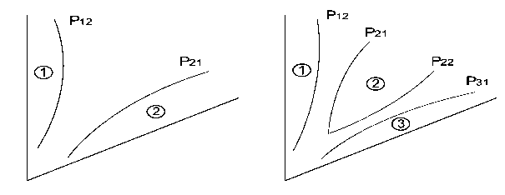
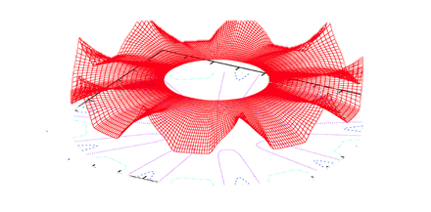
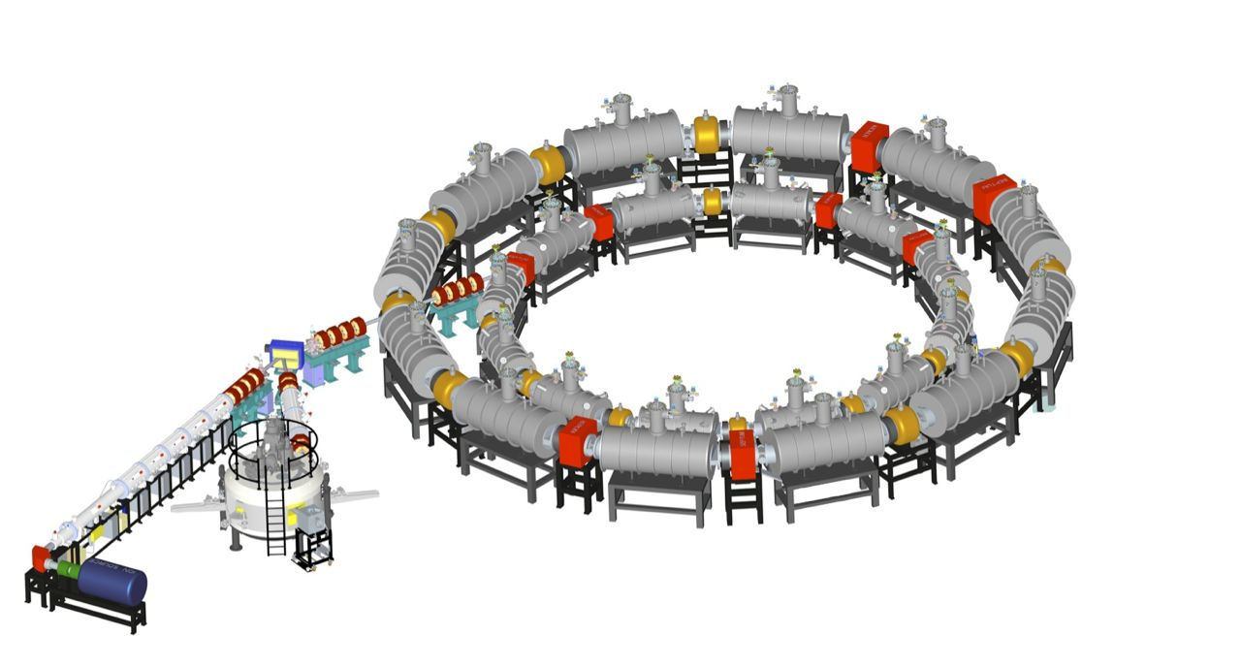
“Other” ns-FFAGs
Non-Linear or “tune-stable” type:
“Tune stable” to avoid resonance crossing
Approximated (to decapole) scaling law to flatten (total) tunes to within ½ integer
  See PAMELA (medical) design project
OR change edge contour to control edge focusing cf. C. Johnstone
S. Machida PAMELA layout
C. Johnstone design with edge contour
PAMELA design for cancer therapy

Slide 7
Applications
Low power:
Proton therapy
Security (downsized)
Industrial
High Power:
Accelerator driven systems (ADS) – waste transmutation or power generation
Proton driver for neutron spallation, neutrino factory or other applications
All have different requirements in terms of bunch structure, beam energy and intensity.

Slide 8

Requirements – ADS type machine
 | Cyclotron (Isochronous) | Linac | FFAG
High duty (CW) |  |  | ?
Size
Cost |  | $200M+? | ?
Energy
Reliability |  | ? | Good?
Notes:
Assuming that a machine of each type could be designed which could provide the necessary current, which is a big assumption in some cases.
Obvious choice at the moment seems to be the linac – most people have recognised this.
But if the FFAG could offer CW & Fixed RF would be a competitor.
LINAC - $176M/GeV excluding tunnel or outer building costs (driven by cryo…) (based on Jlab upgrade costs from B. Rimmer – in references.)
Even if construction costs for the linac were similar – operation costs would be much higher (RF power)

Slide 9
Recent developments
In a fixed field machine:
  Orbit moves outward (radially) with energy
  Orbital path length changes with energy
Isochronous FFAG, C. Johnstone et al.
  Can we “tailor an arbitrary radial field profile to both constrain tunes & confine orbits to isochronous ones”?
In an isochronous machine:
  RF frequency stays constant
  Increase average field with gamma (rel)
  With FFAG have stronger focusing (AG)
Notes:
This is the point at which the design existed before I started looking at it…

Slide 10
Focusing terms
In “conventional” accelerator terminology:
  Strong (gradient) AG focusing (Horizontal & vertical)
  Weak (centripetal) focusing (Horizontal)
  Edge focusing (Horizontal & vertical)
All three types are related!
Edge & weak can be enhanced in presence of gradient & can increase with radius.
Focusing can be tailored to meet our criteria.
Non-linear field gradient serves to stabilize tune
η
η
η

Slide 11
Design & parameters
Parameter | 250 MeV |  | 1000 MeV
Avg. Radius [m] | 3.419 |  | 5.030
Cell tune (x/y) | 0.380 | 0.237 | 0.383 | 0.242
Ring tune (x/y) | 1.520 | 0.948 | 1.532 | 0.968
Field F [T] | 1.62 |  | 2.35
Field D [T] | -0.14 |  | -0.42
Magnet Length F [m] | 1.17 |  | 1.94
Magnet Length D [m] | 0.38 |  | 1.14

Slide 12
Modelling
Mathematica script (C. Johnstone & M. Berz)
  initial parameters
Original dynamics – using COSY Infinity (updated)
  Kinematic code using Taylor maps
    Fringe field effects
    Non-linearities
    Symplecticity can be imposed
    Full kinematics (no paraxial approximation)
Dynamics - verification using ZGOUBI
  Ray tracing code
  Can make analytical model or use field maps

Slide 13
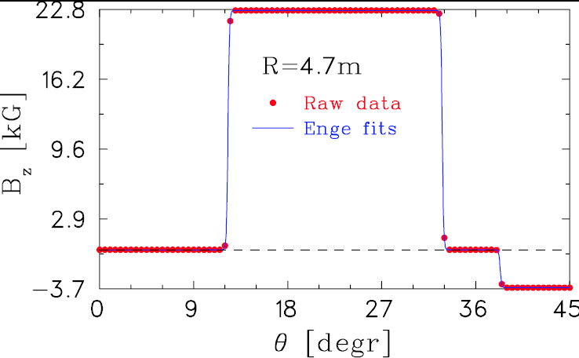
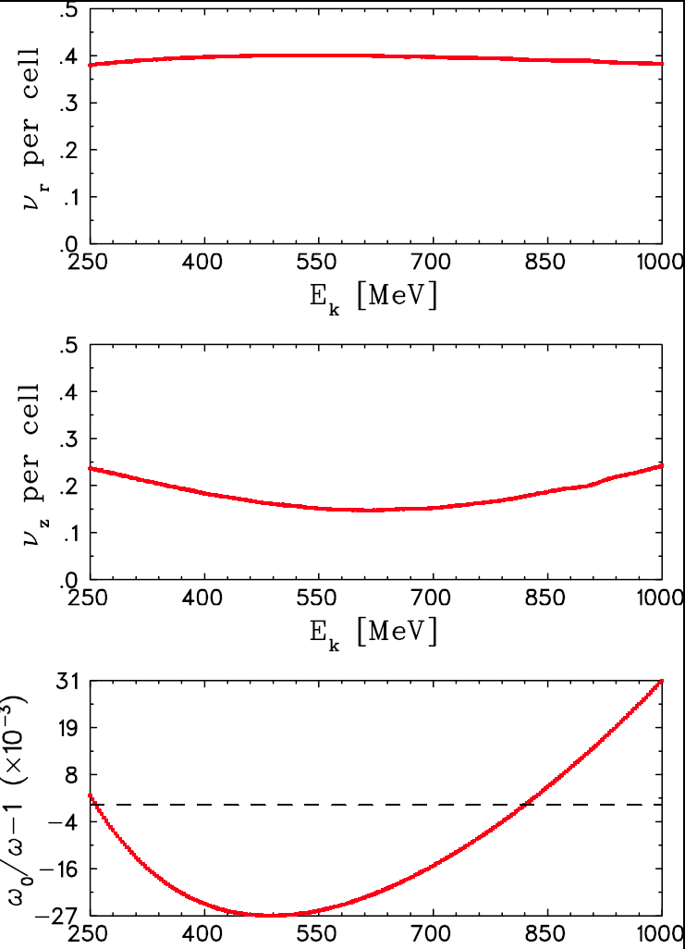
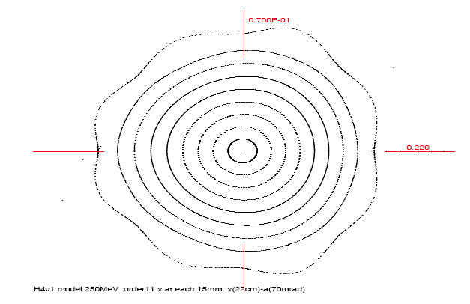
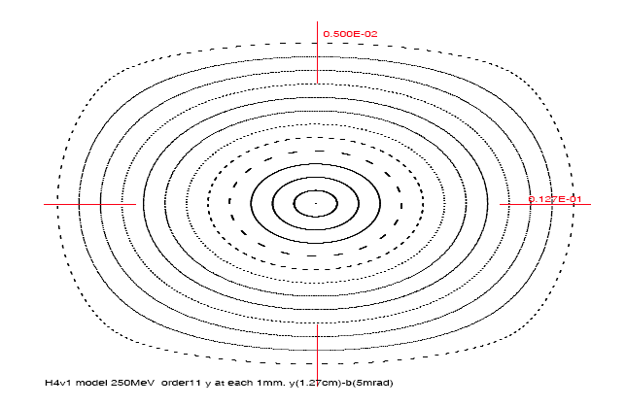
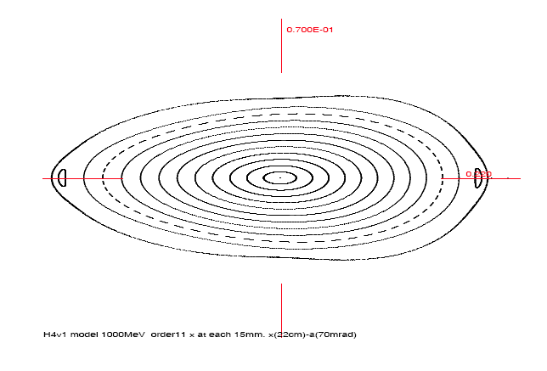
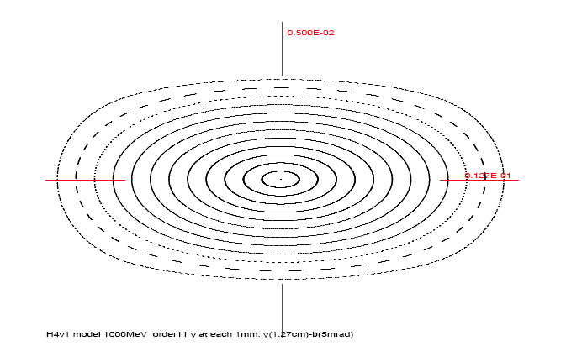
Original (COSY) Results
Y. N. Ray and M. Craddock, using CYCLOPS
+/- 3% isochronicity
Total machine tunes both within 0.5
50 – 100 pi mm mrad dynamic aperture (preliminary)
INJECTION = 250 MeV
Horiz.
Vert.
EXTRACTION = 1 GeV
C. Johnstone, COSY Infinity tracking of DA

Slide 14
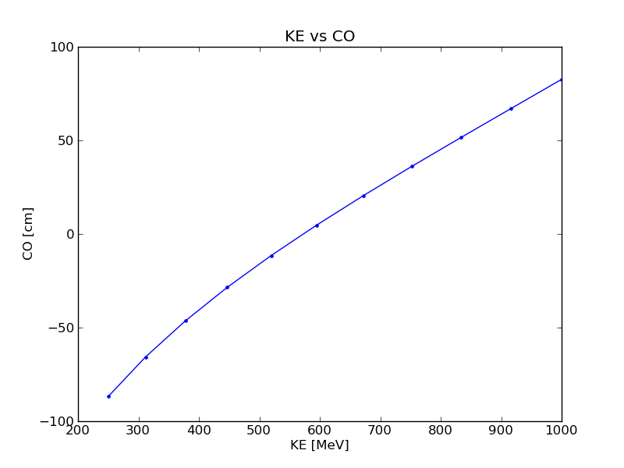
Recent (ZGOUBI) results
Modeled using polynomial fit to radial field profiles
Multipoles up to decapole
Analytical magnet model “DIPOLES”
5cm fringe fields (Enge)
F radial profile
D radial profile

Slide 15
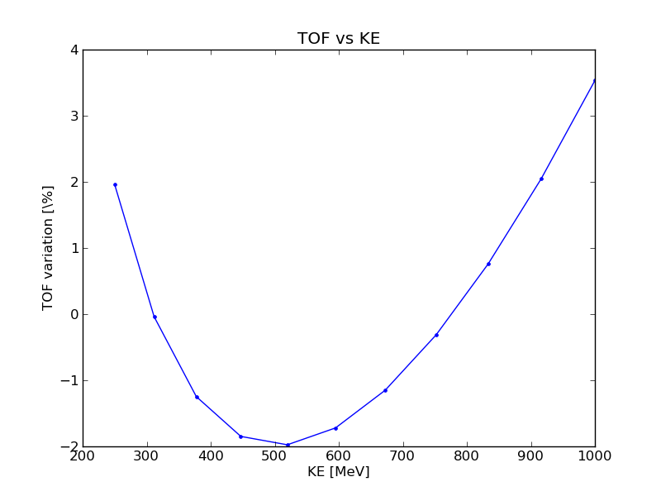
Recent (ZGOUBI) results
Dynamic aperture (preliminary)
Single particle with given amplitude in (x,y) tracked to extraction
Transverse only (!) – synchronous
Accel frequency = N * 8.13 MHz
Acceleration rate | Number of turns | Dynamic aperture (π mm mrad normalised)
None (@250 MeV) | 1000 | >420
1MV/turn | 750 | 374
2MV/turn | 375 | 411
4+MV/turn | 188 | 450+

Slide 16
Challenges - Space charge
First thoughts:
  CW beam – less direct space charge
  Strong focusing
Interaction between subsequent orbits
  Depends on acceleration rate (no. turns)
Eg. Direct SC for unbunched round beam in synchrotron (pretty unrealistic)
10 mA beam
100 pi mm mrad emittance (100%)
‘smallest possible’ tune shift is:
Rate | Avg. orbit separation
1 MV/turn | 0.21 cm
2 MV/turn | 0.43 cm
4 MV/turn | 0.85 cm
8 MV/turn | 1.7 cm
From K. Schindl, CAS notes

Slide 17
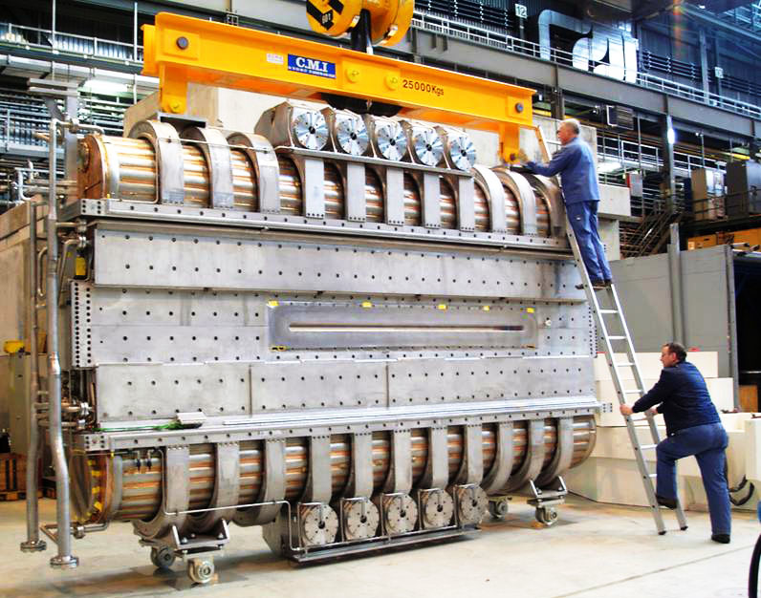
Challenges – acceleration
Large aperture (due to orbit excursion in FFAGs) can need large amount of power for acceleration (with changing frequency)
If fixed frequency – much easier! Like a cyclotron
PSI 590 MeV cyclotron has four 1MV RF cavities at 50.633MHz
Radial aperture at least 2.35m (R_{ext} – R_{inj})
Max line power 4*520kW
Image copyright 2009, PSI, http://nsdg.web.psi.ch/images/CuKav3b.jpg

Slide 18
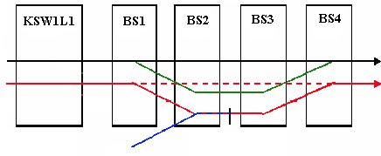
Challenges – Injection
For synchrotrons (or RCS) use charge exchange injection to build up current. Eg:
M. Martini & C.R. Prior, pp.1891 EPAC ‘04
In CW machine: direct injection
Clearly need to think about injector chain (up to 250 MeV)
Septum/kicker single turn setup?

Slide 19
Other issues
Cost: fair to say – uncertain!
No FFAGs quite like this have been built
Will probably rely heavily on magnet cost…
Running costs – potentially lower?
Injection/extraction?
At the moment, more questions than answers, but an interesting development…

Slide 20
Summary
Many challenges for proton FFAGs
New developments look promising for high power applications
But lots of work to do!

Slide 21

Acknowledgements
C. Johnstone, M. Berz, K. Makino @ FNAL
ASTeC Intense Beams Group @ RAL
Royal Commission for the Exhibition of 1851

Slide 22
References
H. Ait Abderrahim, J. Galambos et al., Accelerator and Target Technology for Accelerator Driven Transmutation and Energy Production.
C. Johnstone, Non-scaling FFAG designs for ADSR and Ion Therapy, presented at FFAG’10, KURRI, Japan. [http://hadron.kek.jp/FFAG/FFAG10_HP/slides/Thu/Thu05Johnstone.pdf]
C. Johnstone, M. Berz, K. Makino and P. Snopok, Innovations in Fixed-Field Accelerators: Design and Simulation, In Proceedings of Cyclotrons ’10
C. Johnstone, M. Berz, K. Makino and P. Snopok, Isochronous (CW) Non-Scaling FFAGs: Design and Simulation, AIP Conference Proceedings 1299, pp. 682-687, Nov. 2010. [http://dx.doi.org/10.1063/1.3520412]
B. Rimmer, Accelerator Costs, ADSR Workshop 2010, VTech

Slide 23
Additional slides

Slide 24
Taylor Maps
Equations of motion for particle in EM field can be written:
Can integrate to get final conditions. Initial & final related:
M is transfer map which has a Taylor representation, which converges for sufficiently small z.

