Slide 1
Particle Accelerators
A brief (hystorical) introduction
Reyes alemany fernandez (cern, BEAMS DEPARTMENT)

Slide 2
Particle Accelerators
What for?
How can we observe such small particles?
Let’s try to build an accelerator

Slide 3
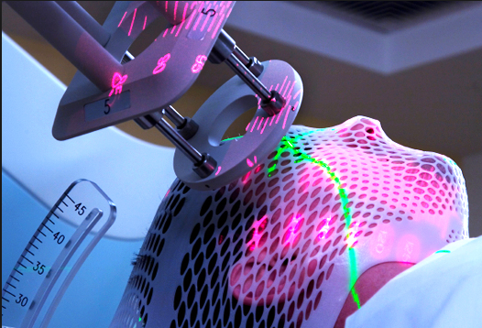
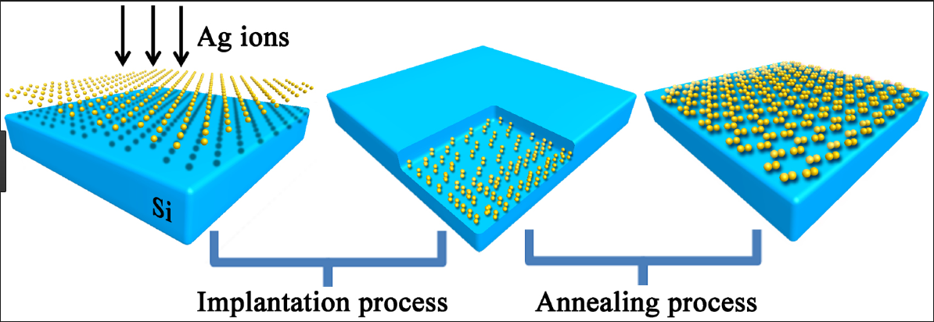
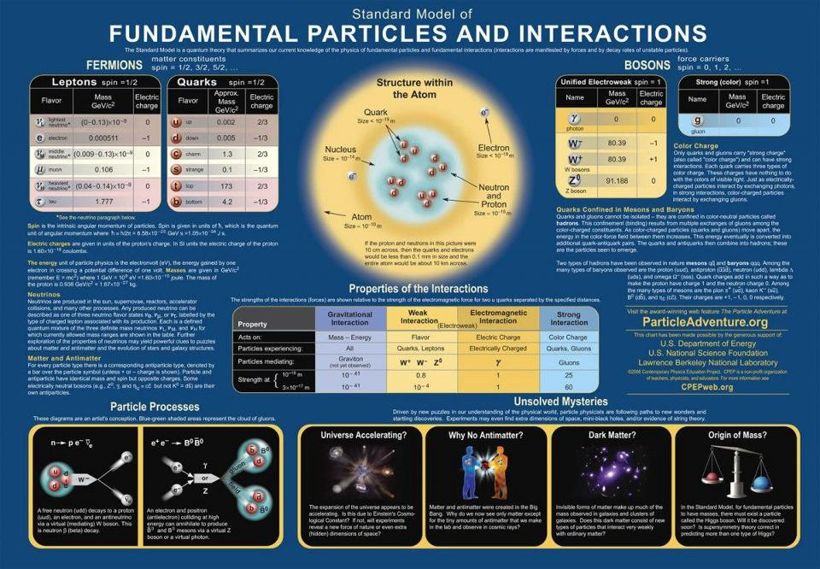
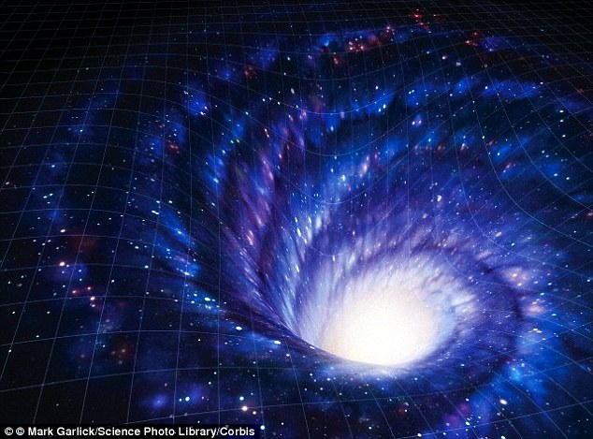
What for?
30000 accelerators in use world-wide:
  44% radiotherapy
  41% ion implantation
  9% industrial applications
  4% low energy research
  1% medical isotope production
  <1% fundamental research

Slide 4

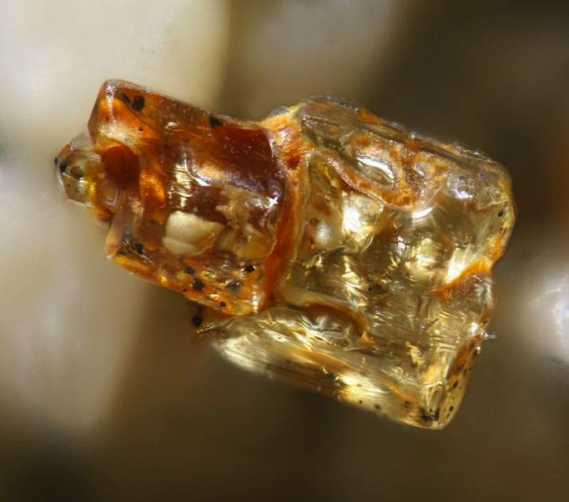
The micro-world ➔ the atoms
In a typical beach there are tens of thousands of millions of millions of sand grains
But … within a single grain of sand, there are as many atoms!

Slide 5


The micro-world ➔ atoms’ constituents
The atom nucleus weights more than 99% of the atom mass
If the atom was as big as the “Stade de France”
… the nucleus would be smaller than the foot ball

Slide 6

How can we observe such small particles?
The structures under research are EXTRAORDINARILY SMALL (~ < 10⁻¹⁵ m)
probes with correspondingly high spatial resolution are needed. Visible light is inadequate: size ~ 5 10⁻⁷ m
what could we use instead?
mm = 10⁻³ m
µm = 10⁻⁶ m
nm = 10⁻⁹ m
pm = 10⁻¹² m
fm = 10⁻¹⁵ m
am =10⁻¹⁸ m
light
➔ R_{atoms} ~ 30 – 300 pm (0.03 – 3 Å)
➔ R_{nucleus} ~ 1 – 10 fm
➔ Quarks - leptons

Slide 7
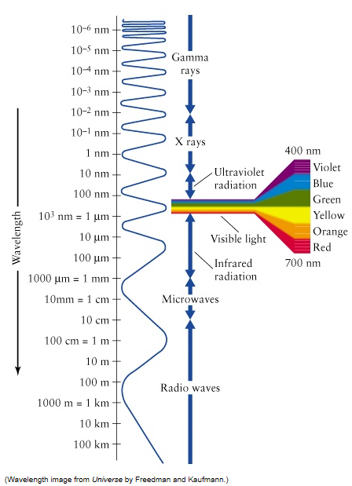
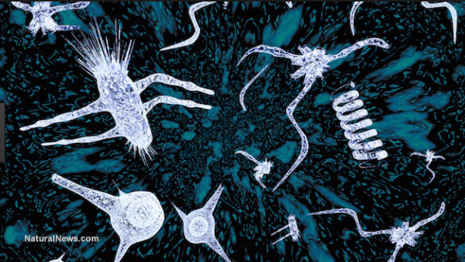
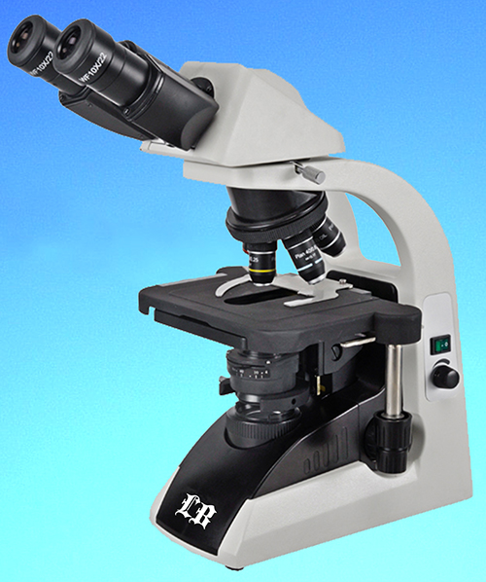



How can we observe such small particles?
Aggregate of molecules: cell/bacteria
Optical microscope
Size: $λ$ = 10⁻⁵ - 10⁻⁷ m
➔ 10 micro – 100 nano
$$E=\frac{hc}{λβ}$$
➔ 0.1 eV – 10 eV
Planck constant:
$h$=E/𝝂=6.6 10⁻³⁴ Js
$$ℏ=\frac{h}{2π}$$
$β$=v/c

Slide 8
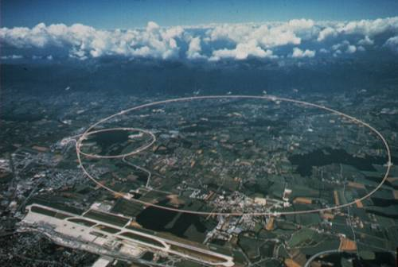
How can we observe such small particles?
 | Size (m) | Size | Beam energy | Instrument
Aggregate of molecules: cell/bacteria | 10⁻⁵ | 10 micro meter | 0.1 eV | Optical microscope
 | 10⁻⁷ | 100 nano meter | 10 eV
Aggregate of atoms: molecules | 10⁻⁹ | 1 nano meter | 1 keV | Electron microscope
Atoms: nucleus+electrons | 10⁻¹⁰ | 0.1 nano meter | 10 keV | Synchrotron radiation
Nucleus (Oxygen: 8p+8n) | 10⁻¹⁴ | 0.01 pico meter | >100 MeV | Low energy e- or p+ accelerator
Aggregate of quarks: hadrons | 10⁻¹⁵ | 1 femto meter | > 1 GeV | High energy p+ accelerator
Quarks+leptons | 10⁻¹⁸ | 1 atto meter | > 1 TeV | High energy e- or p+ collider
LHC 27 km circumference
7 TeV beam energy

Slide 9


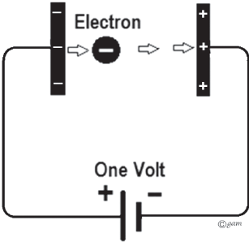
A little parenthesis about Energy Units
Energy = capacity of a physical system to perform work
In physics, energy is usually measured in Joule (J)
1 Joule = energy expended (or work done) in applying a force of one newton through a distance of one metre (SI).
Joule is not convenient when describing particle beams because the energy is very small, e.g.,
Therefore a new unit was invented ➔ eV ➔ kinetic energy gained by a particle of elementary charge 1.602 10⁻¹⁹ C as it crosses a potential difference of 1 V.
Energy = 1.602 10⁻¹⁹ J
1 keV = 10³ eV, 1 MeV = 10⁶ eV, 1 GeV = 10⁹ eV, 1 TeV = 10¹² eV

Slide 10
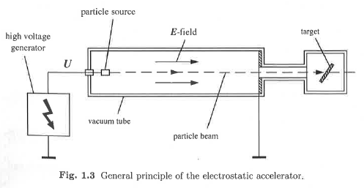
How can we accelerate charged particles?
Simplest particle accelerators use a constant electric field (DC accelerators) between two electrodes, produced by a high energy voltage generator
Exit window towards the target
One of the electrodes has the particle source
If e- beams: particle source is a thermionic cathode (widely used in vacuum technology)
Field-free field region
In the accelerating region there is good vacuum to avoid beam-gas collisions
Limited achievable particle energies
Depends on the maximum voltage that can be given by the generator

Slide 11
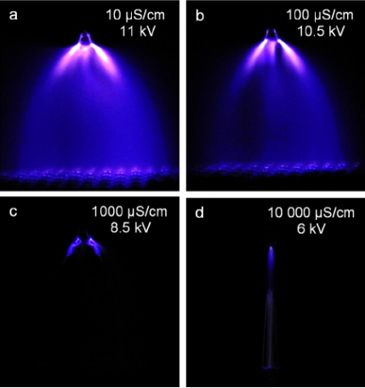
How can we accelerate charged particles?
What is the energy limit in DC accelerators?
CORONA FORMATION is the actual energy limit
electrode
Cascade effect
-
HV
E
e- & ions acceleration
Ionization of residual gas molecules in cascade
Spark discharge & HV breakdown
HV of ~ MV ➔ particle energy ~ few MeV

Slide 12
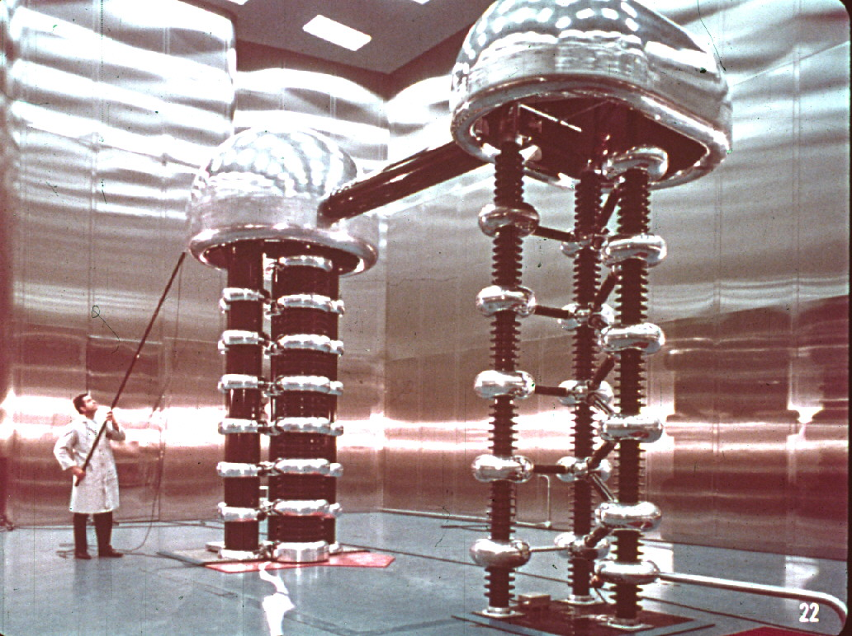
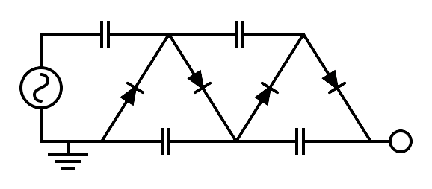
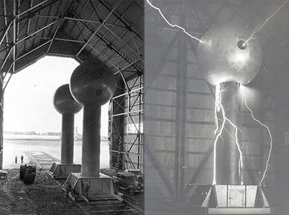
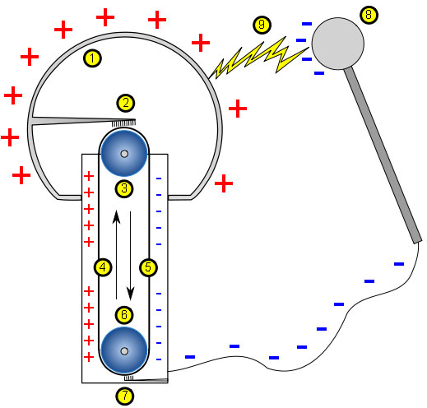
Examples of electrostatic accelerators
Cockroft-Walton (1030’s)
We had one at CERN to accelerate protons up to 750 keV
HV ~ 4 MV
Van de Graaff (1030’s)
HV ~ 2 MV – 10 MV

Slide 13
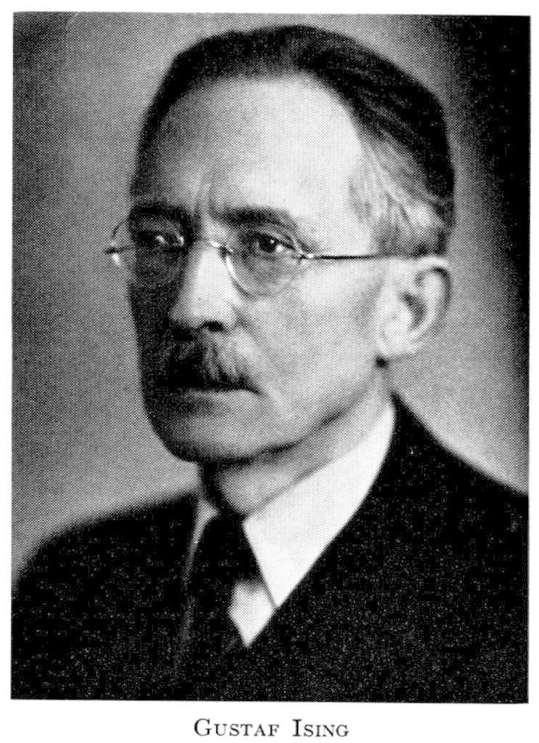
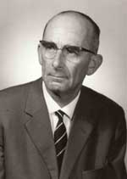
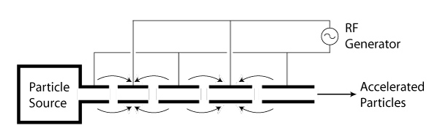
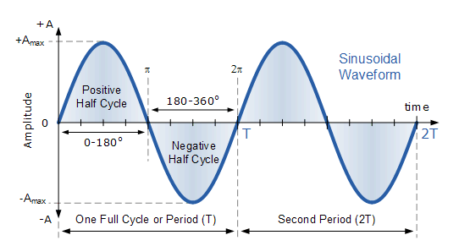

How could we overcome the corona formation energy limit and go beyond few MeV regime?
Ising 1925 ➔ AC voltage!!
Wideroe 1928 ➔ first successful test of AC accelerator
Gustaf Ising
Rolf Wideroe
-
+
+
-
vA
E
vB
vA < vB ➔
LB
> LA
E
➔ L = vTrf = βλo
LA
LB
U(t)
RF generator voltage:
U_{max}
$$U\left(t\right)=U_{max}sinωt$$
U_{min}

Slide 14






AC Linear Accelerators
RF generator voltage:
V$\left(t\right)=V_{max}sinωt$
Energy reached by the particle per crossed gap:
$$∆Energy=\int_{s1}^{s2}{F}ds$$
$$F_{electric }=qE_{electric}$$
E_{electric} is cte between s1 and s2 when the particle crosses the gap, therefore, q and E_{electric} come out from the integral.
We are left with the integral of ds between s1 and s2 ➔ s2-s1 = Δs
$$∆Energy=\int_{s1}^{s2}{qE_{electric}}ds$$
$$∆Energy=qE_{electric}∆s$$
= V
$$∆Energy=qV=qV_{max}sinφ_{0}$$
Average phase of the RF voltage the particle sees as it crosses the gap

Slide 15
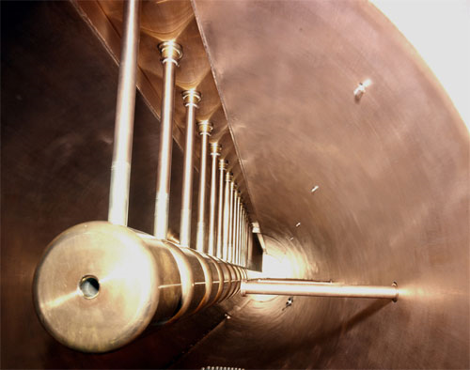
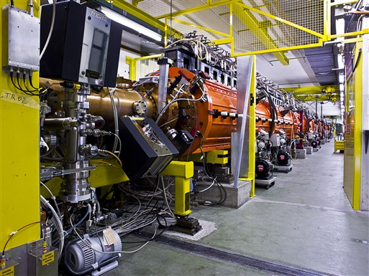

AC Linear Accelerators
Energy gained by the particle after passing the n-th gap:
$$∆Energy=nqV=nqV_{max}sinφ_{0}$$
Energy gain is proportional to the number of stages/gaps traversed by the particle
However, the largest voltage in the entire system is never greater than U_{max}
No corona discharge
At CERN we have linear accelerators for the first acceleration steps: LINAC2, LINAC3, LINAC4
750 keV
50 MeV
DT (4 tanks,33 m)
Pulse of beam ~100 μs long every 1.2 s

Slide 16

What is the limitation of linear accelerators?
radiofrequency (RF) structures and a two-beam concept to produce accelerating fields as high as 100 MV per meter to reach a nominal total energy of 3 TeV
≈ 50 km
Size & cost could be a problem since it grows with energy

Slide 17
How can we overcome the limitation of linear accelerators to increase the energy without increasing the size?
+
-
-
+
E
E

Slide 18
How can we overcome the limitation of linear accelerators to increase the energy without increasing the size?
+
-
-
+
E
E

Slide 19
How can we overcome the limitation of linear accelerators to increase the energy without increasing the size?
+
-
-
+
E
E

Slide 20
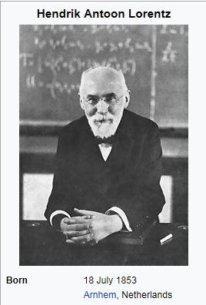
But how can we keep a charged particle running in circles?
Let’s ask Lorentz

Slide 21
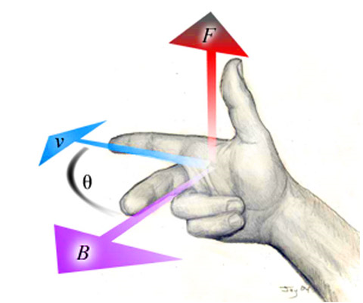

But how can we keep a charged particle running in circles?
N
We need a magnetic field
LORENTZ FORCE
S
$$\vec{F}=q∙\vec{E}+q∙(\vec{v} x \vec{B})$$
If an electric field is present
If a magnetic field is present
Curved trajectory!
F
v
Cross product of two vectors is another vector orthogonal to them
90⁰
90⁰
B
q: particle charge
Can we accelerate and bend neutral particles?

Slide 22
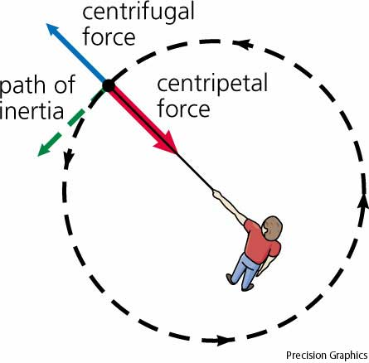




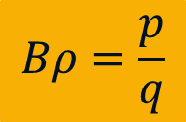
Before we continue, first we should understand the beam rigidity
What is the condition for a circular orbit in the presence of a uniform magnetic field?
Lorentz force = centrifugal force
ρ: curvature radius
m: particle mass
v: particle velocity
$$F_{centrifugal}=\frac{m∙v^{2}}{ρ}$$
$$F_{Lorentz}=q∙v∙B$$
=
$$q∙v∙B=\frac{m∙v^{2}}{ρ}$$
$$Bρ=\frac{p}{q}$$
Lorentz force
ρ
$$p=m∙v$$
B
Particle momentum
Beam rigidity formula
Mechanical equivalent

Slide 23
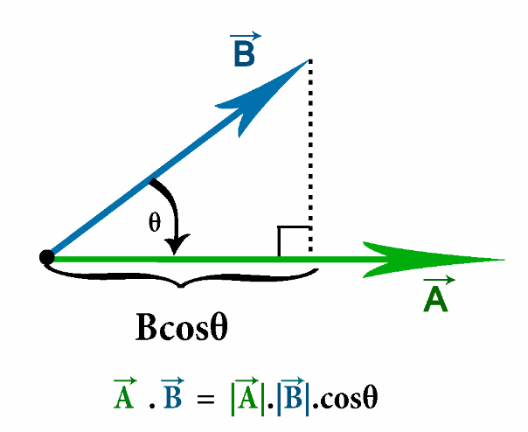



Let’s build our first circular accelerator!!
We need a magnetic field perpendicular to the particle trajectory to bend the particles
We need an electric field to give energy to the particles ➔ magnetic fields do not change the energy of the particles, why?
$$∆Energy= \int_{s1}^{s2}{\vec{F}d\vec{s}}$$
Those are vectors! They have direction and magnitude
This is the scalar product:
If A and B are parallel ➔ θ = 0⁰ ➔ cosθ = 1
If A and B are orthogonal ➔ θ = 90º ➔ cosθ = 0
The force gives the maximum energy increase
$∆Energy$ = 0
Since the magnetic field is orthogonal to the particle trajectory $∆Energy$ = 0

Slide 24
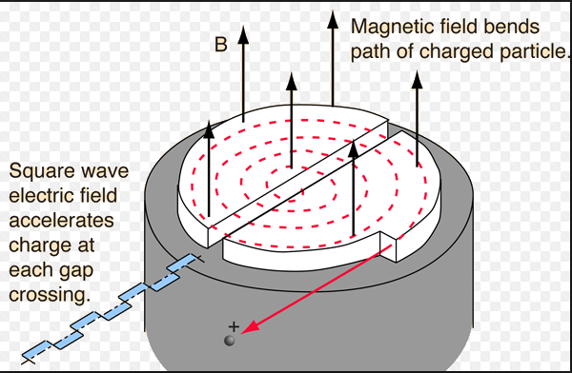
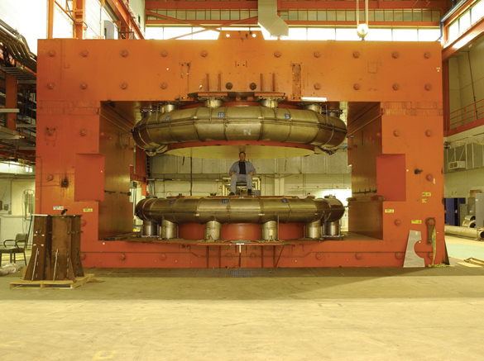
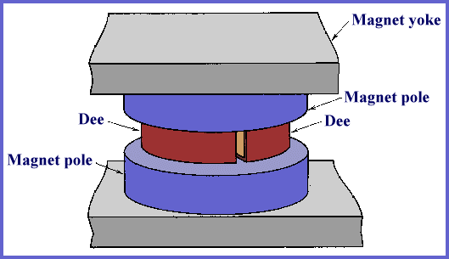
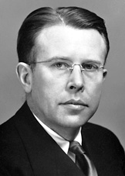

This is our first circular accelerator ➔ cyclotron
Vacuum chamber
B ~ 2 T
$$ρ=\frac{p}{qB}$$
The first circular accelerator was developed by E. O. Lawrence at Univ. California in 1930.
In 1932 Lawrence and Livingston built the first cyclotron suitable for experiments with 1.2 MeV peak energy.
If B is a constant uniform magnetic field ➔ ρ increases as the particle momentum increases
The vacuum chamber has to be big enough to accommodate the full particle trajectory before extraction
E. O. Lawrence

Slide 25
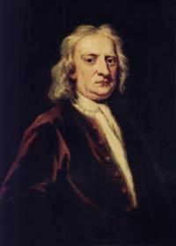


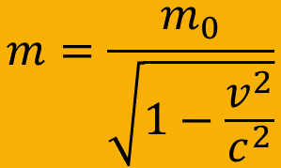
A little parenthesis about Relativity
For over 200 years Newton’s equations of motion were believed to describe nature correctly. But in 1905 Einstein discovered an error in these laws and proposed a solution.
$$F=\frac{d(m∙v)}{dt}=m\frac{dv}{dt}=m∙a$$
Newton assumes m is constant
But Einstein, based on experimental observations, realised that the mass of a body increases with velocity!!
$$m=\frac{m_{0}}{\sqrt{1−\frac{v^{2}}{c^{2}}}}$$
m₀ is the rest mass, the mass of a not-moving body
c: speed of light (3x10⁵ km/s)

Slide 26
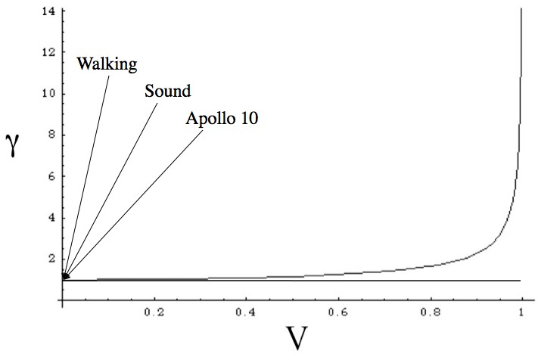
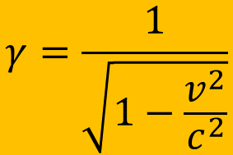







A little parenthesis about Relativity
$$m=\frac{m_{0}}{\sqrt{1−\frac{v^{2}}{c^{2}}}}$$
$$γ=\frac{1}{\sqrt{1−\frac{v^{2}}{c^{2}}}}$$
$$m=γ∙m_{0}$$
$$m{∙c}^{2}=γ∙m_{0}{∙c}^{2}$$
Relativistic gamma factor
$$E=m{∙c}^{2}=γ∙m_{0}{∙c}^{2}$$
As the velocity of the particle gets closer to c, the mass m is greater and greater
LHC protons
The body inertia increases and increases and the force applied to move the particle is less and less efficient, so the velocity increases more and more slowly and asymptotically approaches c
$$γ=7463$$
v/c
But it will never be equal to c because the mass grows exponentially
e.g. LHC
$$γ=\frac{E}{E_{0}}=\frac{m∙c^{2}}{m_{0}∙c^{2}}=\frac{7000 GeV}{0.938 GeV}=7463$$
$$\frac{v}{c}=0.9999=β$$
Relativistic beta factor

Slide 27
We are doing well so far, but MeV it is not enough, how can we reach GeV energies?
 | Size (m) | Size | Beam energy | Instrument
Aggregate of molecules: cell/bacteria | 10⁻⁵ | 10 micro meter | 0.1 eV | Optical microscope
 | 10⁻⁷ | 100 nano meter | 10 eV
Aggregate of atoms: molecules | 10⁻⁹ | 1 nano meter | 1 keV | Electron microscope
Atoms: nucleus+electrons | 10⁻¹⁰ | 0.1 nano meter | 10 keV | Synchrotron radiation
Nucleus (Oxygen: 8p+8n) | 10⁻¹⁴ | 0.01 pico meter | >100 MeV | Low energy e- or p+ accelerator
Aggregate of quarks: hadrons | 10⁻¹⁵ | 1 femto meter | > 1 GeV | High energy p+ accelerator
Quarks+leptons | 10⁻¹⁸ | 1 atto meter | > 1 TeV | High energy e- or p+ collider

Slide 28

What is the limitation of the cyclotrons?
If B is a constant uniform magnetic field ➔ ρ increases as the particle momentum increases ➔ we get a spiral orbit ➔ cyclotron
$$ρ=\frac{p}{qB}$$
But there is a limitation to the B field
In the end the spiral gets bigger and bigger
➔ the size (= cost) of the cyclotron has to increase!

Slide 29
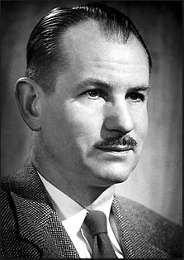
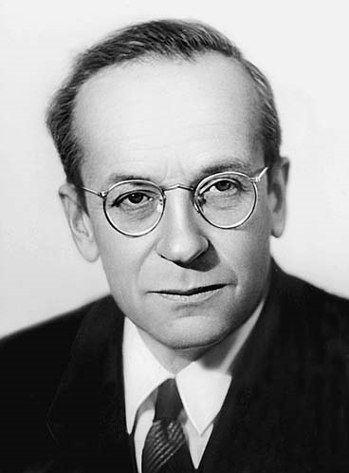
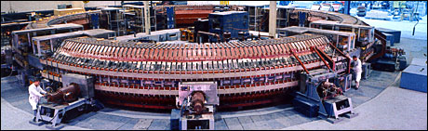
What can we do to keep the radius of the accelerator cte?
Synchrotrons
If B increases synchronously with the particle momentum such the ratio p/B remains cte, then the accelerator radius is cte.
Synchrotron principle developed almost simultaneously by E. M. McMillan (California University) & V. Veksler (Soviet Union) in 1945.
E. M. McMillan
V. Veksler
1949: Cosmotron @BNL ➔ proton synchrotron of 3.3 GeV, C ~ 57 m
2008: LHC ➔ proton synchrotron of 7000 GeV, C = 27 km
There is a technical limit to the value of B, ~ 1.5 Tesla for normal conducting magnets and ~ 8 Tesla for superconducting magnets

Slide 30
Let’s build a synchrotron

Slide 31








We need dipole magnets
N
S
A dipole with a uniform field deviates a particle by an angle θ
The bending angle θ depends on:
  the length L
  the magnetic field B
  the particle momentum
Curved trajectory!
F
v
90⁰
90⁰
B
$$arc≈angle∙radius$$
$$arc=L$$
$$angle=θ$$
$$radius=ρ$$
L$=θ∙ρ$
Dipole seen from the top
$$θ=\frac{L}{ρ}$$
$$∙\frac{B}{B}$$
$$θ=\frac{LB}{Bρ}=\frac{LB}{\frac{p}{q}}$$

Slide 32
Two particles in a dipole field
What happens with two particles that travel in a dipole field with different initial angles, but with equal initial position and equal momentum ?
Particle A
Particle B
Assume that Bρ is the same for both particles.
Lets unfold these circles……

Slide 33


The 2 trajectories unfolded
Remember, this is the horizontal plane
The horizontal displacement of particle B with respect to particle A.
Particle B oscillates around particle A ➔ a dipole magnet bends the particle in the horizontal plane and has a focusing effect proportional to 1/ρ (1/bending radius)
Particle B
x
Particle A
Strength of the dipole field normalized to the particle momentum/charge:
displacement
Remember two slides ago:
L$=θ∙ρ$
2π
$$\frac{B}{p/q}=\frac{1}{ρ}$$
0
This type of oscillation forms the basis of all transverse motion in an accelerator.
It is called Betatron Oscillation

Slide 34
What happens in the vertical plane?
Particle B
y = αL
Particle is lost
y
Particle A
α
displacement
L
Vacuum pipe aperture
0
2π
What can we do to keep the particle inside the vacuum pipe?
We need something that when the particle deviates from the reference trajectory by an amount y, there is a force applied to the particle proportional to y that brings the particle back on track
Do you know a force of this kind?

Slide 35
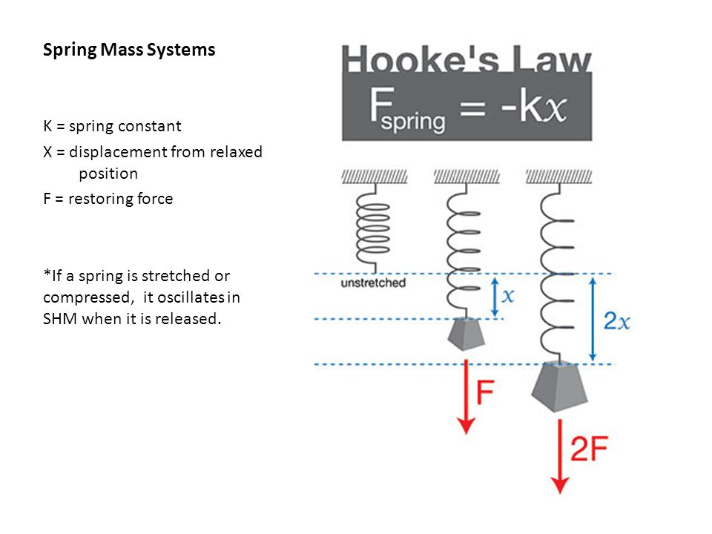
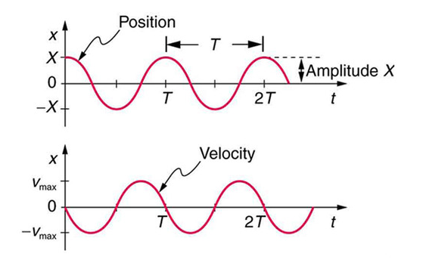
The mechanical equivalent
The gutter below illustrates how the particles in our accelerator should be focused
The force we are looking for is of the type:

Slide 36
A particle during its transverse motion in our accelerator is characterized by:
  Position or displacement from the central orbit
  Angle with respect to the central orbit
x
x = displacement
x’ = angle = dx/ds
x’
x
x
s
ds
x’
dx
This is a motion with a linear restoring force =f(position), like the pendulum or spring mass system

Slide 37
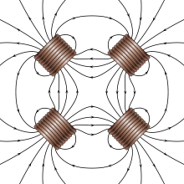
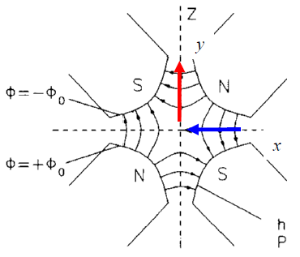
Quadrupole fields
Hook’s law
A Quadrupole has 4 poles, 2 north and 2 south
On the x-axis (horizontal) the field is vertical and given by
B_{y} ∝ x
On the y-axis (vertical) the field is horizontal and given by
They are symmetrically arranged around the centre of the magnet
B_{x} ∝ y
Field gradient, K:
There is no magnetic field along the central axis
Normalised gradient, k:
Horizontal focusing quadrupole
Vertical focusing quadrupole
Magnetic field
y
Magnetic field
x
x
y

Slide 38



Focusing and Stable motion
Using a combination of focusing (QF) and defocusing (QD) quadrupoles solves our problem of ‘unstable’ vertical motion.
Remember that the focusing strength of a dipole magnet goes with
$$\frac{B}{p/q}=\frac{1}{ρ}$$
The bigger the accelerator radius, ρ, the smaller the strength of the dipole field
So the focusing effect in the horizontal plane works for small radius accelerators, but would it work for LHC?
$$ρ≈ \frac{26658.9 m}{2π}∙66\% ≈2800 m$$
$$\frac{1}{ρ}=\frac{1}{2800}=0.0004 m^{−1}$$
Even for smaller radius accelerators would not work
Does not matter!! We’ll profit from the focusing effect of the quadrupoles because it works in both planes!!!!

Slide 39
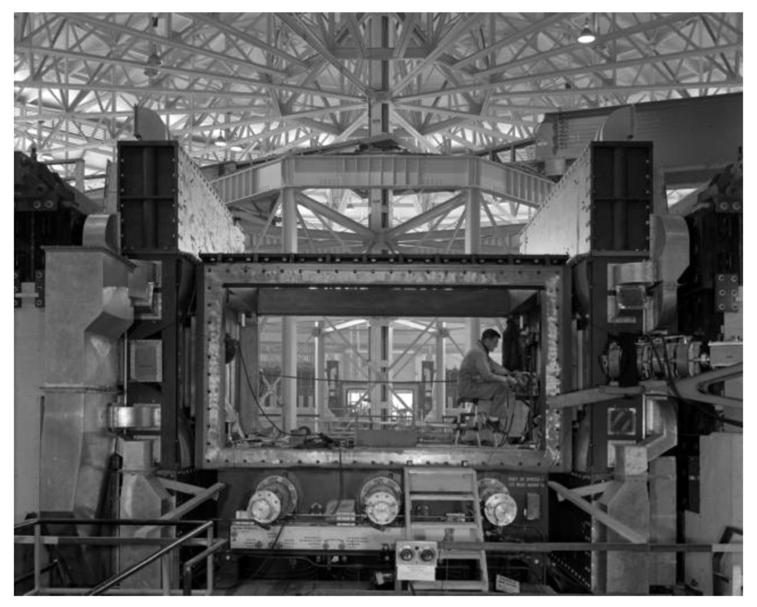
COSMOTRON (1949) & BEVATRON (1954) used weak focusing (strong focusing not yet invented) ➔ beam area in BEVATRON ~ 120 cm2 ➔ huge vacuum chambers
Vacuum chamber
Beam direction

Slide 40
Focusing and Stable motion
Quadrupoles will keep the beams focused in both planes when the position in the accelerator, type and strength of the quadrupoles are well chosen
By now our accelerator is composed of:
  Dipoles, constrain the beam to some closed path (orbit)
  Focusing and Defocusing Quadrupoles, provide horizontal and vertical focusing in order to constrain the beam in transverse directions
A combination of focusing and defocusing sections that is very often used is the so called: FODO lattice
This is a configuration of magnets where focusing and defocusing magnets alternate and are separated by non-focusing drift spaces

Slide 41
FODO cell
Magnetic field
x
Defocusing quadrupole (QD) focuses in vertical and defocuses in horizontal
y
The FODO cell is defined as follows:
QF
QD
QF
L1
L2
Magnetic field
y
‘FODO’ cell
Focusing quadrupole (QF) focuses in horizontal and defocuses in vertical
x
Beam

Slide 42
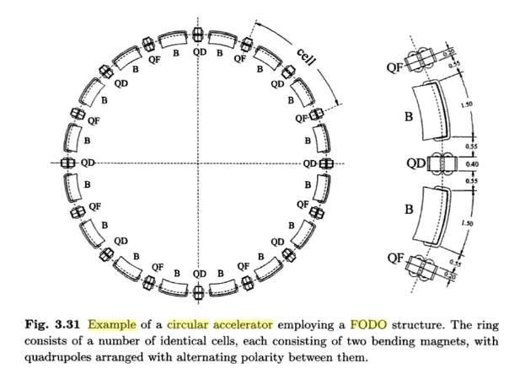
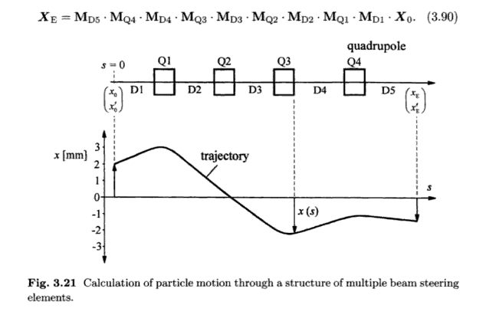
Circular accelerator with a FODO structure
(by K. Wille)
(by K. Wille)

Slide 43
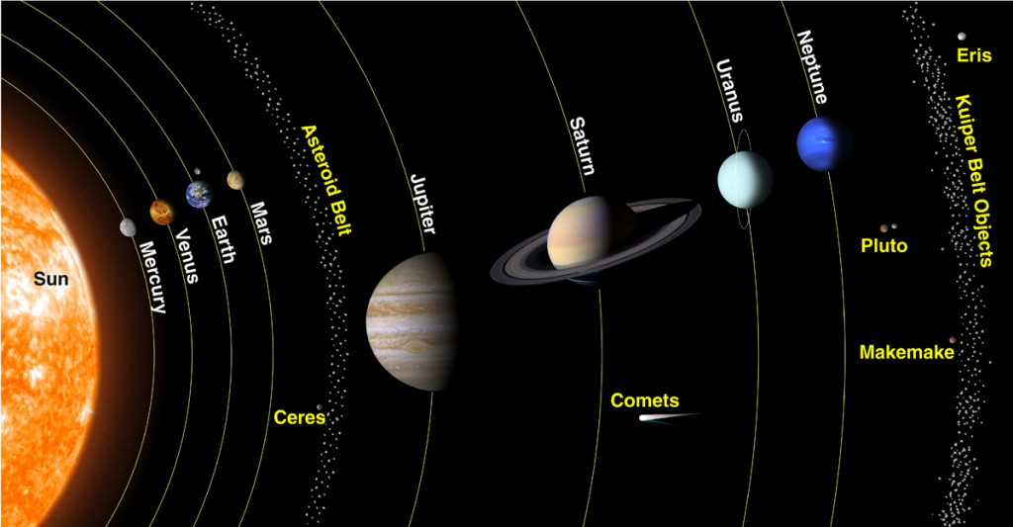
What do we know by now?
We know how to guide the particles on a well defined design orbit
We know how to focus the particles to keep each single particle trajectory with in the vacuum chamber of the accelerator close to the design orbit
In this way particles are accelerated and stored for several hours (~ 12 hours or more) travelling at about v~c ➔ L= 10¹⁰-10¹¹ km several times the distance Sun-Pluto and back
Diameter ~ 4-5 cm
LHC vacuum pipe Ultra high vacuum: 10⁻¹⁰ mbar, like at 1000 km over see level

Slide 44
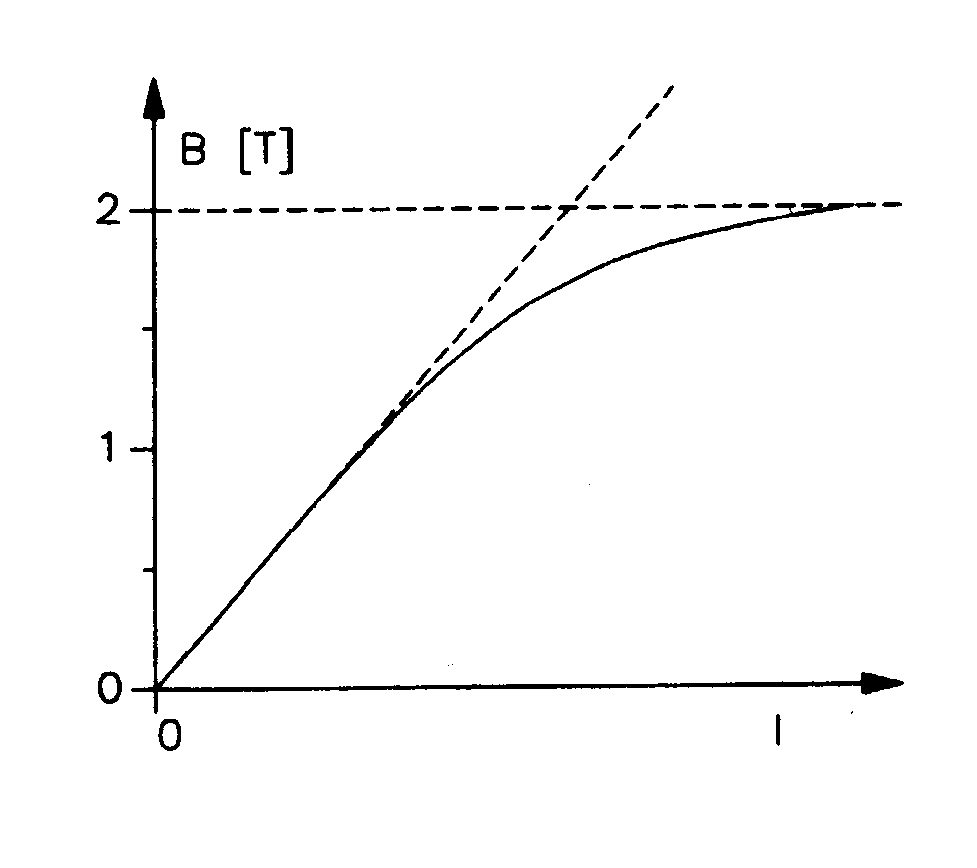


At which energy can we accelerate the particles now? Let’s take LHC as example
Golden formula (you should know by heart) ➔
$$Bρ= \frac{p}{q}$$
Circumference ➔ FIXED!!! by LEP: 26658.9 m ➔
$$ρ≈ \frac{26658.9 m}{2π}∙66\% ≈2800 m$$
~ 66% of the lattice elements are dipoles
Magnetic field in the dipole magnets = 8 Tesla
We need SUPERCONDUCTING technology!!
$p=0.33∙q∙B∙ρ≈0.33∙8 T∙2780 m≈$ 7 TeV
 | Size (m) | Size | Beam energy | Instrument
Aggregate of molecules: cell/bacteria | 10⁻⁵ | 10 micro meter | 0.1 eV | Optical microscope
 | 10⁻⁷ | 100 nano meter | 10 eV
Aggregate of atoms: molecules | 10⁻⁹ | 1 nano meter | 1 keV | Electron microscope
Atoms: nucleus+electrons | 10⁻¹⁰ | 0.1 nano meter | 10 keV | Synchrotron radiation
Nucleus (Oxygen: 8p+8n) | 10⁻¹⁴ | 0.01 pico meter | >100 MeV | Low energy e- or p+ accelerator
Aggregate of quarks: hadrons | 10⁻¹⁵ | 1 femto meter | > 1 GeV | High energy p+ accelerator
Quarks+leptons | 10⁻¹⁸ | 1 atto meter | > 1 TeV | High energy e- or p+ collider
Finally we can observe quarks and leptons!!
Field limit for normal conducting magnets due to saturation
WELL DONE !!!

Slide 45
Spares

Slide 46







Hill’s equation
These betatron oscillations exist in both horizontal and vertical planes.
The number of betatron oscillations per turn is called the betatron tune and is defined as Qx and Qy.
Harmonic oscillator equation of motion:
$$F=m\frac{dv}{dt}=m\frac{d}{dt}\left(\frac{dx}{dt}\right)=m\frac{d^{2}x}{{dt}^{2}}$$
$$F=ma$$
Newton’s second law
$$\frac{d^{2}x}{{dt}^{2}}+Kx=0$$
$$F=−kx$$
Hooke’s law
$$m\frac{d^{2}x}{{dt}^{2}}=−kx$$
$$\frac{d^{2}x}{{dt}^{2}}=−\frac{k}{m}x$$
➔
K
If the restoring force, K is constant in ‘s’ then this is just a Simple Harmonic Motion.
In a real accelerator K = f(s), remember the FODO, there are different quadrupole magnets, each can have its own value for the restoring force.
Hill’s equation, with K(s):
The equation of motion is in this case
$$K\left(s\right)=\frac{1}{{ρ(s)}^{2}}−k(s)$$
Focusing effect: from dipoles from quadrupoles

Slide 47
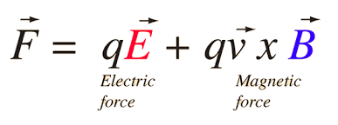


This is our first circular accelerator ➔ cyclotron
Not valid for relativistic particles
Equation of motion within the homogeneous magnetic field:
It is the Lorentz force without the electric field:
The particle follows a circular orbit with revolution frequency:
$$ω_{z}=\frac{q}{m}B_{z}$$
Cyclotron frequency
The RF frequency = cyclotron frequency
The higher the velocity the larger the radius of curvature (provided the mass remains cte) ➔ the particle gets more and more “rigid” and the magnetic field, which remains constant, has more and more difficulties to bend the particle.
$ω_{z}≠$ f(particle velocity)

Slide 48


This is our first circular accelerator ➔ (synchro)cyclotron
Classical cyclotrons can accelerate protons, deuterons and alpha particles up to 22 MeV per charge.
At this energies those particles are not relativistic ( v ~ 0.15c), so the mass ~ cte, so the cyclotron frequency remains cte.
$$ω_{z}=\frac{q}{m}B_{z}$$
As the energy increases the particles are more and more relativistic and their mass is not cte, it increases:
$$E=mc^{2}=γm_{0}c^{2}$$
Therefore, ω_{z} decreases with increasing m
If ω_{RF} is decreased accordingly, higher energies can be reached.
This is the synchrocyclotron principle

Slide 49
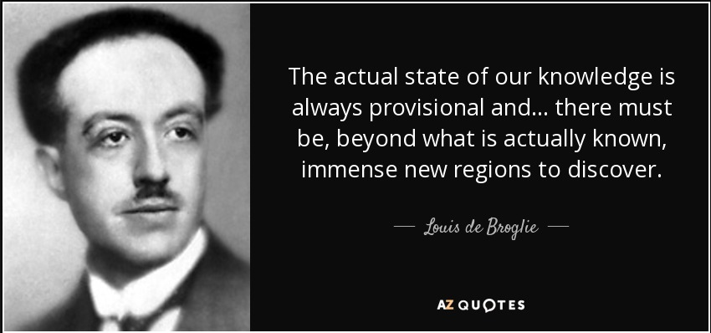

How can we observe such small particles?
Let’s ask De Broglie
In his 1924 PhD thesis suggested that
“MOVING OBJECTS ACT LIKE WAVES”
A particle of mass m and speed v behaves like a wave with wavelength λ:
$$λ=\frac{h}{mv}$$

Slide 50
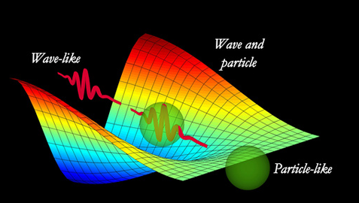



How can we observe such small particles?
We just saw that photons are limited in size, what else we can use?
Good candidates are the microscopic particles itself
We just learnt they are waves as well
Its De Broglie wavelength must be small compared to the size of the structure we want to observe
De Broglie wavelength
$$λ=\frac{h}{mv}$$
$$λ=\frac{h}{mv}=\frac{hc}{Eβ}$$
$$E=\frac{hc}{λβ}$$

Slide 51



How can we observe such small particles?
Aggregate of atoms: molecules
Electron microscope
Size = 10⁻⁹ m ➔ 1 nano
This is an accelerator!!
$$E=\frac{hc}{λβ}$$
➔ 1 keV

Slide 52



How can we observe such small particles?
Atoms: nucleus+electrons
Synchrotron radiation facility
Size = 10⁻¹⁰ m ➔ 0.1 nano
$$E=\frac{hc}{λβ}$$
➔ 10 keV

