Slide 1


QFib Test Beam
S. OZKORUCUKLU
27 July 2023

Slide 2
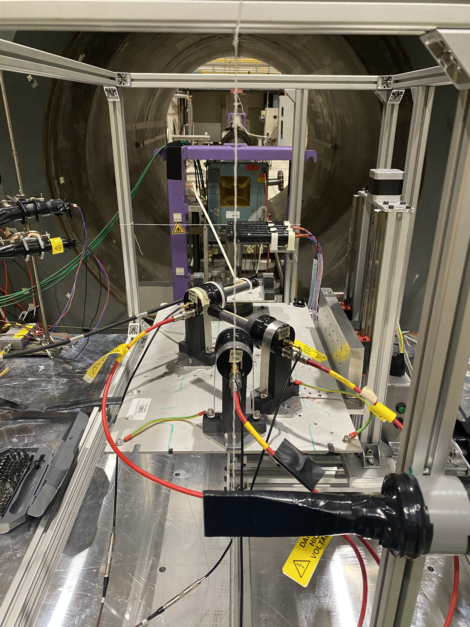
Qfib Test Beam Setup
Beam defining counters
Beam defıned as 5mm diameter or 10x10mm² according to combination of coincidence of beam counters
DUT: Detector Under Test
1.5m long HF-PPP fibers + MCP-PMT/PMT
TRS: Time Reference System
SB1-2: MCP-PMT + Qbar doublets (two 5x5x100mm³), 45º to the beam
TRC: MCP-PMT + Qblock (12x12x25mm³)/UVT Plexi (12x12x20mm³), Head on

Slide 3
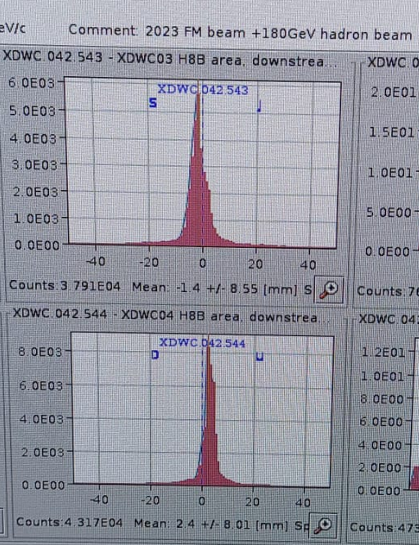
Data Taking Conditions
180 GeV pion beam with high intensity
Almost all the beam time(180GeV pion) was used with the runs and scans.
The team used almost all the beam time with a 180GeV pion beam. It was not possible to get data with the main user's beam request, which is a 20GeV positron beam.
24 Runs and 4 Scans were taken.
More than 14 Million events were taken.
TRS calibrated with the scans.
Attenuation and time resolution in the long fiber is investigated with the DUT study.

Slide 4
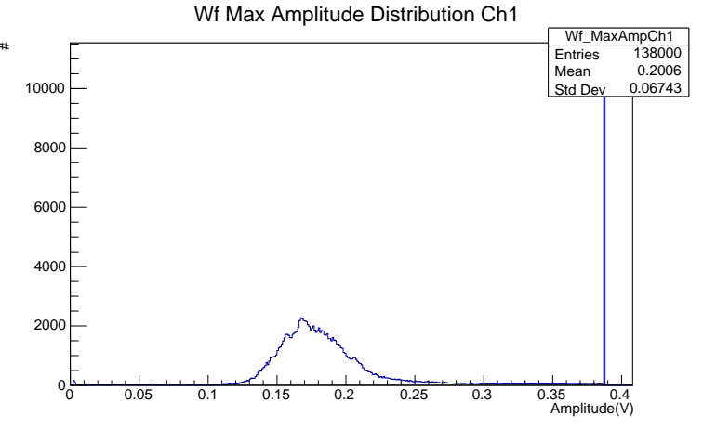
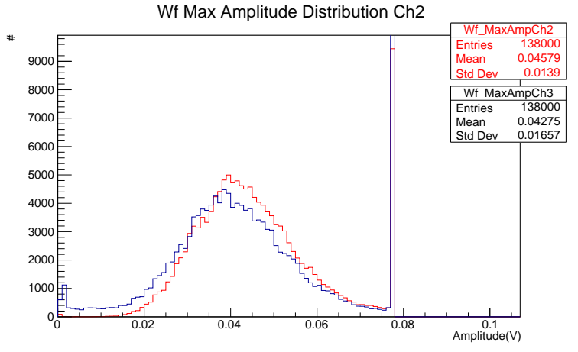
TRS Amplitudes
TRC
Beam
180 GeV Pions
SB2
Blue – SB2 – Ch3
Red – SB1 – Ch2
SB1
TRC – With 12x12x25mm³ QBlock

Slide 5

TRS Timing
Sigma_1-2 → 20.71 $±$ 0.084 ps
Sigma_1-3 → 22.8 $±0.11$ ps
Sigma_2-3 → 29.1 $±1.07$ ps
Intrinsic time resolutions
  Sigma1(TRC) →7.14 $±$ 2.19 ps
  Sigma2(SB1) →19.44 $±$ 0.80 ps
  Sigma3(SB2) → $22.65±$ 0.72 ps
SB1 → 5 cm
SB2 → 5 cm
SBs are 45 deg

Slide 6
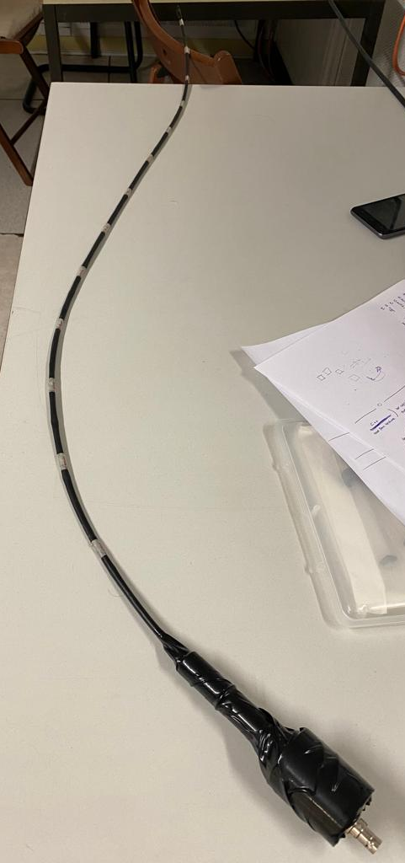
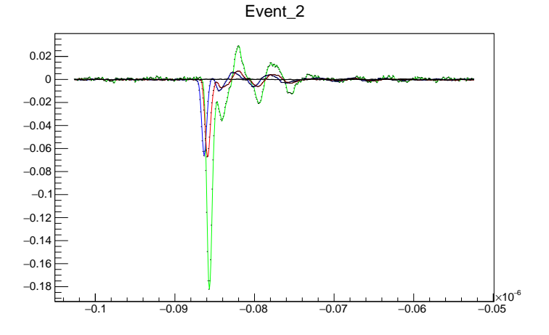
DUT Setup
Beam
Different kind of photodetectors (PMT/MCP-PMT) were used.
Timing measurement was performed using long fibers for different distances to the photodetector.
180 GeV Pions
MCP-PMT
R7525 PMT
1.5 m long
HF-PPP Fibers
SB2
SB1
TRC – With 12x12x25mm³ QBlock

Slide 7
Time Resolution
Beam
Different kind of photodetectors (PMT/MCP-PMT) were used.
Timing measurement was performed using long fibers for different distances to the photodetector.
180 GeV Pions
MCP-PMT
R7525 PMT
1.5 m long
HF-PPP Fibers
Time resolution of HF-PPP fiber 20 cm away from the photodetector
HF-PPP + R7525
HF-PPP + MCP-PMT
SB2
135.8 ps
31.48 ps
SB1
TRC – With 12x12x25mm³ QBlock

