Slide 1
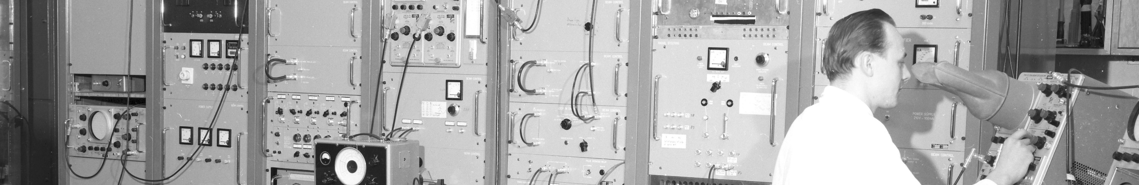
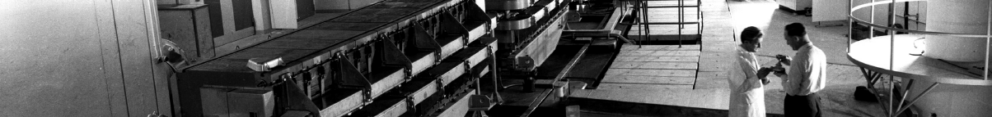
PS Report week 29/30
Many thanks
to the PS OP and coordination teams as well as all equipment experts and support teams!

Slide 2
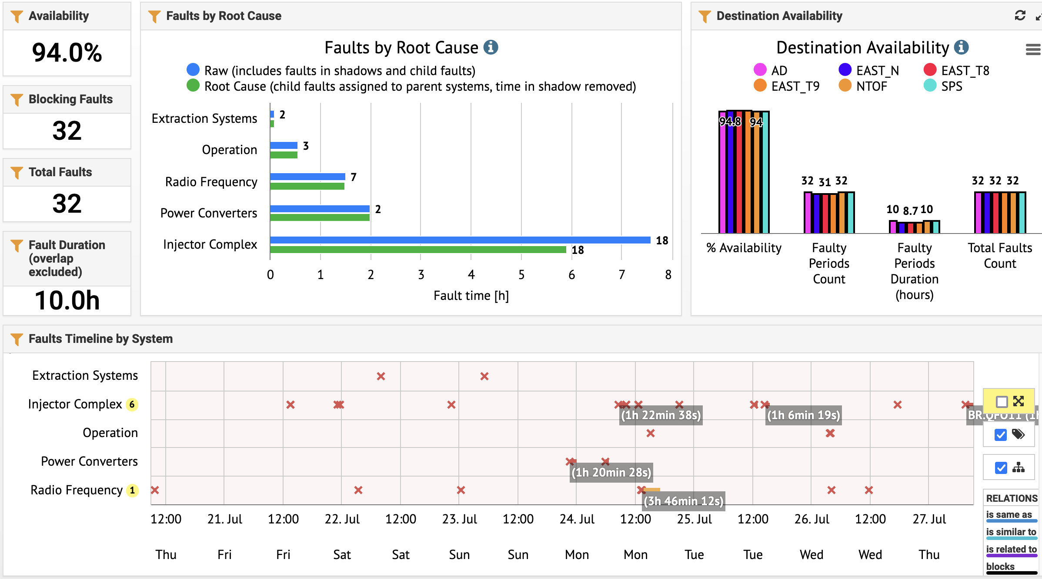
Availability W29/30 (Thu – Thu 9am)

Slide 3
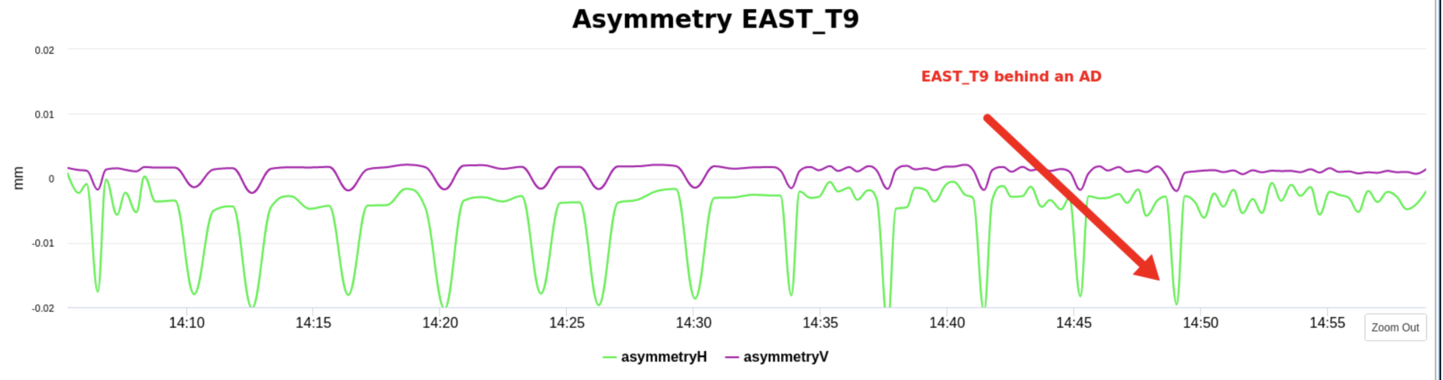
Main Points
                Very good availability
                Frequent parameter drifts on all kind of beams, especially EAST target steering and MTE efficiency. Root cause not clear, might be linked to high temperatures, but certainly also to super cycle composition (AD cycle is particularly perturbing) – longer-term studies and mitigations required
                New WRAP displays in the CCC showing the T9/TN asymmetry measured with the target BLMs and n_TOF SEM grid position and beam size are regularly checked and the steering adjusted

Slide 4
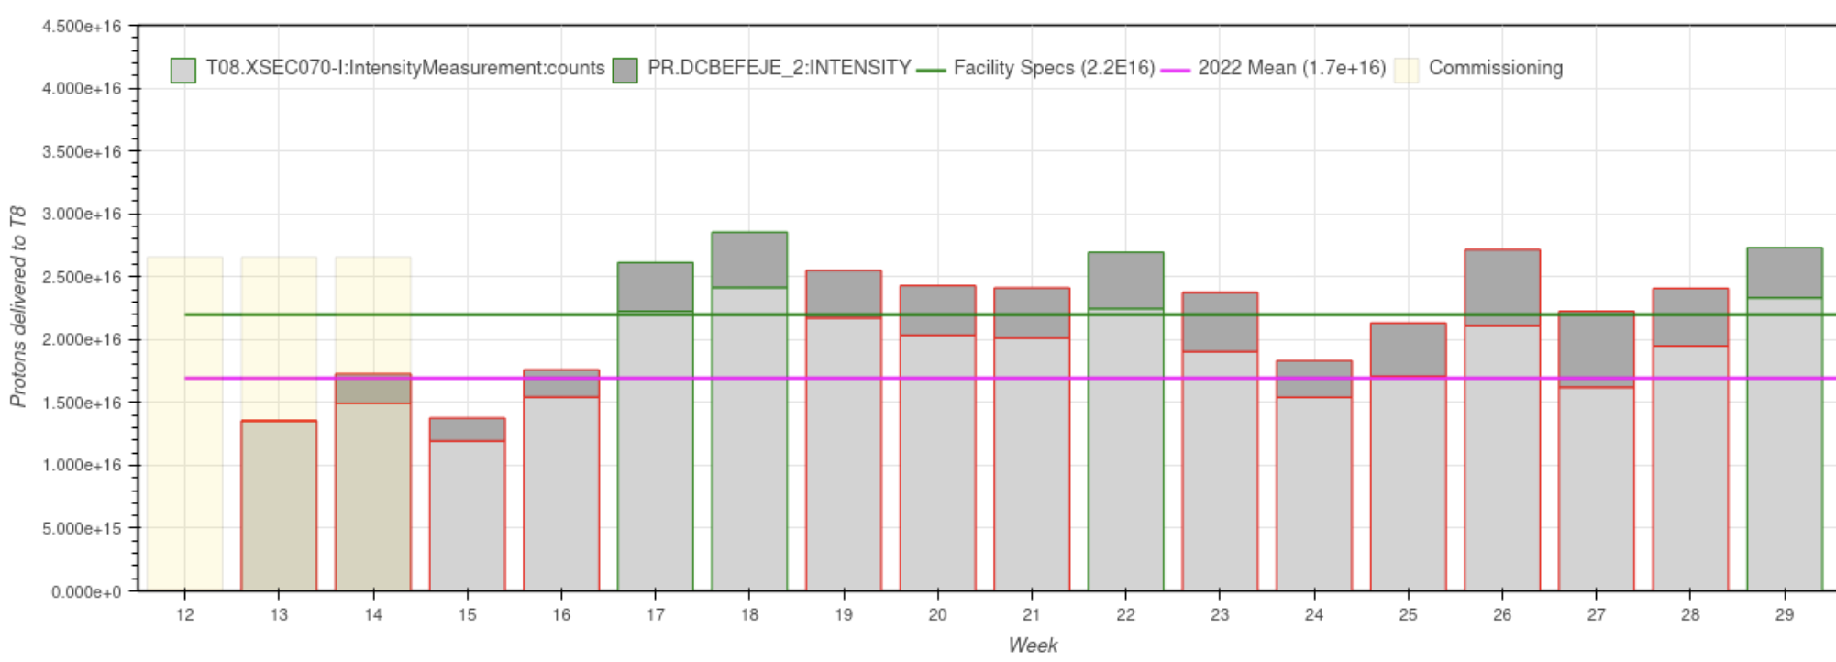
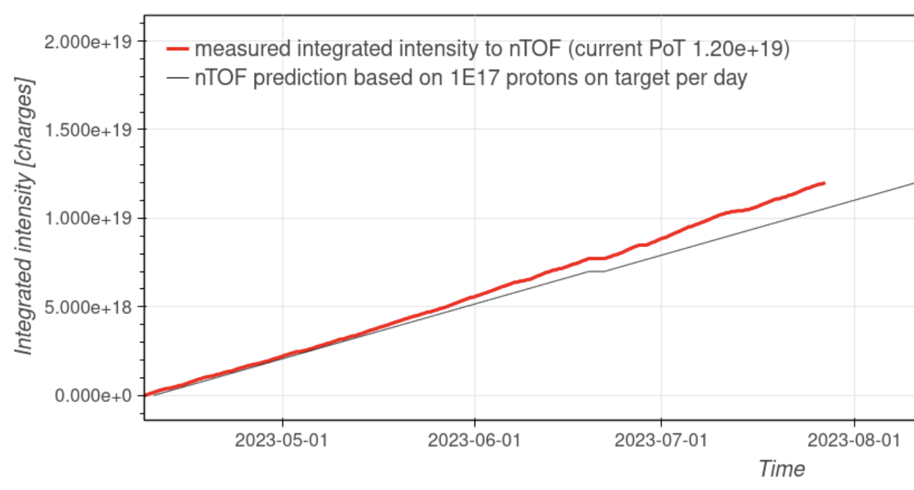
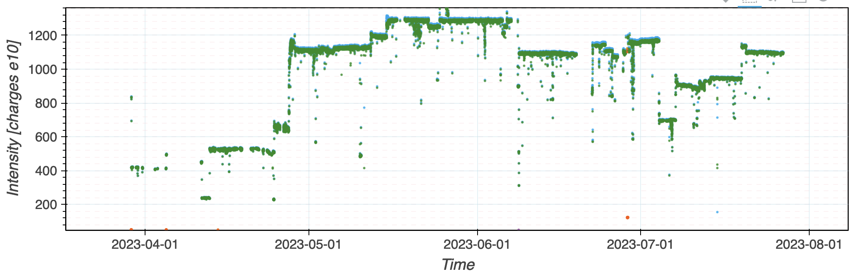
Delivered Intensity
                Managed to compensate in w29 for T8 the slightly lower delivered integrated flux of the previous 2 weeks
                SFTPRO intensity and n_TOF delivered flux curve

Slide 5
Special Test
                Today special test from 3pm – 7pm requested by n_TOF:
                Supercycle with mix of different intensity TOF cycles (2 x 50 + 2 x 100 + 2 x 200 + 2 x 350 + 2x 850 ) e10 p.

Slide 6

PS Coordinator for week 29 – Alexander Huschauer
PS Coordinator for week 30 – Bettina Mikulec
PS Coordinator for week 31 – Matthew Fraser
Questions and Comments
9:00 live meeting in the CCC on Wednesday and Friday
Zoom link to follow the meeting on remote: https://cern.zoom.us/j/9372114100?pwd=L29BcmlHUENCdFBRSytXYVcrM1B4Zz09
Meeting ID : 937 211 4100
Passcode: 525463

