Slide 1


Aggregating Heterogeneous Computing Resources
Nathan Pacey
Luca Atzori, Krzysztof Michal Mastyna, Joaquim Santos
15/08/2023
1

Slide 2

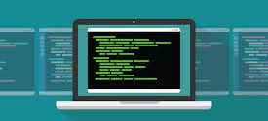
Introduction & Background
What computing resources does openlab have?
  Openlab has over 100 machines all with different configurations
  Types of machines include cloud-based quantum computing and AI infrastructure, on-site servers, and personal devices.
How are openlab’s resources managed?
  There are two ways resources are configured and managed, either with a deployment tool like Puppet or Ansible or manually by administrators.
15 August 2023
Nathan Pacey | Aggregating Heterogeneous Computing Resources
<number>

Slide 3
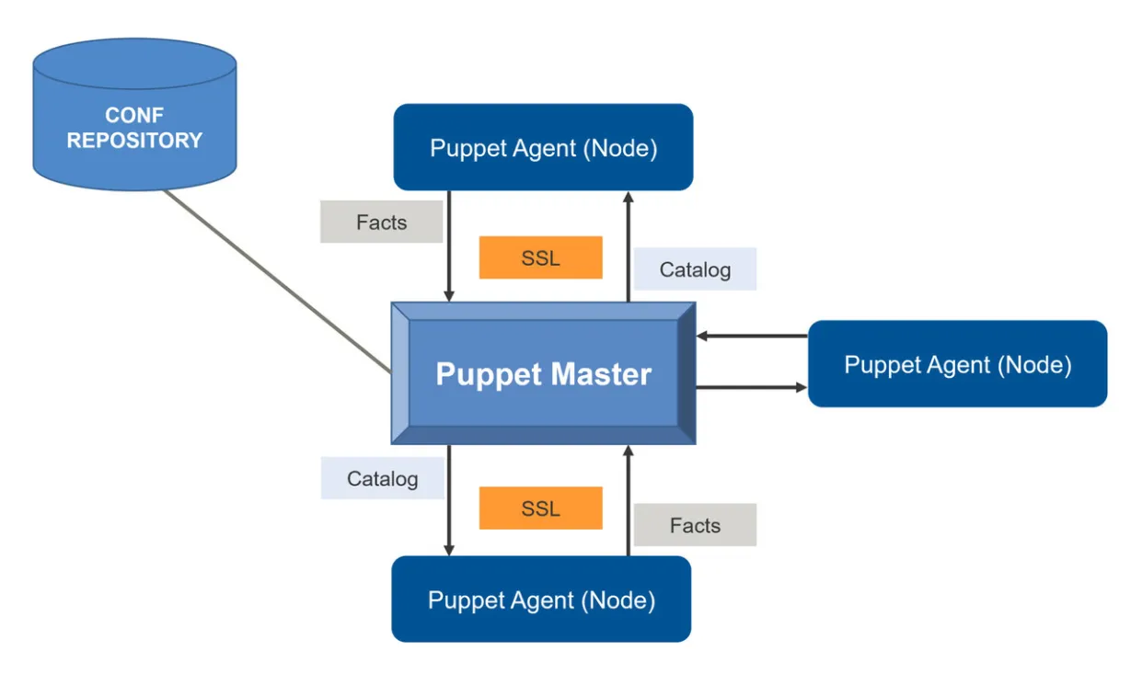

Efficient Resource Management
Puppet and Ansible for Resource Management
  Automate the management and configuration of machines using a hierarchy structure and statically typed language.
  Ideal for larger systems with similar needs
Manual Management
  Direct intervention by administrators.
  Suitable for small-scale setups or customization.
  Prone to inconsistencies, time-consuming in larger environments.
15 August 2023
Nathan Pacey | Aggregating Heterogeneous Computing Resources
<number>

Slide 4



Why Manage and Update Resources?
Diverse Project Requirements
  Different projects demand specific resources based on scale and nature.
  Flexibility to adapt resources to changing project demands.
Optimizing Resource Utilization
  System Administrators maximize available resources.
  Allocate right resources to projects, prevent wastage.
Monitoring Hardware Performance
  Track performance of equipment to inform collaborating companies
  Improve resource allocation and future decision making
Enhancing System Reliability
  Regular updates include security patches, fixes.
  Managed, up-to-date resources ensure stability.
15 August 2023
Nathan Pacey | Aggregating Heterogeneous Computing Resources
<number>

Slide 5
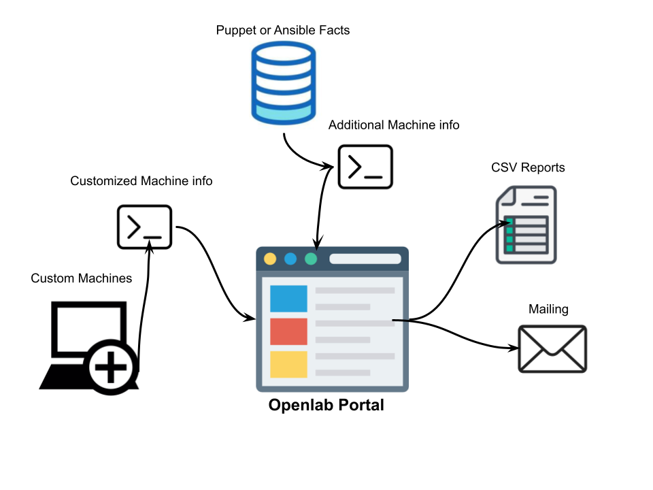
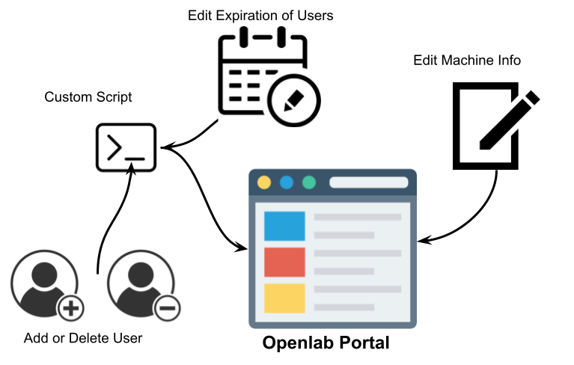
How Does the Portal Help?
Automated Tasks (scheduled jobs)
  Hardware information taken from Puppet and Ansible
  Data scraped using scripts
  Generating reports and mailing users
Manual Tasks
  Addition / deletion of machines
  updating information
  addition/deletion of users and expiration
15 August 2023
Nathan Pacey | Aggregating Heterogeneous Computing Resources
<number>

Slide 6
New Features
New Front End Visuals
Additional Info (Load, current users)
Add Nodes without Puppet/Ansible
Add/Delete machines
Add/Delete/Edit users
Automate Expiration reports for added machines
Edit Machine info
Specify Public vs. Private Nodes and generate cumulative CSV and JSON files
15 August 2023
Nathan Pacey | Aggregating Heterogeneous Computing Resources
<number>

Slide 7
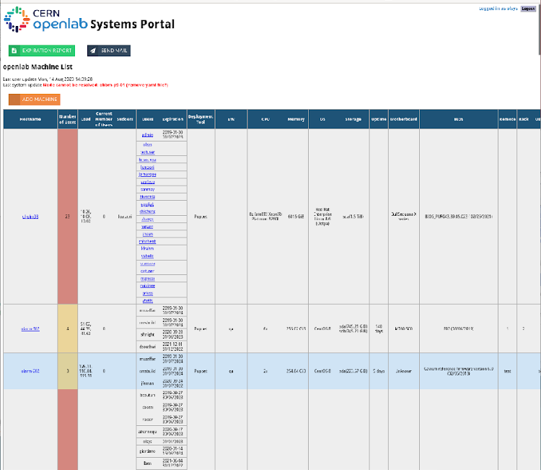

Future Work
Increasing efficiency with revised code
Handling nodes with limitations
  password required
  no sudo/root access
  remote resources with multiple gateways
Making the portal available to multiple users
  Users can utilize the portal while viewing only their machine information
15 August 2023
Nathan Pacey | Aggregating Heterogeneous Computing Resources
<number>

Slide 8

Thank You!
Questions?
Nathaniel.james.pacey@cern.ch
npacey01@gmail.com
15 August 2023
Nathan Pacey | Aggregating Heterogeneous Computing Resources
<number>

