Slide 1
Evaluating Kubernetes batch scheduling systems for containerized declarative data analyses
CERN openlab Summer Student Lightning Talks
Author:
Xavier Tintin
Supervisors:
Marco Donadoni
Tibor Šimko

Slide 2
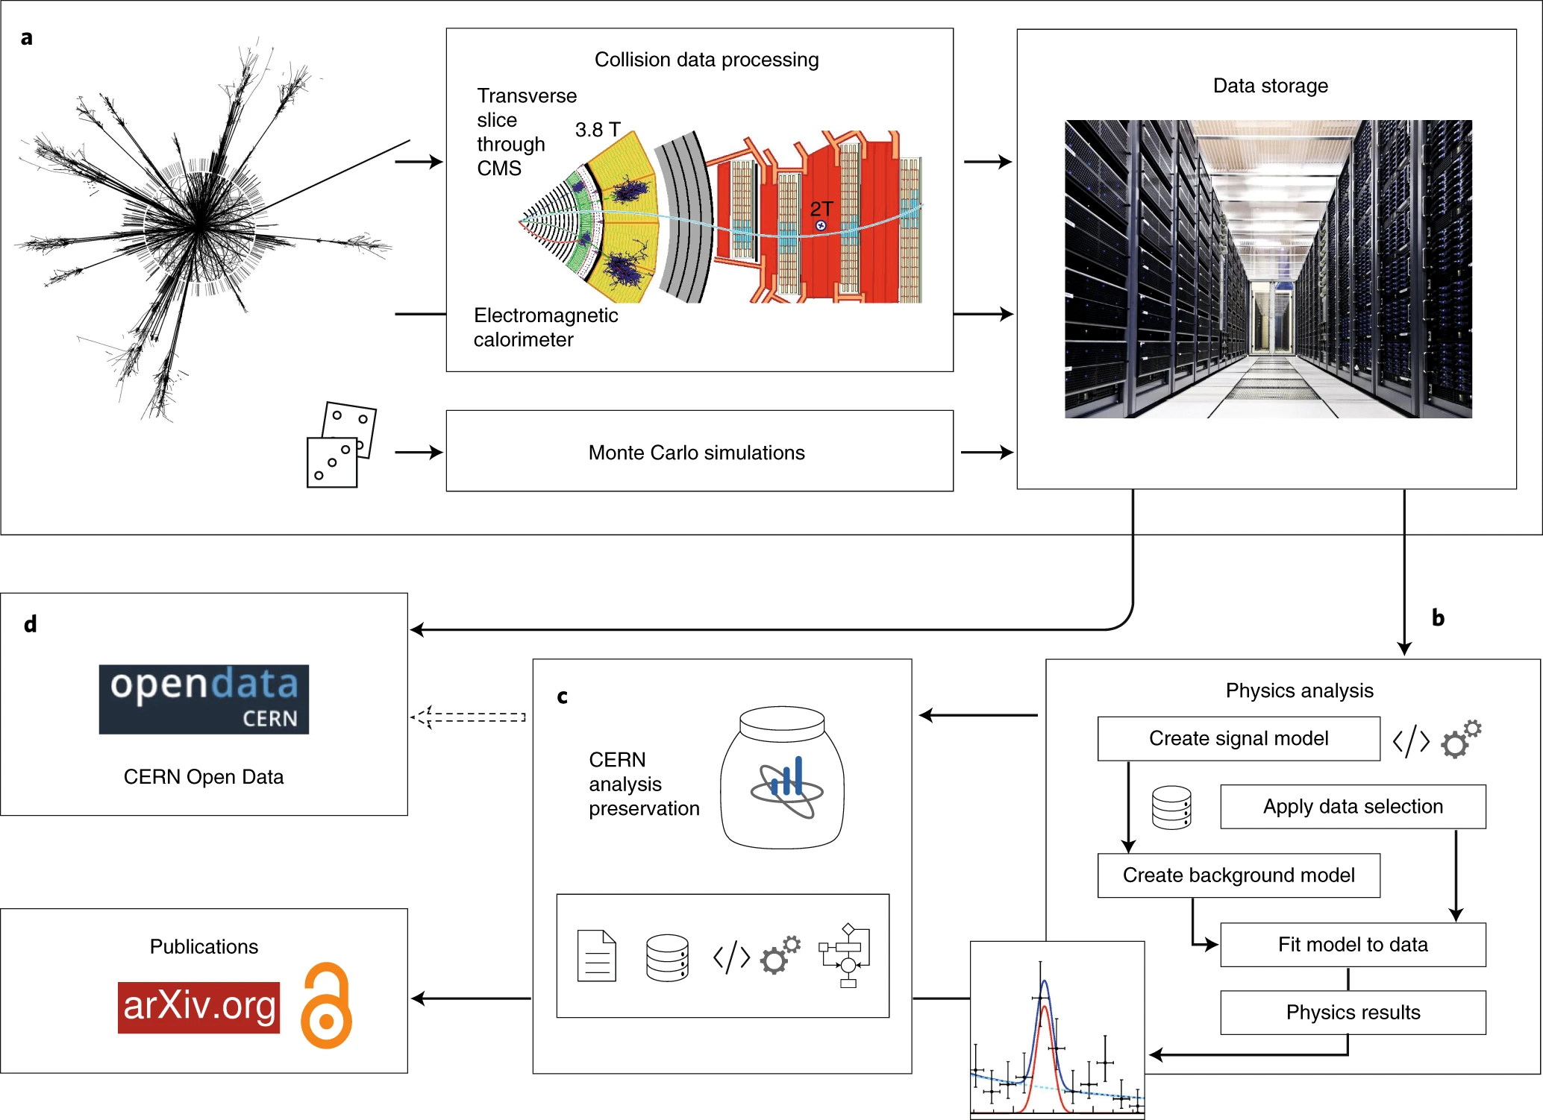
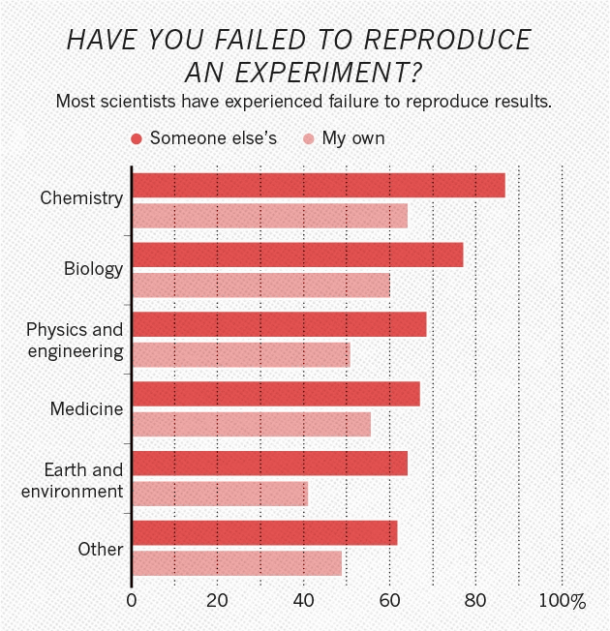
Reproducible and reusable science
When testing new theories, building on previous data analyses is necessary, but very challenging
Scientific workflows represent the complex flow of data that through various steps of collection, transformation, and analysis produces published results.
https://doi.org/10.1038/533452a

Slide 3
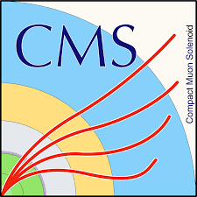

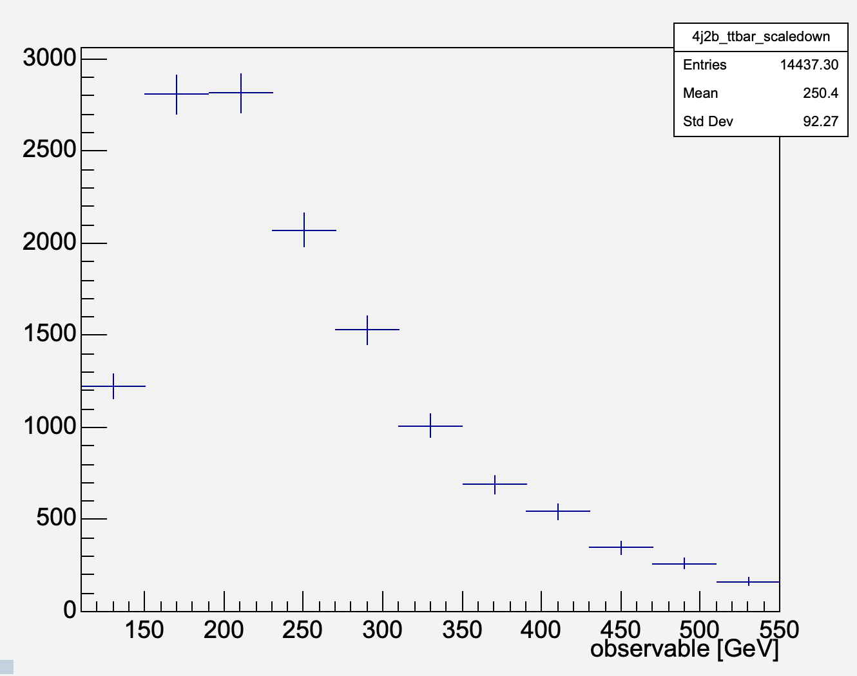
Declarative HEP analysis workflows
Workflow input
Workflows
● A workflow is a recipe explaining how to compute results from the input data
● What is needed?
  ○ Input data
  ○ Code
  ○ Computing environment
  ○ Workflow steps
● Each step can use different container images
● Steps can be described by means of declarative workflow languages
prepare
filelist1
filelist2
filelist3
filelist4
runpoet1
runpoet2
runpoet3
runpoet4
flat1
flat2
flat3
flat4
merge-step
analysis-step
Workflow output

Slide 4
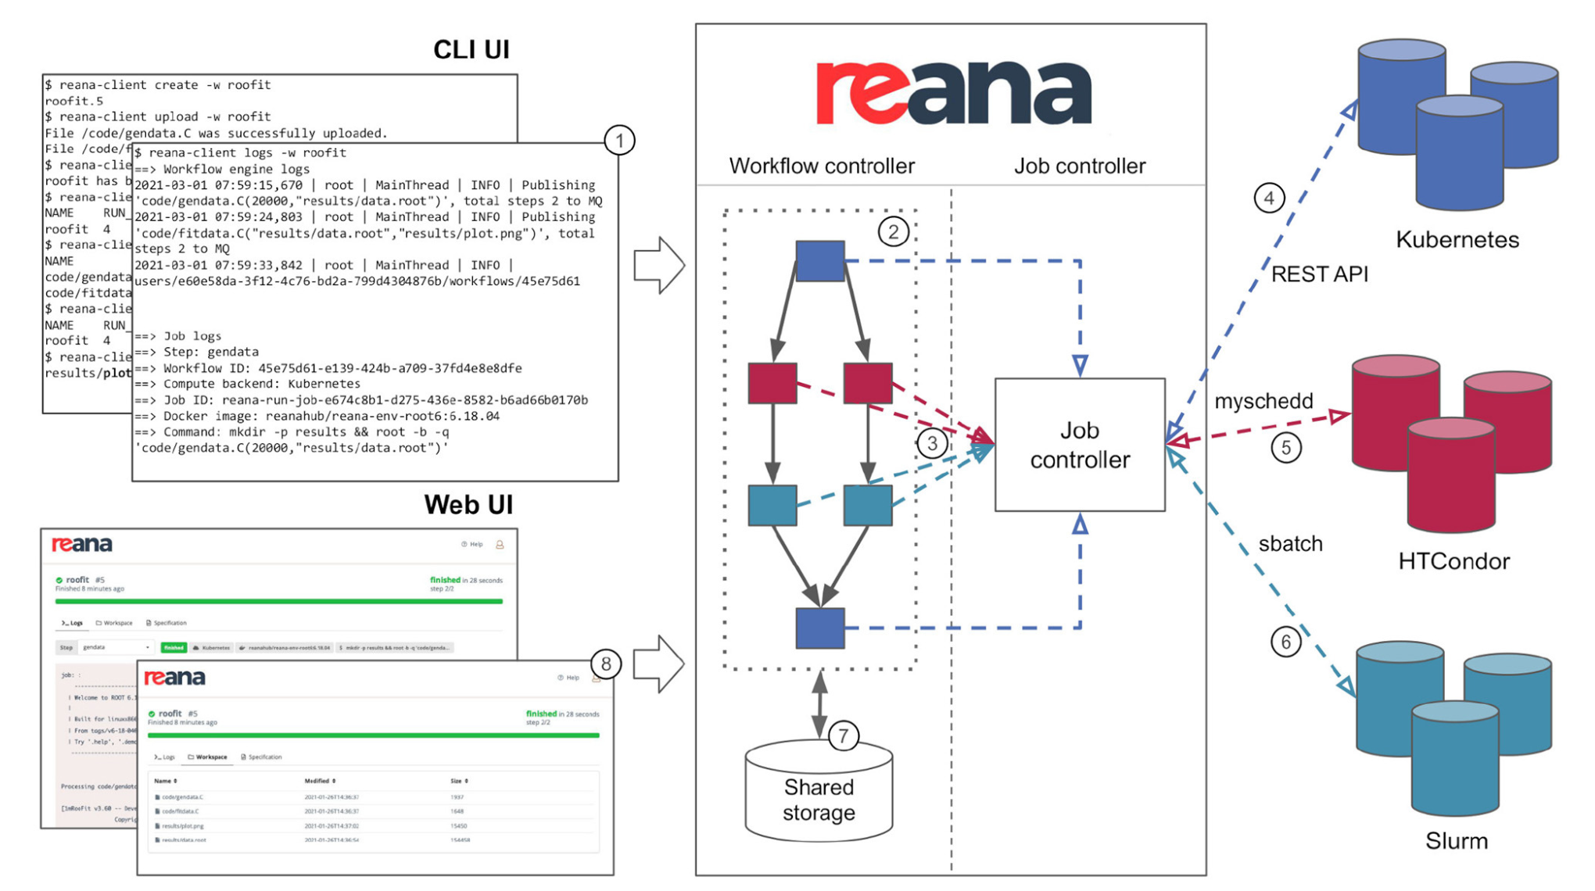


REANA: reusable analyses

Slide 5
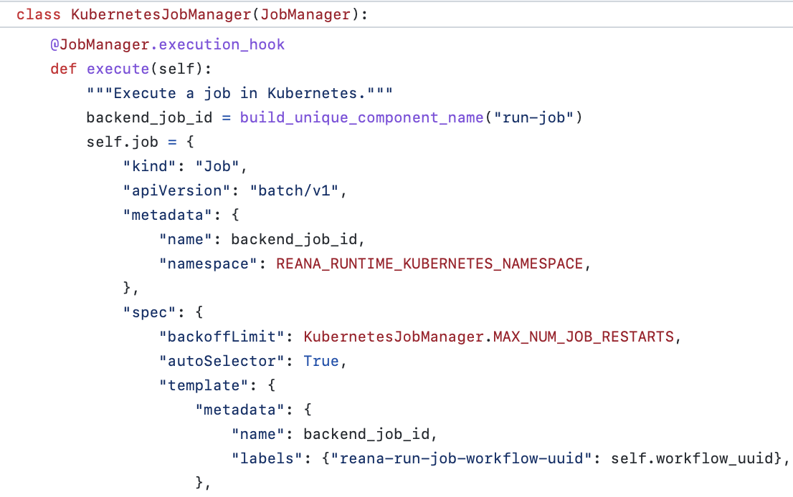
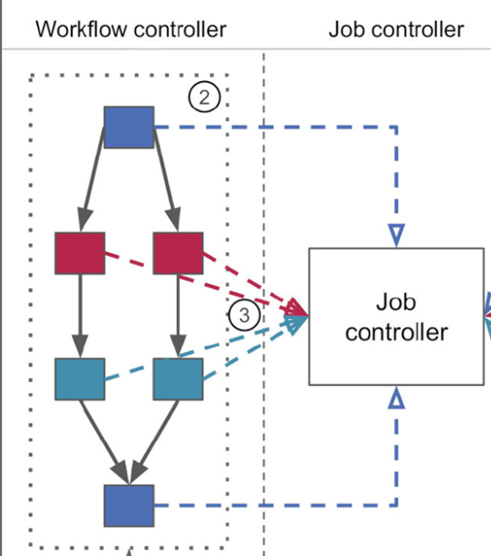

Current solution: Kubernetes API
REANA job controller uses native Kubernetes Job API and necessitated custom developments for efficient and fair workflow scheduling.

Slide 6



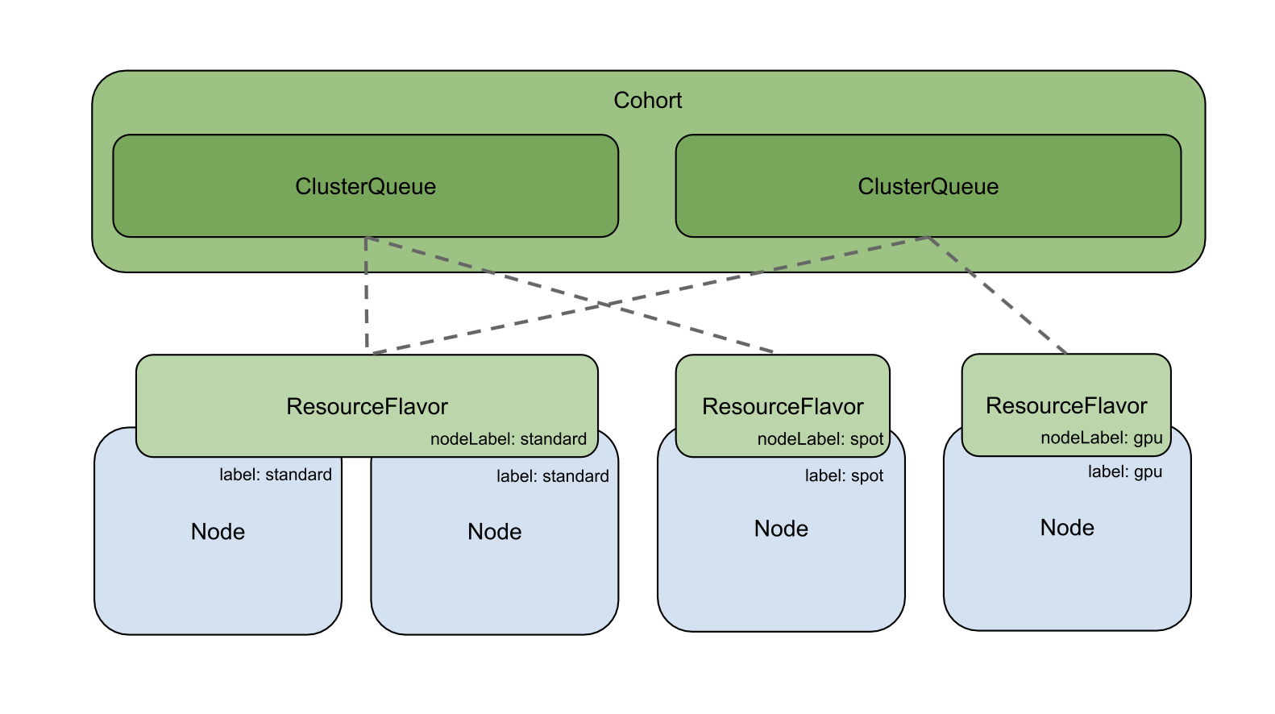


New kids on the block?
Kueue: Kubernetes-native batch scheduling system
nodeLabel: highMem
label: highMem

Slide 7

Kueue evaluation setup
Namespace: REANA
LocalQueue1
LocalQueue2
ClusterQueue
Workflow
ClusterQueue
Job
Few workloads
Long lives
Many workloads
Short lives

Slide 8
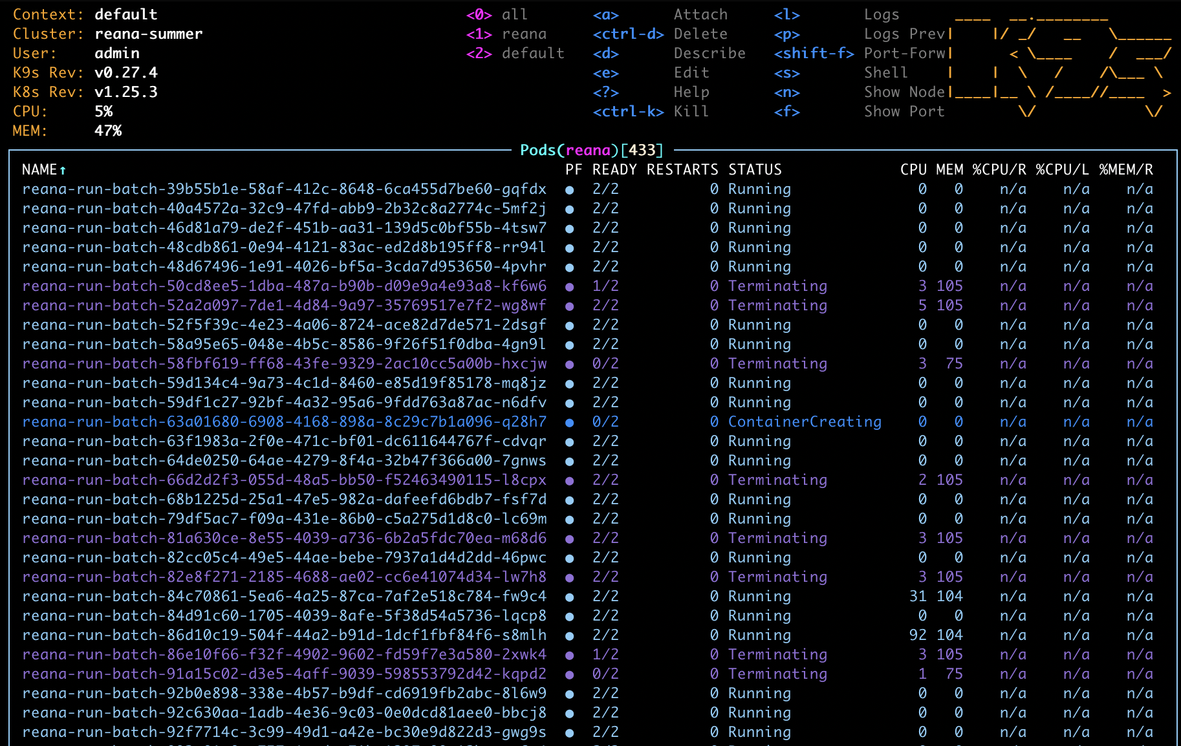
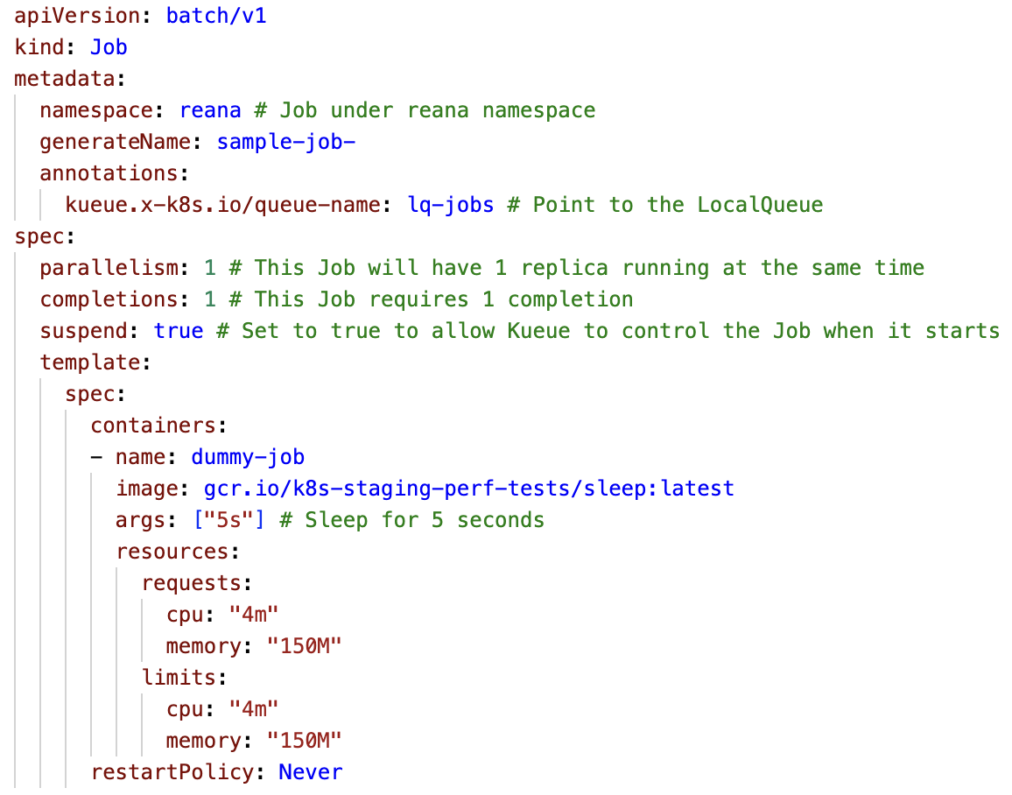
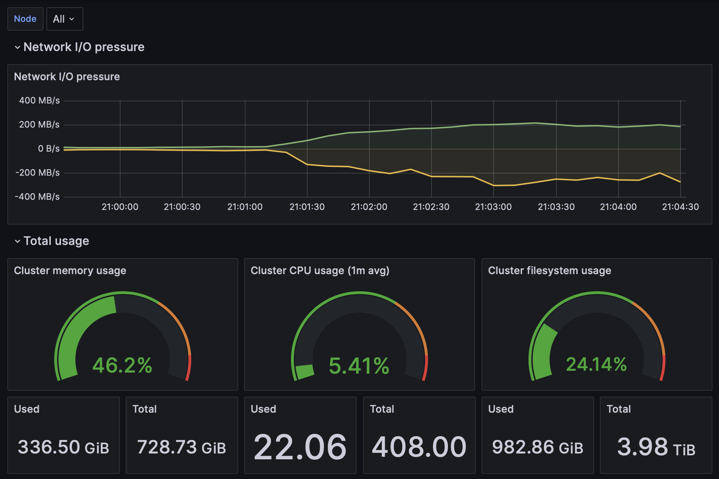
Typical evaluation experiment

Slide 9
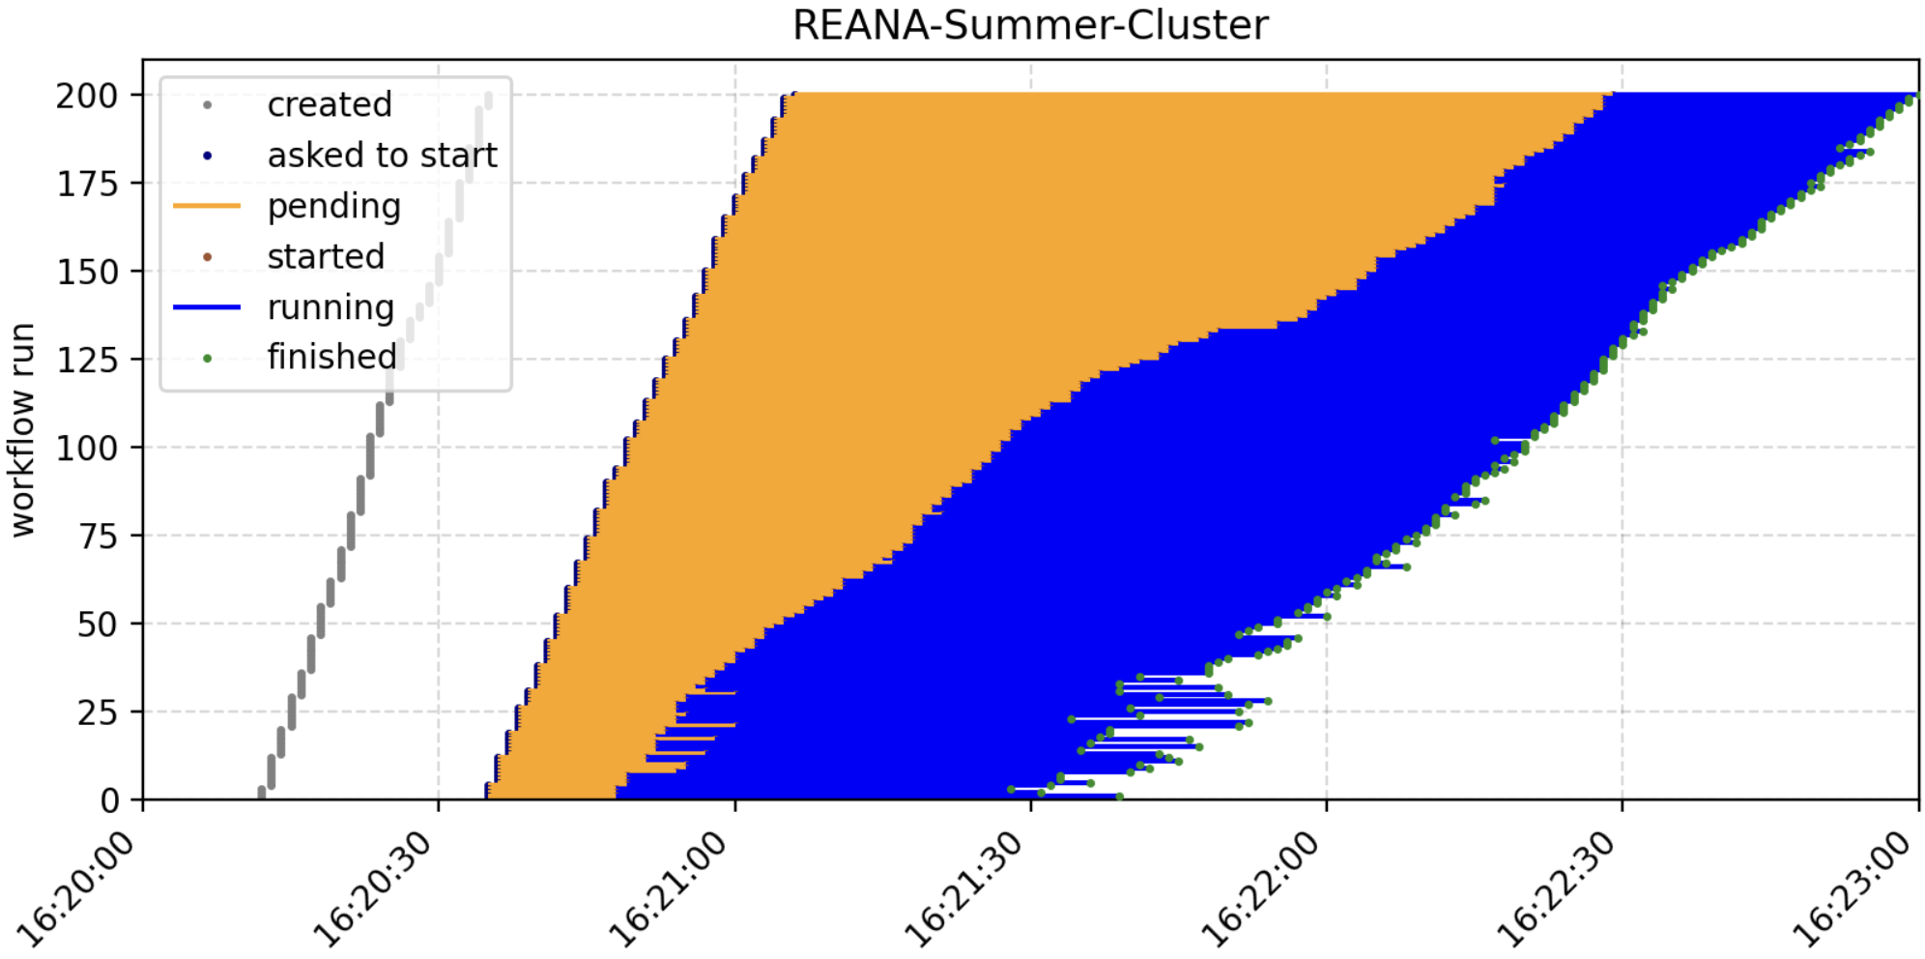
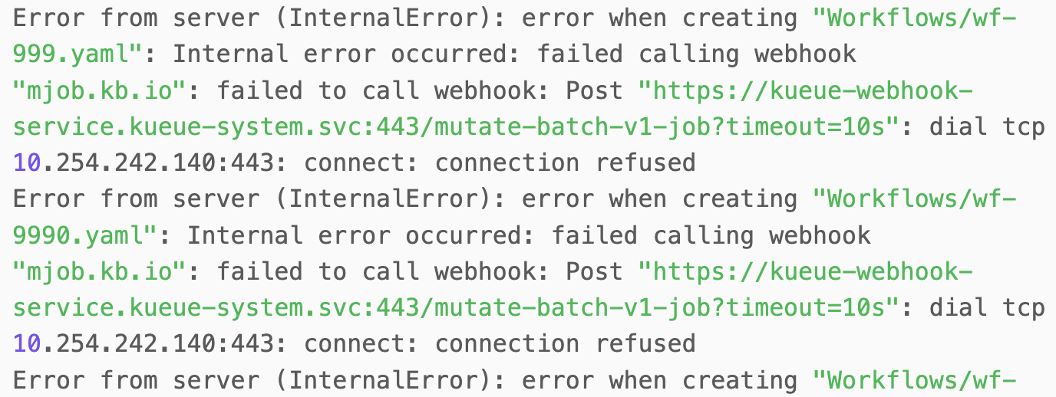
First results
Kueue succeeded on several demo examples for thousands of submissions
Encountered a few corner cases when submitting a high number of jobs
Kueue UUID job allocation issues
Unresponsive when overloaded with 20k jobs
200 workflows running in parallel on 46 nodes
Kueue is promising… but still maturing

Slide 10

Thank you
Questions?
xavier.tintin@cern.ch
https://www.linkedin.com/in/xavier-tintin/
@reanahub

