Slide 1

Faster FPGA firmware synthesis with hls4ml
FastML group
Sarai Sokolovsky
Supervised by Vladimir Loncar

Slide 2
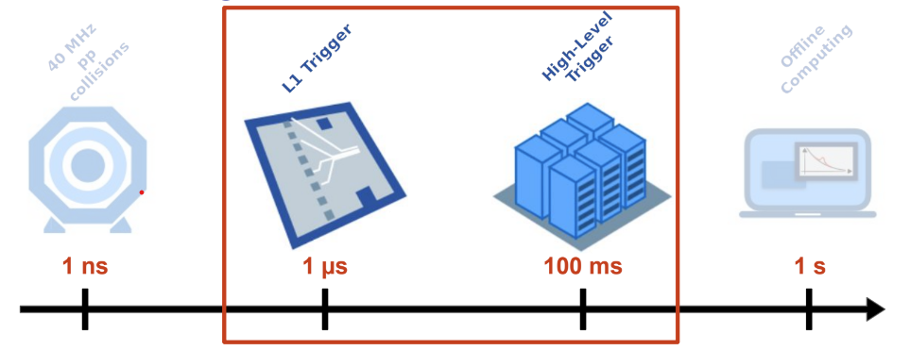
THE LHC BIG DATA PROBLEM
Deploy ML algorithms very early
Challenge: strict latency constraints!
Fast processing of raw data
Flexibility and modularity

Slide 3
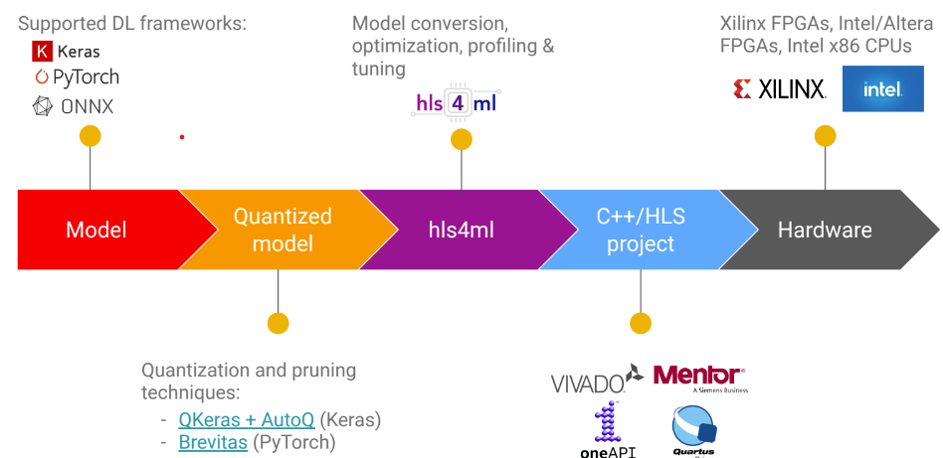
Field-programmable gate arrays (FPGAs
Reprogrammable integrated circuits
Massively parallel = low latency
Low power

Slide 4
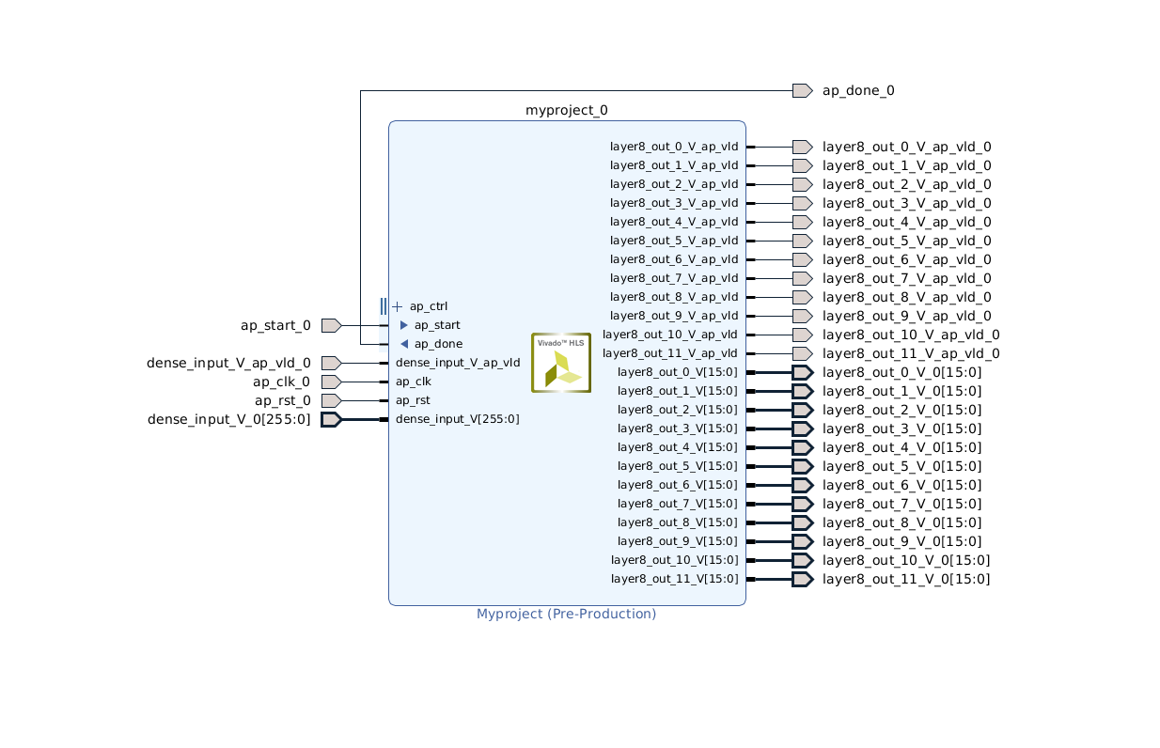
CURRENT ARCITECTURE
inputs
outputs
module

Slide 5
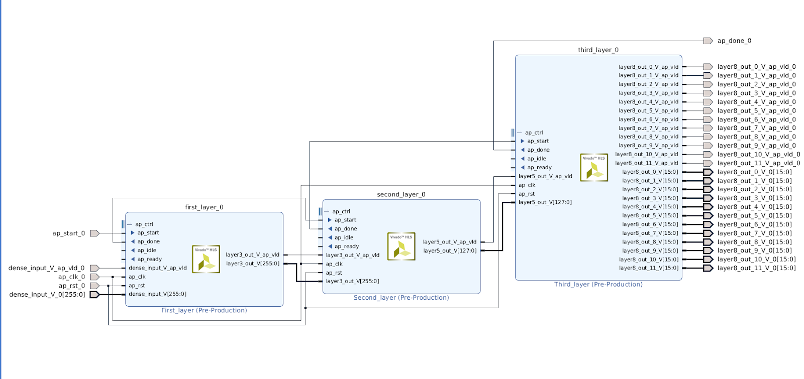
SOLUTION
dividing the neural network into blocks that can be synthesized in parallel
==
reduce the latency and the synthesis time
Less gates -> less output capacitance -> less time for the signal to go through

Slide 6
IMPROVEMENTS
Reduced by 2x-20x!
Reduced by 7%!
 | Synthesis (s) | Latency (ns) | Power (W) | Total BRAM | Total DSP | Total LUT | Total FF
old | 50 | 145 | 464 | 3 | 408 | 16149 | 11656
new | 20-30 | 135 | 459 | 3 | 408 | 16149 | 11656
Same amount!

Slide 7
THANK YOU!

