Slide 1



Accelerator Control Using Gaussian Process-Model Predictive Control (GP-MPC) Based Reinforcement Learning (RL)
Su Lei Aye
BE-CSS-DSB
Aug 16th, 2023
Supervised By Michael Schenk, Verena Kain

Slide 2




Table of Contents
01
Introduction
02
PCG (Problems, Challenges & Goal)
03
Process
04
Result

Slide 3

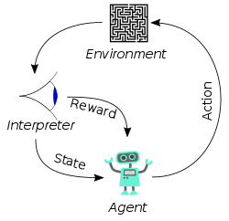
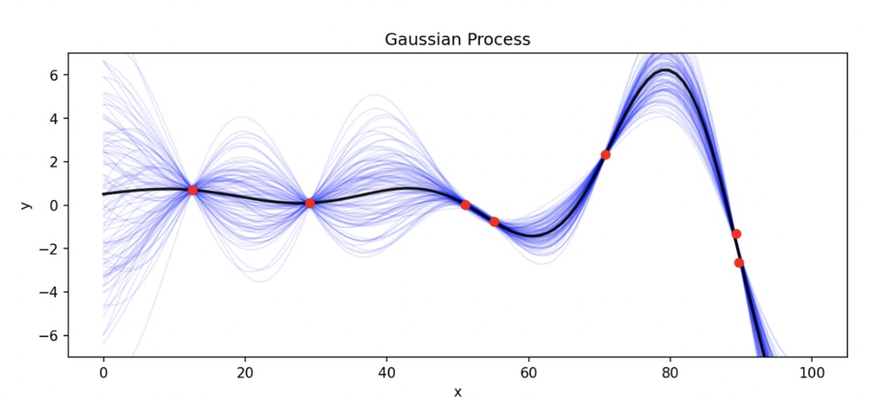
Introduction
CERN AWAKE Environment
What’s Reinforcement Learning?
Machine learning technique
An agent to learn an interactive environment by trial and error
Using feedback from its own actions and experiences.
What’s Gaussian Process?
Probability theory and Statistics Concept
Represent distribution over a class of functions
Predict mean values along with uncertainties (confidence intervals)
source: https://towardsdatascience.com/reinforcement-learning-101-e24b50e1d292
https://medium.com/geekculture/what-is-gaussian-process-intuitive-explaination-fcee3c78c587

Slide 4

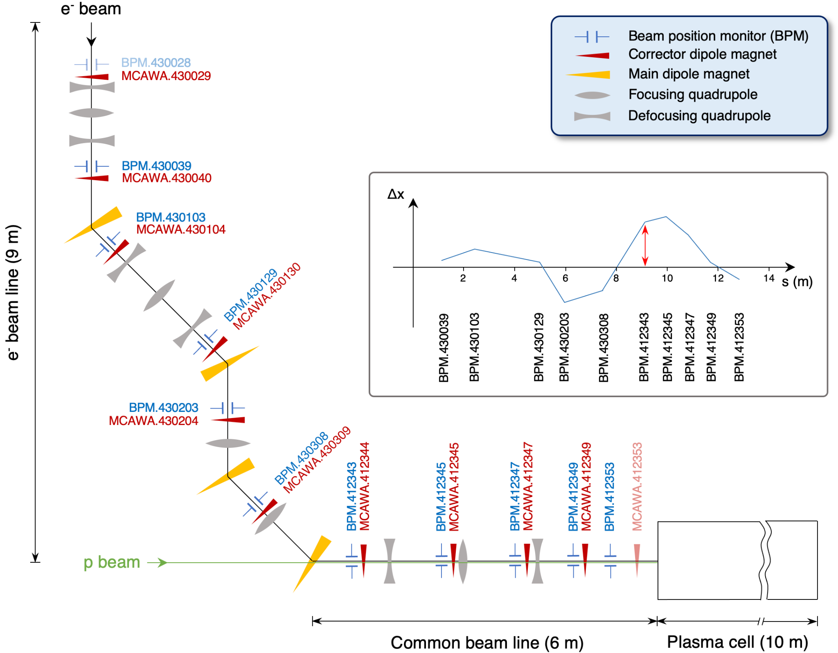
Benchmark: AWAKE electron beam line

Slide 5

PCG (Problems, Challenges & Goal)
Problems: Applying Reinforcement Learning to control accelerator system using Gaussian Process Model-Predictive Control (GP-MPC) algorithm.
Use GPs to make models of the real world
  1) Transition model: (state, action) -> next_state
  2) Reward model: next_state -> reward
Combine the models to plan ahead and choose the best action with an optimizer (maximize rewards, minimize risks)
Challenges: 1. High sample efficiency (how much training data you need)
2. Include uncertainty and risk estimates
3. Not sufficient beam instrumentation available to define the state.
Goal: Implement and test GP-MPC algorithm overcoming the challenges and making it compatible with CERN's Generic Optimisation Framework.

Slide 6

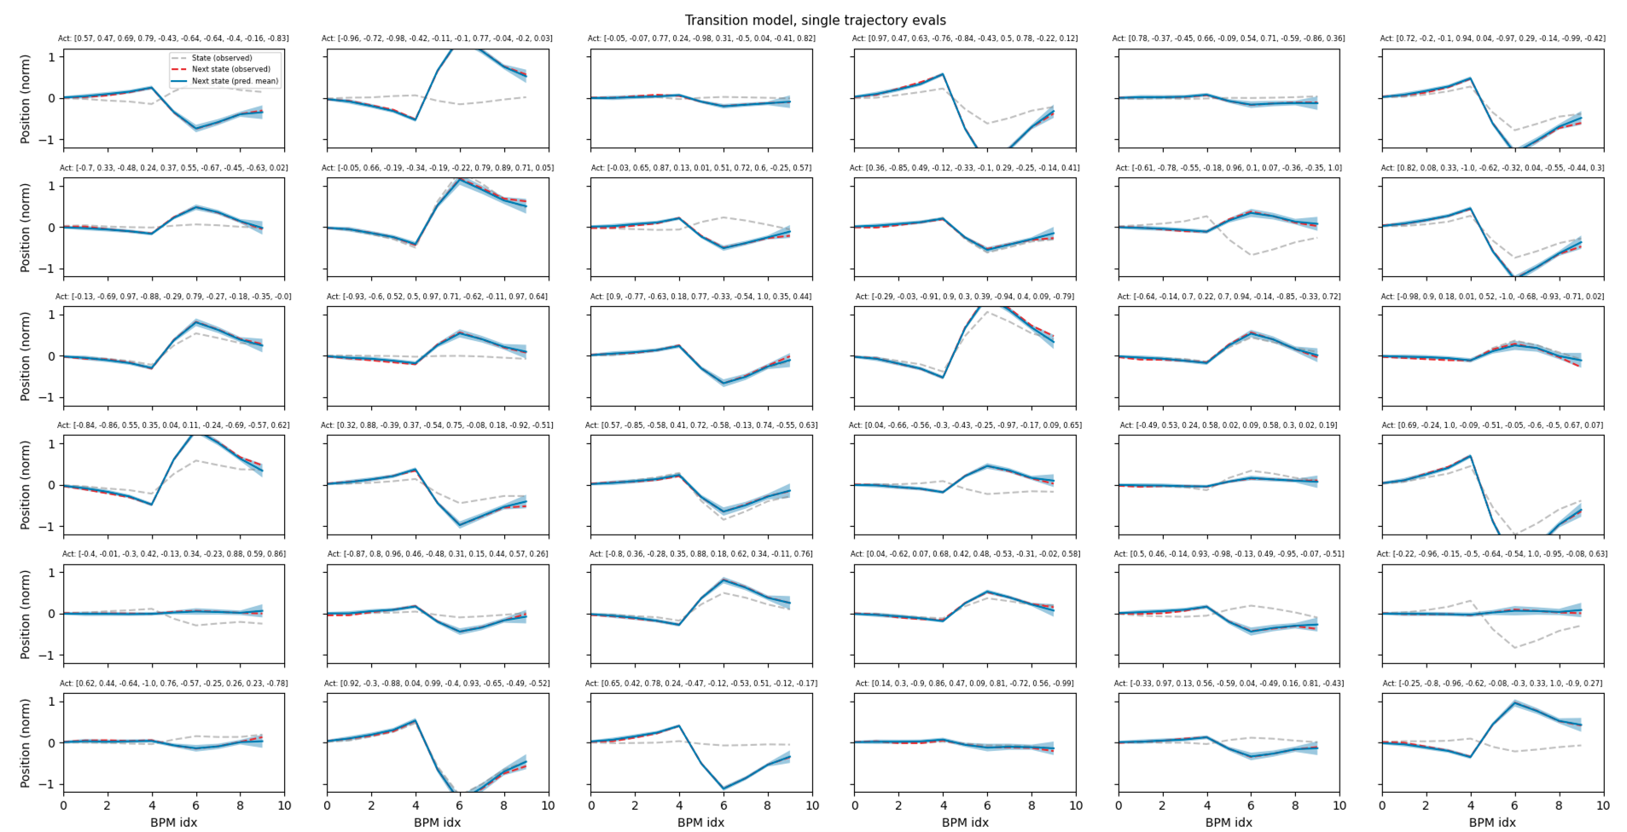
CERN AWAKE Environment
Process
Transition model: (state, action) -> next_state
Transition Model: Given state & action (state_action) learn to predict next_states, i.e. how the environment changes when agent takes particular actions.
Purpose: For agent to plan and optimize its action effectively (reward and safety), without applying the action in the real world yet.

Slide 7
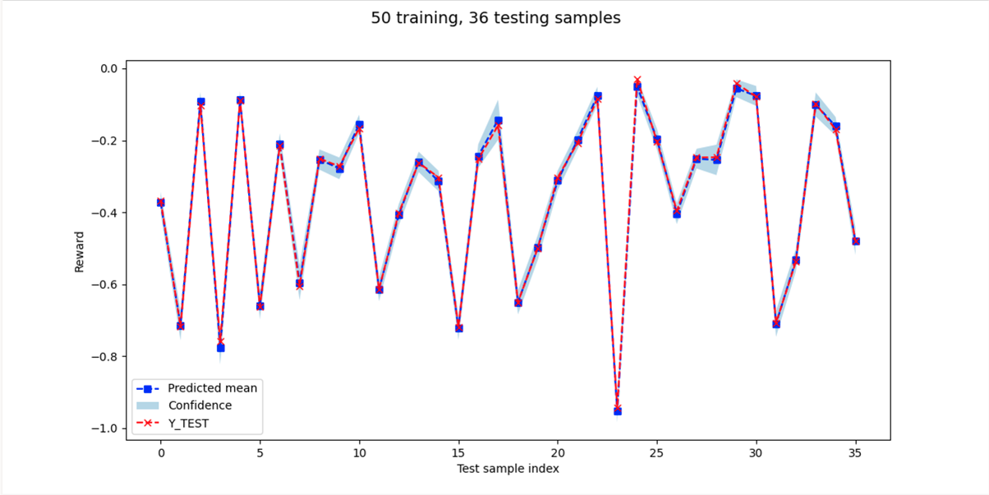
Reward model: next_state -> reward
Reward Model: Given the next state learn to predict the Expected Reward.
Purpose: For agent to make informed decision and optimize its behavior to achieve highest rewards.

Slide 8
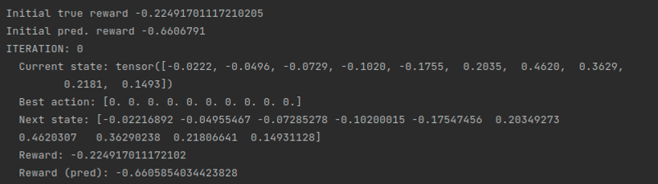
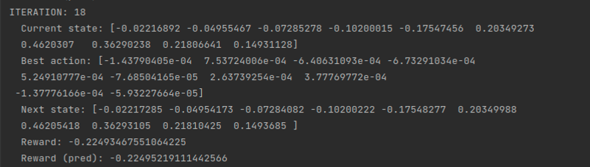
GP-MPC Based RL
Combined transition & reward models -> best action (maximize rewards, minimize risks)
Methodology: acq = OurAcqFunc(self.transition_gp, self.reward_gp, self.beta)
FIRST ITERATION:
AFTER 18th ITERATION:

Slide 9
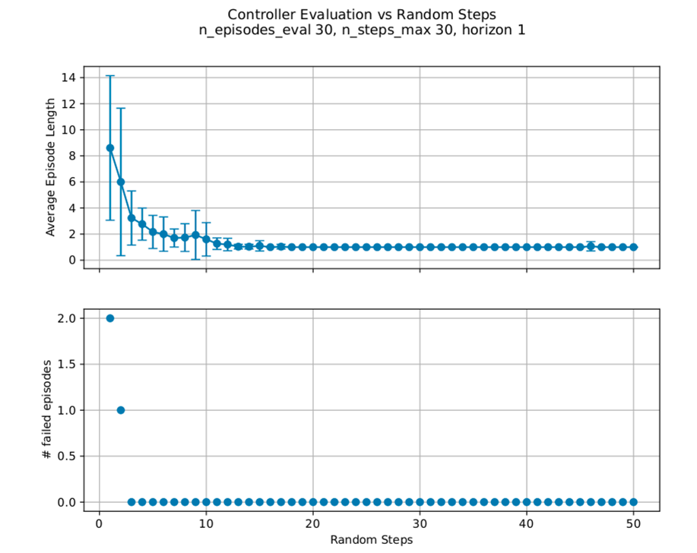
Result
High Sample Efficiency: only 13 random initial samples needed to have successful controller.
Successful Controller –> agent can solve an episode in one step, i.e. from any beam trajectory it only needs one iteration to reach the objective.
Simulation Variables
random_steps_array = np.arange(1, 51, 1)
n_steps_max = 30
n_episodes_eval = 30
horizon = 1

Slide 10


Thanks!
QUESTIONS?
saye@cern.ch
suaye@ucsd.edu

