Slide 1
Load Testing and Benchmarking EOS
Andrej Čop; Supervisor: Emmanouil Bagakis
CERN Openlab summer student project 2023
IT-SD-GSS EOSHPM

Slide 2
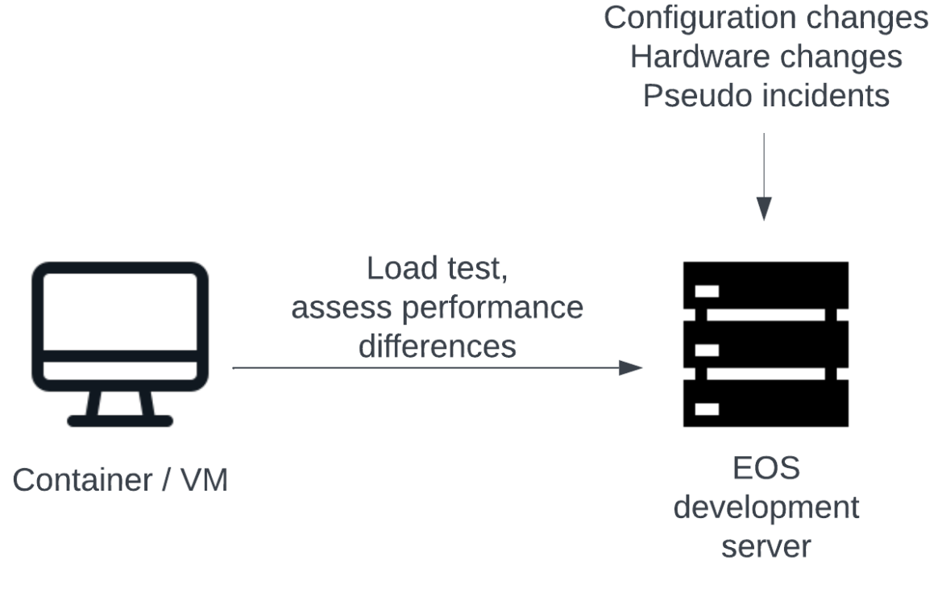
Purpose of this project
Develop easy to use modular tool that can:
Load test and assess performance of EOS
Display metrics in a simple and readable format
Compare metrics between runs
Create output report that describes differences

Slide 3
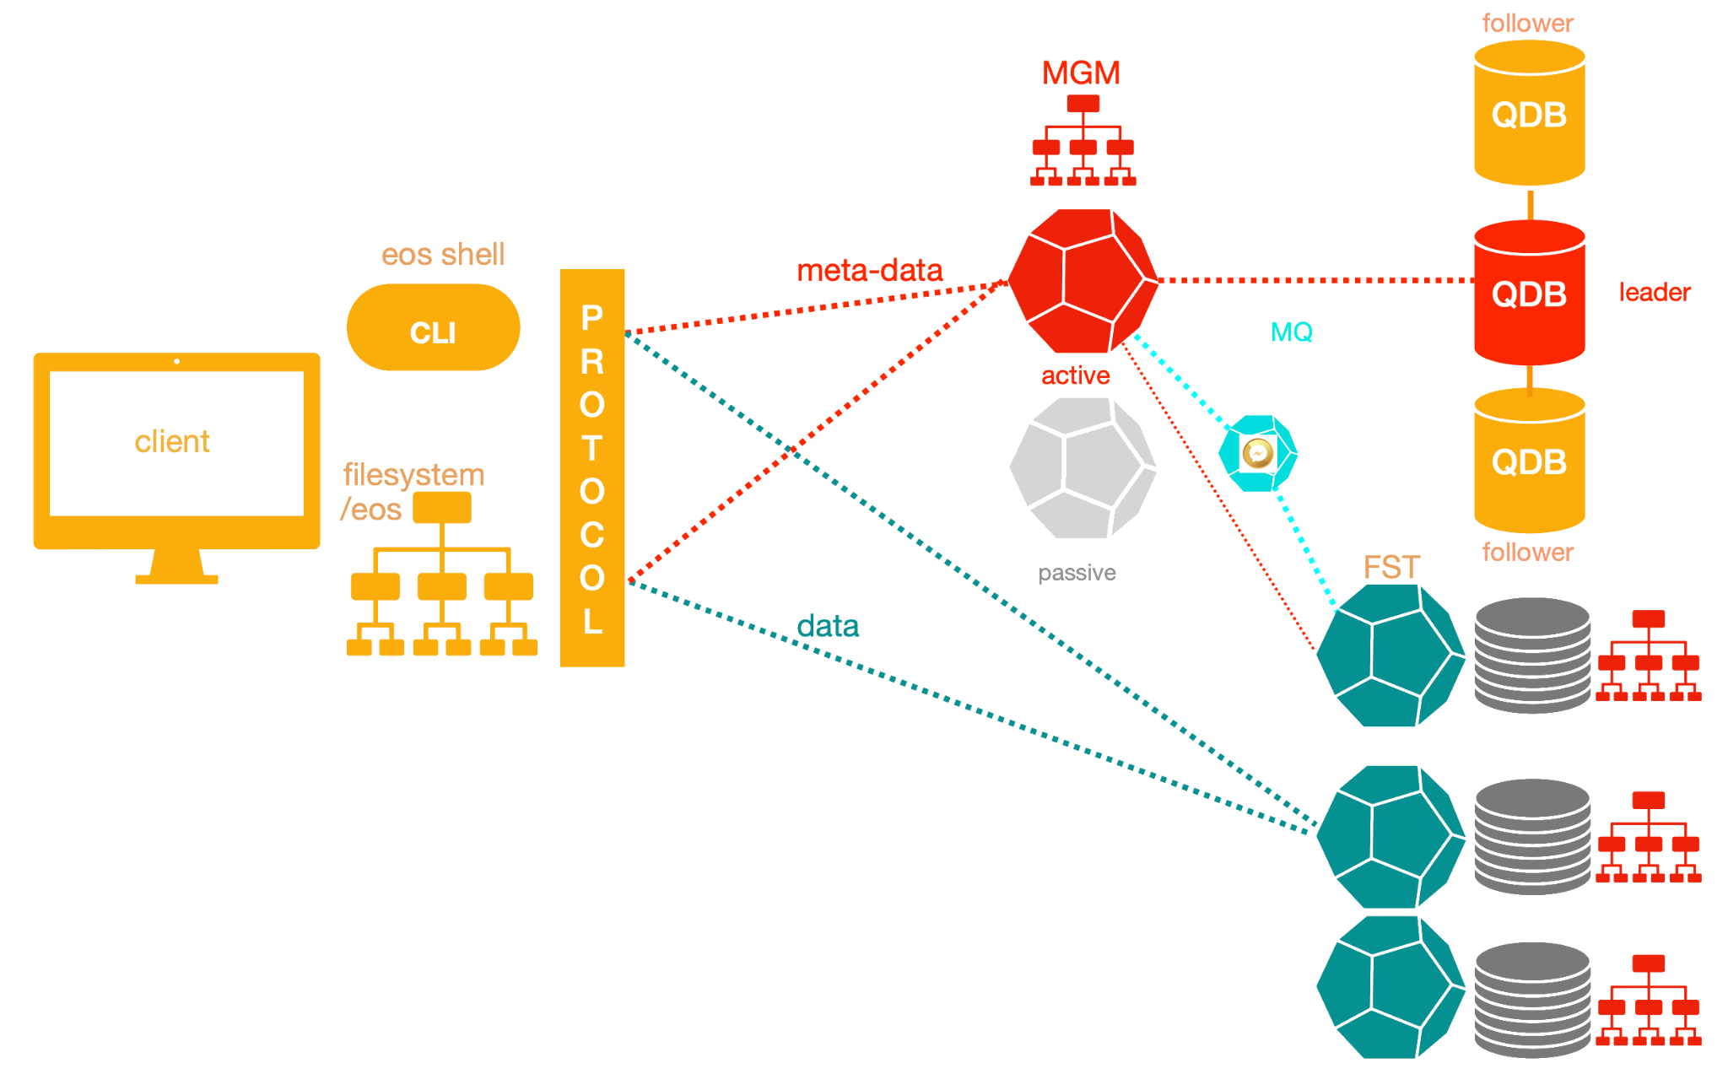
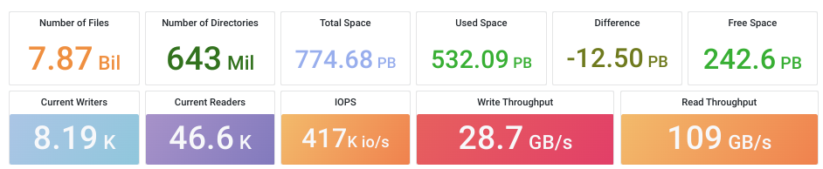
EOS Open storage
Service for storing large amounts of physics data and user files
Developed by CERN
Supports thousands of users simultaneously
Hierarchical namespace /eos
Petabytes of data
Data collected on 14. 8. 2023
Credits: EOS documentation

Slide 4
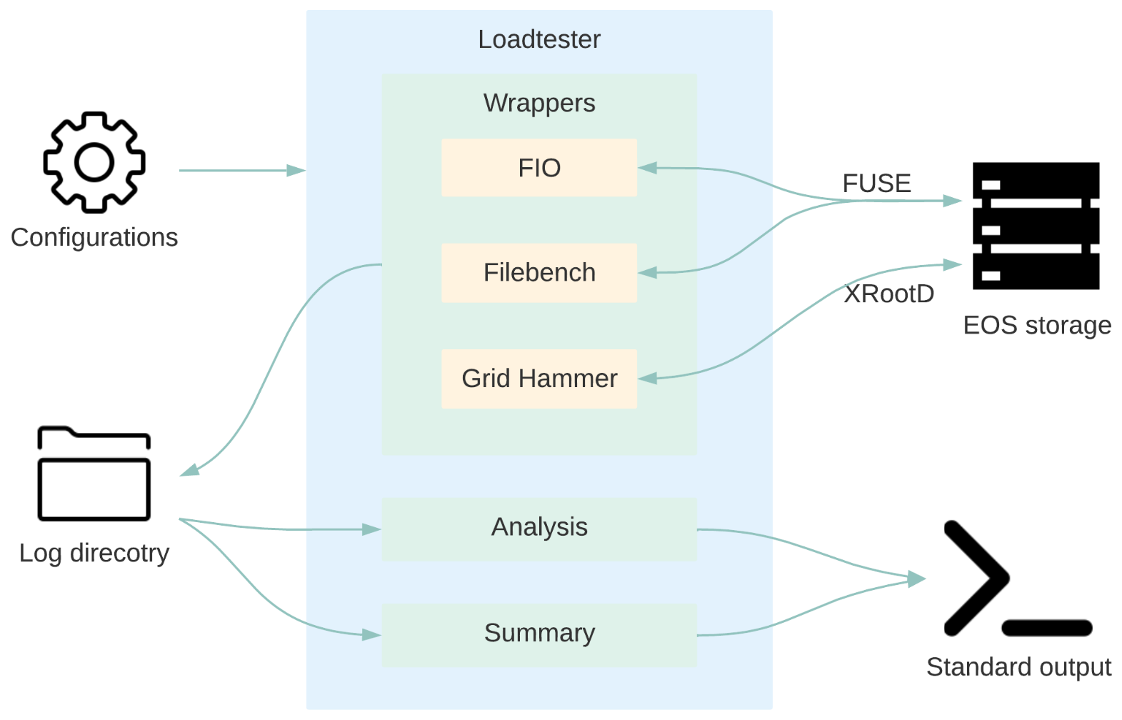
Toolkit and development
Wrappers over existing tools
Analysis software
Automation scripts
Organized log storing
Summary report

Slide 5
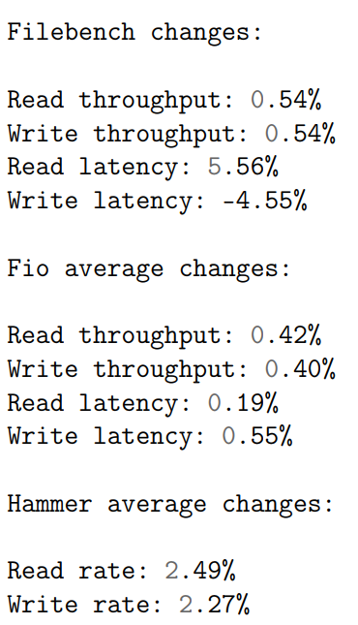
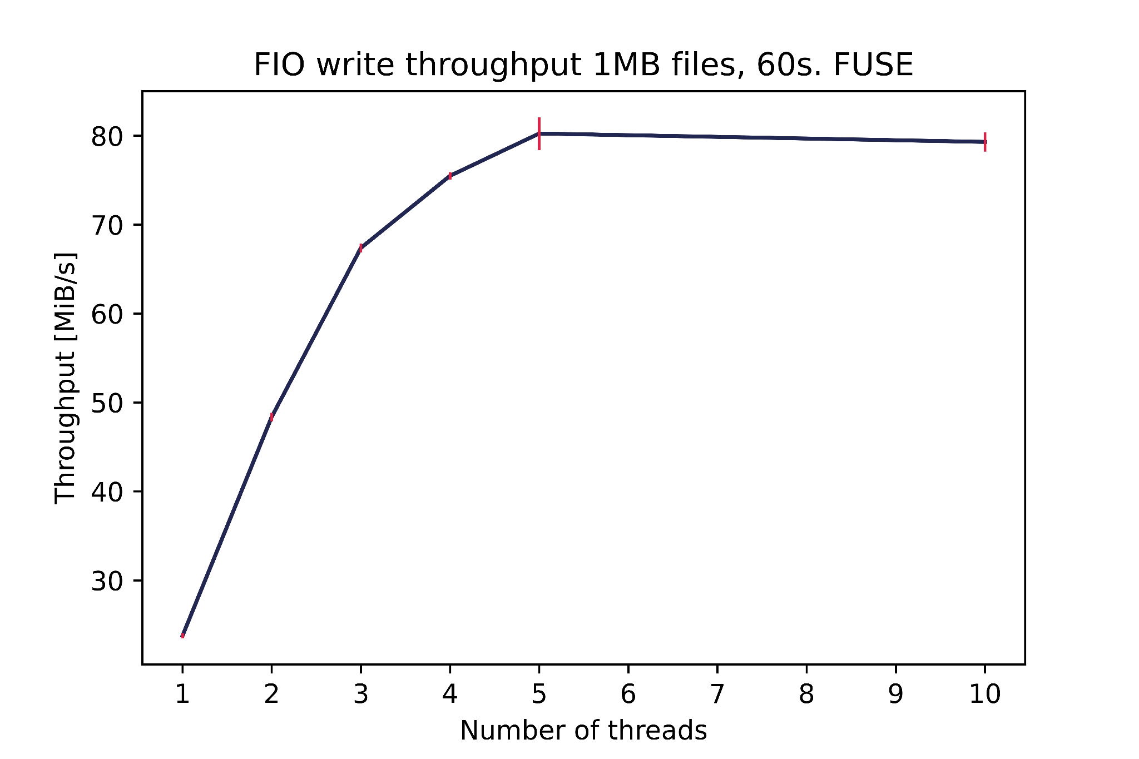
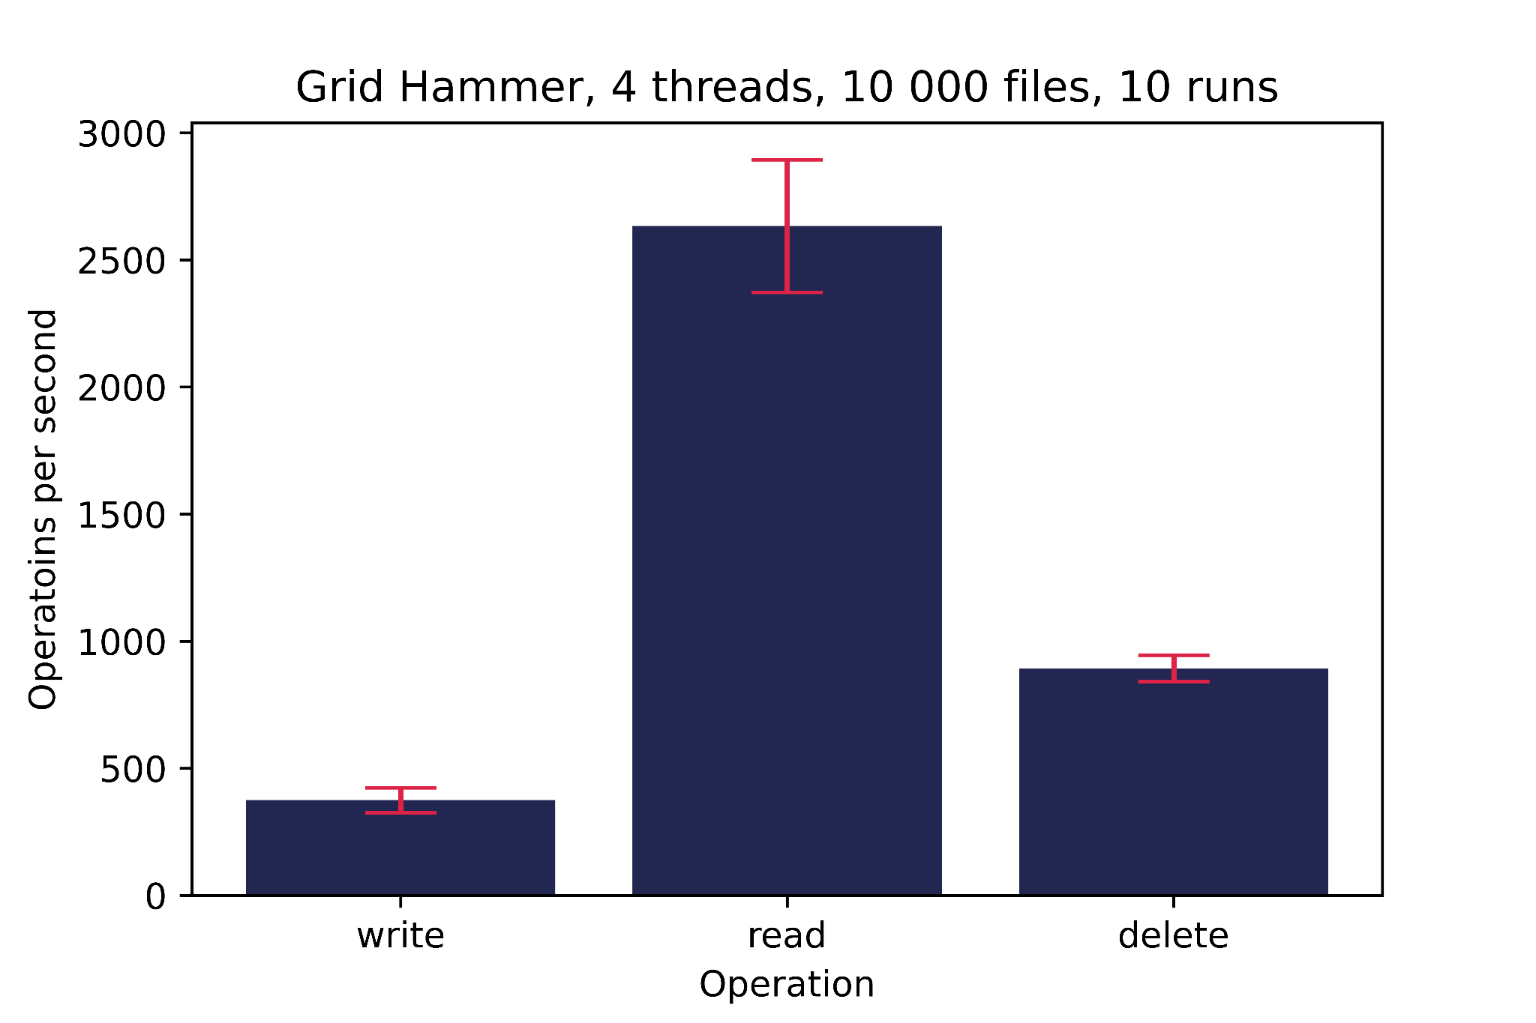
Results
Already proven useful with configuration changes

Slide 6
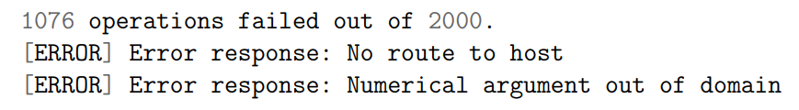
Challenges and errors
Open files limit
default on VM was too low (1024)
DNS 114 requests/sec
dns caching/dnsmasq
Results inconsistencies, big variance
time based tests
containerized environment
multiple runs

Slide 7
Thank you!
andrej.cop@cern.ch
linkedin.com/in/andrejcop
“The only source of knowledge is experience.” ~ Albert Einstein

