Slide 1
Inference of ML Models on Intel GPUs with SYCL and Intel OneAPI using SOFIE
SFT Group
Supervisor: Lorenzo Moneta
Ioanna-Maria Panagou
16/09/2022

Slide 2
Introduction
Prerequisites
ROOT is an open-source framework for high-scale data processing and analysis in HEP
ROOT offers support for supervised learning techniques for data analysis through the TMVA (Toolkit of Multi-varied Analysis) module
TMVA SOFIE (System for Optimised Fast Inference code Emit) is a fast machine-learning inference engine
Notes:
ROOT is an open-source framework developed here at CERN for data processing and analysis and is predominantly used in High Energy Physics Research
ROOT offers native support for supervised learning and machine learning techniques for data analysis through the TMVA module, which stands for Toolkit for Multi-varied analysis module
Part of the TMVA module is SOFIE, which stands for System for Optimised Fast Inference code Emit

Slide 3
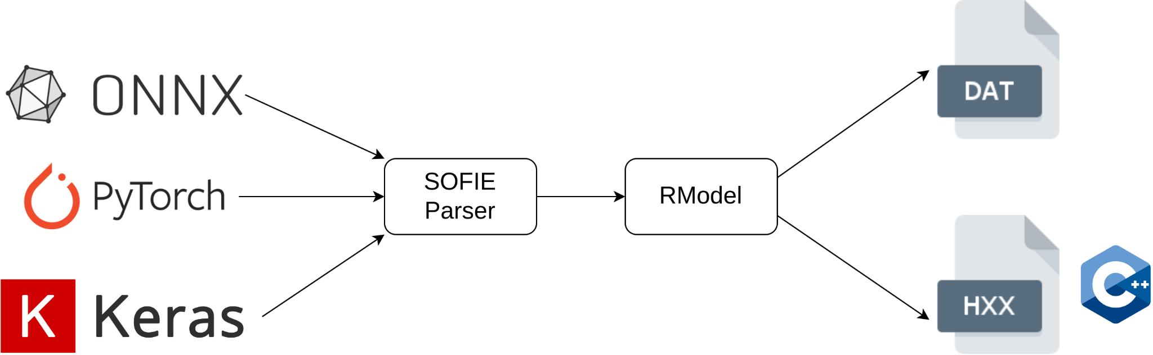
Introduction
Outputs
How SOFIE works
Input: Trained ML Model
(.onnx, .pt, .h5)
Weight File (.dat)
Parser: From ONNX (or Pytorch
or Keras) to SOFIE::RModel
C++ File (.hxx)
C++ file hardcodes the inference function
Directly invokable from other C++ projects
Minimal dependencies (on BLAS only)
Notes:
SOFIE takes as input a trained machine learning model either in onnx format, pytorch or keras
Then, the appropriate parser is invoked and transforms the input model into an object of the SOFIE::RModel class, which is an intermediate representation that holds the structure of th input network as well as its weights.
SOFIE then uses the RModel to generate two files, a weight file and a c++ header file, which hardcodes the inference function corresponding to the input network. This c++ file can be included from any other C++ project and has minimal dependencies, only on the BLAS libraries.

Slide 4
Introduction
model.hxx
How SOFIE works
namespace TMVA_SOFIE_model {
struct Session {
Session(std::string = “”) {
. . .
}
// hardcoded inference function
std::vector<float> infer(float *input) {
. . .
}
};
}
// Parser
using namespace TMVA::Experimental::SOFIE;
RModelParser_ONNX parser;
RModel model = parser.Parse(“model.onnx”);
// Generate Code Internally
model.Generate();
// Write Output Header File and Data Weight File
model.OutputGenerated();
infer.cpp
#include “model.hxx”
// Create Session Class
TMVA_SOFIE_model::Session s();
// Event Loop
{
auto result = s.infer(input);
}
Inference code: needs to be linked against the BLAS Libraries
Notes:
We call the Generate and OutputGenerated functions on the Rmodel and generate an .hxx file. We can directly include this file in the inference code, for example infer.cpp, and then we compile it with a standard c++ compiler and link it against the BLAS libraries.

Slide 5
Project Description
model.hxx
Extend SOFIE functionality to produce SYCL code
namespace TMVA_SOFIE_model {
struct Session {
Session(std::string = “”) {
. . .
}
// hardcoded inference function
std::vector<float> infer(std::vector *input) {
. . .
}
};
}
// Parser
using namespace TMVA::Experimental::SOFIE;
RModelParser_ONNX parser;
RModel model = parser.Parse(“model.onnx”);
// Generate SYCL Code Internally
model.GenerateGPU();
// Write Output Header File and Data Weight File
model.OutputGeneratedGPU();
infer.cpp
#include “model.hxx”
// Create Session Class
TMVA_SOFIE_model::Session s();
// Event Loop
{
auto result = s.infer(input);
}
Inference code: needs to be linked against the oneAPI MKL Libraries (oneapi::mkl::blas) and compiled using a SYCL compiler
Notes:
My job is to add to SOFIE the functionality to produce SYCL C++ code to target Intel GPUs.
More specifically I had to add the implementations of the Generate and OutputGenerated functions for GPU. The new API is almost identical to the one for CPU inference. The only difference is that the new code must be compiled with a SYCL Compiler and linked against the Intel oneAPI MKL (math kernel library), which provide the SYCL implementations for the BLAS functions

Slide 6
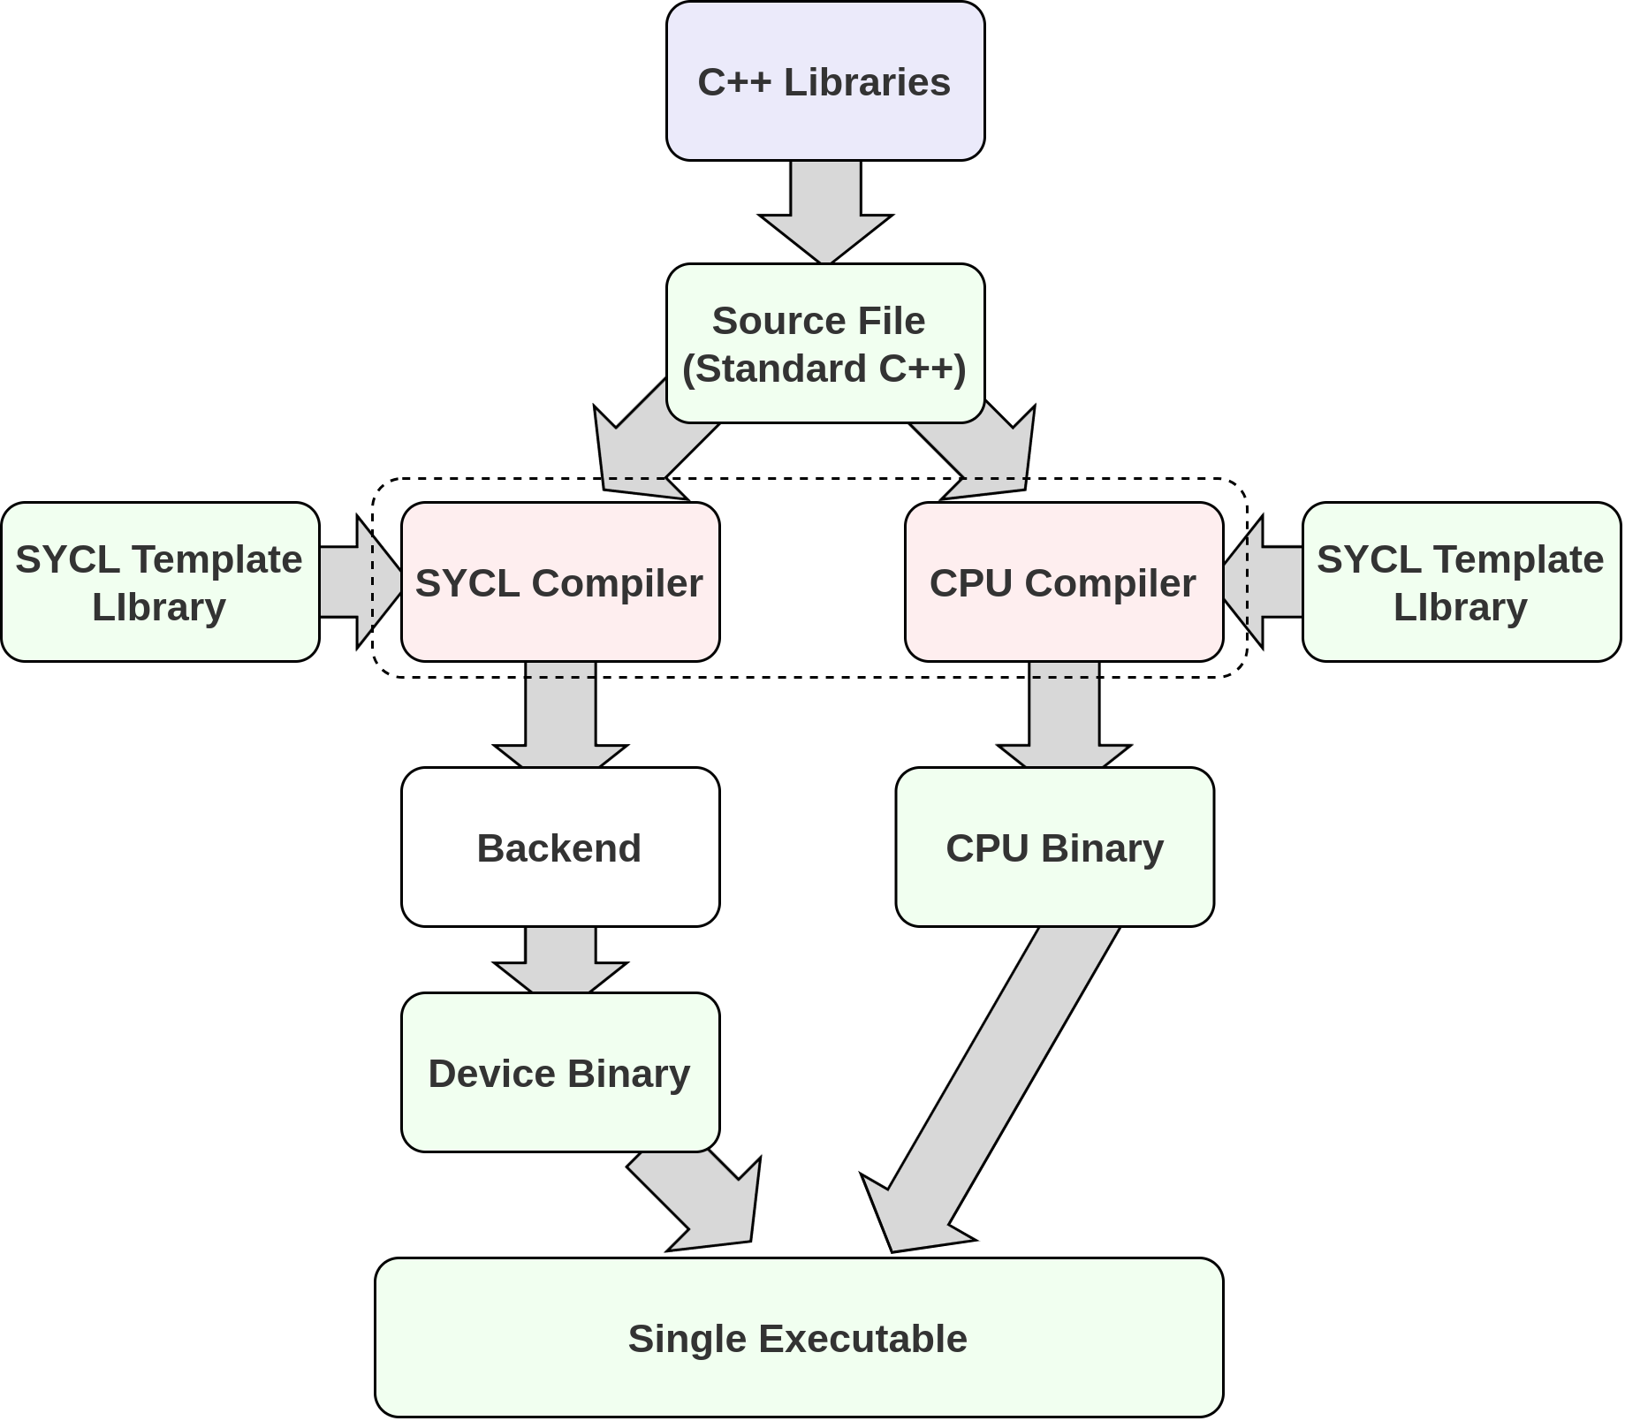
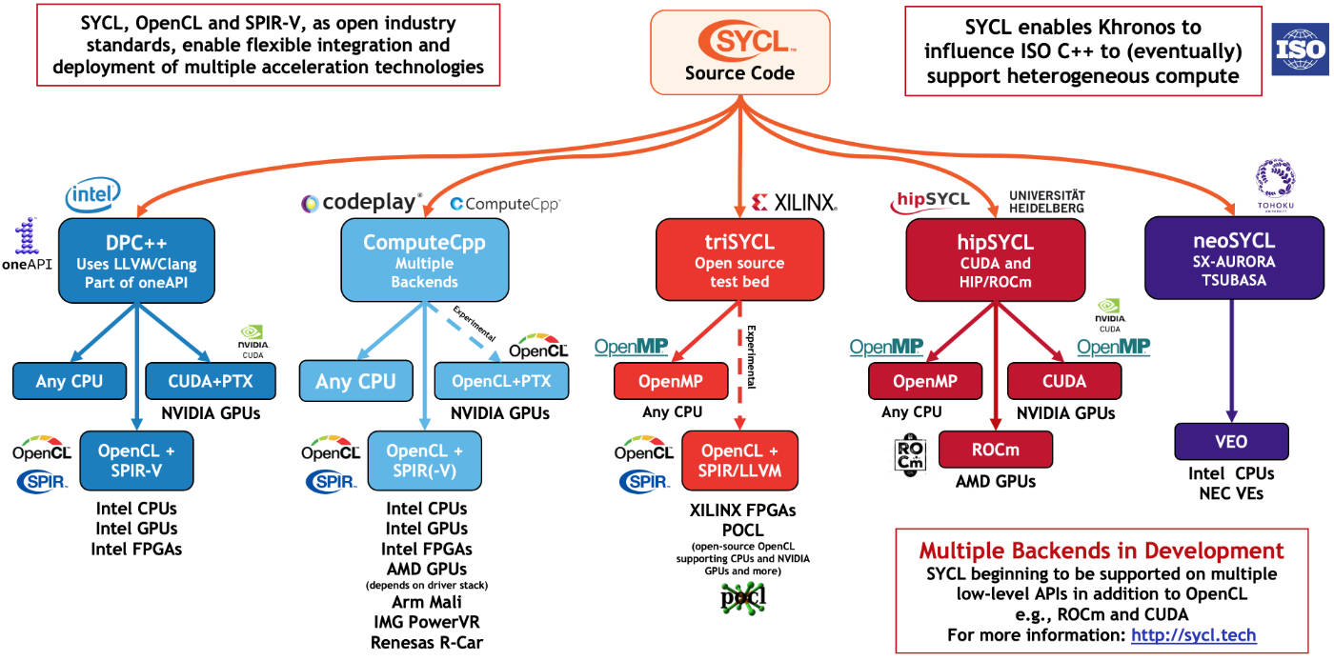
What is SYCL?
SYCL is a single-source, high-level, standard C++ programming model, that can target a wide range of heterogeneous platforms (CPUs, GPUs, FPGAs)
Notes:
Single source: Unlike OpenCL, which is also used for heterogeneous programming, the host and device code is in the same source file. To produce the final executable, we need two compiler passes, one for the host and one for the device compiler. Both of them see the same SYCL API but interpret it differently. The device compiler pulls out the kernel functions and creates a binary for the requested IR/ISA, using a backend such as OpenCL. Then, the two binaries will be linked producing a single CPU executable.
There are multiple implementations of SYCL for different backends that target multiple devices.

Slide 7
SYCL Application Structure
#include <CL/sycl.hpp> // header file
namespace sycl = cl::sycl;
int main() {
// host storage (a = b * 2)
std::vector<float> a = {1.0, 2.0, 3.0, 4.0};
std::vector<float> b = {0.0, 0.0, 0.0, 0.0};
auto length = a.size();
sycl::default_selector device_selector; // device selector
sycl::queue queue(device_selector); // queue
{ // begin scope
// device storage
sycl::buffer<float, 1> a_buf(a.data(), sycl::range<1>(length);
sycl::buffer<float, 1> b_buf(b.data(), sycl::range<1>(length);
// kernel execution
queue.submit([&] (sycl::handler& cgh) {
auto a_acc = a_buf.get_access<sycl::access::mode::discard_write>(cgh);
auto b_acc = b_buf.get_access<sycl::access::mode::read>(cgh);
cgh.parallel_for<class op>(sycl::range<1>(length), [=] (sycl::id<1> id) {
a_acc[id] = b_acc[id] * 2;
});
});
} // end scope
return (0);
}
Include SYCL header
Setup Host Storage
Initialize Device Selector
Initialize Device Queue
Setup Device Storage
Execute Kernel
Notes:
Next we will talk about the structure of a sycl application
First, we include the universal sycl header, which gives us access to the sycl namespace
In main, we begin by setting the host storage of the data we want to operate on
The next step is to decide which device we want to execute our kernel on, here we use the default selector provided by sycl, but we can also use custom selectors to select devices that match some criterion. Default selector chooses an accelerator or the host CPU if one is not available
Then, we initialize a queue associated with the chosen device. The queue is used by the host CPU to issue kernels and data transfers to and from the device.
Because typically host and device do not share physical memory, we need to tell SYCL which data will be used between host and devices. That’s why we create the sycl buffers which take ownership of the memory they have been passed to
After initializing the device storage, we submit the kernel to the queue, using the submit function. The submit function encapsulates a command group handler object, which is constructed by the SYCL runtime. A command group handler basically groups together all related commands and data transfers associated with a device operation. First, we create accessors, which are used to define the inputs and outputs of a device operation and access the memory held by the buffers
Then, we submit a kernel function to the command handler. Typically, we use the parallel_for clause for that. It accepts a parameter that defines how many times the function will be executed and a lambda function, which is the function we want to execute.

Slide 8
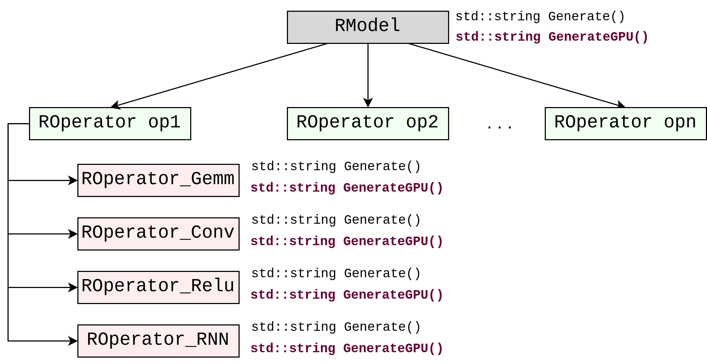
C++ to SYCL
RModel::GenerateGPU generates code for:
Device Selection
Queue Initialization
Host & Device storage
ROperator::GenerateGPU generates code for the kernel execution
//------ RELU
for (int id = 0; id < length ; id++){
tensor_out[id] = ((tensor_in[id] > 0 )? tensor_in[id] : 0);
}
//------ RELU
q.submit([&](cl::sycl::handler &cgh){
auto acc_tensor_in = cl::sycl::accessor{buf_tensor_in, cgh, cl::sycl::read_only};
auto acc_tensor_out = cl::sycl::accessor{buf_tensor_out, cgh, cl::sycl::write_only,
cl::sycl::no_init};
cgh.parallel_for<class op_17>(cl::sycl::range<1>(length), [=](cl::sycl::id<1> id){
acc_tensor_out[id] = cl::sycl::max(acc_tensor_in[id], 0.0f);
});
});
Notes:
Now, I will describe the process I followed to migrate from C++ to SYCL.
The RModel object we mentioned before is the internal representation of the model we want to generate inference code for. This model contains a vector of ROperators, which loosely correspond to the layers or operations that need to be performed for the inference of the model. There are different kinds of operators that inherit from the ROperator class, GEMM for linear layers, CONV for convolutional, different activations, such as relu, or more complex layers like Recurrent neural networks. The Generate function of the RModel internally calls the generate function of the operators that make up this RModel. Those functions return a string, which contains the inference code that will be written to the c++ header file. A different function was added, GenerateGPU, to the RModel and to each Operator that returns a string with the SYCL code needed.

Slide 9
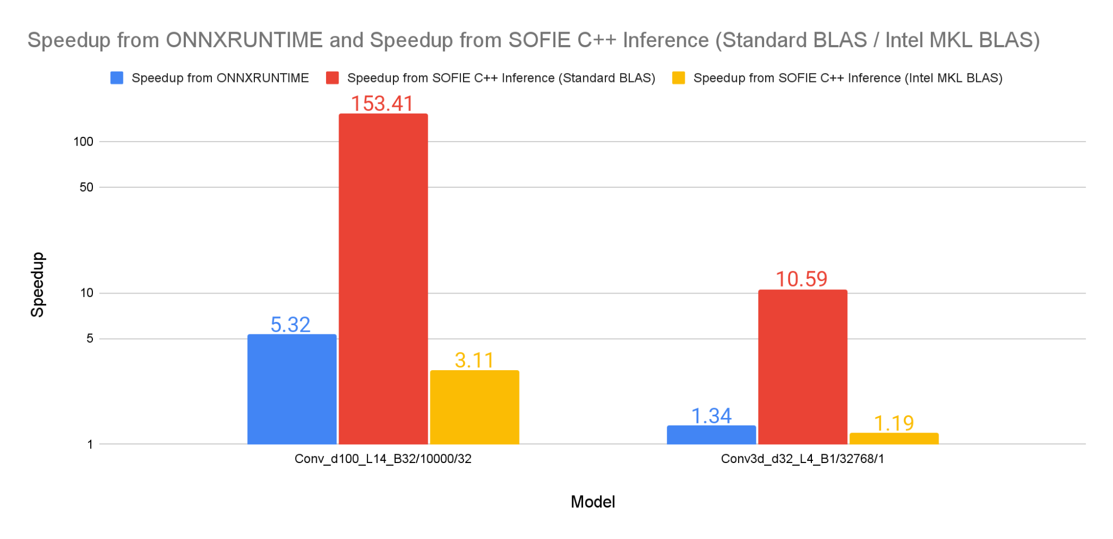
Benchmarking
Higher = Better
Notes:
At this point most of the operators have been implemented in SYCL, so we were able to benchmark some models. Here we present the results of some of the available convolutional models, which are comprised of convolution and activation layers. We compared our GPU execution time per event against the same model inferenced with ONNXRUNTIME and the standard C++ SOFIE generated code using both the standard BLAS libraries and the ones provided from the Intel Math Kernel Library. As for the names of the models, d stands for the dimension of the input image, so a d of 100 stands for an image 100x100, L for the number of convolution+activation layers and B for the batch size. We can see that the larger the model, the more speedup in comparison to both the onnx runtime and the sofie c++ cpu inference, which is due to the fact that the overhead of initializing queues and transferring data is negligible compared to the total execution time for larger models. Also, the CPU performance using the mkl blas libraries is superior to both the onnx runtime and sofie inference with standard blas libraries.

Slide 10
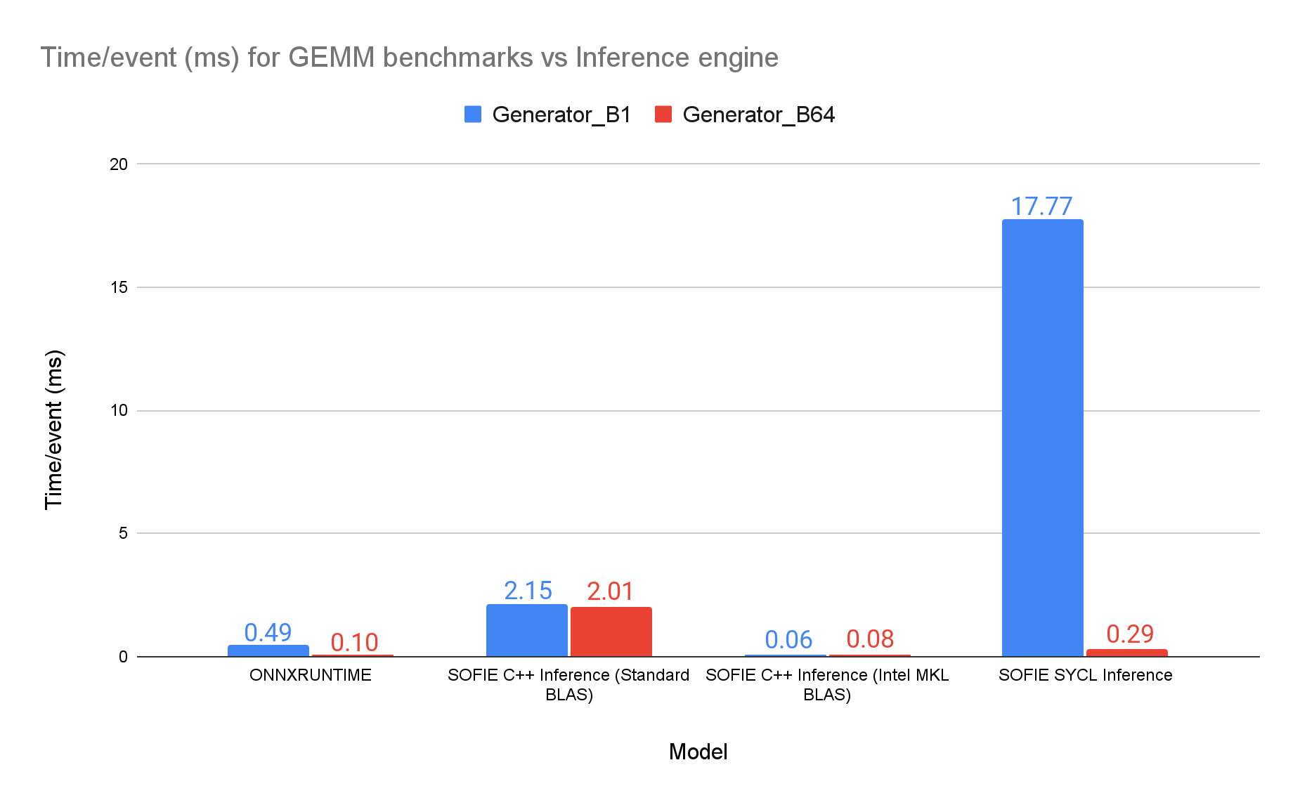
Benchmarking
Lower = Better
Notes:
Here we have the execution time per event for the Generator models which are basically fc layers with batch norm and relu activations. They have the same structure only the generator b64 has a batch size of 64 instead of 1. We can see that for the larger model the execution time per event is significantly lower, because the transfer overhead is amortized, but the models are still not that large that it is worth it porting them to the GPU.

Slide 11

Thank you!
Questions?

