Slide 1
Quantum-Powered Times Series Forecasting
Lighting Talks- openlab
Supervisors: Sofia Vallecorsa, Michele Grossi, Alice Barthe
Andrew Spiro
andrew.charles.spiro@cern.ch
16 / 08 / 2023

Slide 2

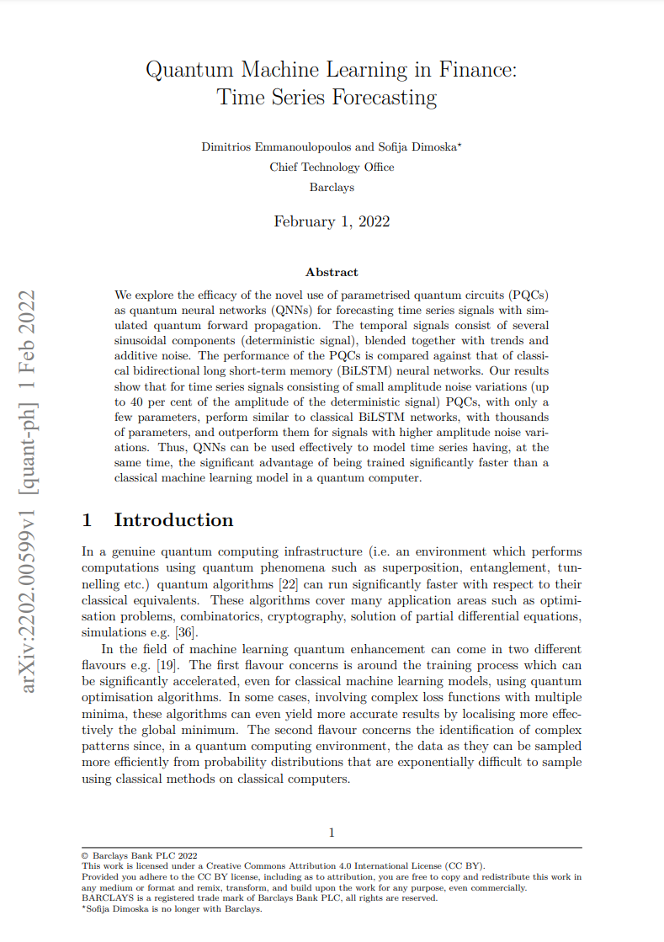
Background
Setting up QML for time series prediction
Quantum Computing
NISQ
+
PQC
QML for
Time Series
ML
NN

Slide 3
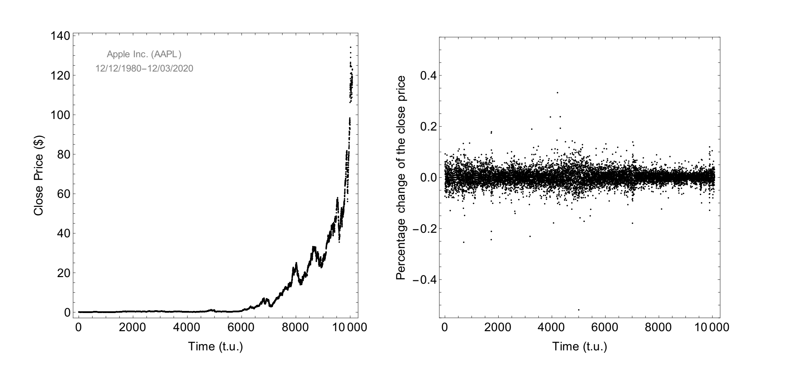
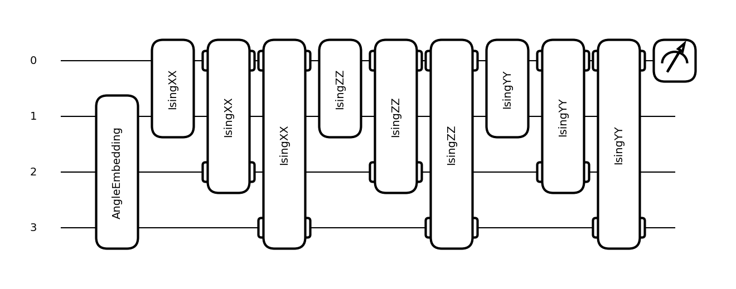
Measuring an output
Encoding data
One layer of optimization

Slide 4
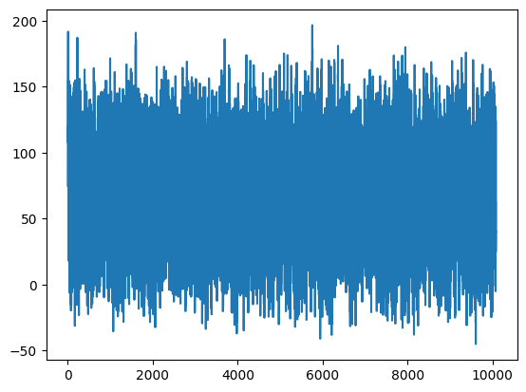
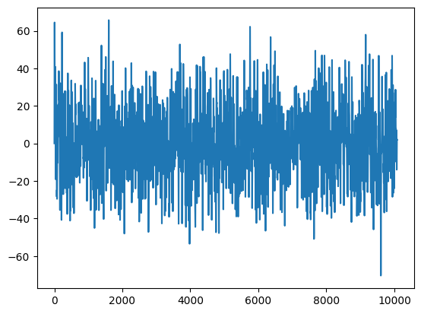
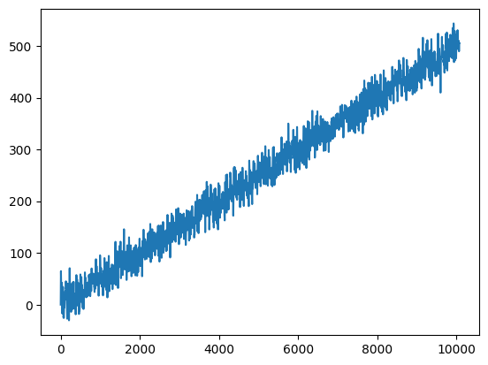
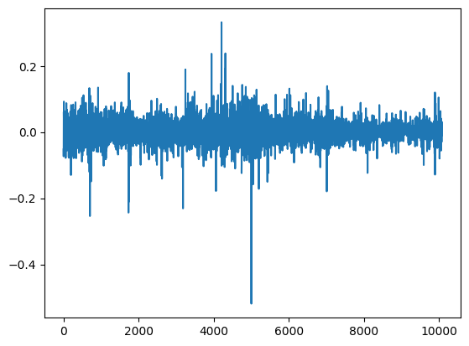
Plus, Noise
Sinusoidal Components
Plus, Linear Trends
Full Signal
Complexity

Slide 5
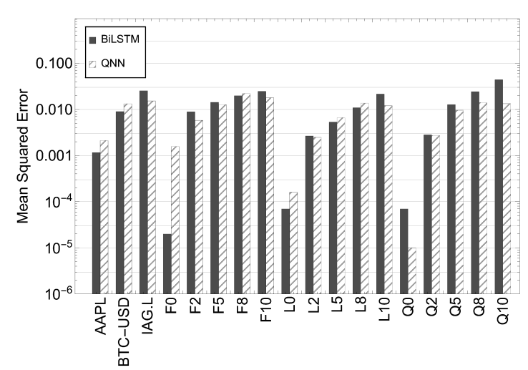

Slide 6

Code structure
Data
Folder
Array
DataProcessing
Script
Data
Signal
Weights
Training
Testing
Results
Test data
“Circuit”
Circuits
Circuits

Slide 7
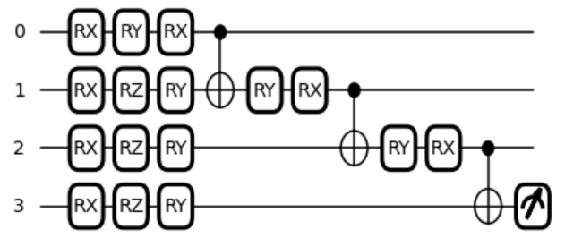

MPS architecture
Measuring an output
Encoding data
Optimization

Slide 8
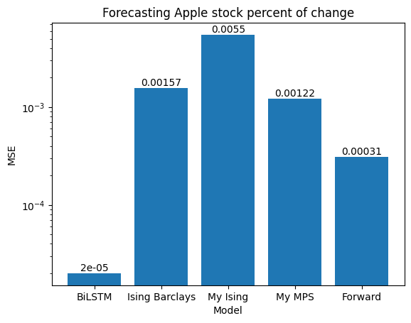
Results
Barclays Comparison
My Ising
My MPS
Forward

Slide 9
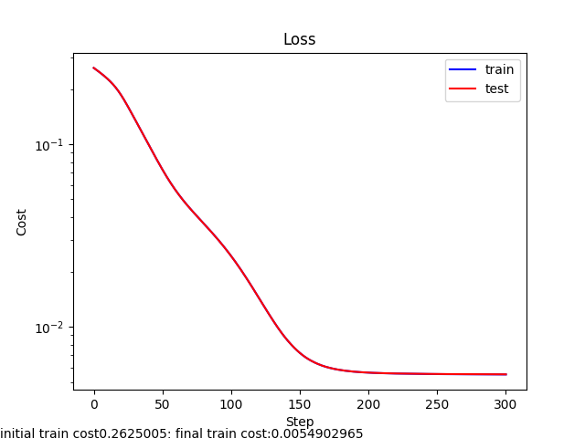
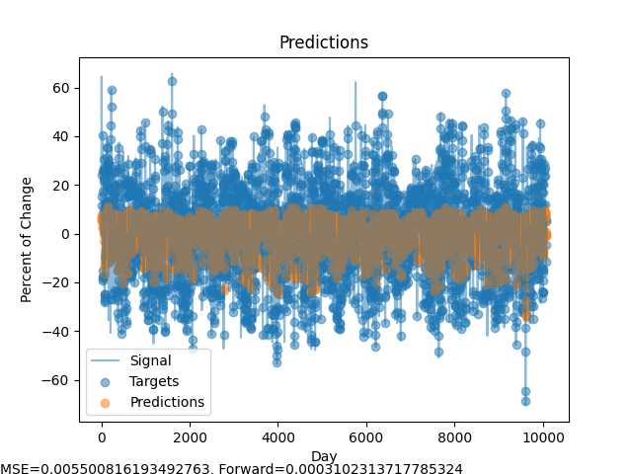
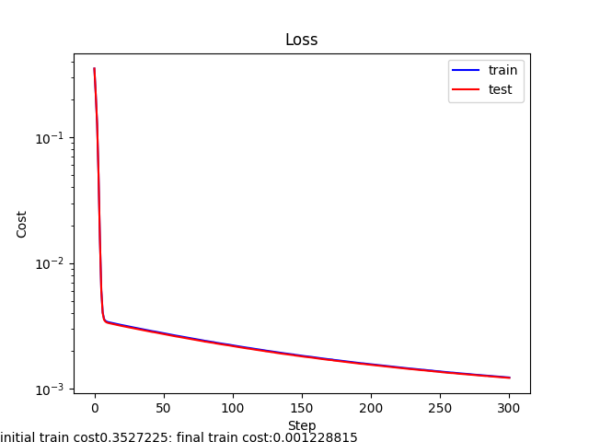
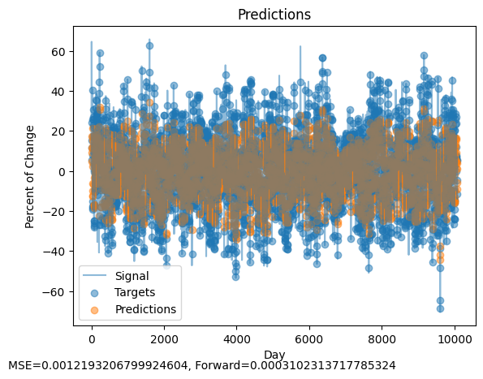
Results
Loss and Predictions
Ising
MPS

Slide 10
Hyperparameters
Model:
Training
Data
Ising
Layers: 2
Sample size
Threshold: 50
Noise coefficient: 0-1
Trend: FLQ
Sampling strategy: random
Max steps: 10
Epochs: 300
MPS

Slide 11
Try it yourself and Thank You!
https://github.com/CERN-IT-INNOVATION
Model:
Training
Data
Architecture: Ising, MPS, TTN, SEL
Finance
Weather
Traffic
Social media
Sampling strategy: Chronological
Epochs
Training sizes
andrew.charles.spiro@cern.ch

