Slide 1
HLS with Intel OneAPI on Allen algorithm
Openlab student: Eleni Xochelli :)
Supervisors: Paolo Durante, Niko Neufeld

Slide 2
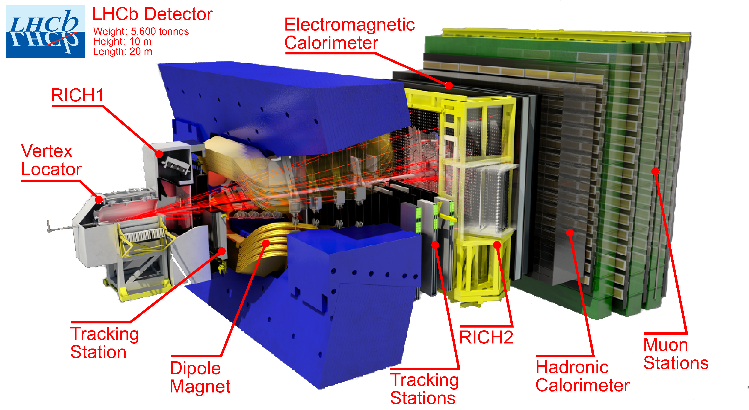
Theoretical background
Defining the project
  - Allen project
  Specifically "masked Velo clustering" algorithm
  Current status
  - Allen in SYCL for GPU
  - FPGA Implementation
Goal
- Allen in SYCL for FPGA

Slide 3



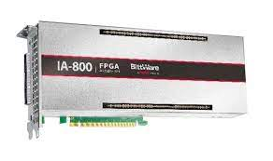
Theoretical background
Defining the tools
High level Sythesis: SYCL for heterogeneous computing
  - Data Parallel C++
FPGA hardware​
- custom hardware implementation for specific tasks

Slide 4


Challenges
​
​
Allen size​
​
-code volume
-compilation time
​
​
​
​
​
​Setting up the System
​
​
​-combining the above
-getting started
​
GPU -> FPGA
-initial implementation
focused on GPUs

Slide 5
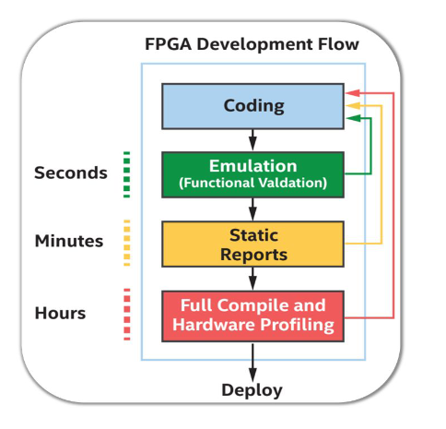
Methodology
Experimenting on SYCL Allen
  Setting up a SYCL kernel
  - memory allocation
  - queue jobs
  - invoke kernel
  - getting results
  OneAPI Compilation Stages
  1. FPGA Emulation for verification
  2. FPGA Simulation reports
  3. FPGA Compilation

Slide 6
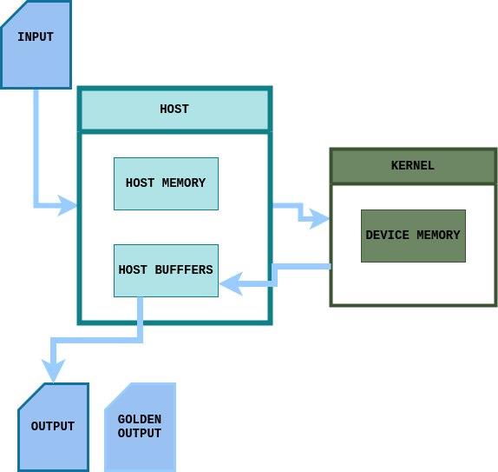
Techniques
Making specific changes
  Seperating the algorithm
  - sequence change
  - input/output redirection
  Memory management
  - memory allocation in the device
  - host buffers for device memory
  Kernel Invocation
  - specialiazed for the FPGA
  - parallel_for -> single_task

Slide 7
Future work
Experimenting on SYCL Allen
​
  Future implementation​
- standalone implementation​ - further seperating the algorithm
- working more on FPGA performance specialized architecture

Slide 8
QUESTIONS?
THANK YOUU :)
xeleni@uth.gr
eleni.xoheli@yahoo.gr

Slide 9
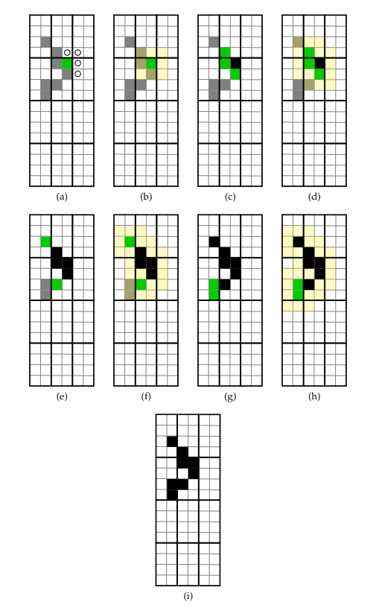
Detailed explanation
Masked Velo clustering logic
Optimization of high-throughput real-time processes in physics reconstruction
Daniel Hugo Campora Perez
http://cds.cern.ch/record/2718278?ln=en

