Slide 1
PUR Mechanical characterisation
Specification for manufacturing
M.Noir – 2023-08-22

Slide 2
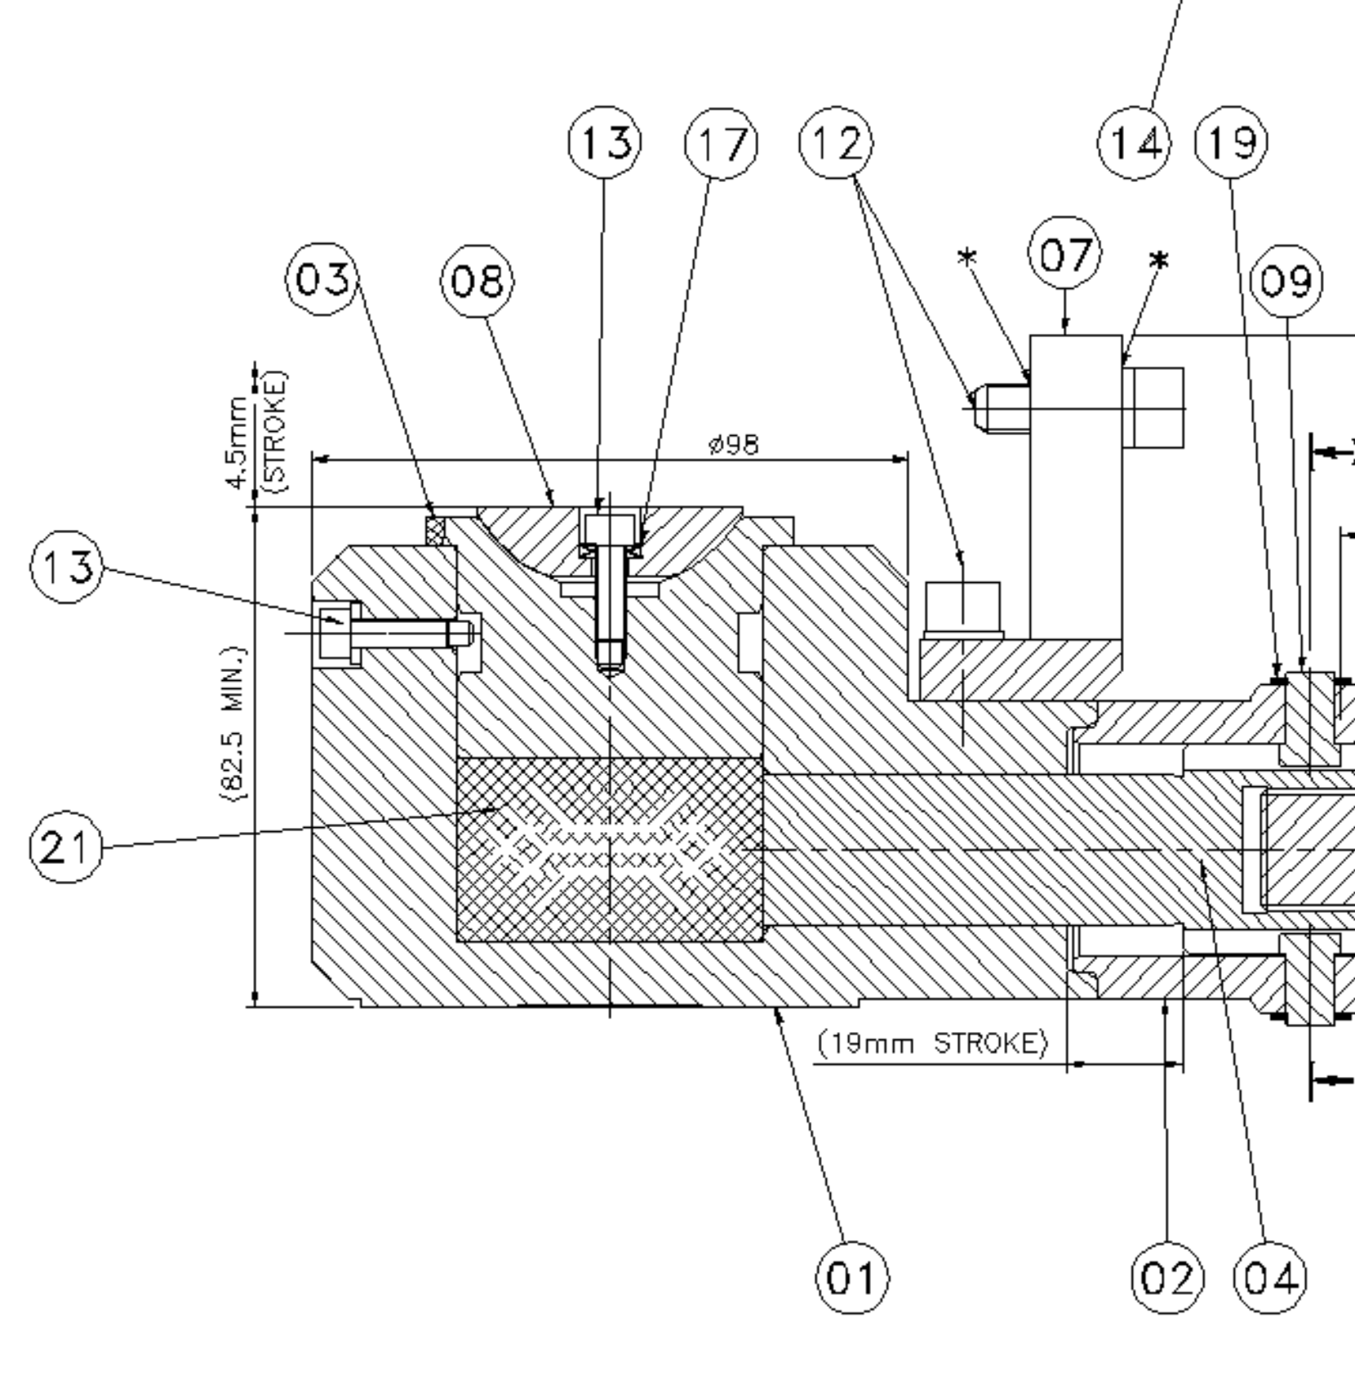
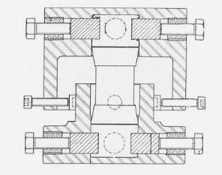
Context
PU has been used in the design of the Jacks in order to get a behaviour like liquids without leak drawbacks.
Isostatic pressure in the pastille is quite high for a polymer (~80MPa – 800Bar) and local deformation close to actuation pistons are important.
Specification cannot be reduced to a simple Elastic or Ultimate tensile load request as the hyperelasticity behaviour of the material should be an input for the FEM computation.

Slide 3
Material Validation process
Hyperelastic characteristic of such material are not available in literature or supplier datasheets.
In order to validate a material, the following process will be necessary:
Sample production
Mechanical tests – simple load cases

Slide 4
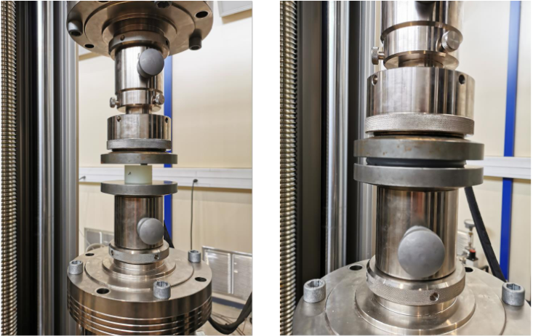
Pastille Behaviour - Characterisation
Even if current pastilles hardness is quite important (70 and 90 Shore A), the deformation values without any break goes up to 77 % - Tested by Recovery tests.
Illustration based on EDMS #2922835 – M.Crouvizier

Slide 5
Material Validation process
In order to validate a material, the following process will be necessary:
Sample production
Mechanical tests – simple load cases
Mechanical Behaviour characterisation – digital Twin

Slide 6
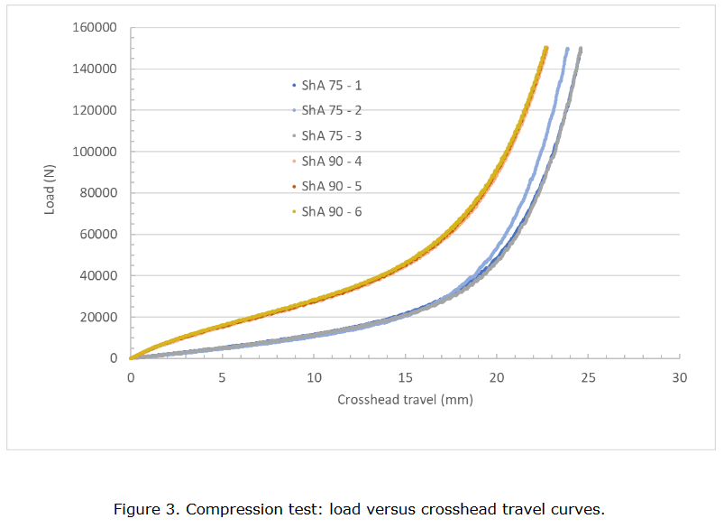
Pastille Behaviour - Characterisation
In order to validate the use of any new formulation, the mechanical tests shall be used as input to create a digital twin of the material and check its behaviour in more complex situation like the PU Jacks using FEM.
Illustration based on EDMS #2922835 – M.Crouvizier

Slide 7
Material Validation process
In order to validate a material, the following process will be necessary:
It implies that the material characteristics remains stable within time (manufacturing batches / ageing…)
Sample production
Mechanical tests – simple load cases
Mechanical Behaviour characterisation – digital Twin
FEM computation on Jack models
Material Validated ?
Material Specification based on actual results

