Slide 1
PUR Jack Taskforce
Mandate & Organisation
P. Bestmann

Slide 2
Proposed Mandate
The PU jack task force will coordinate studies and actions related to the issues met on polyurethane pastilles used in the jacks in the SPS, North area, LHC and foreseen for HL-LHC.
Specifically, it will investigate the cause, analyze the failed PU pastilles and coordinate mitigation measures over short, medium and long-term, for both the PU pastilles manufacturing and control process
Prepare a consolidation plan of current jacks and conclude on the use of PU pastilles for future ones.
The chair is Patrick Bestmann (BE-GM). Membership is drawn from the following groups: EN-MME, BE-EA, BE-GM, TE-MSC, TE-VSC.
Time limited task force to prepare and implement urgent mitigation measures during YETS 23-24 and define actions for LS3, with a consolidation plan for the next LSs.

Slide 3
Proposed Members
Members |  | Group
Jeremie Bauche |  | TE-MSC
Philip Schwarz |  | TE-MSC
Roland Piccin |  | TE-MSC
Patrick Bestmann |  | BE-GM
Michel Noir |  | BE-GM
Mateusz Sosin |  | BE-GM
Sylvain Girod |  | BE-EA
Vincent Marchand |  | BE-EA
Michael Lazzaroni |  | BE-EA
Miguel Lino Diaggo Dos Santos |  | BE-EA
Stefano Sgobba |  | EN-MME
Mickael Denis Crouvizier |  | EN-MME
Colette Charvet |  | TE-VSC
Definition of additional members and alternates
Designation of a secretary

Slide 4
Ongoing & urgent actions
Purchase
  The next batch of PUR pads for YETS23-24 is ordered with A+P
  Purchase Requisition (DAI) 9835980 (cern.ch)
Testing & Analysis
  Mechanical and chemical testing of all available batches at CERN
  Corrosion analysis PUR vs. Molykote (Polymer Lab)
  Full mechanical characterisation of currently used material (MME)
  Long Term Test samples to be installed in the different machines (GM+EA)
Specifications
  Need to developp a full mechanical specification adapted to our use case
Traceability
  Serial numbers for all Jacks and physical PUR batch identification is without any alternative

Slide 5
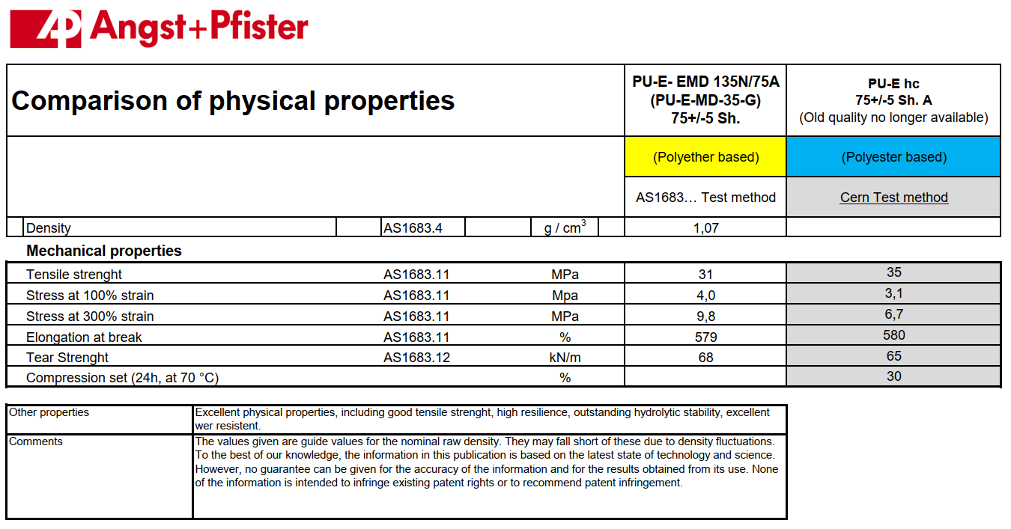
Ongoing & urgent actions
Purchase
  The next batch of PUR pads for YETS23-24 is ordered with A+P
  Purchase Requisition (DAI) 9835980 (cern.ch)
  Test samples in plates 2+4mm 130x280mm are included
  Price raised from 9 (2015) to 23CHF/Piece
  Documentation
    So far no success for direct contact with manufacturer
    No spec sheets or material properties (recently received comparison tables)
    We cannot longer rely on A+P with these conditions
    Search for alternative suppliers with full specification

Slide 6
Latest news from Analysis & Tests
Analysis 2019 Batch
  PU Pads used in LS2 are Polyurethan ether type, a different Polymer family, but conform to specifications and equivalent in tested mechanical properties
  Purchase Requisition (DAI) 7774631 (cern.ch)
  https://edms.cern.ch/file/2138759/1/EDMS2138759_Comparison_of_SPS_PU_Jacks_mechanicals_characteristics_rev_1.docx
  https://edms.cern.ch/file/2141845/1/EDMS2141845_2017-2019-Comparison_of_SPS_PU_Jacks_mechanicals_characteristics.docx
  https://edms.cern.ch/file/2914250/1/20230710_P._Bestmann.pdf
Analysis 2017 Batch
  Also Polyurethan ether but conform to specifications and equivalent in tested mechanical properties
  https://edms.cern.ch/document/2922835/1

Slide 7
Specification
We need a full mechanical specification
  Today only the dimensions, color and hardness are specified
  That is not sufficient to search for alternative suppliers and ensure a coherent composition and quality
  Should be confirmed by FEM analysis => Can MME do this?
  With a full specification we can search for new manufacturers => Need a list of possible suppliers
  What are the parameters to specify?

Slide 8
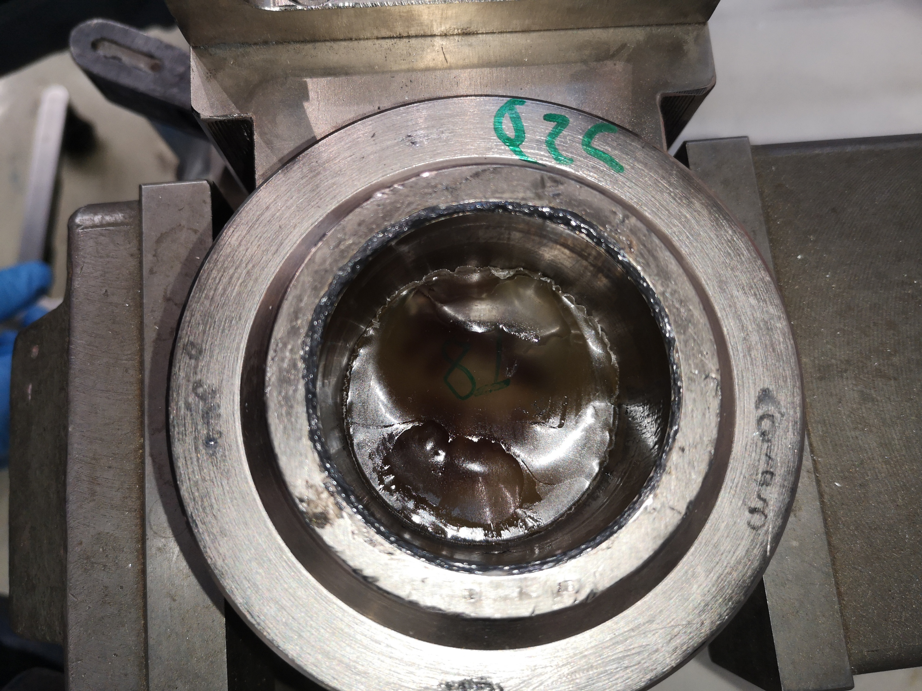
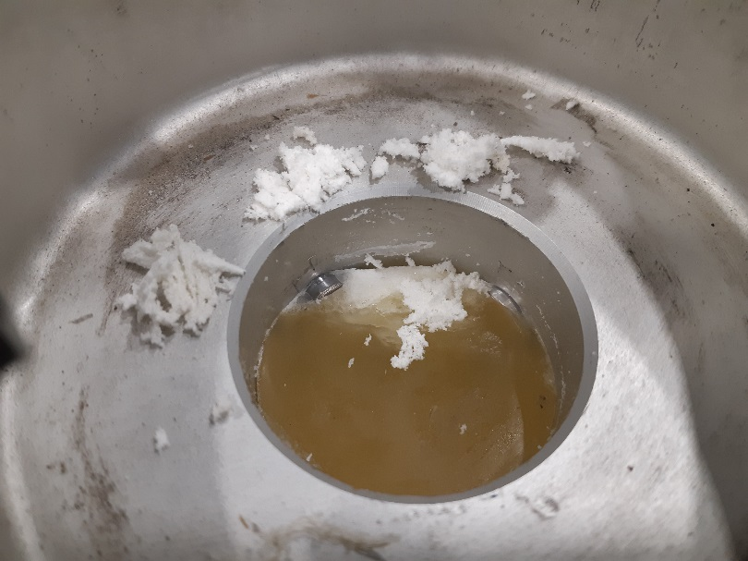
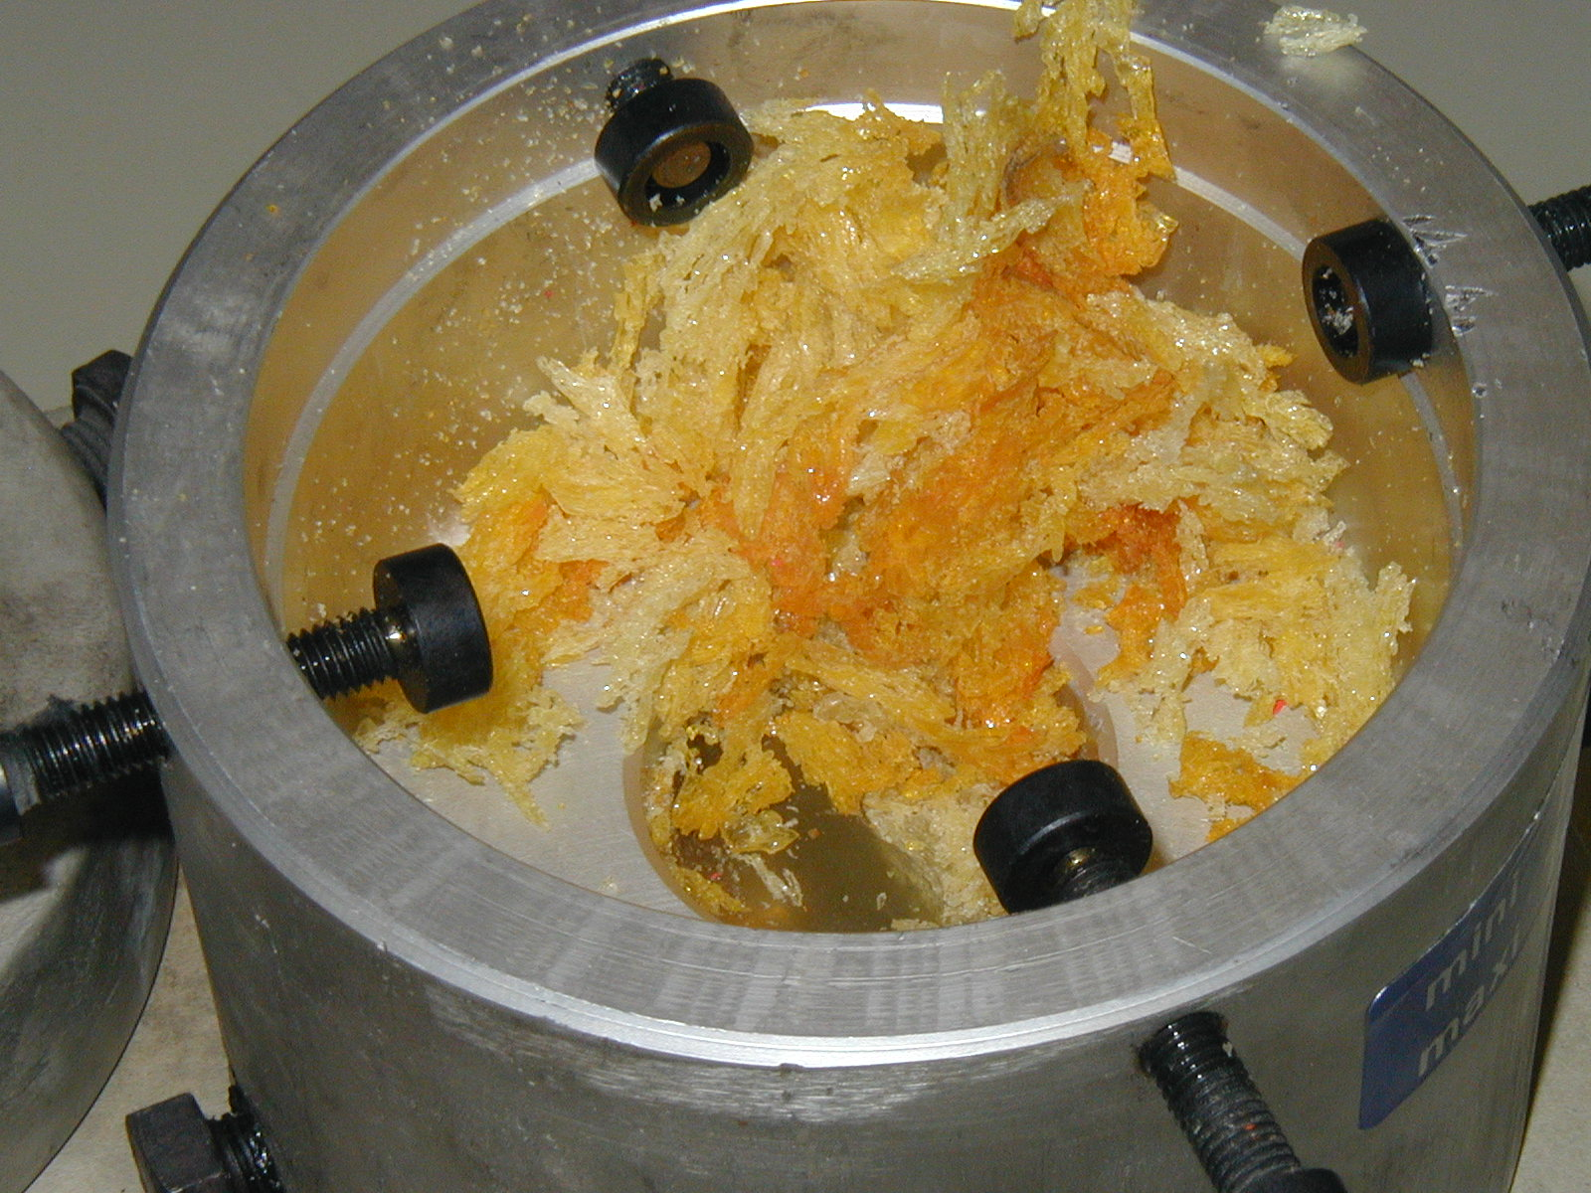
Failure Analysis
  Three different failure modes have been seen:
  Liquefaction in the case of LHC Triplet jacks
  Breaking PUR pads in chips in the SPS (LS2)
  Extrusion of PUR pads SPS (2003)

Slide 9
Failure Analysis
  Liquefaction in the case of LHC Triplet jacks
    Most probable scenario is a chemical reaction with the used lubricant Molykote
    Analysis ongoing by Polymer Lab
  Breaking PUR pads in chips in the SPS (LS2)
    Mechanical stress seems too high in asymmetric configuration
    To be confirmed by simulation enhanced with characterization of used material
    Test in Mechanical test lab for stress in asymmetric positions
  Extrusion of PUR pads SPS (2003)
    At the time the solution was reducing the asymmetric load by reducing the horizontal stroke from 8 to 4mm and adapting the hardness

Slide 10
Tracability
  Traceability is key for the follow up
  So far we have more doubts than answers and a clear association of the pads to a specific order or a specific Jack in a location is impossible
  The only installation to be 100% sure is the SPS with the exchange from 2019
    Some specific positions have not been done, but are well known and can be traced
  Serial numbers should be given to all PUR Jacks (Upper+Lower Part)
  Each batch should be clearly associate to an order
    Coloring agents are difficult, a pattern or number in the mold could be possible. Lateral Laser engraving also…

Slide 11
Testing @ reception
A full test procedure at reception of orders should be established
  For now we compare to previous batches:
    Hardness
    Punch resistance
    Compression & recovery
  We should have acceptation criteria for those and certainly more parameters
  Chemical analysis to be included systematically

Slide 12
Testing on site
A set of loaded jacks should be distributed in the machines as pre-warning sample
  At strategic places with different environmental conditions (Humidity/ Temperature/ Radiation)
  Together with unloaded pads for comparison
  Analysis of elasticity every shutdown in MME lab under controlled conditions
  Teststands are already produced by BE-EA

Slide 13
Next actions
Tracing to be implemented as from now on
  BE-GM proposes to provide serial numbers and evtl. Stickers (GM)
  Tracing to be done by equipment owners (MSC/EA)
Clear identification of remaining stock
  Identification when tested (MSC/EA)
  Destruction when non conform! (MSC/EA)
  Define and enhance storage conditions (MSC/EA)
Test tools
  Asymmetric compression test tool (GM/MSC/MME)
  Long Term Test sample preparation (GM/MSC/EA)
  Preparation of reception tests for next batch (procedure GM/MSC/MME/VSC)

